Slide 2

Video Bible Study
Lessons
presented by
David E. Pratte
gospelway.com

Slide 3
The Book of
1 Corinthians
Thanks to Christians in the Hillcrest church for their participation.
© Copyright David E. Pratte, 2024
Scripture quotations are generally from the New King James Version (NKJV), copyright 1982, 1988 by Thomas Nelson, Inc. used by permission. All rights reserved.

Slide 4
Bible Study Questions on the Book of
1 Corinthians
Available at
biblestudylessons.com/classbooks
gospelway.com/sales/books.php

Slide 5
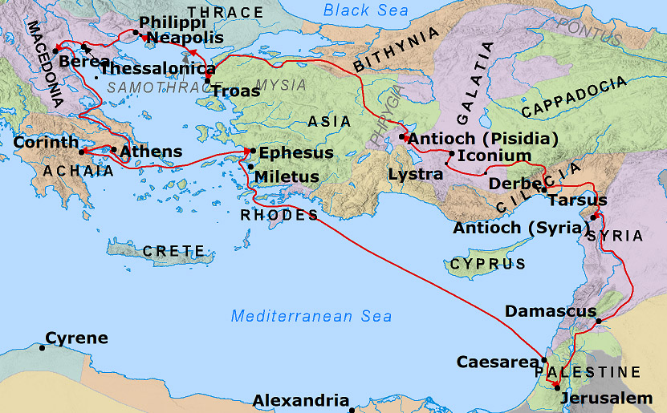
Index

Slide 6
Timeline of Paul’s Letters
First
Journey
Second
Journey
Third
Journey
Rome
Philemon
Colossians
Philippians
Ephesians
Galatians (?)
Romans
1 & 2 Timothy
Titus
1 & 2 Corinthians
1 & 2 Thessalonians
Concept credit: Darryl Smelser

Slide 7
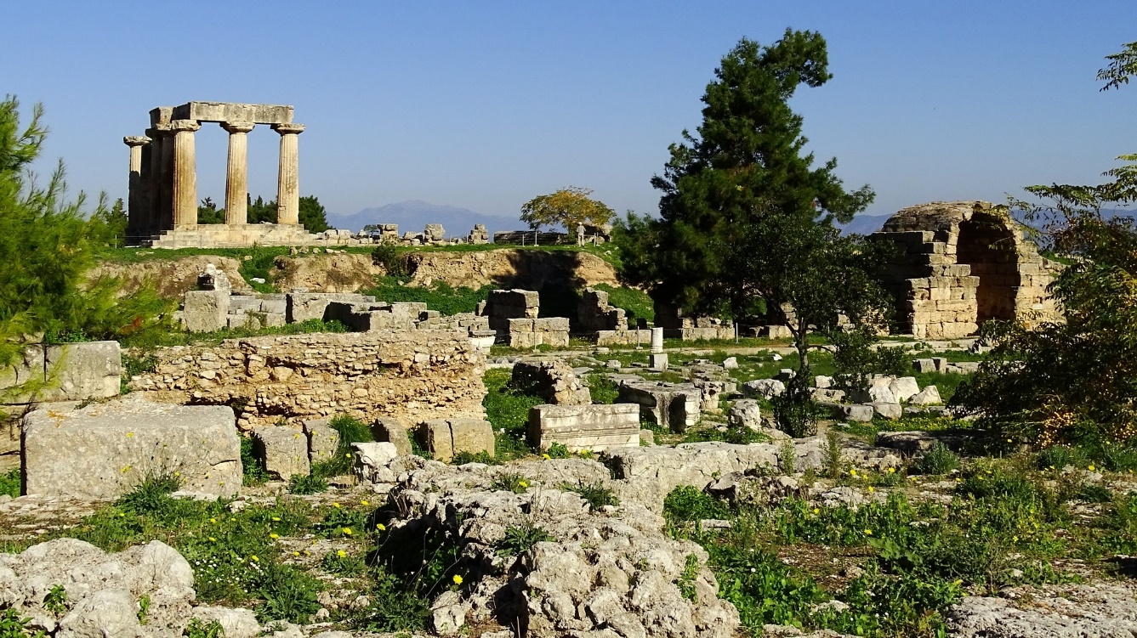
The City of Corinth
* Isthmus across the Grecian peninsula
* Major trading city
* Capital of the region of Achaia
* Known for wealth, materialism, worldly wisdom
* Rivaled Athens in culture, architecture, philosophy, sports
* The Isthmian games
* Known for immorality, esp. drunken feasts and sexual immorality
* Considered themselves intellectual, loving to dispute, and a spirit of rivalry and contention

Slide 8
The Church in Corinth
Paul preached in Corinth on second preaching trip (Acts 18:1-17)
Met Aquila and Priscilla and made tents (18:2,3)
Taught in the synagogue; many obeyed the gospel (Acts 18:8)
Remained a year and a half (18:11)
Apollos later taught there (18:27-19:1) (also Erastus - 2 Tim. 4:20)
Paul sent Timothy there (1 Corinthians 4:17; 16:10) and later Titus (2 Corinthians 8:16-24; 7:6,7,13,15).
Passed through on his third journey to take up money collected for the needy saints in Jerusalem (1 Corinthians 16:1-4).

Slide 9
Theme and Major Sections of 1 Corinthians
Theme: Correction of problems at Corinth
Major Sections
Chapters 1-4 - Division over Preachers and Human Wisdom
Chapters 5,6 – Erring Members, Legal Conflicts, Related Issues
Chapter 7 – Instructions Regarding Marriage
Chapters 8-10 – Meat Offered to Idols and Matters of Liberty
Chapters 11-14 – Proper Conduct in Assemblies vs. Disorder and Confusion
Chapter 15 – The Resurrection of the Dead
Chapter 16 – Church Collection and Concluding Thoughts

Slide 10
Who Are Saints?
Sanctified or holy: separated (set apart) from sin and dedicated to God, consecrated, purified
Living people in the church (verse 2). Saul persecuted “saints” (Acts 9:13; 26:10), the “church” (Acts 8:3), “disciples” (9:1).
Set apart by hearing, believing, and obeying the gospel, so sins are forgiven (6:11; 2 Thessalonians 2:13,14; John 17:17; Ephesians 5:26; Hebrews 13:12; 10:10; Acts 26:18).
Sanctified “in Christ Jesus” - baptized into Christ (Romans 6:3; Galatians 3:27; 1 Corinthians 12:13).
Committed to live a pure life: 1 Peter 1:14-16; 1 Thessalonians 4:3-7; Ephesians 5:3-11; 26,27; 2 Corinthians 6:14-7:1; Romans 6:19,22; 2 Timothy 2:19-22.
Receive the eternal inheritance (Acts 20:32; Hebrews 12:14).

Slide 11
Enriched in Everything – 1:4-9
Enriched in all utterance and all knowledge
The testimony of Christ was confirmed
Confirmed to the end, blameless in the day of our Lord Jesus Christ
Called into the fellowship of His Son

Slide 12
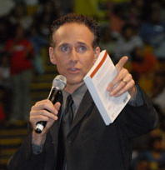
Chapters 1-4 - Division over Preachers and Human Wisdom
1:10-17 – The Problem of Division Stated and Rebuked
1:18-31 – The Power of the Cross vs. Human Wisdom
Chapter 2 – The Revelation of God’s Wisdom
Chapter 3 – Proper Estimation of Preachers
Chapter 4 – Apostles as Faithful, Humble Stewards

Slide 13
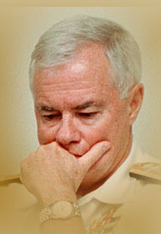
Let There Be No Divisions among You – 1:10-17
Speak the same thing
no divisions among you
perfectly joined together
in the same mind
and in the same judgment
Is Christ divided?
Was Paul crucified for you?
Were you baptized in the name of Paul?

Slide 14
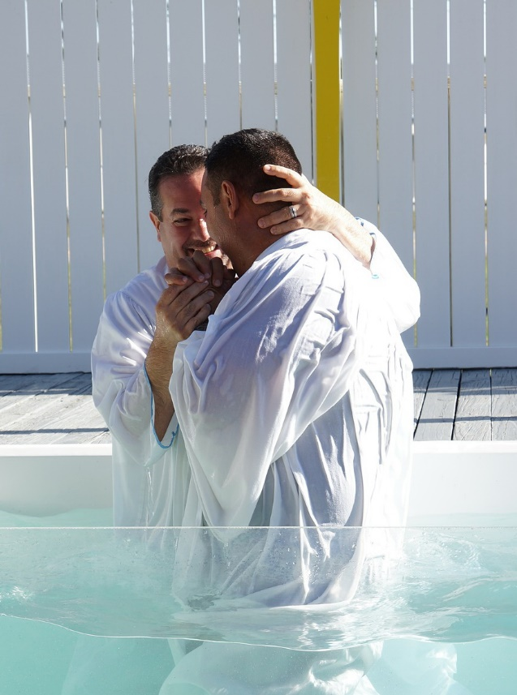
Sent Not to Baptize but to Preach the Gospel
Baptism connected to Jesus’ crucifixion (vs 13)
Paul did not want people to exalt him
Paul was baptized to wash away sins (Acts 22:16)
Paul taught Corinthians to be baptized (Acts 18:8)
He taught baptism is essential
(Romans 6:3,4; Galatians 3:27)
Other passages show baptism is essential
(Mark 16:15,16; Acts 2:38; 1 Peter 3:21)
Paul called to teach not personally do baptisms
John 4:1,2 – Jesus taught but others did baptisms
1 Corinthians 1:17 is a “not ... but” passage

Slide 15
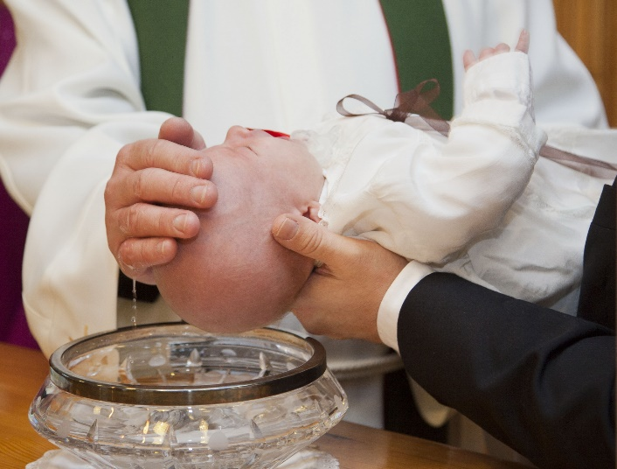
Household Conversions and Infant Baptism?
* No example says babies were included.
* 1 Corinthians 16:15-17 - the household of Stephanas ministered to the saints.
* Before baptism one must hear, believe, repent, and confess (Mark 16:15,16; Acts 2:38; Romans 10:9,10)
* Baptized people must fulfill duties of church membership (1 Cor. 12:13; 10:16,17)
* Babies have no sins to forgive (Matthew 18:3; Psalm 106:37,38; 2 Corinthians 5:10)

Slide 16

Man’s Wisdom vs. God’s Wisdom – 1:18-25
Man’s Wisdom | God’s Wisdom
Gospel is foolish | Gospel is power of God
Perish | Saves those who believe
God will destroy it | Stumbling block to Jews
God made it foolish | Foolishness to Greeks
Do not know God | Wiser/stronger than men

Slide 17
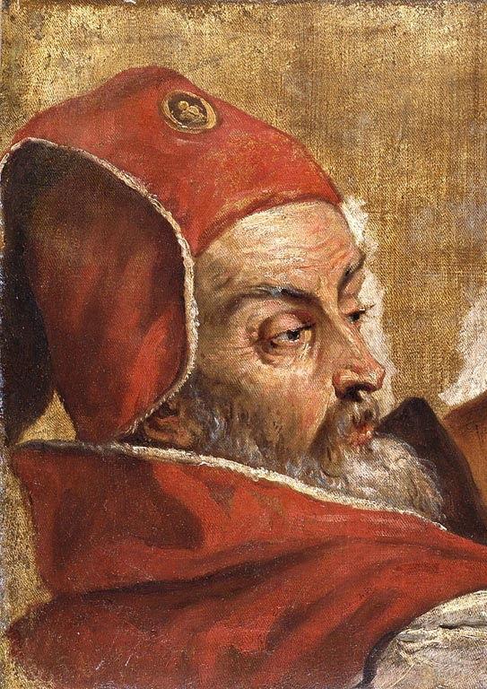
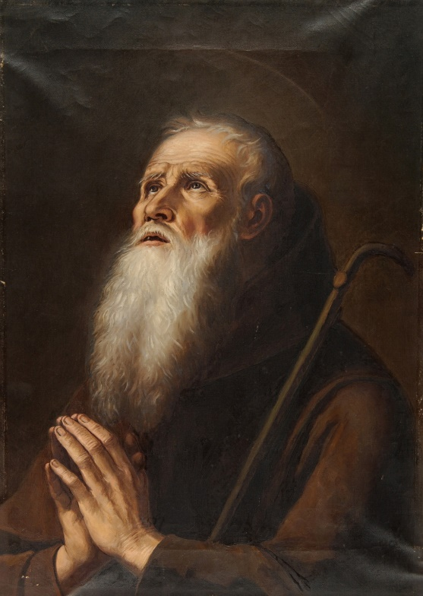
No Flesh Should Glory in His Presence – 1:26-31
Not Many Called | God Has Chosen
wise according to the flesh | foolish
mighty | weak
noble | base
 | despised
 | things which are not
1:31 - He who glories, let him glory in the Lord.

Slide 18
God’s Wisdom Revealed and Preached – chap 2
Preaching should emphasize the power of the gospel of Christ rather than the ability of the preacher.
Inspired men spoke the wisdom of God not the wisdom of men.
The Spirit of God revealed the things of God in words taught by the Spirit.
The natural man does not receive the things of the Spirit, but we have the mind of Christ.

Slide 19
Dangers of Human Wisdom - 1
Proverbs 14:12 – There is a way that seems right to a man, but its end is the way of death.
Proverbs 3:5 – Trust in the Lord with all your heart, And lean not on your own understanding
Psalm 81:12 – So I gave them over to their own stubborn heart, To walk in their own counsels.
Isaiah 47:10 – Your wisdom and your knowledge have warped you
Isaiah 55:8,9 – “For My thoughts are not your thoughts, Nor are your ways My ways,” says the Lord.
Isaiah 65:2 – a rebellious people walk according to their thoughts
Jeremiah 7:24 – Yet they did not obey or incline their ear, but followed the counsels and the dictates of their evil hearts.

Slide 20
Dangers of Human Wisdom - 2
Jeremiah 8:9 – Wise men rejected the word of the Lord; So what wisdom do they have?
Jeremiah 10:23 – O Lord, I know the way of man is not in himself; It is not in man who walks to direct his own steps.
Jeremiah 16:12 – Each one follows the dictates of his own evil heart, so that no one listens to Me.
Romans 1:22 – Professing to be wise, they became fools,
1 Corinthians 3:19 – Wisdom of this world is foolishness with God.
Colossians 2:8 – Beware lest anyone cheat you … according to the basic principles of the world, and not according to Christ.
1 Timothy 6:20 - avoiding the profane and idle babblings and contradictions of what is falsely called knowledge

Slide 21
Inspiration of Scripture
1 Corinthians 14:37 – The things I write are the commandments of the Lord.
Ephesians 3:3-5 – The things Paul wrote were made known to him by revelation … revealed by the Spirit to apostles and prophets.
1 Thessalonians 4:15 – We say by the word of the Lord.
1 Timothy 4:1 – The Spirit expressly says.
Matthew 10:19,20 – It is not you who speaks but the Spirit of your Father who speaks in you.
1 Thessalonians 2:13 – Not the word of men but the word of God.
2 Peter 1:20,21 – Prophecy never came by will of man, but holy men spoke as moved by the Holy Spirit.
2 Timothy 3:16 – All Scripture is given by inspiration of God

Slide 22

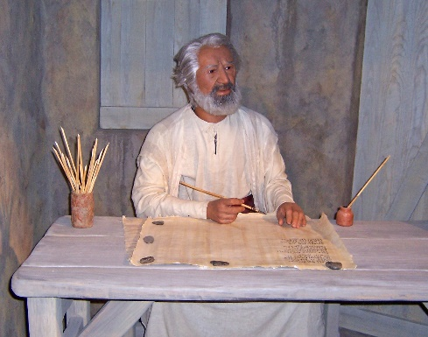
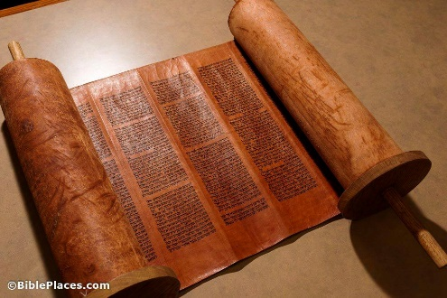
The Process of Revelation
Holy Spirit
Inspired
Men

Slide 23
Verbal Inspiration of Scripture
Deuteronomy 18:18 – I will put My words in His mouth, and He shall speak to them all that I command Him.
2 Samuel 23:2 – The Spirit of the Lord spoke by me, And His word was on my tongue.
Isaiah 51:16 – And I have put My words in your mouth…
Jeremiah 30:1-4 – “Write in a book for yourself all the words that I have spoken.” Now these are the words that the Lord spoke …
Matthew 10:19,20 – Do not worry about how or what you should speak. For it will be given to you in that hour … for it is not you who speak, but the Spirit of your Father who speaks in you.
1 Corinthians 2:13 – These things we also speak, not in words which man's wisdom teaches but which the Holy Spirit teaches

Slide 24
No Errors in Scripture
Numbers 22:35,38; 23:5,12,16,19,20 – God does not lie or repent
Deuteronomy 18:18-22 – Prophet who errs is not from God
Psalms 12:6 – The Lord’s words are pure words
Psalm 19:7-9 – God’s word is perfect, right, true.
Psalm 33:4 – God’s word is right and done faithfully.
Psalm 119:128,142,160 – All God’s precepts are right.
John 17:17 – God’s word is truth.
Titus 1:2,3 – God, who cannot lie, manifested the word.
Hebrews 6:18 – It is impossible for God to lie.
Revelation 19:9 – These are the true sayings of God.
Revelation 21:5 – The words are true and faithful.

Slide 25
The Divine Wisdom We Should Preach – Chapter 2
Results in faith in God’s power not human wisdom
Ordained before the ages but hidden in the past
Rulers did not know so crucified the Lord of glory
Did not enter the heart of man (in times past)
Revealed to inspired men through the Spirit
Inspired men knew the things given by God
Spoken in words taught by the Spirit
Natural man does not receive things of the Spirit
We have the mind of Christ

Slide 26


The Natural Man and the Spiritual Man – 2:14-3:4
Natural Man | Spiritual Man
Does not receive spiritual things | Judges all things
Carnal | Not judged by other men
Cannot take meat | Has mind of Christ
Envy, strife, divisions

Slide 27
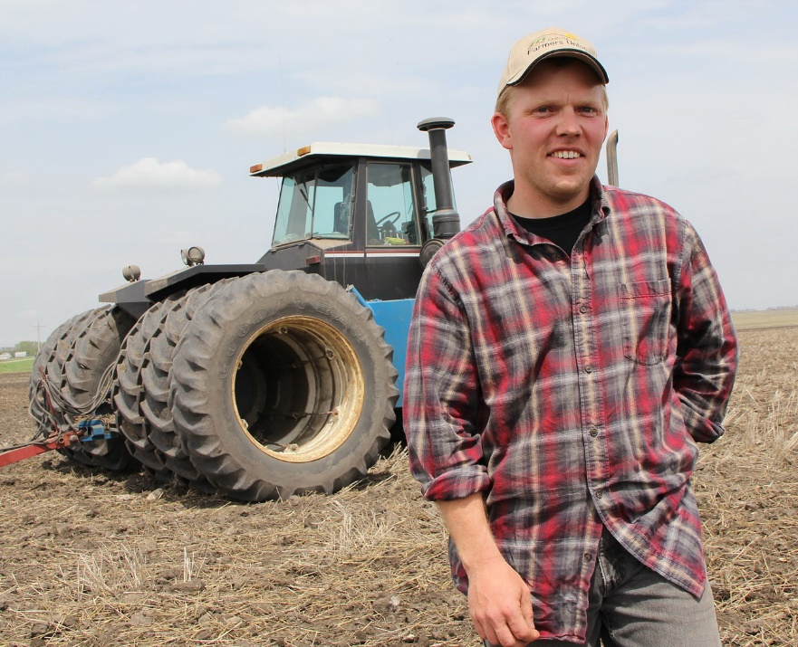
Proper View of Preachers - Chapter 3
Preachers as Farmers – 3:5-8
Servants through whom we believe
God gives their abilities and message
Plant & water but God gives increase
Men not important; God receives glory
Preachers should be one (united)
Each rewarded according to his labor

Slide 28

The Proper Foundation
Jesus Christ, not Peter
(1 Corinthians 3:11; 1 Peter 2:4-8; Ephesians 2:20; Matthew 16:18)
CHRIST
Peter

Slide 29
Building on the Foundation
gold, silver, precious stones
wood, hay, straw
CHRIST

Slide 30
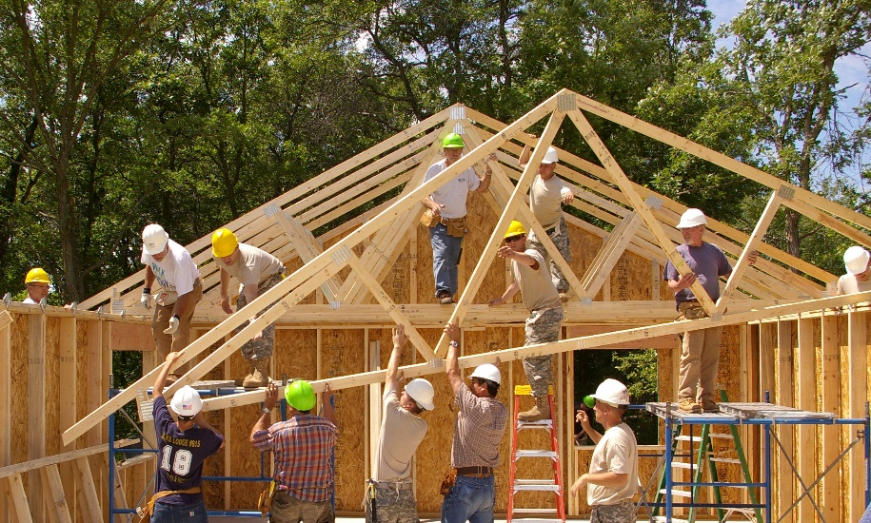
Proper View of Preachers - Chapter 3
Preachers as Builders – 3:9-15
Hearers are God’s building
Some lay a foundation, others build on it
Each should take heed how he builds
Jesus is the only foundation
Fire will test each one’s work
If work endures, the builder is rewarded
If work is lost, the builder is still saved

Slide 31
Does the Spirit Dwell in People Today?
1 Corinthians 3:16 – We are a temple of God, and the Spirit of God dwells in us.
1 Corinthians 6:19 – Our body is a temple of the Holy Spirit, who is in us because we are bought with a price.
Romans 8:9 – If the Spirit of God (Christ) does not dwell in us, we do not belong to God.
(Romans 5:5; Acts 5:32; Ephesians 5:18; James 4:5.)
Conclusions:
* The Spirit does dwell in all children of God today.
* He begins to dwell in us at the moment we become God’s children.

Slide 32
The indwelling is a work of the Spirit separate and distinct from Holy Spirit baptism or miraculous gifts.
The Indwelling | Holy Spirit Baptism and Spiritual Gifts
For all Christians | Not for all Christians
Received at conversion | Came other times & ways
Unchanged today | Not found today
Still needed | Purposes fulfilled
Still exists | Ceased in 1st century

Slide 33
Who Dwells in Whom?
Father
Holy Spirit
2 Cor. 6:16
1 John 4:14-16
John 14:10f,20;
10:37,38
1 Cor. 3:16
1 Cor. 6:19
Rom. 8:9
Son
Christians
Eph. 3:17; John 15:4-6; 2 Cor. 5:17; Rom. 8:1; Gal. 3:27; Rom. 6:3,4
2 Cor. 7:3
Phil. 1:7
Understand how the Father & Son dwell in us, etc., and you understand how the Spirit dwells in us!

Slide 34
What Does the Indwelling Involve?
Fellowship (because we obey the word)
John 17:20-23 -- "In" each other = being "one”
John 15:1-6 -- "Abide in" = not cut off
2 Corinthians 6:14-18 -- Indwelling = fellowship
I John 1:3,6,7f; 2:3-6 -- Fellowship = abiding, knowing
Through the Influence of the word
1 John 2:3-6; 3:24 – Abide in Him if keep His commands
Ephesians 3:17; Romans 10:17 -- Dwells by faith (by word)
Ephesians 6:17 -- Word is the sword of Spirit
Fruit in our lives (produced through the word)
Galatians 5:22-25 -- Fruit of the Spirit
Col. 1:5f,9f; Luke 8:11,15 -- God's word bears fruit
John 15:1-6 -- Abide in Christ; bear fruit

Slide 35
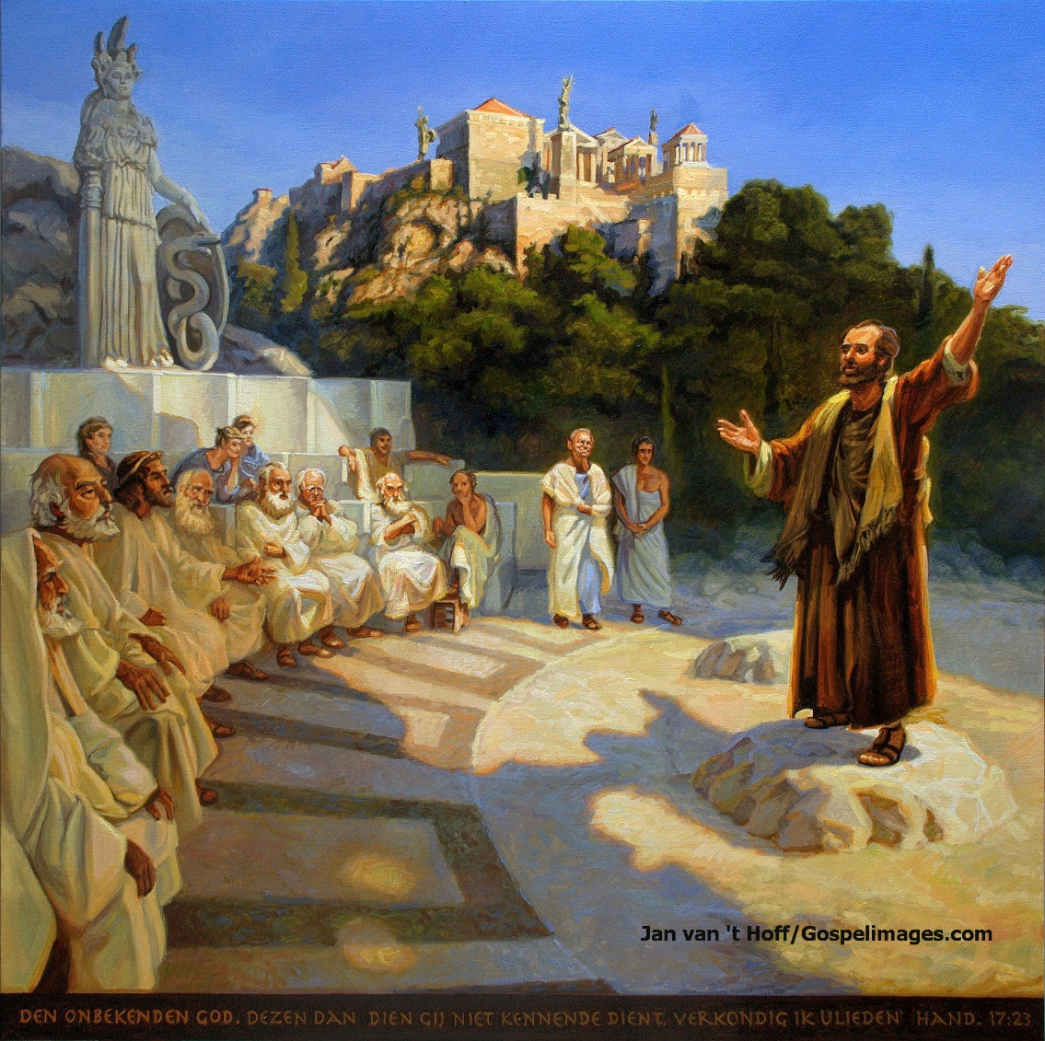
Let No One Boast in Men
All things are yours:
Paul or Apollos or Cephas
The world or life or death
Things present or things to come.
BUT
You are Christ’s, and Christ is God’s

Slide 36
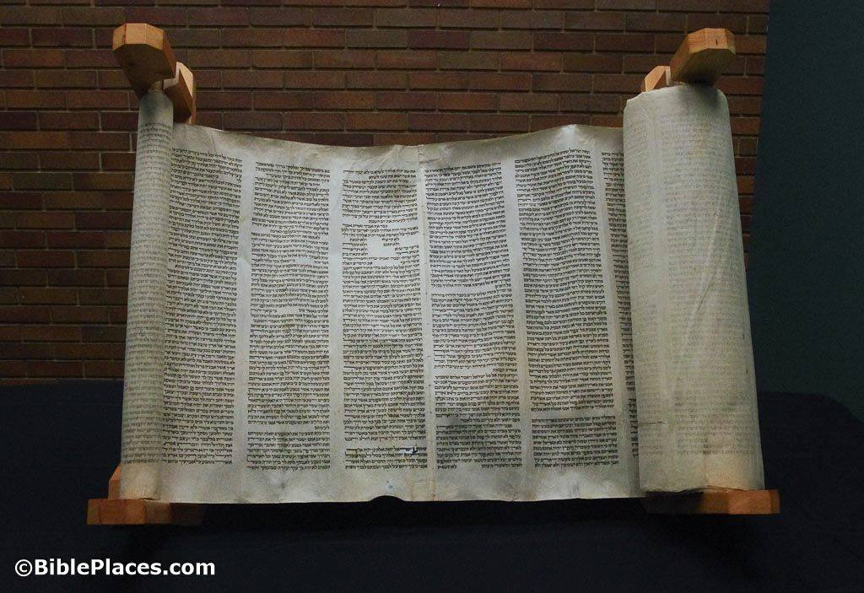
Let a Man So Consider Us…
Servants of Christ and stewards of the mysteries of God.
Required to be found faithful.
Judged not by man but by the Lord
Judge nothing before the Lord comes
Do not think beyond what is written

Slide 37
The Corinthians | Paul & Apostles
Full Rich Reigning | Not reigning As condemned to death Spectacle
Wise/Strong/Distinguished | Fools/Weak/Dishonored
 | Hunger and thirst Poorly clothed Beaten and homeless Working with our hands Reviled, we bless Persecuted, we endure Defamed, we entreat Filth of the world

Slide 38
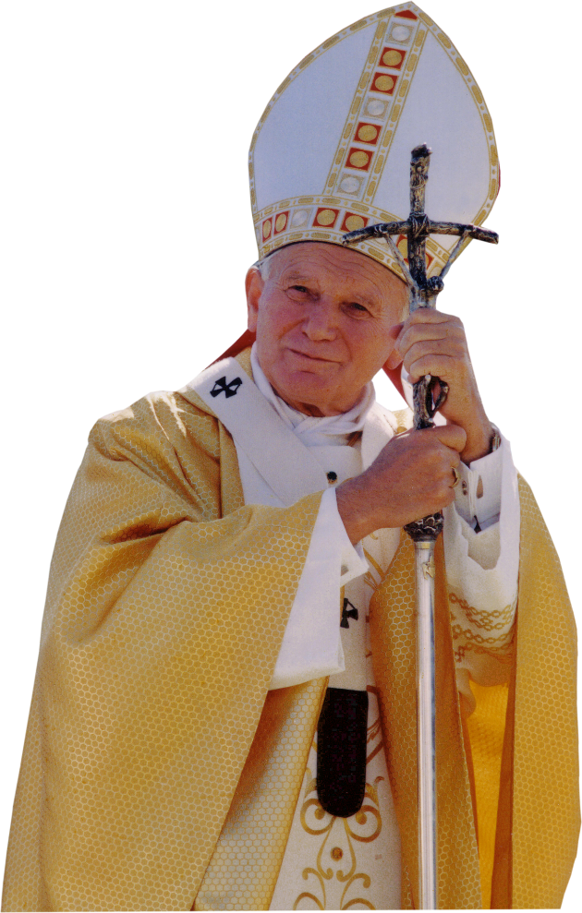
Many Instructors; Not Many Fathers
Many instructors ( “tutors,” “guardians,” “guides”)
Not many fathers: Paul’s teaching led to their conversion
Matthew 23:9 – Call no man “father” (religious honor)
Which way do denominations use the term?

Slide 39
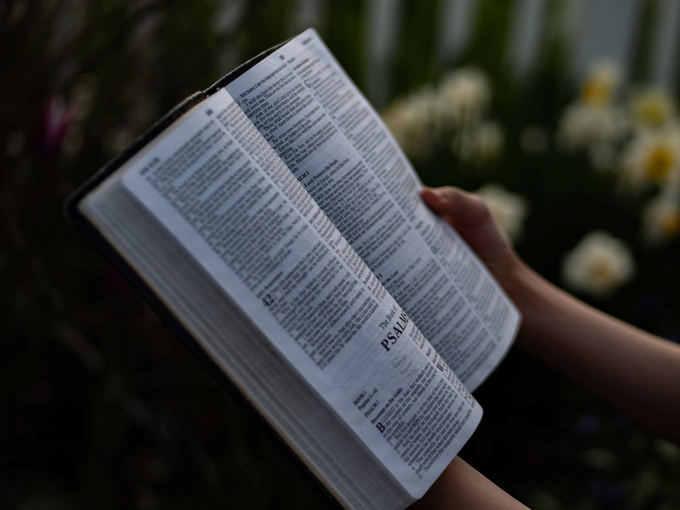
“Imitate Me”: Follow Paul’s example
Apostolic examples are authoritative
1 Corinthians 4:16; 11:1; Philippians; 3:17; 4:9; 1 Timothy 1:16; 2 Timothy 3:10
We should follow Paul’s inspired teaching and example.
Paul taught same things in every church.
Teachers should be consistent.
Churches should not teach different doctrines.

Slide 40
Steps to Deal with Sin Problems
1 Corinthians 5 | General Problems
1. Mourn that one has sinned | 1. Recognize and acknowledge problem.
2. Judge him who did the deed | 2. Decide to deal with the problem.
(3. Rebuke the sinner) | 3. Confront and rebuke the sinner.
4. Deliver him to Satan that his spirit may be saved | 4. Give the sinner reason to be ashamed so he can be saved.
5. Purge out the leaven of malice and wickedness | 5. Eliminate the influence of the sin.

Slide 41
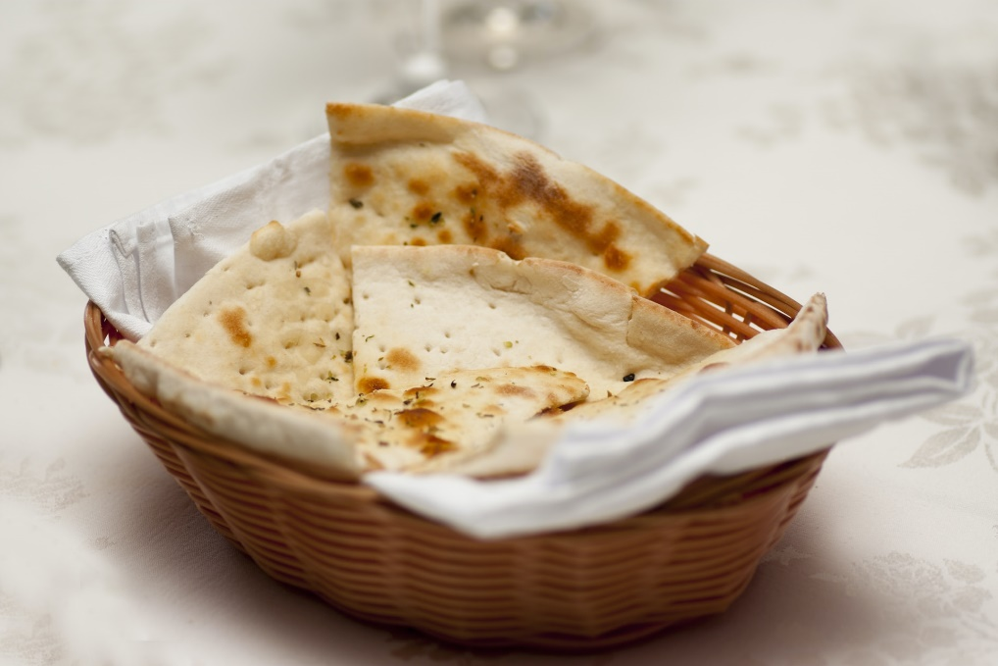
Purge Out the Old Leaven – verses 6-8
A little leaven leavens the whole lump
Purge out the old leaven
Be a new lump … truly unleavened
Christ, our Passover, was sacrificed for us
Keep the feast not with the leaven of malice and wickedness
But with the unleavened bread of sincerity and truth

Slide 42
Have No Company, Not to Eat with…
Fornicator – one who is guilty of sexual relations outside of scriptural marriage (Hebrews 13:4).
Covetous – greedy, desiring to obtain what others have by some unauthorized means.
Idolater – one who worships false gods.
Reviler – one who slanders or reviles others.
Drunkard – one who gets intoxicated.
Extortioner – thief, robber, swindler.
Such a person – this kind of person.

Slide 43
1 Corinthians 5
Reason for Discipline
General: Malice and wickedness (v8); evil (v13)
Specific: Fornicators, Covetous, Idolater, Railer, Drunkard, Extortioner (v11)
Action Taken
Make a judgment (v12)
Gathered together deliver one to Satan (vv 4,5)
Put away that wicked person (vv 13,2)
Purge out the old leaven (v7)
Do not keep company not even to eat (vv 9-11).

Slide 44
Sinner’s Action / Church’s Action
What the Sinner Does | What the Church Does
Commits sin Refuses to repent (Breaks fellowship – 1 John 1:7) | Make judgment Rebuke sinner Mark/identify sinner Keep no company / put away sinner / purge out leaven / punish / prove selves to be clear / shame / withdraw Forgive sinner (if repents)
The church does not break fellowship. The sinner did that.
The church simply recognizes what the sinner did and applies the consequences that God commands.

Slide 45
Church Discipline Passages
Matthew 18:15-17
Romans 16:17
1 Corinthians 5
2 Corinthians 2:4-11; 7:5-12
2 Thessalonians 3:6-15
1 Timothy 1:18-20,3-11
Titus 3:10,11
God believes in discipline.
He ordains and commands it!

Slide 46
Action of Church Discipline
1. Make a judgment & admonish | Matt. 18:15-17; 1 Cor. 5:12; Titus 3:10; 2 Thess. 3:15;
2. Mark & note (Identify) | Rom. 16:17; 2 Thess. 3:14; 1 Cor. 5:4,5; 1 Tim. 1:20
3. Refuse to keep company | Matt. 18:17; Rom. 16:17 1 Cor 5; 2 Thess. 3; Titus 3:10
4. Forgive (If the sinner repents) | Matt. 18:21-35; 6:12,14,15 2 Cor. 2:6-11

Slide 47
Purposes of Discipline
To Encourage the Sinner to Repent
Matthew 18:15; 1 Corinthians 5:5; 2 Thessalonians 3:14;
1 Timothy 1:20
To Warn Members & Overcome Bad Influence
1 Corinthians 5:6-8 (Acts 5:11; 1 Timothy 5:20; Titus 1:10-14;
1 Cor. 15:33; Hebrews 12:15; 2 Peter 3:17; 2 Timothy 2:16-18)
To Maintain Respect for God and His People
2 Corinthians 7:11 (Acts 5:11; 1 Peter 2:11,12; 3:16
Romans 2:17-24; 2 Corinthians 6:3)
To Obey God’s Commands
2 Corinthians 2:9 2 Thessalonians 3:6 (Matthew 18:15-17; Romans 16:17; Titus 3:10; etc.)

Slide 48
Sins that Require Discipline
General
Malice /wickedness; walk disorderly not according to inspired tradition; put away faith and a good conscience, suffer shipwreck of the faith; lawless and disobedient, ungodly and sinners; anything contrary to sound doctrine; Sin against a brother.; causing division or occasion of stumbling; heresy
Specific
Fornicators, covetous, idolaters, railers, drunkards, extortioners; those who do not work, busybodies;
blasphemy, unholy and profane, murderers, fornicators, homosexuals, kidnappers, liars, teachers of different doctrines

Slide 49
2 Corinthians 2:4-11; 7:8-12
1 Cor. 5
Same Situation
2 Cor. 2 & 7
2:4,9 – Paul had written them about this
2:5 – Some “one” caused grief to Paul and Corinth
2:6 – The majority had inflicted a punishment
2:7-11 – Now he should be forgiven and comforted
7:11,12 – A man did wrong in a “matter”
7:8-12 – Paul wrote a letter about this “matter” that caused them to be sorry. Corinth repented and corrected themselves with godly indignation.

Slide 50
2 Corinthians 2:4-11; 7:8-13
Additional Lessons
7:11 – The church acted to clear their own reputation. (They “demonstrated [them]selves to be innocent” - NASB)
2:6 – The church acted for the purpose of “punishment” (7:11)
2:9 – The church acted also to obey God’s command (7:7-11)
2:6-10 – The church must forgive a sinner who repents

Slide 51

Suing Christians in Civil Courts
Saints will judge the world and angels.
Wise men in the church should judge between brethren.
(Consider the pattern of Matthew 18:15-17.)
Better to accept wrong and be cheated than to take another Christian before a civil court.

Slide 52
Evil and the Kingdom of God
Fornicators
Idolaters
Adulterers
Homosexuals
Sodomites
Thieves
Covetous
Drunkards
Revilers
Extortioners
Kingdom
Of God
These will not inherit the Kingdom of God.
Such people can be washed, justified, and sanctified.
Sin is not inborn; people choose to sin and can choose to change.

Slide 53

Proper Use of the Body – 6:12-20
Not all things are helpful.
I will not be brought under the power of any.
God will destroy both the stomach and the foods.
The body is not for fornication but for the Lord, and the Lord for the body.
God will raise up the body.
Bodies are members of Christ not members of a harlot.
Fornication sins against the body.
Your body is a temple of the Holy Spirit. You are bought at a price. Glorify God in your body.

Slide 54
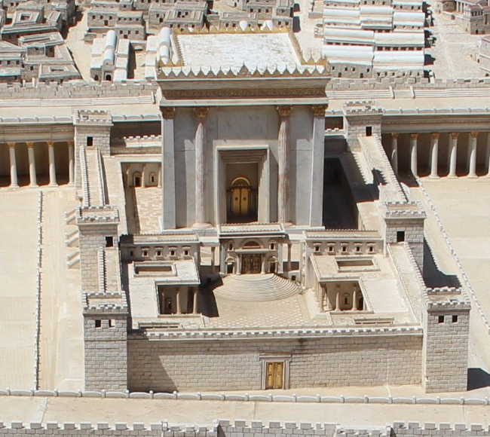
A Temple of the Holy Spirit – 6:19-20
Your body is a member of Christ
(verse 15).
God will raise the body from the dead (verse 14)
Your spirit is one with Christ (verse 17).
Your body is a temple of the Holy Spirit.
You are bought at a price.
So glorify God in your body and your spirit.

Slide 55

Chapter 7 - Instructions regarding Marriage
Marriage, sexual purity, and divorce
Abiding in one’s calling
Virgins and widows

Slide 56
What Is Marriage?
1) Marriage is a relationship defined and ordained by God;
2) A mutual agreement or commitment between one man and one woman (a male and a female) to be husband and wife;
3) A new relationship, separate from parents’ families:
4) A lifetime commitment intended to be a permanent relationship: the two cleave to one another;
5) Begun with a ceremony (initiation ritual) in the presence of witnesses in harmony with civil law;
6) The sexual union is to occur only within this marriage relationship: the two become one flesh.
See Genesis 1:26-28; 2:24; Romans 7:2,3; 13:1-7; Matthew 19:3-6; Hebrews 13:4; Malachi 2:14; Genesis 29:21-23; Ruth 4:9-13;

Slide 57
7:1-16 – What Is Fornication?
7:1-16 – What Is Fornication?
To avoid fornication:
* “Husband” and “wife” excludes sexual relationships with a person to whom one is not married at all (premarital relations).
* “His own wife” … “her own husband” exclude sexual relationships with someone else’s spouse (extramarital relations).
* “Husband” and “wife” literally “man” and “woman,” so exclude all homosexual relationships (6:9-11; Genesis 2:18-24; Jude 7).
  * “Husband” and “wife” (singular) excludes polygamy.
* So, fornication is any sexual union with someone other than the person to whom one is married in harmony with God’s law (“husband” or “wife”) – Hebrews 13:4.

Slide 58

7:1-16 - Marriage, Sexual Conduct, Divorce
To avoid fornication, a person should marry and give proper affection to his/her spouse.
Marriage avoids fornication
Render due affection
Do not deprive one another

Slide 59
7:1-16 - Marriage, Sexual Conduct, Divorce
To avoid fornication, a person should marry and give proper affection to his/her spouse.
Married people should not divorce; but if they have, they should remain unmarried or else reconcile.

Slide 60
Divorce and Remarriage
General teaching: Divorce is forbidden; Remarriage is adultery
  Matthew 19:3-9; 5:31,32; Romans 7:2,3; 1 Corinthians 7:10,11
Remarriage is adultery because it is sexual union outside the marriage bond.
  Malachi 2:14-16; Hebrews 13:4; Romans 7:2,3;
  Matthew 19:3-9; 1 Corinthians 7:10,11
One exception: For the cause of fornication
  Matthew 19:9; 5:32

Slide 61
Divorce NOT for Fornication
What Happens
Married
Divorced
(unmarried)
Remarried
God’s View
Bound/Joined in covenant
Sin
(still bound)
Adultery

Slide 62
Command to Those Who Are Married – 1 Corinthians 7:10,11
Do Not Depart (Divorce)
But if You Do Depart
Be reconciled
Remain Unmarried
OR
One exception: For the cause of fornication

Slide 63
What to Do about Unscriptural Remarriage?
To continue in the relationship is to continue in adultery.
Malachi 2:14-16; Romans 7:2,3; Matthew 19:3-9;
1 Corinthians 7:10,11
Repentance requires ceasing sin.
Repentance requires fruits of repentance.
Forgiveness does not release lawful obligations and covenants.

Slide 64
7:1-16 - Marriage, Sexual Conduct, Divorce
To avoid fornication, a person should marry and give proper affection to his/her spouse.
Married people should not divorce; but if they have, they should remain unmarried or else reconcile.
If an unbelieving spouse is content to be married, the believer should not divorce. But if the unbeliever departs, let him/her depart.

Slide 65
The Unbeliever Is Sanctified by the Believer, Otherwise Your Children Would Be Unclean.
Not This
But This
Believer
Unbeliever
Believer
Unbeliever
Unclean
Sanctified

Slide 66

Does 1 Cor. 7:15 Allow Remarriage?
The Bible allows remarriage only for one who divorces a spouse for fornication.
1 Cor. 7:15 applies only to non-Christians leaving Christians.
“Under bondage” (δουλοω) means slavery and is never used for the marriage bond (δεω).
“Not under bondage” does not allow remarriage in case of desertion.

Slide 67
Chapter 7 - Instructions regarding Marriage
Marriage, sexual purity, and divorce
Abiding in one’s calling
Virgins and widows

Slide 68
As the Lord Has Called Each One,
So Let Him Walk
Callings that Do Not Matter:
Circumcision / uncircumcision
Slave / free
Married / unmarried
What DOES Matter
Keeping the Commands of God

Slide 69
What Callings Matter?
Callings that Matter
(May Not Continue)
prostitute, alcoholic,
drug addict, thief,
hired killer, polygamist,
bar tender, homosexual
Callings that Are “Nothing” (May Continue)
Circumcision / uncircumcision
Slave / free
Legitimate occupation
Home owner / renter
Cell phone / land line
Married / unmarried
What Matters Is
Keeping the Commands of God

Slide 70
Chapter 7 - Instructions regarding Marriage
Marriage, sexual purity, and divorce
Abiding in one’s calling
Virgins and widows

Slide 71
Those That Do Are Like Those Who Do Not – 7:29-31
Those Who Do | Those Who Do Not
Marry | Do not marry
Weep | Do not weep
Rejoice | Do not rejoice
Buy | Do not possess
Even in times of distress our choices must not become excuses for unfaithfulness.

Slide 72
Virgins and Widows
In the present distress…
Those That Do Are Like Those Who Do Not
One who is unmarried cares about pleasing the Lord, but one who is married cares about pleasing the wife or husband.
One who gives a virgin in marriage does well, but one who keeps her a virgin does better.
A widow is happier if she remains as she is.

Slide 73

An Overview of 1 Corinthians 8-10:
Meat Offered to Idols and Matters of Liberty
Chapter 8 – Eating meat in an idol’s temple
9:1-23 – Financial support of preachers (and Paul’s liberty)
9:24-10:13 – Self-Control and the Danger of Falling into Sin
10:14-33 – Further Warnings Against Idolatry and Eating Meat Offered to Idols

Slide 74

Eating Meat Offered to an Idol: Different Circumstances
In an idol’s temple as act of worship
In an idol’s temple for nourishment
At a private meal for nourishment
Bought at a market, eaten for nourishment
Chapter 8 discusses the second case.

Slide 75
Why Banquets in an Idol’s Temple
Tempted Christians
Why might a Christian be tempted to eat meat in an idol’s temple even though he did not believe in the idol?
* Good food: Nourishment
* Fun and good times
* Visiting with friends
* Business associations
* Family expectations
For all the same reasons some people attend denominations or other group meetings even when they do not agree with the group’s purposes.

Slide 76
Some Characteristics of Matters of Liberty
* A matter of liberty is a practice which, whether we participate or not, does not make us better or worse spiritually.
* There are such things as matters of liberty (verses 8,9; see 7:17-24).
* There are practices to which some people attach significance as religious worship or service, but those acts may be practiced for other purposes without attaching religious significance to them.

Slide 77

Things Offered to Idols; Matters of Liberty
If one knows there is only one true God, he could eat meat offered to an idol simply as food.
But some defile their conscience by eating meat offered to an idol as an act of worship.
So, a Christian should not eat meat in an idol’s temple lest he lead others to violate their conscience.

Slide 78
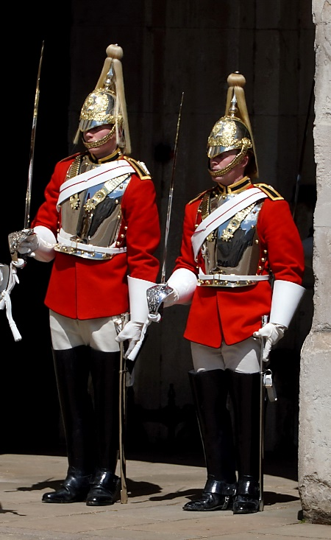
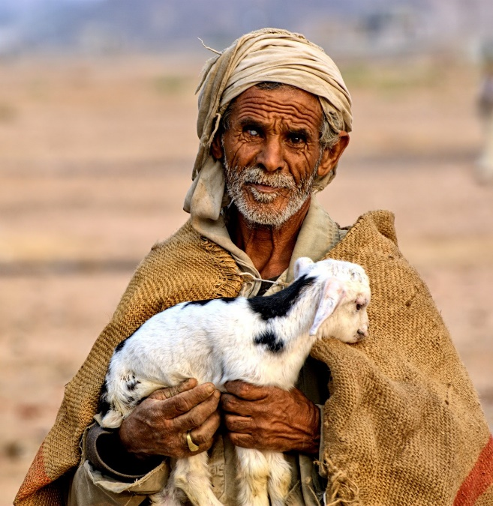
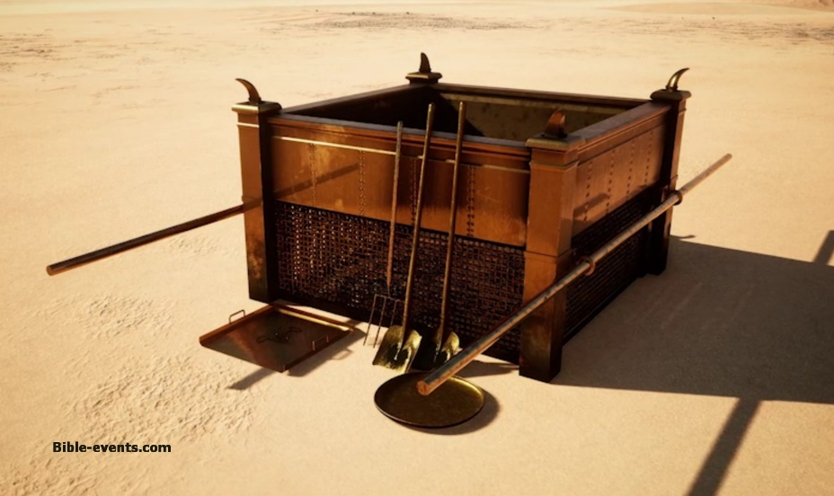

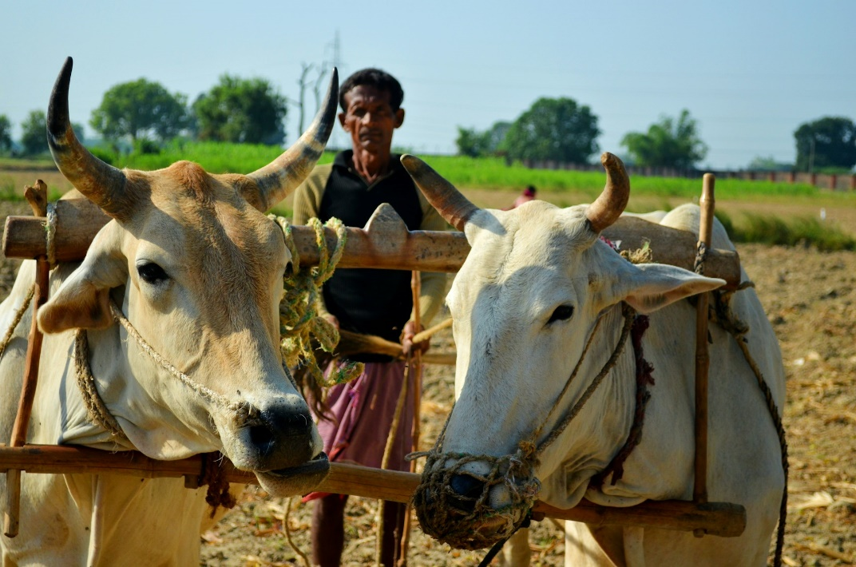
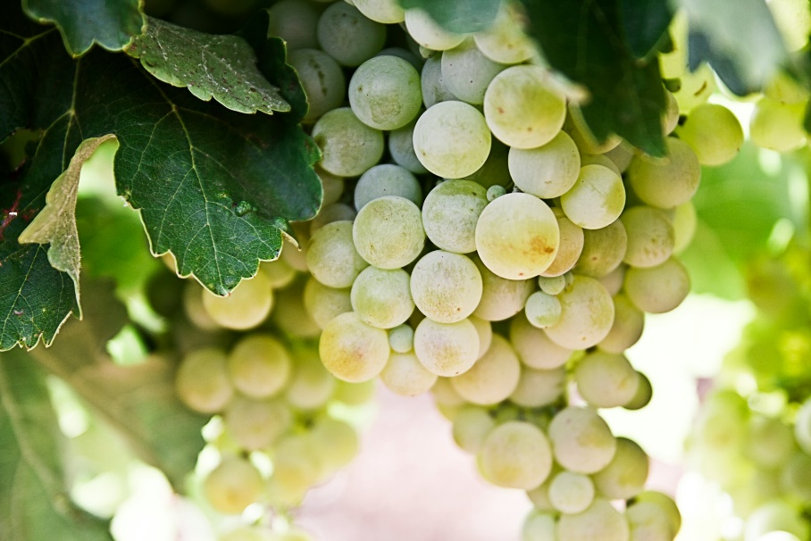
The Laborer Is Worthy of His Hire.

Slide 79

9:1-23 – Financial Support of Preachers and Paul’s Liberty
Paul had a right to eat, drink, marry, and refrain from working.
The laborer is worthy of his hire.
So the Lord commanded that those who preach the gospel should live of the gospel
But Paul had chosen to forego this liberty.
We should sacrifice liberties or adapt to customs to save others.

Slide 80
All Things to All Men to Save Some
To Jews under the law | As a Jew under the law | To win Jews under the law | Yet not subject to the law
To those without law (Gentiles) | As without law | To win those without law | Yet under law to Christ
To the weak | As weak | To win the weak | (Though not really weak)
To all men | All things | To save some
Free from all men but a servant to all in order to win more

Slide 81

9:24-10:13 – The Need for Sacrifice and Self-Control to Be Victorious over Sin
Athletes must practice self-discipline and sacrifice to win a temporary victory.
So Christians must exercise self-control and sacrifice to receive the crown of life.
Old Testament Israel illustrates the need for self-control to avoid the danger of falling.

Slide 82
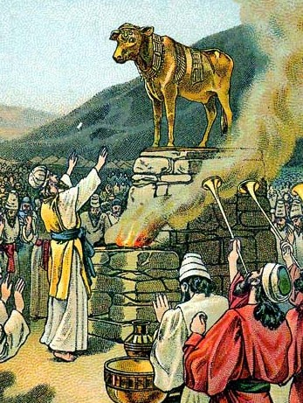
Warnings of Apostasy from Israel’s History – 10:1-13
Evil lust (verse 6)
Idolatry (verse 7)
Fornication (verse 8)
Tempting Christ (verse 9)
Murmuring (verse 10)
1 Cor 10:12 - Therefore let him who thinks he stands take heed lest he fall.

Slide 83

No Temptation Beyond Our Ability – 10:13
God will not allow a temptation beyond our ability to endure
With the temptation He will also make the way of escape
There is never an excuse for sin. We do not “have to sin” but can overcome every temptation by taking the way of escape.

Slide 84
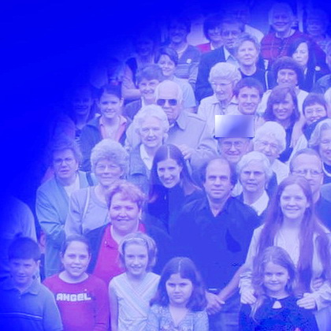
“We” = One Body - 10:16,17
“We” who bless the cup = “we” in the one body, “all” of whom partake of the one bread (verse 17).
The “one body” is the universal church including Paul & the Corinthians. It is not a local congregation.
All Christians in all places and all ages use the same bread and the same “cup.”
So “the cup” is just the element, regardless of the containers!

Slide 85
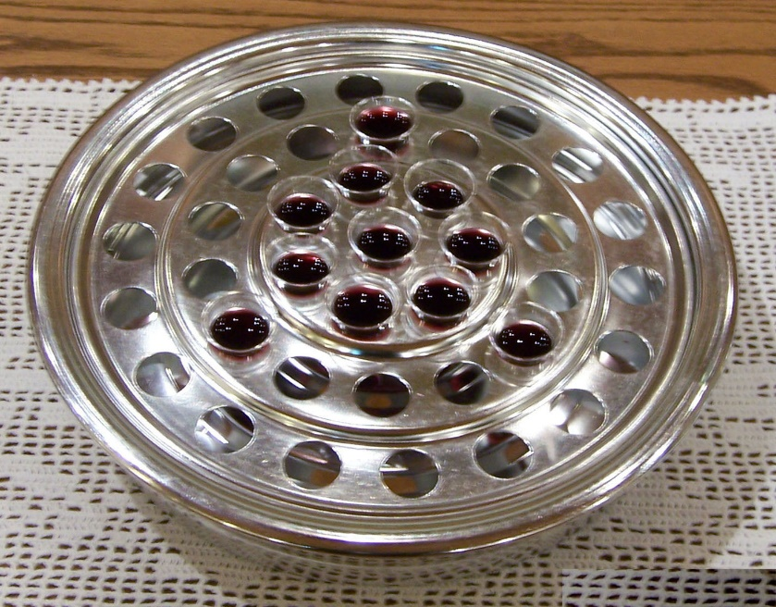
What Is “the Cup”?
Three Alternative Meanings:
(1) a container
(2) a container with its contents
(3) a liquid or beverage (no reference to a container)
In the Lord’s Supper there is one cup, the same for all Christians everywhere in every age.
That cup refers only to the element, never the container.
No passage defines the nature or number of containers.

Slide 86
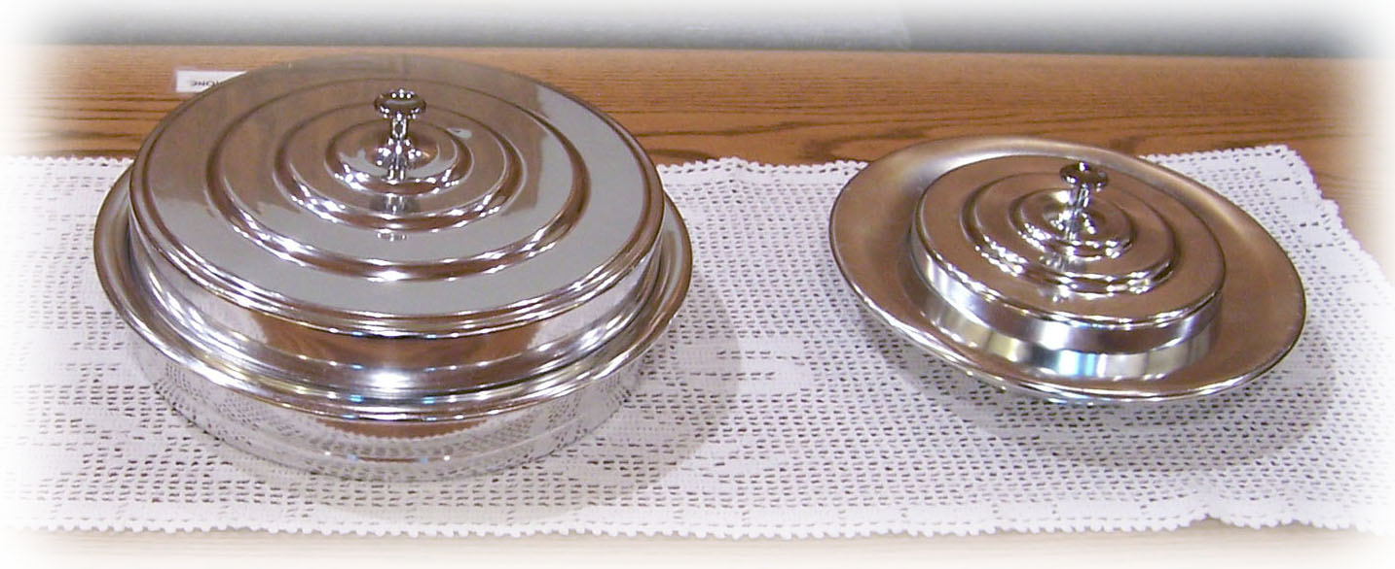
Three Examples of Fellowship by Eating in Public Worship
1) Eating the Lord’s Supper (verses 16,17)

Slide 87
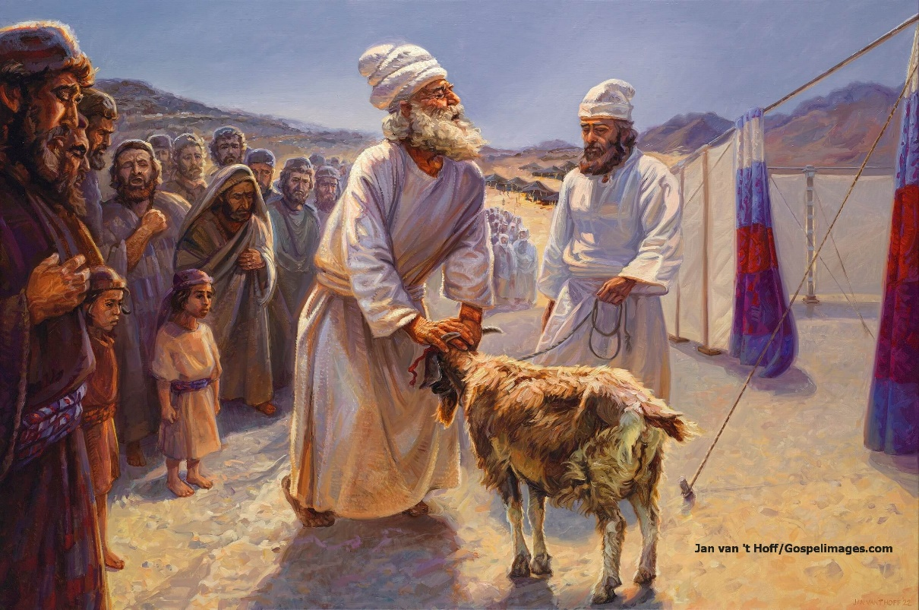
Three Examples of Fellowship by Eating in Public Worship
1) Eating the Lord’s Supper (verses 16,17)
2) Eating the Old Testament animal sacrifices (verse 18)

Slide 88

Three Examples of Fellowship by Eating in Public Worship
1) Eating the Lord’s Supper (verses 16,17)
2) Eating the Old Testament animal sacrifices (verse 18)
3) Eating meats offered to idols in the idol’s temple (verses 19-22)

Slide 89
Reasons to Avoid Eating Meat in an Idol’s Temple
(1) It would be a stumbling block or bad influence on others (chapter 8).
(2) It would tempt even the knowledgeable Christian to participate in sinful aspects of idolatry (10:1-12).
(3) It constitutes fellowship in sinful worship of the idol (verses 14-22).

Slide 90
Matters of Liberty: Circumstances Alter Conclusions
Eating Meats Offered to Idols: Three Circumstances
10:14-22 | In an idol’s temple | Wrong
10:25,26 | Bought at a market | Acceptable
10:27-30 | At a private dinner | Depends
Eating meat offered to an idol is a matter of liberty (8:8,9) because it is not always wrong.
Yet it is sometimes wrong depending on circumstances.

Slide 91
The Underlying Principles
* Knowledge
1 Corinthians 8:7 – there is not in everyone that knowledge
* Influence
1 Corinthians 8:9 – beware lest liberty be a stumbling block
* Love for Brothers
1 Corinthians 8:1; 10:24 – love edifies; seek other’s well-being
* Edification, Peace, and unity
1 Corinthians 8:1 – Knowledge puffs up, but love edifies.
* Glory for God
1 Corinthians 10:31 – ... do all to the glory of God.
* Salvation of Souls
1 Corinthians 10:33 – …seek that many may be saved.

Slide 92
Matters of Liberty: Other Specific Principles
Matters of liberty, not required or forbidden practices.
Past religious ties do not necessarily make an act sinful.
Circumstances alter application of the principles.
Considering cases where our conduct tempts someone to sin.
Avoid tempting anyone to sin: weak, strong, or aliens.
Some people are contentious and divisive.
Some people may be offended by whatever course we take.
Conclusions apply to individuals, not local churches.
Local churches must consider the needs of many people
The strong should bear the burden of the weak.
Some object to authorized practices with spiritual benefits.

Slide 93
Matters of Liberty: Specific Examples
10:14-22 | In an idol’s temple | Wrong
10:25,26 | Bought at a market | Acceptable
10:27-30 | At a private dinner | Depends
* Using names that originated in heathen idolatry
* Eating at a tavern to be with friends even if I do not drink.
* Eating at a family restaurant that serves alcohol
* Buying groceries or gas at a store that sells alcohol, lottery
* Going into a casino to eat or be with friends not gambling.
* Attending typical school dances but not dancing.
* Attending a Catholic mass and eating the communion
* Attending a funeral of a relative in a Catholic church
* Attending a denomination and singing to instruments

Slide 94
Matters of Liberty: Specific Examples
10:14-22 | In an idol’s temple | Wrong
10:25,26 | Bought at a market | Acceptable
10:27-30 | At a private dinner | Depends
* Attending a false religious group but not participating in error
* Displaying a manger scene in one’s yard during “Christmas”
* Putting up a “Christmas” tree in one’s house
* Exchanging gifts with family at “Christmas”
* Taking “Christmas” as a day of vacation from work
* Woman wear slacks when visiting someone who objects
* Drinking coffee (if others may think it is wrong)
* Voting in an election if we know Christians who object

Slide 95
Common Issues in 1 Corinthians 11-14
Section | Issues (Problems)
11:2-16 | Women’s subjection regarding worship (praying), and spiritual gifts (prophesying)
11:17-34 | Division, confusion, disorder, disregard for others regarding the Lord’s Supper in their assemblies
chapter 12 | Disunity and disregard for others regarding spiritual gifts
chapter 13 | Lack of love for others regarding spiritual gifts
chapter 14 | Division, disorder, confusion, disregard for others regarding spiritual gifts and women’s disregard for subjection in church assemblies
Chapters 11-14 – Proper Conduct in Assemblies vs. Disorder/Confusion

Slide 96
Principles Taught in 11:2-14:40 that Still Apply
* Women should be subject to men – 11:2-16; 14:34,35.
* Everyone focus together on each worship act – 11:21,33; 14:27-32
* Lord’s Supper a memorial of Jesus’ body and blood – 11:23-29.
* Do elsewhere individual acts that are not church acts – 11:34.
* Members should care for one another, not be divided – chap. 12.
* We were all baptized into one body – 12:13.
* Service to God and others must be motivated by love – 13:1-7.
* Characteristics of love – 13:5-8
* Spiritual gifts were temporary and would cease – 13:8-13.
* Faith, hope, and love abide, but love is greatest– 13:13.
* Everything should be understandable & edifying– 14:1-26.
* God is the author of peace, not confusion – 14:33.
* All should be done decently and in order – 14:40

Slide 97
General Views Regarding Covering(s)
Each view may have some variation.
1. Teaching regarding the artificial covering is binding today.
2. Long hair is the only covering required of women today.
3. Artificial covering was a custom of time and place no longer binding.
4. Artificial covering was required only of women who exercised spiritual gifts. It is no longer required.
5. The covering was a custom in that society. Women with spiritual gifts thought they were exceptions. Paul required them to wear the veil to show their position of subjection. This does not apply today.
Please wait till we have studied the whole passage before discussing which view applies today.

Slide 98

Authority in 1 Corinthians 11
MAN
WOMAN

Slide 99
“Cover” (verses 4-6): Different Word from Verse 15
Translations use forms of the word “cover” in verses 4-7:
NKJV, KJV, NASB, ESV, LEB, MEV, HCSB, MLB, LSB.
NKJV: Every man praying or prophesying, having his head covered, dishonors his head. But every woman who prays or prophesies with her head uncovered dishonors her head, for that is one and the same as if her head were shaved. For if a woman is not covered, let her also be shorn. But if it is shameful for a woman to be shorn or shaved, let her be covered.
Translations use forms of “veil”: ASV, NRSV, RSV, MLV, (MLB)
ASV: Every man praying or prophesying, having his head covered, dishonoreth his head. But every woman praying or prophesying with her head unveiled dishonoreth her head; for it is one and the same thing as if she were shaven. For if a woman is not veiled, let her also be shorn: but if it is a shame to a woman to be shorn or shaven, let her be veiled.

Slide 100
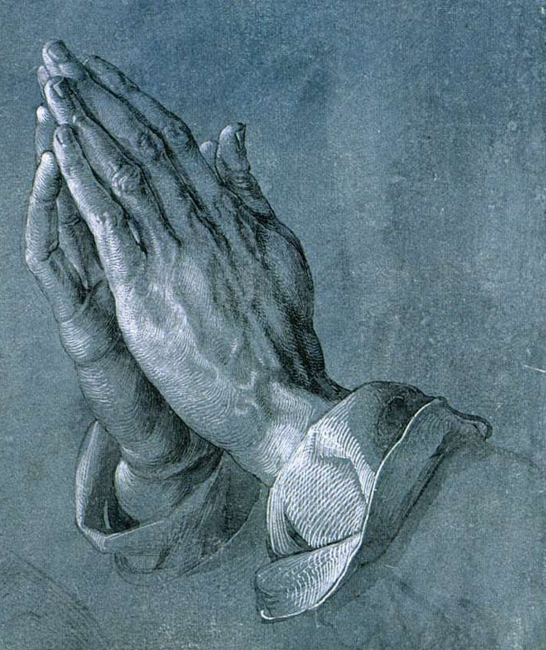
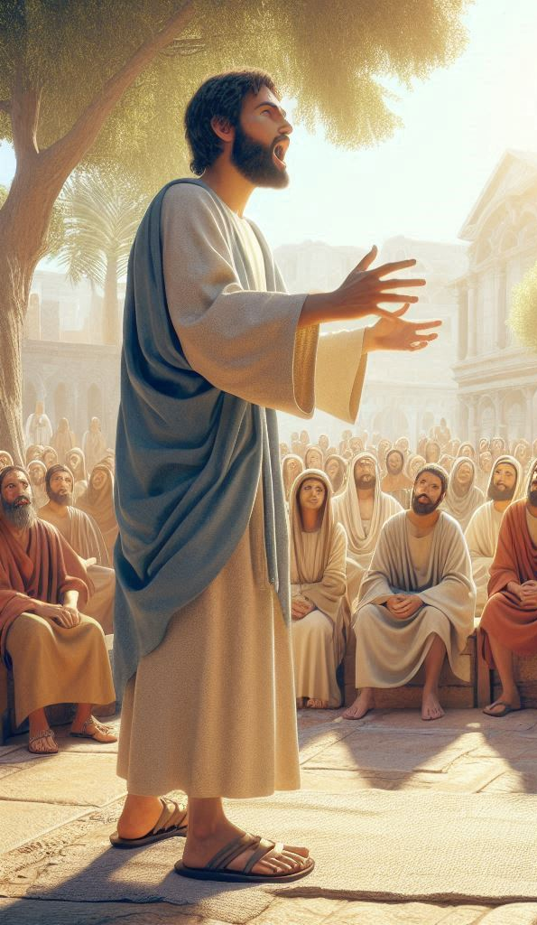
Praying
Prophesying
or
Acts 2:42; Luke 18:1; Colossians 4:2,3; 1 Thessalonians 5:17;
1 John 5:14,15; 3:21,22; James 5:16; Matthew 7:7-11; 18:19
Matthew 7:22; Acts 2:17,18; 19:6; 21:9;
1 Corinthians 13:9; 14:1,3,5,24,31,39

Slide 101
“Praying or Prophesying” = All Worship Activities?
“Synecdoché … one part or member is put for, and includes, every part or member.” – Bullinger, Figures of Speech Used in the Bible
Matthew 6:6 – Go into your room (closet), shut your door, and pray.
Matthew 6:11 – Give us this day our daily bread
Acts 2:42; 20:7 – “Break bread” (the Lord’s Supper)
Acts 16:13,16 – Paul & Silas went to place where prayer was made
Matthew 7:15-20; 2 Corinthians 11:13-15 – Beware of false prophets
1 Corinthians 7:5 – Husband & wife give selves to fasting & prayer.
1 Corinthians 11:34; 14:35 – “Let him eat at home.” “Let her ask her husband at home.”
1 Corinthians 13:8 lists three spiritual gifts that were done away
1 Corinthians 14:15 - sing & pray with the spirit and understanding.

Slide 102
If Shaved / Shorn Is Shameful, Let Her Be Covered
Shaved as by a razor like a Nazirite – Acts 21:24
Shorn: cut short like a sheep (Acts 8:32). Ezekiel 44:20
If being shorn or shaved is shameful (base, dishonorable), then she ought to wear a veil.
Verses 14,15 – Nature teaches long hair is a glory to woman and expresses the God-given distinction between men and women.
So, nature teaches women should not wear short hair and it confuses them with men.
And if it is shameful for women to wear short hair, she should wear a covering.

Slide 103
The Passage Discusses Two Different Coverings
* “Cover” in verses 4-7 (katakalupto) is a different word from verse 15 (peribolaion)
* Several translations show this by translating “veil.”
* Note verse 6: Being uncovered is in addition to being shorn.
“For if a woman does not cover her head, let her also have her hair cut off” (NASB).
If the covering of verse 6 is long hair, the verse would be saying: “If she does not have long hair, then let her also cut her hair short.”
The covering of verses 4-7,13 is different from long hair in verse 15. These are two separate coverings.
But if short hair (shorn) is shameful (and nature teaches that it is – verses 14,15), then let her wear a covering too.

Slide 104


Man is the image and glory of God
Woman is the glory of man.
For man is not from woman but woman from man. Nor was man created for woman but woman for man.

Slide 105
Woman Ought to Have a Symbol of Authority on Her Head
“For this reason”: Because she should be subject to man (verse 3) and because she was made from him and for him (verses 7-9)
“Woman ought to have a symbol of authority on her head”
“a symbol of authority on her head” – NKJV, NASB, ESV, LSB, LEB
“power on her head”– KJV
“a sign of authority on her head” – (ASV)
“a veil of authority” (MEV)
(There is no specific word for “symbol” or “sign”)
“Because of the angels”: Jude 6 - The angels who did not keep their proper domain (2 Peter 2:4)?

Slide 106
My Observations on verses 2-17
Context contrasts women’s subjection and wearing a covering to men who do not wear it.
Paul bases his teaching on the Biblical principle of headship.
“Cover” (verses 4-6) is a different word from verse 15.
Significance of “covering” is hard to determine by other passages.
Prophecy is generally inspired, but prayer is generally not inspired.
“Praying or prophesying” may sensibly mean all assembly activities.
If woman being shaved or shorn is shameful, let her be covered.
The passage discusses two different coverings.
Man is God’s image / glory; woman is man’s glory (created for man)
Woman ought to have a sign of authority on her head.

Slide 107
Is It Proper for a Woman to Pray to God with Her Head Uncovered?
“Judge” - to reach a decision based on evidence (Luke 7:43; Acts 15:19; 2 Corinthians 5:14; Acts 16:15; 13:46; 26:8)
“Proper” (NKJV, NASB, ESV, MEV), “comely” (KJV), “seemly” (ASV), “fitting” (LEB) or “becoming” (MLB) (according to God’s word)
Matthew 3:15 – thus it is fitting for us to fulfill all righteousness.
Ephesians 5:3 – not named among you, as is fitting for saints
1 Timothy 2:10 – which is proper for women professing godliness
Titus 2:1 – speak the things which are proper for sound doctrine
Hebrews 2:10 – fitting … to make the captain of salvation perfect
Hebrews 7:26 – such a High Priest was fitting for us,
1 Corinthians 11:13 – Is it proper for a woman to pray uncovered?

Slide 108


A man has long hair
Nature Teaches
A woman has long hair
A dishonor
A glory
How long/short? Do not confuse the distinctions between the genders!

Slide 109
Other Passages regarding Hair Length
Numbers 6:1-21 – Nazirites did not cut their hair (out of ordinary)
Ezekiel 44:20 – Men (Levites) cut their hair, not let hair grow long.
Song 4:1; 6:5; 7:5 – Women’s hair was admired and praised.
Luke 7:38,44; John 11:2; 12:3 – Women wiped Jesus’ feet with hair.
Revelation 9:8 – Hair can be recognized as being women’s hair.
Deuteronomy 22:5 - A woman shall not wear anything that pertains to a man, nor shall a man put on a woman's garment, for all who do so are an abomination to the Lord your God.

Slide 110
“We Have No Such Custom”
“No other practice/custom” (NASB, LSB, RSV, HCSB).
Why just in Corinth? If a Jewish, Roman, or Greek custom, why does Paul say “we have no such custom”?
Consider the issue as Paul stated it: “no such custom” as what?
Verse 5 – Every woman who prays or prophesies with her head uncovered dishonors her head … We have no such custom.
Verse 6 – If a woman is not covered … We have no such custom.
Verse 7 – A man ought not cover his head …We have no such custom
Verse 13 – Is it proper for a woman to pray to God with her head uncovered? … We have no such custom.
Verse 16 – If anyone seems to be contentious, we have no such custom

Slide 111

Things We Should Agree About
1. Women are subject to men from creation.
2. The distinction between sexes must be indicated by appearance.
3. This distinction in appearance includes a difference in hair length, women wearing long hair and men not wearing long hair.
4. No disciple should fellowship any movement of rebellion against ordained authority.

Slide 112
“These Instructions” / “This That I Declare”-1
This verse effectively summarizes chapters 11 through 14. Assemblies were characterized by problems resulting in harm.
Translations: “these/this instruction(s)” (NKJV, MLB, NASB, LSB, LEB), “this that I declare” (KJV), “this charge” (ASV), “what I have to say” (MEV), “in commanding this” (MLV), “the following instructions” (ESV, NRSV, HCSB, RSV – but no word for following)
Paul’s use of the word “this” (or “these”) almost invariably refers to, or at least includes, what he has already said (transition).
“This (τουτο [touto]). Probably the preceding one about the head-dress of women, and transition to what follows.” – Robertson
“There is nothing in the Greek corresponding to following…; Paul says, ‘commanding you this’, where ‘this’ would naturally refer to the preceding … Then he goes on to a further matter.” - Morris

Slide 113
“These Instructions” / “This That I Declare”-2
1 Corinthians 4:6 – these things I have transferred to myself …
1 Corinthians 4:14 – I do not write these things to shame you …
1 Corinthians 7:6 – But I say this as a concession.
1 Corinthians 7:35 – And this I say for your own profit …
1 Corinthians 9:8 – Do I say these things as a mere man?
1 Corinthians 9:15 – But I have used none of these things …
1 Corinthians 9:17 – For if I do this willingly, I have a reward …
1 Corinthians 9:23 – Now this I do for the gospel's sake …
1 Corinthians 10:11 – Now all these things happened as examples …
1 Corinthians 11:22 – Shall I praise you in this? I do not praise you.
1 Corinthians 11:30 – For this reason many are weak and sick …:
This would confirm that 11:2-16 refers to conduct in worship assemblies as does the rest of chapter 11 and chapters 12-14.

Slide 114
Alternative Applications of 11:2-16
1) The teaching applies during assemblies
2) The passage requires only long hair
3) The covering is a matter of liberty
4) The covering is her submission
5) The veil was required only during spiritual gifts
6) The covering was just a social custom
7) Women should wear a special covering today

Slide 115
Why Apply the Teaching to Assemblies?
* The context connects 11:2-16 to the discussion of assemblies.
* Verse 17 connects the discussion of coverings to assemblies.
* “Praying or prophesying” is an expression referring to worship in general.
Every view concludes that the teaching applies to more than just praying or prophesying!
Scripture, especially the context of 1 Corinthians 11, often uses a figure of speech where a part refers to the whole thing
* Special rules re. women’s subjection apply in assemblies.
1 Corinthians 14:34,35 expressly teaches women to do “at home” what they are forbidden to do in the assembly!
* Special symbols often relate to worship.

Slide 116
The Passage Requires Only Long Hair?
Pro
11:15 says long hair is given her for a covering.
The covering must “hang down,” which fits long hair.
Con
Different words are used for two coverings.
Some translations distinguish the coverings.
** Verse 6 distinguishes two coverings.
No evidence confirms the “hanging down” definition for women
Hair does not appear to fit the covering of verses 4-7.
Why discuss praying/prophesying: long hair is always worn?
Why wait till verse 15 to mention the only covering?
This contradicts other arguments against a special covering.

Slide 117
The Covering Was a Matter of Liberty? 1
Pro
11:2-16 continues the discussion of matters of liberty in ch. 8-10.
So, women are at “liberty” to not wear the covering.
Con
Why mention praying or prophesying?
The discussion of coverings relates to assemblies in ch.11-14.
Are the teachings about the Lord’s Supper and spiritual gifts matters of liberty?
** The reasons and language used for coverings differs from matters of liberty.
** Does this view seek to surrender liberty or practice it?

Slide 118
The Covering Was a Matter of Liberty? 2
Consider the language used for matters of liberty:
8:8 – Food does not commend to God; neither are we better or worse
8:9 – Beware lest this liberty become a stumbling block to the weak
8:10-13 – I will never eat meat, lest I make my brother stumble
9:12,15 – We have not used this right, lest we hinder the gospel.
10:27 – Ask no question for conscience’ sake.
10:33 – I also please all men in all things…
Consider the language used for the special covering:
11:5 – dishonors her head.
11:6 – it is shameful
11:10 – woman ought to have a symbol of authority on her head
11: 13 – Is it proper for a woman to pray with her head uncovered?
The reasons for the covering are based on Biblical principles

Slide 119
The Covering Is Her Submission
Pro
The coverings refer, not to something physical but to her submissiveness to men. Verse 10 says she has authority on her head.
Con
Why mention only praying or prophesying?
Verse 10 says she has “authority” on her head, not “submission.”
Verse 10 says it is “on” her head: something resting on her head. Compare Revelation 12:1 – “ on her head a garland of twelve stars.”
Verse 15 says her hair (not submissiveness) is given for a covering.
Verses 5-7 refer to another covering as shown by the word “also”: something else physical on her head like the hair. If she is not covered it is as if she is shaved or shorn (physical acts).

Slide 120
The Veil Was Required Only During Spiritual Gifts
Pro
Some women could prophesy (Acts 2:17; 21:9; Luke 2:36). Paul required them to wear the veil. But spiritual gifts no longer exist.
Con
Why mention just prophesying but not other spiritual gifts?
** The teaching applies to “every woman praying,” but prayer is generally not inspired. (Note list of gifts in 12:6-11.)
The reason for the teaching is subjection, not spiritual gifts.
The context emphasizes subjection / covering, not spiritual gifts.
“Praying or prophesying” symbolizes worship inspired or not.
The teaching is based on universal principles that still apply.
Arguments against covering for today contradict one another.

Slide 121
Covered = Hanging Down = Long Hair (verses 5,6)?
No English translation or use of the word mentions hanging down.
Greek lexicons/dictionaries do not mention hanging down:
“Cover” (κατακαλυπτω) – “...to cover up … to veil or cover one’s self …” – Grimm-Wilke-Thayer.
“… cover, veil…” – Bauer-Danker-Arndt-Gingrich
“…5. …“to cover up” (kata, intensive), in the middle voice, ‘to cover oneself,’ is used in 1 Cor. 11:6–7 (rv, ‘veiled’)…” – Vine
What about veils? Hair is not a veil, and a veil is not hair.
A veil can be put on or taken off: Tamar (Genesis 38:14-19), Rebekah (Genesis 24:65), Moses (Exodus 34:33-35). Hair behind veil (SS 4:1).
What about the covering of verse 15 (hair)? “an article of apparel that covers much of the body, covering, wrap, cloak, robe.” - BDAG

Slide 122
“Nature” Defined - 1
“Nature” (ϕυσις) – “…1. condition or circumstance as determined by birth, natural endowment/condition, nature … 2. the natural character of an entity, natural characteristic/disposition … – 3. the regular or established order of things, nature … they exchanged the natural function for one contrary to nature Ro 1:26 … 1 Cor 11:14… 4. an entity as a product of nature, natural being, creature…” – Bauer-Danker-Arndt-Gingrich

Slide 123
“Nature” Defined - 2
“…a. the nature of things, the force, laws, order, of nature; … that which is contrary to nature’s laws, against nature, Ro. 1:26 … nature, i.e. natural sense, native conviction or knowledge, as opp. to what is learned by instruction and accomplished by training or prescribed by law:… (i. e. the native sense of propriety) … 1 Co. 11:14 … b. birth, physical origin: … c. a mode of feeling and acting which by long habit has become nature: … Eph. 2:3 … d. the sum of innate properties and powers by which one person differs from others, distinctive native peculiarities, natural characteristics: …” – Grimm-Wilke-Thayer

Slide 124
The Covering Was Just a Social Custom - 1
Pro
Scripture mentions social customs that do not apply today.
Secular history says women customarily wore coverings.
“Seemly” or “comely” in 11:13 refers to custom, not requirement
Paul identifies the practice as “custom” in 11:16
Con
Why mention praying or prophesying?
Historical evidence is uncertain and inconclusive.
“The injunctions were neither Jewish, which required men to be veiled in prayer, nor Greek, by which men and women were alike ‘unveiled.’” – Vine
We should determine God’s will by Scripture, not secular history.

Slide 125
The Covering Was Just a Social Custom - 2
Other passages give no consistent pattern regarding veils.
The teaching applies to “every man” and “every woman.”
“Proper” (“seemly” or “comely” - 11:13) = Divine requirement
“Proper” (NKJV, NASB, ESV, MEV), “comely” (KJV), “seemly” (ASV), “fitting” (LEB) or “becoming” (MLB) (according to God’s word)
Matthew 3:15 – thus it is fitting for us to fulfill all righteousness.
Ephesians 5:3 – not named among you, as is fitting for saints
1 Timothy 2:10 – which is proper for women professing godliness
Titus 2:1 – speak the things which are proper for sound doctrine
Hebrews 2:10 – fitting … to make the captain of salvation perfect
Hebrews 7:26 – such a High Priest was fitting for us,
1 Corinthians 11:13 – Is it proper for a woman to pray uncovered?

Slide 126
The Covering Was Just a Social Custom? - 3
The language of 11:2-16 implies a Divine requirement.
Verse 5 – dishonors her head.
Verse 6 – it is shameful
Verse 10 – woman ought to have a symbol of authority on her head
Verse 13 – Is it proper for a woman to pray with head uncovered?
The reasons for the instruction imply more than custom.
Verses 4-7 – Women should be covered because of man’s headship
Verse 10 – The “reason” is that man was created first then woman,
Verses 14,15 – Nature teaches that long hair is a glory to a woman.
“Custom” in 11:16 may refer to the practice of being uncovered.
This contradicts other arguments against a special covering.
We must avoid dismissing divine principles as being mere custom.

Slide 127
“We Have No Such Custom”
“No other practice/custom” (NASB, LSB, RSV, HCSB).
Why just in Corinth? If a Jewish, Roman, or Greek custom, why does Paul say “we have no such custom”?
Consider the issue as Paul stated it: “no such custom” as what?
Verse 5 – Every woman who prays or prophesies with her head uncovered dishonors her head … We have no such custom.
Verse 6 – If a woman is not covered … We have no such custom.
Verse 7 – A man ought not cover his head …We have no such custom
Verse 13 – Is it proper for a woman to pray to God with her head uncovered? … We have no such custom.
Verse 16 – If anyone seems to be contentious, we have no such custom

Slide 128
Context Connects 11:2-16 to Chapters 11-14
The letter is divided into distinct sections each re. a problem
Other sections discuss a problem different from worship or assemblies in chapters 11-14:
Chapters 1-4 – Problem: exalting preachers and human wisdom instead of Jesus and His word.
Chapters 5,6 – Problem: erring members, legal conflicts
Chapter 7 – Problem: questions about marriage
Chapters 8-10 – Problem: meat offered to idols / matters of liberty
Chapters 11-14 – Problem: disorder and confusion in worship and assemblies
Chapter 15 – Problem: denial of the Resurrection
Chapter 16 – Church collection

Slide 129
Common Issues (Problems) in 1 Corinthians 11-14
Section | Issues
11:2-16 | Women’s subjection in worship (praying), and spiritual gifts (prophesying)
11:17-34 | Disorder, disregard for others regarding the Lord’s Supper (worship) in the assemblies
chapter 12 | Disunity and disregard for others regarding spiritual gifts
chapter 13 | Lack of love for others regarding temporary spiritual gifts
chapter 14 | Disorder, confusion, disregard for others regarding spiritual gifts and women’s disregard for subjection in church assemblies

Slide 130
The Special Covering Still in Effect? 1
“Every man” and “every woman” (not just a certain place/time)
The language used regarding covering
11:4,5 – ….every woman who prays or prophesies with her head uncovered dishonors her head.
11:6 – If it is shameful for a woman to be shorn or shaved, let her be covered.
11:7 – For a man indeed ought not to cover his head, since he is the image and glory of God; but woman is the glory of man.
11:10 – For this reason the woman ought to have a symbol of authority on her head, because of the angels.
11:13 – Is it proper for a woman to pray with her head uncovered?

Slide 131
The Special Covering Still in Effect? 2
Principles on which the teaching is based:
The principle of headship (the reason is still in effect)
The shame of being shorn (If it is shameful to be shorn, let her be covered. But verse 15 says it is shameful for her to be shorn.
The principle of image and glory (For this reason [creation] woman ought to have a symbol of authority on her head” - v10)
A rhetoric question – verse 13? Is it proper for a woman to pray to God with her head uncovered?

Slide 132
If the Evidence Is Not 100% Conclusive…
Either God wants women to wear the covering or else He considers it unnecessary
Either a woman wears the covering or else she does not..
Consider the possible consequences:
Alternatives | God views the covering as unnecessary | God requires the covering
A woman wears the covering
A woman does not wear the covering

Slide 133
If the Evidence Is Not 100% Conclusive…
Either God wants women to wear the covering or else He considers it unnecessary
Either a woman wears the covering or else she does not..
Consider the possible consequences:
Alternatives | God views the covering as unnecessary | God requires the covering
A woman wears the covering | Acceptable | Acceptable
A woman does not wear the covering | Acceptable | What then???
Why not take “a way that is right and cannot be wrong”?

Slide 134
An Overview of 11:17-34
11:17 - A transition verse
11:18,19 – When they “come together as a church” division existed
11:20-22 – Disorder and confusion. Failure to focus on the same activity at the same time (some went ahead to eat before others were ready.) Some did not care if others had little to eat.
11:23-32 – The proper manner of partaking of the supper.
11:33,34 – “When you come together to eat,” wait for one another. Eat to satisfy hunger “at home.”
What we do in the assemblies is not necessarily the same as what we do outside.
Instructions tell what to do when assembled, not how often to assemble.

Slide 135
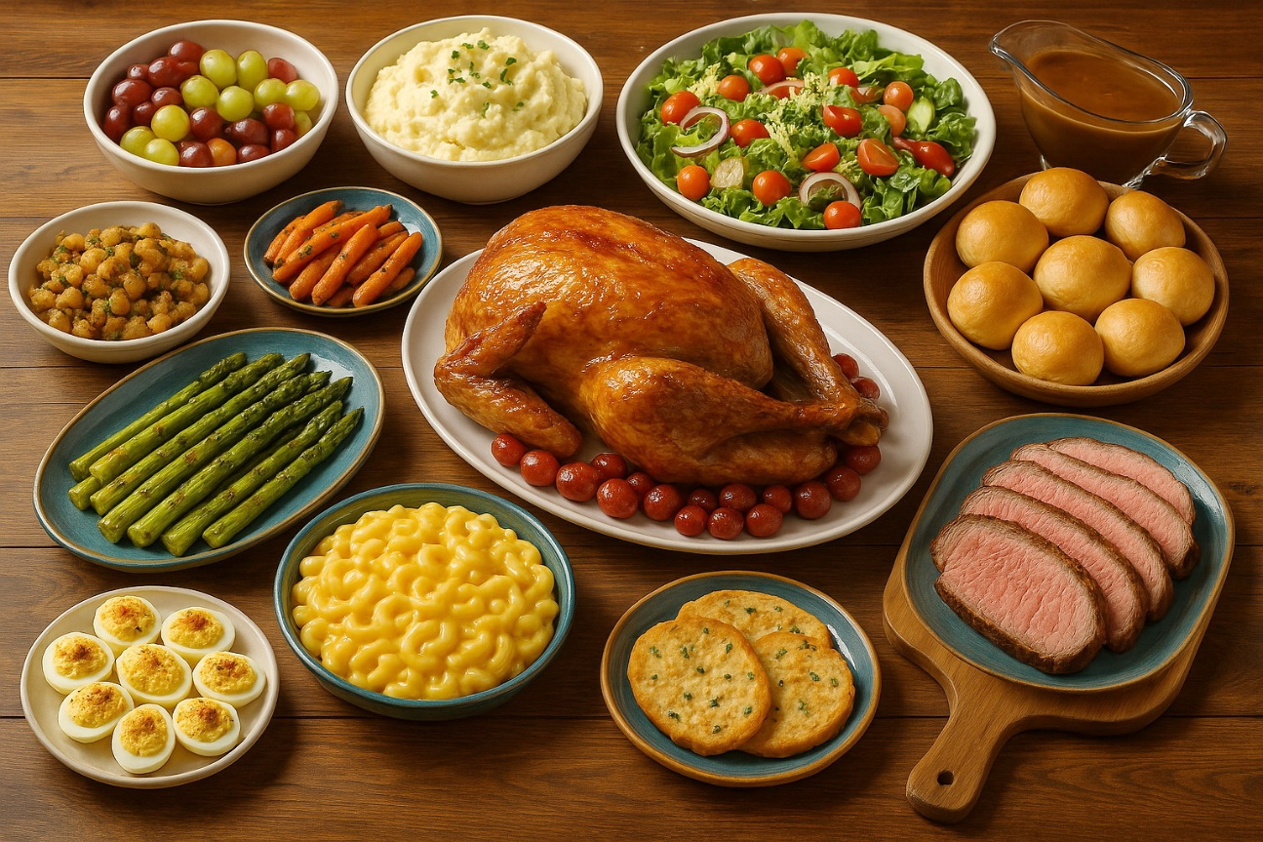
Corinthian Errors in the Lord’s Supper
* Turned the Lord’s Supper into a common meal.
* Satisfied selfish desires instead of loving and respecting others.
* Disregarded whether others had the opportunity to participate.
* Were disorderly, participating in different acts at the same time.

Slide 136
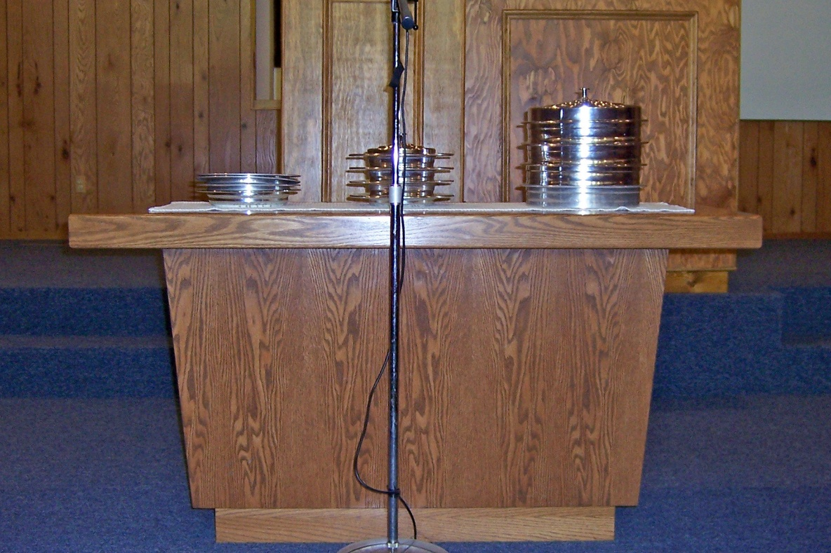
Correcting Errors in the Lord’s Supper
* Focus on the Lord’s Supper as a spiritual memorial of Jesus’ death.
* Everyone focus on each act at the same time (“wait one for another”)
* Give everyone opportunity to participate.
* Eat common meals elsewhere.

Slide 137
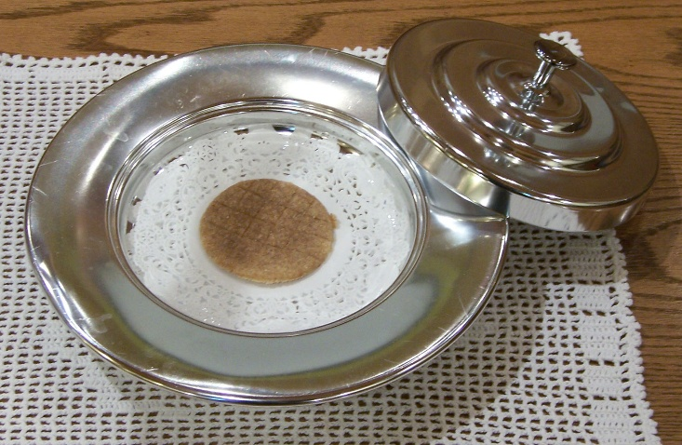
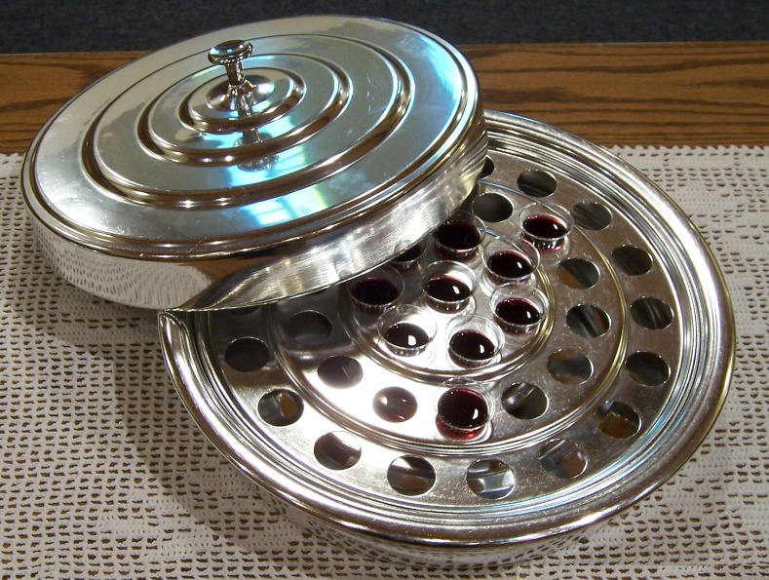
Do This in Remembrance of Me
The bread: remember His body
The cup: remember His blood
Proclaim the Lord’s death till He comes

Slide 138
Elements = Literal Flesh/Blood?
The sacrifice of Jesus can not be repeated
Mass contradicts the nature of true miracles
Literal flesh and blood would constitute blood drinking and cannibalism
No special priests to offer such a sacrifice
Called “fruit of the vine” after “My blood”
Communion is a spiritual memorial

Slide 139
“The Cup” in 1 Corinthians 11:23-29
Jesus took bread, “this is my body …” In the same manner the cup...you eat this bread and drink this cup (verses 26,27,28)
(1) The bread is what we eat; the cup is what we drink (element)
(2) The cup is parallel to the bread (the element)
(3) Matthew 26:27,28 - The “cup” “This is my blood” (element)
(4) Matthew 26:27 the cup = “this fruit of the vine” (verse 29).
(5) 1 Corinthians 10:16,17 – “We” bless the cup and we all break the one bread. all in the body drink the cup and break the bread.
(6) 1 Corinthians 11:26 – As often as you eat this bread and drink this cup. It is the same bread and same cup (substance) each time
(7) 1 Corinthians 10:21 and 1 Corinthians 11:26-29 - We “eat the bread” and “drink the cup (element) of the Lord.”

Slide 140
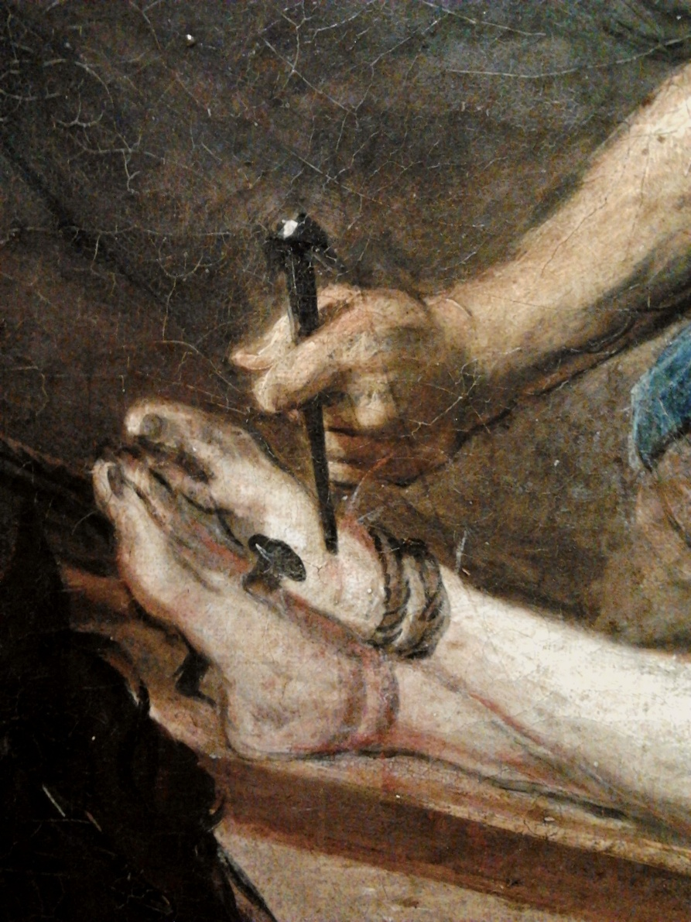
He who eats and drinks in an unworthy manner eats and drinks judgment to himself, not discerning the Lord’s body.

Slide 141
If anyone is hungry, let him eat at home

Slide 142

Spiritual Gifts in Corinth – Chapters 12-14
Chapter 12 – The body has many members with different gifts but should seek unity and care for one another
Chapter 13 - The gifts were temporary and would cease, but love is greater
Chapter 14 – Gifts in the assembly should be used for edification and understanding, not confusion and strife

Slide 143
Gifts of the Spirit in One Body – Chapter 12
* Spirit teaches Jesus is Lord
* Different gifts from the same Spirit
* Gifts given for the profit of all

Slide 144
Different Kinds of Gifts from the Spirit
word of wisdom
word of knowledge
faith
gifts of healing
working of miracles
prophecy
discerning of spirits
tongues
interpretation of tongues
The Spirit distributes to each one individually as He wills.

Slide 145
The Nature of Miraculous Healings
Conclusive Evidence the Event Occurred
* Lazarus — John 11:17,38,39,43-45
* Blind man — John 9:1,7,18-20,21,25
* Woman bowed together — Luke 13:11,13,16
* Lame man — Acts 3:2,7,8,10; 4:22

Slide 146
The Nature of Miraculous Healings
Conclusive Evidence the Event Occurred
Instantaneous
* The lame man — Acts 3:7
* The hunchbacked woman — Luke 13:11-13
* The paralyzed man — Mark 2:10-12
* The woman who bled for 12 years — Mark 5:35-42 * Jairus’ dead daughter — Mark 5:25-29

Slide 147
The Nature of Miraculous Healings
Conclusive Evidence the Event Occurred
Instantaneous
Always Successful
Matthew 4:23,24 — All manner of diseases
Matthew 14:34-36 — All were healed
Acts 5:12,15,16 — They were healed every one
People born blind (John 9:1), born lame (Acts 3:2; 4:22), lepers (Mark 1:40-45), dead (John 11; Luke 7:11-17; Acts 9:36-42), or missing or withered body parts (Luke 22:49-51; Mark 3:1-5).

Slide 148
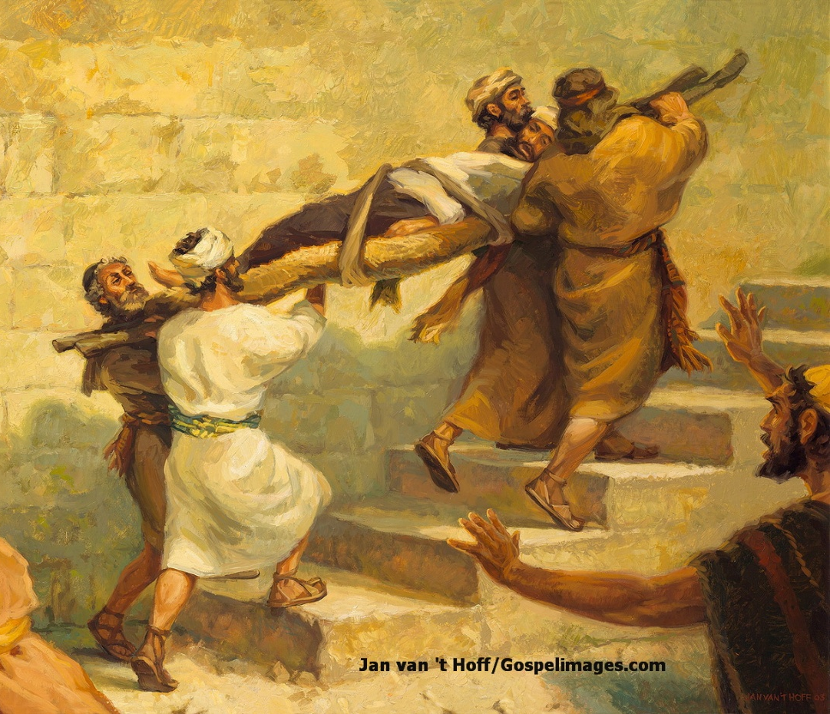
The Nature of Miraculous Healings
Conclusive Evidence Event Occurred
Instantaneous
Always Successful
Complete and Perfect
* Withered hand — Matthew 12:10,13
* Leper — Mark 1:40-45
* Paralyzed man — Mark 2:10-12
* Lame man — Acts 3:8

Slide 149
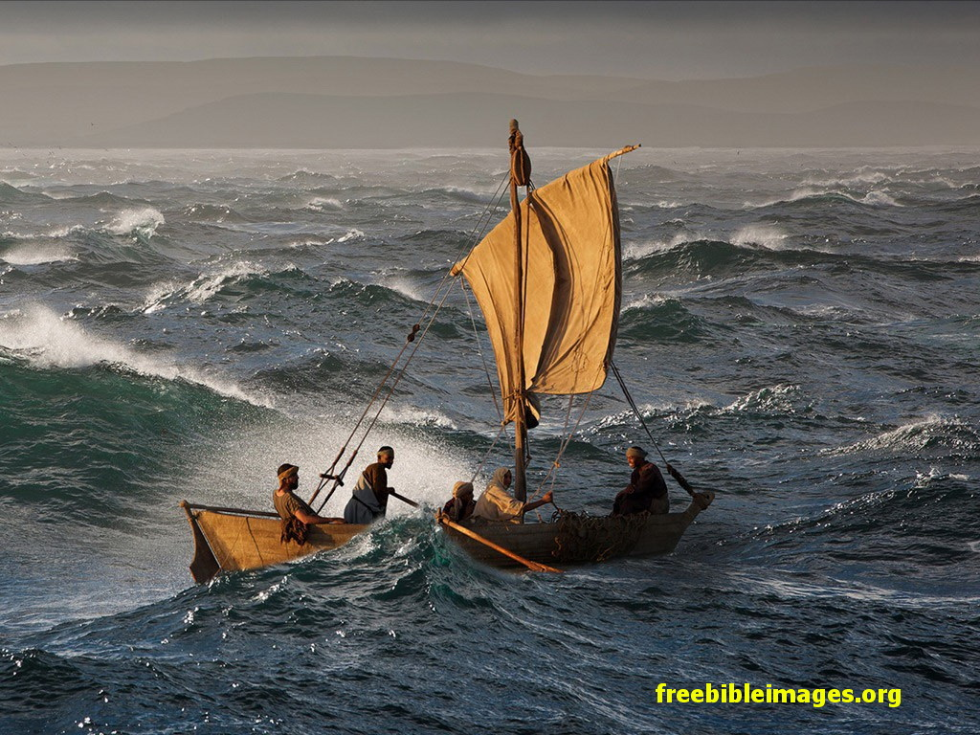
Miracles, Signs, Wonders
* Turning water to wine – John 2:1ff
* Walking on water – Matthew 14:22ff
* Feeding thousands – Matthew 14:13ff; 15:32ff
* Calming storms – Matthew 8:23ff
* Transfiguration – Matthew 17:1ff
* Casting out demons – Matthew 8:28ff; 15:21ff; 17:14ff
* Raising the dead – Matthew 9:18ff; John 2:18-22; Matthew 27,28
* Freedom from harm – Mark 16:17ff; Acts 28:1ff.

Slide 150
The Nature of Tongue Speaking
Existing native languages - Revelation 5:9; 7:9; 10:11; 11:9; 13:7; 14:6; 17:15
An understandable message - Acts 2:1-11
Message capable of interpretation – 1 Corinthians 14:5,13f,27f
Tongues not learned by the speaker
Impossible by natural law

Slide 151
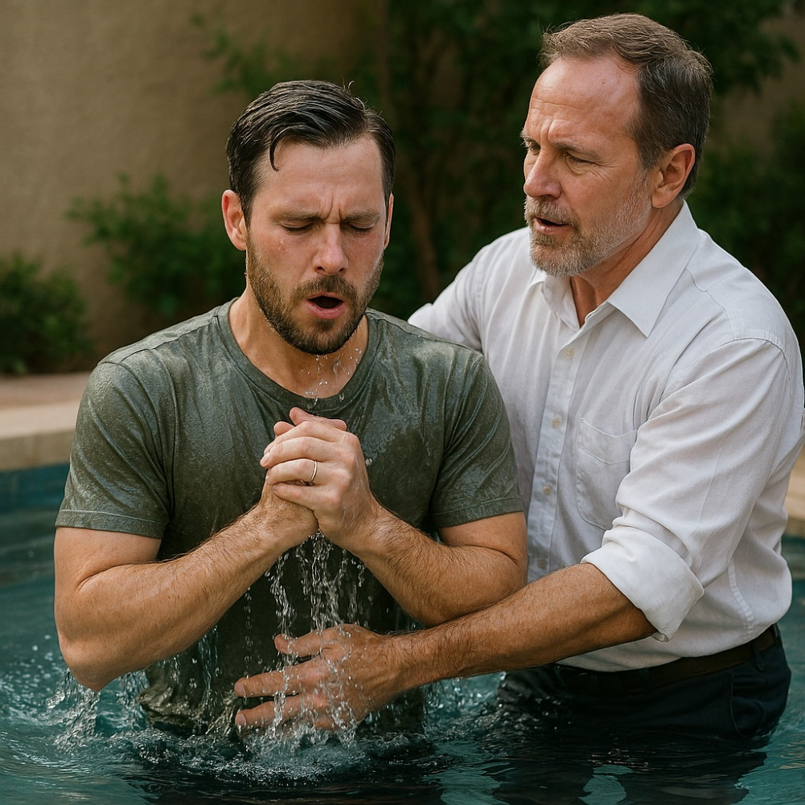
One Body with Many Members
All baptized into one body
Every member needed and valued
God set each member in the body as He pleased.
Honor members of the body

Slide 152

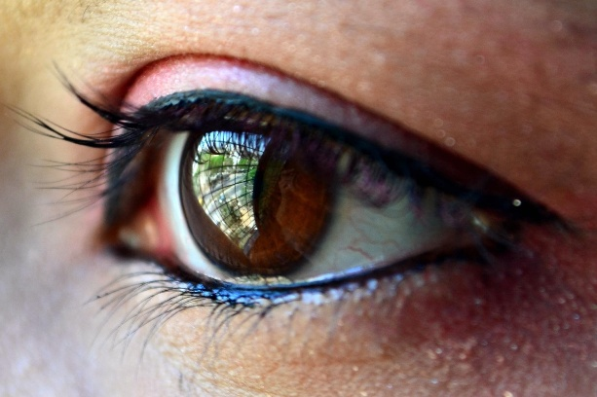
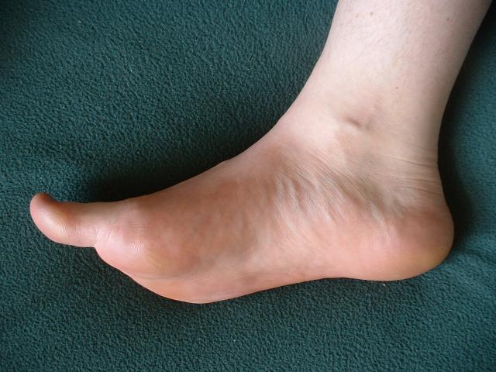
You Are the Body of Christ and Members Individually
No schism in the body
Members should have the same care for one another.
If one member suffers, all the members suffer with it; or if one member is honored, all the members rejoice with it.

Slide 153

God Has Appointed These in the Church
Apostles
Prophets
Teachers
Miracles
Gifts of healings
Helps
Administrations
Varieties of tongues.
You are the body of Christ, and members individually

Slide 154

Without Love…
Tongues
Prophecy
Understanding
Knowledge
Faith
Feed poor
Body burned

Slide 155

Love Is …
This:
Suffers long (patient)
Kind
Rejoice in the truth
Bears all things
Believes all things
Hopes all things
Endures all things
Not This:
Envy (jealousy)
Parade (brag, boast)
Puffed up (proud)
Rude (unseemly)
Seek its own (selfish)
Provoked (easily angered)
Think evil (keep score)
Rejoice in iniquity

Slide 156

What Fails vs. What Does Not
This Never Fails
LOVE
These Would Fail, Cease or Vanish Away
Prophecy
Tongues
(Miraculous) Knowledge
(And all spiritual gifts)
When and why would the gifts cease?

Slide 157
Works God Has Ceased
Creation of the world — Genesis 2:1,2
Universal flood — Genesis 9:8-17
Sacrifice a son — Genesis 22
Animal sacrifices — Hebrews 10:1-18
Circumcision — 1 Corinthians 7:18-20
Virgin birth – Mattew 1:18,20; Luke 1:35
Jesus’ earthly life & death — Hebrews 9:26,28; 7:26,27
Jesus’ resurrection – Romans 1:4
God’s works cease when their purpose is fulfilled. Can you name an exception?
God’s character doesn’t change, but His works do.
Miracles fulfilled their purpose; so they ceased.

Slide 158
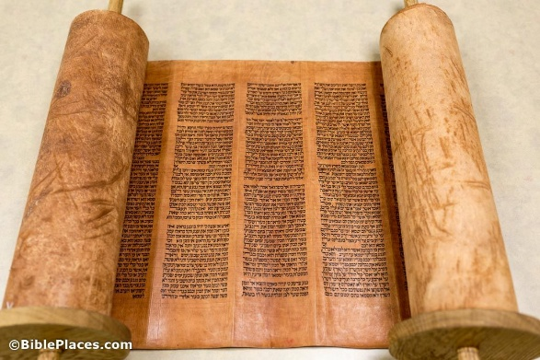
“In Part” vs. “Perfect”
“In Part” |  | “Perfect”
 | Revelation 1 Corinthians 13:8-11; Jude 3

Slide 159
The Purpose of Direct Revelation
To Reveal God’s Will to Man
Deuteronomy 18:18,19 – God would put His words in the prophet’s mouth, so the prophet would speak what God commanded.
Matthew 10:19,20 — The Spirit spoke directly through inspired men.
John 16:13 — The Spirit would guide the apostles into all truth
Ephesians 3:3-5 — The Spirit revealed to the apostles and prophets the mystery of the. These men then wrote it down so others could know.
2 Peter 1:21 – Holy men of God spoke as they were moved by the Holy Spirit.

Slide 160
The Purpose of Revelation Fulfilled
Scripture is complete.
John 16:13 — The Spirit guided apostles into all truth.
Acts 20:20,27 — The whole counsel of God
2 Peter 1:3 - All things pertaining to life and godliness
2 Timothy 3:16,17 — Complete to all good works

Slide 161
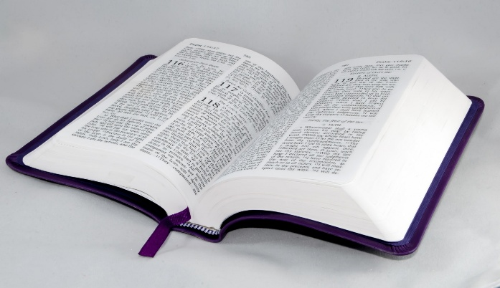
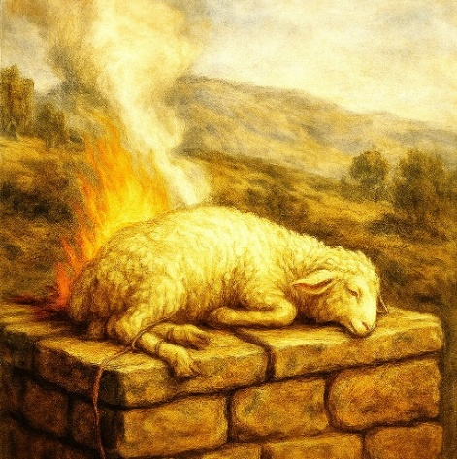

“In Part” vs. “Perfect”
“In Part” |  | “Perfect”
 | Revelation 1 Corinthians 13:8-11; Jude 3
 | Sacrifice Hebrews 7:27; 9:25-28; 10:1-4,10-14,18; 1 Peter 3:18

Slide 162
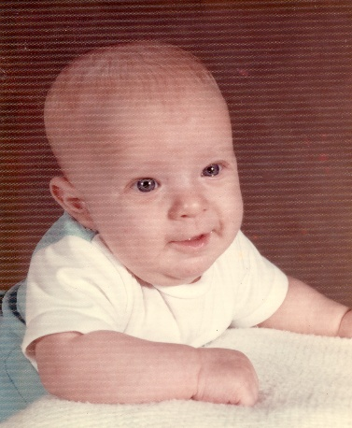

“In Part” vs. “Perfect”
“In Part” |  | “Perfect”
 | Revelation 1 Corinthians 13:8-11; Jude 3
 | Human Growth 1 Corinthians 13:11

Slide 163


“In Part” vs. “Perfect”
“In Part” |  | “Perfect”
 | Revelation 1 Corinthians 13:8-11; Jude 3
 | Vision 1 Corinthians 13:12
To return to the partial is to belittle the perfect.

Slide 164
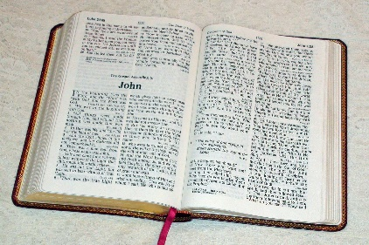
“That Which Is Perfect” = Jesus’ 2nd Coming?
What Paul Said (1 Corinthians 13)
Gifts
Faith, hope, love
What Men Say
Gifts
Faith, hope
Love
Jesus’ 2nd Coming
The gifts must cease before Jesus returns!

Slide 165
Evidence Miracles Have Ceased
1. The Bible says signs would cease when they fulfilled their purpose
1 Corinthians 13:8-11; Jude 3
2. There is no means to receive the gifts today
Ephesians 4:3-6; Acts 1:5
3. No modern events have the characteristics of miracles
2 Thessalonians 2:9-12; Acts 8:5-13
God’s kingdoms (plants, animals, humans, and the church) were all set in order by miracles but continue to reproduce and function according to law.

Slide 166
How Gifts Were Imparted
Holy Spirit Baptism | Laying on of Apostles’ Hands
Apostles Acts 1:3-8; 2:1-21 Cornelius’ House Acts 10 & 11 | Acts 8:14-21 Acts 19:1-7 Romans 1:8-11 2 Timothy 1:6
Spiritual gifts were imparted only with the personal involvement of apostles!
Neither method is available today.
Ephesians 4:3-6; Acts 1:5 – One baptism today

Slide 167
The Nature of Miraculous Signs
Conclusive Evidence Event Occurred
Instantaneous
Always Successful
Complete and Perfect
Summary: True miracles are impossible by natural law!

Slide 168
Instructions to Correct Problems in the Corinthian Assemblies - 1
Love and regard for one another
11:20-22 – Some were rebuked for not caring about others.
12:20 – Many different members make up one body.
12:25,26 – No schism in body but members care for one another.
12:31-13:13 – Love is more essential than spiritual gifts. Service without love does not profit.
Understanding and edification
11:29 – Must discern the spiritual meaning of the Lord’s Supper.
14:4,5,12 – Spiritual gifts should be used to edify the church.
14:9-17 – Tongues were misused when people did not understand.
14:14-20 – Speak with understanding so others may be edified.
14:23 – Let all things be done for edification.

Slide 169
Instructions to Correct Problems in the Corinthian Assemblies - 2
Unity and order (acting together)
11:18,19 – When “together as a church,” division existed
11:20-22 – Some went ahead to eat before others were ready.
11:33 – Wait for one another (so all can join in the same activity)
14:27 – Tongue speakers should take turns speaking.
14:30 – If one person has something to say, others should listen.
14:31 – Prophets should speak one by one so all may be edified.
14:33 – God is not the author of confusion but of peace.
14:40 – Let all things be done decently and in order.
Submission of women
11:2-16 – Women should be subject to men.
14:34,35 – Women must not speak in church.

Slide 170
General Principles in Chapters 11-14 that Still Apply
* Women should be subject to men – 11:2-16; 14:34,35.
* Everyone should focus together on each act – 11:21,33; 14:27-32
* Lord’s Supper is a spiritual memorial of Jesus’ death – 11:23-29.
* Individual acts (not church acts) done elsewhere – 11:34.
* Members should care for one another, not be divided – chap. 12.
* We were all baptized into one body – 12:13.
* Service to God and others must be motivated by love – 13:1-7.
* Characteristics of love – 13:5-8
* Spiritual gifts were temporary and would cease – 13:8-13.
* Faith, hope, and love abide, but love is greatest– 13:13.
* Everything in assemblies understandable and edifying– 14:1-26.
* God is the author of peace, not confusion – 14:33.
* All should be done decently and in order – 14:40

Slide 171
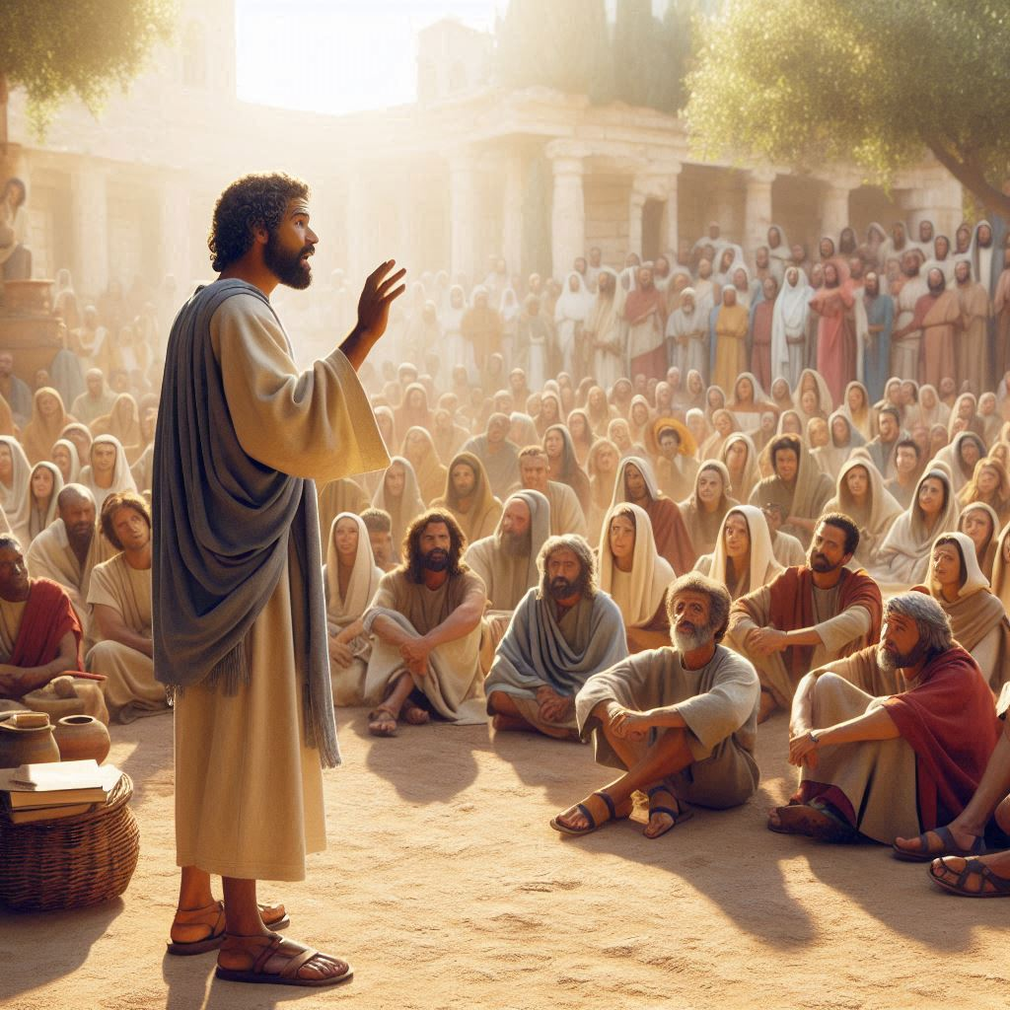
Tongues and Prophecy at Corinth
* Tongue-speakers did not speak an understandable message
* Prophecy spoke a message that edified
* So prophecy was greater unless the tongue was interpreted
* Tongue speaking did have a message that could be interpreted
* Gifts existed to profit others, not to exalt the speaker

Slide 172

Building Up the Church
* Gifts should be used to edify the church.
* The tongue speaker should pray for the ability to interpret.
* Worship with spirit and understanding.
* Five words understood are better than thousands not understood.

Slide 173
Mature in Understanding but Babes in Malice
* Worship with spirit & understanding
* Be mature in understanding but babes in malice
* Tongues a sign to unbelievers but prophecy benefits believers
* Tongues confuse uninformed visitors, but prophecy convicts.

Slide 174
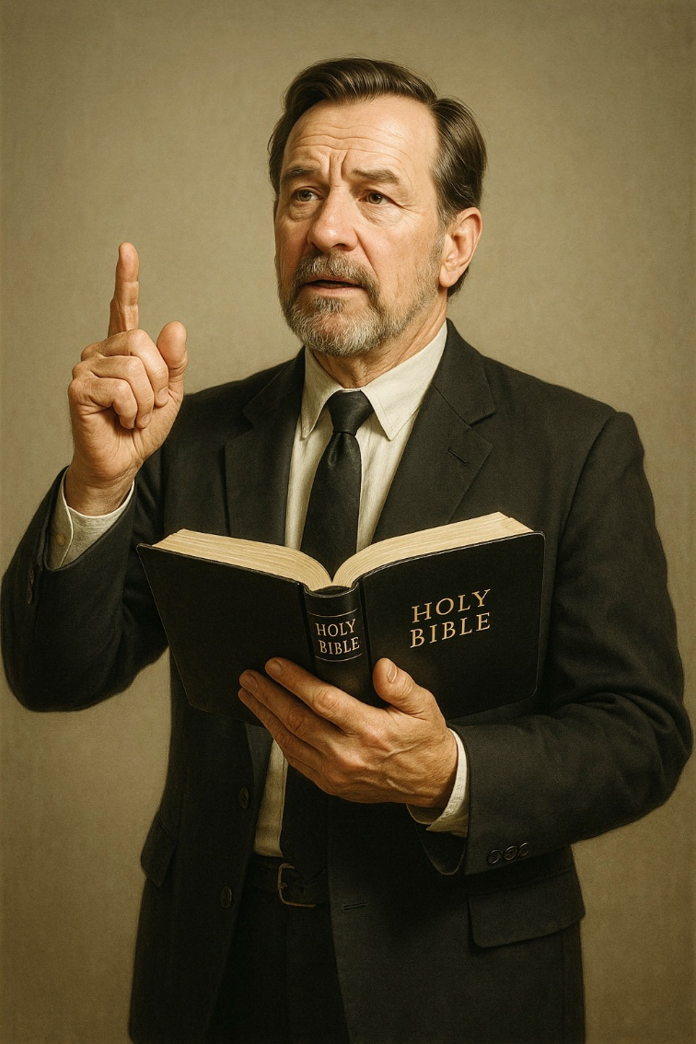
“Let All Things Be Done for Edification.”
* Tongue speakers speak in turn.
* Tongues must be interpreted.
* Each should be silent when others spoke.
* Prophets speak one by one.
* God is not the author of confusion but of peace.

Slide 175

Women Speaking “in Church”
Women’s Submission to Men
Women Teaching Women/Children
Meaning of “in Church”
Women Discussing with Men Outside Church

Slide 176
Women’s Submission to Men
Men directed spiritual teaching in groups involving men.
* Jesus – Matthew 5-7; Luke 6:20ff; etc.
* His apostles – Acts 2:14ff; 3::12ff; 5:17-20,25; 10:24-34; etc.
* Stephen and Philip – Acts 7; 8:5-12
* Paul & companions – Acts 9:20; 11:25f; 13:15ff; 16:4,5; 17:22ff
* Churches sent men preachers – Acts 11:22ff; 13:ff; 15:27,30ff
* Men preached in church assemblies – Acts 11:25f; 15:30-35; 20:7
* 1 Timothy 2:11-14 – Women submit in spiritual teaching
Church leaders must be men.
Hebrews 13:17; Acts 20:28; 1 Peter 5:1-3 – Elders are men
1 Timothy 2:11-14 – Women have no authority over men.
Women submit to men in spiritual teaching and church decisions.

Slide 177
Women Teaching Women or Children
Exodus 15:20,21 – Miriam, a prophetess, led the women of Israel in singing praise to God (teaching – Col. 3:16).
Ruth 1:8-17; 2:20 – Ruth and Naomi had spiritual discussions.
Proverbs 31:1 — King Lemuel taught by his mother.
Proverbs 1:8 — Son should not forsake his mother’s law.
Luke 1:39-56 — Elisabeth and Mary admonished and exhorted one another by the guidance of the Spirit.
Acts 2:17; 21:9 – Women exercised the gift of prophecy.
2 Timothy 1:5 — From childhood Timothy had been taught the Scriptures (3:15) by his grandmother & mother.
Titus 2:3-5 — Older women should teach younger women.

Slide 178
What Does “In Church” Mean in This Context?
Verse 4 – A man (“he”) speaking edifies “the church.”
Verse 5 – A man speaks so “the church” receives edification.
Verse 12 – Seek to excel for the edification of “the church.”
Verse 19 – “In the church” I should speak so I may teach others.
Verse 23 – “The whole church comes together in one place.”
Verse 26 – “Brethren” “come together”/all things done to edify
Verse 28 – No interpreter, tongue speakers “keep silent in church”
Verses 29,30 – When one spoke, others “keep silent” and listen.
Verse 31 – Teaching was done so that “all” learn & be encouraged.
The church arranged assemblies that everyone is expected to attend and focus together on each activity. Each one who speaks is addressing the whole church.

Slide 179
Women Discussing with Men Outside Assemblies
1 Samuel 1:9-18,24-28 – Hannah discussed with the high priest Eli
1 Samuel 25:14-35 – Abigail admonished David in presence of men
Judges 4:4-9,14 – Deborah revealed God’s will to Barak
Esther 4:5-17; 7:1-7 – Esther discussed with Mordecai
Luke 2:36-39 – Anna spoke to “all who looked for redemption”
John 4:19-26,28-30,39,42 – Jesus discussed with Samaritan woman
Luke 11:27,28 – A woman in the crowd called a spiritual comment.
John 11:20-27 – Jesus and Martha conducted a spiritual discussion
Luke 10:38-42 – Jesus discussed with Martha proper priorities
Matthew 28:1-8; Luke 24:9,10; John 20:16-18 – Women report res.
Acts 16:13 – Paul/Silas in a small-group study with women at river.
Acts 18:26 – Aquila & Priscilla took Apollos aside and taught
Acts 21:8,9 – Philip’s four daughters prophesied to Paul and others

Slide 180
“Let All Things Be Done for Edification.”
* Tongue speakers speak in turn.
* Tongues must be interpreted.
* Each should be silent when others spoke.
* Prophets speak one by one.
* God is not the author of confusion but of peace.
* Women should not speak in church.
* These commands were from Christ.
* Let all things be done decently and in order.

Slide 181
Summary of Teaching about Spiritual Gifts – 1 Corinthians 12-14
* The Spirit gave different gifts to different people as He chose.
* Having different gifts, members should yet work together with unity and love, not confusion or division.
* Gifts served a temporary purpose but would cease when they had completely revealed and recorded the Scriptures.
* Gifts were given to instruct and edify, not to glorify those who possessed them nor to assure they were acceptable to God.
* Women are not allowed to speak to the assembled church even to ask questions.
* Everything in church assemblies should be understandable and orderly to promote instruction and edification.

Slide 182
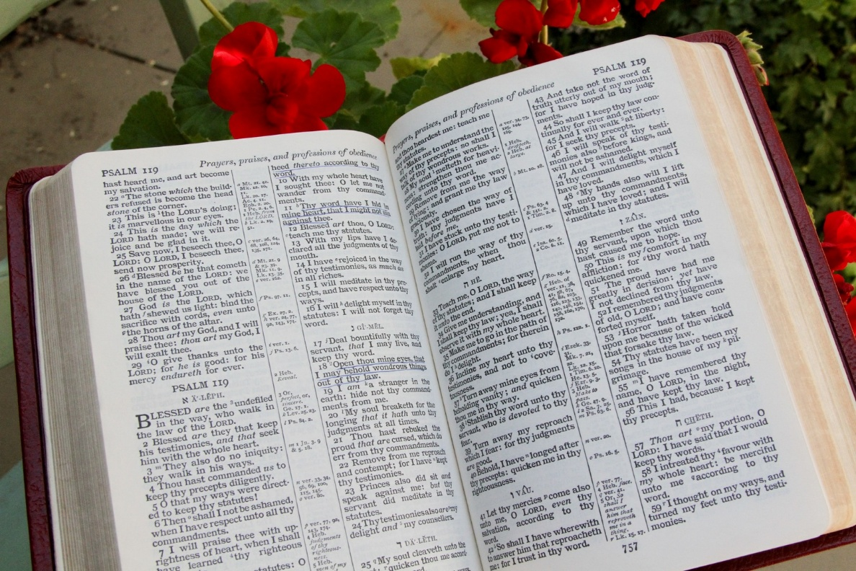
Lessons about the Gospel – 15:1-2
1) It is the message necessary to salvation.
2) It must be preached (people must hear and understand it).
3) Those who seek to benefit from the gospel must receive it.
4) Then they must stand in it and hold it fast, otherwise they will believe it in vain.

Slide 183
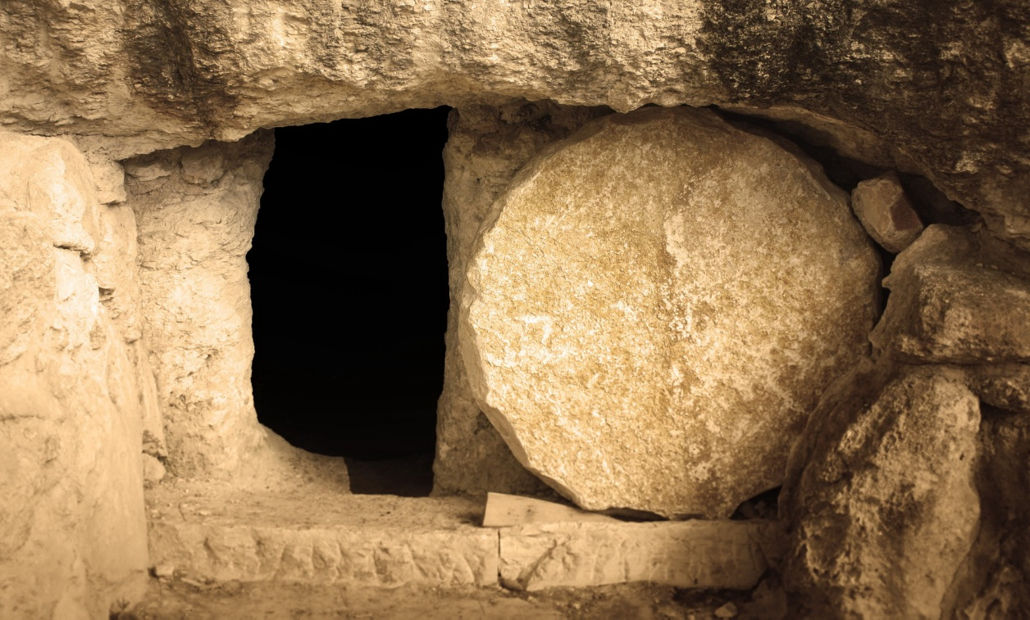
The Fundamentals of the Gospel – 15:3-5
Christ died for our sins
He was buried
He rose again the third day
He appeared to witnesses

Slide 184
What the Gospel Includes
* The record of Jesus’ death, burial, resurrection, appearances - 1 Corinthians 1:17-24
* The message of man’s eternal destiny - 1 Corinthians 15:12-23
* Conditions to meet and commands to obey - Mark 1:14,15; 16:15,16; 1 Peter 1:22-25; 2 Thessalonians 1:7-9
* The message of the kingdom (church) - Matthew 4:23; Acts 20:24,25; 8:12; Colossians 1:13
* Sound doctrine: all of God’s commands - 1 Timothy 1:10,11; Acts 20:24,27; Matthew 28:18-20; Acts 3:22,23

Slide 185
Witnesses of Jesus’ Resurrection
1) Mary Magdalene – Mark 16:9; John 20:11-18
2) The women – Matthew 28:8-10
3) Two disciples on the road to Emmaus – Luke 24:13-35
4) The eleven apostles – Matthew 27:16-20; 1 Corinthians 15:5,7; John 20:19-21:25; Acts 1:3-11;
5) Joseph and Matthias – Acts 1:20-26
6) Peter – 1 Corinthians 15:5
7) Five hundred brethren – 1 Corinthians 15:6 (Matthew 28:7,16?)
8) James – 1 Corinthians 15:7
9) Paul – 1 Corinthians 15:8; 9:1; Acts 9:1ff; 22:1ff; 26:1ff

Slide 186
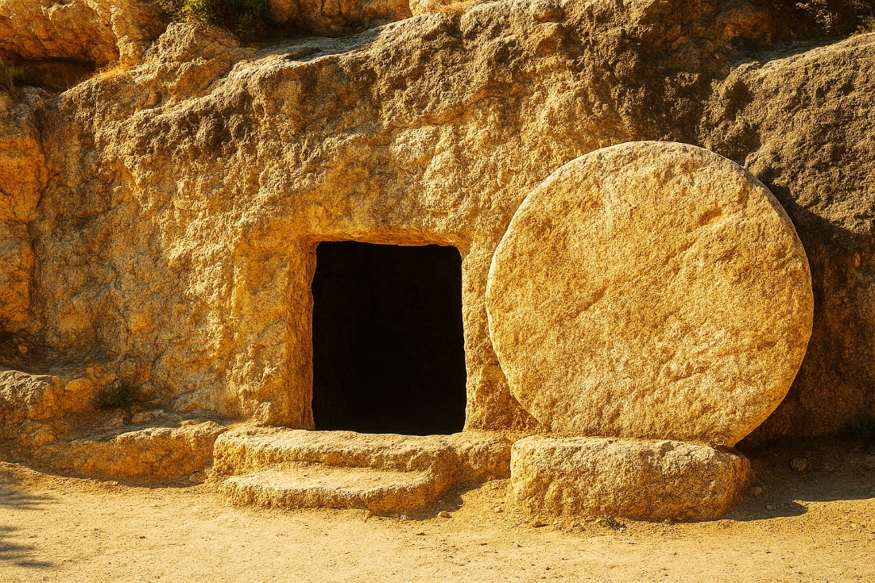
If There Is No Resurrection of the Dead:
* Christ was not raised from the dead.
* The apostles and other inspired teachers were false witnesses.
* The faith of Christians is empty.
* Those who profess to be Christians are still in their sins.
* Those who died in Christ have perished without hope.
* We are of all men most pitiable.
* Christ is not the all-powerful Ruler of the universe but has been defeated by the consequences of sin.

Slide 187

Christ’s Resurrection and Our Resurrection
* Jesus’ resurrection guarantees our resurrection
* All people will arise surely as all die.
* Jesus is reigning now.
* Jesus reigns till death is destroyed.
* Jesus will then return the authority to God.

Slide 188
Further Consequnces of Denying the Resurrection
* Why be baptized for the dead?
* Why die for the cause of Christ?
* The danger of evil companionships

Slide 189

Sown in Corruption, Raised in Incorruption
The Body Planted | The Body Raised
Seed | Plant
Corruption | Incorruption
Dishonor | Glory
Weakness | Power
Natural | Spiritual
Mortal | Immortal

Slide 190

The First Adam and the Last Adam
The First Adam | The Last Adam
A living being | A life-giving spirit
First | Afterward
Of the earth | Lord from Heaven
Made of dust | Heavenly
Corruptible | Incorruptible
Mortal | Immortal

Slide 191

The Collection for the Saints
A Collection
For the saints
Orders
To the churches
On the first day of (every) week
Each one of you
As he may prosper
As they have prospered, individuals contribute funds into the church treasury on each first day of the week.

Slide 192
Whom Should Local Churches Help?
Acts 2:44,45 — “all that believed”
Acts 4:32-5:11 — “them that believed” (4:32)
Acts 6:1-6 — “number of the disciples (v1)
Acts 11:27-30 — “unto the brethren” (v29)
Romans 15:25-27 — “unto the saints…saints”
1 Corinthians 16:1-4 — “for the saints”
2 Corinthians 8:4; 9:1,12 — “to the saints”
1 Timothy 5:16 – “widows indeed” (trust in God)
Individuals should help non-members as they can.
Leave the church free to emphasize spiritual work.

Slide 193
Memorial Days in the Bible
Memorial | Scripture | Time | Frequency
Passover | Exodus 12 | Day 14, Month 1 | Annual
Trumpets | Leviticus 23:24 | Day 1, Month 7 | Annual
Atonement | Leviticus 23:27 | Day 10, Month 7 | Annual
Tabernacles | Leviticus 23:39ff | Day 15, Month 7 | Annual
Sabbath | Exodus 20:8ff | 7th day of week | Weekly
Lord’s Supper | Acts 20:7 | 1st day of week | Weekly
God reveals the time for His memorials.
The frequency is implied by the time.

Slide 194
The First Day of the Week in Scripture
Mark 16:9 – Jesus arose (all 4 accounts)
John 20:19 – First appearances; the disciples were assembled
John 20:26 – 2nd appearances; the disciples were assembled
Acts 2 (Lev. 23:15f) – Pentecost; the disciples were assembled
The Holy Spirit came (verse 4)
The gospel preached for the first time (verses 14ff)
Christ was announced as reigning in His kingdom (verse 30ff)
The first gospel converts (verse 41)
People began entering the church (verse 47)
From then on they continued in the Lord’s Supper (verse 42)
Acts 20:7 – The disciples met to break bread
1 Corinthians 16:1,2 – Collection taken up
No other day is ever mentioned as significant!

Slide 195
Church-to-Church Donations
Two Bible Cases - Acts 11; 1 Cor. 16 (Rom. 15; 2 Cor. 8,9)
SUBJECT - A church needing help to care for its needy members
(Acts 11:28,29; Rom. 15:26; 2 Cor. 8:14; 9:12; Acts 24:17)
PURPOSE - To relieve needy members
(Acts 11:29; 2 Cor. 8:14; 9:12)
DURATION - Temporary until the receiving church could meet its own obligations (2 Cor. 8:14)
RESULT - Independence and equality of churches (2 Cor. 8:14)
Scriptural cooperation gives freedom from destitution without centralizing supervision, power, or funds.

Slide 196


Slide 197

Standing Fast with Love
Watch
Stand fast in the faith
Be brave
Be strong
Do all with love.

Slide 198
The Holy Kiss - 1
Romans 16:16; 2 Corinthians 13:12; 1 Corinthians 16:20; 1 Thessalonians 5:26; 1 Peter 5:14.
Customary form of greeting - Luke 7:45; 22:48; 15:20; Acts 20:37; Genesis 27:26; 33:4. (See also Matthew 26:49; Mark 14:45; Matthew 26:48; Mark 14:44; Luke 22:47; Genesis 48:10; 50:1; Exodus 4:27; 18:7; Ruth 1:14; 1 Samuel 10:1; 20:41: 2 Samuel 14:33; 15:5; 19:39; 20:9; 1 Kings 19:20; Genesis 29:13; 45:15; Song of Solomon 1:2; 2 Samuel 20:9; 1 Kings 19:18; Job 31:27; Proverbs 24:26.)

Slide 199
The Holy Kiss - 2
Romans 16:16; 2 Corinthians 13:12; 1 Corinthians 16:20; 1 Thessalonians 5:26; 1 Peter 5:14.
Customary form of greeting - The Scriptures simply regulate a custom that already existed.
Luke 7:44-46 - washing of feet kissing, anointing with oil, were common forms of hospitality, greeting, or respect in that day.
The words emphasized are “love” or “holy.”
Mentioned only in greetings. It is a greeting, not a command.
With baptism and the Lord’s Supper, we are told specifically when, how, or why we should do it, but not for kissing.
Consider a parallel in 1 Peter 2:17: “Honor the king.”

Slide 200
The Holy Kiss - 3
No example of Jesus or early Christians greeting with a kiss
Kissing was never a unique greeting among Christians. Other people used it, and Christians used other greetings:
Shaking hands – Galatians 2:9
Embracing (a “hug”) - Acts 20:1 (Genesis 29:13; 33:4; 48:10)
Bowing - Genesis 18:2; 19:1; 33:3,6,7; Ex. 18:7; 1 Sam. 20:41
No other ancient social custom is bound on God’s people for all times: foot-washing, slaves, tearing garments, sackcloth
In our society, it is more commonly a sexual act, especially by people of the opposite gender who are not relatives.

Slide 202
© Copyright David E. Pratte, 2024
Permission is granted to display this PowerPoint under the following conditions:
* Display the link to www.BibleStudyLessons.com
* Minor changes in content are permitted, but no teaching should be presented that disagrees with the teaching in the article associated with this PowerPoint on www.BibleStudyLessons.com/powerpoint
* In no case may a fee of any kind be charged for our PowerPoints.
* If you have a website, please add a link to www.BibleStudyLessons.com
Scripture quotations are generally from the New King James Version (NKJV), copyright 1982, 1988 by Thomas Nelson, Inc. Used by permission. All rights reserved.
www.BibleStudyLessons.com

