Slide 1

Video Bible Study
presented by
David E. Pratte
www.gospelway.com

Slide 2
Paul’s First Letter to Thessalonica
Thanks to Christians in the Hillcrest church for their participation.
© Copyright David E. Pratte, 2020
Scripture quotations are generally from the New King James Version (NKJV), copyright 1982, 1988 by Thomas Nelson, Inc. used by permission. All rights reserved.

Slide 3
Questions from Bible Study Questions on
1 and 2 Thessalonians
Available at
www.biblestudylessons.com/classbooks

Slide 4
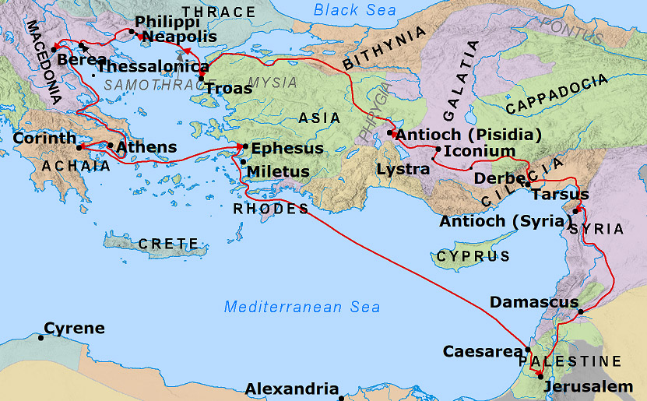
Paul’s Second Preaching Trip
Index

Slide 5
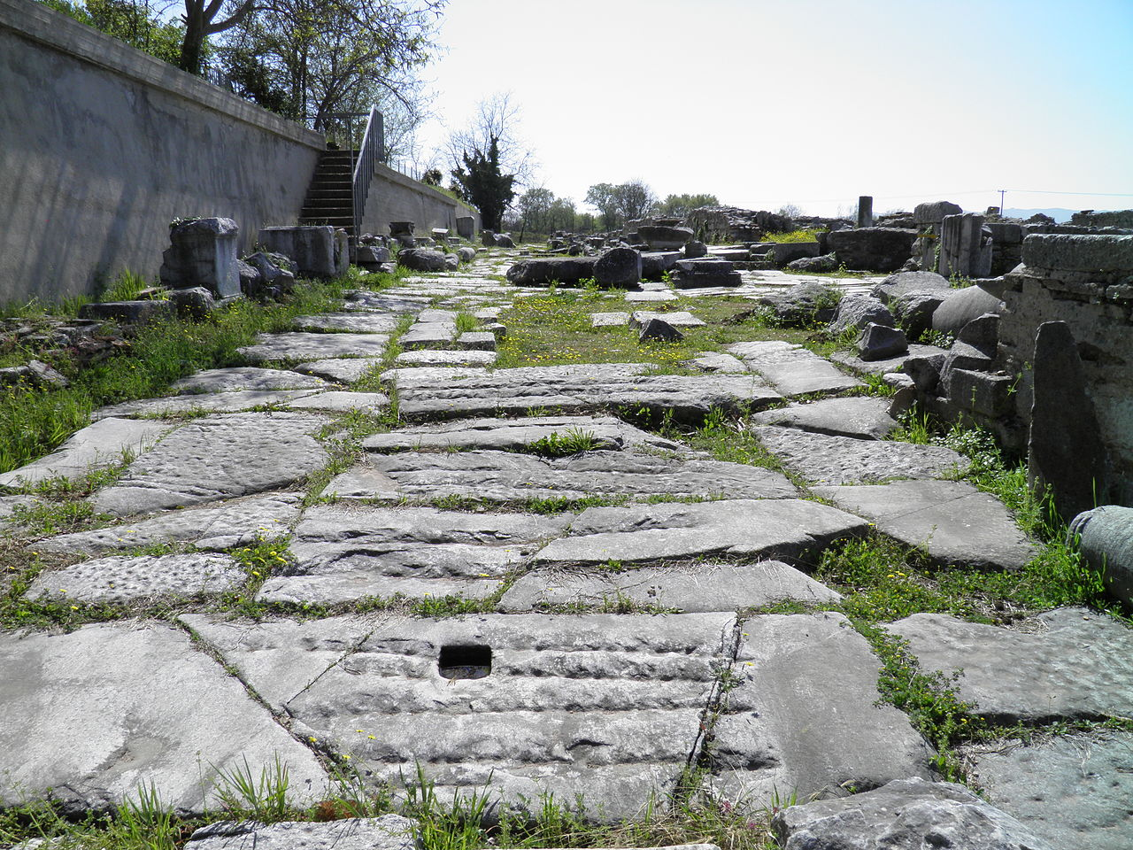
Egnatian Way – Philippi
Photo credit: Carole Raddato from FRANKFURT, Germany, CC BY-SA 2.0 <https://creativecommons.org/licenses/by-sa/2.0>, via Wikimedia Commons
Index

Slide 6
Index

Slide 7
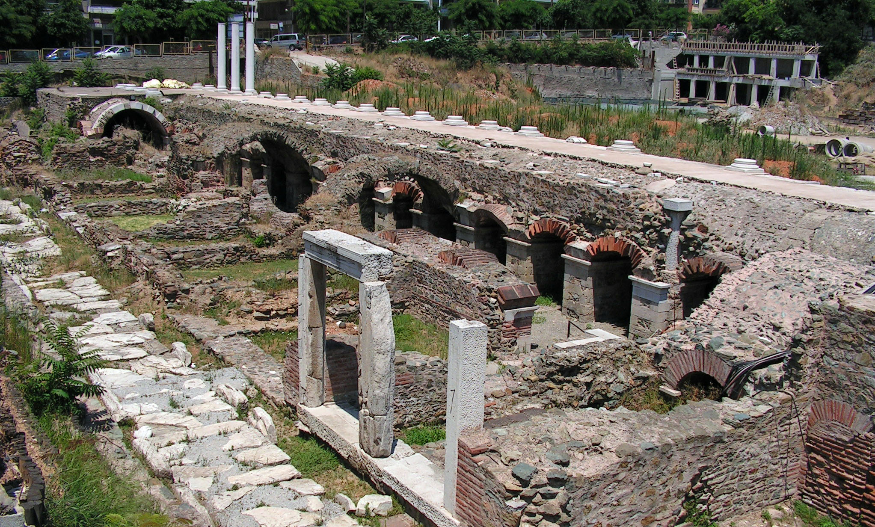
Thessalonica – agora (marketplace)
Photo public domain
Index
Index

Slide 8
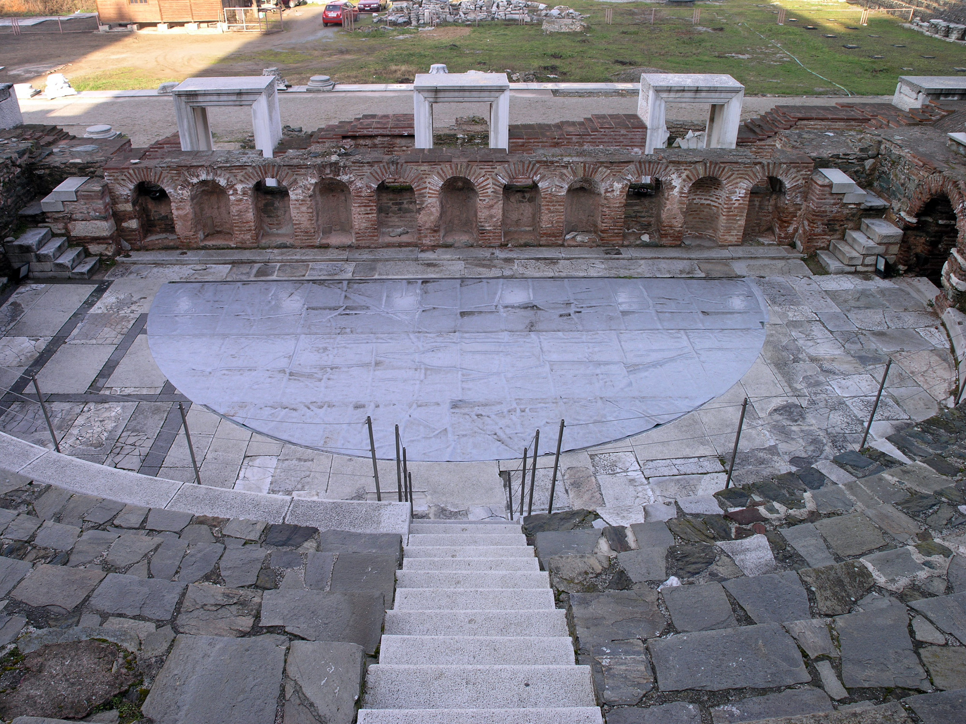
Thessalonica – agora (marketplace)
Photo public domain
Index

Slide 9
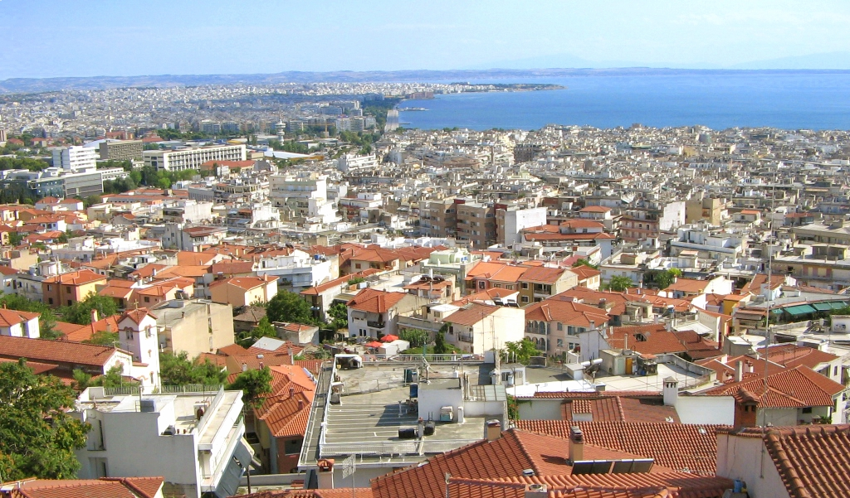
Modern Thessaloniki (Salonika)
Photo public domain
Index

Slide 10
Overview of 1 Thessalonians
Theme: Encouragement for a new but persecuted church, including instructions about Jesus’ return
Chap. 1-3 – The church and Paul’s relationship
1:1-10 – They received the gospel then sounded it forth.
2:1-12 – Paul preached God’s word with great sacrifice, honesty, and concern for people.
2:13-20 – People accepted the gospel as the word of God, so they suffered for it.
3:1-13 – Timothy visited and reported their circumstances
Chap. 4,5 – Future coming of Jesus and applications
4:1-8 – Avoid fornication.
4:9-11 – Love the brethren and work diligently.
4:13-5:11 – Jesus will return unexpectedly, the dead will be raised, and the righteous will live with the Lord.
5:12-28 – Concluding admonitions

Slide 11
What Paul Remembered (1:3)
Work of faith
Labor of love
Patience of hope

Slide 12
Different Kinds of Works
1. Works of the flesh or darkness – These do not save but condemn. (Galatians 5:19-21; Romans 13:12-14)
2. Works of Old Testament law or of human righteousness – One earns salvation by a lifetime without sin (Galatians 3:10). No forgiveness available (Hebrews 10:3,4). No one can be saved this way. (Romans 3:23; 4:4; 3:27; 11:6; Ephesians 2:8,9; Titus 3:5; 2 Timothy 1:9)
3. Works of obedience as conditions of salvation –Essential to salvation but do not earn eternal life. We trust God for forgiveness by grace; but must meet conditions He requires. (Matthew 7:21-27; 22:36-39; John 14:15,21-24; Acts 10:34,35; Romans 2:6-10; 6:17,18; Heb. 5:9; 10:39; 11:8,30; Galatians 5:6; 2 Thess. 1:8,9; James 2:14-26; 1 Peter 1:22,23; 1 John 5:3; 2:3-6)

Slide 13
God’s Plan for Election/Predestination (1:4)
1. God chooses and predestines man according to His purpose and will revealed in Scripture. (Ephesians 1:4,5,9,11; 2 Timothy 3:16,17)
2. God’s plan offers salvation to all through the gospel.
(John 3:16; Romans 5:18,19; 2 Peter 3:9; Titus 2:11; 1 Timothy 2:4,6; Hebrews 2:92; Thessalonians 2:14; Mark 16:15,16; Acts 2:38,39)
3. The gospel states conditions all can meet in order to receive salvation. (Mark 16:15,16; John 3:14-16; Acts 17:30,31; 2 Peter 3:9; Matthew 10:32; Acts 2:38,39; Romans 10:13,14,17; 1:16; John 6:44,45; 1:7; 6:40; Acts 10:43; 13:39; Hebrews 5:9; John 12:26; 2 John 9; Acts 22:16)
4. God grants the power to choose whether to meet the conditions and be saved or to refuse and be lost. (Revelation 22:17; Deuteronomy 30:15-19; Joshua 24:15; Exodus 32:26; 1 Kings 18:21; Hebrews 11:24,25; Isaiah 1:18-20; Matthew 23:37; Matthew 13:14,15; 1 Peter 1:22; Romans 6:13,16-18; 2 Corinthians 8:5; Philippians 2:12; 1 Timothy 4:16; Acts 2:40; 2 Corinthians 5:20)
5. God is no respecter of persons. (Romans 2:6-11; Acts 10:34,35)
God chooses/predestines to salvation all who choose to obey His plan as revealed in the gospel.

Slide 14
How the Gospel Came – 1:5
In Word – John 6:44,45; 8:31,32; Matthew 13:23; Romans 1:16; 10:13,14,17; Mark 16:15,16; Acts 8:26,29,35; 9:6; 11:14; 18:8; Luke 6:46-49; 11:28;
2 Thessalonians 2:14; Revelation 3:20
Also in power – 1 Corinthians 2:4,5; 1:18,24; 1 Thessalonians 2:13; Romans 1:16; 2 Peter 1:16; Hebrews 4:12,13
And in the Holy Spirit – 1 Corinthians 14:37; Galatians 1:8-12; 1 Thess. 2:13; 2 Timothy 3:16,17; Luke 10:16; 2 Peter 1:20,21; Matthew 10:19,20; Ephesians 3:3-5; 1 Cor. 2:10-13; 4:20; Romans 15:19
And in much assurance – Mark 16:20; John 5:36; 20:30,31; Acts 2:22; 14:3; 2 Corinthians 12:11,12; Hebrews 2:3,4; 1 Kings 18:36-39

Slide 15
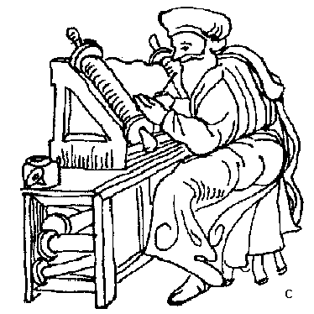

How Does the Spirit Lead Today?
GOD
John 14:16; 16:13
Holy Spirit
1 Cor. 14:37
Eph. 3:3-5; 2 Tim. 3:16,17; John 20:30,31; 2 Pet. 1:12-15

Slide 16
The Word Does What the Spirit Does
Holy Spirit | Work | The Word
Eph 5:18f; 1 Cor 6:19 | Dwells in us | Col. 3:16; 2 John 2
Rom. 8:14; Gal. 5:18 | Leads or Guides | Ps 119:105; 2 Tim 3:16f
2 Thess. 2:13 | Sanctifies | John 17:17,19
Gal. 5:22,23 | Bears fruit | Col 1:5ff; Luke 8:11ff
Rom. 15:13; Eph. 3:16 | Gives power | Rom. 1:16; Heb. 4:12
Rom. 8:15; Eph. 1:13f | Testifies we are God’s | 1 John 2:3-6; 1 Peter 1:23
Acts 9:31 | Comforts | Rom 15:4; 1 Thess 4:18
Heb. 2:3,4 | Gives evidence | John 20:30,31

Slide 17
Paul’s Teaching in Thessalonica – 2:1-12
This | But Not This
Bold despite conflict Pleasing God Gentle Willing to suffer/die Laboring night & day Devout, just, blameless Exhorted, comforted, charged | Error, uncleanness, deceit Pleasing men Flattering words, covetousness Glory from men

Slide 18

Lessons about the Gospel – chap 1,2
Came in word, power, Holy Spirit, & assurance
Sounded forth by disciples
The word of God, not of men
Works effectively in believers
Gives strength during persecution
Rejecting it is rejecting God

Slide 19
Abstain from Fornication – 4:3-8
God wills sanctification (holiness)
Abstain from fornication
Know how to possess your vessel in sanctification
Not in passion of lust, like Gentiles who know not God
Do not defraud a brother in this matter
The Lord is the avenger of all such
God called us, not to uncleanness, but holiness
He who rejects this rejects not man, but God

Slide 20
Know How to Possess Your Vessel
1) Remember that the sexual relationship was ordained by God.
2) So it must be guided by God’s word.
3) Realize that sexual immorality constitutes sin that violates your relationship with God the Creator.
4) Appreciate the beauty of marriage and respect the sexual act as the highest expression of love and devotion between a man and a woman.
5) Recognize fornication as a form of defrauding others: a form of robbery.
6) Set specific boundaries to avoid temptation.
7) Remember that you will be judged by God for your sexual conduct.

Slide 21
Admonitions for New Christians – 4:1-12
* Abstain from fornication
* Love the brethren
* Lead a quiet life
* Mind your own business
* Work with your own hands
So you may walk properly toward those who are outside and may lack nothing

Slide 22
Second Coming – 4:13-5:11
Lord will descend from heaven with a shout, with the voice of an archangel, and with the trumpet of God.
Dead in Christ will rise first before those still alive are caught up to meet the Lord.
We shall always be with the Lord.
Regarding times and seasons, the day of the Lord comes as a thief in the night.
Watch and be sober.
Whether we wake or sleep, we should live together with Him.

Slide 23
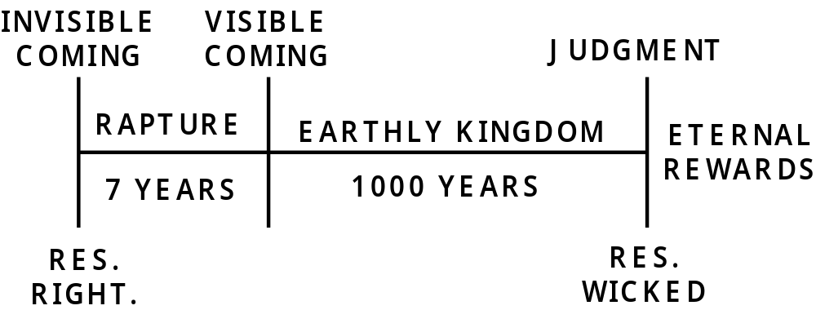
Premillennialism & the 2nd Coming
Scriptural Problems
The kingdom already exists!
All men will be raised at the same time.
Earth will be completely destroyed.
At Jesus’ coming, men will be eternally rewarded.
No one knows when Jesus will come.

Slide 24
Concluding Admonitions - 5:14-22
Warn those who are unruly, comfort the fainthearted, uphold the weak, be patient with all.
Do not render evil for evil to anyone, but always pursue what is good
Rejoice always
Pray without ceasing
In everything give thanks
Do not quench the Spirit.
Do not despise prophecies.
Test all things
Hold fast what is good
Abstain from every form of evil.

Slide 25
© Copyright David E. Pratte, 2020
Permission is granted to display this PowerPoint under the following conditions:
* Display the link to www.BibleStudyLessons.com
* Minor changes in content are permitted, but no teaching should be presented that disagrees with the teaching in the article associated with this PowerPoint on www.BibleStudyLessons.com/powerpoint
* In no case may a fee of any kind be charged for our PowerPoints.
* If you have a website, please add a link to www.BibleStudyLessons.com
Scripture quotations are generally from the New King James Version (NKJV), copyright 1982, 1988 by Thomas Nelson, Inc. Used by permission. All rights reserved.
www.BibleStudyLessons.com

