Slide 2

Video Bible Study
Lessons
presented by
David E. Pratte
www.gospelway.com

Slide 3
The Epistle of
1 Timothy
Thanks to Christians in the Hillcrest church for their participation.
© Copyright David E. Pratte, 2020
Scripture quotations are generally from the New King James Version (NKJV), copyright 1982, 1988 by Thomas Nelson, Inc. used by permission. All rights reserved.

Slide 4
Bible Study Questions on the Books of
1&2 Timothy, Titus, & Philemon
Available at
www.biblestudylessons.com/classbooks

Slide 5
Theme and Major Divisions of 1 Timothy
Theme: Instructions to a young preacher regarding opposing error, preaching truth, and personal conduct
Major divisions
Chapter 1 – A charge to warn men not to stray from the truth
Chapter 2 – Instructions about prayer and the conduct of women
Chapter 3 – Qualifications of church leaders
Chapter 4 – Admonitions about apostasy and preaching responsibilities
5:1-19 – Instructions about various groups of disciples
5:20-6:21 – Various instructions about teaching

Slide 6
Evidence Paul Was an Apostle
* He claimed it (verse 1).
* He spoke by direct guidance of the Holy Spirit
(1 Corinthians 14:37; 2:10-16; Ephesians 3:3-5; 2 Corinthians 12:7-10).
* His claim to apostleship was confirmed by miracles
(2 Corinthians 12:12; Acts 14:3,8-18; 13:6-12; 19:8-20).
* He was an eyewitness of the resurrected Christ
(Acts 9:1-18; 22:14,15; 26:16; 1 Corinthians 15:1-8; 9:1).
* He could lay hands on others to give them miraculous powers (Acts 19:1-7; Romans 1:8-11; 2 Timothy 1:6).
* Jesus chose him and commanded him to be a witness of His resurrection (Acts 26:13-19).

Slide 7
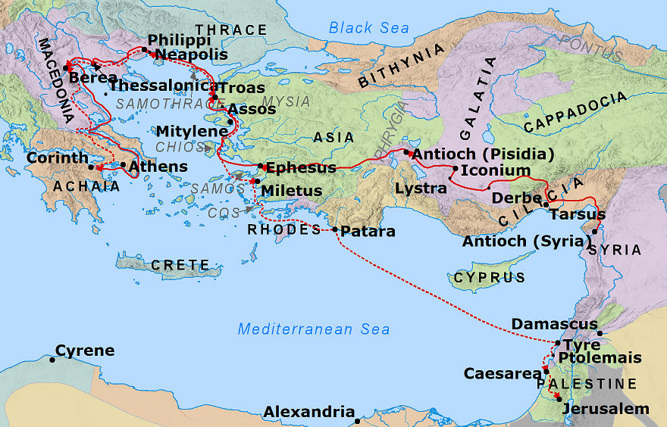
Ephesus – Paul’s Third Journey

Slide 8
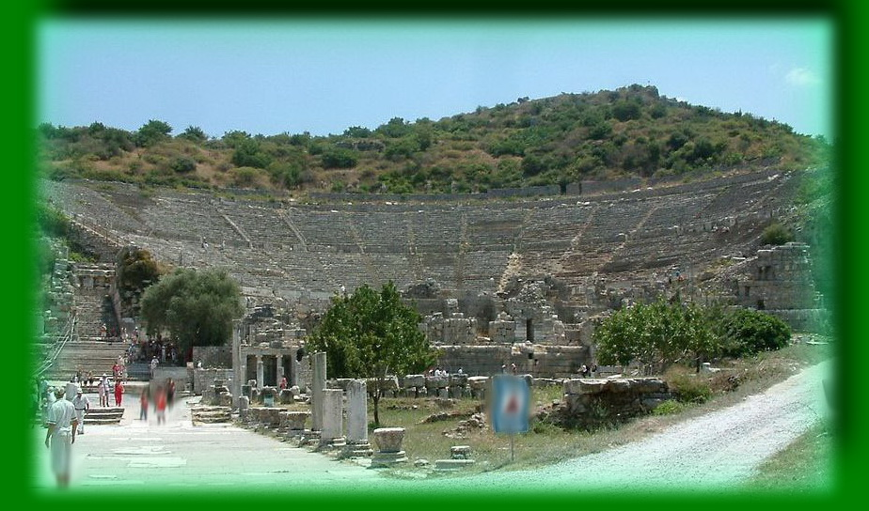
Theater in Ephesus – Acts 19
Credit: Radomil, distributed under GNU Free Documentation License 1.2 via Wikimedia Commons

Slide 9
The Purpose of the Command – 1:3-5
Not This (verses 3,4) | But This (verse 5)
Different doctrine Fables Genealogies | Love from a pure heart Good conscience Sincere faith

Slide 10
Contrary to Sound Doctrine – 1:8-11
lawless and insubordinate
ungodly and sinners
unholy and profane
murderers and manslayers
fornicators
sodomites
kidnappers
liars
perjurers

Slide 11
Paul an Example of Salvation – 1:12-16
Chief of sinners: blasphemer, persecutor – verse 13,15
Ignorant (but not excused) – verse 13
Saved by grace through faith and love – verse 14
Obedience required (not “faith only”) - 1 Peter 1:22; James 2:14-26; Hebrews 10:39; chapter 11
Baptism required – Acts 22:16; Romans 6:3,4,17,18; Galatians 3:26,27; 5:6. See also Acts 2:38; Mark 16:16;
1 Peter 3:21
Zeal, sincerity, and a good conscience are not enough - Galatians 1:14; Acts 23:1; 26:9
Jesus can save any penitent believer - 1 Corinthians 6:9-11

Slide 12
Praise to God – 1:17
The King
Matthew 19:26; Genesis 17:1; 18:14; Mark 14:36; Luke 1:37; Job 42:2; 26:14; Revelation 19:6; Jeremiah 32:17,20-22 Eternal, Immortal
Genesis 21:33; Exodus 3:13,14; Deuteronomy 32:40; 33:27; Psalm 90:1-4; 93:2; Isaiah 44:6-8; Habakkuk 1:12
Invisible
John 1:18; 6:46; Numbers 12:8; Isaiah 6:5; Psalms 17:15; Exodus 24:11; 33:17-23; 24:11; Colossians 1:15;
The only God
Ephesians 4:6; Compare Deuteronomy 4:19; 5:7-9; 17:2-5; 2 Kings 21:1-6; 23:4,5; 1 Corinthians 6:9-11; 10:7,14 Deserving of our honor and glory forever and ever

Slide 13
Note the Connection – 1 Timothy 1
Verses 3-11 | Verses 18-20
Charge to Timothy (verses 3-5) | Charge to Timothy (verse 18)
Oppose error (verses 3,4) | Wage good warfare (verse 18)
Love, pure heart, good conscience and faith (verse 5) | Hold faith and good conscience (verse 19)
Some have strayed, turned aside (verse 6) | Some have put away, etc. (verse 19)
Specific examples (verses 3-11) | Specific instance (verse 20)

Slide 14
What It Takes to Keep the Church Pure
- 1 Timothy 1
Teach the need for love, pure heart, good conscience, and sincere faith (verse 5) | Oppose other doctrines, fables, and all that opposes the gospel (verses 3-11) | Discipline those who reject faith and a good conscience and make shipwreck of the faith (verses 19,20)

Slide 15
For “ALL”
Prayer for ALL men
and ALL in authority – verses 1,2
Salvation and knowledge of truth for ALL – v 4
One God and one Mediator – v 5

Slide 16
For “ALL”
Prayer for ALL men
and ALL in authority – 2:1,2
Salvation and knowledge of truth for ALL – 2:4
One God and one Mediator – 2:5
A ransom for ALL – 2:6

Slide 17
One God
One Mediator
Men
Christ Jesus who gave Himself
a ransom for all

Slide 18
Posture in Prayer
* Kneeling, falling down prostrate – Luke 22:41 (Matthew 26:39; Acts 9:40; 20:36; 21:5; Ephesians 3:14; Daniel 6:10,11)
* Sitting – Nehemiah 1:4 (1 Kings 19:4; 2 Samuel 7:18)
* Standing – Mark 11:25; Luke 18:13,14. (1 Samuel 1:26; Genesis 24:12,13; Nehemiah 9:4,5)
* Bowed heads – 1 Chronicles 29:20; Luke 18:13 (Genesis 24:27,48; Exodus 34:8,9; 4:31; 12:27)
* Eyes lifted toward heaven – John 17:1ff (John 11:41; Matt. 14:19)
No specific posture or physical position is required in prayer.

Slide 19
The Problem of Suggestiveness/Indecency
Modesty/Propriety/Moderation
  1 Timothy 2:9,10
Pure Vs. Evil Thoughts
  Matthew 5:27,28; Proverbs 6:25
Temptation & Sin
  Proverbs 7:10,5; 2 Samuel 11:2-4; Job 31:1
Chastity
  Titus 2:5; 1 Peter 3:2
Lasciviousness/Licentiousness
  Mark 7:20-23; Galatians 5:19-21; Romans 13:13,14

Slide 20
The Problem of Nakedness
Insufficient Clothing Is Still Nakedness
Genesis 3:7-11,21
Shameful Under Both Covenants
Genesis 3:7-11,21; Revelation 3:18; 16:15
A Shame Regardless of Activity
Exodus 20:26
Requires Covering Loins and Thighs
Exodus 28:41-43
  Meaning of “trousers”
  Meaning of “from … to”

Slide 21
“From … To” (MIN … AD)
Lev. 13:12,13 — Leprosy “from his head to his foot”
Num. 6:4 — Nothing from grape “from seed to skin.”
2 Sam. 14:25 — No blemish “from…foot to…head.”
Esther 8:9 — All provinces “from India to Ethiopia.”
Job 2:7 — Boils “from the sole of his foot to the crown of his head.”
Isa. 1:6 — Disease “from … foot even to the head.”
Jer. 6:13 — Covetous, from the least to the greatest; all dealt falsely, from the prophet to the priest.
Exodus 28:42 — Cover the naked flesh “from the loins to the thighs.”

Slide 22

Looking in the Mirror
Am I fully covered so as to avoid tempting others?
Too low, too short, too tight?
What shows when I bend, lift my arms, sit, cross my legs?
Do I emphasize fashion or godliness?
Will I influence others toward godliness?
If Jesus went with me, would I dress like this?
Would I want to be dressed like this at Judgment?

Slide 23
Male Leadership in the Scriptures
God is always described with masculine terms.
The Head of the church is masculine.
Ephesians 1:22,23; Colossians 1:18; Matthew 16:18
Husbands lead in the home.
Ephesians 5:22-33; Colossians 3:18; Titus 2:4,5; 1 Peter 3:1-7
The apostles were all men.
Matthew 10:2-4; Luke 10:13-16; Acts 1:13,26
Each elder must be the husband of one wife.
1 Timothy 3:1,2; Titus 1:5,6
Only men wrote books of the Bible.
Only men preach in congregational assemblies.
Acts 11:25,26; 15:30-35; 20:7
1 Timothy 2:11-14; 1 Corinthians 14:34,35 – Women subject to men in the church and in spiritual teaching

Slide 24
Women Valued in Scripture
1 Peter 3:7 – Husbands should honor their wives as heirs together of the grace of life
Mary was highly honored to be Jesus’ mother
Luke 1:26-56
Several women followed Jesus as His disciples
Matthew 27:55,56; Luke 8:2,3
Mary and Martha were two of Jesus’ closest disciples Luke 10:38-42
Dorcas, Lydia, Phoebe and other women are expressly commended for good works
Acts 9:36-42; 16:11-15; Romans 16:1,2
Old Testament women upheld as good examples
1 Peter 3:5,6; Hebrews 11:11,31
Women commended for their role as homemakers
Titus 2:4,5; Proverbs 31:10-31; Proverbs 19:14; 18:22

Slide 25
Women as Spiritual Teachers
Teach children or other women
Proverbs 1:8 – Son should not forsake mother’s law.
2 Timothy 1:5 –The faith Timothy possessed came from his grandmother Lois and mother Eunice.
Titus 2:3-5 – Older women teach younger women.
Discuss with men outside church assemblies without exercising authority
John 4:19-30,39,42 – Samaritan woman
Acts 18:26 – Aquila and Priscilla with Apollos
God values people for their service, not their authority
Matthew 20:25-28

Slide 26
Limited to Church Assemblies?
Note the context of 1 Timothy 2:11,12
Verses 1,2,8 – Prayer is done “everywhere”
Verses 3-7 – Salvation is not limited to church assemblies.
Verses 9,10 – Modesty applies in and out of church assemblies.
Verses 13-15 – The principle of women being subject is general, not just in church assemblies.
While the principles of verses 11,12 apply in church assemblies, they are not limited to there.
But the context of 1 Corinthians 14 does refer to assemblies of the whole church where women should not speak even to ask a question.

Slide 27
Meaning of “Silence”/”Quietness”
“Silence” (KJV, NKJV, NRSV); “quietness”/”quietly (ASV, NASB, ESV, MLV, NIV): A restrained, reserved manner.
2 Thessalonians 3:12 – Christians work in quietness and eat their own bread.
1 Timothy 2:2 – Lead a quiet and peaceable life
1 Peter 3:4 - Subjection of women: “a meek and quiet spirit.”
“Quietness” means a submissive attitude, in contrast to a loud, stubborn, rebellious, bossy manner.
This passage forbids women to lead men in teaching or spiritual matters, even outside church assemblies.
But 1 Corinthians 14:34,35 forbids women in congregational assemblies to speak even to ask a question.

Slide 28
1 Timothy 2 cf. to 1 Corinthians 14
1 Timothy 2:11,12 | 1 Corinthians 14:34,35
Spiritual teaching and leadership in general | Whole church assembled together
Women act (and speak) quietly in submission | Women be silent and submissive Not permitted to speak Shameful to speak Ask questions elsewhere
1 Corinthians 14 is more specific than 1 Timothy 2, regarding both the circumstances where it applies and the conduct it permits.

Slide 29
Reasons for Subjection
Man Was Formed First (2:13)
Genesis 2:18ff; (1 Corinthians 11:3,8,9)
Woman was created to be a helper or companion to man, not a leader or authority figure. Man and woman were created with different natures for different roles.
Woman Was Deceived (2:14)
Genesis 3:16
Eve took the lead and made a sinful decision without consulting her husband. Both man and woman were punished. But the punishment fit the sin.
God required that she would always be subject to her husband.

Slide 30

Terms for Elders
BISHOPS (Overseers)
Acts 20:28; I Tim. 3:1,2; Phil. 1:1; I Pet. 5:2
"overseer ... guardian, or superintendent“ - Thayer
ELDERS (Presbyters)
Acts 14:23; 20:17; I Pet. 5:1; I Tim. 4:14
"a term of rank or office ... those who presided over the (churches)" -- Thayer
PASTORS (Shepherds)
Eph. 4:11; (Acts 20:28; I Pet. 5:2)
"a shepherd ... the presiding officer, manager, director, of any assembly" -- Thayer

Slide 31
Different Terms: Same Work
Acts 20:17,28
  V17 - Elders
  V28 - Overseers/bishops
  V28 - Shepherd (pastor) the flock
Titus 1:5-9
  V5 - Elders
  V7 - Bishop
1 Peter 5:1-3
  V1 - Elders
  V2 - Shepherd (pastor)
  V2 - Overseers (bishops)

Slide 32
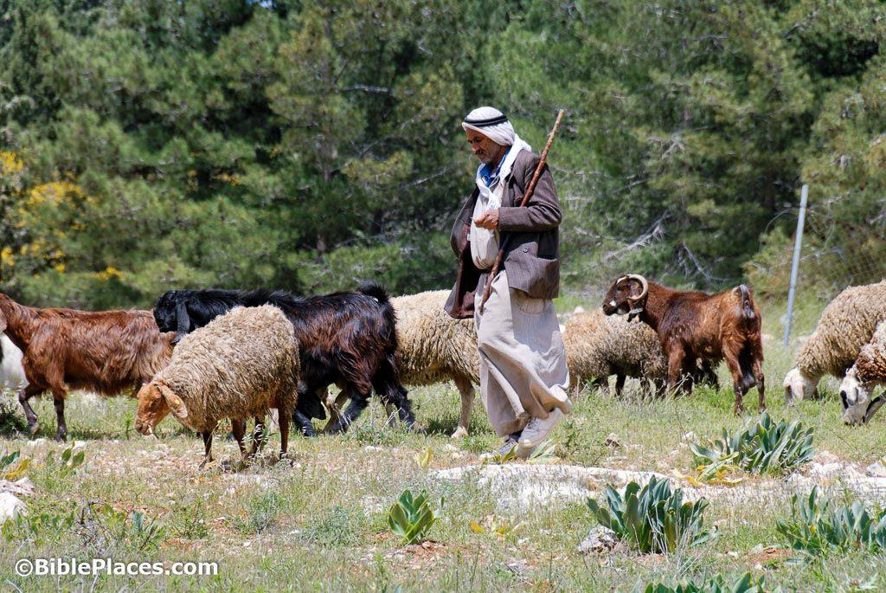
The Work of Elders
Set Good Examples
  1 Peter 5:2,3; Acts 20:28-30; Hebrews 13:7
Watch for Members’ Souls
  Heb. 13:17; Acts 20:28ff;
  Titus 1:9ff
Teach Truth/Rebuke Error
  1 Peter 5:2; Acts 20:28; Heb. 13:7;
  1 Thess. 5:12; 1 Tim. 3:2; Ti. 1:9ff
Oversee/Rule Local Church
  Acts 20:28; 1 Peter 5:2; 1 Timothy 5:17; Hebrews 13:7,17; Titus 1:7

Slide 33
Terms Implying Supervision
Shepherd
Eph. 4:11; (Acts 20:28; 1 Pet. 5:2)
Overseer
Acts 20:28; 1 Tim. 3:1,2;
Phil. 1:1; 1 Pet. 5:2
Rule/Obey
1 Timothy 5:17; Hebrews 13:7,17
Steward
Titus 1:7

Slide 34


Scriptural Church Organization
CHRIST
LOCAL CHURCHES

Slide 35
A Plurality in Each Church
Phil. 1:1 -- Bishops (plural) in church at Philippi
Acts 15:4,22 -- Elders (plural) in church at Jerusalem
Acts 20:17 -- Elders (plural) of the church at Ephesus
Acts 20:28 -- Overseers (plural) of the flock (singular)
1 Peter 5:1-3 -- Elders (plural) to tend the flock (singular)
Acts 14:23 -- Elders (plural) in EVERY church (singular)

Slide 36
The Importance of Elders
Faithful churches had them.
Paul ordained them in every church.
Serving as a bishop is a good work.
Churches without them have something “lacking.”

Slide 37
Principles Re. Qualifications
"IF A MAN ... A BISHOP MUST BE ..."
The qualifications are necessary
ALL qualifications are necessary
Each man must have all qualifications
Each man must be qualified when appointed and must continue to be qualified
We must not add man-made qualifications
The purpose is to select men able to do work
Lack of evidence is reason NOT to appoint
Some qualities are absolute; others are matters of degree
Developing qualifications requires time.

Slide 38
Qualifications - 1 Timothy 3:1-7
Blameless - v2
Husband of one wife - v2
Temperate - v2
Sober-minded - v2
Good behavior - v2
Hospitable - v2
Able to teach - v2
Not given to wine - v3

Slide 39
Elders and Alcoholic Drinks
Forbidding an extreme does not excuse less extreme
Isaiah 10:2; Romans 13:9; Proverbs 23:29-33
Modern “social drinking” is excessive drinking
Bible “wine” is fermented or unfermented or diluted (Isaiah 16:10; 65:8; Jeremiah 48:33; Song 5:1; Genesis 40:9-11; Revelation 19:15; 14:19,20). Compare “cider.”
Distilled alcoholic beverages unknown in Bible times.
One can of beer as alcoholic as a shot of whiskey!
1 Peter 4:3 condemns various degrees of drinking
Vigilance, self-control and sobriety
1 Peter 5:8;1 Corinthians 9:25-27
Good example
Good report outside the church (1 Timothy 3:7).

Slide 40
Qualifications - 1 Timothy 3:1-7
Blameless - v2
Husband of one wife - v2
Temperate - v2
Sober-minded - v2
Good behavior - v2
Hospitable - v2
Able to teach - v2
Not given to wine - v3
Not violent - v3
Gentle - v3
Not quarrelsome - v3
Not greedy/covetous - v3
Rule house well/children subject – vv 4,5
Not a novice - v6
Good testimony from outside - v7

Slide 41
Deacons/Servants
* Physical servants – Matthew 22:13; 20:26; 23:11
* Any Christian (a servant to God and other people) – Colossians 1:25; John 12:26; Romans 16:1
* Preachers – 1 Corinthians 3:5; 2 Corinthians 3:6; 6:4; 11:23; Colossians 1:7; 4:7; 1 Thessalonians 3:2; Ephesians 3:7; 1 Timothy 4:6
* Civil rulers – Romans 13:4
* Jesus – Romans 15:8
* Men appointed to a specially qualified position to do works of service on behalf of the church – Philippians 1:1; 1 Timothy 3:8,12
(1) The deacons are listed in a similar way to bishops
(2) Special qualifications are listed

Slide 42
Qualifications of Deacons
Reverent
Not double-tongued
Not given to much wine
Not greedy for money
Hold the mystery of the faith with a pure conscience
Blameless

Slide 43
Qualifications of Wives
Reverent
Not slanderers
Temperate
Faithful in all things
Acts 16:15 – If you have judged me to be faithful to the Lord.
Ephesians 1:1 – To the faithful in Christ Jesus.
1 Timothy 6:2 – Believing masters … they are brethren.
Revelation 2:10 – Be thou faithful unto death…
1 Timothy 3:11 – Elders’ and deacons’ wives must be faithful in all things.

Slide 44
Qualifications of Deacons
Reverent
Not double-tongued
Not given to much wine
Not greedy for money
Hold the mystery of the faith with a pure conscience
Blameless
Husbands of one wife
Ruling their children and their own houses well

Slide 45
The Mystery of Godliness: God was…
Manifested in the flesh
Heb. 2:14-18; Phil. 2:6-8; John 1:1,14; 1 John 4:2,3
Justified in the Spirit
John 20:30,31; Acts 2:14-36; 1 Cor. 15:1-8; Matt. 1:20
Seen by angels
Matt. 1&2; 4:11; 28:1-8; Luke 1&2; 22:43 Acts 1:9-11
Preached among the Gentiles
Col. 1:5,23; Mark 16:16; Acts 2:39; 10,11,15; 22:21; 26:17; Romans 1:16; 2:6-11; 15:8-12; 16:26; Gal. 2:7
Believed on in the world
Mark 16:15,16; John 8:24; 20:30,31; 3:15-18; Romans 10:9,10,13-17; John 1:12
Received up in glory
Acts 1:9-11; Phil. 2:5-12; Eph. 1:19-23; Acts 2:22-36; Rev. 5:9-14; John 17:4,5; Psalm 24:7-10; Daniel 7:13

Slide 46
Some Will Depart from the Faith – 4:1-5
Forbidding to Marry
“The law of the [Roman] Church forbids persons living in the married state to be ordained, and persons in holy orders [priests] to marry.” – Catholic Dictionary, p. 132
“Although celibacy is not expressly enforced by our Savior, … the church felt it her duty to lay it down as a law.” – Faith of Our Fathers, page 328
Genesis 2:18 – “It is not good that man should be alone
Hebrews 13:4 – Marriage is honorable among all
Matthew 8:14 – [Peter’s] wife's mother lying sick
1 Corinthians 9:5 – a believing wife, as do … Cephas
Titus 1:5,6; 1 Timothy 3:2 - the husband of one wife…
“There is no question of a right to marry. The Apostles had that right…”. “priestly celibacy as a law is of later ecclesiastical institution.” - St. Joseph New Catholic Edition

Slide 47
Some Will Depart from the Faith – 4:1-5
Commanding to abstain from meats
“What is abstinence? The Church’s law of abstinence says that on certain days you may not eat meat … What are the days of obligatory abstinence? Ash Wednesday and all the Fridays of Lent” – Catholic Catechism, p. 132
Genesis 9:1-6 – “every moving thing” is food for us
Bible examples of eating meat: Genesis 25:27,28;
27:1-4; 43:16; 1 Samuel 25:18; 1 Kings 4:22,23; 19:21;
1 Chronicles 12:39,40; Nehemiah 5:17,18.
Divine approval for eating meat: Genesis 18:2,7,8; Exodus 12:3,6,8,46; Deuteronomy 12:15,20-22;
Leviticus 17:13,14; 1 Kings 17:4,6.
Jesus’ approval for eating meat: Luke 5:4-10; 11:11-13; Mark 6:35-44; 8:1-9; Luke 15:23,27; Mark 14:12,18; Luke 24:36-43; John 21:3,6,8-13

Slide 48
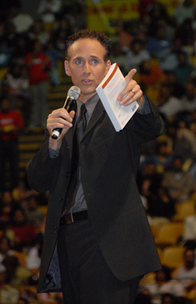
A Good Minister – 4:6,7
Instruct the brethren
Nourished in the doctrine
Avoid fables
Practice godliness

Slide 49
Exercise: Body or Godliness – 4:8
Bodily Exercise | Exercise in Godliness

Slide 50
Exercise: Body or Godliness – 4:8
Bodily Exercise | Exercise in Godliness
Athletics, recreation, sports | Bible study, prayer, church meetings, teaching others, training children

Slide 51
Exercise: Body or Godliness – 4:8
Bodily Exercise | Exercise in Godliness
Athletics, recreation, sports | Bible study, prayer, church meetings, teaching others, training children
Profits a little | Profits all things: the life that now is and that which is to come.
Spiritual takes priority over physical
Matthew 6:19-33; 10:34- 39; 16:24-27; Romans 12:1,2;
John 6:27,63; Luke 12:15-21; 1 Timothy 4:8; 6:6-19;
2 Corinthians 4:16-18

Slide 52

An Example to the Believers – 4:12
Word
Conduct
Love
Spirit
Faith
Purity
Importance of Example
Matthew 5:13-16; 18:6,7; Titus 2:7,8; 1 Peter 2:11,12; 2 Corinthians 6:3; 8:20,21; 1 Corinthians 8:9-13; 10:23-33; Romans 2:21-24; 12:17; 16:17

Slide 53
A Good Minister – 4:6-16
Instruct the brethren
Nourished in the doctrine
Avoid fables
Practice godliness
Good example
Reading, exhortation, and teaching
Diligent, not negligent
Take heed to yourself and to the doctrine. Continue in them

Slide 54
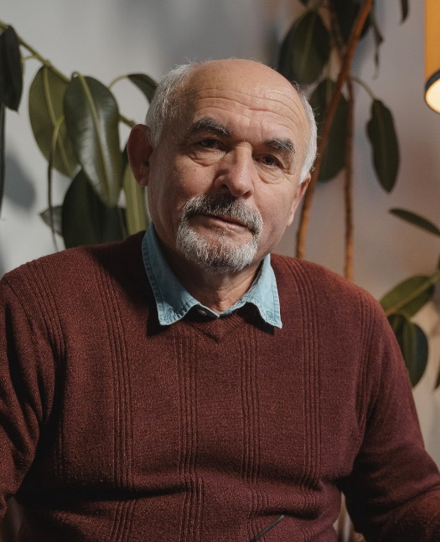




Like Family – 5:1,2

Slide 55
Classes of Widows – 1 Timothy 5
Widows Indeed
Widows
Enrolled
Widows
Young Widows

Slide 56
A Widow Indeed – 5:5,6
Desolate (left alone)
Trusts in God
Continues in supplications and prayers night and day
Does not live in pleasure

Slide 57

An Enrolled Widow– 5:5,6
(at least) sixty years old
wife of one man
well reported for good works
brought up children
lodged strangers
washed the saints’ feet
relieved the afflicted
diligently followed every good work.

Slide 58

Younger Widows – 5:11-14
Marry
bear children
manage the house
give no opportunity to the adversary to speak reproachfully

Slide 59
Lessons for Women 5:3-16
Trust in God
Continue in prayer
Do not live in pleasure
Marry/wife of one man
Bear/bring up children
Manage the household
Be hospitable
Relieve the afflicted
Diligently follow every good work

Slide 60
Lessons about Care of Widows – 5:3-16
Primary responsibility rests on family
Church responsibility is limited
Church responsibility differs from individual
God has a plan for women’s service
Roles of men and women differ

Slide 61
Miscellaneous Instructions 5:17-25
Honor elders
Accusations – 2/3 witnesses
Public rebukes
Avoid prejudice/partiality
Keep pure from other people’s sins
Health infirmity

Slide 62
Instructions about Groups of People
Elders
Deacons
Older men/women
Younger men/women
Widows
Servants/masters

Slide 63
Instructions for Special Groups
Elders
Deacons
Older men/women
Younger men/women
Widows
Servants/masters
False Teachers

Slide 64
Description of False Teachers – 6:3-5
Characteristics
Teach different from words of Jesus & godliness
Proud
Knowing nothing
Obsessed with disputes over words
Corrupt minds
Destitute of truth
View godliness as means of gain
Effects
Envy
Strife
Reviling
Evil suspicions
Useless wrangling

Slide 65
Flee Love of Money – 6:6-12
Avoid
Lack of contentment
Temptation
Snare
Many foolish and hurtful lusts
Led astray from the faith
Pierced through with many sorrows
Pursue
Righteousness
Godliness
Faith
Love
Patience
Gentleness
The good fight of faith
Eternal life
The good confession

Slide 66

Our Lord Will Appear – 6:15,16
The blessed and only Potentate
The King of kings and Lord of lords
Who alone has immortality
Dwelling in unapproachable light
Whom no man has seen or can see
To whom be honor and everlasting power

Slide 67

Admonitions to the Rich – 6:17-19
Do not be haughty
Do not trust in uncertain riches but in the living God
Do good
Be rich in good works
Be ready to give, willing to share
Storing up a good foundation for the time to come
Lay hold of eternal life

Slide 68
© Copyright David E. Pratte, 2020
Permission is granted to display this PowerPoint under the following conditions:
* Display the link to www.BibleStudyLessons.com
* Minor changes in content are permitted, but no teaching should be presented that disagrees with the teaching in the article associated with this PowerPoint on www.BibleStudyLessons.com/powerpoint
* In no case may a fee of any kind be charged for our PowerPoints.
* If you have a website, please add a link to www.BibleStudyLessons.com
Scripture quotations are generally from the New King James Version (NKJV), copyright 1982, 1988 by Thomas Nelson, Inc. Used by permission. All rights reserved.
www.BibleStudyLessons.com

