Slide 2
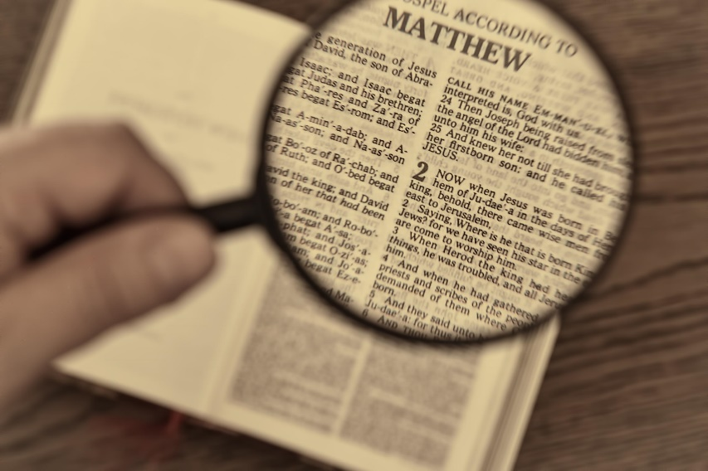
Video Bible Study
Lessons
presented by
David E. Pratte
www.gospelway.com

Slide 3
The Epistle of
2 Timothy
Thanks to Christians in the Hillcrest church for their participation.
© Copyright David E. Pratte, 2021
Scripture quotations are generally from the New King James Version (NKJV), copyright 1982, 1988 by Thomas Nelson, Inc. used by permission. All rights reserved.

Slide 4
Bible Study Questions on the Books of
1&2 Timothy, Titus, & Philemon
Available at
www.biblestudylessons.com/classbooks

Slide 5
Theme and Major Divisions of 2 Timothy
Theme: Encouragement to Timothy to continue to preach and practice the truth despite hardship and suffering even after Paul was gone.
Major divisions
Chapter 1 – Imitating Paul’s faith and suffering
Chapter 2 – Teaching God’s word with labor and hardship
Chapters 3,4 – Continuing in the truth despite dangers

Slide 6
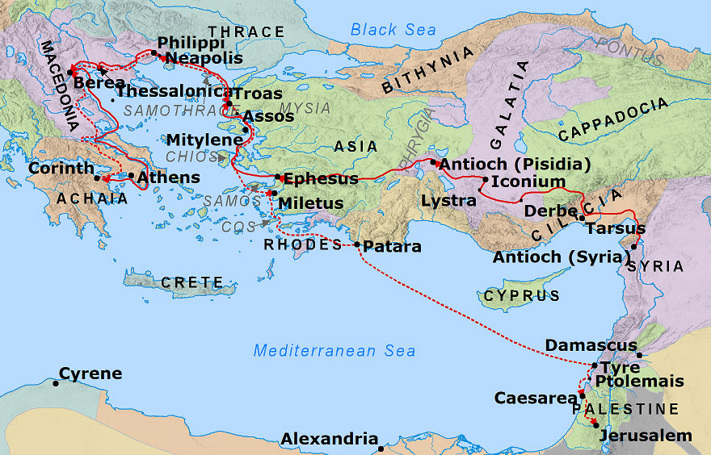
Ephesus – Paul’s Third Journey

Slide 7
Chapter 1:
Imitating Paul’s Faith and Suffering
Paul remembered Timothy’s sincere faith that his mother and grandmother first possessed.

Slide 8
A Proper Faith
Faith must be sincere.
Faith must be a personal conviction based on God’s word.
Neither accept nor reject a belief just because of parents.
Children of Christians can become dedicated Christians.
Christians can raise good children even when a spouse is not a faithful Christian.
See the value of the work done by Christian women.

Slide 9
Chapter 1:
Imitating Paul’s Faith and Suffering
Paul remembered Timothy’s sincere faith that his mother and grandmother first possessed.
Timothy should suffer for the gospel without fear but with power, love, and a sound mind.

Slide 10
A Proper Spirit
But This
power
love
a sound mind
Not This
fear
shame

Slide 11
Chapter 1:
Imitating Paul’s Faith and Suffering
Paul remembered Timothy’s sincere faith that his mother and grandmother first possessed.
Timothy should suffer for the gospel without fear but with power, love, and a sound mind.
We are saved, not according to our works, but according to God’s purpose and grace in Christ.

Slide 12
Proper Salvation
But This
According to God’s purpose and grace in Christ
Not This
According to Our Works

Slide 13
Chapter 1:
Imitating Paul’s Faith and Suffering
Paul remembered Timothy’s sincere faith that his mother and grandmother first possessed.
Timothy should suffer for the gospel without fear but with power, love, and a sound mind.
We are saved, not according to our works, but according to God’s purpose and grace in Christ.
Hold fast the pattern of sound words in faith and love.

Slide 14
A Proper Pattern
Hold fast the pattern of sound words
Heard from inspired men
In faith and love which are in Christ Jesus.
Keep by the Holy Spirit

Slide 15
Chapter 1:
Imitating Paul’s Faith and Suffering
Paul remembered Timothy’s sincere faith that his mother and grandmother first possessed.
Timothy should suffer for the gospel without fear but with power, love, and a sound mind.
We are saved, not according to our works, but according to God’s purpose and grace in Christ.
Hold fast the pattern of sound words in faith and love.
Some had fallen away but Onesiphorus cared for Paul in his chain.

Slide 16
Chapter 2:
Teaching God’s word with labor and hardship
Labor and hardship to teach others

Slide 17
Spreading the Word
Apostles and prophets
Teachers
and preachers
Teachers
and preachers
Teachers
and preachers
Faithful
men
Faithful
men
Faithful
men
Faithful
men
Faithful
men
Faithful
men
Others Others
Others Others
Others Others
Others Others
Others Others
Others Others

Slide 18
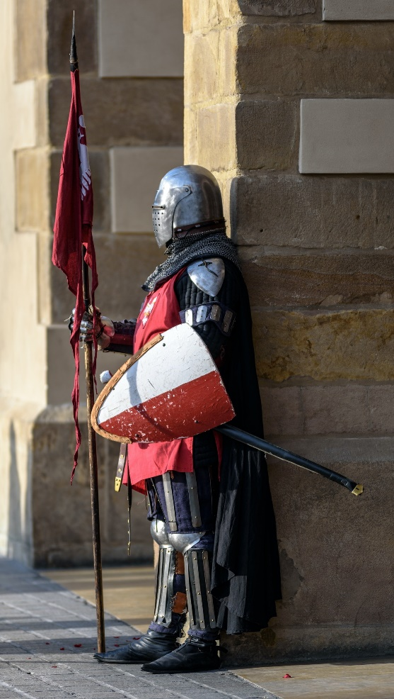
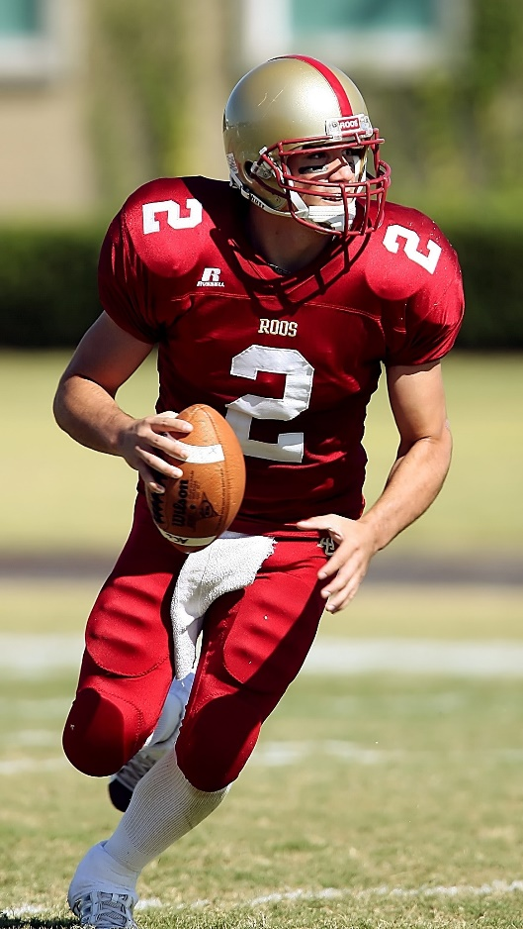
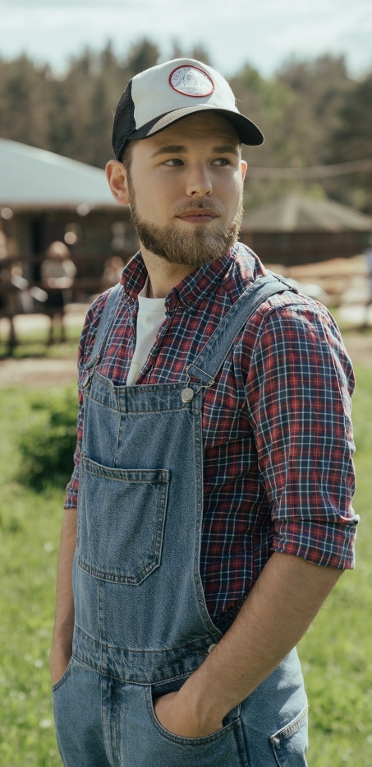
3 Views of Teachers
Soldier
Athlete
Farmer

Slide 19
Chapter 2:
Teaching God’s word with labor and hardship
Labor and hardship to teach others
Suffering for the Lord

Slide 20
A Faithful Saying
If This… | Then This
We die with Him | We will live with Him

Slide 21
A Faithful Saying
If This… | Then This
We die with Him | We will live with Him
We endure | We will reign with Him

Slide 22
A Faithful Saying
If This… | Then This
We die with Him | We will live with Him
We endure | We will reign with Him
We deny Him | He will deny us

Slide 23
A Faithful Saying
If This… | Then This
We die with Him | We will live with Him
We endure | We will reign with Him
We deny Him | He will deny us
We are faithless | He remains faithful

Slide 24
Chapter 2:
Teaching God’s word with labor and hardship
Labor and hardship to teach others
Suffering for the Lord
Using God’s word properly and avoiding error

Slide 25
Using God’s Word Properly
Do not strive about words to no profit
Present yourself approved to God, not ashamed
Rightly dividing the word of truth.
Shun profane and idle babblings:
They lead to ungodliness
spread like cancer
stray concerning the truth
and overthrow the faith of some

Slide 26
Using God’s Word Properly
Do not strive about words to no profit
Present yourself approved to God, not ashamed
Rightly dividing the word of truth.
Shun profane and idle babblings
Vessels of Honor and Vessels of Dishonor

Slide 27
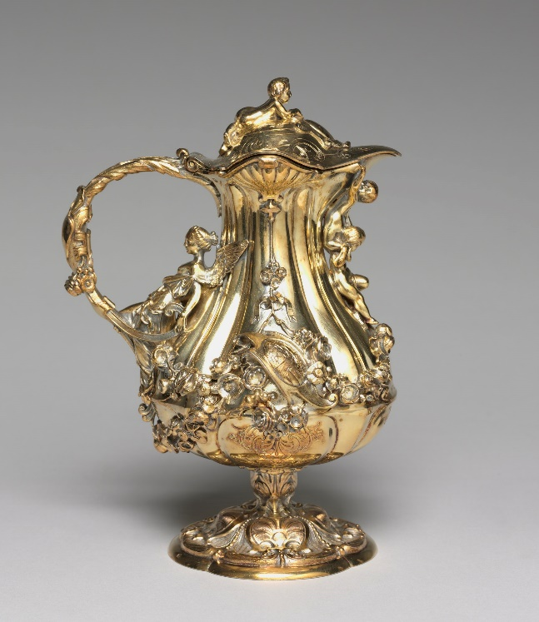
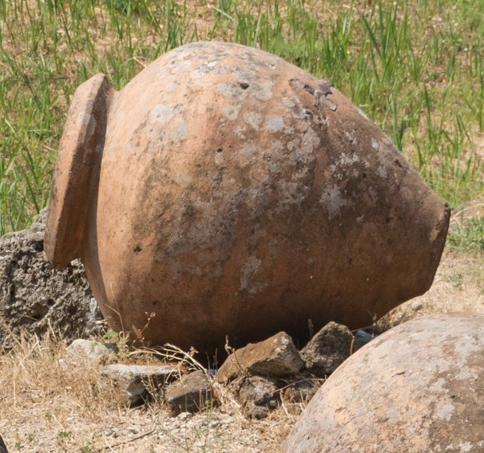
Vessels of Honor and Vessels of Dishonor
Sanctified and useful
for the Master
Prepared for every good work
Flee also youthful lusts
Pursue righteousness,
faith, love, peace
Avoid foolish
and ignorant disputes

Slide 28
Using God’s Word Properly
Do not strive about words to no profit
Present yourself approved to God, not ashamed
Rightly dividing the word of truth.
Shun profane and idle babblings
Vessels of Honor and Vessels of Dishonor
Flee Youthful Lusts

Slide 29
Using God’s Word Properly
Do not strive about words to no profit
Present yourself approved to God, not ashamed
Rightly dividing the word of truth.
Shun profane and idle babblings
Vessels of Honor and Vessels of Dishonor
Flee Youthful Lusts
In humility correcting those who are in opposition

Slide 30

Correcting Those in Error
Must not quarrel but be gentle to all, able to teach, patient
In humility correcting those who are in opposition
If God perhaps will grant them repentance
So that they may know the truth
That they may come to their senses
And escape the snare of the devil having been taken captive by him to do his will.

Slide 31
Perilous Times in the Last Days
Lovers of themselves
Lovers of money
Boasters
Proud
Blasphemers
Disobedient to parents
Unthankful
Unholy
Unloving
Unforgiving
Slanderers
Without self-control
Brutal
Despisers of good
Traitors
Headstrong
Haughty
Lovers of pleasure
Form of godliness but deny power
Make captives of gullible women
Always learning and never able to know truth

Slide 32
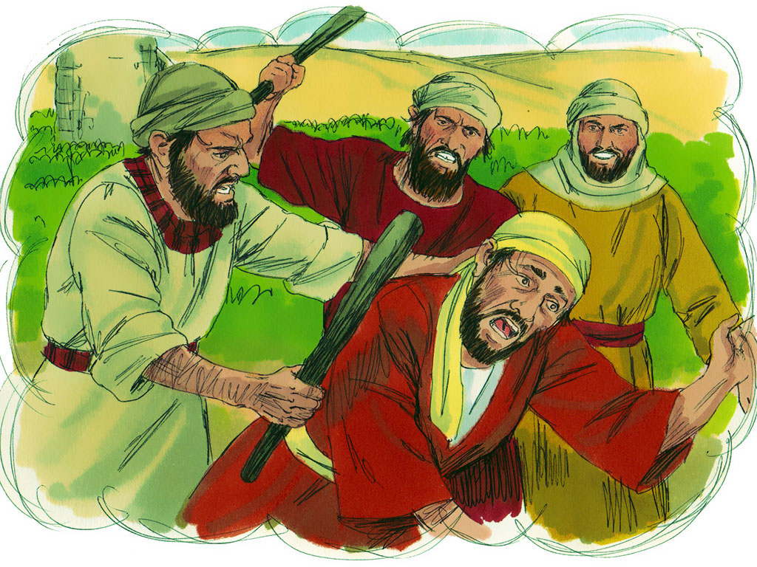
Imitating the Apostle
Doctrine
Manner of life
Purpose
Faith
Longsuffering
Love
Perseverance
Persecutions
Afflictions
Image Credit: Good News / College Press

Slide 33
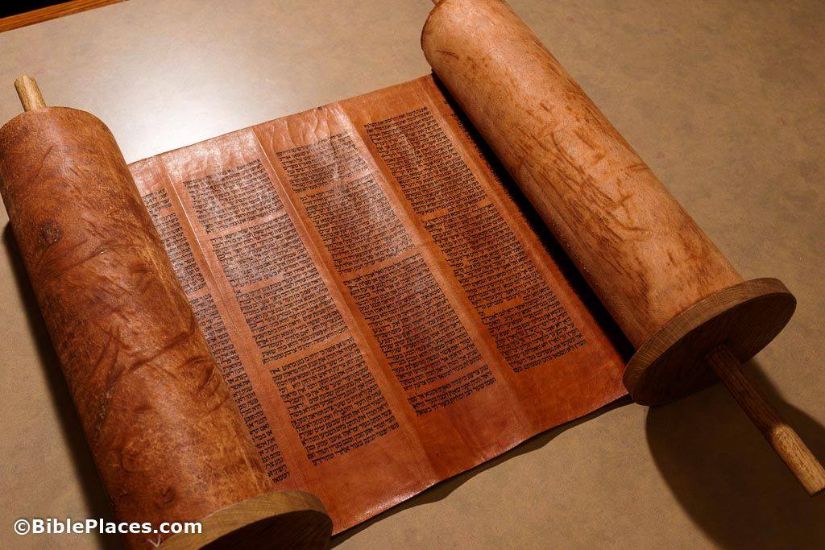
Proper View of Scripture
Able to make us wise to salvation
Should be taught beginning in youth
Given by inspiration of God
Profitable (understandable) for:
Doctrine
Reproof
Correction
Instruction in righteousness
Provides completely to all good works

Slide 34
“Scripture”: Old and New
1. “All Scripture” refers to everything that fits the definition of “Scripture.”
2. New Testament writers claimed the characteristics of Scripture for their writing and called it “Scripture.”
3. Paul knew what Scripture is, knew inspired men were writing Scripture, and claimed the characteristics of Scripture for his writing.
4. Nearly all Scripture had been recorded before 2 Timothy.
(20 of the 27 New Testament books already completed)
5. 2 Timothy 3:16,17 is a general statement of God’s intent regarding all Scripture.

Slide 35
Timothy’s Knowledge of Scripture
Various New Testament Scriptures had existed for much of Timothy’s life (he even helped write it - 2 Corinthians 1:1)!
Specific Example | General Principle
V11 - Paul was persecuted | V12 – All will suffer persecution
4:8 – Paul would receive a crown | So will all who love His appearing
V15 - Timothy knew Scripture | V16 - All Scripture is inspired…

Slide 36
Some Will Not Endure Sound Doctrine
The Problem
Some will not endure sound doctrine According to their own desires they have itching ears They will heap up for themselves teachers They will turn their ears away from the truth, and be turned aside to fables.

Slide 37
Some Will Not Endure Sound Doctrine
The Problem | The Solution
Some will not endure sound doctrine According to their own desires they have itching ears They will heap up for themselves teachers They will turn their ears away from the truth, and be turned aside to fables. | Preach the word! Be ready in season and out of season Convince, rebuke, exhort, with all longsuffering and teaching Be watchful in all things Endure afflictions Do the work of an evangelist Fulfill your ministry

Slide 38
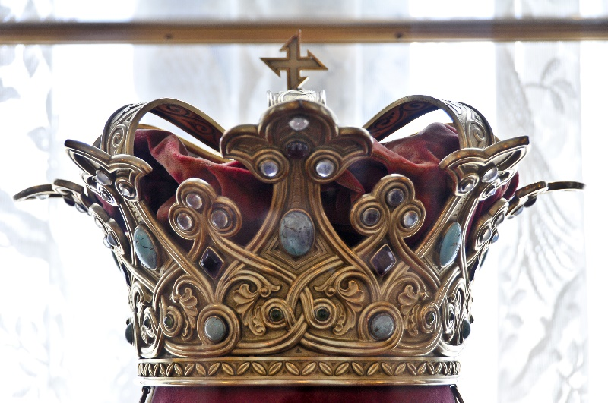
Paul’s Time of Departure
I have fought the good fight
I have finished the race
I have kept the faith
there is laid up for me the crown of righteousness

Slide 39
© Copyright David E. Pratte, 2020
Permission is granted to display this PowerPoint under the following conditions:
* Display the link to www.BibleStudyLessons.com
* Minor changes in content are permitted, but no teaching should be presented that disagrees with the teaching in the article associated with this PowerPoint on www.BibleStudyLessons.com/powerpoint
* In no case may a fee of any kind be charged for our PowerPoints.
* If you have a website, please add a link to www.BibleStudyLessons.com
Scripture quotations are generally from the New King James Version (NKJV), copyright 1982, 1988 by Thomas Nelson, Inc. Used by permission. All rights reserved.
www.BibleStudyLessons.com

