Slide 2
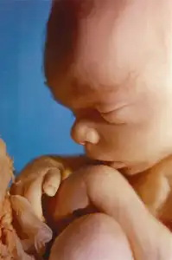
Do Not Kill the Innocent and Righteous
Credit: National Right to Life
biblestudylessons.com

Slide 3

Legalizing Abortion Is:
Anti Life
Exodus 23:7 - Do not kill the innocent and righteous.
Proverbs 6:16,17 – God hates hands that shed innocent blood.
Deuteronomy 27:25 – Cursed is the one who takes a bribe to slay an innocent person.
Genesis 9:2-6 – People may kill plants and animals but must not shed man's blood.

Slide 4
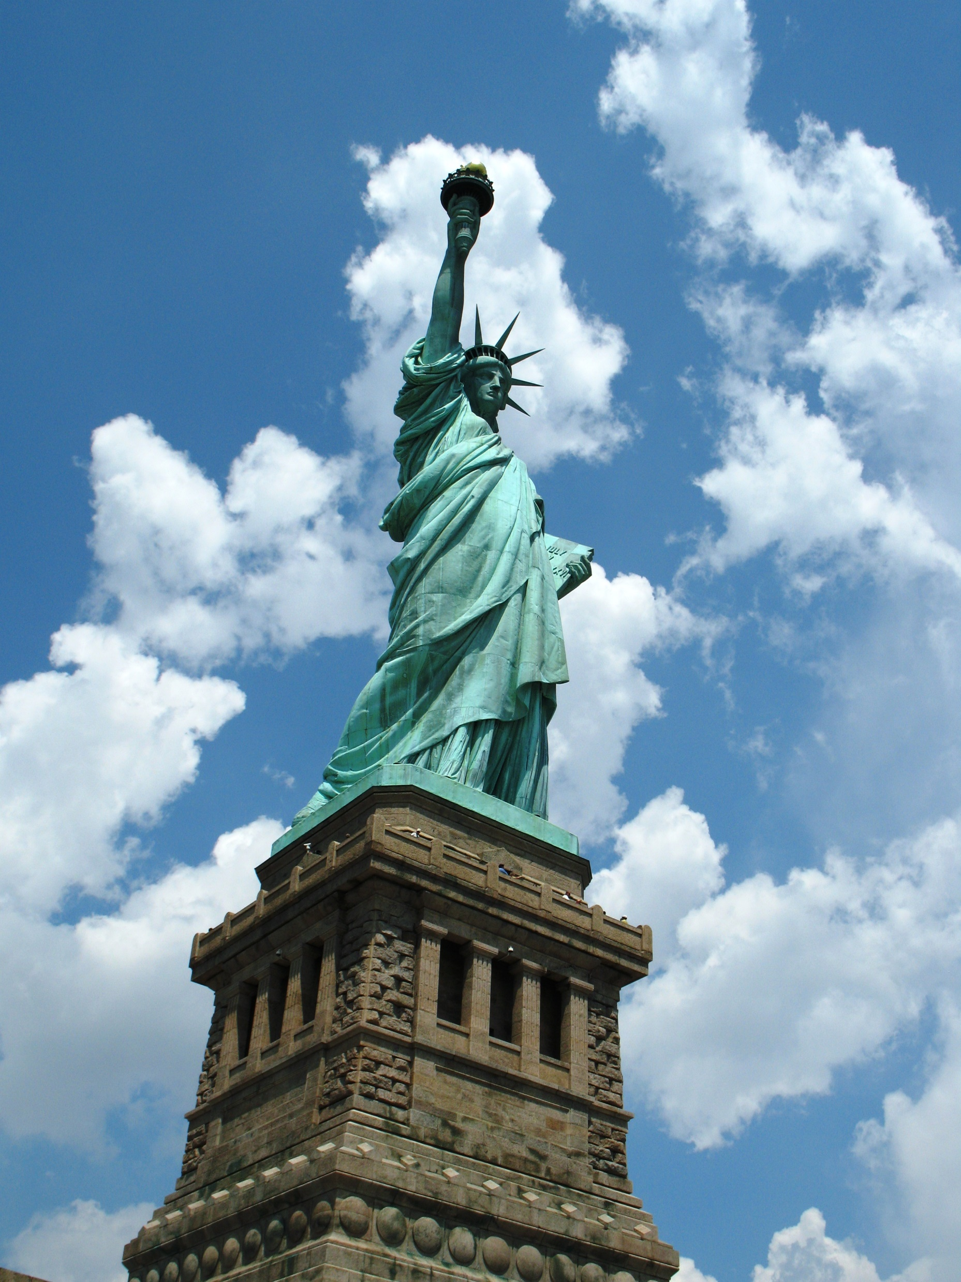
Legalizing Abortion Is:
Anti Life
Anti Government
1 Peter 2:13,14 – Rulers are sent by God for the punishment of evildoers and for the praise of those who do good.
Romans 13:1-4 – The authorities are appointed by God. … For he is God's minister to you for good … an avenger to execute wrath on him who practices evil.

Slide 5

Legalizing Abortion Is:
Anti Life
Anti Government
Anti Mother
Luke 1:43 – A woman who has conceived is a “mother” even before childbirth.
Titus 2:4 – Women should learn to love their children.
Romans 1:31,32; 2 Timothy 3:3 – God opposes those “without natural affection.”

Slide 6

Legalizing Abortion Is:
Anti Life
Anti Government
Anti Mother
Anti Father
Psalm 127:3-5; 128:3-5 – Fathers should appreciate children as a heritage and reward from the Lord.
1 Timothy 5:8 – Fathers should provide for their own. If not, they are worse than unbelievers.
Ephesians 6:4 – Fathers should raise their children in the training and admonition of the Lord.

Slide 7
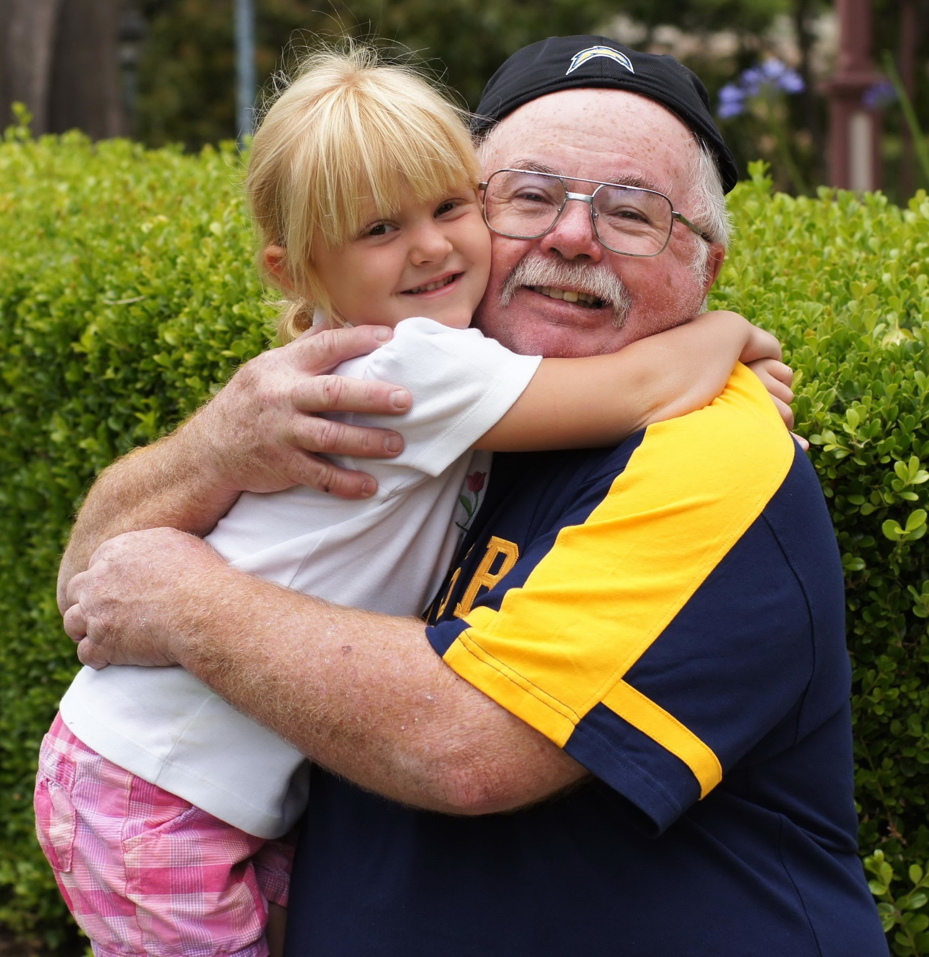
Legalizing Abortion Is:
Anti Life
Anti Government
Anti Mother
Anti Father
Anti Parent
Ephesians 6:1-3 – A minor daughter should honor and obey her parents.

Slide 8

Legalizing Abortion Is:
Anti Life
Anti Government
Anti Mother
Anti Father
Anti Parent
Anti Child
“Children” in the womb – Genesis 25:21,22
A “man child” is conceived – Job 3:3
“Infants” that never saw light – Job 3:16
A “baby” in the womb – Luke 1:41,44
A woman conceived a “son” – Luke 1:36
Luke 1:36 – Elizabeth conceived a son
Luke 1:57 – Elizabeth brought forth a son

Slide 9

Legalizing Abortion Is:
Anti Life
Anti Government
Anti Mother
Anti Father
Anti Parent
Anti Child
Anti Family
Families should love and care for children, not kill them.

Slide 10

Legalizing Abortion Is:
Anti Life
Anti Government
Anti Mother
Anti Father
Anti Parent
Anti Child
Anti Family
Anti Love
Matthew 22:39 – Second-greatest command is: “You shall love your neighbor as yourself
Romans 13:8-10 – Loving your neighbor means you do not kill or harm him.

Slide 11
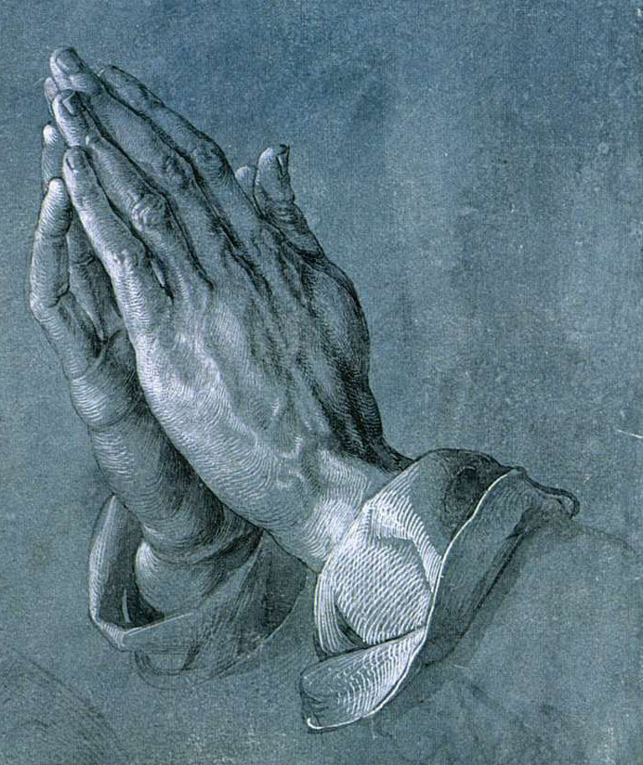
Legalizing Abortion Is:
Anti Life
Anti Government
Anti Mother
Anti Father
Anti Parent
Anti Child
Anti Family
Anti Love
Anti Morality, Anti Religion

Slide 12

Legalizing Abortion Is:
Anti Life
Anti Government
Anti Mother
Anti Father
Anti Parent
Anti Child
Anti Family
Anti Love
Anti Morality, Anti Religion
Anti Bible and Anti God
Acts 17:24; 2 Timothy 3:16; Proverbs 3:5,6; Jeremiah 10:23; Acts 5:29

Slide 13

How to Solve the Abortion Problem
(1) Flee fornication.
(2) Learn to love, appreciate, and care for the baby.
(3) Learn to trust God for the strength to face any hardships life brings.
(4) Help those who have problems caused by the birth of a baby
(5) Speak out in defense of life.
What should a woman do if she has aborted a baby? Ephesians 1:7; Romans 1:16; 6:3,4; 10:9,10; Acts 17:30; 2:38; 22:16; Mark 16:16

Slide 15
© Copyright David E. Pratte, 2023
Permission is granted to display this PowerPoint under the following conditions:
* Display the link to BibleStudyLessons.com
* Minor changes in content are permitted, but no teaching should be presented that disagrees with the teaching in the article associated with this PowerPoint at www.BibleStudyLessons.com/powerpoint
* In no case may a fee of any kind be charged for our PowerPoints.
* If you have a website, please add a link to https://BibleStudyLessons.com
Scripture quotations are generally from the New King James Version (NKJV), copyright 1982, 1988 by Thomas Nelson, Inc. Used by permission. All rights reserved.
biblestudylessons.com

