Slide 1

Video Bible Study
presented by
David E. Pratte
www.gospelway.com

Slide 2
The Prophecy of Amos
Thanks to Christians in the Hillcrest church for their participation.
© Copyright David E. Pratte, 2021
Scripture quotations are generally from the New King James Version (NKJV), copyright 1982, 1988 by Thomas Nelson, Inc. used by permission. All rights reserved.

Slide 3
Questions from Bible Study Questions on Hosea, Joel, Amos, Obadiah
Available at
www.biblestudylessons.com/classbooks

Slide 4
Understanding Old Testament prophecy
* The prophets are part of Scripture, and all Scripture is profitable to equip us in our service to God today
– 2 Timothy 3:16,17; Romans 15:4; 1 Corinthians 10:6,11.
* Old Testament history may help us understand the background behind prophets’ teachings.
* The prophets often used symbolic teaching. But that does not give us the right to assign a meaning to the symbols according to our own imagination.
* The prophets often included predictions about the Messiah, His Kingdom, and His message.
* Often New Testament writers give us an inspired explanation.

Slide 5
Periods of Bible history
1. Before the Flood (Creation to the flood)
2. After the Flood (the flood to the call of Abraham)
3. Patriarchs (the call of Abraham to the death of Joseph)
4. Egyptian Bondage (Joseph’s death to crossing Red Sea)
5. Wilderness Wandering (Red Sea to crossing the Jordan)
6. Conquest of Canaan (crossing Jordan to Joshua’s death)
7. Judges (death of Joshua to crowning of King Saul)
8. United Kingdom (crowning of Saul to death of Solomon)
9. Divided Kingdom (death of Solomon to the fall of Israel)
10. Judah Alone (the fall of Israel to the fall of Judah)
11. Babylonian Captivity (fall of Judah to end of captivity)
12. Restoration of Israel (return to the completion of OT)
13. Years of Silence (completion of OT to the birth of Jesus)
14. Life of Christ (from the birth of Jesus to His ascension)
15. Early Church (Jesus’ ascension to the completion of NT)

Slide 6
Prophets by Period
Period of History | Prophets
Divided Kingdom | Israel: Jonah Amos Hosea | Judah: Obadiah (?) Joel (?) Isaiah Micah
Judah Alone | Jeremiah (Lamentations) Zephaniah Nahum (?) Habakkuk (?)
Babylonian Captivity | Ezekiel Daniel
Return from Captivity | Haggai Zechariah Malachi

Slide 7
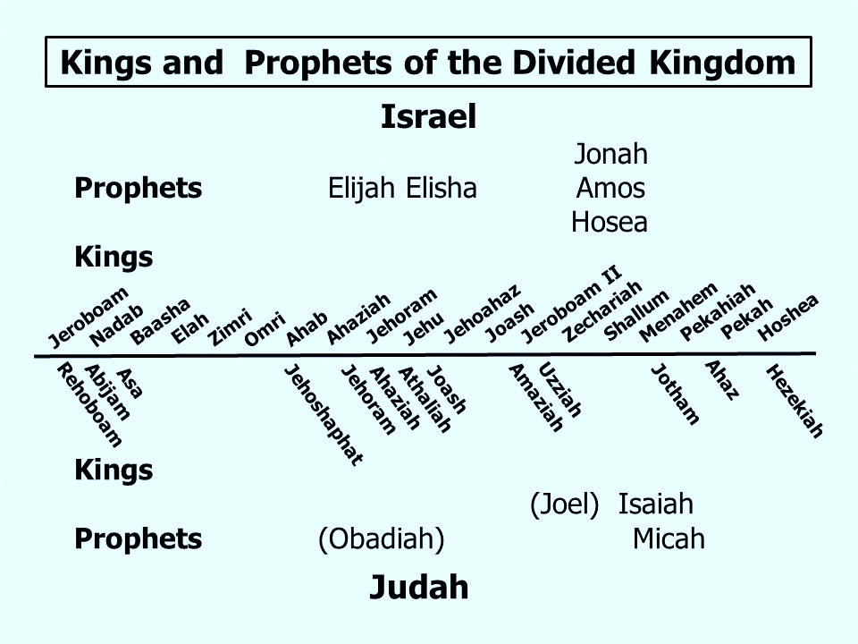

Slide 8
Themes of the Minor Prophets
Hosea – Israel’s unfaithfulness compared to Hosea’s wife
Joel – Locust plague shows Israel’s need to repent
Amos – Israel would go into captivity because of sins like those of the surrounding nations
Obadiah – Fall of Edom for rejoicing in Judah’s affliction
Jonah – God uses a fish and a plant to teach Jonah His concern for the salvation of Nineveh and all people
Micah – God puts Israel and Judah on trial for their sins.
Nahum – Prophecy of the fall of Nineveh
Habakkuk – Habakkuk questions God’s punishments
Zephaniah – God’s wrath is coming against Jerusalem and surrounding nations, but a remnant will be spared.
Haggai – Returning Jews should rebuild the temple
Zechariah – The future glory of God’s people
Malachi – Spiritual restoration among the returned Jews

Slide 9
Theme and Major Divisions of Amos
Theme: Amos predicts that Israel would go into captivity because of idolatry, materialism, spiritual indifference, and sins like those of the surrounding nations.
Major divisions
Chapters 1,2 – Condemnation of Israel and surrounding nations
Chapters 3-6 – Description of Israel’s sins
7:1-9:10 – Visions of impending doom
9:11-15 – Promise of future hope

Slide 10
Reasons for the Downfall of Israel – 2 Kings 17
* 17:7,8,11,12 – They served other gods like the nations God cast out of Canaan (compare verses 15-17,21-23).
* 17:13,14 – They refused to listen to the prophets God sent to warn them.
* 17:15 – They rejected God’s commands and covenant and testimonies.
* 17:17 – They caused their sons and daughters to pass through the fire.
* 17:17 – They practiced witchcraft and soothsaying.

Slide 11
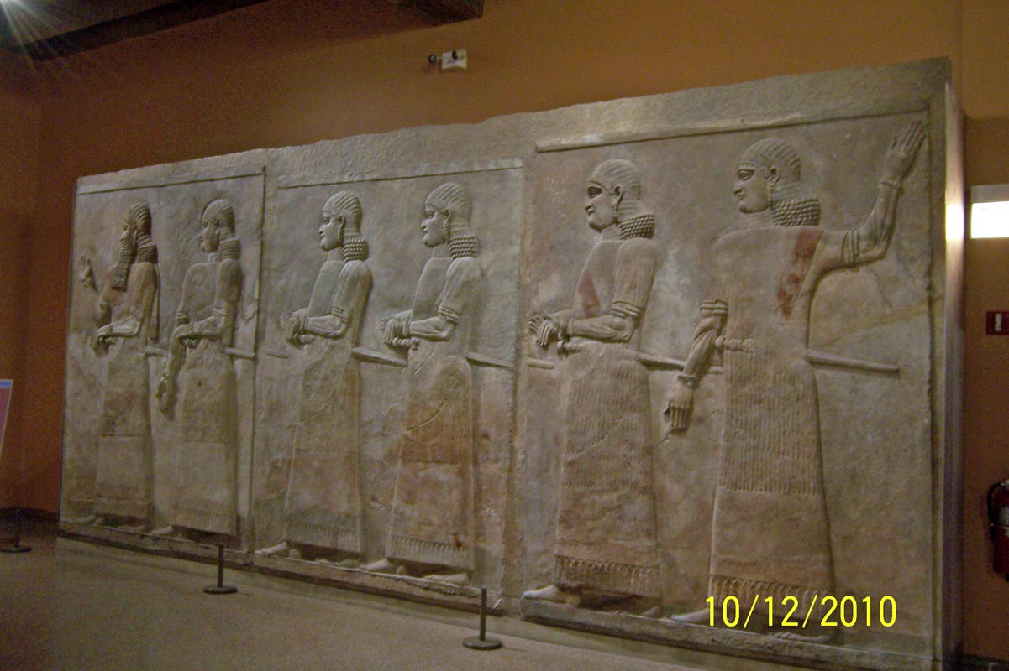
Relief Carvings from the Palace of King Sargon of Assyria
Oriental Institute

Slide 12
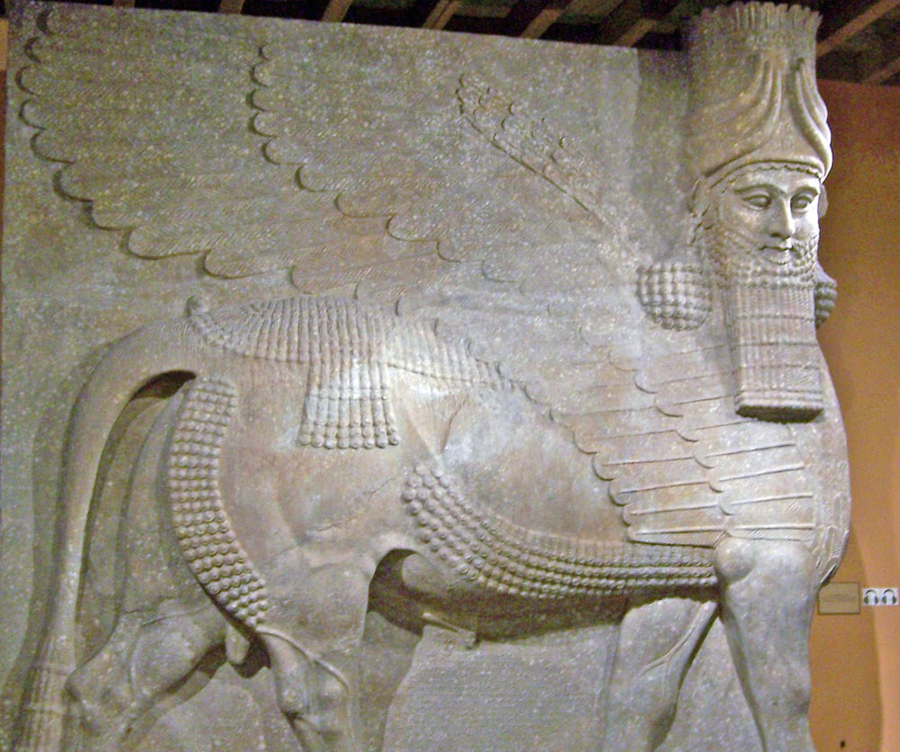
Winged Bull from the Palace of King Sargon of Assyria
Oriental Institute

Slide 13
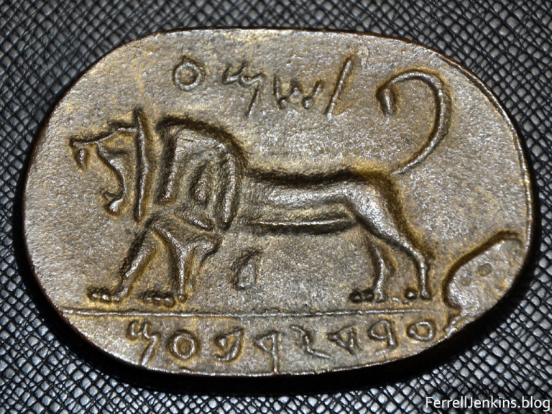
Megiddo Seal: “(belonging) to Shema, Servant of Jeroboam.”
Photo credit: Ferrell Jenkins
ferrelljenkins.blog/2018/07/15/the-shema-seal-from-megiddo/

Slide 14
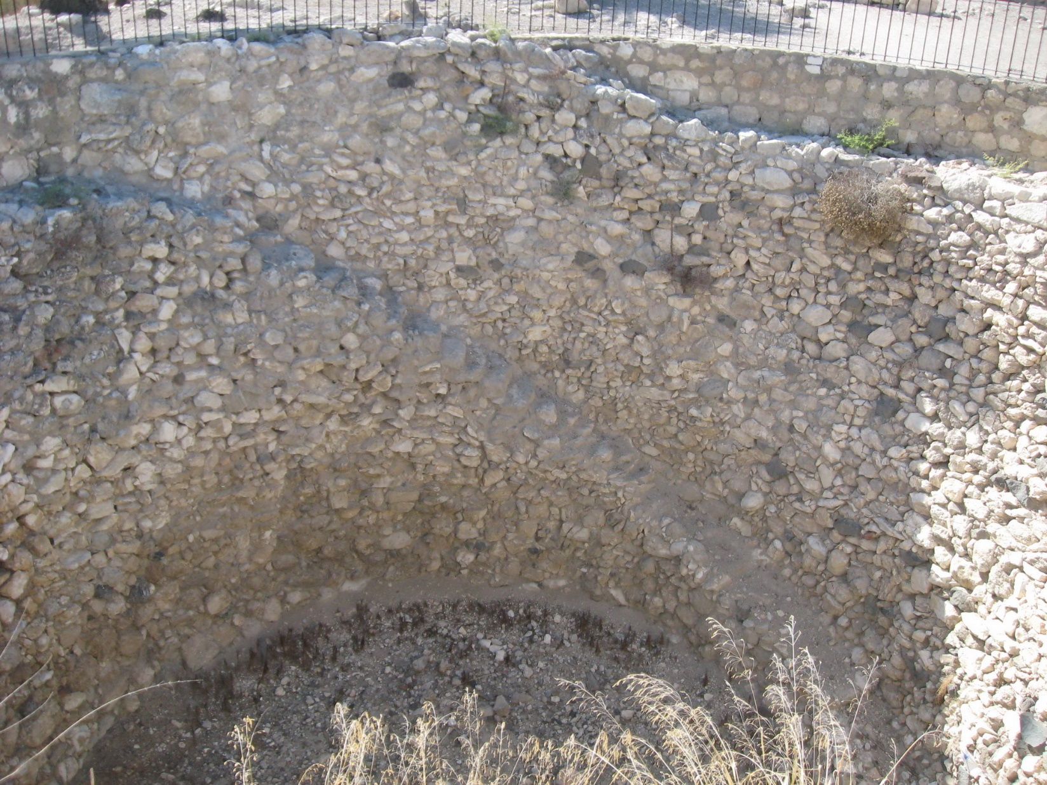
Grain Silo from Megiddo Dated to Jeroboam II’s reign
Photo credit: Acer11, CC BY-SA 3.0 <https://creativecommons.org/licenses/by-sa/3.0>, via Wikimedia Commons

Slide 15
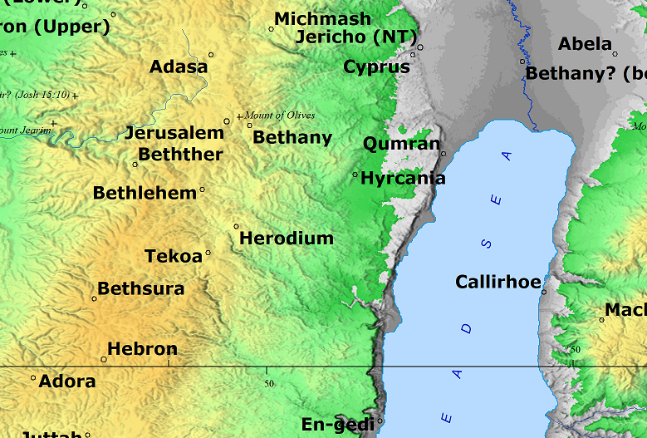
Tekoa
Bible Mapper 5.0

Slide 16
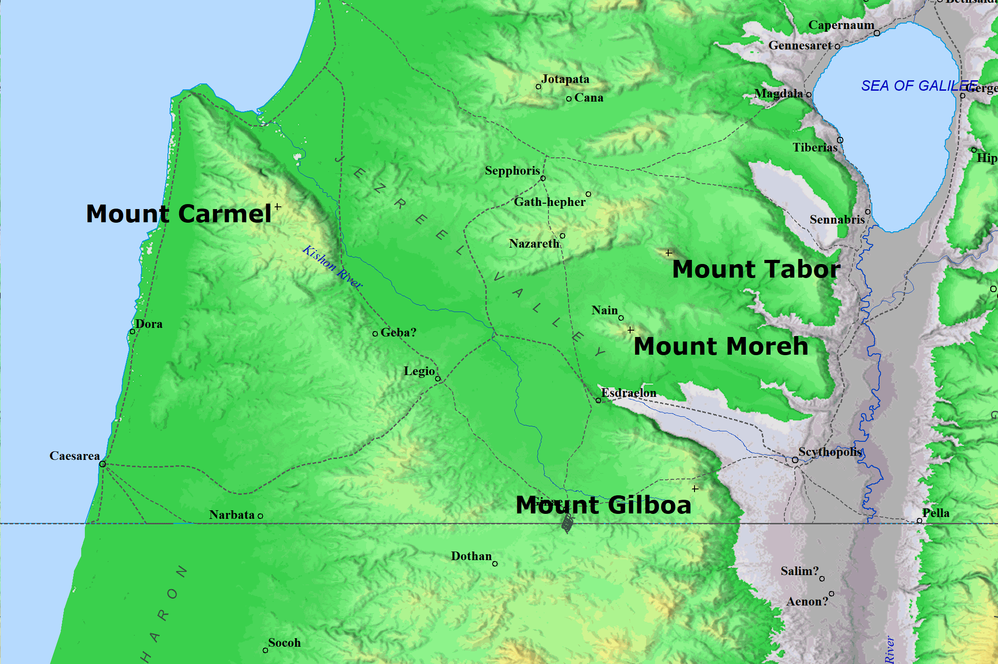
Mount Carmel
Bible Mapper 5.0

Slide 17
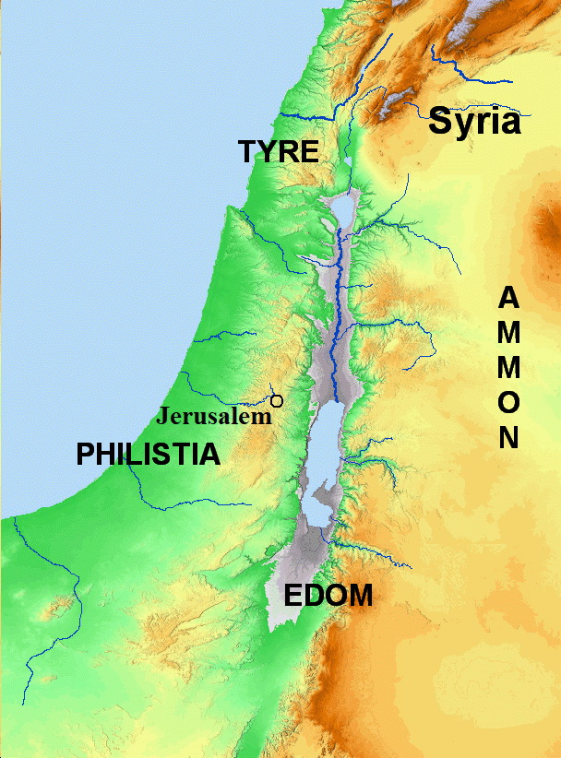
Nations around Israel –
Amos 1
Bible Mapper 5.0

Slide 18
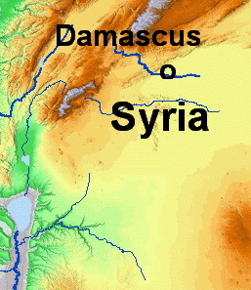
Damascus in Syria
Bible Mapper 5.0

Slide 19
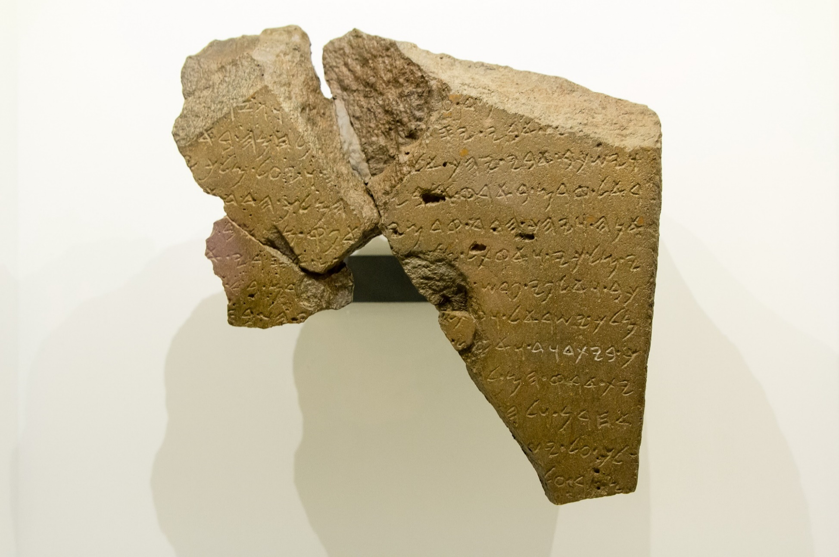
Tel Dan Steele mentions the dynasty of David
Photo credit: Oren Rozen, CC BY-SA 4.0 <https://creativecommons.org/licenses/by-sa/4.0>, via Wikimedia Commons

Slide 20
Nations around Israel
Bible Mapper 5.0

Slide 21
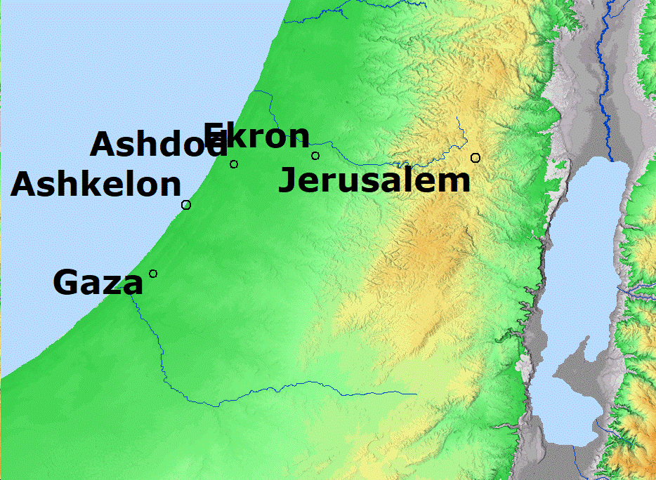
Cities of the Philistines
Bible Mapper 5.0

Slide 22
Nations around Israel
Bible Mapper 5.0

Slide 23
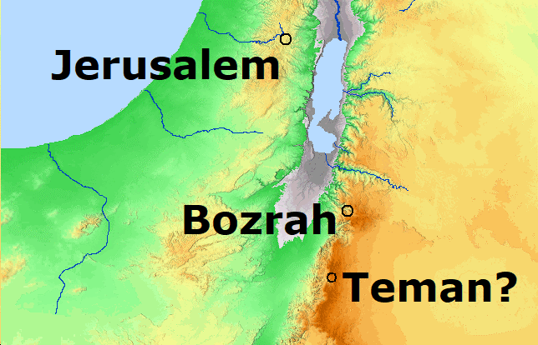
Cities of Edom
Bible Mapper 5.0

Slide 24
Nations around Israel
Bible Mapper 5.0

Slide 25
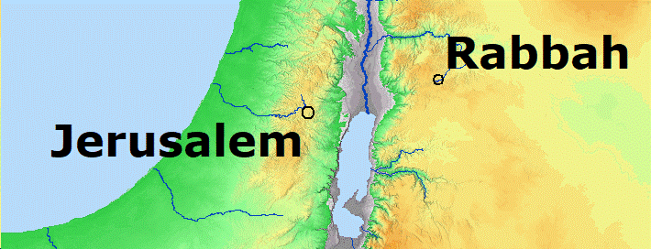
Rabbah in Ammon
Bible Mapper 5.0

Slide 26
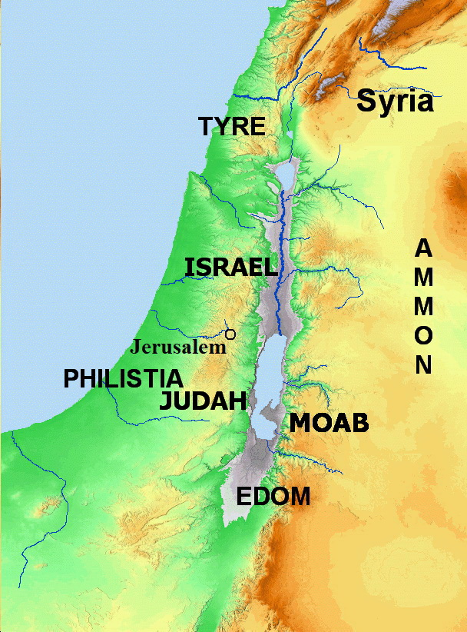
Nations around Israel
Bible Mapper 5.0

Slide 27
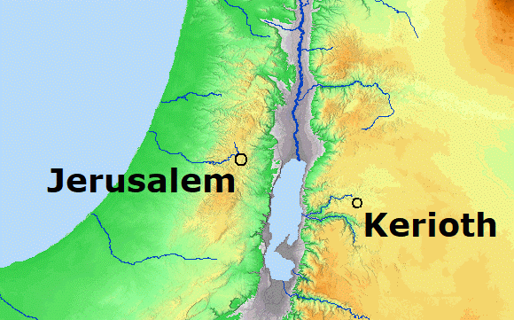
Kerioth
In Moab
Bible Mapper 5.0

Slide 28
Nations around Israel
Bible Mapper 5.0

Slide 29
Lessons Learned about God and the Nations
* God rules over all the nations.
* God knows the conduct of all nations.
* God warns nations to turn from sin.
* Persistence in evil eventually leads to decline and fall.
* Nations that claim to serve God are no exception.

Slide 30
Nations around Israel
Bible Mapper 5.0

Slide 31
Sins of Israel – Amos 2:6-8,12
Sell the righteous for silver and the poor for a pair of sandals
Pant after the dust of the earth on the head of the poor
Pervert the way of the humble
Man and his father go in to the same girl
Lie down by every altar on clothes taken in pledge
Drink the wine of the condemned in the house of their god
Gave the Nazirites wine to drink
Commanded the prophets to not prophesy

Slide 32
A lion has roared! Who will not fear? God has spoken! Who can but prophesy? – Amos 3:1-8
“I will punish you for all your iniquities.”
* Can two walk together, unless they are agreed?
* Will a lion roar in the forest, when he has no prey?
* Will a young lion cry, if he has caught nothing?
* Will a bird fall into a snare, where there is no trap?
* Will a snare spring up, if it has caught nothing?
* If a trumpet is blown, will not the people be afraid?
* If there is calamity, will not the LORD have done it?
* The Lord does nothing, unless He reveals His secret to His servants the prophets.

Slide 33
They Do Not Know to Do Right - Amos 3:9-15
“See great tumults in her midst, violence and robbery”
Consequences
3:11 – Surrounded by an adversary
Palaces plundered
3:12 – Just a small remnant remains
3:14 – Altars destroyed
3:15 – Houses perish

Slide 34
Prepare to Meet Your God - Amos 4
Sins of Israel
Oppress the poor and needy – verse 1
Emphasize luxury and pleasure - verse 1
False worship (idolatry) – verse 4,5
God’s Warnings to Repent
Famine – verse 6
Drought – verses 7,8
Blight, mildew, and locusts – verse 9
Plagues and military defeat – verse 10
Overthrown cities – verse 11

Slide 35
Lamentation against Israel - Amos 5
Israel has fallen and will rise no more – verse 2
A thousand has a hundred left; a hundred has ten – verse 3
Bethel and Gilgal captured so nothing is left – verse 5
Justice to wormwood, righteousness laid to rest – verse 7
God controls the stars, day and night, and seas – verse 8
They hated rebuke and upright speech – verse 10
Mistreated the poor/afflicted the just/bribes – verses 11,12
Solution: seek good, not evil; establish justice – verses 14,15
Alternative: Punishment and grief – verses 16,17
Do not desire a day of the Lord – verses 18-20
Worship not accepted from impenitent sinners – verses 21-23
Justice and righteousness or captivity – verses 24-27

Slide 36
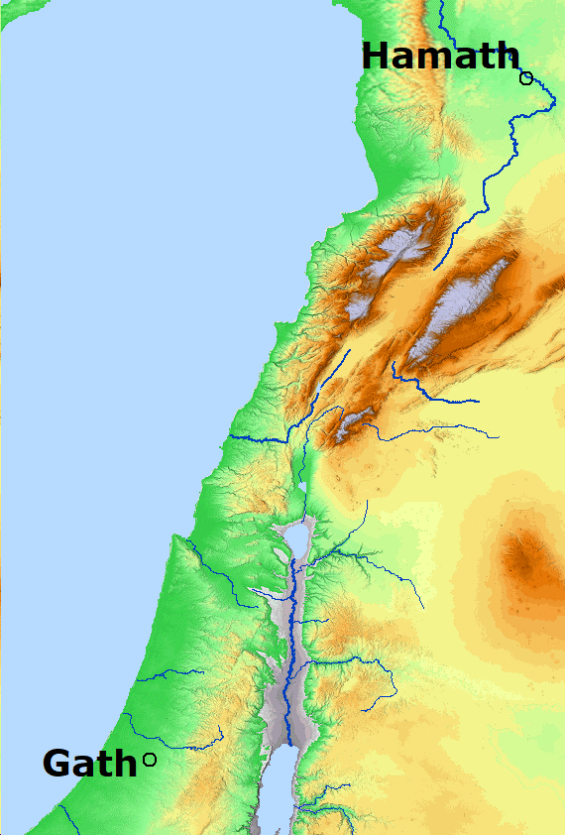
Hamath
and
Gath
Bible Mapper 5.0

Slide 37
Woe to Those at Ease in Zion - Amos 6
Conduct of the people
Put far off the day of doom – verse 3
Lie on beds of ivory; eat lambs & calves – verse 4
Sing to instruments; invent instruments like David – verse 5
Drink wine; anoint selves – verse 6
Not grieved for affliction of Joseph – verse 6
Consequences
First of the captives - verse 7
God will deliver up the city and all in it – verse 8
Everyone in the house will die – verse 9,10
Houses destroyed – verse 11

Slide 38
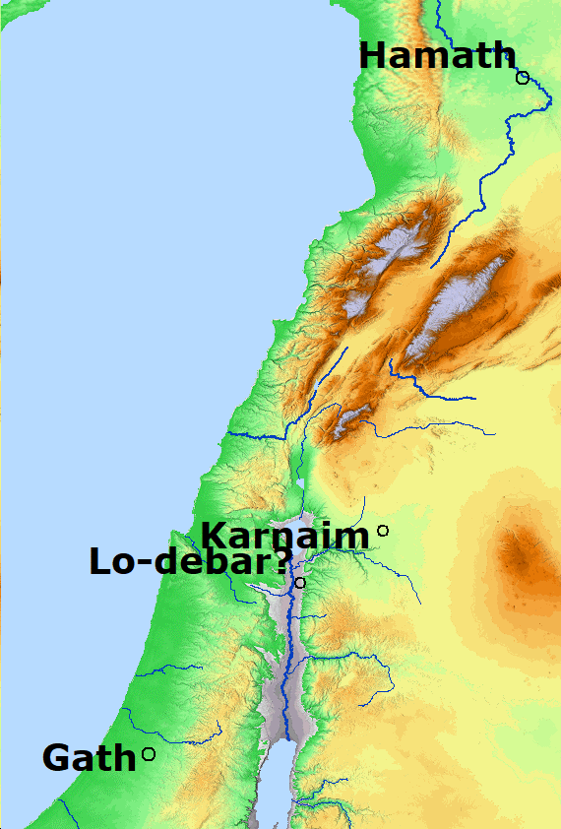
LoDebar
And
Karnaim
Bible Mapper 5.0

Slide 39
Woe to Those at Ease in Zion - Amos 6
Conduct of the people
Put far off the day of doom – verse 3
Lie on beds of ivory; eat lambs & calves – verse 4
Sing to instruments; invent instruments like David – verse 5
Drink wine; anoint selves – verse 6
Not grieved for affliction of Joseph – verse 6
Consequences
First of the captives - verse 7
God will deliver up the city and all in it – verse 8
Everyone in the house will die – verse 9,10
Houses destroyed – verse 11
Nation will afflict them from Hamath to Arabah – verse 14

Slide 40
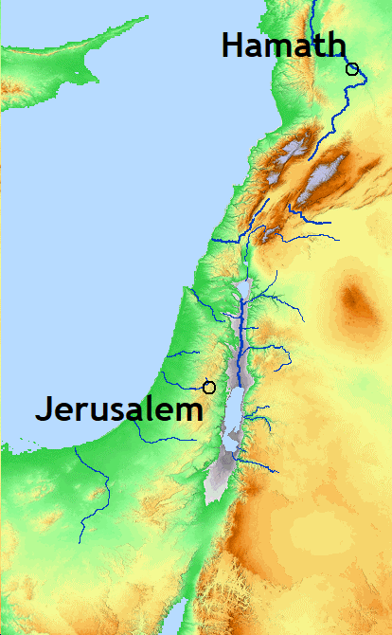
Hamath
to the
Valley of the Arabah
Bible Mapper 5.0
Arabah Valley

Slide 41
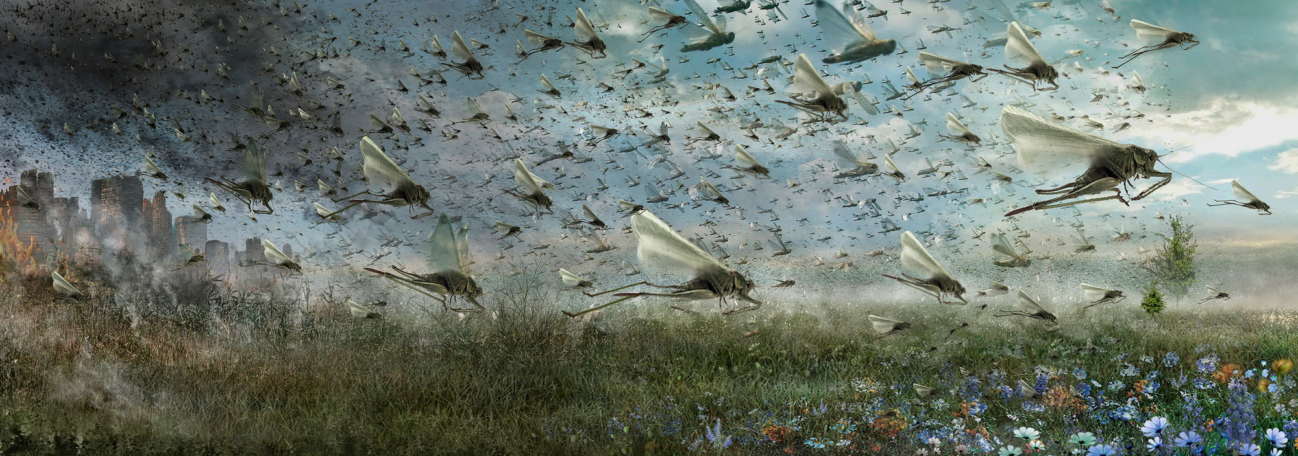
Visions of Impending Doom – Chap 7-9
Swarm of locusts

Slide 42
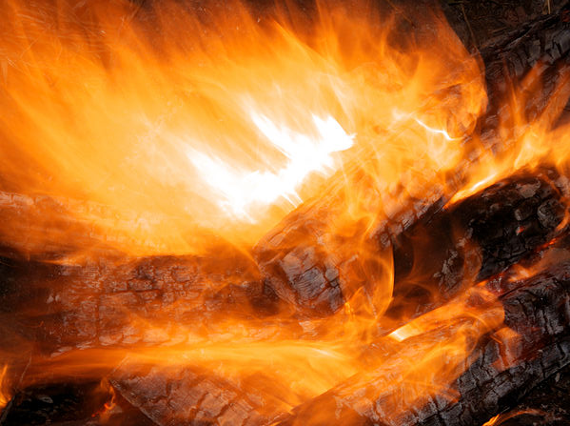
Visions of Impending Doom – Chap 7-9
Swarm of locusts
Consuming fire

Slide 43
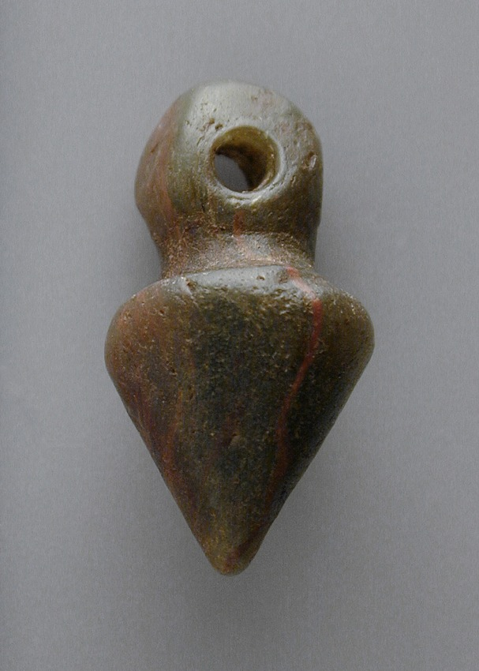
Visions of Impending Doom – Chap 7-9
Swarm of locusts
Consuming fire
Plumb line

Slide 44

Visions of Impending Doom – Chap 7-9
Swarm of locusts
Consuming fire
Plumb line
Basket of Summer Fruit

Slide 45
I Will Not Pass Them by Any More – Amos 8
Sins of the People
Mistreatment of the poor
Worship an outward ritual to be tolerated
Dishonest business practices
Consequences
God will not forget their works
Earthquake, flood, darkness
Famine of revelation and guidance from God
They shall fall and never rise again

Slide 46
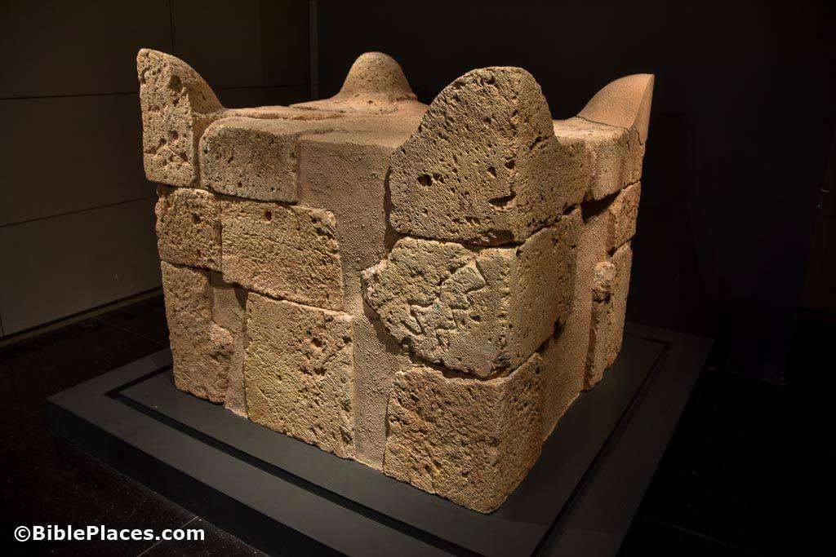
Visions of Impending Doom – Chap 7-9
Swarm of locusts
Consuming fire
Plumb line
Basket of Summer Fruit
The Lord Beside the Altar

Slide 47
I Will Raise Up the Tabernacle of David - Chapter 9
Destruction on the People
God would destroy the altar and temple
No one would escape
Israel was like surrounding nations
They would be destroyed but Jacob would not be
Israel would be sifted like grain in a sieve
Promise of Future Hope
God will rebuild the tabernacle of David
Gentiles would be called by the name of God
Captives of Israel would return to the land

Slide 48
Lessons Taught in the Book of Amos
* God’s people must seek first His service, not personal gain and pleasure.
* God demands justice and righteousness, including concern for the poor and needy.
* God will cause evil nations to decline and fall.
* Faithful teachers must warn about sin and its consequences.
* God calls people to repent before destruction.
* A remnant may give heed to the warning.
* Punishment comes in God's time and God's way.
* Teachers should not take personally the rejection of their message.

Slide 49
© Copyright David E. Pratte, 2021
Permission is granted to display this PowerPoint under the following conditions:
* Display the link to www.BibleStudyLessons.com
* Minor changes in content are permitted, but no teaching should be presented that disagrees with the teaching in the article associated with this PowerPoint on www.BibleStudyLessons.com/powerpoint
* In no case may a fee of any kind be charged for our PowerPoints.
* If you have a website, please add a link to www.BibleStudyLessons.com
Scripture quotations are generally from the New King James Version (NKJV), copyright 1982, 1988 by Thomas Nelson, Inc. Used by permission. All rights reserved.
www.BibleStudyLessons.com

