Slide 2
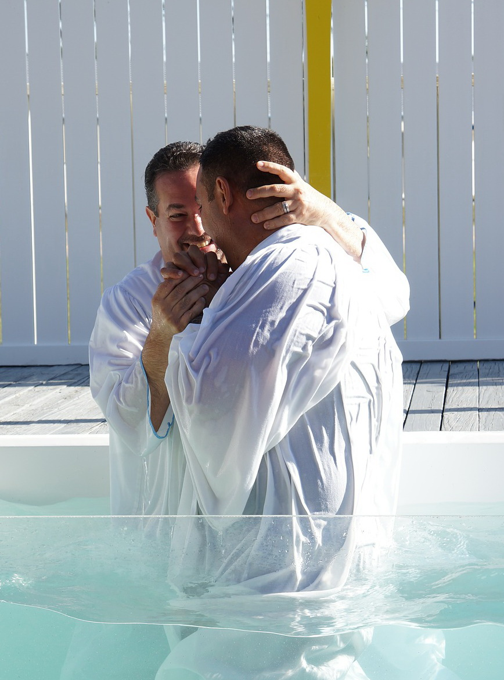
What Is Proper (Scriptural) Baptism?
Acts 19:3-5
Proper Baptism Requires:
Conditions Before Baptism
www.BibleStudyLessons.com

Slide 3
Proper Conditions before Baptism
    Before Baptism One Must:
    Hear and Understand the Gospel
    Mark 16:15,16; John 6:44,45; Acts 2:36,41
    Believe the Gospel
    Mark 16:15,16; Galatians 3:26,27; Acts 8:12; James 2:24
    Repent of Sins
    Acts 2:38; 26:20
    Confess Christ
    Romans 10:9,10; Acts 8:35-39

Slide 4
What Is Proper (Scriptural) Baptism?
Acts 19:3-5
Proper Baptism Requires:
Conditions Before Baptism
Proper Action

Slide 5
Proper Baptism Requires Proper Action
Water
Acts 10:47
Much Water
John 3:23
    Going Down into the Water
    Acts 8:38
    Coming Up Out of the Water
    Acts 8:39; Mark 1:9,10
    A Burial
    Colossians 2:12; Romans 6:4
    A Resurrection
    Colossians 2:12; Romans 6:4
    Washing the Body
    Hebrews 10:22 (2 Kings 5:10-14)

Slide 6
What Is Proper (Scriptural) Baptism?
Acts 19:3-5
Proper Baptism Requires:
Conditions Before Baptism
Proper Action
Proper Purpose

Slide 7
Proper Purpose
Purpose for Baptism Must Be:
Romans 6:17,18; Acts 2:40,41
Mark 16:16 - saved
Acts 2:38 – remission of sins
Acts 22:16 –wash away sins
Romans 6:3; Galatians 3:27 – come into Christ, into His death
1 Peter 3:21 – saved
John 3:3,5 – Born again and enter the kingdom

Slide 8
What Is Proper (Scriptural) Baptism?
Acts 19:3-5
Proper Baptism Requires:
Conditions Before Baptism
Proper Action
Proper Purpose
Dedication to Faithful Living

Slide 9
Proper Dedication to a Faithful Life
Put God First in Life
Romans 6:3,4,11-18; 12:1,2; 1 Corinthians 15:58; Matthew 28:19,20; 6:33
Fulfill Church Responsibilities
John 3:3,5; Acts 2:38,41,47
Worship God
Acts 2:38,41,42; 1 Corinthians 10:16,17; 11:23-29
Repent and Pray for Forgiveness
1 John 1:8-10; Acts 8:22

Slide 10
What Is Proper (Scriptural) Baptism?
Acts 19:3-5
Proper Baptism Requires:
Conditions Before Baptism
Proper Action
Proper Purpose
Dedication to Faithful Living
Have you been properly baptized?

Slide 11
Have You Been Properly Baptized?
What about?
* Those who were baptized as a baby or otherwise did not properly understand and believe the gospel?
* Those who were “baptized” by sprinkling or pouring, not by complete immersion in water?
* Those who were “baptized” without understanding that baptism is necessary to receive forgiveness?
* Those who did not truly repent and dedicate themselves to putting God first for life?

Slide 12
© Copyright David E. Pratte, 2022
Permission is granted to display this PowerPoint under the following conditions:
* Display the link to www.BibleStudyLessons.com
* Minor changes in content are permitted, but no teaching should be presented that disagrees with the teaching in the article associated with this PowerPoint at www.BibleStudyLessons.com/powerpoint
* In no case may a fee of any kind be charged for our PowerPoints.
* If you have a website, please add a link to www.BibleStudyLessons.com
Scripture quotations are generally from the New King James Version (NKJV), copyright 1982, 1988 by Thomas Nelson, Inc. Used by permission. All rights reserved.
www.BibleStudyLessons.com

