Slide 2
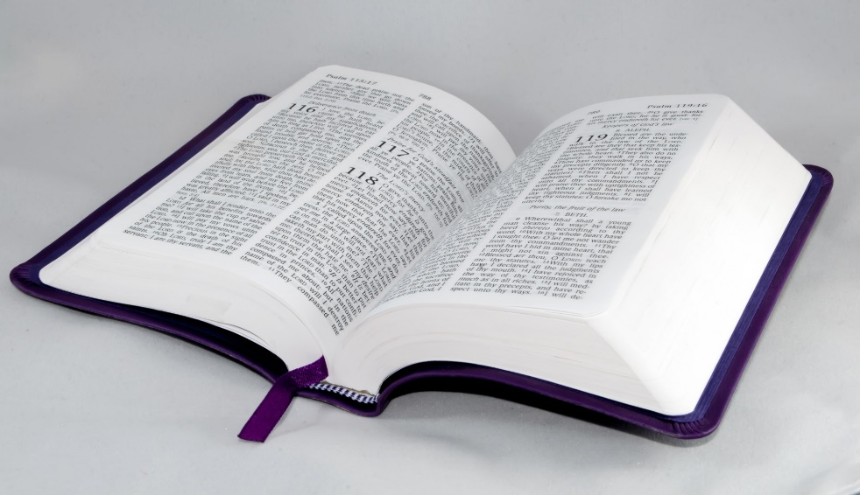
How to Validate a Will
Last Will
and Testament
of ...
Invalid Methods
Outside Evidence
Internal Evidence
www.BibleStudyLessons.com

Slide 3
Invalid Tests
Personal Feelings
Jeremiah 17:9; Proverbs 28:26

Slide 4
Invalid Tests
Personal Feelings
Majority Opinion
Romans 12:2; 2 Corinthians 10:12,18

Slide 5
Invalid Tests
Personal Feelings
Majority Opinion
Family Belief
Matthew 10:35-37; Galatians 1:11-14

Slide 6
Invalid Tests
Personal Feelings
Majority Opinion
Family Belief
Personal Experience/Satisfaction
2 Corinthians 5:7; Hebrews 11:1

Slide 7
Invalid Tests
Personal Feelings
Majority Opinion
Family Belief
Personal Experience/Satisfaction
Personal Agreement/Understanding
Isaiah 55:8,9; Luke 16:15; 1 Corinthians 1:18-25

Slide 8
How to Validate a Will
Last Will
and Testament
of ...
Invalid Methods
Outside Evidence
Internal Evidence
www.BibleStudyLessons.com

Slide 9
External Evidence
External Evidence Helps Confirm Scripture.
Archaeology, secular history, geography, and science are helpful.
But such evidence will never confirm all Bible statements.
When outside evidence appears to conflict, the Bible is still true!
Internal Evidence Is Primary and Sufficient.
Romans 10:17 – Faith comes by hearing, and hearing by the word of God.
John 20:30,31 – Bible writers wrote sufficient evidence to convince us to believe
2 Timothy 3:16,17 – Scripture is sufficient to provide us to every good work.

Slide 10
How to Validate a Will
Last Will
and Testament
of ...
Invalid Methods
Outside Evidence
Internal Evidence
www.BibleStudyLessons.com

Slide 11
Internal Evidence: The Primary Tests
Claims
2 Timothy 3:16; 2 Peter 1:20,21; 1 Corinthians 14:37

Slide 12
Internal Evidence: The Primary Tests
Claims
Testimony of Witnesses
(John 8:17; Matthew 18:16; 2 Corinthians 13:1;
1 Timothy 5:19; Hebrews 10:28; Deuteronomy 19:15)
John 20:30,31; 21:24; 1 John 1:1-3; 2 Peter 1:16-18;
1 Corinthians 15:3-8

Slide 13
Internal Evidence: The Primary Tests
Claims
Testimony of Witnesses
Unique Internal Authentication
Fulfilled Prophecy
Isaiah 42:8,9; 41:21-23; 46:9,10; Jeremiah 28:9; John 13:19; 14:29
Miracles
Mark 16:20; Acts 14:3; Hebrews 2:3,4
Jesus’ resurrection
John 20:30,31; Romans 1:4

Slide 15
God’s Signature on Scripture:
Fulfilled Prophecy
Isaiah 42:8,9; 41:21-23; 46:8-11; Deuteronomy 18:21,22; Jeremiah 28:9; John 13:19; 14:29

Slide 16
God’s Signature on Scripture:
Fulfilled Prophecy
Prophecies Concerning Israel
Genesis 26:3,4; 28:13,14; 22:17; 12:7 – Abraham’s descendants would become a great nation and receive the land of Canaan.
Deuteronomy 28:15-64; 30:1-5 – Moses warned Israel that, if they disobeyed God, they would be taken captive to foreign lands.
Deuteronomy 30:1-5; Jeremiah 25:11,12; 29:10-14 – They would not be completely consumed but would return from captivity (70 years)
Isaiah 44:24-45:7 – Isaiah named Cyrus, who would allow God’s people to return and rebuild Jerusalem.

Slide 17
God’s Signature on Scripture:
Fulfilled Prophecy
Prophecies about Other Nations/Cities
Tyre would be completed destroyed and thrown into the sea – Ezekiel 26:3-14.
Sidon would suffer attack and defeat, but permanent destruction was not predicted - Ezekiel 28:22,23.
Nineveh would be destroyed and become a desolate wilderness – Zephaniah 2:13-15
Babylon would be destroyed and never inhabited from generation to generation - Isaiah 13:17-21
Note Jeremiah 30:10,11; 46:28 - God would make a full end of the nations where the Jews were driven (Assyria and Babylon), but would not make a full end of the Jews.

Slide 18
God’s Signature on Scripture:
Fulfilled Prophecy
Prophecies about Jesus
Birth in Bethlehem - Micah 5:2 (Matthew 2:1-6)
Virgin birth - Isaiah 7:14 (Matt. 1:18-25; Luke 1:26-38)
Prophet like Moses – Deut. 18:18,19 (Acts 3:20-23; 7:37)
Both priest and king - Psalms 110:1-4; Zechariah 6:12,13 (Acts 2:32-36; Hebrews 7:17; 8:1)
Rejection and death - Psalm 118:22,23; Isaiah 53:1-12; Zechariah 13:7 (John 2:19-22; Matthew 16:21,22; 20:18,19; Mark 14:27-31; John 13:21-30)
Details of the crucifixion - Psalms 22:16-18; 34:20 (John 19:18,23,24,31-37)
Death for the guilt of others - Isaiah 53:4-12 (1 Peter 2:21-25; Matthew 20:28; 26:28; 2 Corinthians 5:21)
Resurrection - Psalms 16:10 (Acts 2:24-32; 13:34-37)

Slide 19
God’s Signature on Scripture:
Miracles and the Resurrection
Purposes of Miracles
Exodus 14:30,31 — Moses
Joshua 3:7-17 – Joshua
1 Kings 18:36-39 – Elijah
Mark 16:20 — Signs confirmed the word
Acts 14:3 — God bore witness by signs and wonders
2 Corinthians 12:11,12 — Miracles confirmed apostleship
Hebrews 2:3,4 — God bore witness by signs, wonders
Jesus’ Resurrection Proves He is:
Christ, the Son of God - John 20:24-31; Romans 1:4
Lord and Christ - Acts 2:32-36; Acts 17:3; Romans 14:9; Ephesians 1:20-23
Savior who forgives sins - Acts 13:30-39; Luke 24:46,47
Judge of all mankind - Acts 17:30,31

Slide 20
Proper Methods of Validation
Last Will
and Testament
of ...
Claims
Unique internal authentication
Testimony of Witnesses

Slide 21
Eyewitnesses to Miracles
Moses - Exodus 14:15-18,21-23,26-29
Joshua - Joshua 24:5-7; 3:7-17; chap. 4; 6:1-20
Matthew - Matthew 9:9; 10:1-8; 14:33
Luke - Luke 1:1-4; (Acts 1:1-3)
John - John 20:30,31; 21:24; 1 John 1:1-3
Peter - 2 Peter 1:16-21
Paul - 2 Corinthians 12:11,12

Slide 22
Witnesses to the Resurrection
Mary Magdalene - John 20:11-18; Mark 16:9-11
Other women - Matthew 28:9,10; Mark 16:1ff
Two disciples on the road to Emmaus - Luke 24:13-35; Mark 16:12,13
Peter - Luke 24:34 (1 Cor. 15:5)
All the apostles - Luke 24:36-43; Acts 1:3
Thomas with the apostles - John 20:24-29
James and over 500 brethren at once - 1 Corinthians 15:3-8
Saul - Acts 9:1-9; 22:4-15; 26:9-18; 1 Corinthians 9:1; 15:8,9

Slide 23
Saul’s Testimony to the Resurrection
Acts 9:1-9 - Saul was an enemy of the gospel
Acts 9:3-6; 22:7,8 - At noon on an open highway Jesus appeared to Saul in a bright light
Acts 9:4-6; 22:7,8,10; 26:14-18 – Saul heard and spoke to Jesus
Acts 26:16 – Jesus said He appeared to Saul make him a witness of what he had seen
Acts 9:17; 22:14,15 – Ananias confirmed Jesus appeared to Saul
Acts 9:8,9,18; 22:11-13 - Saul was struck blind till Ananias came and restored his sight
1 Corinthians 15:3-9; 9:1 – Paul lists himself with other people who saw Jesus alive again

Slide 24
Honesty and Integrity of the Witnesses
The witnesses immediately and repeatedly proclaimed their testimony – Acts 1:22; 2:32; 3:15; 4:33; 10:39-41; 13:30-32; 22:14,15; 26:16; 1 Cor. 15:3-8,15. This began, not hundreds of years later, but less than 50 days after the resurrection.
Men throughout the Old and New Testaments suffered and died for their testimony. All the apostles were persecuted and most gave their lives for this testimony.
Yet none ever withdrew it, denied it, or retracted it. That is the supreme proof of integrity.

Slide 25
Proper Methods of Validation
Last Will
and Testament
of ...
Claims
Unique internal authentication
Testimony of Witnesses

Slide 26
© Copyright David E. Pratte, 2020
Permission is granted to display this PowerPoint under the following conditions:
* Display the link to www.BibleStudyLessons.com
* Minor changes in content are permitted, but no teaching should be presented that disagrees with the teaching in the article associated with this PowerPoint on www.BibleStudyLessons.com/powerpoint
* In no case may a fee of any kind be charged for our PowerPoints.
* If you have a website, please add a link to www.BibleStudyLessons.com
Scripture quotations are generally from the New King James Version (NKJV), copyright 1982, 1988 by Thomas Nelson, Inc. Used by permission. All rights reserved.
www.BibleStudyLessons.com

