Slide 2
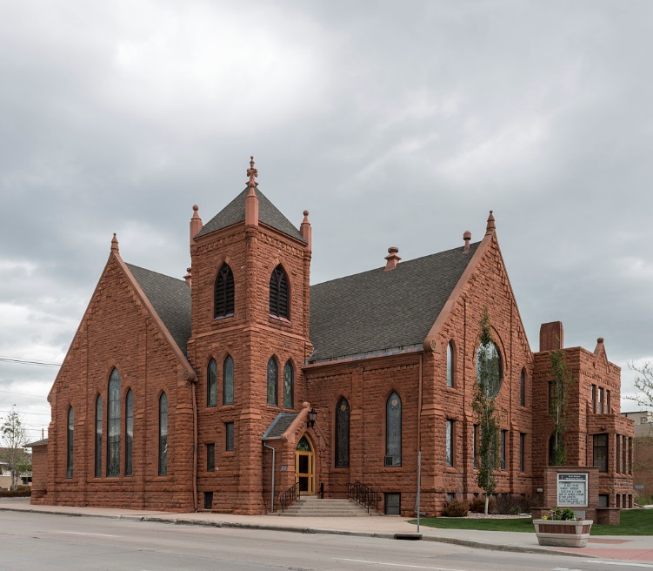
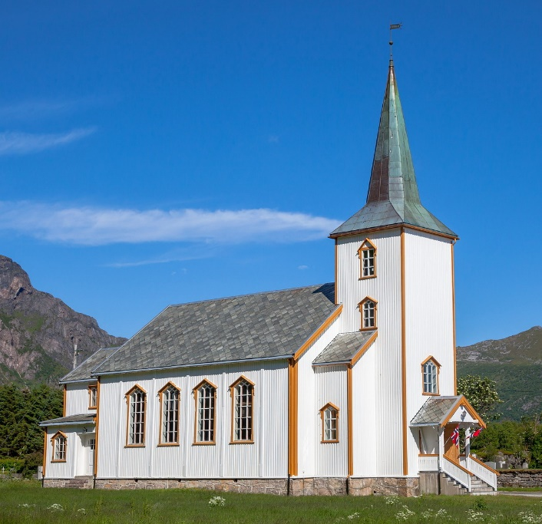
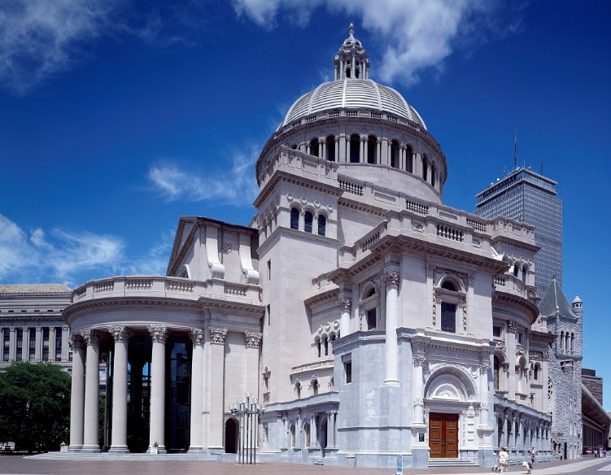
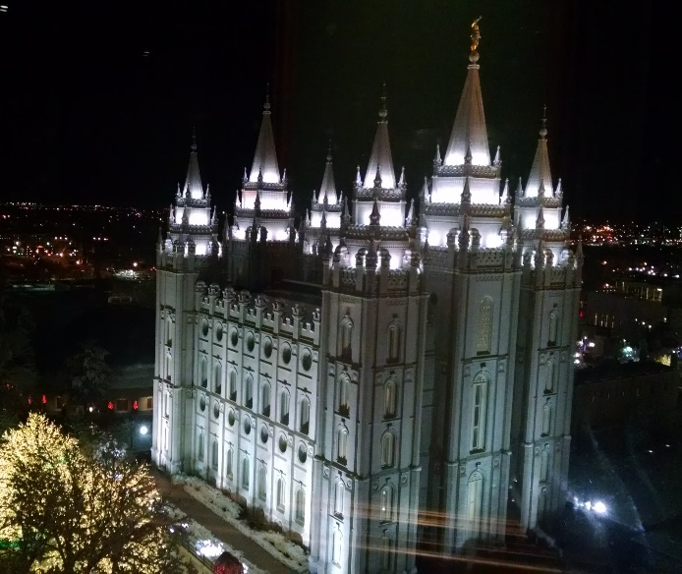
Why So Many Denominations?
biblestudylessons.com

Slide 3
Why So Many Denominations?
Jesus’ Church |  | Denominations
 | Origin
 | Authority
 | Organization

Slide 4
The Origin of Jesus’ Church

Slide 5
The Origin of Jesus’ Church
Prophecy
Daniel 2:31-45 | Roman Empire

Slide 6
The Origin of Jesus’ Church
Prophecy
Daniel 2:31-45 | Roman Empire
Matthew 3:1,2; 10:7; Mark 1:15 | Kingdom at hand

Slide 7
The Origin of Jesus’ Church
Prophecy
Daniel 2:31-45 | Roman Empire
Matthew 3:1,2; 10:7; Mark 1:15 | Kingdom at hand
Matthew 16:18,19 | Jesus the Founder and owner

Slide 8
The Origin of Jesus’ Church
Prophecy
Daniel 2:31-45 | Roman kings
Matthew 3:1,2; 10:7; Mark 1:15 | Kingdom at hand
Matthew 16:18,19 | Jesus the Founder and owner
Mark 9:1 | During apostles’ lives Come with power

Slide 9
The Origin of Jesus’ Church
Prophecy
Daniel 2:31-45 | Roman Empire
Matthew 3:1,2; 10:7; Mark 1:15 | Kingdom at hand
Matthew 16:18,19 | Jesus the Founder and owner
Mark 9:1 | During apostles’ lives Come with power
Acts 1:3-8 | When Spirit came Not many days hence In Jerusalem Apostles bear witness

Slide 10
The Origin of Jesus’ Church
Prophecy | Fulfillment - Acts 2
Daniel 2:31-45 | Roman Empire
Matthew 3:1,2; 10:7; Mark 1:15 | Kingdom at hand
Matthew 16:18,19 | Jesus the Founder and owner
Mark 9:1 | During apostles’ lives Come with power
Acts 1:3-8 | When Spirit came Not many days hence In Jerusalem Apostles bear witness

Slide 11
The Origin of Jesus’ Church
Prophecy | Fulfillment - Acts 2 | Confirmation
Daniel 2:31-45 | Roman Empire | Acts 8:1 Acts 11:22,26 Acts 13:1 Acts 20:28 Colossians 1:13
Matthew 3:1,2; 10:7; Mark 1:15 | Kingdom at hand
Matthew 16:18,19 | Jesus the Founder and owner
Mark 9:1 | During apostles’ lives Come with power
Acts 1:3-8 | When Spirit came Not many days hence In Jerusalem Apostles bear witness

Slide 12
Why So Many Denominations?
Jesus’ Church |  | Denominations
Jerusalem Pentecost Acts 2 | Origin
 | Authority
 | Organization

Slide 13
Jesus’ church: Authority & Organization
Authority
Bible the only authority; No human laws
John 16:13 1 Corinthians 14:37; 2 Timothy 3:16,17
Matthew 15:9,13,14; Galatians 1:8,9; 2 John 9-11
Church Organization
Christ the only Head; no central earthly organization
Ephesians 1:22,23; 5:22-25; Hebrews 8:1
Independent local churches
Acts 14:23; 20:28; 1 Peter 5:1-3

Slide 14
Warnings of Apostasy
Acts 20:28-30; 2 Timothy 4:2-4; 1 Timothy 4:1-3
Why So Many Denominations?
Jesus’ Church |  | Denominations
Jerusalem Pentecost Acts 2 | Origin
Scripture only | Authority
Jesus as Head No earthly headquarters | Organization

Slide 15
Origin of denominations - 1
At the end of the fifth century the Roman Church was completely organized...” (“Canon Law,” Catholic Encyclopedia, vol. IX, p61); http://www.newadvent.org/cathen/09056a.htm (7/2011)
“… Lutheran churches, can trace [their] roots directly to the Protestant Reformation that took place in Europe in the 16th century. Martin Luther, a German monk, became aware of differences between the Bible and church practices of the day. … By the late 1500s the Reformation had spread throughout Europe. Followers of Martin Luther’s teachings were labeled ‘Lutherans’ by their enemies and adopted the name themselves. – Website of the Evangelical Lutheran Church in America, http://www.elca.org/Who-We-Are/History/Lutheran-Roots-in-America.aspx (6/2011)

Slide 16
Origin of denominations - 2
“…in 1533 [Parliament] declared that the Church of England was free and independent, ... and that, so far as the law of Christ allowed, in England the King was the supreme temporal head of the Church” – The Episcopal Church – Its Teachings and Worship, Latta Griswold; Morehouse-Gorham Co., New York, 1917, pages 8-12.
“The origin of all Presbyterian and Reformed churches can be traced back to [John] Calvin’s Geneva. – Website of the American Presbyterian Church: http://www.americanpresbyterianchurch.org/the_church_of_scotland.htm (6/2011)

Slide 17
Origin of denominations - 3
“…there are those who hold that one way or another there has been a continuous line from the days of John the Baptist … But the most widely held view, it would seem, conceded to be supported best by historical research, is that the beginnings were in English Congregationalism in the 17th century … The leader … in Holland was John Smyth … This congregation in Holland in 1609 is widely recognized as the first church formed on basic Baptist principles” – “These Are the Baptists,” Gene Bartlett; Cathedral Publishers, Royal Oak, MI, 1972, p. 3,4.
“This church is a great Protestant body, though it did not come directly out of the Reformation but had its origin within the Church of England. Its founder was John Wesley…” – The Book of Discipline of the United Methodist Church; United Methodist Pub. House, Nashville, 1972, p. 7.

Slide 18
Warnings of Apostasy
Acts 20:28-30; 2 Timothy 4:2-4; 1 Timothy 4:1-3
Why So Many Denominations?
Jesus’ Church |  | Denominations
Jerusalem Pentecost Acts 2 | Origin | Other places Centuries later
Scripture only | Authority
Jesus as Head No earthly headquarters | Organization

Slide 19
Authority of denominations - 1
“We must, therefore, conclude that the Scriptures alone cannot be a sufficient guide and rule of faith … because they are not of themselves clear and intelligible even in matters of the highest importance, and because they do not contain all the truths necessary for salvation” The Faith of Our Fathers, James Cardinal Gibbons, 110th Edition, p. 73.
“Do we get from the Bible alone all our knowledge and certainty about what God has told us? No, there is also Sacred Tradition … Do you have to believe in Tradition? Yes, … we are obliged to accept all the truths contained in the Bible and Tradition…” – A Catechism for Adults, William Cogan, 1975 Edition, pp. 9,10.

Slide 20
Authority of denominations - 2
“The United Presbyterian Church ... is guided by the Nicene and Apostles’ Creed from the time of the early church; the Scots Confession, the Heidelberg Catechism, and the Second Helvetic Confession from the era of the Reformation; the Westminster Confession and Shorter Catechism from the seventeenth century; and the Theological Declaration of Barmen from the twentieth century.” – The Book of Confessions of the United Presbyterian Church, section 9.04

Slide 21
Authority of denominations - 3
“Traditionally United Methodists have not only been happy to be guided by the Discipline as a book of church law, but they have usually regarded it with a certain degree of reverence...” – The Book of Discipline, p. v, vi.
“…we, the ministers and lay members of the Church of the Nazarene, in accordance with the principles of constitutional legislation established among us, do hereby ordain, adopt, and set forth as the fundamental law or constitution of the Church of the Nazarene the Articles of Faith, the General Rules, and the Articles of Organization and Government here following…” – Church of the Nazarene Manual, p. 27.

Slide 22
Warnings of Apostasy
Acts 20:28-30; 2 Timothy 4:2-4; 1 Timothy 4:1-3
Why So Many Denominations?
Jesus’ Church |  | Denominations
Jerusalem Pentecost Acts 2 | Origin | Other places Centuries later
Scripture only | Authority | Man-made creeds and rules
Jesus as Head No earthly headquarters | Organization

Slide 23
Organization of denominations - 1
“The Pope, who is the bishop of Rome and the Vicar of Christ … is the visible head of the whole Catholic Church … Does Jesus require us to follow the Pope in matters of religion? Yes, because obedience and loyalty to the Pope are among the chief requirements of Our Lord’s plan for unity” – A Catechism for Adults, William Cogan, 1975 Edition, pages 55,56.
“…in 1533 [Parliament] declared that the Church of England was free and independent, ... and that, so far as the law of Christ allowed, in England the King was the supreme temporal head of the Church” – The Episcopal Church – Its Teachings and Worship, Latta Griswold; Morehouse-Gorham Co., New York, 1917, pages 8-12.

Slide 24
Organization of denominations - 2
The General Conference of the Methodist church has “full legislative power” over all denominational matters – The Book of Discipline, page 20.
“In 1863 the General Conference was organized …. This set the Advent Movement on a coordinated, organized course.” – Website of the Seventh Day Adventist Church (quoting the church manual): http://www.adventist.org/beliefs/church-manual/index.html (6/2011)
“The General Assembly shall have power to legislate for the Church of the Nazarene, and to make rules and regulations for all the departments related to or associated with it … The General Assembly is the supreme doctrine-formulating and lawmaking and elective authority of the Church of the Nazarene, subject to the provisions of the church constitution” – Church of the Nazarene Manual, pages 43, 141.

Slide 25
Warnings of Apostasy
Acts 20:28-30; 2 Timothy 4:2-4; 1 Timothy 4:1-3
Why So Many Denominations?
Jesus’ Church |  | Denominations
Jerusalem Pentecost Acts 2 | Origin | Other places Centuries later
Scripture only | Authority | Man-made creeds and rules
Jesus as Head No earthly headquarters | Organization | Human head or central earthly governing body

Slide 27
© Copyright David E. Pratte, 2023
Permission is granted to display this PowerPoint under the following conditions:
* Display the link to BibleStudyLessons.com
* Minor changes in content are permitted, but no teaching should be presented that disagrees with the teaching in the article associated with this PowerPoint at www.BibleStudyLessons.com/powerpoint
* In no case may a fee of any kind be charged for our PowerPoints.
* If you have a website, please add a link to https://BibleStudyLessons.com
Scripture quotations are generally from the New King James Version (NKJV), copyright 1982, 1988 by Thomas Nelson, Inc. Used by permission. All rights reserved.
biblestudylessons.com

