Slide 2
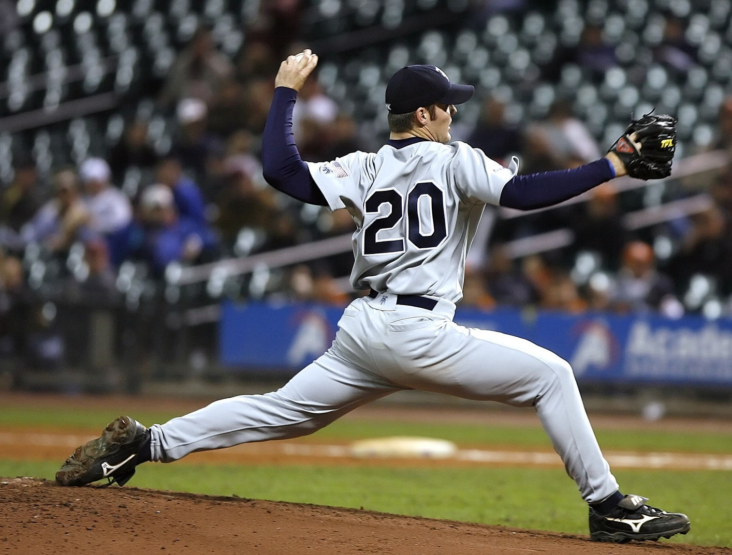
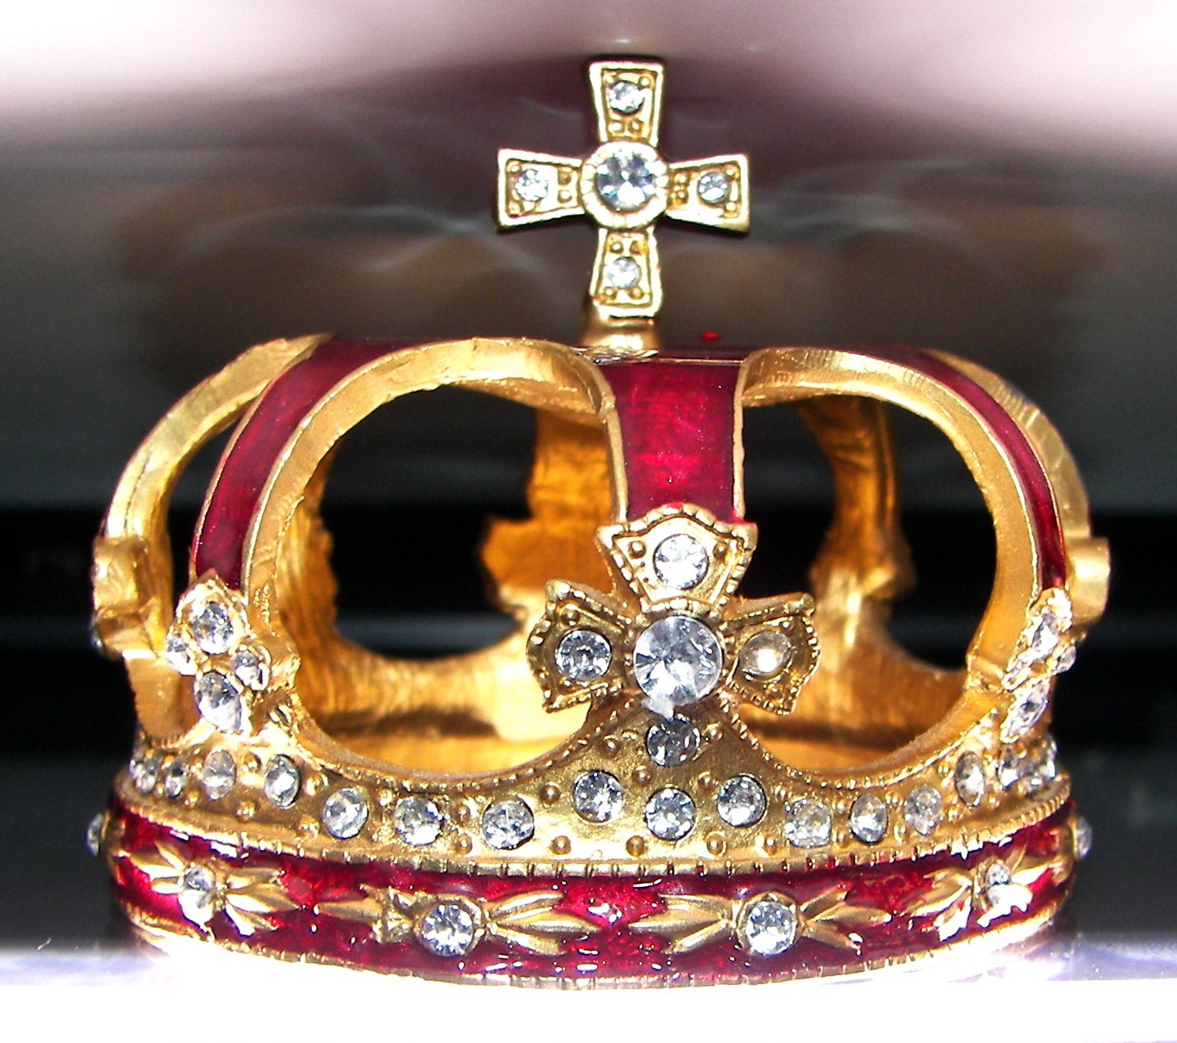

“We’re number one!”
“Care enough to send the very best”
“Our product beats brand X”
“Often imitated but never equaled”
www.BibleStudyLessons.com

Slide 3
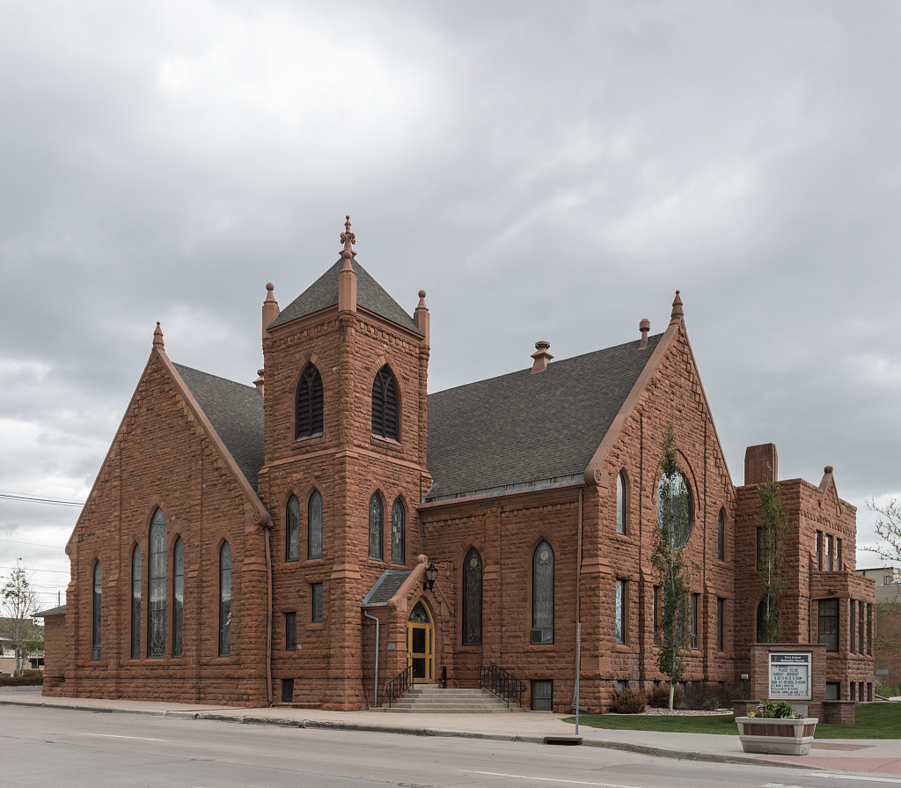

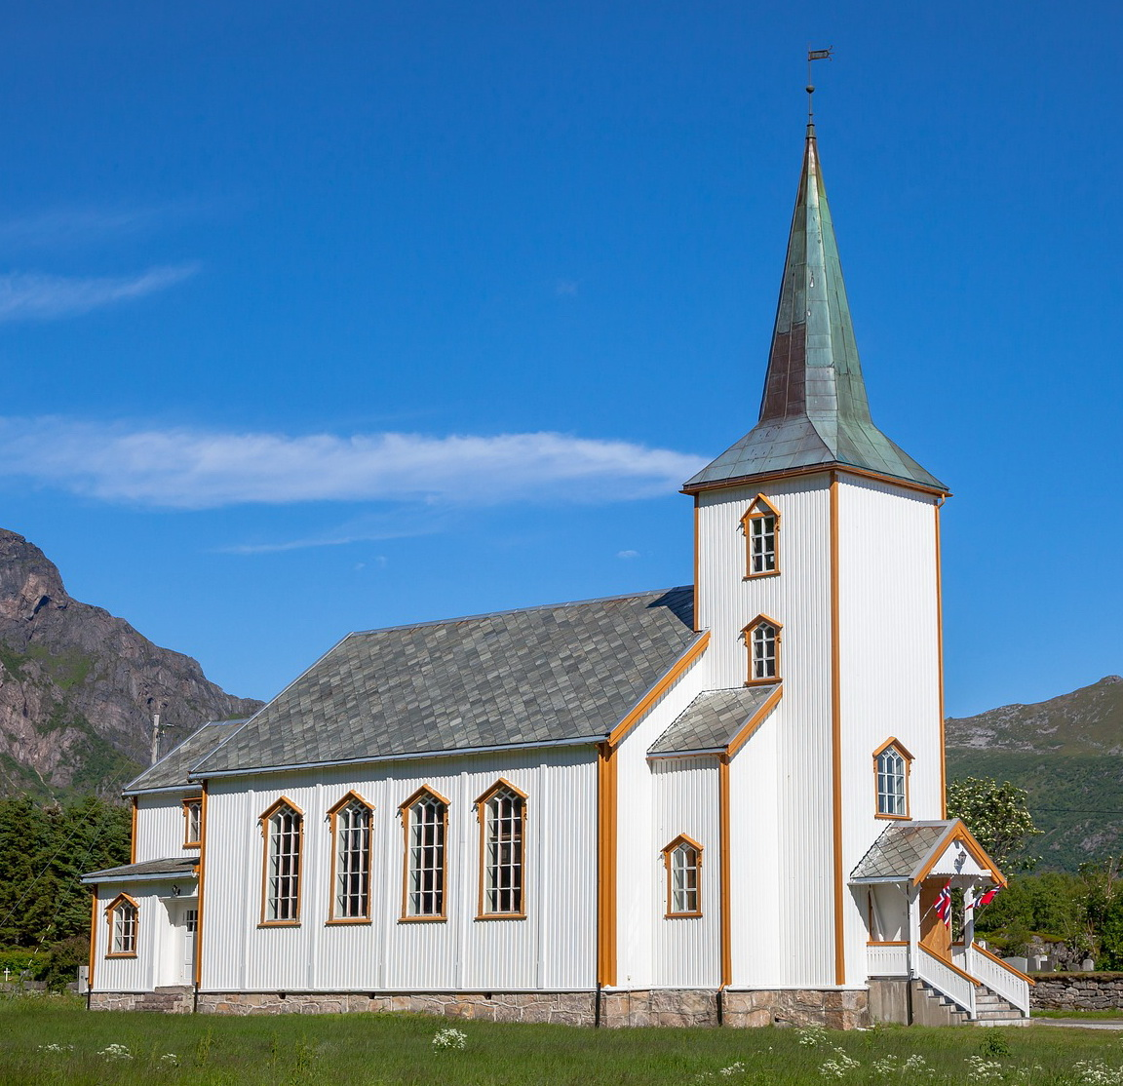
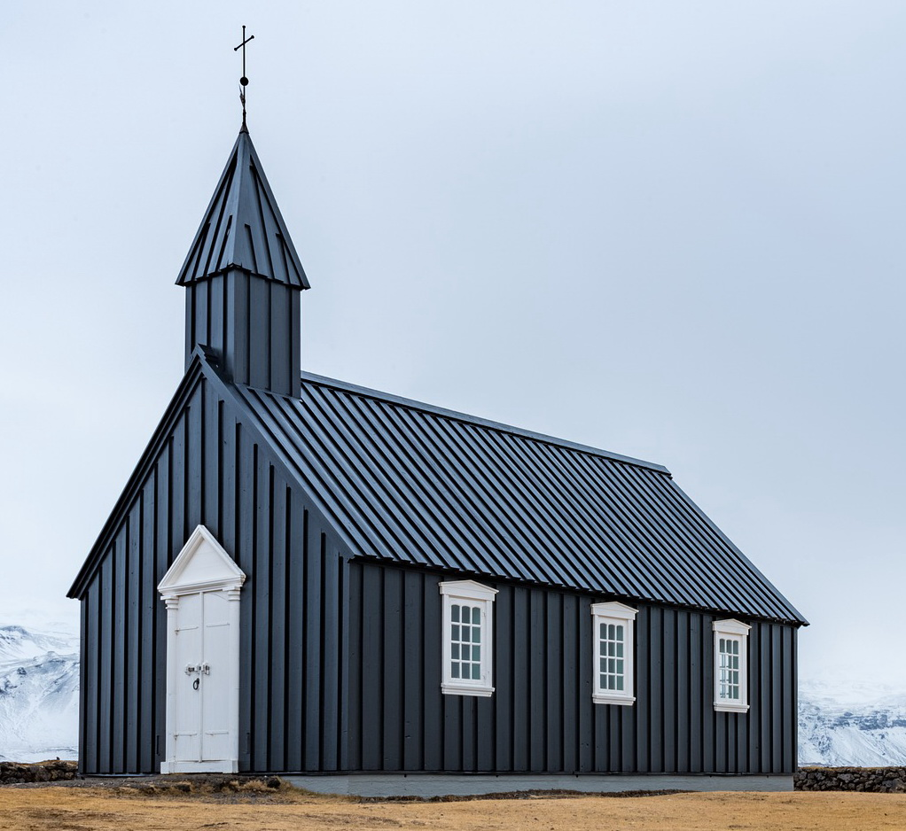
“One church is as good as another.”
“Don’t criticize other churches”
“Be more
tolerant”
“Celebrate diversity”

Slide 4
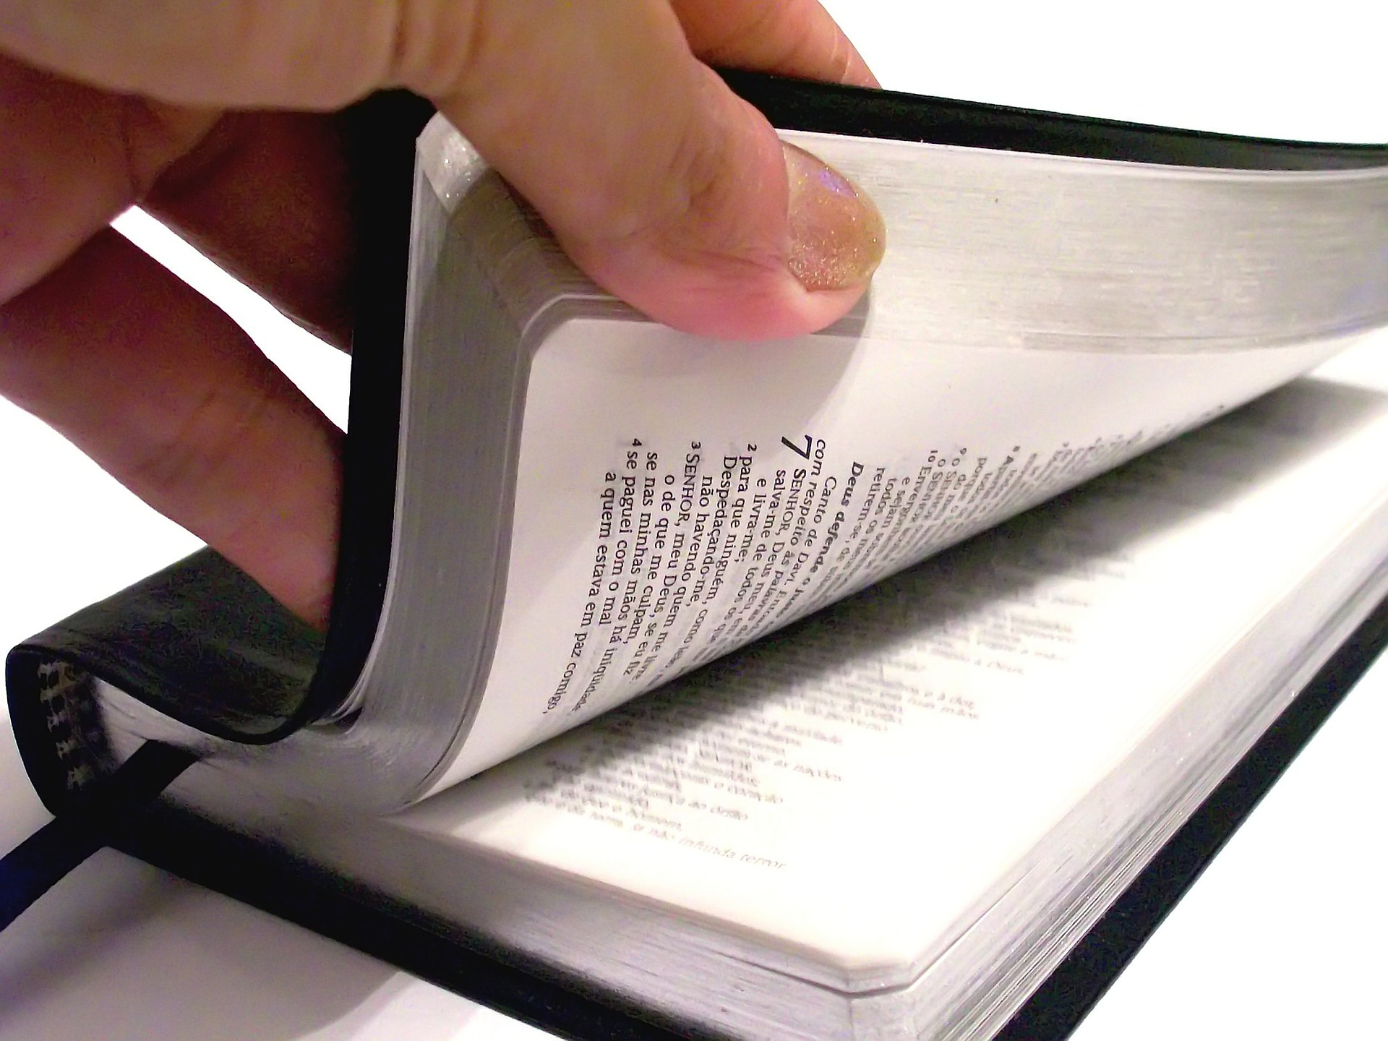
Jesus’ Church
Often Imitated, Never Equaled
Importance of Obedience
Ephesians 1:22,23; Matthew 15:9; 7:21-27; Hebrews 5:9;
2 Thessalonians 1:8,9

Slide 5
Jesus’ Church
Often Imitated, Never Equaled
Importance of Obedience
Number of People Saved
Matthew 7:13,14; 1 Peter 3:20; 1 Corinthians 10:1-6;
Romans 9:27; 11:2-5

Slide 6
Jesus’ Church
Often Imitated, Never Equaled
Importance of Obedience
Number of People Saved
Direct Statements about Uniqueness
Matthew 16:18; Colossians 1:13; Ephesians 5:22-25;
1 Corinthians 12:20;
John 17:20,21;
1 Corinthians 1:10,13;
Ephesians 4:3-6

Slide 7
Jesus’ Church
Often Imitated, Never Equaled
Importance of Obedience
Number of People Saved
Direct Statements about Uniqueness
Rebuking Error
2 Timothy 4:2-4; Proverbs 28:4; Ephesians 5:11; Jude 3;
Ezekiel 33:1-9; Luke 24:47; Revelation 3:19;
2 Timothy 2:25,26; John 3:20; 7:7

Slide 9
© Copyright David E. Pratte, 2022
Permission is granted to display this PowerPoint under the following conditions:
* Display the link to www.BibleStudyLessons.com
* Minor changes in content are permitted, but no teaching should be presented that disagrees with the teaching in the article associated with this PowerPoint at www.BibleStudyLessons.com/powerpoint
* In no case may a fee of any kind be charged for our PowerPoints.
* If you have a website, please add a link to www.BibleStudyLessons.com
Scripture quotations are generally from the New King James Version (NKJV), copyright 1982, 1988 by Thomas Nelson, Inc. Used by permission. All rights reserved.
www.BibleStudyLessons.com

