Slide 2

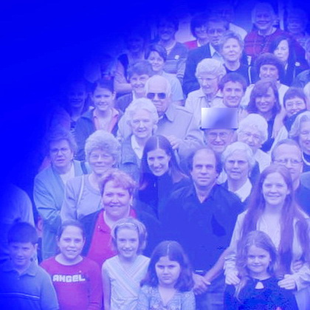
The Work of the Local Church
biblestudylessons.com

Slide 3
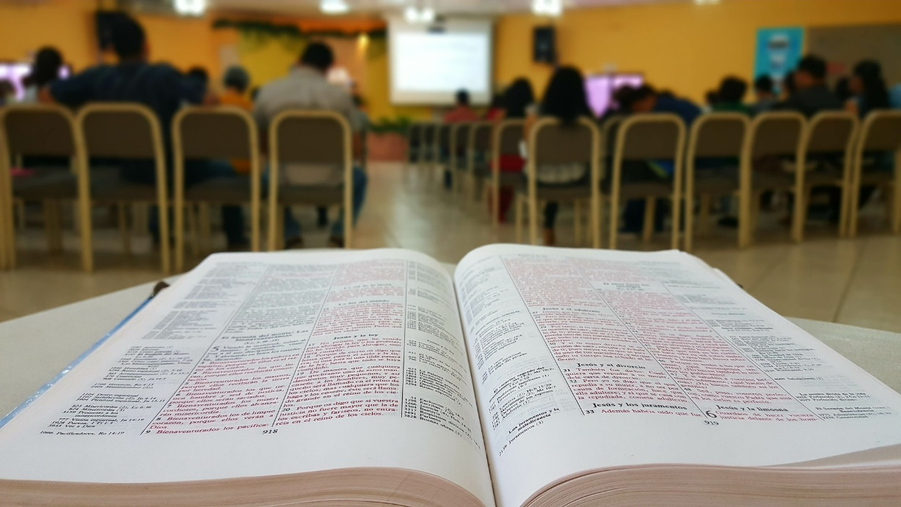
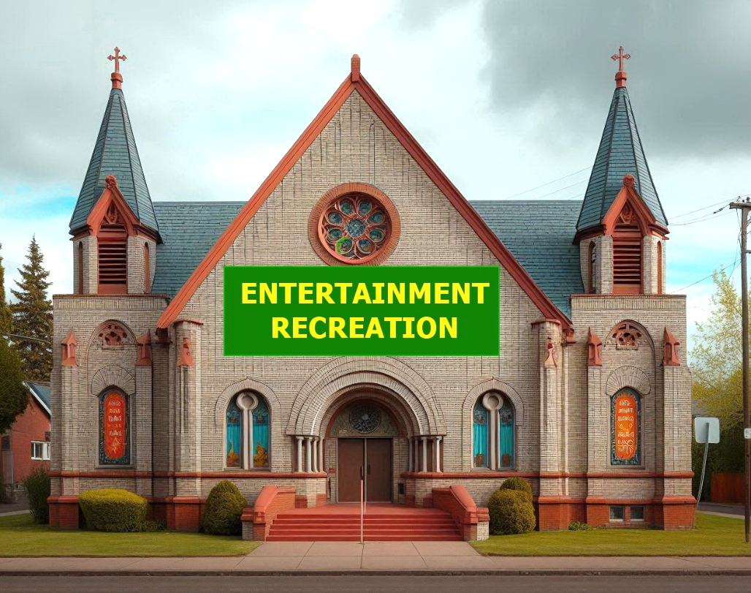
The Work of the Local Church
Social Activities
(Entertainment, Recreation)
OR
Spiritual Work

Slide 4
The Work of the Local Church
The Local Church Contrasted to Individuals
The Nature of Local Church Work
Danger of Changing the Work of the Church
Examples of Improper Church Work
Defenses of Other Church Works

Slide 5

The Local Church Contrasted to the Individual
The Individual Christian
The Local Church

Slide 6
The Local Church Contrasted to the Individual
 | Local Church | Individual
Nature | Group | Individual

Slide 7
The Local Church Contrasted to the Individual
A Local Church Consists of Christians in a Local Area.
Particular churches in various localities.
Acts 8:1 – The church which was at Jerusalem
1 Corinthians 1:2 – The church of God which is at Corinth.
Local churches distinguished from one another
Philippians 4:14-16 – No church shared with Paul but Philippi
Revelation 1:4 – Jesus addressed 7 churches of Asia one by one
Local churches consisted of individual disciples
Acts 13:1 – Men were “in” the church in Antioch (9:26-29)
Local churches were groups consisting of individual Christians. These churches were distinguished from one another, each having its own identity as a group.

Slide 8
The Local Church and the Individual
 | Local Church | Individual
Nature | Group | Individual
Rules | Church | Individual

Slide 9
The Local Church Contrasted to the Individual
Local Churches and Individuals Follow Separate Rules.
Rules to guide local churches.
1 Corinthians 16:1,2 – Orders given Corinth & Galatian churches
Revelation 1:4; chapters 2 & 3 – Instructions to local churches
Other instructions addressed to individual Christians.
1 Corinthians 7 – Conduct of “each man” toward “his own wife.”
Ephesians 5:22-6:9 – Husbands, wives, parents, children, servants, and masters instructed about their personal duties.
Scripture reveals different rules for married vs. single people, parents vs. children, masters vs. servants, elders vs. members.
Likewise, rules for churches differ from those for individuals.

Slide 10
The Local Church and the Individual
 | Local Church | Individual
Nature | Group | Individual
Rules | Church | Individual
Funds | Church treasury (collects donations) | Individual funds (business/donates)

Slide 11
The Local Church Contrasted to the Individual
Local Churches and Individuals Have Separate Funds.
Local churches possessed and used funds to do their work.
1 Corinthians 16:1-4 – Churches collected pools of funds
Philippians 4:14-16; 2 Corinthians 11:8,9 – Preacher support
Local church obtains funds differently from individuals.
1 Cor. 16:1f; 2 Cor. 8 & 9 – Church takes donations from members
Eph. 4:28; 1 Thess. 4:11; 2 Thess. 3:10ff – Individual has business
Local church controls funds differently from individuals.
Acts 4:32-5:11; 6:1-6; 11:30 – Church funds supervised by leaders
Acts 5:4 – Christian’s funds are his “own” and under his “control”
2 Cor. 9:6,7; 1 Cor. 16:1,2 – Each person “purposes” for himself.
The church and the individual obtain and control funds differently.

Slide 12
The Local Church and the Individual
 | Local Church | Individual
Nature | Group | Individual
Rules | Church | Individual
Funds | Church treasury (collects donations) | Individual funds (business/donates)
Supervision | Elders | Individual responsibility

Slide 13
The Local Church Contrasted to the Individual
Churches Act Under Different Supervision from Individuals.
A local church is overseen by elders (bishops/pastors).
Acts 14:23; Titus 1:5; 1 Peter 5:2,3; Acts 20:28; 1 Timothy 5:17
Individuals are responsible to make decisions for themselves.
The choice to obey and follow Christ
Matthew 7:21-28; James 1:23-25
The choice to meet the conditions of forgiveness
Mark 16:15,16; Acts 2:38
Preparation for judgment
2 Corinthians 5:10; Galatians 6:7,8
The local church makes decisions differently from individuals.

Slide 14
The Local Church and the Individual
 | Local Church | Individual
Nature | Group | Individual
Rules | Church | Individual
Funds | Church treasury (collects donations) | Individual funds (business/donates)
Supervision | Elders | Individual responsibility
Work | Church | Individual

Slide 15
Examples of Different Works
Scripture | Individual | Local Church
Ephesians 4:28; 1 Corinthians 16:1,2 | Earns by labor | Receives contributions
Acts 5:4; 2 Cor. 9:7 | Decides what to give | Accepts gifts
1 Timothy 5:8,16 | Cares for needy relatives | Cares for members without relatives
Matthew 18:15-17 | Speak alone, 2 or 3 | Rebukes, withdraws
Ephesians 5:22-6:4 | Marry, raise children | Bride of Christ
1 Corinthians 11:22,34 | Eat common meals | Eat Lord’s Supper
1 Corinthians 1:10-13 | Wear human names | No human names
1 Corinthians 14:7; Hebrews 2:12 | Play instruments | Sing spiritual songs

Slide 16
The Local Church and the Individual
 | Local Church | Individual
Nature | Group | Individual
Rules | Church | Individual
Funds | Church treasury (collects donations) | Individual funds (business/donates)
Supervision | Elders | Individual responsibility
Work | Church | Individual
Membership | Receives | Requests

Slide 17
The Local Church Contrasted to the Individual
Local Churches and Individuals Have Distinct Roles in Deciding Church Membership.
Individuals choose to request membership; the church decides to receive members.
Acts 9:26-29 – Paul sought to join the disciples in Jerusalem. The church determined he was faithful and received him.
Acts 18:27,28 – Ephesus sent a letter to Achaia to receive Apollos
The church excludes unruly members.
1 Corinthians chapter 5; 2 Thessalonians 3:6-15 – Because of member’s conduct, the church may refuse to keep company.
The role of the individual differs from that of the church in deciding who is and is not included in the group.

Slide 18
The Local Church and the Individual
 | Local Church | Individual
Nature | Group | Individual
Rules | Church | Individual
Funds | Church treasury (collects donations) | Individual funds (business/donates)
Supervision | Elders | Individual responsibility
Work | Church | Individual
Membership | Receives | Requests
Intent | Church | Individual

Slide 19
The Local Church Contrasted to the Individual
The Local Church Intends to Be a Church (Not Just Individuals).
A group of Christians constitutes a local church only by deliberate choice, by common consent, and mutual intent and purpose.
This follows as a necessary conclusion from previous points.
* A local church intentionally qualifies and appoints men as elders.
* It intentionally establishes a treasury of church funds.
* It deliberately does the works of a local church.
* Every individual member must make a deliberate choice to become part of the local church.
So a local church is not just any group of Christians, but a group of Christians that are ordered, arranged, or organized to work and worship together as a local church.

Slide 20



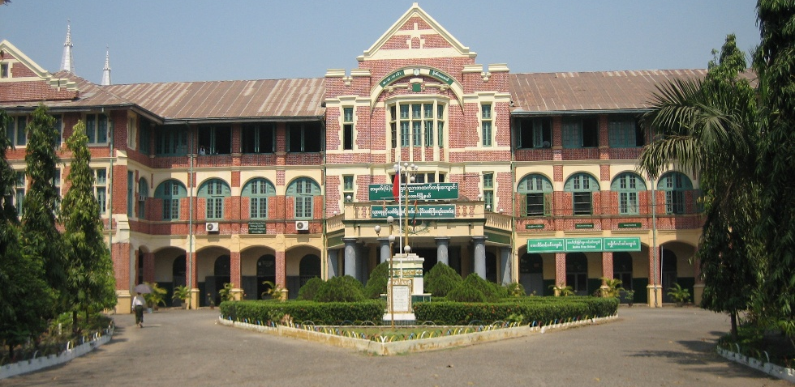
The Local Church Contrasted to the Individual
Organized Group of Blocks
Individual Blocks

Slide 21

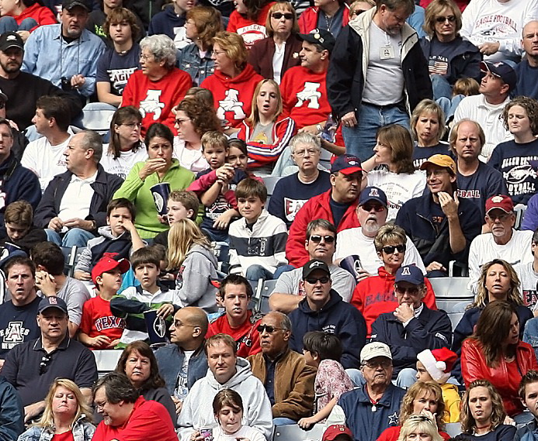

The Local Church Contrasted to the Individual
Individual People
Organized Groups of People

Slide 22
The Work of the Local Church
The Local Church Contrasted to Individuals
The Nature of Local Church Work
Danger of Changing the Work of the Church
Examples of Improper Church Work
Defenses of Other Church Works

Slide 23
The Work of the Local Church
Preach the gospel to the lost
Acts 11:22-26; Philippians 4:14-18; 1 Timothy 3:15
Instruct and edify Christians
1 Corinthians 14:19,23-26; Ephesians 4:15,16; 1 Corinthians 5
Provide opportunities to praise God
Preaching (see above)
Prayer (1 Corinthians 14:15; Acts 2:42)
Lord’s Supper (1 Corinthians 11:17-34; Acts 20:7)
Singing (1 Corinthians 14:15; Hebrews 2:12)
Collection (1 Corinthians 16:1,2; 2 Corinthians 8 & 9).
Care for certain destitute members
1 Corinthians 16:1,2; 2 Corinthians 8 & 9; Acts 4:32-35

Slide 24
What Pattern May We Change?
Salvation | Worship | Church Work
Hear Believe Repent Confess Baptism | Bible study Prayer Singing Lord’s Supper Collection | Teach lost Edify members Praise God Help needy members
We must not change any area of the Divine pattern.

Slide 25
The Spiritual Nature of the Church
Its Founder, Owner, and Head came to meet spiritual needs.
Luke 19:10; 5:32; Matthew 20:28; 26:28; Ephesians 1:7
It was purchased with a spiritual price.
Acts 20:28; Ephesians 5:23-25
It consists of spiritually saved people who seek eternal life.
Acts 2:47 (Acts 20:28; Ephesians 5:23,25; Col. 1:12-14)
It is entered by a spiritual birth.
John 3:3,5 (Rom. 6:3,4; 1 Corinthians 12:13; Acts 2:38,47)
The primary work of its highest leaders is spiritual.
Acts 6:2-4; 20:28-30; Hebrews 13:7,17
It is a spiritual house, a kingdom not of this world
1 Peter 2:5; John 18:36
biblestudylessons.com

Slide 26
The Work of the Local Church
The Local Church Contrasted to Individuals
The Nature of Local Church Work
Danger of Changing the Work of the Church
Examples of Improper Church Work
Defenses of Other Church Works

Slide 27
Unauthorized Practices: The Principle
The Bible completely reveals ALL good works.
John 16:13; Acts 20:20,27; 2 Timothy 3:16,17; 2 Peter 1:3
Practices not included in God’s word are unacceptable.
Matthew 15:9,13,14 – Worship is vain if based on human precepts.
Isaiah 55:8,9; Luke 16:15 – God’s thoughts are different from ours.
Jeremiah 10:23; Proverbs 14:12; 2 Corinthians 10:18 – The way of man is not in himself.
Proverbs 3:5,6 – Trust in the Lord, not on your own understanding.
Colossians 3:17 – All we do should be done in Jesus’ name
Galatians 1:6-9 – Man is accursed if he preaches a different gospel.
2 John 9 – Whoever does not abide in Jesus’ teaching, has not God.
We must restrict ourselves to works that God has authorized.

Slide 28
Unauthorized Practices: Applications
Naaman - Dipping in the Jordan (2 Kings 5:10-14)
Baptism - Immersion of a penitent believer (Romans 6:4; Mark 16:16; Acts 2:38)
The Lord’s Supper - Bread and fruit of the vine (Matthew 26:26ff)
Musical praise – Singing (Ephesians 5:19; Colossians 3:16; etc.)
Work of the church -Teaching the lost, edifying the members, providing for worship, and caring for destitute members
The church may provide tools, facilities, and legitimate aids.
But other acts as works of the local church are eliminated because they differ from what God says.

Slide 29
The Danger of Losing Spiritual Emphasis
Spiritual things more important than physical.
Matthew 16:26,27 – The world or your soul?
John 6:27,63 – Food that perishes or eternal life?
Romans 8:6 – Carnally minded or spiritually minded?
Maintaining a spiritual emphasis.
Matthew 6:19-21,33 – Seek first the kingdom of God
John 4:23,24 – Spiritual worship for a spiritual God
Spiritual emphasis in the work of the church.
John 18:36 – No physical fighting in a spiritual kingdom
1 Peter 2:5,9 – Spiritual sacrifices for a spiritual house
Some inspired examples
Acts 6:1-4; Matthew 21:12,13; 1 Corinthians 11:17-34

Slide 30
The Work of the Local Church
The Local Church Contrasted to Individuals
The Nature of Local Church Work
Danger of Changing the Work of the Church
Examples of Improper Church Work
Defenses of Other Church Works

Slide 31
Authority and Church Work
Instruction | Unauthorized | Authorized
Preach the gospel Edify members Worship God Help destitute members | Carnal attractions

Slide 32
Gospel or Gimmicks?
The Gospel | Carnal appeals
God’s Power Romans 1:16 Called by the gospel 2 Thessalonians 2:14 Jesus Draws/Invites John 12:32; Matt. 11:28-30 Apostles preached Acts 17:2,17; 18:4,11,19 | No fleshly weapons 2 Corinthians 10:3-5 Spiritual armor/sword Ephesians 6:10-18 Preach the cross 1 Corinthians 1:18-25; 2:1-5 Flesh doesn’t profit John 6:26f,44f,63,68
Spiritual work requires spiritual weapons.

Slide 33
Authority and Church Work
Instruction | Unauthorized | Authorized
Preach the gospel Edify members Worship God Help destitute members | Carnal attractions Businesses, hospitals, schools, politics

Slide 34
Authority and Church Work
Instruction | Unauthorized | Authorized
Preach the gospel Edify members Worship God Help destitute members | Carnal attractions Businesses, hospitals, schools, politics Entertainment, recreation, social activities

Slide 35
Authority and Church Work
Instruction | Unauthorized | Authorized
Preach the gospel Edify members Worship God Help destitute members | Carnal attractions Businesses, hospitals, schools, politics Entertainment, recreation, social activities Caring for needy non-members

Slide 36
Whom Should Local Churches Help?
Acts 2:44,45 — “all that believed”
Acts 4:32-5:11 — “them that believed” (4:32)
Acts 6:1-6 — “number of the disciples (v1)
Acts 11:27-30 — “unto the brethren” (v29)
Romans 15:25-27 — “unto the saints…saints”
1 Corinthians 16:1-4 — “for the saints”
2 Corinthians 8:4; 9:1,12 — “to the saints”
1 Timothy 5:16 – “widows indeed” (trust in God)
Individuals should help non-members as they can.
Leave the church free to emphasize spiritual work.

Slide 37
Authority and Church Work
Instruction | Unauthorized | Authorized
Preach the gospel Edify members Worship God Help destitute members | Carnal attractions Businesses, hospitals, schools, politics Entertainment, recreation, social activities Caring for needy non-members | Building Printed material Bible classes TV/Internet Songbooks Lights, pews Utilities, etc.
Churches may provide tools & facilities to aid their works, but must use them for authorized works.

Slide 38

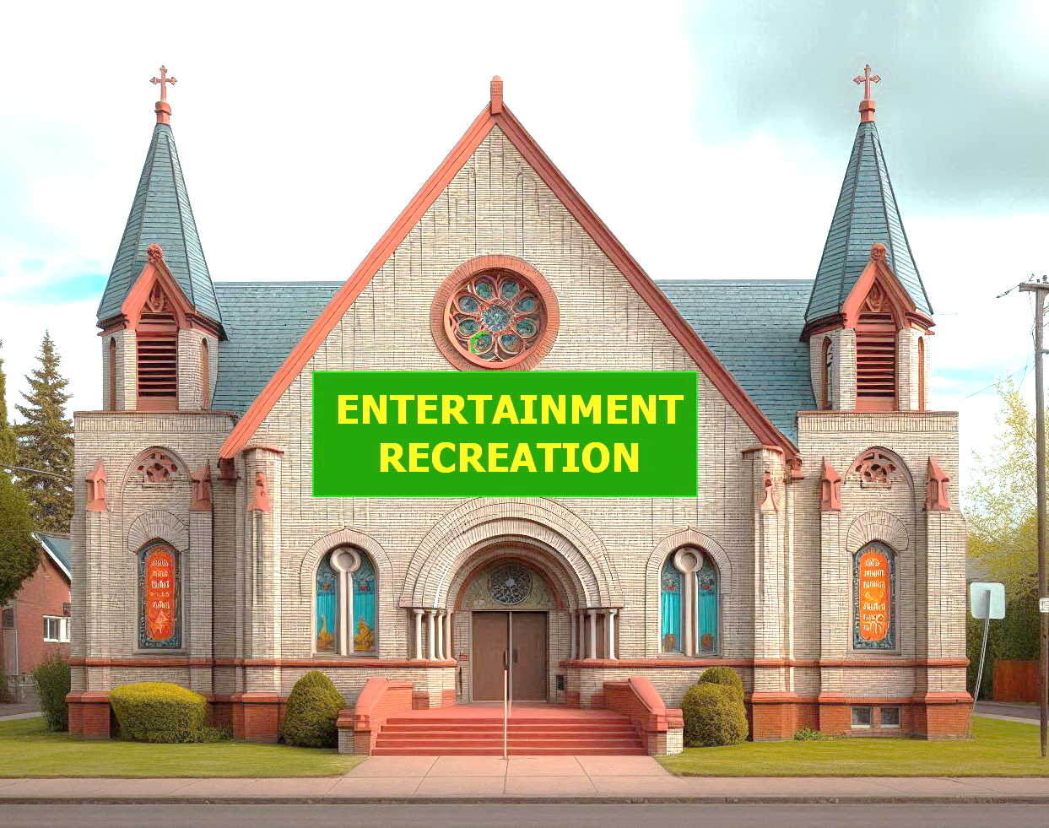
Wrong Purpose / Wrong Emphasis

Slide 39
The Work of the Local Church
The Local Church Contrasted to Individuals
The Nature of Local Church Work
Danger of Changing the Work of the Church
Examples of Improper Church Work
Defenses of Other Church Works

Slide 40
Fellowship in Authorized or Unauthorized Works?
2 John 9-11 – Not all “fellowship” is acceptable.
Church fellowship limited to authorized/primarily spiritual work
* Fellowship in worship/edification – Acts 2:42; 1 Cor. 10:16,17
* Fellowship in supporting preachers – Philippians 4:14-18
* Fellowship with needy saints – Acts 4:32,34,35; 2 Cor. 8:4.
Acts 2:42 - Fellowship was part of spiritual worship acts.
These acts may be done in church assemblies.
1 Cor. 11:34 - Social acts, etc., should not be in assemblies.
So local church fellowship does not include social activities, recreation, or entertainment!
Social activities, etc., change God’s pattern like different music, baptism, etc. They change spiritual emphasis to carnal.

Slide 41
Edification: Spiritual or Physical - 1
What Scripture do you use to draw the line?
This is the same error as using carnal attractions.
The church should edify by spiritual teaching.
Ephesians 4:15,16 - discusses spiritual growth (verses 13-15)
Verse 15 – The body edifies by speaking the truth in love.
2 Peter 3:18 – Grow in the grace and knowledge of our Lord Jesus
1 Peter 2:2 – …desire the milk of the word, that you may grow
Colossians 1:28 – Him we preach, warning and teaching every man in all wisdom, to present every man perfect in Christ.
Spiritual growth requires spiritual methods, especially teaching.
What verse shows spiritual growth is caused by social activities?

Slide 42
Edification: Spiritual or Physical - 2
1 Corinthians 14 includes guidelines about church edification.
Edify (v26) by teaching (v3) understandable message (verses
6-10, 15-19) so all can learn (verse 31).
Recreation and entertainment give no understandable message, so they are not an authorized form of church edification.
Church edification is appropriate in assemblies.
1 Corinthians 11:34 forbids social activities, etc., in assemblies.
So they are not legitimate forms of church edification.
Edification by the church is spiritual in nature, instructing and exhorting men to serve God. Recreation, etc., perverts the work and spiritual nature of the church.

Slide 43
Hospitality
Hospitality involves providing food, lodging, health care, and washing feet.
Genesis 18:1-8; 19:2,3; Hebrews 13:2; Matthew 25:35,36; 1 Timothy 5:9,10; Matthew 25:34-36
Hospitality toward people in general is always individual, not local church activity.
Genesis 18:1-8; 19:1-3; Matthew 25:34-36,40; 1 Timothy 3:2; 5:9,10; 1 Peter 4:9; Romans 12:13
Scriptural hospitality always refers to caring for needs, not recreation/entertainment.
Genesis 18,19; Matthew 25; 1 Timothy 5:9,10; etc.
This would involve the church in acting without Bible authority and changing church emphasis from spiritual to physical.

Slide 44
Good Works
Good works must be authorized in Scripture: 2 Timothy 3:16,17; Matthew 15:9,13,14; Galatians 1:6-9;2 John 9; Matthew 7:21-23
The church teaches many good works that are practiced only individually. Hebrews 10:24,25; Titus 3:14
The church provokes love/good works in its assemblies
(Hebrews 10:24,25).
If this authorizes church entertainment, etc., the church may have entertainment, social activities in their assemblies.
But this contradicts 1 Corinthians 11:34.
This reasoning leads the church to act without Biblical authority and perverts the spiritual nature of church work.

Slide 45
“No Church Funds Used” or “Call It Individual Work”
The local church may finance authorized church works.
1 Corinthians 16:1-4; 2 Corinthians 8 & 9; 11:8,9; Acts 4:32-5:11; Philippians 4:14-16.
The local church it may supervise authorized church works.
1 Peter 5:2,3; Acts 20:28 – The elders in a local church oversee or shepherd the “flock” - exercise oversight
Elders may supervise only authorized church works.
They should not arrange, organize, or supervise unauthorized works, nor may they appoint others to supervise them.
If the church supervises an activity, calling it individual work does not make it individual.

Slide 46
Where Does It End?
* Ball teams, track meets, exercise programs, boy scouts,
* Church dinners, banquets, kitchens, or ice cream socials
* Parties, plays, magic shows, drama, carnivals, circuses
* Summer camps
* Businesses (bookstore, grocery store, gas station)
* Hospitals or health clinics
* Daycare centers, kindergartens, elementary or secondary schools, or colleges
* Campaign rallies for political candidates or parties
* Centralized institutions such as missionary, orphan, or widow institutions

Slide 47
Just Trust the Elders’ Decisions? - 1
This approach has repeatedly led to apostasy.
* In Jesus’ day, the elders led the people into error.
Matthew 15:1-9 – Elders’ traditions transgressed God’s law.
Matthew 16:21; 27:20 – Elders demanded Jesus’ death.
* In the second and third centuries AD, elders led the apostasy that developed the Catholic church.
* In the mid-1800s elders led to division over the missionary society and instrumental music.
* In the mid1900s elders led churches to support benevolent institutions and social activities.
Unauthorized practices are error regardless of the source.

Slide 48
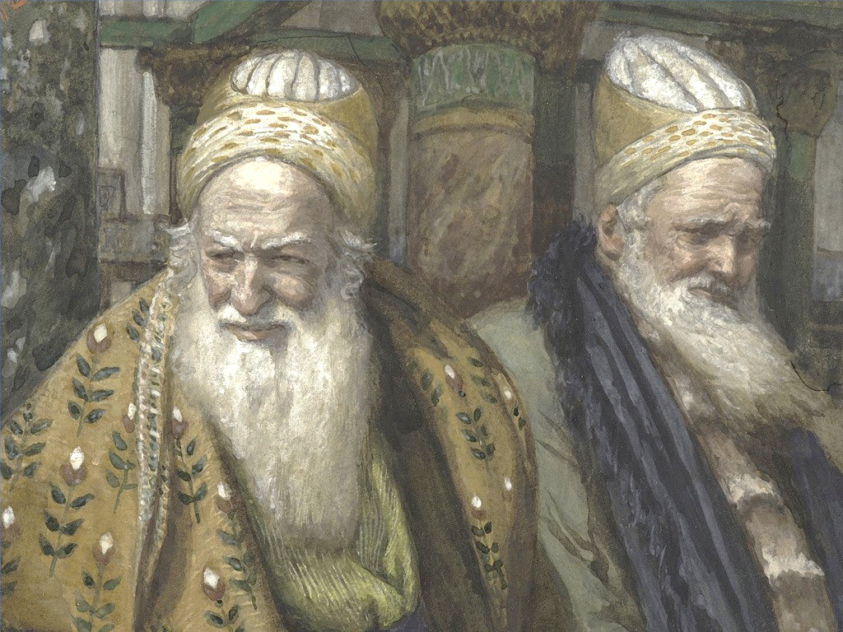
Just Trust the Elders’ Decisions? - 2
Acts 20:28-30 – Some elders would lead disciples into error.
Acts 5:29 – We must obey God rather than man
Titus 1:9 – Elders must hold fast faithful word & sound doctrine.
Matthew 15:14 – If the blind lead the blind, both fall in a ditch.
1 Thessalonians 5:21,22; Acts 17:11 – We must study for ourselves.
If recreation, etc., are authorized, why do people not simply provide Scripture showing local churches involved?

Slide 49
The Slippery Slope
Regardless of intent, church involvement in unauthorized activities constitutes a slippery slope. Unless they repent, churches invariably practice more such activities, increasingly emphasizing physical activities instead of the spiritual role God requires.
To involve the local church in activities that God never authorized – whether by financing them or by arranging, organizing or supervising them – is to act without Divine authority. It leads the church away from spiritual emphasis into physical emphasis.
The inevitable result causes a local church to cease to be a church of Christ.

Slide 51
© Copyright David E. Pratte, 2024
Permission is granted to display this PowerPoint under the following conditions:
* Display the link to BibleStudyLessons.com
* Minor changes in content are permitted, but no teaching should be presented that disagrees with the teaching in the article associated with this PowerPoint at BibleStudyLessons.com/powerpoint
* In no case may a fee of any kind be charged for our PowerPoints.
* If you have a website, please add a link to BibleStudyLessons.com
Scripture quotations are generally from the New King James Version (NKJV), copyright 1982, 1988 by Thomas Nelson, Inc. Used by permission. All rights reserved.
biblestudylessons.com

