Slide 2


Examples of Consensus Thinking
Consensus Thinking
www.BibleStudyLessons.com

Slide 3
Examples of Consensus Thinking
Politics and Government
Media
Science and Education
Moral Issues
Religious Issues

Slide 4
Examples of Consensus Thinking
Politics and Government
Media
Science and Education
Moral Issues
Religious Issues
Jesus Seminar - “the goal of the Seminar was to review each of the sayings and deeds attributed to Jesus in the gospels and determine which of them could be considered authentic. … Eventually more than 200 professionally trained specialists … joined the group … trained in the best universities...”
– https://www.westarinstitute.org/projects/the-jesus-seminar/

Slide 5
Examples of Consensus Thinking
People Who Were Not “in the Mainstream”
Consensus Thinking

Slide 6
Outside the Mainstream
Noah - Genesis 6:5-8; 7:21-23
Joshua and Caleb - Numbers 14:1-10
Elijah – 1 Kings 18:21-24
Shadrach, Meshach, and Abednego – Daniel 3:13-15
Daniel – Daniel 6:11-13
Jesus - Matthew 26:56; 27:21-26

Slide 7
Examples of Consensus Thinking
People Who Were Not “in the Mainstream”
Consensus Thinking and Human Authority
Consensus Thinking

Slide 8
The Mainstream
& Human Authority
Human Authority Does Not Determine Right or Wrong.
Proverbs 14:12; Luke 16:15;
1 Corinthians 1:18-25; 2 Corinthians 10:12,18
The Majority Is Often Wrong in Religion.
Exodus 23:2 ; Matthew 7:13,14; Romans 12:2;
Acts 28:22

Slide 9
Examples of Consensus Thinking
People Who Were Not “in the Mainstream”
Consensus Thinking and Human Authority
The Proper Source of Authority
Consensus Thinking

Slide 10
God’s Word:
True Authority
God’s Will Is Recorded in the Bible.
Ephesians 3:3-5; 1 Corinthians 14:37; 2 Timothy 3:16,17;
2 Peter 1:20,21
The Scriptures Are A Complete Revelation.
Acts 20:20,27; 2 Timothy 3:16,17; 2 Peter 1:3
We Must Follow God’s Revealed Will
Without Human Changes.
Colossians 3:17; Galatians 1:6-9; 2 John 9

Slide 11
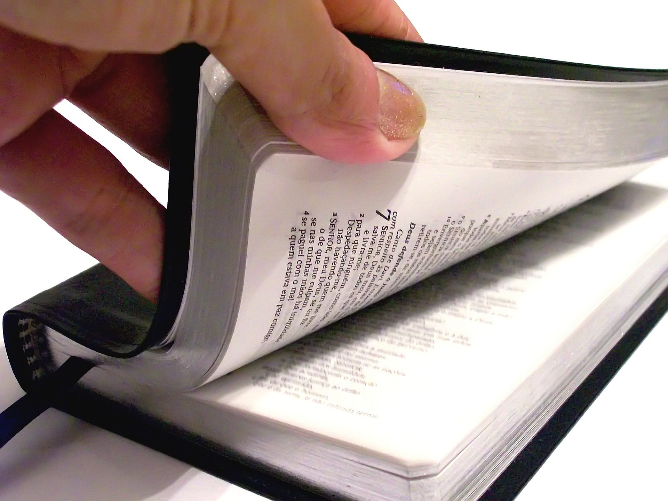
Are you following the word of God or the opinions of men?

Slide 12
© Copyright David E. Pratte, 2020
Permission is granted to display this PowerPoint under the following conditions:
* Display the link to www.BibleStudyLessons.com
* Minor changes in content are permitted, but no teaching should be presented that disagrees with the teaching in the article associated with this PowerPoint on www.BibleStudyLessons.com/powerpoint
* In no case may a fee of any kind be charged for our PowerPoints.
* If you have a website, please add a link to www.BibleStudyLessons.com
Scripture quotations are generally from the New King James Version (NKJV), copyright 1982, 1988 by Thomas Nelson, Inc. Used by permission. All rights reserved.
www.BibleStudyLessons.com

