Slide 2
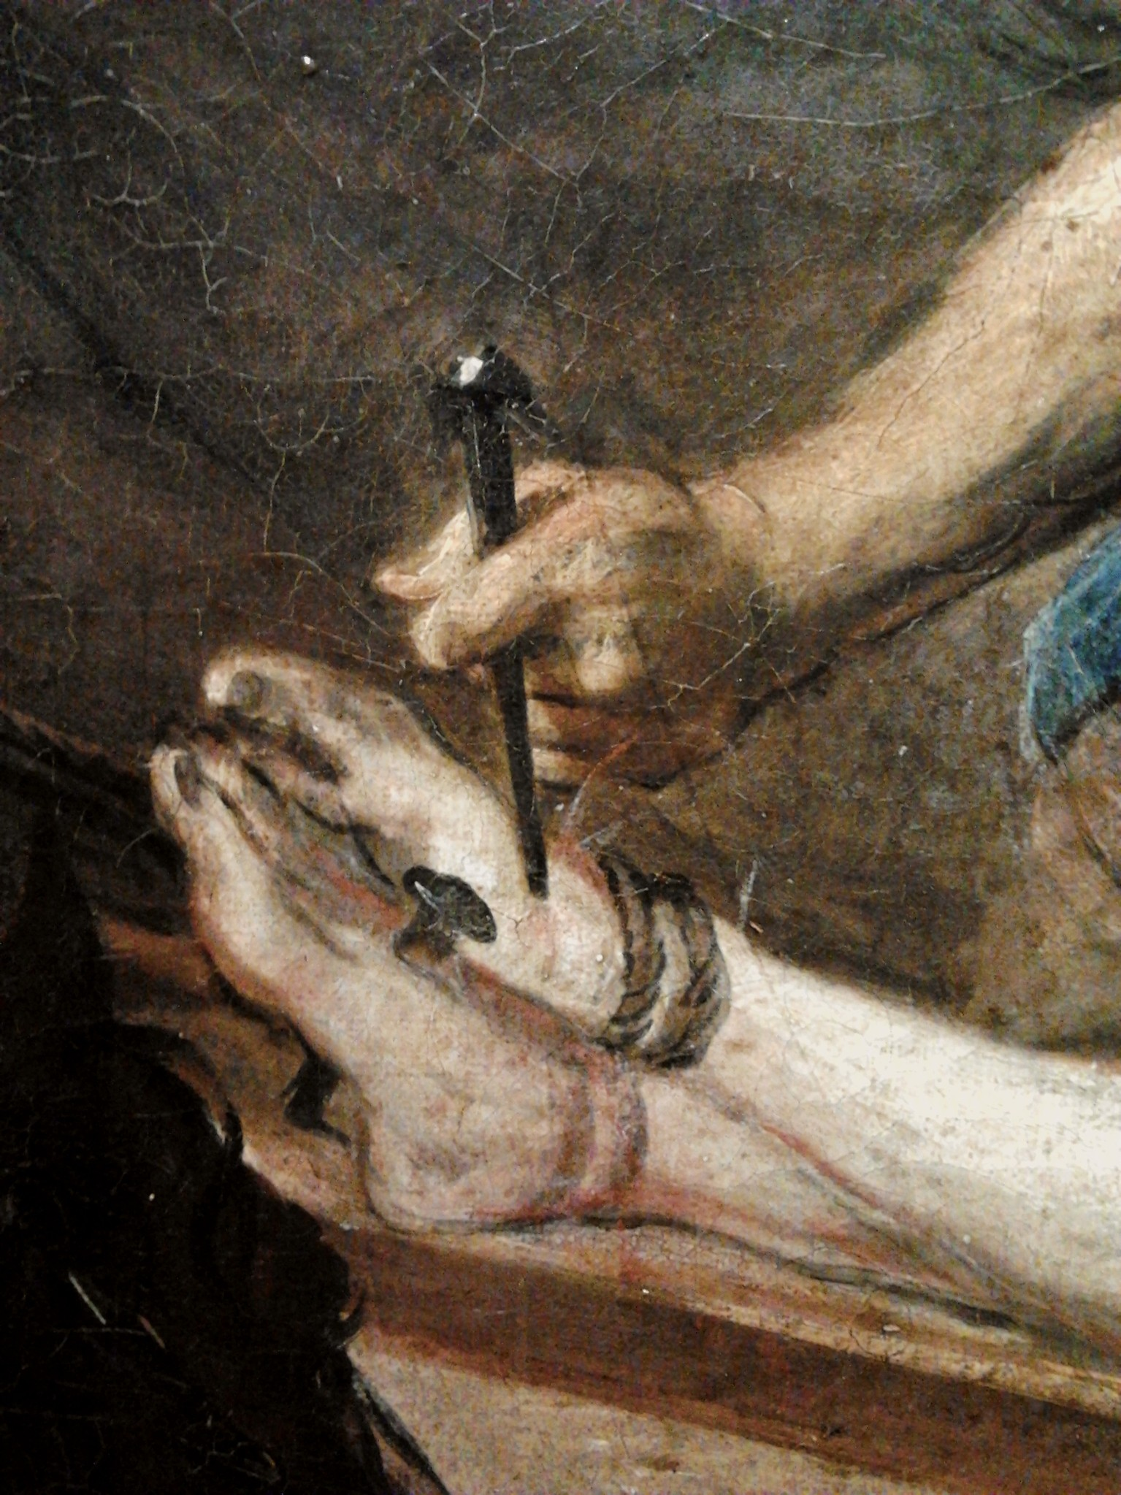
Consequences of the Cross
Forgiveness
biblestudylessons.com

Slide 3
The Cross and Forgiveness
Everlasting life
John 3:16
Ransom
Matthew 20:28
Redemption, forgiveness
Ephesians 1:7

Slide 4
Consequences of the Cross
Forgiveness
The Gospel

Slide 5
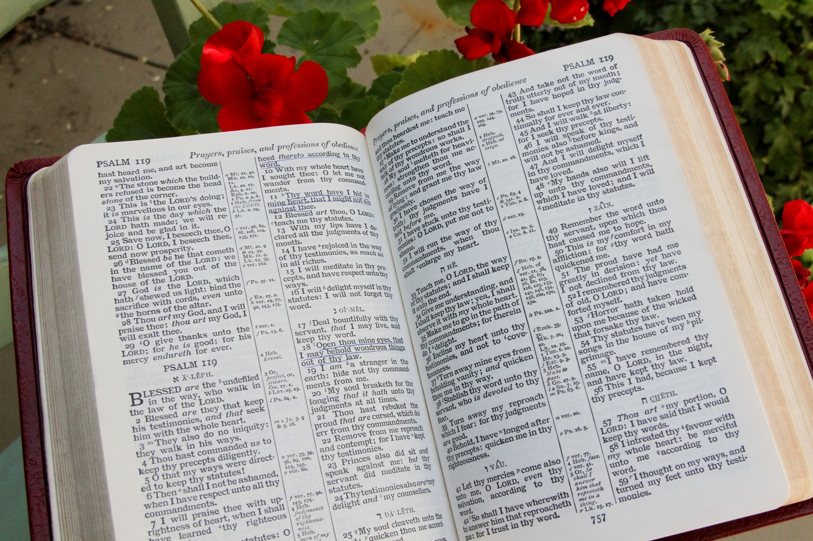
The Cross and the Gospel
Faith comes by hearing
John 3:16; Romans 10:17
Gospel is based on death, burial, & resurrection
1 Corinthians 15:1-4
Preach the gospel, not human wisdom
1 Corinthians 1:18-24; 2:1-5
Gospel is God’s power
Romans 1:16

Slide 6
Consequences of the Cross
Forgiveness
The Gospel
The Church

Slide 7

The Cross and the Church
Church purchased by the blood - Acts 20:28
Saved added to the church
Acts 2:47
Jesus is Savior of the body; He gave Himself for the church
Ephesians 5:23,25

Slide 8
Consequences of the Cross
Forgiveness
The Gospel
The Church
Baptism

Slide 9
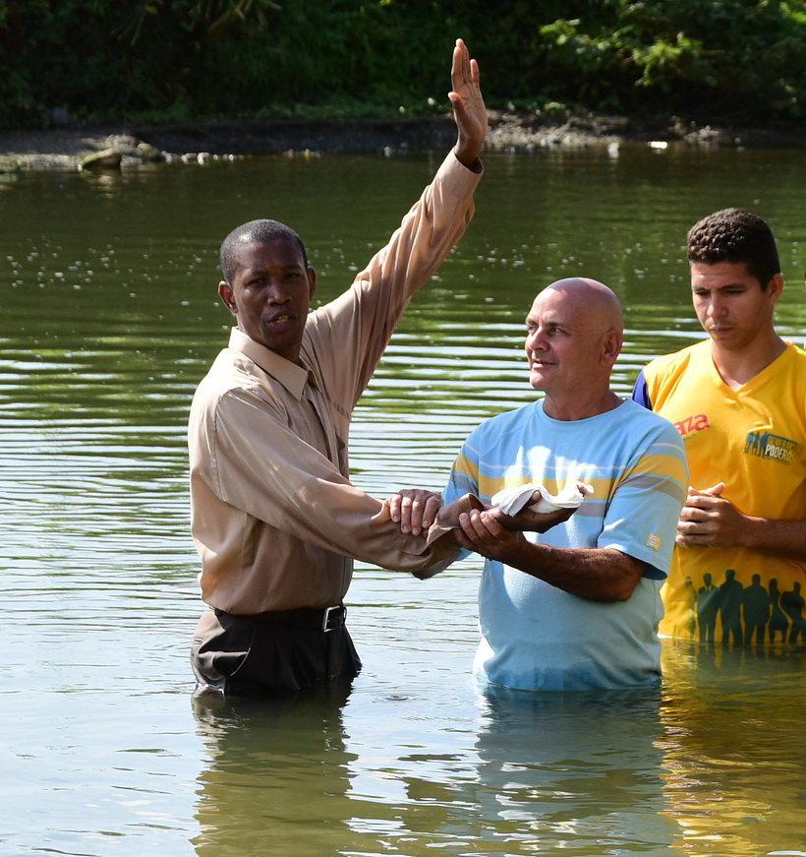
The Cross and Baptism
Remission by blood in baptism
Matthew 26:28; Acts 2:38
Sins washed away by blood in baptism
Revelation 1:5; Acts 22:16
Saved by blood in baptism
Romans 5:6-9; Mark 16:16;
1 Peter 3:21
Baptized into Christ into His death
Ephesians 1:7; Romans 6:3,4

Slide 10
Consequences of the Cross
Forgiveness
The Gospel
The Church
Baptism
Faithful Living

Slide 11

The Cross and Faithful Living
Zealous of good works
Titus 2:11-14
Live for Him
2 Corinthians 5:14,15
Walk in light & confess sins
1 John 1:7-9

Slide 12
The Cross and You
Have you obeyed the gospel to be forgiven by the blood?
Are you living faithfully, confessing your sins?

Slide 14
© Copyright David E. Pratte, 2023
Permission is granted to display this PowerPoint under the following conditions:
* Display the link to BibleStudyLessons.com
* Minor changes in content are permitted, but no teaching should be presented that disagrees with the teaching in the article associated with this PowerPoint at www.BibleStudyLessons.com/powerpoint
* In no case may a fee of any kind be charged for our PowerPoints.
* If you have a website, please add a link to https://BibleStudyLessons.com
Scripture quotations are generally from the New King James Version (NKJV), copyright 1982, 1988 by Thomas Nelson, Inc. Used by permission. All rights reserved.
biblestudylessons.com

