Slide 1
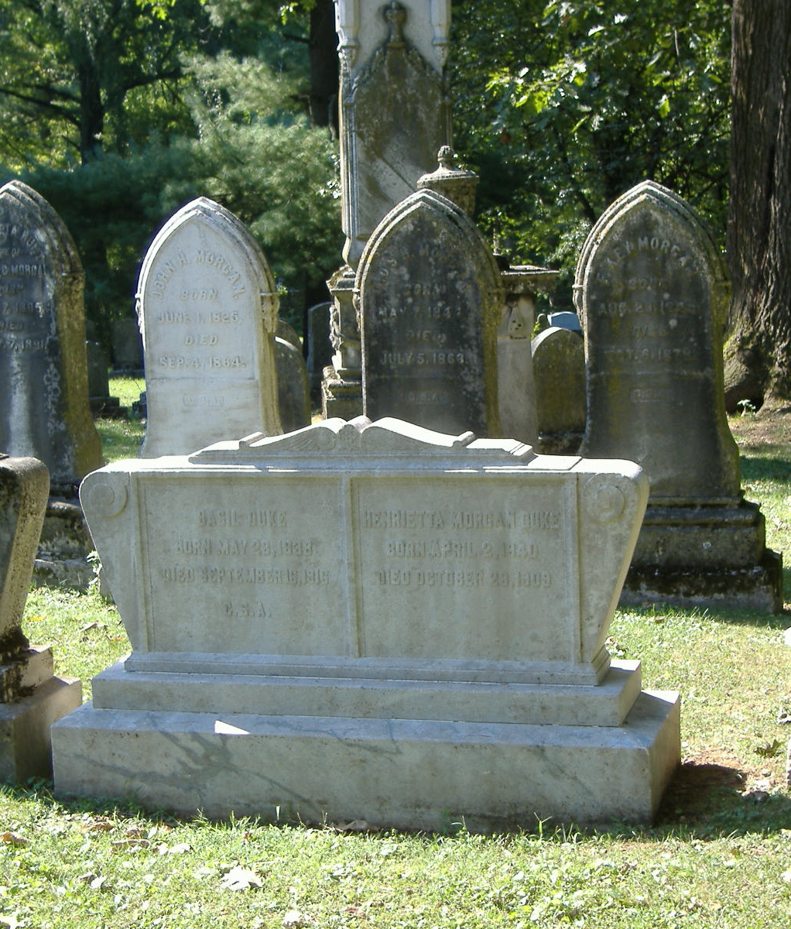
Dying Words of Unbelievers
SIR THOMAS SCOTT – “Until this moment I thought there was neither a God nor a hell. Now I know and feel that there are both, and I am doomed to perdition by the just judgment of the Almighty.”
DAVID STRAUSS – “My philosophy leaves me utterly forlorn! I feel like one caught in the merciless jaws of an automatic machine, not knowing at what time one of its great hammers may crush me!”
ANTON LEVEY – Author of the Satanic Bible and high priest of Satanic worship: “Oh my, oh my, what have I done? There is something very wrong.”
biblestudylessons.com

Slide 2
Dying Words of Unbelievers
JOSEPH STALIN – Russian Communist dictator responsible for millions of murders: “My father died a difficult and terrible death…. At what seemed the very last moment, he suddenly opened his eyes and cast a glance over everyone in the room. It was a terrible glance, insane or perhaps angry. His left hand was raised, as though he were pointing to something above and bringing down a curse on us all. The gesture was full of menace…the next morning he was dead.”

Slide 3
Dying Words of Unbelievers
ROBERT INGERSOLL – “Oh God, if there be a God, save my soul, if I have a soul, from hell, if there be a hell!”
DAVID HUME – He cried loud on his death bed “I am in flames!” His desperation was a horrible scene.
VOLTAIRE – “I am abandoned by God and man.” He said to his physician, Dr. Fochin: “I will give you half of what I am worth if you will give me six months of life.” When he was told this was impossible, he said, “Then I shall die and go to hell!” His nurse said: “For all the money in Europe I wouldn’t want to see another unbeliever die! All night long he cried for forgiveness.”

Slide 4
Dying Words of Unbelievers
THOMAS PAYNE – “Stay with me, for God’s sake; I cannot bear to be left alone, O Lord, help me! O God, what have I done to suffer so much? What will become of me hereafter? I would give worlds if I had them, that The Age of Reason had never been published. O Lord, help me! Christ, help me! No, don’t leave; stay with me! Send even a child to stay with me; for I am on the edge of hell here alone. If ever the Devil had an agent, I have been that one.”
(From The Banner of Truth with some explanation by Jefferson David Tant; adapted)

Slide 5
Dying Words of Unbelievers
SIR FRANCIS NEWPORT – “You need not tell me there is no God, for I know there is one, and that I am in his presence! You need not tell me there is no hell. I feel myself already slipping. Wretches, cease your idle talk about there being hope for me! I know I am lost forever! Oh, that fire! Oh, the insufferable pangs of hell! Oh, that I could lie for a thousand years upon the fire that is never quenched, to purchase the favor of God and be united to Him again. But it is a fruitless wish. Millions and millions of years will bring me no nearer the end of my torments than one poor hour. Oh, eternity, eternity forever and forever! Oh, the insufferable pangs of Hell!”

Slide 6
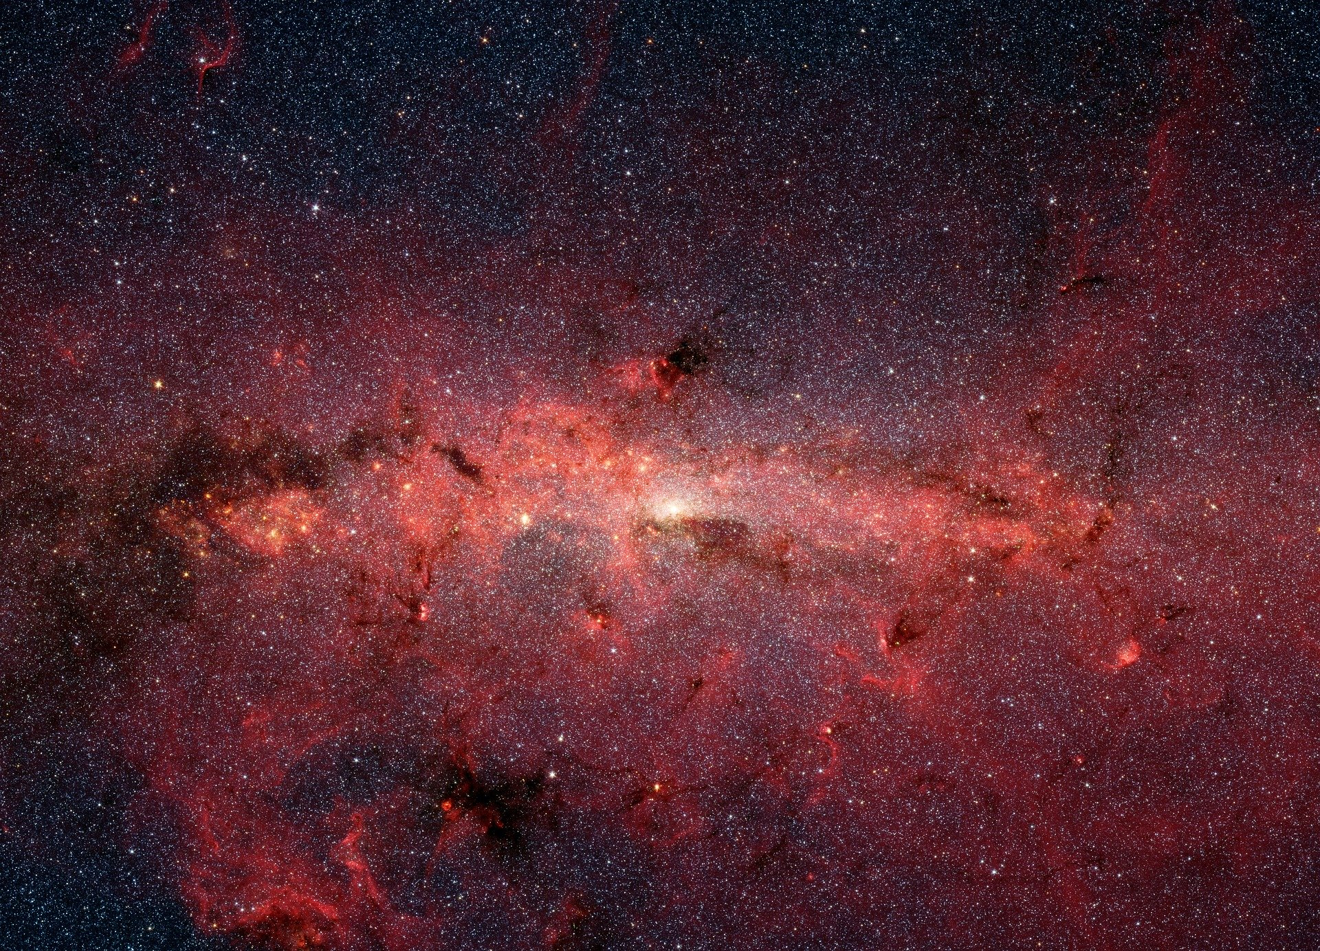
The Bible’s Response
Romans 1:20,22 – For since the creation of the world His invisible attributes are clearly seen, being understood by the things that are made, even His eternal power and Godhead, so that they are without excuse … Professing to be wise, they became fools
Psalm 14:1 – The fool has said in his heart, “There is no God.”
John 8:24 – Therefore I said to you that you will die in your sins; for if you do not believe that I am He, you will die in your sins.

Slide 7
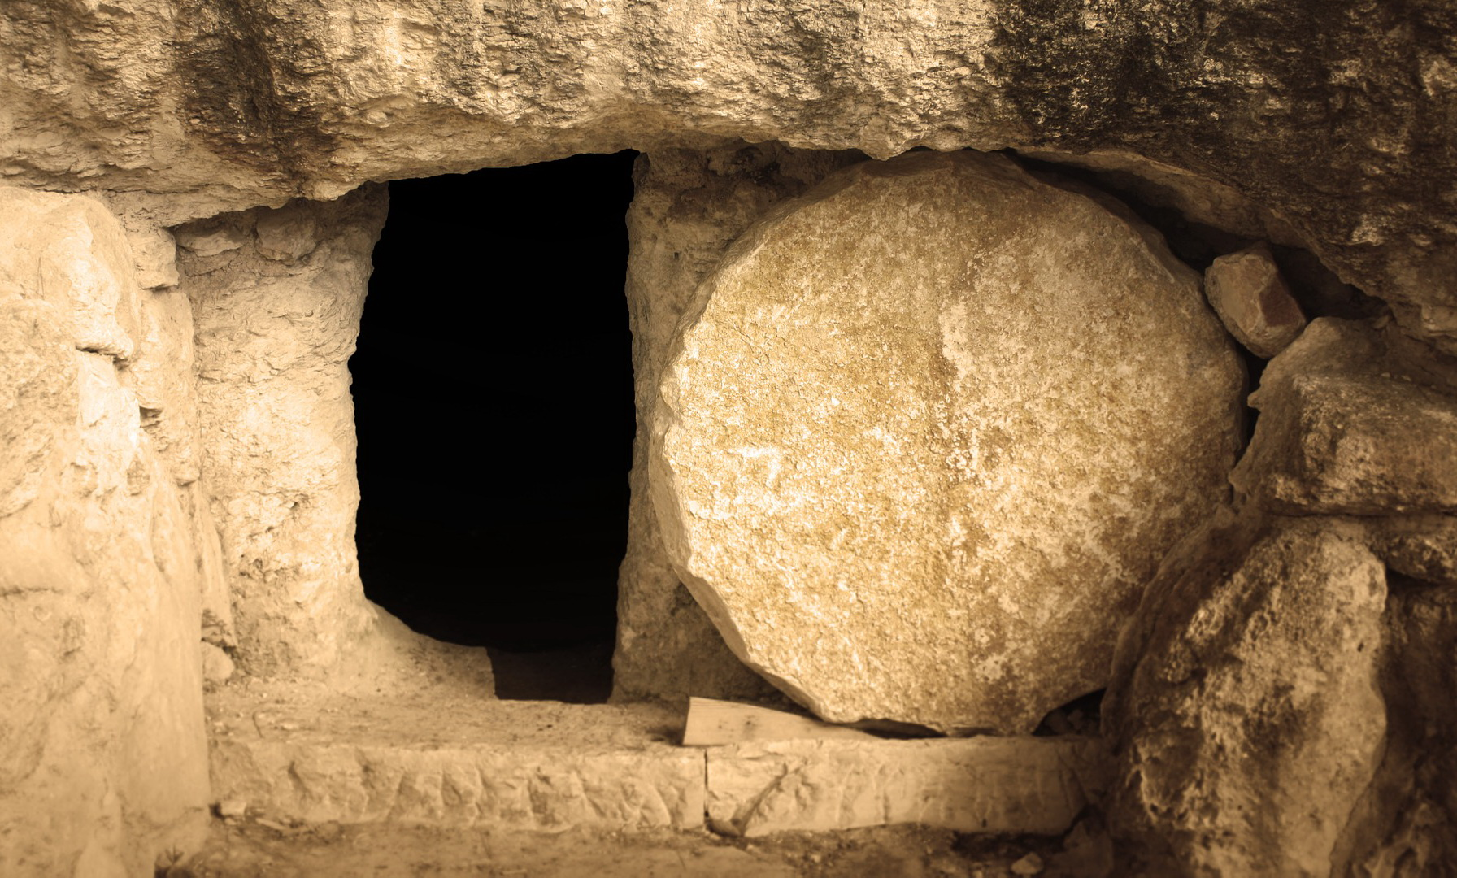
The Bible’s Response
John 11:25 – I am the resurrection and the life. He who believes in Me, though he may die, he shall live.

Slide 8
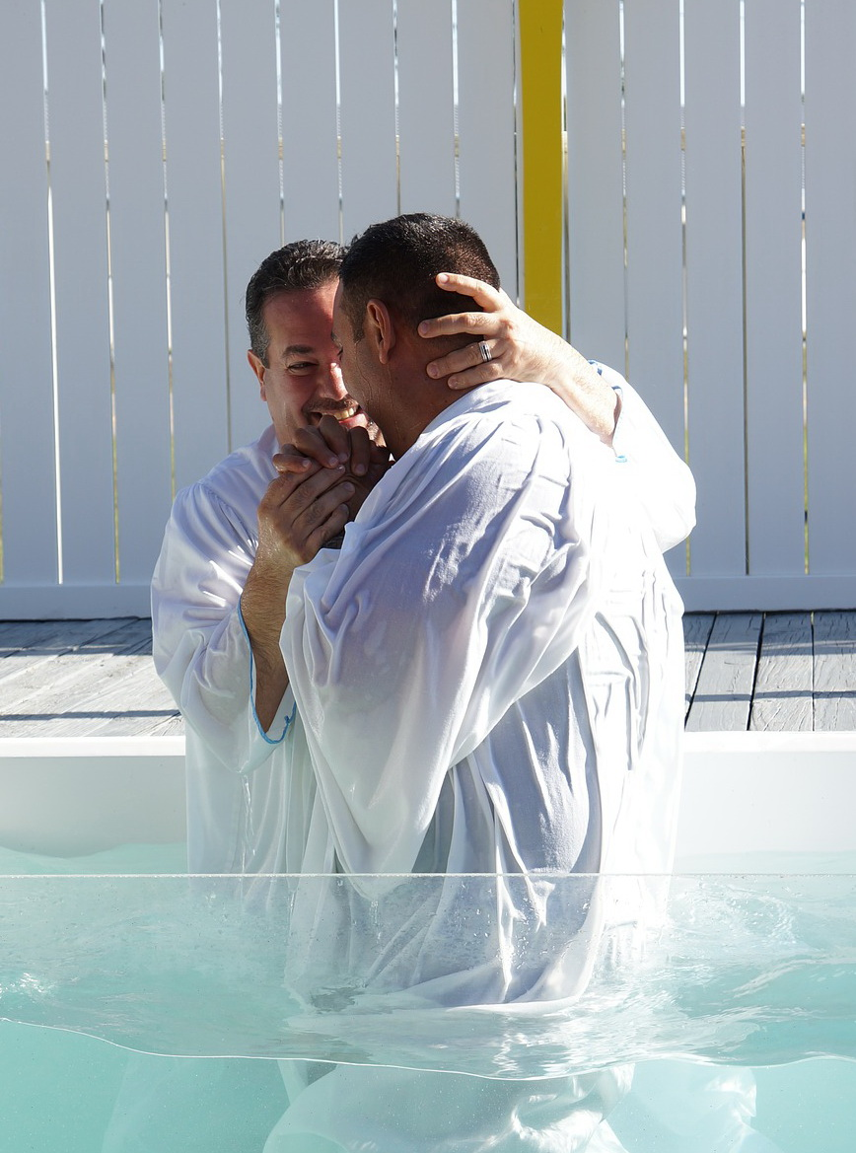
The Bible’s Response
Acts 22:16 – And now why are you waiting? Arise and be baptized, and wash away your sins, calling on the name of the Lord.

Slide 9
© Copyright David E. Pratte, 2023
Permission is granted to display this PowerPoint under the following conditions:
* Display the link to BibleStudyLessons.com
* Minor changes in content are permitted, but no teaching should be presented that disagrees with the teaching in the article associated with this PowerPoint at www.BibleStudyLessons.com/powerpoint
* In no case may a fee of any kind be charged for our PowerPoints.
* If you have a website, please add a link to https://BibleStudyLessons.com
Scripture quotations are generally from the New King James Version (NKJV), copyright 1982, 1988 by Thomas Nelson, Inc. Used by permission. All rights reserved.
biblestudylessons.com

