Slide 2
For 200 years, to become a Christian meant the great renunciation, the joining of a despised and persecuted sect, the swimming against the tide of popular prejudice, the coming under the ban of the Empire, the possibility at any moment of imprisonment and death under its most fearful forms. For 200 years he that would follow Christ must count the cost, and be prepared to pay the same with his liberty or life. For 200 years the mere profession of Christianity was itself a crime … For the name [Christian] itself … meant the rack, the blazing shirt of pitch, the lion, the panther, or in the case of maidens an infamy worse than death.
- ISBE, pp 2326f
biblestudylessons.com

Slide 3

A Living Sacrifice
Social Rejection
Hatred
John 7:7; 15:18-21
Mockery and Lies
Matthew 5:10-12; 10:25; 26:59-68; 27:27-31,39-44; Hebrews 12:2,3
Alienation from Friends
and Loved Ones
Luke 6:22,23; Matthew 10:21,34-37; Luke 14:26

Slide 4
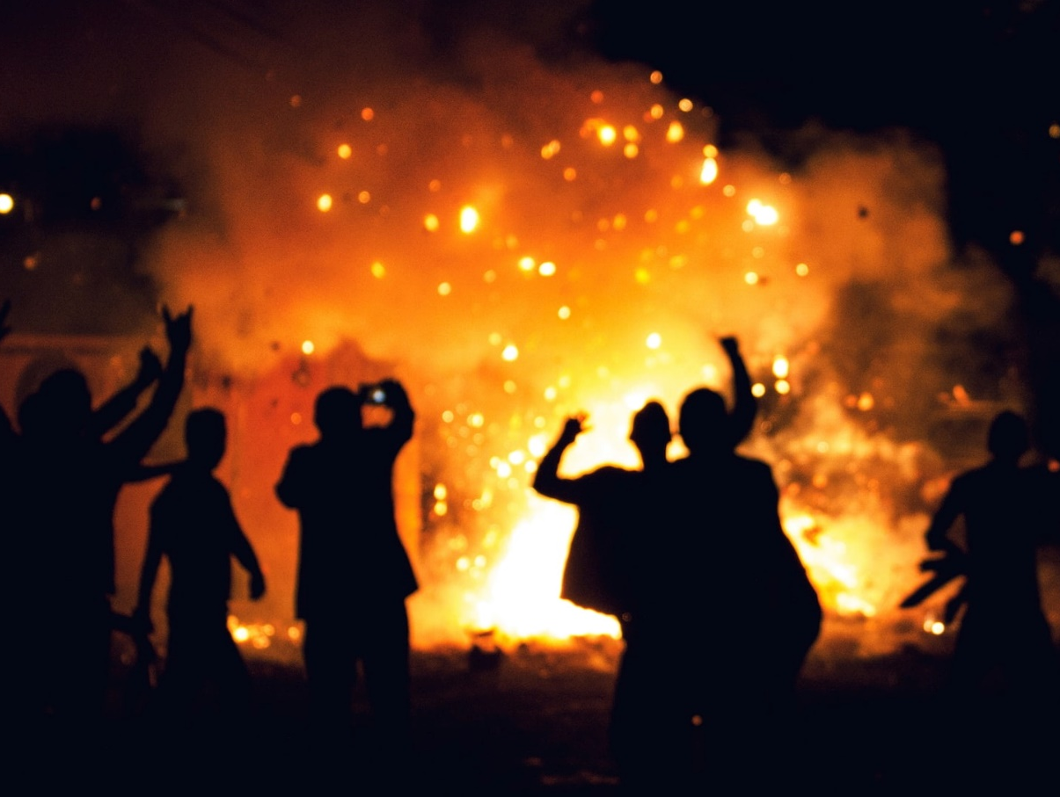
A Living Sacrifice
Personal/Material Loss
Loss of Home, Property,
Possessions, Job, Income
Genesis 12:1; 1 Kings 18:4; Acts 8:1; Luke 14:33; Matthew 19:29
Sacrifice of Personal Pleasures
1 John 2:15-17; Hebrews 11:24-26; Acts 24:25; Philippians 3:7,8

Slide 5
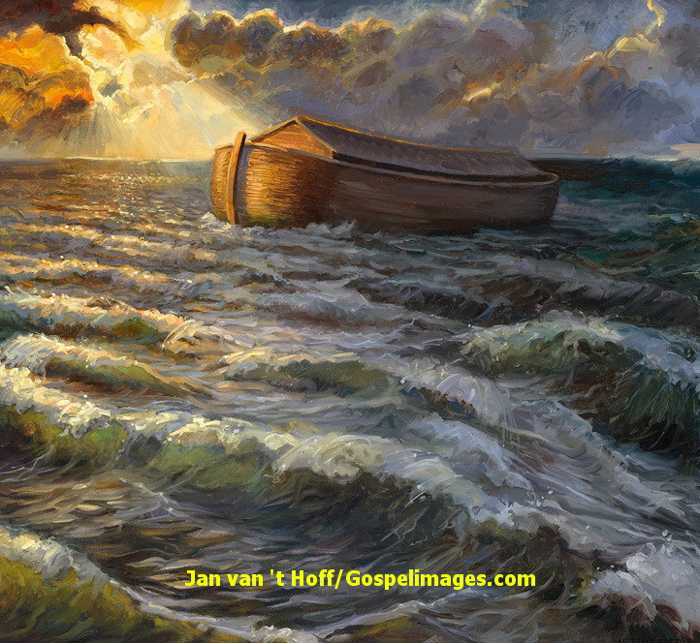
A Living Sacrifice
Difficult Labors
Noah -- Genesis 6:14-16
Moses (Book of Exodus)
Apostles - Mark 16:15; Colossians 1:23; Hebrews 11:26

Slide 6
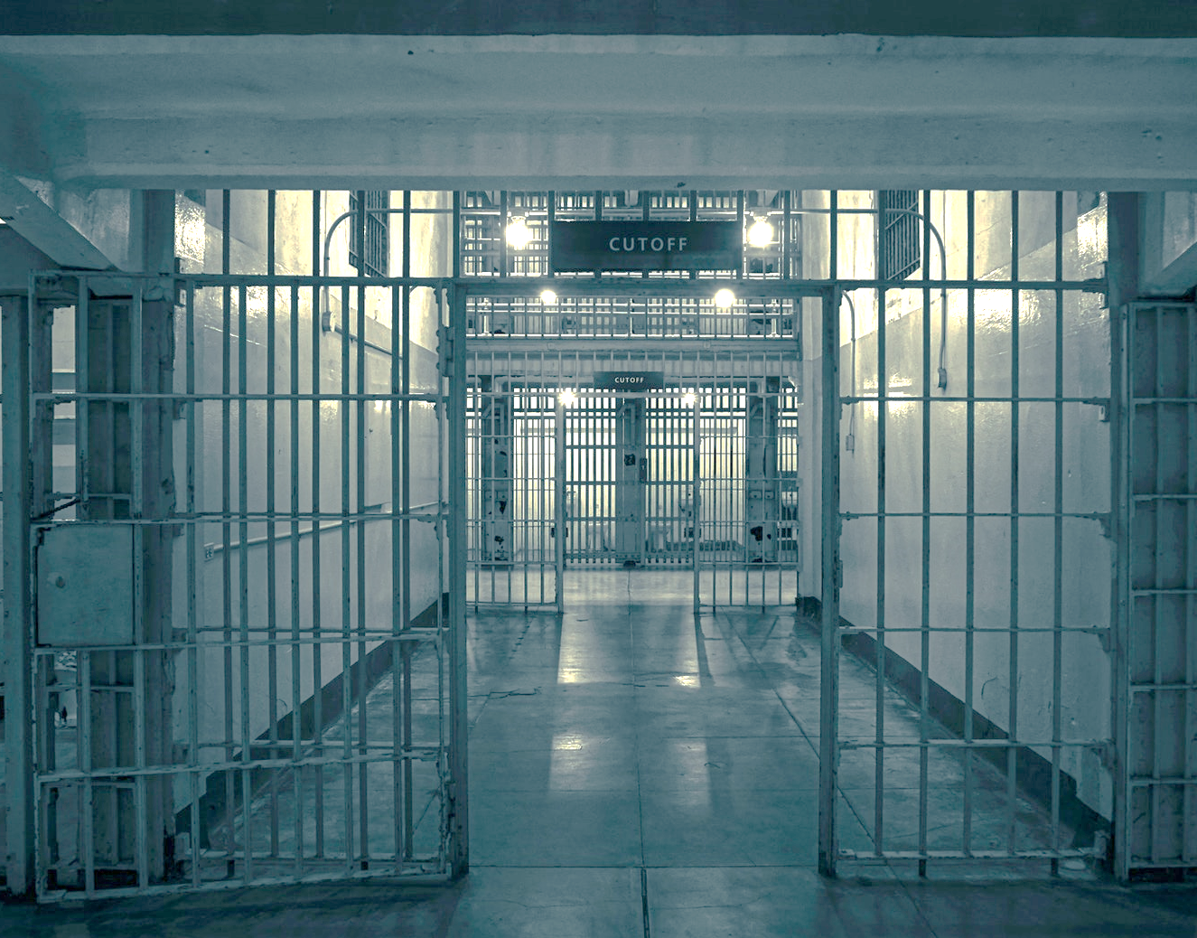
A Living Sacrifice
Physical Danger
Old Testament
Genesis 39:1-20; Jeremiah 37:15-17 Daniel 3 & 6
New Testament
Matt. 14:1-12; Acts 5:40-42; 7:51-60; 12:1,2; 8:3; 9:1,2;
2 Cor. 11:23-27; 2 Tim. 3:12

Slide 7
“Accordingly, first, those were seized who confessed they were Christians; next, on their information, a vast multitude were convicted … And in their deaths they were made the subject of sport, for they were covered with the skins of wild beasts and were worried to death by dogs, or nailed to crosses, or set fire to, and when day declined were burned to serve for nocturnal lights. Nero offered his own gardens for that spectacle, and exhibited circus games … — Roman Historian Tacitus (via ISBE, p. 2325)

Slide 8
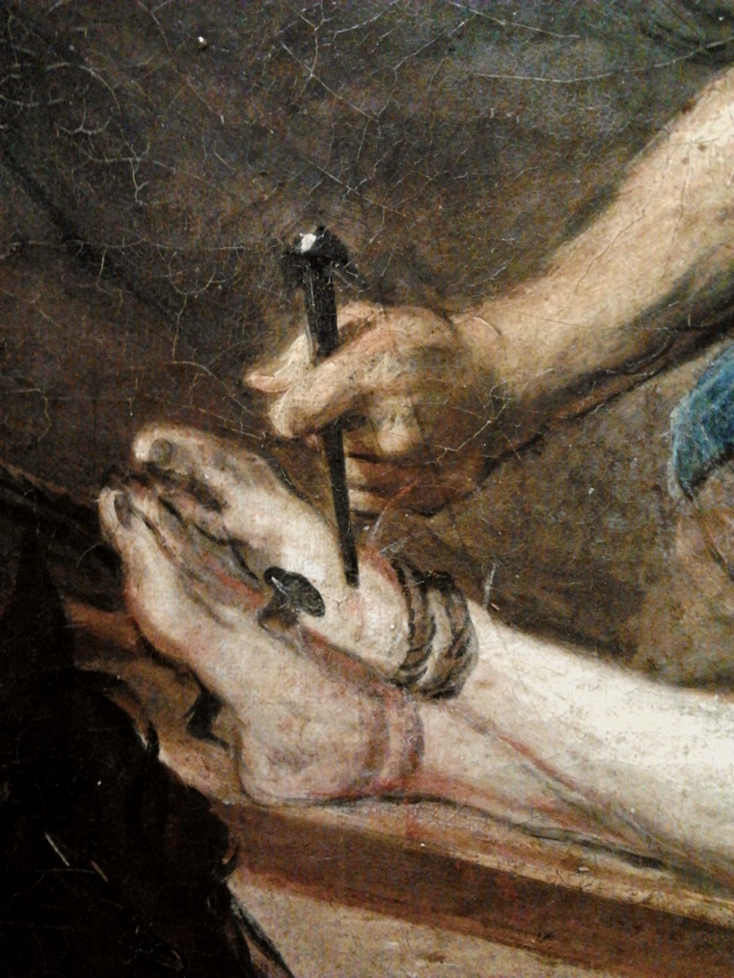
A Living Sacrifice
Social Rejection
Personal/Material Loss
Difficult Labors
Physical Danger
Luke 14:26; Acts 5:40-42; Romans 8:16-18
Are we willing to sacrifice to please our Lord?
If we appreciated God’s gifts, would we have a better attitude?
Are you making the sacrifices of true discipleship?

Slide 10
© Copyright David E. Pratte, 2023
Permission is granted to display this PowerPoint under the following conditions:
* Display the link to BibleStudyLessons.com
* Minor changes in content are permitted, but no teaching should be presented that disagrees with the teaching in the article associated with this PowerPoint at www.BibleStudyLessons.com/powerpoint
* In no case may a fee of any kind be charged for our PowerPoints.
* If you have a website, please add a link to https://BibleStudyLessons.com
Scripture quotations are generally from the New King James Version (NKJV), copyright 1982, 1988 by Thomas Nelson, Inc. Used by permission. All rights reserved.
biblestudylessons.com

