Slide 2

Emotions:
Who Is in Charge?
Emotions Are Natural
Fppt.com
www.BibleStudyLessons.com

Slide 3

Emotions Are Natural
Sorrow
Ecclesiastes 3:4 – There is a time to weep, and a time to laugh.
Romans 12:15 – Rejoice with those who rejoice, and weep with those who weep.
Isaiah 53:3 – Jesus was a Man of sorrows and acquainted with grief.
John 11:35 – Jesus wept at the death of Lazarus.
Luke 19:41 – Jesus wept over the sins of Jerusalem.

Slide 4

Emotions Are Natural
Fear
Philippians 2:12 – Work out your own salvation with fear and trembling.
1 Corinthians 2:3 – I was with you in weakness, in fear, and in much trembling.
Proverbs 14:16 – A wise man fears and departs from evil.
Hebrews 10:30,31 – It is a fearful thing to fall into the hands of the living God.

Slide 5
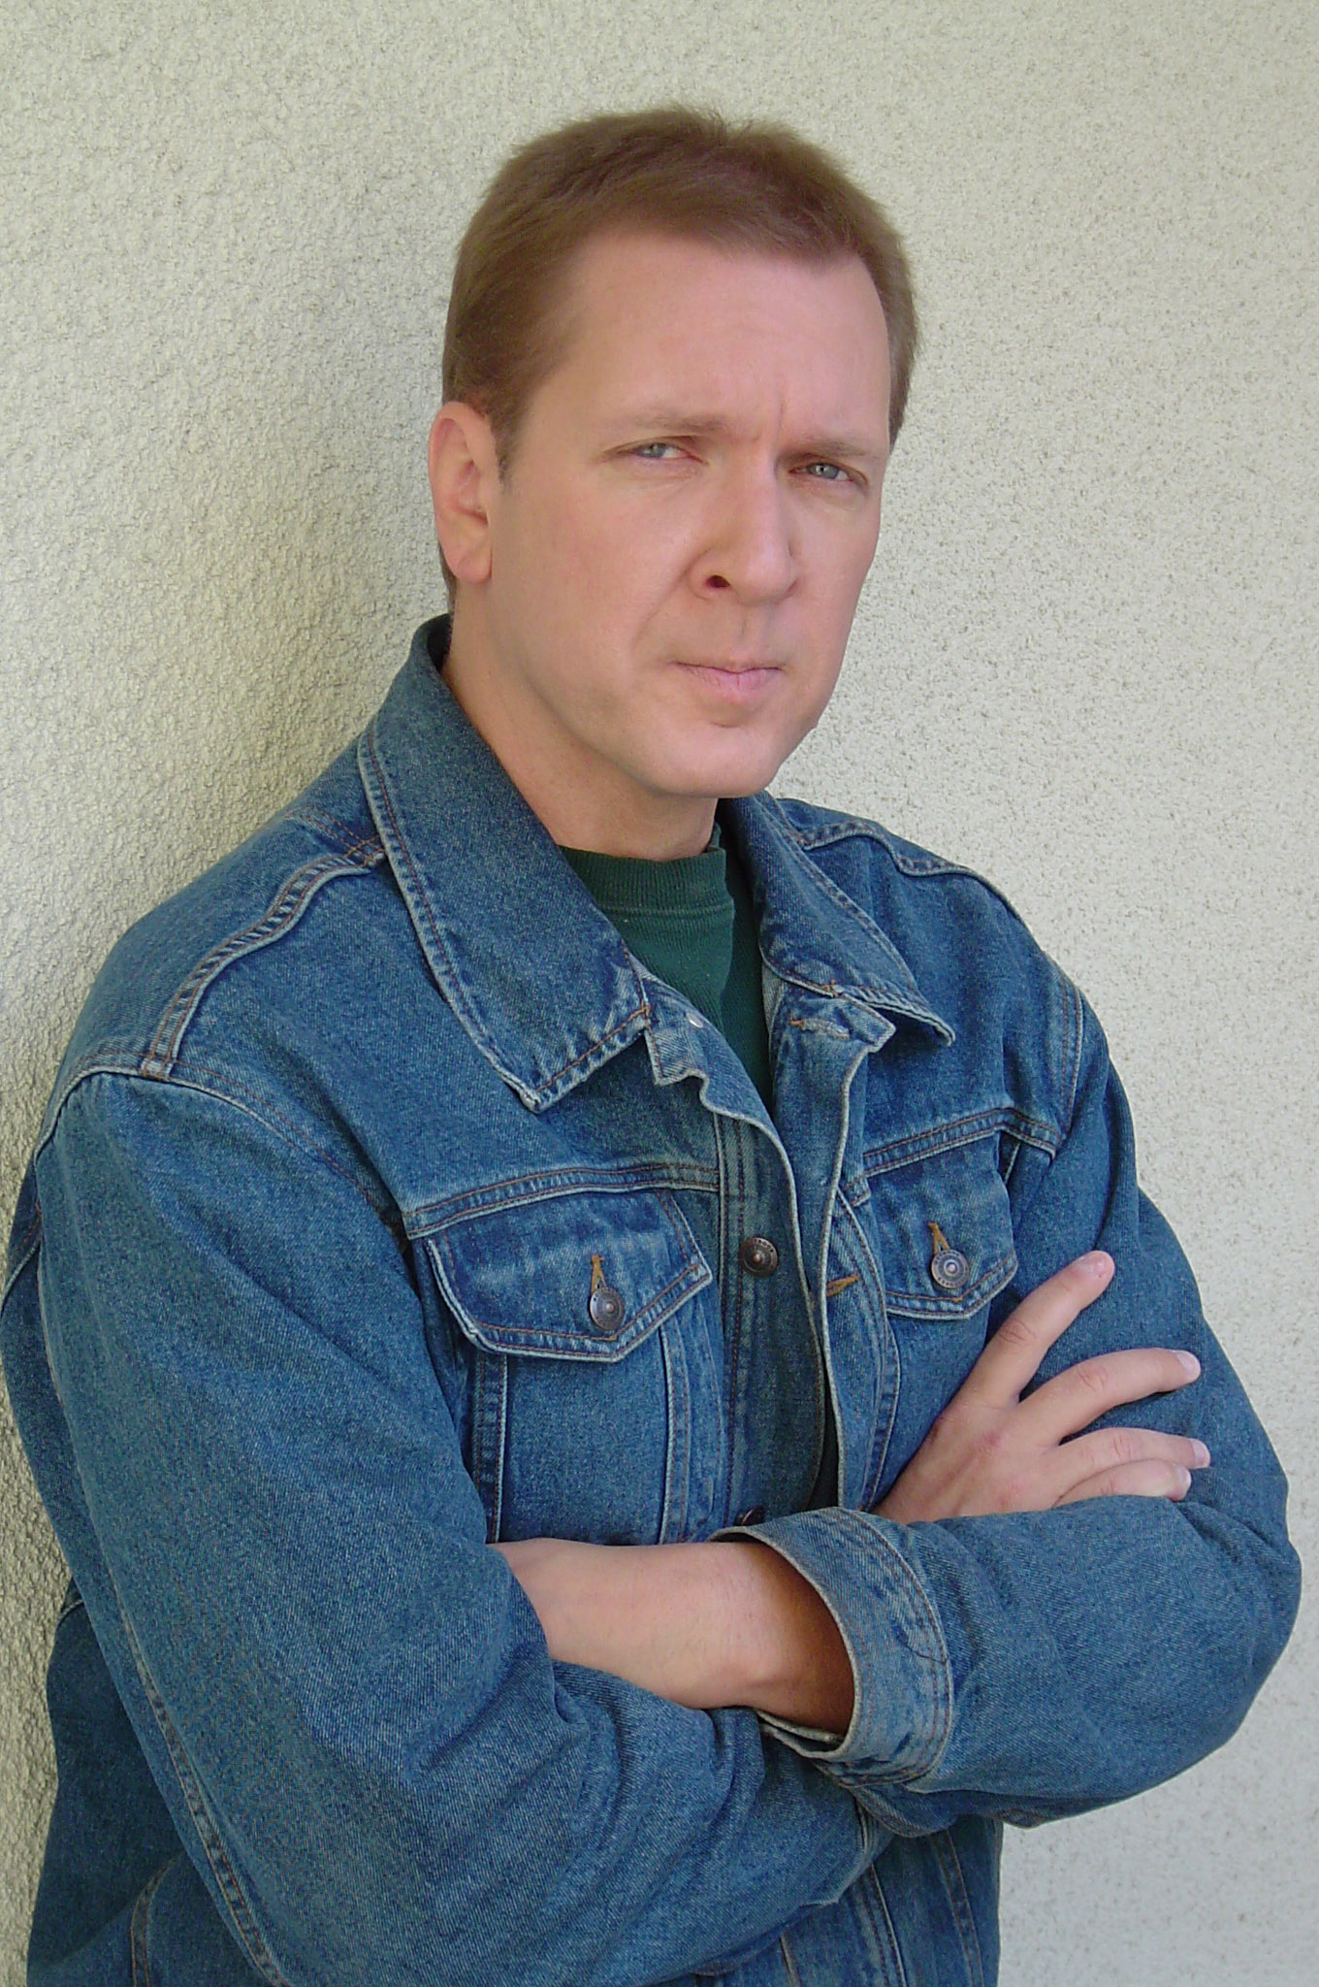
Emotions Are Natural
Anger
Ephesians 4:26 – Be angry, and do not sin.
Psalm 7:11 – God is angry with sinners every day.
Mark 3:5 – Jesus looked on the Jewish leaders in anger, being grieved at their hardness of heart.

Slide 6
Emotions:
Who Is in Charge?
Emotions Are Natural
Emotions Must Be Controlled

Slide 7
Emotions Must Be Controlled
Anger
Ephesians 4:26; James 1:19,20; Proverbs 16:32; 25:28; 29:11,20
Fear
Do not allow fear of people to lead us to disobey God.
Luke 12:4,5; Revelation 2:10; Galatians 2:12
Trusting God can give us strength to overcome fear.
Hebrews 13:6; Proverbs 29:25
Sorrow
Job 1,2; 2:9; 42:3,6

Slide 8
Emotions:
Who Is in Charge?
Emotions Are Natural
Emotions Must Be Controlled
We Need a Better Standard

Slide 9
We Need a Better Standard than Emotions
    Are Feelings a Reliable Guide in Religion?
Many errors occur because people follow feelings.
People who follow feelings often contradict one another.
1 Corinthians 1:10-13
How do you know which feelings come from God and which come from Satan?
2 Corinthians 11:13-15
The Bible specifically warns that feelings may lead us into error.
Proverbs 28:26; 14:12; Jeremiah 17:9; 10:23

Slide 10

We Need a Better Standard than Emotions
    What Guide Can Tell Us What Is True in Religion?
    Romans 10:17; Psalms 119:105; Acts 17:2,3; 17:11; 2 Timothy 3:13-17; 1 John 2:3-6

Slide 11
Emotions:
Who Is in Charge?
Emotions Are Natural
Emotions Must Be Controlled
We Need a Better Standard
Worship Seeks Higher Goals

Slide 12
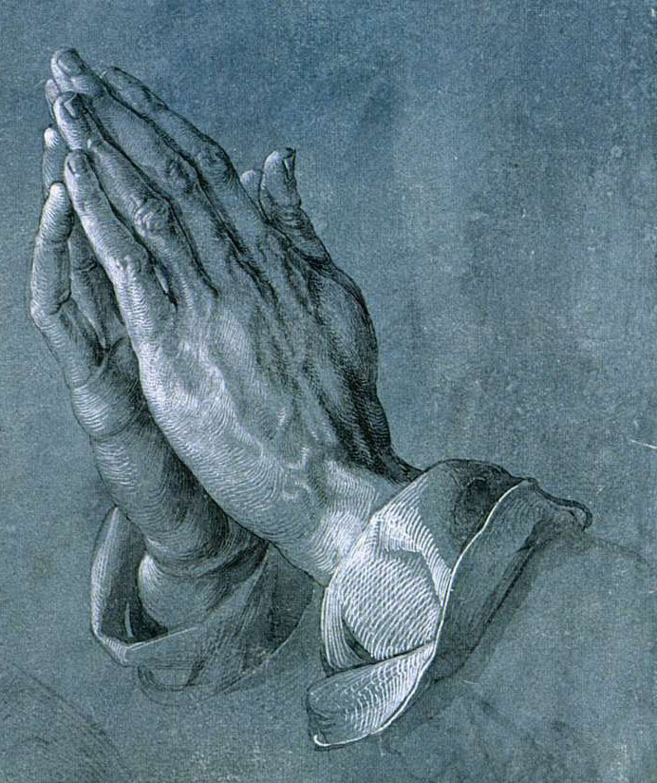
Worship Should Seek Spiritual Goals
1 Kings 18:25-40; 2 Corinthians 10:3-5
The primary purpose of worship is to honor and praise God.
Hebrews 13:15; Revelation 4:9-11;
Isaiah 55:8,9; Luke 16:15
Worship should also teach God’s will and encourage obedience
Col. 3:16; Hebrews 10:24,25; Ephesians 4:14-16
Proper worship practices only what God authorizes.
Matthew 15:9; Colossians 3:17; 2 John 9; Galatians 1:8,9

Slide 13
Emotions:
Who Is in Charge?
Are emotions inherently bad? NO!
Is it wrong to be emotional about religion? NO!
Is it wrong to be emotional in worship? NO!
But: We should control our emotions so our beliefs, practices, and worship are determined, not by emotions, but by God’s word to please Him and teach others the truth.

Slide 14
© Copyright David E. Pratte, 2020
Permission is granted to display this PowerPoint under the following conditions:
* Display the link to www.BibleStudyLessons.com
* Minor changes in content are permitted, but no teaching should be presented that disagrees with the teaching in the article associated with this PowerPoint on www.BibleStudyLessons.com/powerpoint
* In no case may a fee of any kind be charged for our PowerPoints.
* If you have a website, please add a link to www.BibleStudyLessons.com
Scripture quotations are generally from the New King James Version (NKJV), copyright 1982, 1988 by Thomas Nelson, Inc. Used by permission. All rights reserved.
www.BibleStudyLessons.com

