Slide 1

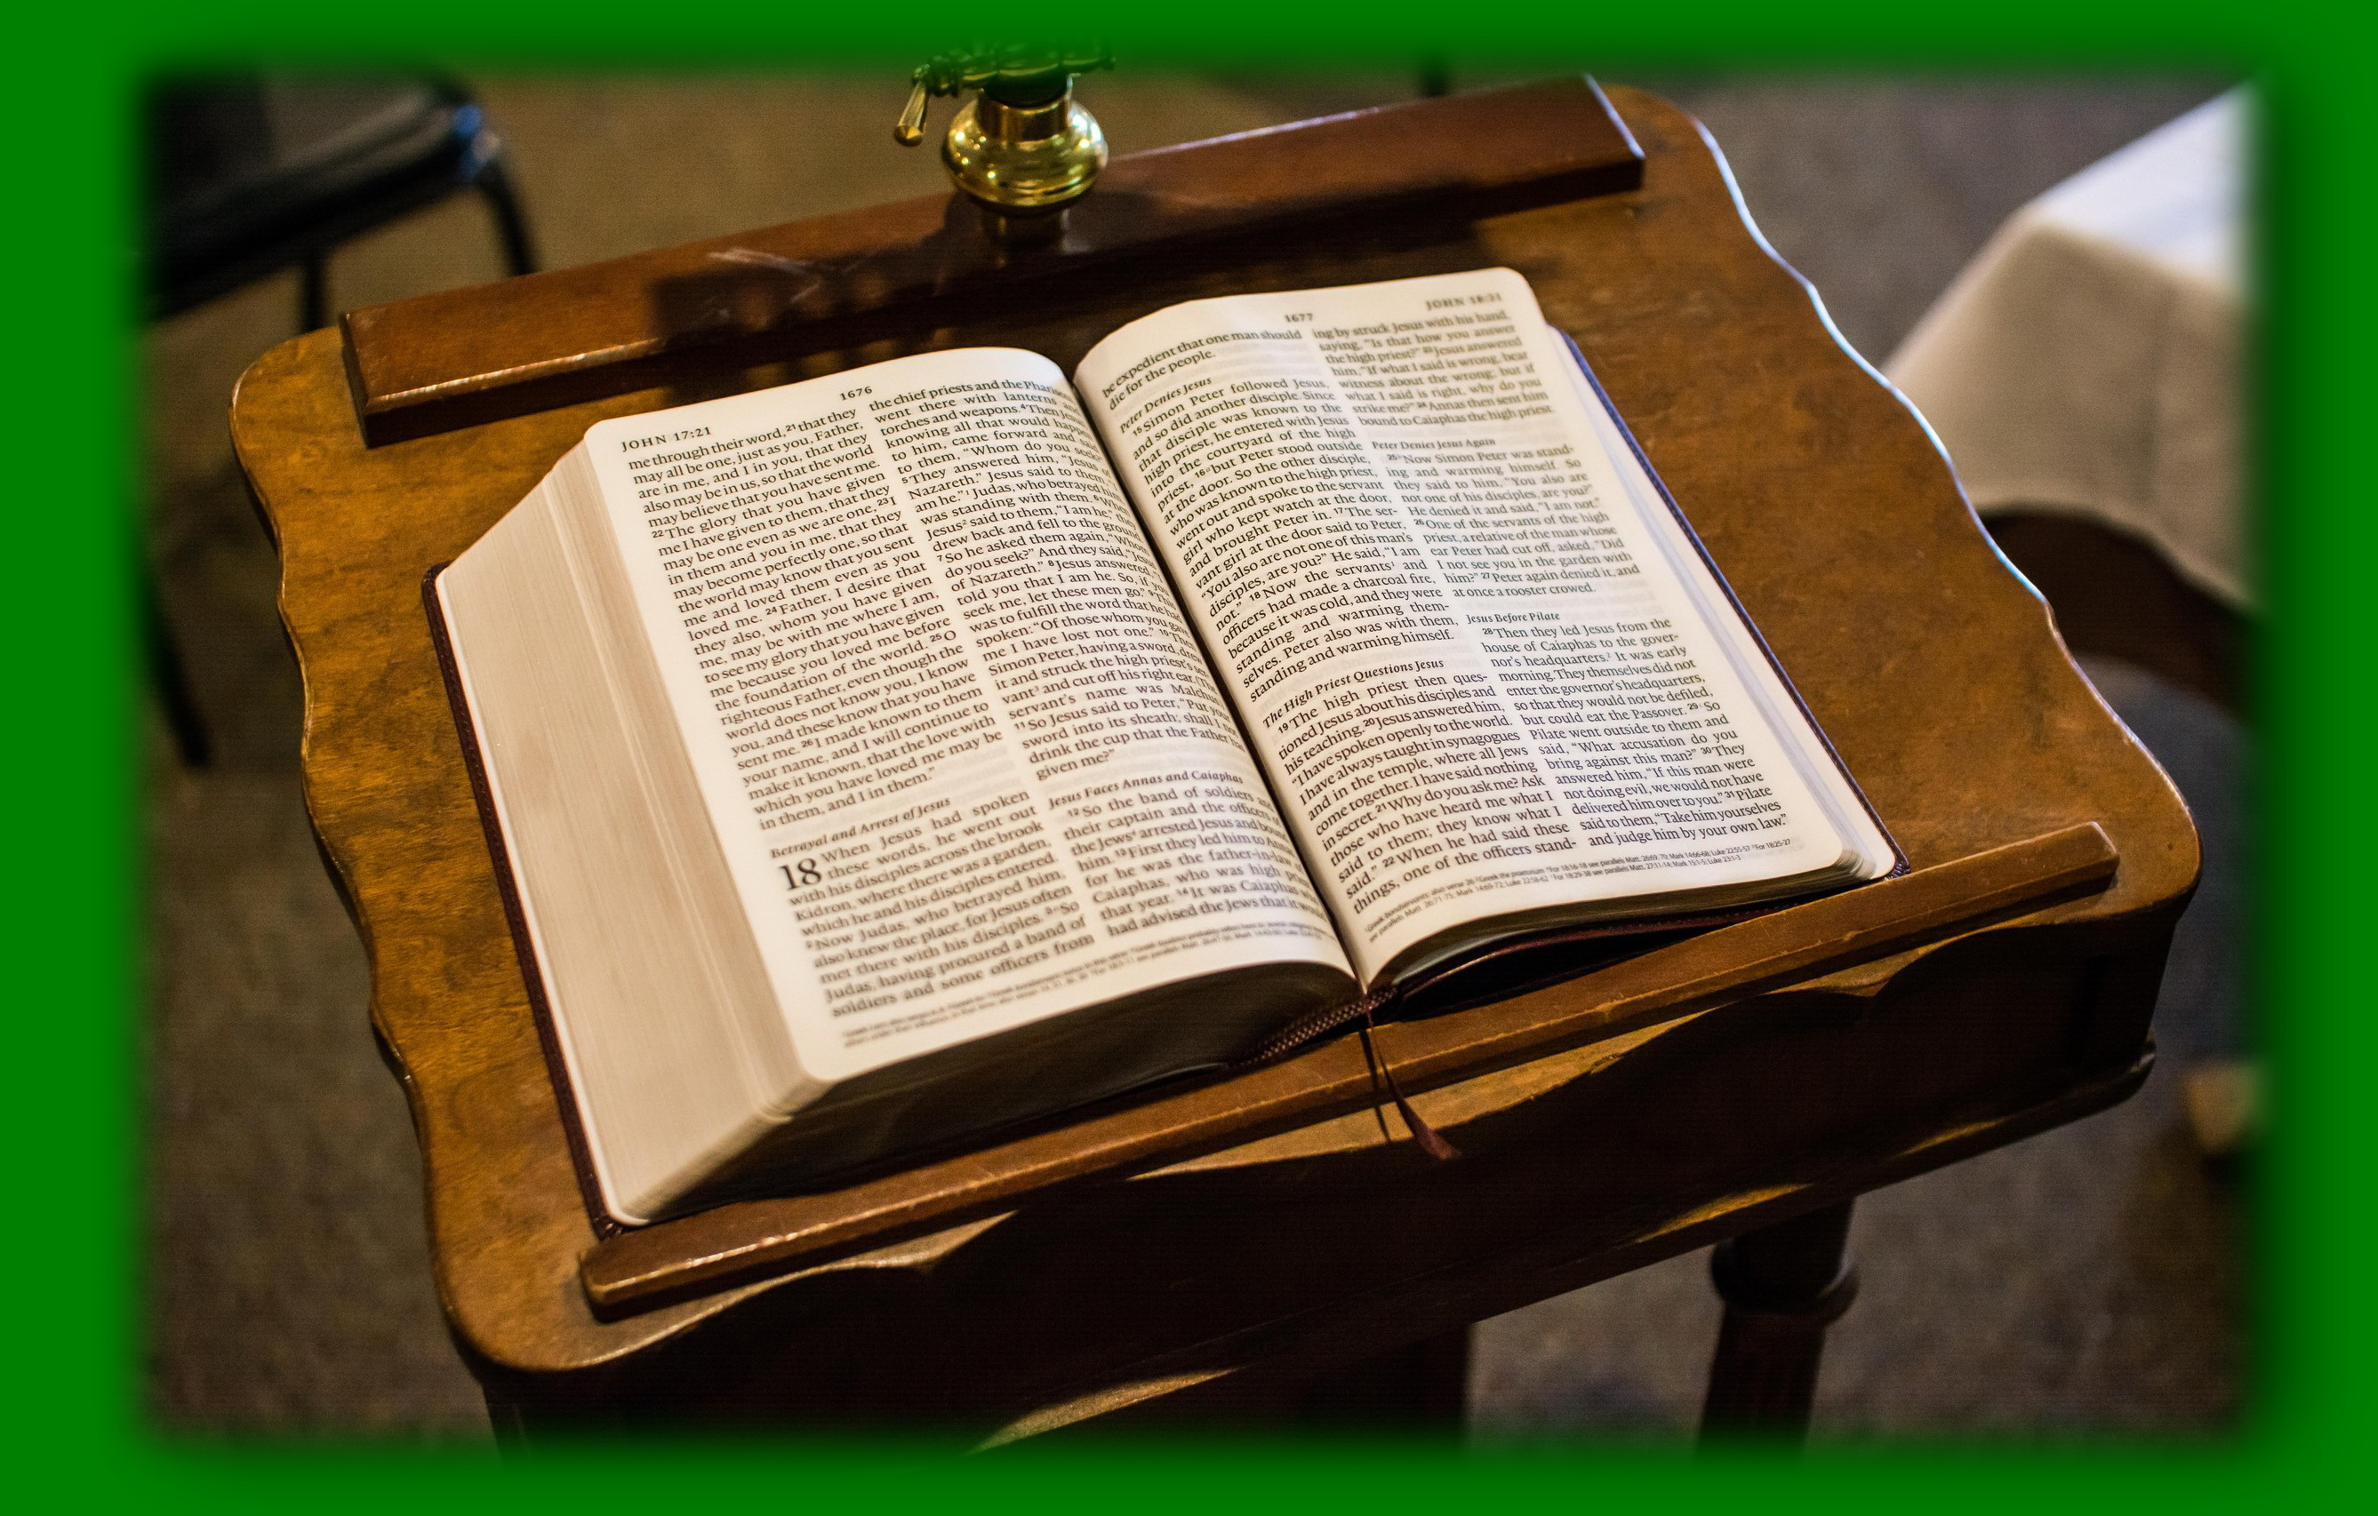
Revelation and God’s Eternal Purpose
Major Themes
www.BibleStudyLessons.com

Slide 2
Major Themes
Acts 15:18 – Known to God from eternity are all His works. Forgiveness/Salvation from Sin
Ephesians 1:4 – He chose us in Him [Christ] before the foundation of the world
Ephesians 1:9 – His good pleasure which He purposed in Himself.
Ephesians 1:11 – according to the purpose of Him who works all things according to the counsel of His will

Slide 3
Major Themes
Acts 15:18 – Known to God from eternity are all His works. Forgiveness/Salvation from Sin
Jesus’ Life, Death, and Resurrection
Acts 2:23 – [Jesus] delivered by the determined purpose and foreknowledge of God
Acts 4:27,28 – [Jesus’ enemies] were gathered together to do whatever Your hand and Your purpose determined before to be done.
1 Peter 1:18-20 – He was foreordained before the foundation of the world, but was manifest in these last times.

Slide 4
Major Themes
Acts 15:18 – Known to God from eternity are all His works. Forgiveness/Salvation from Sin
Jesus’ Life, Death, and Resurrection
The Church
Ephesians 3:9-11 – …the mystery, which from the beginning of the ages has been hidden in God who created all things … that now the manifold wisdom of God might be made known by the church to the principalities and powers in the heavenly places, according to the eternal purpose which He accomplished in Christ Jesus our Lord.

Slide 5
Major Themes
Acts 15:18 – Known to God from eternity are all His works. Forgiveness/Salvation from Sin
Jesus’ Life, Death, and Resurrection
The Church
Judgment and Eternal Rewards
Acts 17:31 – God has appointed a day on which He will judge the world in righteousness by the Man whom He has ordained.
Matthew 25:34 –‘Come, you blessed of My Father, inherit the kingdom prepared for you from the foundation of the world’

Slide 6
Major Themes
Acts 15:18 – Known to God from eternity are all His works. Forgiveness/Salvation from Sin
Jesus’ Life, Death, and Resurrection
The Church
Judgment and Eternal Rewards
A Summary Passage
2 Timothy 1:9,10

Slide 7
Revelation and God’s Eternal Purpose
Major Themes
Major Events

Slide 8
Major Events
Creation
Genesis 1

Slide 9
Major Events
Creation
First sin
Genesis 3:15 – “He shall bruise your head, and you shall bruise His heel.”

Slide 10
Major Events
Creation
First sin
Abraham, the patriarchs, and the nation of Israel
Genesis 12 –Verse 2 – A great nation
Verse 3 – Blessing on all the families of the earth
Verse 7 – Land of Canaan
(Genesis 22:17,18; 26:3,4).
Acts 3:25,26 – The blessing promised upon all nation was redemption from sin through Jesus Christ.

Slide 11
Major Events
Creation
First sin
Abraham, the patriarchs, and the nation of Israel
The Law of Moses
Moses – Deuteronomy 18:18,19; (Acts 3:22,23).
The law –Galatians 3:24,25
Priesthood – Numbers 18; (Hebrews 8:1).

Slide 12
Major Events
Creation
First sin
Abraham, the patriarchs, and the nation of Israel
The Law of Moses
Conquest of Canaan
Joshua 21:43-45; 23:14

Slide 13
Major Events
Creation
First sin
Abraham, the patriarchs, and the nation of Israel
The Law of Moses
Conquest of Canaan
Judges
Ruth 4:13-22; (Matthew 1:5)

Slide 14
Major Events
Creation
First sin
Abraham, the patriarchs, and the nation of Israel
The Law of Moses
Conquest of Canaan
Judges
Kings: David and his dynasty
2 Samuel 7:12-16; (Acts 2:30)

Slide 15
Major Events
Creation
First sin
Abraham, the patriarchs, and the nation of Israel
The Law of Moses
Conquest of Canaan
Judges
Kings: David and his dynasty
Prophets
Isaiah 53 - The sacrifice of Christ
Jeremiah 31:31-34 - The coming of a new covenant
Daniel chapter 2 - The beginning of God’s kingdom
Acts 3:24 – All the prophets foretold these days

Slide 16
Major Events
Creation
First sin
Abraham, the patriarchs, and the nation of Israel
The Law of Moses
Conquest of Canaan
Judges
Kings: David and his dynasty
Prophets
Christ and His church

Slide 17
Revelation and God’s Eternal Purpose
Major Themes
Major Events
Role of Scripture

Slide 18
Scripture in God’s Eternal Purpose
Romans 16:25,26 – Him who is able to establish you according to my gospel and the preaching of Jesus Christ, according to the revelation of the mystery kept secret since the world began but now has been made manifest, and by the prophetic Scriptures has been made known
1 Corinthians 2:7 – We speak the wisdom of God in a mystery, the hidden wisdom which God ordained before the ages for our glory.
Titus 1:2,3 – In hope of eternal life which God, who cannot lie, promised before time began, but has in due time manifested His word through preaching.
1 Peter 1:10-12 – Prophets prophesied the coming of Christ … They sought to understand, but were told that the fulfillment of the message was for those who came later. That fulfillment has now been preached in the gospel.

Slide 19
Scripture in God’s Eternal Purpose
Observations
God had a plan since the world began.
Before the gospel, God’s plan was a mystery, not fully or clearly revealed.
The mystery was made manifest in the first century to inspired men who taught it in the gospel.
Every story and passage directly or indirectly relate to God’s eternal purpose.
The focus of this entire plan is fulfilled in Jesus Christ, His life, death, and resurrection.
(Compare Stephen in Acts 7 and Paul in Acts 13)

Slide 20
Revelation and God’s Eternal Purpose
The eternal purpose of God: Salvation from sin offered to all through the sacrifice of Jesus Christ.

Slide 21
© Copyright David E. Pratte, 2019
Permission is granted to display this PowerPoint under the following conditions:
* Display the link to www.BibleStudyLessons.com
* Minor changes in content are permitted, but no teaching should be presented that disagrees with the teaching in the article associated with this PowerPoint on www.BibleStudyLessons.com/powerpoint
* In no case may a fee of any kind be charged for our PowerPoints.
* If you have a website, please add a link to www.BibleStudyLessons.com
Scripture quotations are generally from the New King James Version (NKJV), copyright 1982, 1988 by Thomas Nelson, Inc. Used by permission. All rights reserved.
www.BibleStudyLessons.com

