Slide 1

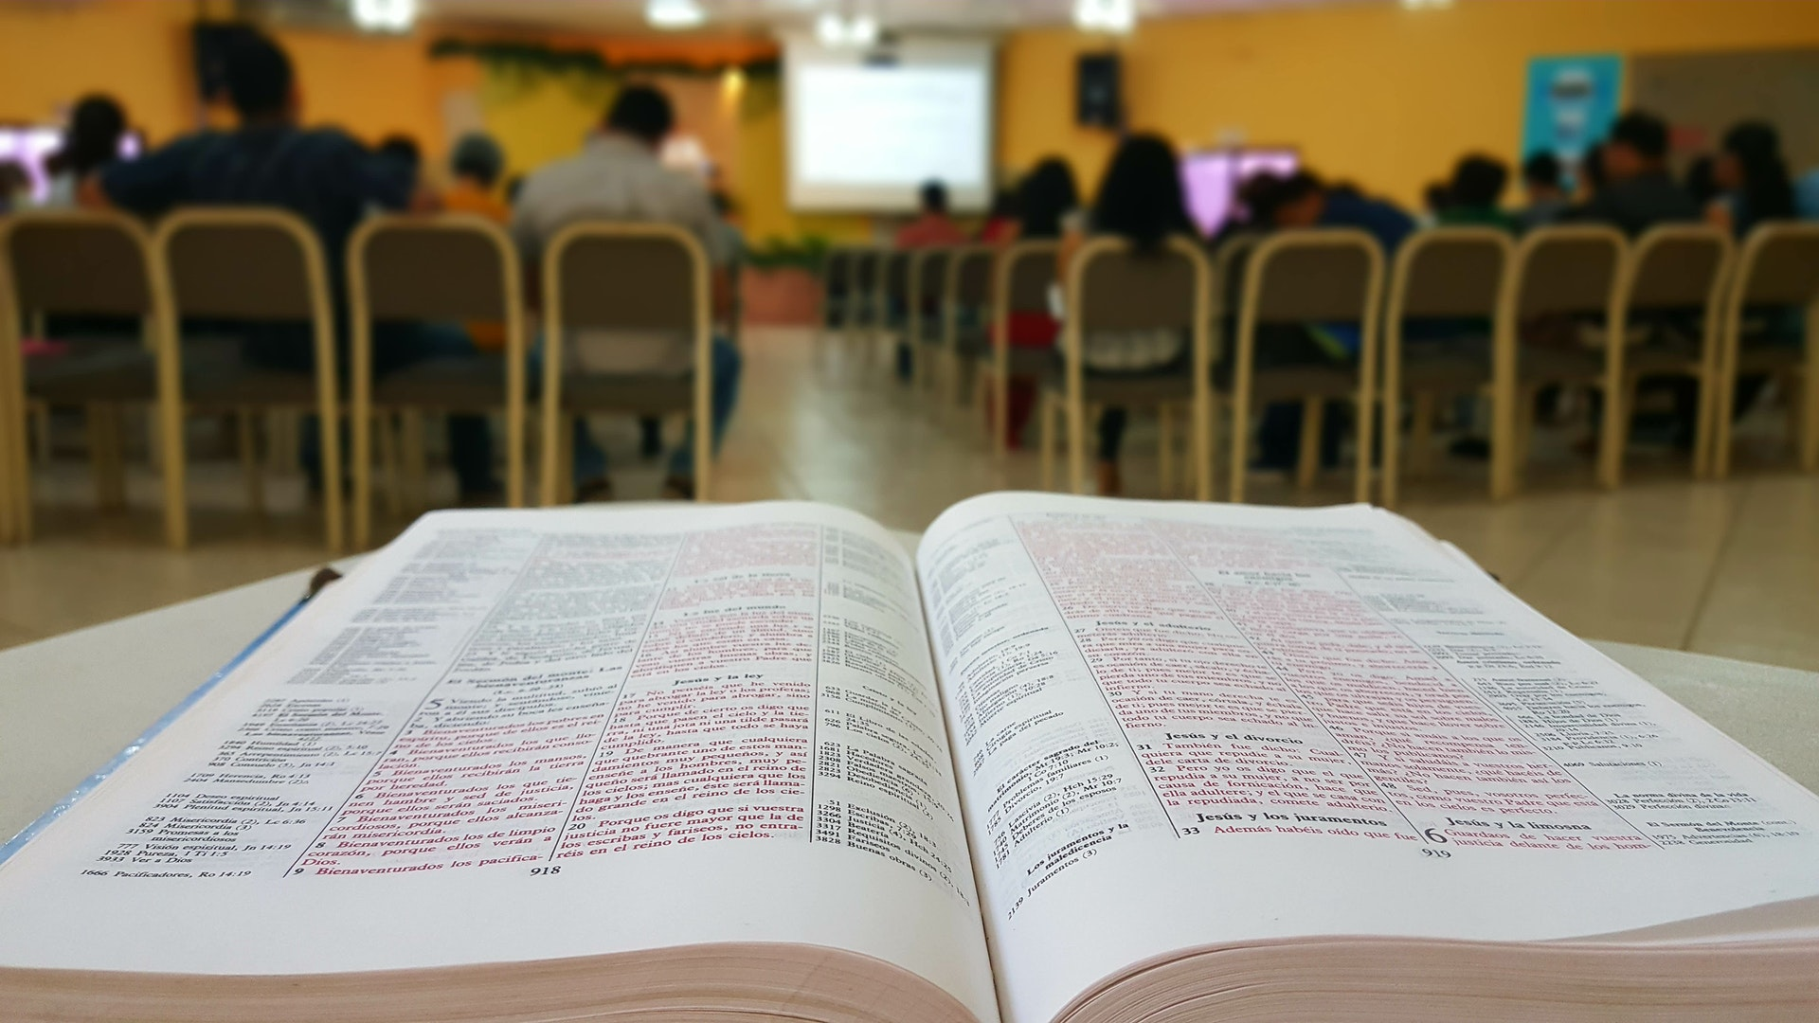
Every Part Doing Its Share
www.BibleStudyLessons.com

Slide 2
Every Member Obeying and Working
Luke 6:40; Romans 2:6-10; Matthew 7:24-27
Every Part Doing Its Share

Slide 3
Every Part Doing Its Share
Every Member Studying the Bible
Knowledge - John 18:37; Colossians 1:28
Unity - John 17:20,21; 1 Corinthians 1:10
Judgment - Romans 14:10-12; John 12:48

Slide 4
Every Member Serving Others
1 Peter 4:10,11; Galatians 5:13;
Matthew 25:34-36
Every Part Doing Its Share

Slide 5
Every Member Teaching and Encouraging Others
Hebrews 3:12-14; Ephesians 4:15,16
Every Part Doing Its Share

Slide 6
** Attend all assemblies and classes
** Arrive on time
** Develop abilities to lead / volunteer
** Prepare diligently for any leadership roles
** Prepare for class
** Invite people to attend
** Greet visitors
** Teach Bible class
** Invite people to home Bible study
** Encourage new, weak, or erring members
** Encourage young people
** Older women teach younger women
** Pass out tracts or literature
** Study the Bible daily with your children
** Speak words of encouragement to others
Ways to Teach/Encourage Others
Every Part Doing Its Share

Slide 7
Every Part Doing Its Share
Each Christian is responsible for no more than his best
2 Corinthians 8:12
Each Christian is responsible for no less than his best
1 John 4:9-11

Slide 8
© Copyright David E. Pratte, 2019
Permission is granted to display this PowerPoint under the following conditions:
* Display the link to www.BibleStudyLessons.com
* Minor changes in content are permitted, but no teaching should be presented that disagrees with the teaching in the article associated with this PowerPoint on www.BibleStudyLessons.com/powerpoint
* In no case may a fee of any kind be charged for our PowerPoints.
* If you have a website, please add a link to www.BibleStudyLessons.com
Scripture quotations are generally from the New King James Version (NKJV), copyright 1982, 1988 by Thomas Nelson, Inc. Used by permission. All rights reserved.
www.BibleStudyLessons.com

