Slide 1
What Must We Believe?
God’s Existence
Hebrews 11:6
God’s Works
Psalms 78:32,33; Hebrews 11:3
God’s Character and Power
John 6:69; 1 Corinthians 2:5;
1 John 4:16
One True God
2 Kings 17:12-14; Isaiah 43:10-12; James 2:19
God
www.BibleStudyLessons.com

Slide 2
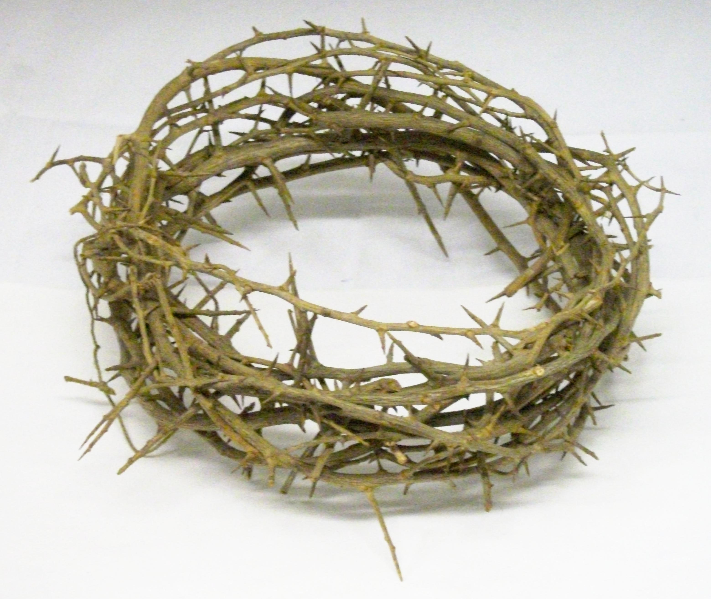
Jesus
What Must We Believe?
Believe in Jesus
John 14:1; 8:24
Character and Works
John 10:38; 11:27;
Matthew 16:13-17; John 20:28-31
Our Sacrifice and Savior
John 4:42; 1 Corinthians 15:1-8
Jesus' Resurrection
1 Corinthians 15:1-8;
Romans 10:9,10; John 20:27-29

Slide 3
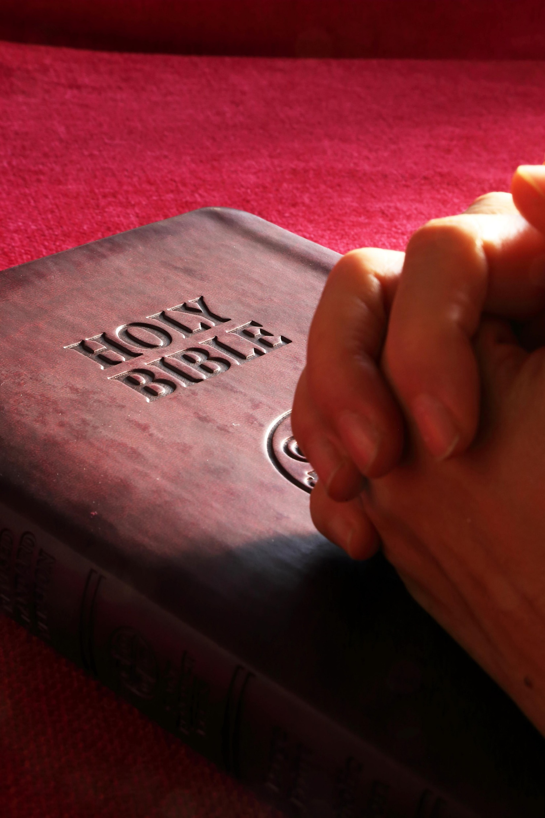
God’s Word
What Must We Believe?
General
God’s word/commands - Psalms 106:12,24,25; 119:66
Prophets - 2 Chronicles 20:20;
Acts 8:12; 1 John 4:1
The Scriptures - John 2:22; 5:46,47
The truth - John 8:45-47;
2 Thessalonians 2:11-13
The gospel - Mark 1:15; 1 Corinthians 15:1-8,11

Slide 4
God’s Word
What Must We Believe?
Specific
Obedience - Deuteronomy 1:26-33;
2 Kings 17:10-14; Hebrews 11
Baptism - Mark 16:15,16; Galatians 3:26,27
The church - Acts 8:12
Worship and marriage - 1 Timothy 4:1-3
Resurrection - 1 Corinthians 15:11-19;
2 Timothy 2:18

Slide 5
© Copyright David E. Pratte, 2019
Permission is granted to display this PowerPoint under the following conditions:
* Display the link to www.BibleStudyLessons.com
* Minor changes in content are permitted, but no teaching should be presented that disagrees with the teaching in the article associated with this PowerPoint on www.BibleStudyLessons.com/powerpoint
* In no case may a fee of any kind be charged for our PowerPoints.
* If you have a website, please add a link to www.BibleStudyLessons.com
Scripture quotations are generally from the New King James Version (NKJV), copyright 1982, 1988 by Thomas Nelson, Inc. Used by permission. All rights reserved.
www.BibleStudyLessons.com

