Slide 1
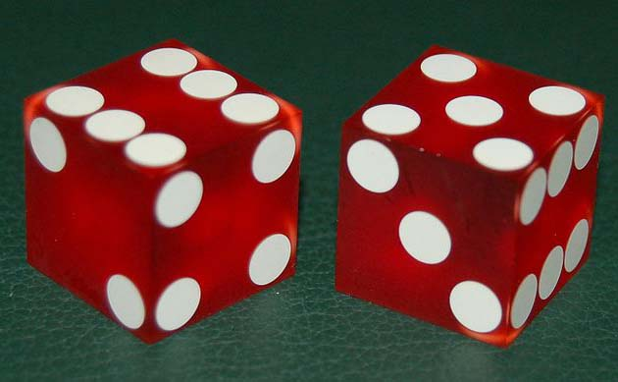
What Constitutes Gambling?
All the following must be present:
1. A game of chance or skill
2. Stakes
3. An agreement (wager or bet)
4. No mutual compensation
www.BibleStudyLessons.com

Slide 2
Examples of Gambling
Not this:
Driving a car
Games with no stakes
Farming, business
Investing in stock
Buying insurance
All the following must be present:
1. A game of chance or skill
2. Stakes
3. An agreement (wager or bet)
4. No mutual compensation
But this:
Casino gambling
Racetrack betting
Lotteries
Charity bingo, raffles
Cards for money
Office pools, etc.

Slide 3
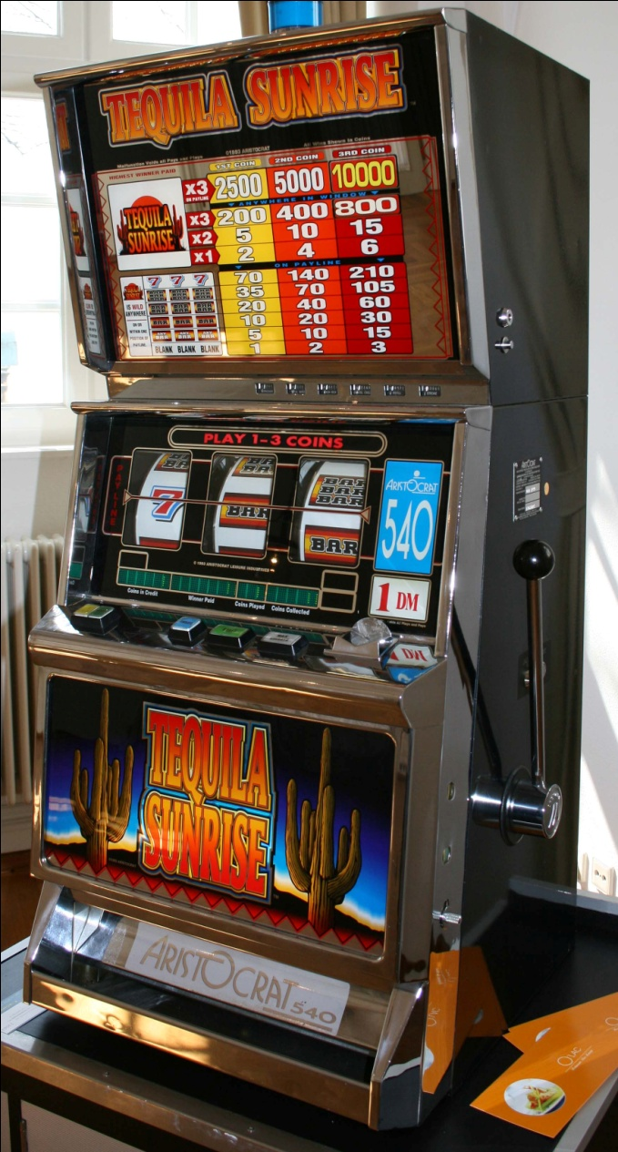
Bible Principles Regarding Gambling
Laws for transfer of property
Covetousness & greed
Stewardship
Law of love
Respect for others
Evil fruits
Evil influence/Temptation
Example & influence
Example of Jesus

Slide 4
Bible Principles Regarding Gambling
Laws for transfer of property

Slide 5
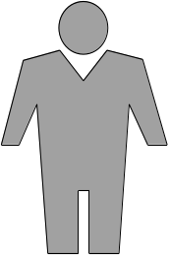
Laws for Transfer of Property
The Law of Exchange
Genesis 23:1-18;
Matthew 13:45,46; John 4:8
$$$
Goods
Mutual benefit, Fair exchange
Gambling fits none of these laws of transfer!

Slide 6
Laws for Transfer of Property
The Law of Exchange
Genesis 23:1-18;
Matthew 13:45,46; John 4:8
The Law of Labor
1 Timothy 5:18; Ephesians 4:28; 1 Thess. 4:11,12;
2 Thess. 3:10-12
$$$
Goods
$$$
Service
Mutual benefit, Fair exchange
Gambling fits none of these laws of transfer!

Slide 7
Laws for Transfer of Property
The Law of Exchange
Genesis 23:1-18;
Matthew 13:45,46; John 4:8
The Law of Labor
1 Timothy 5:18; Ephesians 4:28; 1 Thess. 4:11,12;
2 Thess. 3:10-12
The Law of Giving
Ephesians 4:28; 2 Cor. 9:6,7; Acts 20:35; 1 John 3:17,18; 1 Cor. 13:3
$$$
Goods
$$$
Service
$$$
Willingly: Love,
Compassion, Helpfulness
Gambling fits none of these laws of transfer!

Slide 8
Bible Principles Regarding Gambling
Laws for transfer of property
Covetousness & greed

Slide 9
Covetousness (Greed)
Ephesians 5:5-7; 1 Corinthians 6:9-11; Romans 1:29-32;
1 Corinthians 5:11; Acts 20:33-35; 2 Corinthians 9:5-7
Covetousness is the desire to take someone else’s property without giving mutual benefit or fair value in exchange!
$$$
No mutual benefit or fair exchange
or no love, compassion, helpfulness

Slide 10
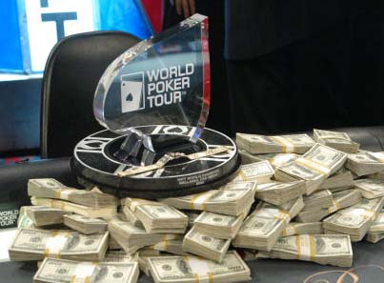
Don’t care about the money?
Listen to the Ads!
Two ways to become a millionaire:
Work hard or win the lottery!
A million a day … Just play!
Money, Money, Money, Money, Money!

Slide 11
Covetousness (Greed)
Ephesians 5:5-7; 1 Corinthians 6:9-11; Romans 1:29-32;
1 Corinthians 5:11; Acts 20:33-35; 2 Corinthians 9:5-7
Covetousness is the desire to take someone else’s property without giving mutual benefit or fair value in exchange!
$$$
No mutual benefit or fair exchange
Unwilling: No love, compassion, helpfulness
Gambling is covetousness and greed!

Slide 12
Bible Principles Regarding Gambling
Laws for transfer of property
Covetousness & greed
Stewardship
Law of love
Respect for others
Evil fruits
Evil influence/Temptation
Example & influence
Example of Jesus

Slide 13
Bible Principles Regarding Gambling
Laws for transfer of property
Covetousness & greed
Stewardship
1 Peter 4:10,11; Psalm 24:1,2; 50:10-12; 1 Timothy 6:9,10,17-19; Luke 16:1,2

Slide 14
Bible Principles Regarding Gambling
Laws for transfer of property
Covetousness & greed
Stewardship
Law of love
Matthew 22:39; 1 John 3:16-18; Romans 13:8-10; Matthew 7:12;
1 Corinthians 13:5; Philippians 2:4

Slide 15
Bible Principles Regarding Gambling
Laws for transfer of property
Covetousness & greed
Stewardship
Law of love
Respect for others
Civil law
Romans 13:1-5; 1 Peter 2:13-15 [2008 Uniform Complaint Book – chap 72, act 5, sec 28-1]

Slide 16
Bible Principles Regarding Gambling
Laws for transfer of property
Covetousness & greed
Stewardship
Law of love
Respect for others
Civil law
Parents
Ephesians 6:1; Romans 1:29-32
Husband/wife
Ephesians 5:22-29

Slide 17
Bible Principles Regarding Gambling
Laws for transfer of property
Covetousness & greed
Stewardship
Law of love
Respect for Others
Evil fruits

Slide 18
A Root of All Kinds of Evil
1 Timothy 6:9,10; Matthew 7:16-19
Poverty, family neglect, quarreling, divorce
Anger, hatred, and murder
Drinking and drugs, alcoholism and addiction
Lying
Crime
Government influence and corruption
Gambling addiction
Prostitution, lasciviousness, and immorality
Suicide

Slide 19
Bible Principles Regarding Gambling
Laws for transfer of property
Covetousness & greed
Stewardship
Law of love
Respect for Others
Evil fruits
Evil influence/Temptation
1 Timothy 6:9; Matthew 6:13; 26:41; 1 Corinthians 15:33; Proverbs 13:20

Slide 20
Bible Principles Regarding Gambling
Laws for transfer of property
Covetousness & greed
Stewardship
Law of love
Respect for others
Evil fruits
Evil influence/Temptation
Example & influence
1 Timothy 4:12;
Matthew 5:13-16; 18:6,7

Slide 21
Bible Principles Regarding Gambling
Laws for transfer of property
Covetousness & greed
Stewardship
Law of love
Respect for others
Evil fruits
Evil influence/Temptation
Example & influence
Example of Jesus
1 Peter 2:21,22

Slide 22
© Copyright David E. Pratte, 2019
Permission is granted to display this PowerPoint under the following conditions:
* Display the link to www.BibleStudyLessons.com
* Minor changes in content are permitted, but no teaching should be presented that disagrees with the teaching in the article associated with this PowerPoint on www.BibleStudyLessons.com/powerpoint
* In no case may a fee of any kind be charged for our PowerPoints.
* If you have a website, please add a link to www.BibleStudyLessons.com
Scripture quotations are generally from the New King James Version (NKJV), copyright 1982, 1988 by Thomas Nelson, Inc. Used by permission. All rights reserved.
www.BibleStudyLessons.com

