Slide 2
Why Should You Serve God?
* Salvation from sin
* Heaven and hell
* Spiritual blessings (peace, hope, guidance, etc.)
* Better life (moral uprightness, good family, etc.)
* Love of God

Slide 3

Glorifying God
Why God Deserves
Glory and Honor
How We Show Glory and Honor to God
www.BibleStudyLessons.com

Slide 4
Why God Deserves Glory and Honor
Majesty / Authority
1 Chronicles 29:11; Psalms 104:1; Revelation 5:13; Malachi 1:6; Daniel 4:34; Acts 12:23
Majesty

Slide 5
Why God Deserves Glory and Honor
Majesty / Authority
1 Chronicles 29:11; Psalms 104:1; Revelation 5:13; Malachi 1:6; Daniel 4:34; Acts 12:23
Character
1 Timothy 1:17; Psalms 99:9; 21:13; Job 42:1-5
Character

Slide 6
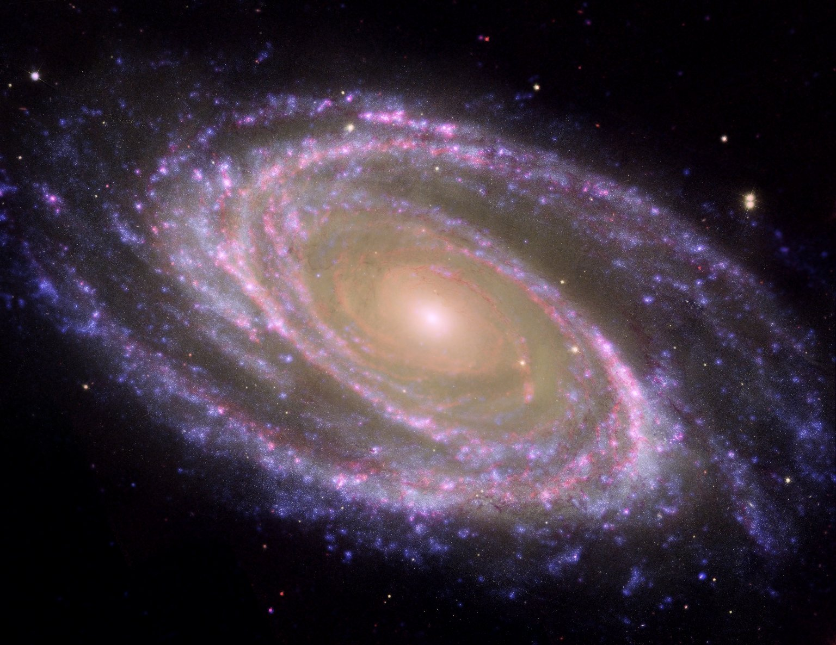
Why God Deserves Glory and Honor
Majesty / Authority
1 Chronicles 29:11; Psalms 104:1; Revelation 5:13; Malachi 1:6; Daniel 4:34; Acts 12:23
Character
1 Timothy 1:17; Psalms 99:9; 21:13; Job 42:1-5 Works
Psalms 138:5; 145:5
Creation - Psalms 19:1; Revelation 4:11
Miracles and fulfilled prophecy - 1 Chronicles 16:24; Matthew 15:31; Acts 4:21; Isaiah 42:8
Salvation/Mercy - Psalms 115:1; Romans 15:9

Slide 7
Glorifying God
Why God Deserves
Glory and Honor
How We Show Glory and Honor to God

Slide 8
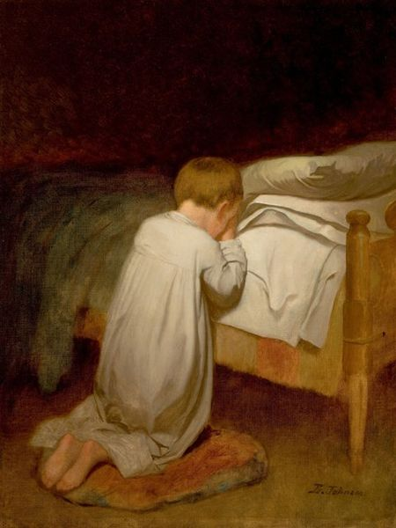
How We Show Glory and Honor to God
Worship and Praise
Psalms 29:2; 148:13; Revelation 5:12-14; Romans 1:21; Matthew 15:8,9

Slide 9
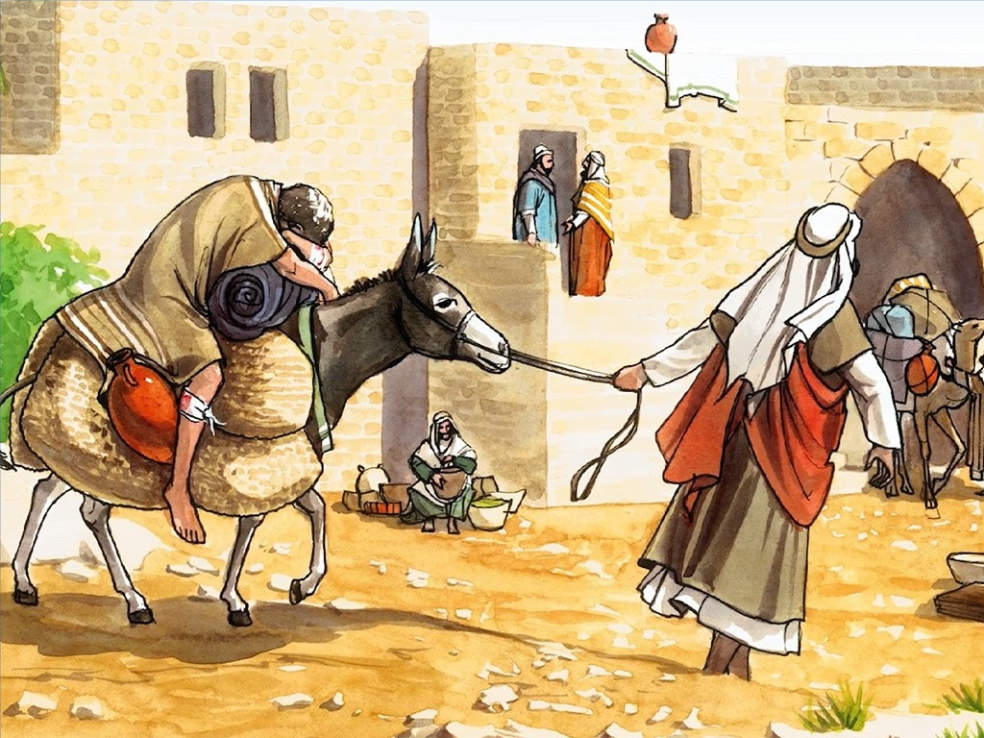
How We Show Glory and Honor to God
Worship and Praise
Psalms 29:2; 148:13; Revelation 5:12-14; Romans 1:21; Matthew 15:8,9
Obedience and Service
Matthew 5:16; 1 Corinthians 6:20; 1 Peter 4:11; Ephesians 3:21; Romans 3:23; 2:23; Leviticus 10:3

Slide 10
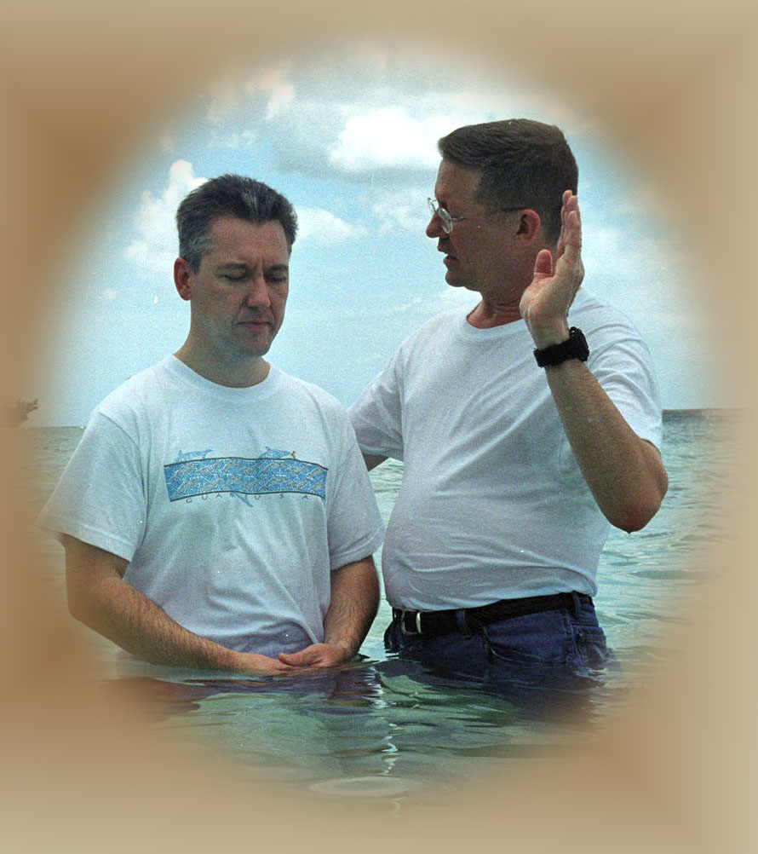
How We Show Glory and Honor to God
Worship and Praise
Psalms 29:2; 148:13; Revelation 5:12-14; Romans 1:21; Matthew 15:8,9
Obedience and Service
Matthew 5:16; 1 Corinthians 6:20; 1 Peter 4:11; Ephesians 3:21; Romans 3:23; 2:23; Leviticus 10:3
Salvation
Ephesians 1:5-7; Judges 7:2

Slide 11
Glorifying God
Why God Deserves
Glory and Honor
How We Show Glory and Honor to God

Slide 12
Why Should You Serve God?
* Salvation from sin
* Heaven and hell
* Spiritual blessings (peace, hope, guidance, etc.)
* Better life (moral uprightness, good family, etc.)
* Love of God
And to Glorify God!

Slide 13
© Copyright David E. Pratte, 2020
Permission is granted to display this PowerPoint under the following conditions:
* Display the link to www.BibleStudyLessons.com
* Minor changes in content are permitted, but no teaching should be presented that disagrees with the teaching in the article associated with this PowerPoint on www.BibleStudyLessons.com/powerpoint
* In no case may a fee of any kind be charged for our PowerPoints.
* If you have a website, please add a link to www.BibleStudyLessons.com
Scripture quotations are generally from the New King James Version (NKJV), copyright 1982, 1988 by Thomas Nelson, Inc. Used by permission. All rights reserved.
www.BibleStudyLessons.com

