Slide 1
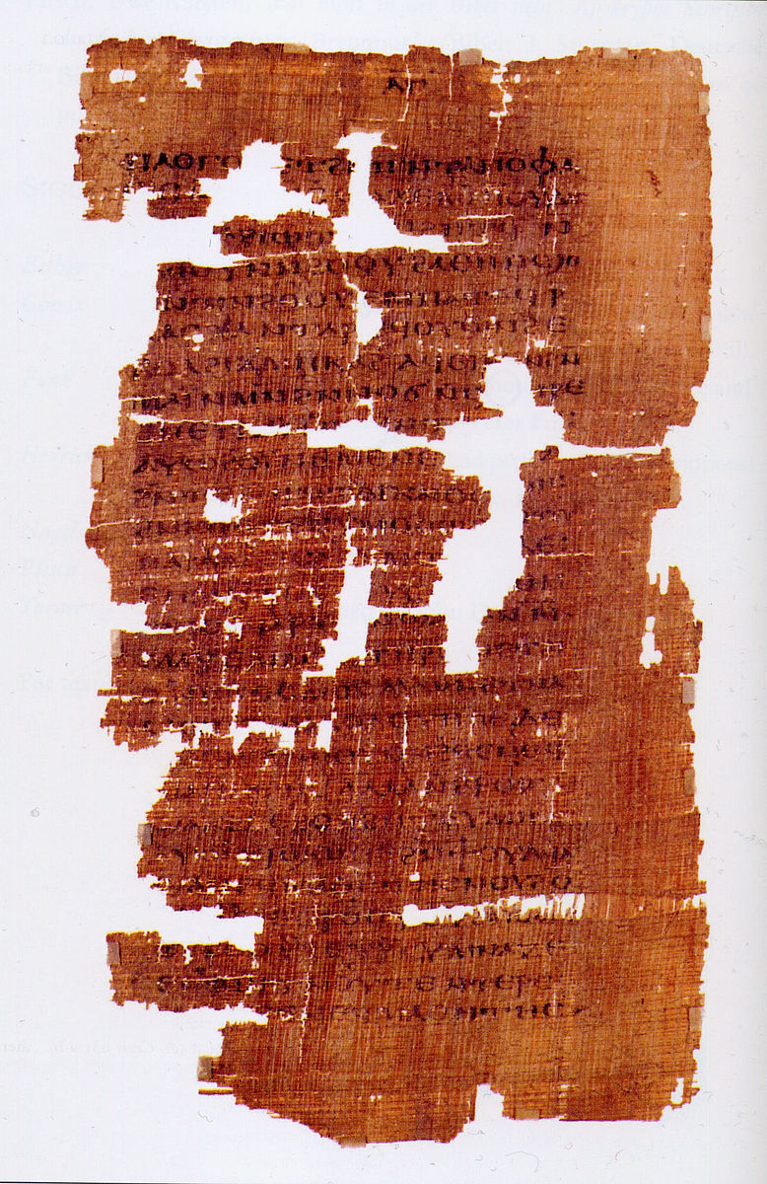
The Gnostic Gospels
“The Gnostic Gospels are a collection of about fifty-two ancient texts … written from the 2nd to the 4th century AD. … These gospels are not part of the standard Biblical canon of any mainstream Christian denomination…” – Wikipedia
www.BibleStudyLessons.com

Slide 2
The Gnostic Gospels
Why do these texts matter to us?
Some claim they belong in the New Testament
Others claim they prove the New Testament is inaccurate
Some base false doctrines on them
They are a fundamental part of modernist doctrine
They influence millions of people by popular books and movies like The DaVinci Code.
In short, they are a significant basis of false doctrine.

Slide 3
The Gnostic Gospels
Most Common Examples
Gospel of Mary
Gospel of Thomas
Gospel of Truth
Gospel of Philip
Gospel of Judas

Slide 4
The Gnostic Gospels
“It is now generally believed that Gnosticism was a Jewish movement which emerged directly in reaction to Christianity. … gnostic gospels were not discovered at a single time, but rather as a series of finds. The Nag Hammadi Library was discovered … in December 1945. … the Gospel of Mary, … was recovered in 1896 … and published in 1955. [For] others, such as with the Gospel of Mary Magdalene, only one copy is currently known to exist. …… the majority of scholars date authorship of the Gnostic gospel [sic] of Nag Hammadi to the 2nd and 3rd century. …” - Wikipedia

Slide 5
The Gnostic Gospels
Not narratives of Christ’s life
Not written by the Bible characters whose names are attached to them!
Dated from the second to the fourth or fifth centuries. Most of them quote the New Testament, so must have been written afterward.

Slide 6
Gnostic Doctrines - 1
Claim to contain secret truths that other Christians did not possess. John 16:13; 2 Timothy 3:16,17
Docetism: God can have nothing to do with the physical earth. So, the real Christ did not live onarth in the flesh and did not die on the cross.
1 John 4:2-4; 2 John 7; John 1:1-18; Hebrews 2:9-18; Acts 17:2,3 – Bible writers claimed that Jesus is Christ and came in the flesh so He could die for our sins.
Matthew 1:18-25; Luke 1:26-38 – The gospel affirms that the Holy Spirit conceived Jesus in Mary’s womb.
1 Corinthians 15:3-11; Matthew 27 & 28; Mark 15 &16; Luke 23 & 24; John 19 & 20 – Jesus’ death, burial, and resurrection are fundamental to the gospel.

Slide 7
Gnostic Doctrines - 2
The supreme god of Gnostics is not the Creator God of the Old Testament.
They view the Old Testament God as wicked or evil, equated with Satan. Adam was born as the result of relationship between Jehovah and Sophia (wisdom). Cain and Abel were not sons of Adam and Eve.
John 1:1-3; Acts 14:15; 17:24; Hebrews 1:10; 11:3 – The one true God made the heavens, the earth, and everything in them.
Leviticus 11:44; 1 Samuel 2:2; Psalm 99:5,9; Revelation 4:8; 15:3,4; 16:5. – God is always righteous, never wicked.
Genesis 2:7; 4:1,2 – God created Adam from the dust. Cain and Abel were sons of Adam and Eve.

Slide 8
Gnostic Doctrines - 3
Confusion of gender roles; God is both god and goddess, both Father and Mother.
The Bible repeatedly calls God our “Father,” never our “mother” nor “goddess” nor by any other feminine name or term. - Matthew 6:9; Hebrews 12:9; James 3:9; 2 Corinthians 6:16-18; 1 Peter 1:17; Matthew 5:43-48; 1 John 1:3; John 14:6-11,20-31
Salvation comes through secret knowledge, not Divine forgiveness.
Matthew 26:28; 20:28; Ephesians 1:7; 1 Peter 1:18,19; 2:24; Hebrews 2:9; Revelation 1:5; 5:9; Hebrews 10:9-13; Romans 5:6-11

Slide 9
Gnostic Doctrines - 4
Reincarnation
Hebrews 9:27; Ecclesiastes 12:7 – The Bible teaches humans have only one earthly life and death.
Hebrews 9:27 – It is appointed unto man once to die.
Ecclesiastes 12:7 – At death, the body returns to dust and the spirit returns to God who gave it
John 5:28,29 – All in the tombs will come forth to the resurrection of life or damnation.
Hebrews 9:27; 2 Corinthians 5:10; Acts 17:30,31 – Just as man is appointed once to die, so he is appointed after that to face judgment.

Slide 10
Preservation of Scripture
God Promised to Preserve His Word
Isaiah 30:8 – God’s words were written in a book for the time to come for ever and ever.
Isaiah 40:8; 1 Peter 1:22-25 – The gospel will live, abide, and endure forever, not like grass that springs forth then dies.
2 Peter 1:15 – Peter wrote so that, after he died, people would be able to remember these teachings “always.”
2 John 2 – The truth will be with us forever.

Slide 11
Preservation of Scripture
Oldest books written by Moses about 1400 BC
Joshua 23:2,6 – (60 years) Israel to obey Moses’ writings
1 Kings 2:3 – (400 years) Solomon to keep Moses’ law
2 Chronicles 34:14-19,29-31 – (800 years) Josiah restored the worship of God by obeying written commands
Nehemiah 8:1-3,8 – (900 years) Service again restored
Matthew 15:1-9 – Jesus quoted laws as command of God
Luke 24:27,44-46; John 5:39,45-47 – (1400 years) Jesus claimed He fulfilled Moses, the prophets, and psalms.
Matthew 22:29-33 – Jesus rebuked people for not knowing the Scriptures. proved resurrection by a verb tense
Acts 17:11 – Bereans searched the Scriptures to know truth
The Dead Sea scrolls (1947) - No change in Old Testament
Confirmed by thousands of New Testament manuscripts and translations

Slide 12
Determining the Canon of Scripture
2 Timothy 3:16,17; 2 Peter 1:20,21
1) Written by an apostle or an associate of an apostle?
Apostles inspired: John 16:13; 14:26; Matthew 10:19,20 Gifts conferred by apostles’ hands: Acts 8:14-21; 19:1-7
Confirmed by miracles: Acts 14:3; Hebrews 2:3,4
2) Written within a lifetime of Jesus’ death?
All New Testament books were written by eyewitnesses of Jesus or people closely associated with eyewitnesses. Acts 1:1-3,8 ;2 Peter 1:16-18
3) Teaching agrees with other inspired books?
Galatians 1:8,9; 2 John 9-11; 1 John 4:1,6; 1 Timothy 1:3
4) Generally accepted soon after 1st century?

Slide 13
Which Meets the Tests?
Test | New Testament | Gnostic texts
Apostles or associates?
First century / Eyewitnesses?
Agrees with other Scripture?
Generally accepted?

Slide 14
Which Meets the Tests?
Test | New Testament | Gnostic texts
Apostles or associates? | Apostles / associates | Too late
First century / Eyewitnesses?
Agrees with other Scripture?
Generally accepted?

Slide 15
Which Meets the Tests?
Test | New Testament | Gnostic texts
Apostles or associates? | Apostles / associates | Too late
First century / Eyewitnesses? | 1st century witnesses | 2nd-5th century
Agrees with other Scripture?
Generally accepted?

Slide 16
Which Meets the Tests?
Test | New Testament | Gnostic texts
Apostles or associates? | Apostles / associates | Too late
First century / Eyewitnesses? | 1st century witnesses | 2nd-5th century
Agrees with other Scripture? | Agreement | Contra-diction
Generally accepted?

Slide 17
Which Meets the Tests?
Test | New Testament | Gnostic texts
Apostles or associates? | Apostles / associates | Too late
First century / Eyewitnesses? | 1st century witnesses | 2nd-5th century
Agrees with other Scripture? | Agreement | Contra-diction
Generally accepted? | Accepted | Rejected

Slide 18
© Copyright David E. Pratte, 2019
Permission is granted to display this PowerPoint under the following conditions:
* Display the link to www.BibleStudyLessons.com
* Minor changes in content are permitted, but no teaching should be presented that disagrees with the teaching in the article associated with this PowerPoint on www.BibleStudyLessons.com/powerpoint
* In no case may a fee of any kind be charged for our PowerPoints.
* If you have a website, please add a link to www.BibleStudyLessons.com
Scripture quotations are generally from the New King James Version (NKJV), copyright 1982, 1988 by Thomas Nelson, Inc. Used by permission. All rights reserved.
www.BibleStudyLessons.com

