Slide 2
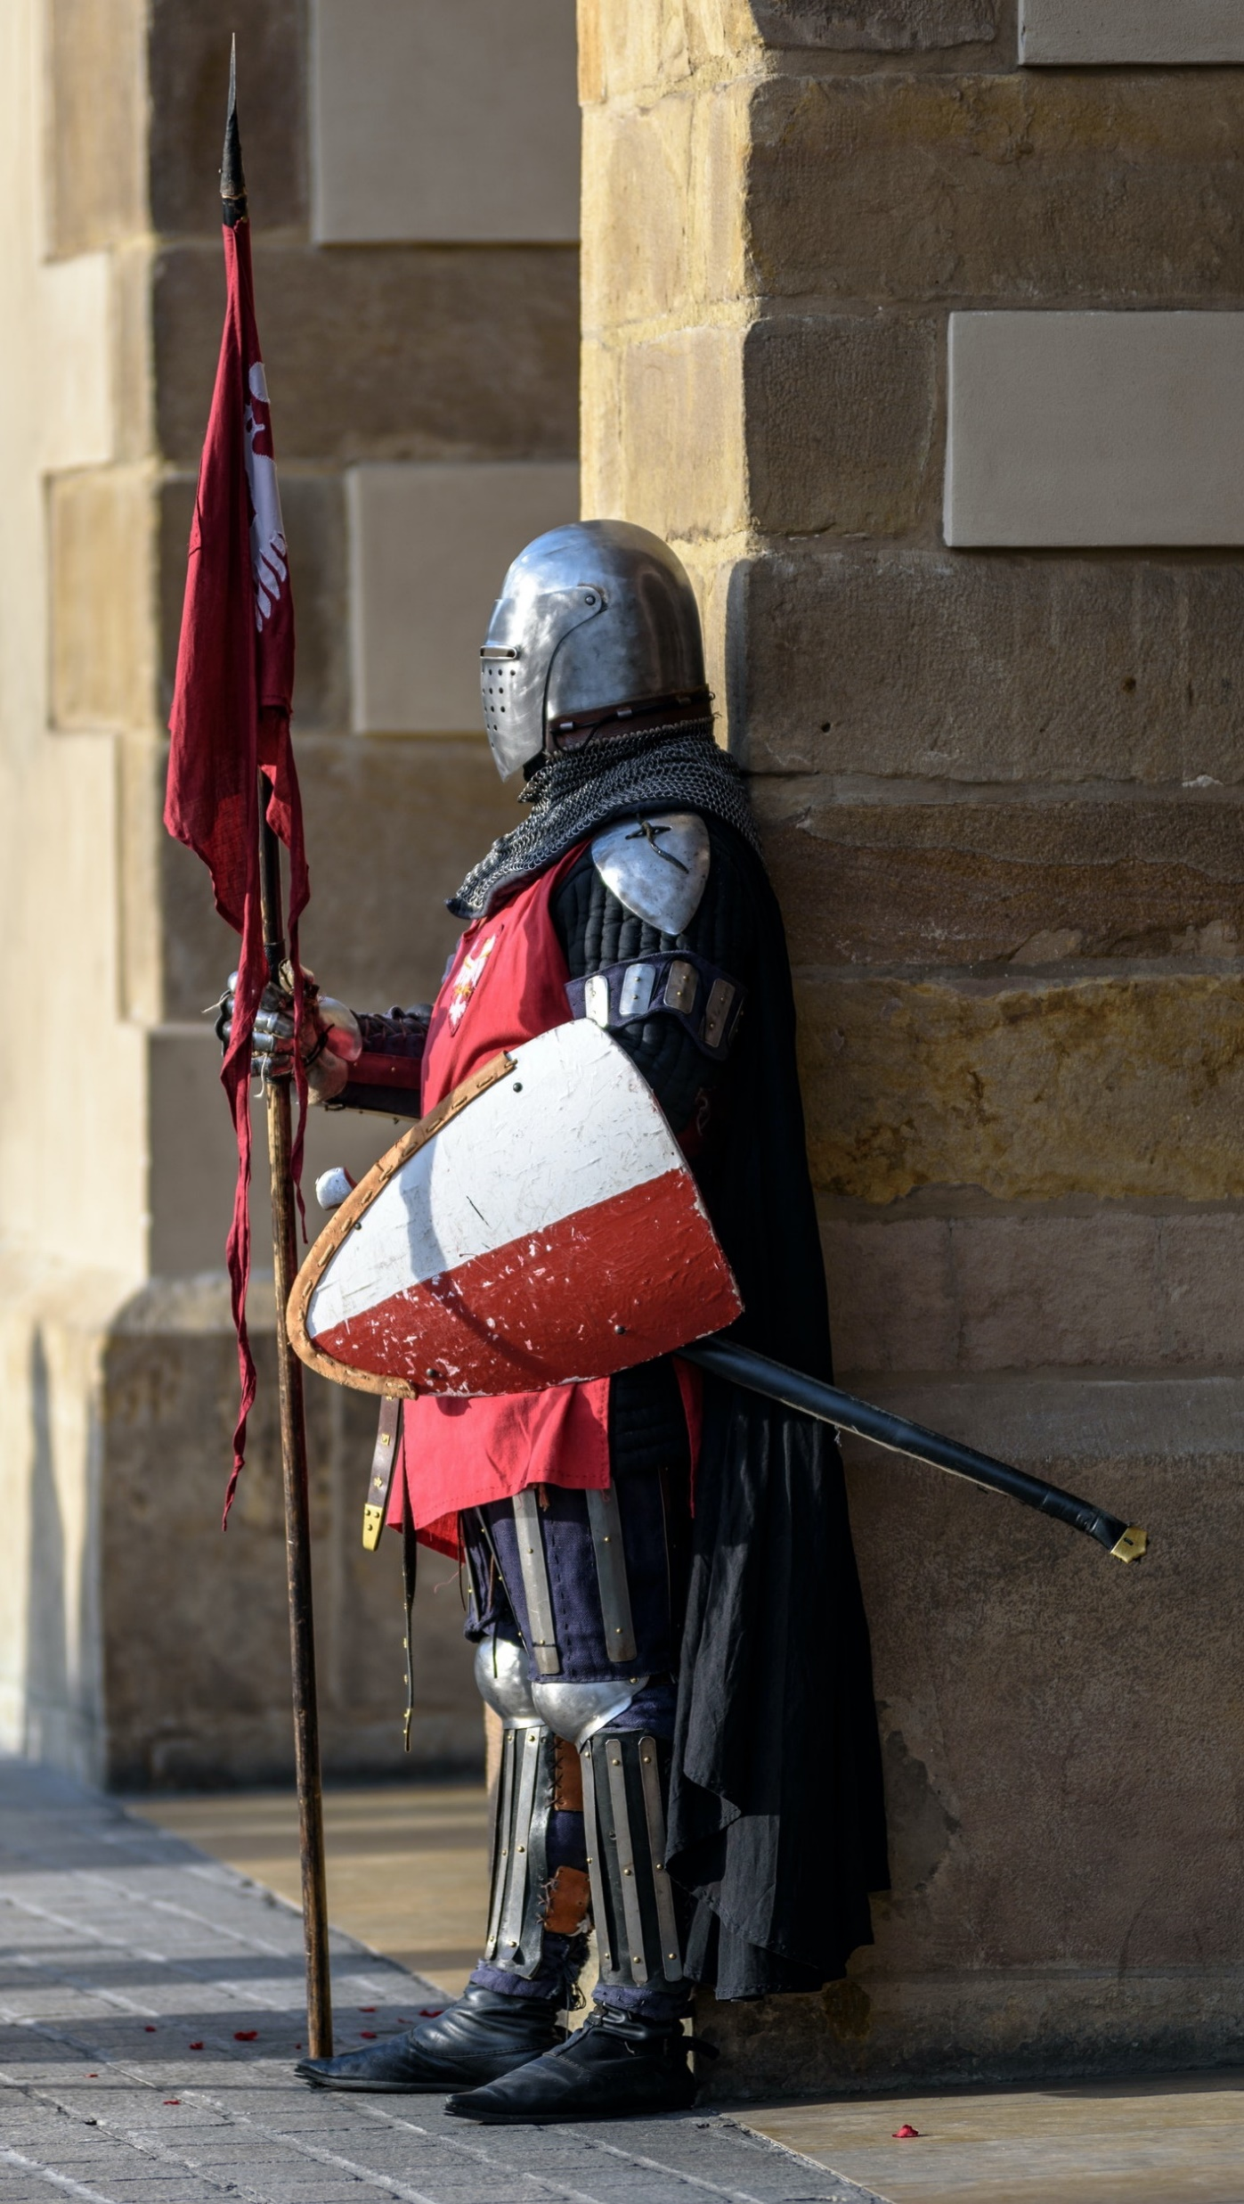
Things that Guard Our Security
Trusting God’s Character & Work
biblestudylessons.com

Slide 3
The Character & Work of God
Love & Grace
Titus 2:11-14; Luke 15:3-24
Death of Jesus
1 Tim. 2:4,6; Heb. 7:25; 1 John 2:1-4
Power to Defeat Sin
John 10:27-29; Hebrews 13:5,6; Romans 8:31-39; Philippians 4:13
Limits on Temptation
1 Corinthians 10:13; James 4:7; Jude 21,24,25; 2 Peter 2:9
Chance to Repent
2 Peter 3:9-14; Revelation 2:20-22
Answer to Prayer
1 Peter 5:7-9; Psalms 138:3

Slide 4
Things that Guard Our Security
Trusting God’s Character & Work
Following the Scriptures

Slide 5
Scripture
Warns about Falling & Encourages Faithfulness
1 Corinthians 10:1-13; James 5:10,11; 1 John 2:1-4; Ephesians 6:10-18
Tells When We Are Wrong & How to Be Faithful
James 1:21-25; 2 Timothy 3:15-17; Psalms 119:11; Matthew 4:4,7,10;
Acts 20:32

Slide 6
Things that Guard Our Security
Trusting God’s Character & Work
Following the Scriptures
Working with Other Christians

Slide 7
Working with Other Christians
Admonition & Exhortation
Romans 15:14; Hebrews 3:12-14; 13:17; 10:24,25
Prayer for One Another
2 Corinthians 1:9-11;
James 5:16
Rebuke & Discipline
Galatians 6:1,2;
1 Thessalonians 5:14;
2 Timothy 4:2-4;
2 Thessalonians 3:14,15

Slide 8
Things that Guard Our Security
Trusting God’s Character & Work
Following the Scriptures
Working with Other Christians
Believing in Heaven & Hell

Slide 9
Heaven & Hell
Galatians 6:7-9
Revelation 2:10
James 1:12
1 Peter 1:3-5
1 Corinthians 9:24-27
Romans 2:5-11

Slide 10
Things that Guard Our Security
Trusting God’s Character & Work
Following the Scriptures
Working with Other Christians
Believing in Heaven & Hell
Where does your life stand before God?

Slide 12
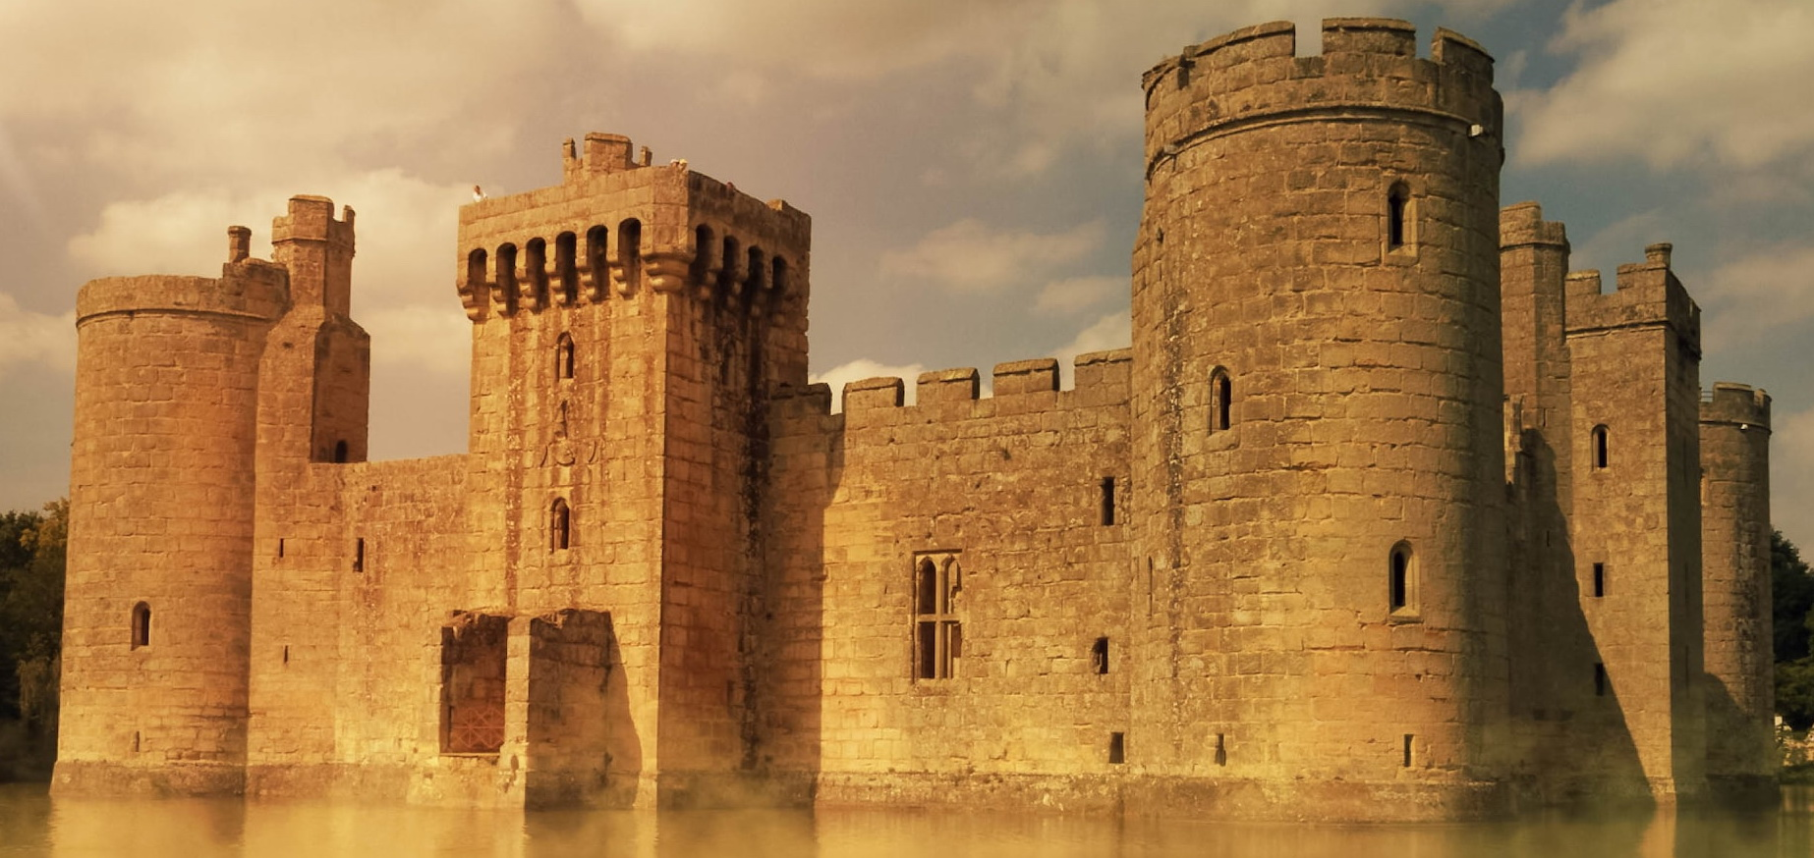
Things that Guard Our Security
© Copyright David E. Pratte, 2022
Permission is granted to display this PowerPoint under the following conditions:
* Display the link to www.BibleStudyLessons.com
* Minor changes in content are permitted, but no teaching should be presented that disagrees with the teaching in the article associated with this PowerPoint at www.BibleStudyLessons.com/powerpoint
* In no case may a fee of any kind be charged for our PowerPoints.
* If you have a website, please add a link to https://BibleStudyLessons.com
Scripture quotations are generally from the New King James Version (NKJV), copyright 1982, 1988 by Thomas Nelson, Inc. Used by permission. All rights reserved.
God has proved He wants us saved.
He has provided all we need to remain secure.
What is your response?
biblestudylessons.com

