Slide 2

Video Bible Study
Lessons
presented by
David E. Pratte
gospelway.com

Slide 3
The Book of
Haggai
Thanks to Christians in the Hillcrest church for their participation.
© Copyright David E. Pratte, 2022
Scripture quotations are generally from the New King James Version (NKJV), copyright 1982, 1988 by Thomas Nelson, Inc. used by permission. All rights reserved.

Slide 4
Bible Study Questions on the Books of
Haggai, Zechariah, and Malachi
Available at
biblestudylessons.com/classbooks

Slide 5
Persian Kings
Cyrus II (559-529 BC) – conquered Babylon in 539 BC with Darius the Mede (Daniel 5:30,31)
Cambyses II (529-522 BC) – commanded work on the temple to cease (Ezra 4:7,11,23)
Darius I “the Great” (522-486 BC) – authorized completion of the temple (Ezra 4:24-6:15)
Xerxes I (486-464 BC) – also called Ahasuerus. Esther was his queen (book of Esther)
Artaxerxes I (465-423 BC) – authorized Nehemiah to rebuild Jerusalem (the book of Nehemiah)

Slide 6
Periods of Bible history
1. Before the Flood (Creation to the flood)
2. After the Flood (the flood to the call of Abraham)
3. Patriarchs (the call of Abraham to the death of Joseph)
4. Egyptian Bondage (Joseph’s death to crossing Red Sea)
5. Wilderness Wandering (Red Sea to crossing the Jordan)
6. Conquest of Canaan (crossing Jordan to Joshua’s death)
7. Judges (death of Joshua to crowning of King Saul)
8. United Kingdom (crowning of Saul to death of Solomon)
9. Divided Kingdom (death of Solomon to the fall of Israel)
10. Judah Alone (the fall of Israel to the fall of Judah)
11. Babylonian Captivity (fall of Judah to end of captivity)
12. Restoration of Israel (return to the completion of OT)
13. Years of Silence (completion of OT to the birth of Jesus)
14. Life of Christ (from the birth of Jesus to His ascension)
15. Early Church (Jesus’ ascension to the completion of NT)

Slide 7
Prophets by Period
Period of History | Prophets
Divided Kingdom | Israel: Jonah Amos Hosea | Judah: Obadiah (?) Joel (?) Isaiah Micah
Judah Alone | Jeremiah (Lamentations) Zephaniah Nahum (?) Habakkuk (?)
Babylonian Captivity | Ezekiel Daniel
Return from Captivity | Haggai Zechariah Malachi

Slide 8
Themes of the Minor Prophets
Hosea – Israel’s unfaithfulness compared to Hosea’s wife
Joel – Locust plague shows Israel’s need to repent
Amos – Israel would go into captivity because of sins like those of the surrounding nations
Obadiah – Fall of Edom for rejoicing in Judah’s affliction
Jonah – God uses a fish and a plant to teach Jonah His concern for the salvation of Nineveh and all people
Micah – God puts Israel and Judah on trial for their sins.
Nahum – Prophecy of the fall of Nineveh
Habakkuk – Habakkuk questions God’s punishments
Zephaniah – God’s wrath is coming against Jerusalem and surrounding nations, but a remnant will be spared.
Haggai – Returning Jews should rebuild the temple
Zechariah – The future glory of God’s people
Malachi – Spiritual restoration among the returned Jews

Slide 9
Theme and Major Divisions of Haggai
Theme: Haggai exhorts the Jews to complete rebuilding the temple.
Major divisions
Chapter 1 – First Revelation: Exhortation to complete the temple
2:1-9 – Second Revelation: Comparison to the former temple
2:10-19 – Third Revelation: Restoration of physical blessings
2:20-23 – Fourth Revelation: Renewal of promise to David’s lineage

Slide 10
Chapter 1: God Rebuked the People for Neglecting the Temple
The problem: the people built nice houses for themselves but the temple remained in ruins.

Slide 11
Causes of Neglect -1:3,4
Improper priorities
John 6:27; Matthew 6:19-21 Matthew 6:33
Making excuses
Genesis 3:9-13; Exodus 32:2-5,21-24; 1 Samuel 15:3,9,15,22,23; Luke 14:15-24
Procrastination
2 Corinthians 6:2; John 9:4; James 4:17
“Consider your ways.”

Slide 12
Chapter 1: God Rebuked the People for Neglecting the Temple
The problem: the people built nice houses for themselves but the temple remained in ruins.
The consequence: God prevented the people from prospering.
The solution: go to work to build the temple.
The response: the people obeyed and God promised to be with them.

Slide 13
2nd Revelation: The Rebuilt Temple Compared to the First Temple
God’s service does not require impressiveness by human standards.
What we need is to work hard to please God.
God would shake heaven and earth “once more”: The new temple was a symbol of the church.

Slide 14
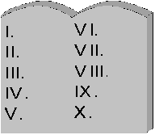
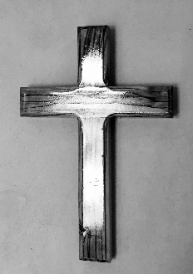
Shaking Heaven and Earth
Haggai 2; Hebrews 12:18-28
First Shaking: Old Covenant | Shaken again: New Covenant
Shook heaven & earth | Shaken “once more”
Replaced previous system | Replaced previous system
Nation of Israel | All nations
Physical temple | Spiritual temple: the church
Kingdom will be shaken | Kingdom will remain (cannot be shaken)

Slide 15

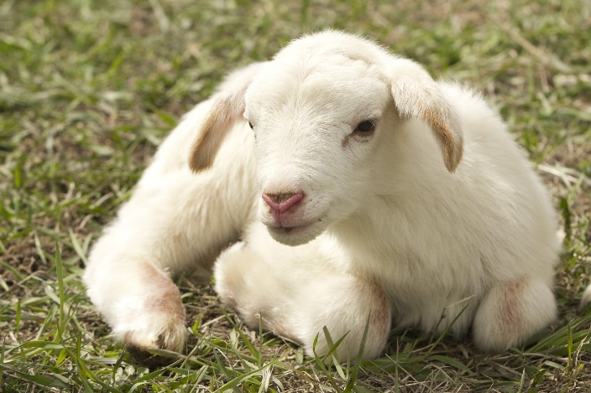
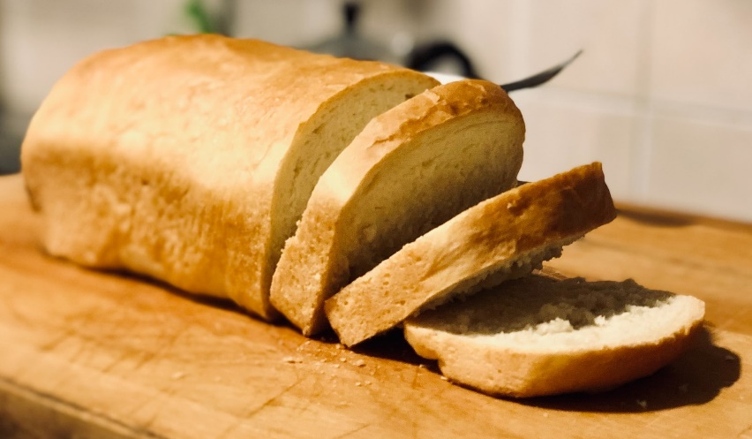
Holy, Unclean, and Common
COMMON
UNCLEAN
HOLY
An unclean thing makes a common thing unclean.
But a holy thing does not make a common thing holy.

Slide 16
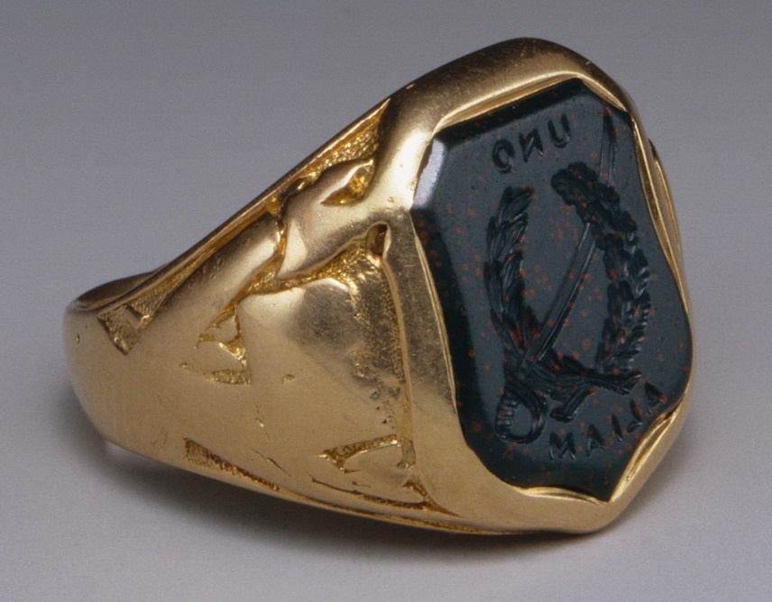

Fourth Revelation: Renewal of the Promise to David’s Lineage
Matthew 1:12,16
Zerubbabel
Jesus

Slide 17
Lessons Learned from Haggai
Focus on spiritual service to God as priority.
Do not procrastinate God’s work to pursue personal interests.
Heed God’s instructions and correct our lives where needed.
God blesses obedience and punishes disobedience.
Leaders and followers must work together in God’s work.
The church fulfills the promise of God’s temple today.

Slide 18
Building God’s Temple Today
The temple of God today is the church - Ephesians 2:19-22; 1 Corinthians 3:16,17; 6:19,20; 2 Corinthians 6:16-18; 1 Peter 2:4-10
We should encourage the growth of individual members - Ephesians 4:15,16; Romans 15:14; 1 Thessalonians 5:11; Hebrews 3:12-14; 10:23-25
We should work to save souls so the church grows in numbers - Acts 8:1,4; 11:26; 2 Timothy 2:2,24-26; Hebrews 5:12-14;
1 Peter 3:15; Mark 16:15,16; Matthew 28:18-20; Acts 5:42; 20:20; Proverbs 11:30; 1 Timothy 3:15
Are we focused on our own interests so we neglect God’s work, or are we emphasizing building God’s spiritual temple?

Slide 19
© Copyright David E. Pratte, 2022
Permission is granted to display this PowerPoint under the following conditions:
* Display the link to www.BibleStudyLessons.com
* Minor changes in content are permitted, but no teaching should be presented that disagrees with the teaching in the article associated with this PowerPoint on www.BibleStudyLessons.com/powerpoint
* In no case may a fee of any kind be charged for our PowerPoints.
* If you have a website, please add a link to www.BibleStudyLessons.com
Scripture quotations are generally from the New King James Version (NKJV), copyright 1982, 1988 by Thomas Nelson, Inc. Used by permission. All rights reserved.
www.BibleStudyLessons.com

