Slide 2
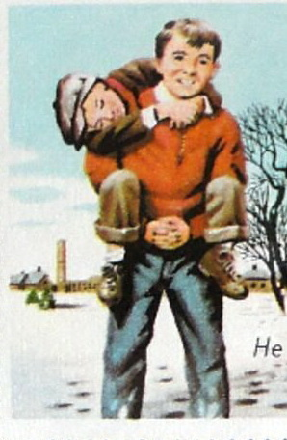
He Ain’t Heavy;
He’s My Brother
Love
Hebrews 13:1; 1 Peter 1:22,23;
1 Thessalonians 4:9,10;
1 John 4:20,21; 5:2,3
www.BibleStudyLessons.com

Slide 3
He Ain’t Heavy;
He’s My Brother
Respect and Appreciate
Appreciate One Another
Acts 15:3; 3 John 3;
2 Thessalonians 1:3
Respect One Another
Matthew 23:8,9; Galatians 3:26-29;
James 2:1-9

Slide 4
He Ain’t Heavy;
He’s My Brother
Avoid Harm
Do Not Defraud or Mistreat
1 Corinthians 6:6-8;
1 Thessalonians 4:6
Do Not Speak Harmfully
James 4:11; 1 Peter 3:8,9
Avoid Causing Others to Stumble
Matthew 18:6,7

Slide 5
He Ain’t Heavy;
He’s My Brother
Help One Another
Help with Needs
Acts 11:29
1 John 3:16-18
Practice Hospitality
Acts 28:13,14; 3 John 5

Slide 6
He Ain’t Heavy;
He’s My Brother
Encourage Proper Conduct
Encourage Faithful Service
Hebrews 10:24,25; Acts 15:32; 16:40
Help Overcome Errors
1 Thessalonians 5:14; James 5:19,20;
Galatians 6:1; 1 Corinthians 5:11

Slide 7
He Ain’t Heavy;
He’s My Brother
Reconcile Differences
Discuss Differences
Luke 17:3,4; Matthew 5:23,24; Genesis 13:8; Philippians 2:2
Forgive One Another
Ephesians 4:32; Luke 15:32;
Matthew 18:21-35

Slide 8
He Ain’t Heavy;
He’s My Brother
Love
Respect and Appreciate
Avoid Harm
Help
Encourage Right
Reconcile Differences

Slide 9
He Ain’t Heavy;
He’s My Brother
Bear one another’s burdens
– Galatians 6:2

Slide 10
© Copyright David E. Pratte, 2020
Permission is granted to display this PowerPoint under the following conditions:
* Display the link to www.BibleStudyLessons.com
* Minor changes in content are permitted, but no teaching should be presented that disagrees with the teaching in the article associated with this PowerPoint on www.BibleStudyLessons.com/powerpoint
* In no case may a fee of any kind be charged for our PowerPoints.
* If you have a website, please add a link to www.BibleStudyLessons.com
Scripture quotations are generally from the New King James Version (NKJV), copyright 1982, 1988 by Thomas Nelson, Inc. Used by permission. All rights reserved.
www.BibleStudyLessons.com

