Slide 2
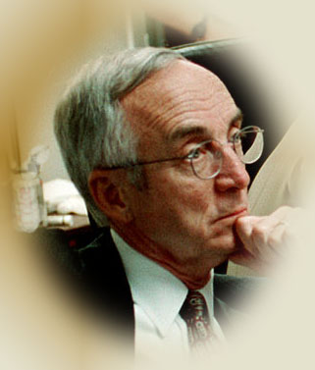
Individual Moral Responsibility
biblestudylessons.com

Slide 3
Each Individual Responsible for
His Own Conduct
Ezekiel 18:20 — The righteousness of the righteous shall be upon himself, and the wickedness of the wicked shall be upon himself
Matthew 7:21-28 – He who does the will of the Father will enter the kingdom.
Acts 10:35 — Whoever fears Him and works righteousness is accepted.
James 1:23-25 – He who looks into the perfect law of liberty and continues doing the work, this one will be blessed in what he does.

Slide 4
Eternal Destinies Based on Individual Choices
2 Corinthians 5:10 — Each one will receive the things done in the body, according to what he has done, whether good or bad.
Romans 2:6-10 – God will render to each one according to his deeds. Tribulation on every soul of man who does evil, but glory and peace to everyone who works what is good.
Galatians 6:7,8 — Whatever a man sows that he will also reap. He who sows to the flesh will reap corruption. He who sows to the spirit will reap everlasting life.

Slide 5
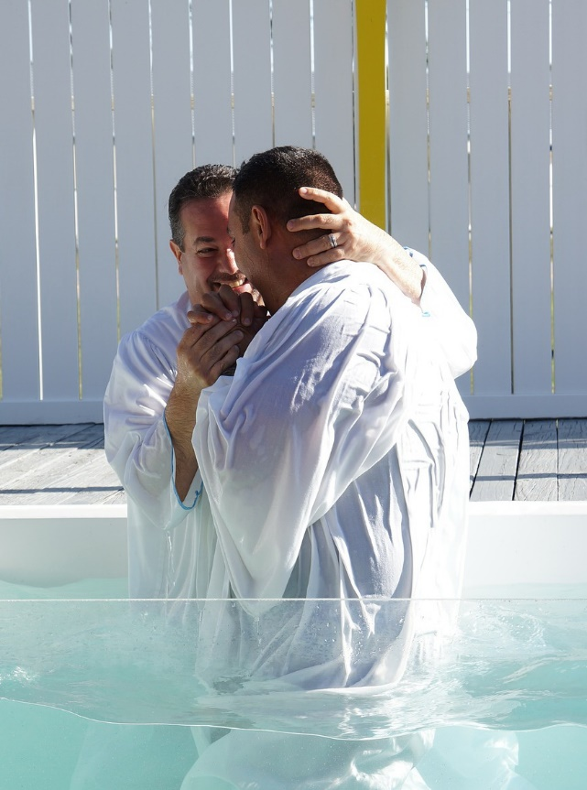
Individual Responsibility in Specific Steps to Salvation
Hearing the Gospel
John 6:44,45; Mark 7:14
Faith
Mark 16:15,16; John 3:16,36;
Hebrews 11:6
Repentance
Acts 2:38
Confession
Romans 10:9,10; Matthew 10:32
Baptism
Mark 16:15,16; Acts 2:38

Slide 6
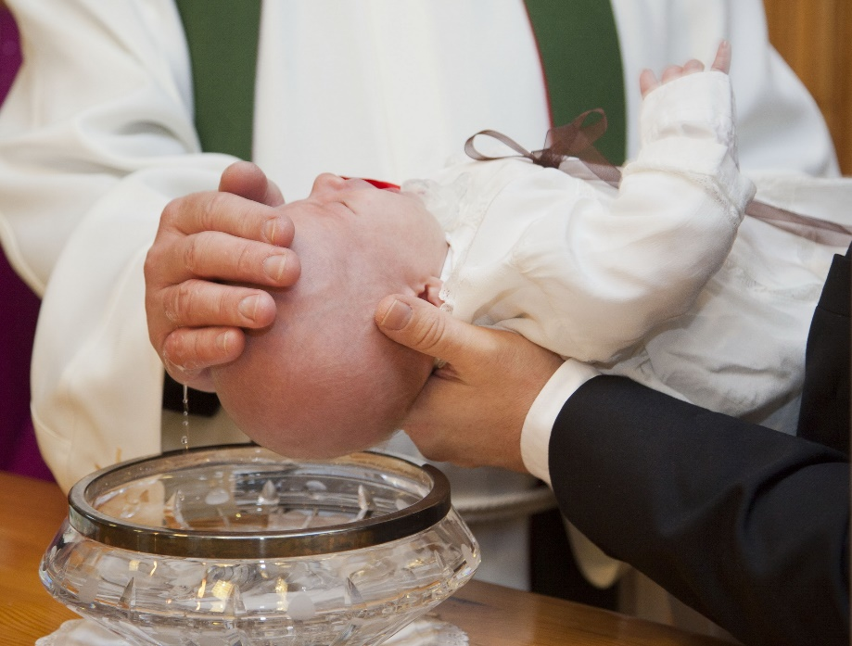
Applications of Individual Responsibility
Inherited Depravity / Infant Baptism
1 John 3:4; Romans 6:16; Ezekiel 18:20;
Mark 16:15,16; Acts 2:38
Mormon Baptism for the Dead
Family Status
Matthew 3:9; Romans 2:9,10;
Ezekiel 18:4,9-18; Matthew 10:34-37
Church Status
Revelation 3:1-4; Philippians 2:12
Race / Gender
2 Corinthians 5:10

Slide 7
Identity politics, Critical Race Theory, Me Too
“…attributing all inequality and injustice to the institutions and actions of the oppressor groups: whites, males, heterosexuals, and religious ‘reactionaries’ – in particular Christians….
“In identity politics only collective rights matter – not individual rights. What matters is one’s membership in a ‘victim’ group or an ‘oppressor’ group… – David Horowitz, Dark Agenda: The War to Destroy Christian America, pages 141-143
“‘white male culture’ was analogous to the ‘KKK,’ ‘white supremacists,’ and ‘mass killings.’”
“straight, white, English-speaking, Christian males are members of the oppressor class and must atone for their privilege and ‘covert white supremacy.’”
– “Critical Race Theory: What It Is and How to Fight It,” Christopher F. Rufo, https://imprimis.hillsdale.edu/critical-race-theory-fight/

Slide 8
Applications of Individual Responsibility
Inherited Depravity / Infant Baptism
1 John 3:4; Romans 6:16; Ezekiel 18:20;
Mark 16:15,16; Acts 2:38
Mormon Baptism for the Dead
Family Status
Matthew 3:9; Romans 2:9,10;
Ezekiel 18:4,9-18; Matthew 10:34-37
Church Status
Revelation 3:1-4; Philippians 2:12
Race / Gender
2 Corinthians 5:10
Revelation 3:20; 22:17

Slide 10
© Copyright David E. Pratte, 2022
Permission is granted to display this PowerPoint under the following conditions:
* Display the link to BibleStudyLessons.com
* Minor changes in content are permitted, but no teaching should be presented that disagrees with the teaching in the article associated with this PowerPoint at www.BibleStudyLessons.com/powerpoint
* In no case may a fee of any kind be charged for our PowerPoints.
* If you have a website, please add a link to https://BibleStudyLessons.com
Scripture quotations are generally from the New King James Version (NKJV), copyright 1982, 1988 by Thomas Nelson, Inc. Used by permission. All rights reserved.
biblestudylessons.com

