Slide 2
Matthew 5:14-16
www.BibleStudyLessons.com

Slide 3
Let Men See Your Good Works
You Do Have Influence.
You Cannot Lose Your Influence.
Matthew 5:14; 2 Kings 5:1-3
Your Influence Lives on After Death.
Hebrews 11:4; 1 John 3:12

Slide 4
Let Men See Your Good Works
Good Works, not Just Good Words
1 Peter 2:12; Titus 2:7,8; Matthew 25:21,23
Many People Talk a Good Religion, but Do Not Practice It.
Matthew 23:3,4; Romans 2:18-21,23,24

Slide 5
Let Men See Your Good Works
Examples of Evil Influence
Genesis 3:6; Joshua 14:8
(Numbers 13:25ff); 2 Samuel 11:2-4; Matthew 5:28; Proverbs 5:15-19
Examples of Good Influence
John 13:34; 15:13; Acts 9:36,39

Slide 6
Let Men Glorify Your Father
Some People Do Good to Receive Praise of Men.
Matthew 6:1, 2-4, 5-8
Our Lives Reflect on Our Father.
2 Samuel 12:14; 1 Timothy 6:1;
Romans 2:23,24; 1 Peter 2:12

Slide 7
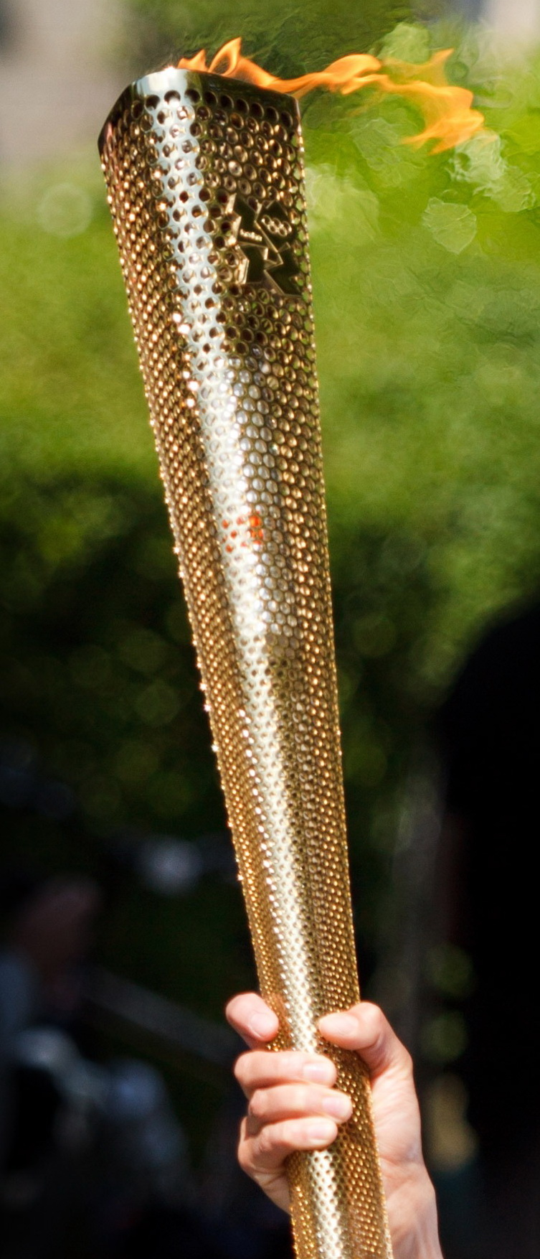
Is Your Light Giving Glory to the Father?

Slide 9
© Copyright David E. Pratte, 2022
Permission is granted to display this PowerPoint under the following conditions:
* Display the link to www.BibleStudyLessons.com
* Minor changes in content are permitted, but no teaching should be presented that disagrees with the teaching in the article associated with this PowerPoint at www.BibleStudyLessons.com/powerpoint
* In no case may a fee of any kind be charged for our PowerPoints.
* If you have a website, please add a link to www.BibleStudyLessons.com
Scripture quotations are generally from the New King James Version (NKJV), copyright 1982, 1988 by Thomas Nelson, Inc. Used by permission. All rights reserved.
www.BibleStudyLessons.com

