Slide 1
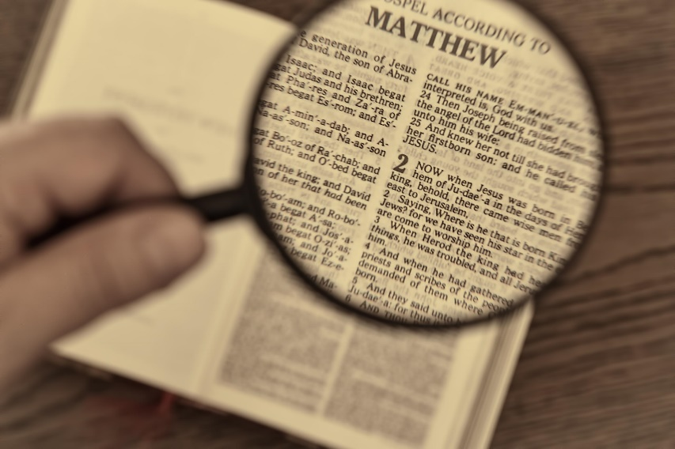
Video Bible Study
presented by
David E. Pratte
www.gospelway.com

Slide 2
The Prophecy of Joel
Thanks to Christians in the Hillcrest church for their participation.
© Copyright David E. Pratte, 2020
Scripture quotations are generally from the New King James Version (NKJV), copyright 1982, 1988 by Thomas Nelson, Inc. used by permission. All rights reserved.

Slide 3
Questions from Bible Study Questions on Hosea, Joel, Amos, Obadiah
Available at
www.biblestudylessons.com/classbooks

Slide 4
Understanding Old Testament prophecy
* The prophets are part of Scripture, and all Scripture is profitable to equip us in our service to God today
– 2 Timothy 3:16,17; Romans 15:4; 1 Corinthians 10:6,11.
* Old Testament history may help us understand the background behind prophets’ teachings.
* The prophets often used symbolic teaching. But that does not give us the right to assign a meaning to the symbols according to our own imagination.
* The prophets often included predictions about the Messiah, His Kingdom, and His message.
* Often New Testament writers give us an inspired explanation.

Slide 5
Periods of Bible history
1. Before the Flood (Creation to the flood)
2. After the Flood (the flood to the call of Abraham)
3. Patriarchs (the call of Abraham to the death of Joseph)
4. Egyptian Bondage (Joseph’s death to crossing Red Sea)
5. Wilderness Wandering (Red Sea to crossing the Jordan)
6. Conquest of Canaan (crossing Jordan to Joshua’s death)
7. Judges (death of Joshua to crowning of King Saul)
8. United Kingdom (crowning of Saul to death of Solomon)
9. Divided Kingdom (death of Solomon to the fall of Israel)
10. Judah Alone (the fall of Israel to the fall of Judah)
11. Babylonian Captivity (fall of Judah to end of captivity)
12. Restoration of Israel (return to the completion of OT)
13. Years of Silence (completion of OT to the birth of Jesus)
14. Life of Christ (from the birth of Jesus to His ascension)
15. Early Church (Jesus’ ascension to the completion of NT)

Slide 6
Prophets by Period
Period of History | Prophets
Divided Kingdom | Israel: Jonah Amos Hosea | Judah: Obadiah (?) Joel (?) Isaiah Micah
Judah Alone | Jeremiah (Lamentations) Zephaniah Nahum (?) Habakkuk (?)
Babylonian Captivity | Ezekiel Daniel
Return from Captivity | Haggai Zechariah Malachi

Slide 7
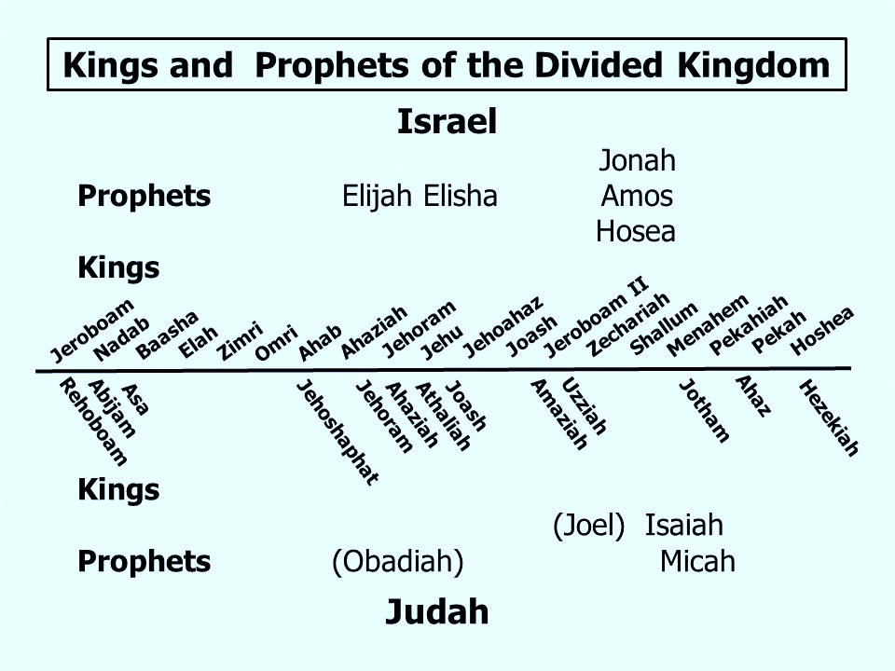

Slide 8
Themes of the Minor Prophets
Hosea – Israel’s unfaithfulness compared to Hosea’s wife
Joel – Locust plague shows Judah’s need to repent.
Amos – Israel would go into captivity because of sins like those of the surrounding nations
Obadiah – Fall of Edom for rejoicing in Judah’s affliction
Jonah – God uses a fish and a plant to teach Jonah His concern for the salvation of Nineveh and all people.
Micah – God puts Israel and Judah on trial for their sins.
Nahum – Prophecy of the fall of Nineveh
Habakkuk – Habakkuk questions God’s punishments
Zephaniah – God’s wrath is coming against Jerusalem and surrounding nations, but a remnant will be spared.
Haggai – Returning Jews should rebuild the temple
Zechariah – The future glory of God’s people
Malachi – Spiritual restoration among the returned Jews.

Slide 9
Theme and Major Divisions of Joel
Theme: A locust plague brings a call to repentance and a promise of restoration
Major divisions
1:1-2:17 – The locust attack: a judgment of God leading to the prophet’s call to repentance.
2:18-3:21 – God’s promise of mercy to His people if they repent

Slide 10
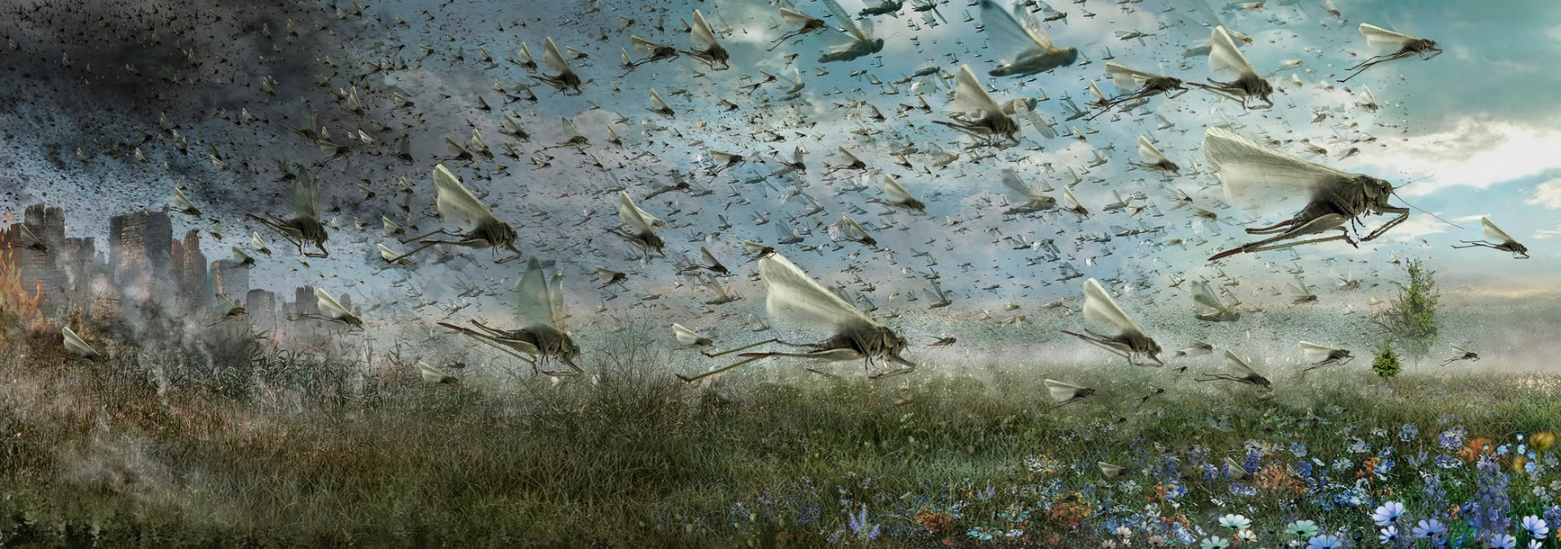
The Plague: A Cause of Grief – 1:8-20
1:9 – The priests mourn
1:10 – The land mourns
1:11,12 – Farmers and vinedressers mourn
1:13-15 – Priests declare a fast and sacred assembly
1:18-20 – Animals suffer

Slide 11
The Day of the Lord Described – 2:1-11
2:1 – Sound the alarm!
2:2 – A day of darkness and gloom
2:3 – Fire and flame; nothing escapes
2:4 – Like war horses
2:5,6 – Like an army in battle array
2:7,8 – Marching in formation
2:8 – Weapons cannot stop them
2:9 – Invade cities and houses
2:10 – Earthquakes; sun, moon, and stars darkened

Slide 12
The Call to Repent – 2:12-17
Urgently needed (“now”)
Requires turning to God
From the heart, not just outward show
Motivated by sorrow for sin
Seeking God’s forgiveness and blessing
Confessing in public assembly
Results in honor to God
Such repentance is still needed for sin
Luke 13:3; 24:47; Acts 2:38; 17:30; 2 Peter 3:9; Acts 8:22; 2 Corinthians 7:10; Revelation 3:19

Slide 13
The Plague Removed – 2:18-27
God shows mercy
Crops restored
Locusts removed
Land, animals, trees prosper
People rejoice and praise God

Slide 14
Pouring Out of God’s Spirit – 2:28-32
Joel 2:28-32 | Acts 2:16-21
Afterward … in those days | In the last days
God’s Spirit | God’s Spirit
Men, women, young, old | Men, women, young, old
Prophecy, visions, dreams | Prophecy, visions, dreams
Wonders in heaven & earth | Wonders in heaven & earth
Before the day of the Lord | Before the day of the Lord
Whoever calls will be saved | Whoever calls will be saved
“This is what was spoken by the prophet Joel”

Slide 15
Calling on the Name of the Lord
The gospel never teaches an alien sinner to pray for forgiveness.
God hears the prayers of righteous people
– 1 John 3:22
Obedience, not just recognizing Jesus, is required – Matthew 7:21
Repent and be baptized for remission of sins
– Acts 2:38
Be baptized and wash away sins “calling on the name of the Lord” – Acts 22:16

Slide 16
O.T. Wars and N.T. Spiritual Warfare
Old Testament | Warfare | New Testament
Psalm 2:1-12 | Nations and rulers plot against Messiah | Acts 4:25,26
Psalm 110:1-6 | Christ rule among enemies, judge nations and execute rulers | Matthew 22:44; 26:64; Hebrews 1:13
Zechariah 9:1-17 | King comes triumphantly riding on a donkey and devours enemies | Matthew 21:5; John 12:15
Put on the armor of God.
Fight the good fight
1 Timothy 1:18; 6:12; 2 Corinthians 10:4,5; 2 Timothy 2:3,4; 4:7; Ephesians 6:10-18

Slide 17
Lessons from a Study of Joel
God punishes sin but rewards obedience.
Forgiveness requires sincere sorrow and repentance from the heart.
God’s promise of the Holy Spirit was fulfilled beginning in Acts 2.
“The last days” refer to the Gospel age.
An alien sinner calls on the Lord for salvation by baptism.
Israel and Jerusalem in prophecy often refer to the New Testament church.

Slide 18
© Copyright David E. Pratte, 2020
Permission is granted to display this PowerPoint under the following conditions:
* Display the link to www.BibleStudyLessons.com
* Minor changes in content are permitted, but no teaching should be presented that disagrees with the teaching in the article associated with this PowerPoint on www.BibleStudyLessons.com/powerpoint
* In no case may a fee of any kind be charged for our PowerPoints.
* If you have a website, please add a link to www.BibleStudyLessons.com
Scripture quotations are generally from the New King James Version (NKJV), copyright 1982, 1988 by Thomas Nelson, Inc. Used by permission. All rights reserved.
www.BibleStudyLessons.com

