Slide 2

Video Bible Study
presented by
David E. Pratte
www.gospelway.com

Slide 3
The Prophecy of Jonah
Thanks to Christians in the Hillcrest church for their participation.
© Copyright David E. Pratte, 2021
Scripture quotations are generally from the New King James Version (NKJV), copyright 1982, 1988 by Thomas Nelson, Inc. used by permission. All rights reserved.

Slide 4
Questions from Bible Study Questions on Jonah, Micah, Nahum, Habakkuk and Zephaniah
Available at
www.biblestudylessons.com/classbooks

Slide 5
Understanding Old Testament prophecy
* The prophets are part of Scripture, and all Scripture is profitable to equip us in our service to God today
– 2 Timothy 3:16,17; Romans 15:4; 1 Corinthians 10:6,11.
* Old Testament history may help us understand the background behind prophets’ teachings.
* The prophets often used symbolic teaching. But that does not give us the right to assign a meaning to the symbols according to our own imagination.
* The prophets often included predictions about the Messiah, His Kingdom, and His message.
* Often New Testament writers give us an inspired explanation.

Slide 6
Periods of Bible history
1. Before the Flood (Creation to the flood)
2. After the Flood (the flood to the call of Abraham)
3. Patriarchs (the call of Abraham to the death of Joseph)
4. Egyptian Bondage (Joseph’s death to crossing Red Sea)
5. Wilderness Wandering (Red Sea to crossing the Jordan)
6. Conquest of Canaan (crossing Jordan to Joshua’s death)
7. Judges (death of Joshua to crowning of King Saul)
8. United Kingdom (crowning of Saul to death of Solomon)
9. Divided Kingdom (death of Solomon to the fall of Israel)
10. Judah Alone (the fall of Israel to the fall of Judah)
11. Babylonian Captivity (fall of Judah to end of captivity)
12. Restoration of Israel (return to the completion of OT)
13. Years of Silence (completion of OT to the birth of Jesus)
14. Life of Christ (from the birth of Jesus to His ascension)
15. Early Church (Jesus’ ascension to the completion of NT)

Slide 7
Prophets by Period
Period of History | Prophets
Divided Kingdom | Israel: Jonah Amos Hosea | Judah: Obadiah (?) Joel (?) Isaiah Micah
Judah Alone | Jeremiah (Lamentations) Zephaniah, Nahum (?), Habakkuk (?)
Babylonian Captivity | Ezekiel, Daniel
Return from Captivity | Haggai, Zechariah, Malachi

Slide 8
Themes of the Minor Prophets
Hosea – Israel’s unfaithfulness compared to Hosea’s wife
Joel – Locust plague shows Israel’s need to repent
Amos – Israel would go into captivity for sins like the surrounding nations
Obadiah – Fall of Edom for rejoicing in Judah’s affliction
Jonah – God uses a fish and a plant to teach Jonah His concern for the salvation of Nineveh and all people
Micah – God puts Israel and Judah on trial for their sins.
Nahum – Prophecy of the fall of Nineveh
Habakkuk – Habakkuk questions God’s punishments
Zephaniah – God’s wrath is coming against Jerusalem and surrounding nations, but a remnant will be spared.
Haggai – Returning Jews should rebuild the temple
Zechariah – The future glory of God’s people
Malachi – Spiritual restoration among the returned Jews

Slide 9
Theme and Major Divisions of Jonah
Theme: God uses a fish and a plant to teach Jonah His concern for the salvation of Nineveh and all people.
Major divisions
Chapter 1 – Jonah Flees from God.
Chapter 2 – Jonah Prayed to God.
Chapter 3 – Jonah Preached to Nineveh.
Chapter 4 – Jonah learned God’s Desire to Save Everyone.

Slide 10
Evidence that the Story Is True History
Acceptance by the Jews
Evidence in the book of Jonah
1:1-3 – Jonah, his father, physical locations are named.
2 Kings 14:25
Old Testament history confirms Jonah lived, was a prophet, father was Amittai, from Gath Hepher.
New Testament references
Luke 11:29-32; Matthew 12:39-42 – Jesus confirmed Jonah preached to Nineveh, lived three days and nights in the fish, compared him to queen of Sheba. Jesus compared the story of Jonah to His resurrection.

Slide 11
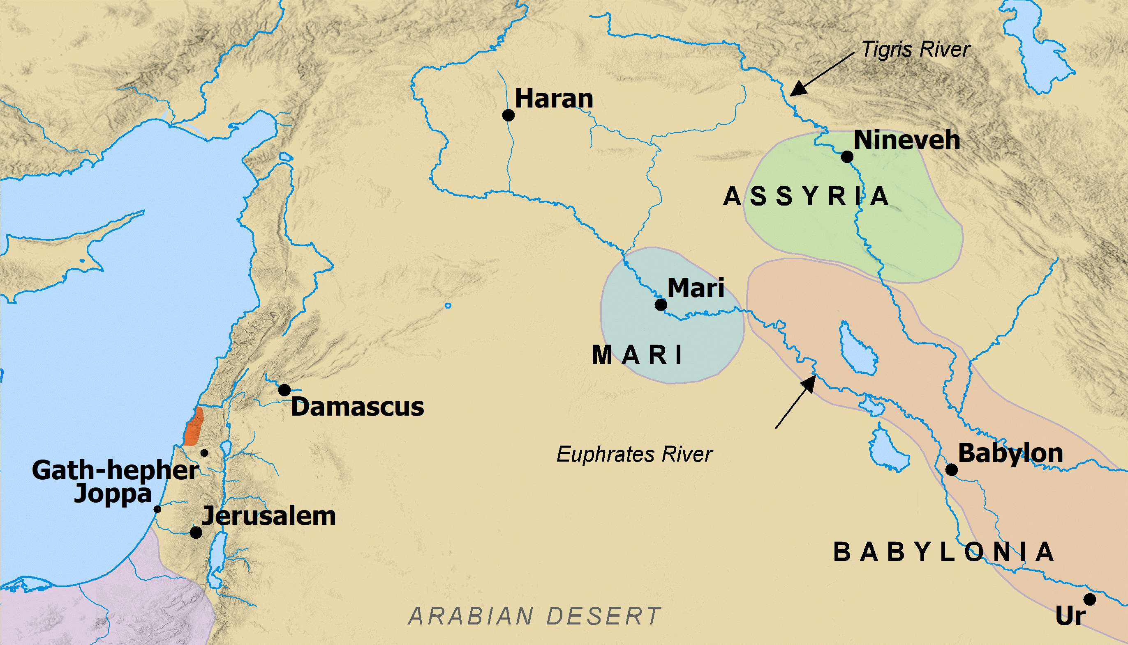
Jonah’s Flight
Bible Mapper 5.0

Slide 12
Jonah Flees from God – chapter 1
God called Jonah to Rebuke Nineveh.
Jonah fled to Tarshish.
God threatened the ship with a great storm.
The sailors prayed to their gods.
The sailors sought to determine the cause of the problem.
Jonah suggested that they throw him overboard.
When they threw Jonah overboard the storm stopped.
God prepared a great fish to swallow Jonah.
“…when God enjoins a disagreeable duty, it is far easier to go and do it than to run away from it.” - McGarvey
“When one sets out to baffle God, there is bound to be a storm.” - Robinson

Slide 13
How People Try to Escape Responsibility
Avoid Spiritual Situations
Genesis 3:6-10 John 3:19-21
Act in the Dark or Secret
Isaiah 29:15; Job 24:13-17; Psalm 10:7-13
Cover Up the Evidence
Joshua 7:20-26; 2 Samuel 11
Lie, Deceive, Deny Guilt
Genesis 37:28,31-35; Proverbs 26:24-26
Blame Others
Genesis 3:9-13; 1 Samuel 15:3,9,15,22,23

Slide 14
Consequences of Avoiding Responsibility
You Can’t Hide from Yourself
You Can’t Hide from God
Jeremiah 16:17; 23:23,24; Psalm 139:1-12
God Will Require an Account
Numbers 32:23; Ecclesiastes 12:14; Luke 12:2
The Only Solution is
Repentance and Forgiveness
Proverbs 28:13

Slide 15
Jonah’s Prayer
God “prepared” a great fish to swallow Jonah. He was in the fish 3 days and 3 nights.
Jonah acknowledged that God had cast him into the sea.
He believed God had cast him out of His sight, but he looked toward God’s temple.
Jonah remembered the Lord and prayed to Him.
Idols are worthless but salvation is from the Lord.
Jonah would pay what he vowed to the Lord.
God commanded the fish to spit Jonah out on dry ground.

Slide 16
Preaching to Nineveh
Bible Mapper 5.0

Slide 17
Jonah’s Preaching and Nineveh’s Repentance
God again told Jonah to preach to Nineveh.
Jonah preached that the city would be destroyed in forty days.
The people believed the message and grieved.
The king urged everyone to turn from evil and ask God for mercy.
When God saw the people’s repentance, He determined not to punish them.

Slide 18
Importance of Repentance
Jeremiah 25:4,5 – “Repent now everyone of his evil way and his evil doing...”
Mark 1:15 – Jesus’ message said: “Repent, and believe in the gospel.”
Luke 13:3 – Unless you repent you will all likewise perish.
Acts 2:38 – “Repent and be baptized, every one of you for the remission of sins…”
Acts 17:30 – God commands all men everywhere to repent.
Revelation 3:19 – “As many as I love, I rebuke and chasten. Therefore be zealous and repent.”
2 Peter 3:9 – God is not willing for men to perish but wants all to come to repentance.

Slide 19
Requirements before Repentance
Repentance is a change of mind: a determination to turn from sin and obey God.
Matthew 21:28-32
Before repentance one must hear and believe God’s will.
Luke 24:47; 2 Timothy 2:25,26; Ezekiel 13:22
One must acknowledge sin.
Psalm 38:18; Proverbs 28:13
One must be sorry for his sins.
Joel 2:12,13; 2 Corinthians 7:10; James 4:8,9

Slide 20
Requirements after Repentance
One who has never become a child of God, must be baptized to receive forgiveness under the gospel.
Acts 2:38; Acts 22:16; Mark 16:15,16; Romans 6:3,4
A child of God who sins must pray for forgiveness.
Acts 8:22; 1 John 1:9
Then one must change his conduct: quit practicing sin.
Acts 26:20; Ezekiel 18:21-32;Proverbs 28:13
We may also need to make restitution.
Ezekiel 33:14,15; Exodus 22:1-15; Luke 19:8; Philemon 10-19; Matthew 21:28-31

Slide 21
God Taught Jonah to Care about All Souls
Jonah was angry that God spared Nineveh.
God prepared a plant to give Jonah shade.
God then caused the plant to wither and sent hot wind and sun on Jonah.
God said He had more reason to care about the people of Nineveh than Jonah did about the plant.

Slide 22
Lessons from the Book of Jonah
Danger of hiding from God instead of fulfilling responsibilities.
Meaning and importance of repentance.
Proper priorities: value of spiritual matters compared to physical matters, especially the importance of lost souls.

Slide 23
© Copyright David E. Pratte, 2021
Permission is granted to display this PowerPoint under the following conditions:
* Display the link to www.BibleStudyLessons.com
* Minor changes in content are permitted, but no teaching should be presented that disagrees with the teaching in the article associated with this PowerPoint on www.BibleStudyLessons.com/powerpoint
* In no case may a fee of any kind be charged for our PowerPoints.
* If you have a website, please add a link to www.BibleStudyLessons.com
Scripture quotations are generally from the New King James Version (NKJV), copyright 1982, 1988 by Thomas Nelson, Inc. Used by permission. All rights reserved.
www.BibleStudyLessons.com

