Slide 2


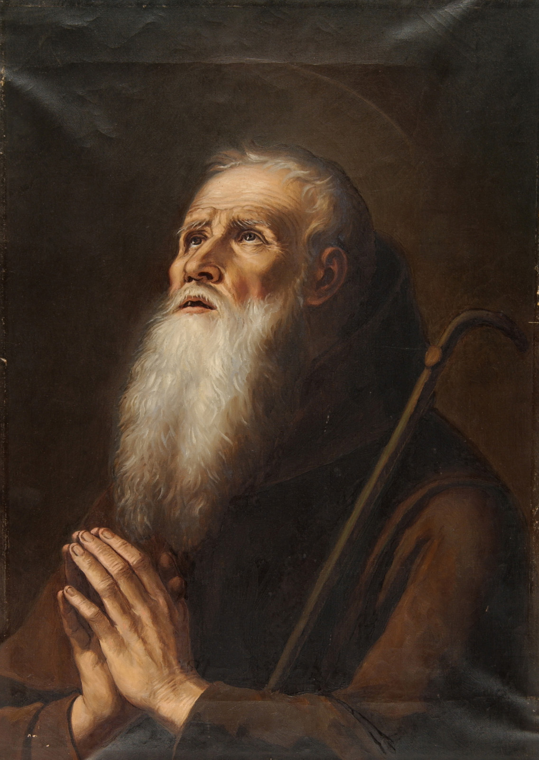
Knowing the Lord
Importance of Knowing God
Necessity of Faith and Trust
Knowing God Better
Importance of Obedience
biblestudylessons.com

Slide 3
Importance of Knowing God
God Desires Us to Know Him.
Jeremiah 9:24 – …glory in this, that he understands and knows Me
Philippians 3:8-10 – I have suffered the loss of all things, that I may gain Christ that I may know Him and the power of His resurrection
2 Thessalonians 1:8 – Vengeance on those who do not know God
God Blesses Those Who Know Him.
Psalm 36:10 – Continue Your lovingkindness to those who know You
Jeremiah 31:34 – … they all shall know Me, For I will forgive their iniquity, and their sin I will remember no more.
2 Peter 1:2 – Grace and peace be multiplied to you in the knowledge of God and of Jesus our Lord.
John 17:3 – And this is eternal life, that they may know You, the only true God, and Jesus Christ whom You have sent.

Slide 4
Knowing the Lord
Importance of Knowing God
Necessity of Faith and Trust
Knowing God Better
Importance of Obedience
biblestudylessons.com

Slide 5
Necessity of Faith and Trust
Some Do Not Believe in God or Desire to Know Him.
Acts 17:23 – The Athenians did not believe in the true God.
Exodus 5:2 – Pharaoh did not know the Lord
John 1:10 – Jesus made the world, but the world did not know Him
Some Who Know God Turn Away from Him.
Romans 1:19-22,28 – Some knew God but did not retain knowledge.
2 Peter 2:20 – Some escaped the pollutions of the world through the knowledge of Jesus Christ, but were again entangled in them
Knowing God Requires Trust and Commitment to His Service.
Psalm 9:10 – Those who know Your name will put their trust in You.
Hebrews 8:11 (Jeremiah 31:34) – All shall know Me
Jeremiah 24:7 – I will give them a heart to know Me; they shall be My people, and I will be their God.

Slide 6
Knowing the Lord
Importance of Knowing God
Necessity of Faith and Trust
Knowing God Better
Importance of Obedience
biblestudylessons.com

Slide 7
Knowing God Better
Study the Word of God
Acts 17:23 – Paul proclaimed what the Athenians did not know.
1 John 4:6 – He who knows God hears Inspired men.
Proverbs 2:2,5,6 – Incline your ear … find the knowledge of God.
1 Corinthians 1:21 – The world through wisdom did not know God
Understand and Value the Character and Work of God
Acts 17:23 – Paul taught about the character and works of God
Jeremiah 9:24 – Lovingkindness, judgment, righteousness
Understand and Value the Life and Teaching of Jesus.
John 1:18 – The only begotten Son has declared Him.
Matthew 11:27 – No one knows Father except the Son reveals Him.
John 14:6-10 – If you know Me, you would know My Father also; … He who has seen Me has seen the Father

Slide 8
Knowing the Lord
Importance of Knowing God
Necessity of Faith and Trust
Knowing God Better
Importance of Obedience
biblestudylessons.com

Slide 9
Importance of Obedience
1 Chronicles 28:9 – Know God and serve Him with a loyal heart and with a willing mind; for the Lord searches hearts and thoughts.
John 10:14,15,27 – I am the good shepherd; and I know My sheep, and am known by My own … and they follow Me.”
Titus 1:16 – They profess to know God, but in works they deny Him, being abominable, disobedient, disqualified for every good work.
1 John 2:3,4 – Now by this we know that we know Him, if we keep His commandments. He who says, “I know Him,” and does not keep His commandments, is a liar, and the truth is not in him.
Acts 17:30,31 – God commands all men everywhere to repent, because He has appointed a day on which He will judge the world

Slide 10
Knowing the Lord
Importance of Knowing God
Necessity of Faith and Trust
Knowing God Better
Importance of Obedience
biblestudylessons.com

Slide 12
© Copyright David E. Pratte, 2024
Permission is granted to display this PowerPoint under the following conditions:
* Display the link to BibleStudyLessons.com
* Minor changes in content are permitted, but no teaching should be presented that disagrees with the teaching in the article associated with this PowerPoint at BibleStudyLessons.com/powerpoint
* In no case may a fee of any kind be charged for our PowerPoints.
* If you have a website, please add a link to BibleStudyLessons.com
Scripture quotations are generally from the New King James Version (NKJV), copyright 1982, 1988 by Thomas Nelson, Inc. Used by permission. All rights reserved.
biblestudylessons.com

