Slide 2

Why Were
You Born?
www.BibleStudyLessons.com

Slide 3

Mistaken Views of the Purpose of Life
You Were Not Born…
Simply as a Product of Nature
Where did the first living thing come from?

Slide 4

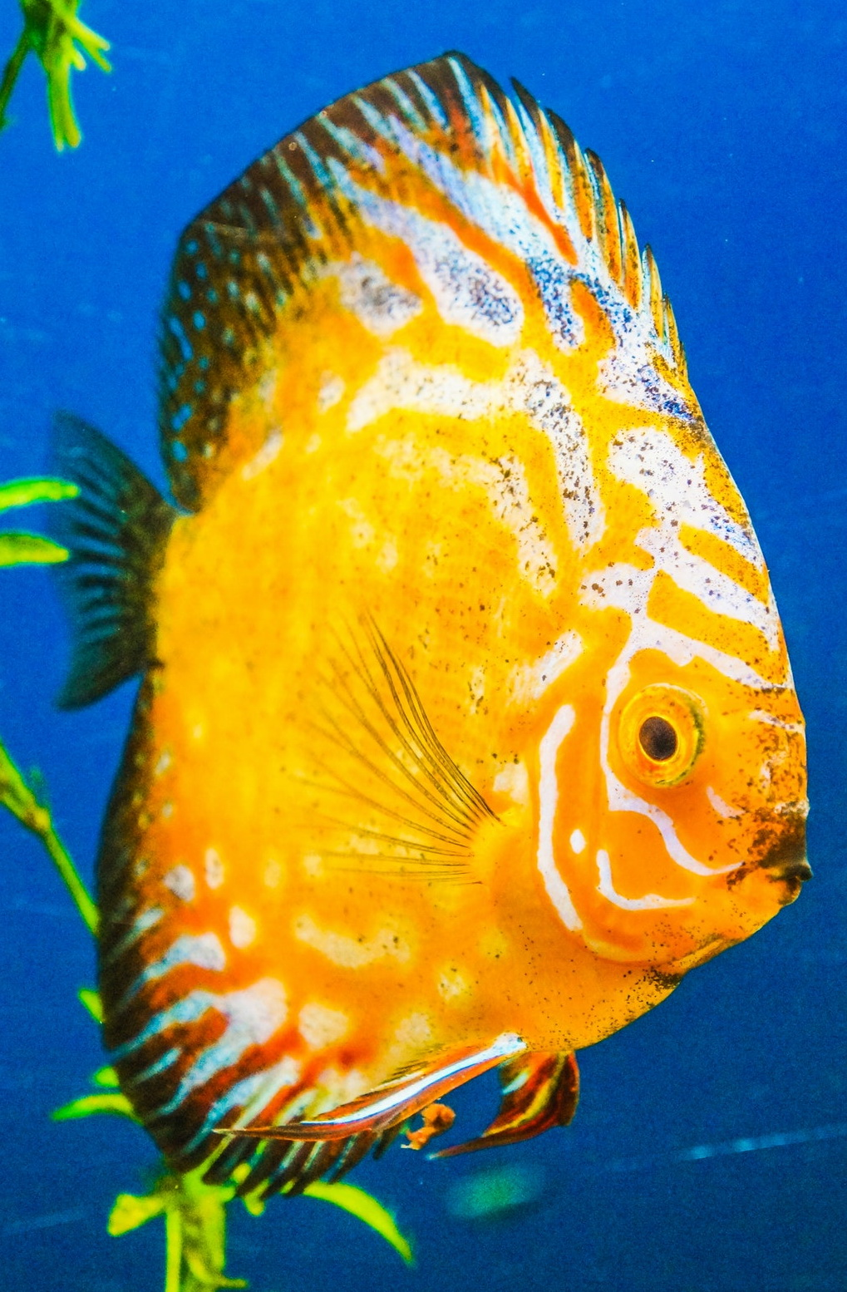

Mistaken Views of the Purpose of Life
You Were Not Born…
Simply as a Product of Nature
Where did the first living thing come from?
How could all the modern kinds of living things come from an original kind?

Slide 5


Mistaken Views of the Purpose of Life
You Were Not Born…
Simply as a Product of Nature
Where did the first living thing come from?
How could all the modern kinds of living things come from an original kind?
Why is man so unique from animals?

Slide 6

Mistaken Views of the Purpose of Life
You Were Not Born…
Simply as a Product of Nature
to Pursue Your Own Self-Gratifying Goals
Riches and material possessions

Slide 7

Mistaken Views of the Purpose of Life
You Were Not Born…
Simply as a Product of Nature
to Pursue Your Own Self-Gratifying Goals
Riches and material possessions
Pleasure and entertainment

Slide 8

Mistaken Views of the Purpose of Life
You Were Not Born…
Simply as a Product of Nature
to Pursue Your Own Self-Gratifying Goals
Riches and material possessions
Pleasure and entertainment
Education
Ecclesiastes 2:1-11;
Colossians 3:1,2

Slide 9

Mistaken Views of the Purpose of Life
You Were Not Born…
Simply as a Product of Nature
to Pursue Your Own Self-Gratifying Goals
Simply to Live and Then Die

Slide 10
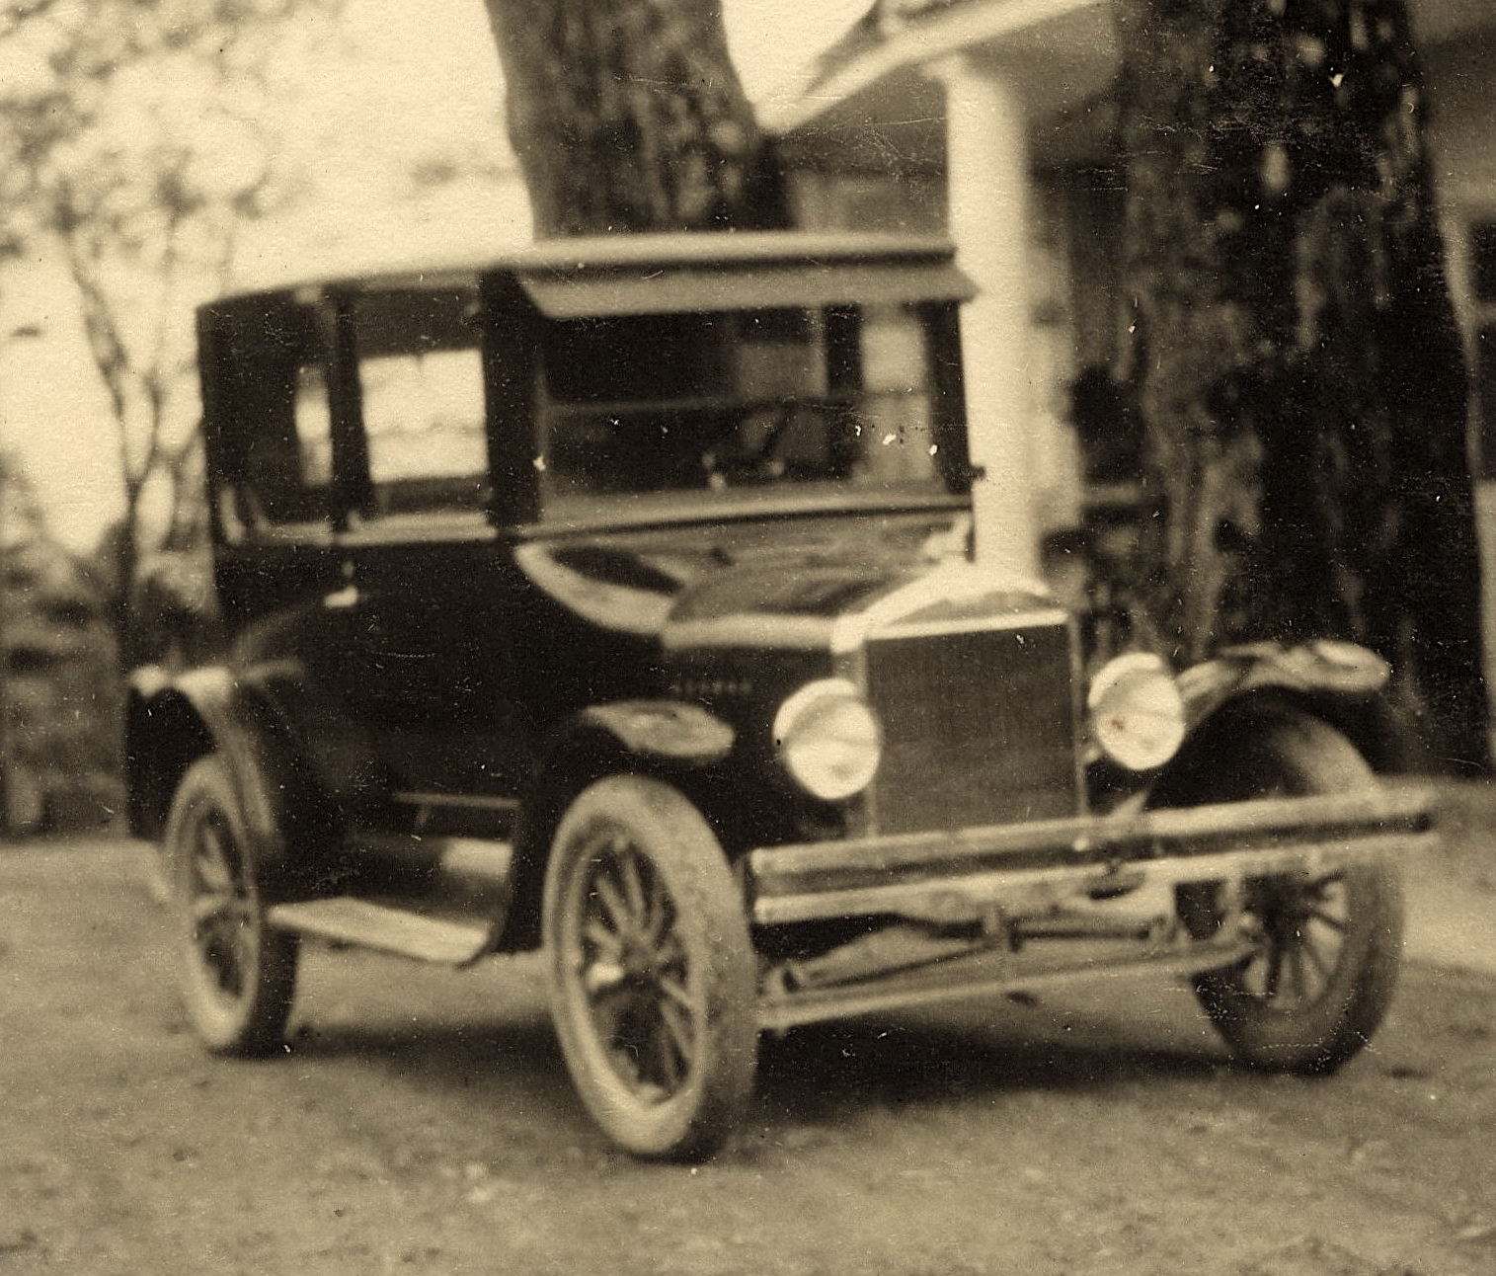
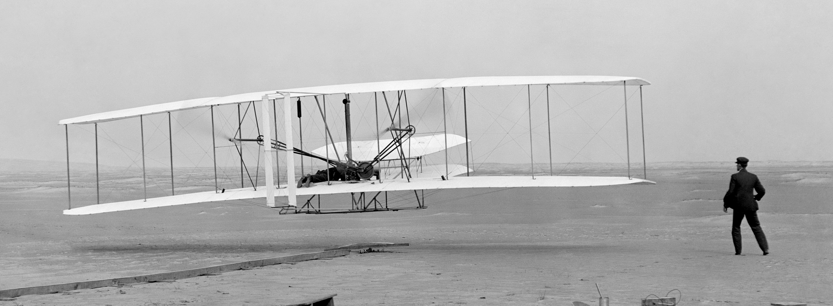
The Truth about the Purpose of Life
You WERE Born…
Because God Created You
Genesis 1:11,12,21-28; Acts 17:24,25,28

Slide 11
The Truth about the Purpose of Life
You WERE Born…
Because God Created You
Genesis 1:11,12,21-28; Acts 17:24,25,28
To Live with God Forever
Hebrews 9:27; Matthew 25:31-34,41,46; Romans 2:6-11;
Acts 17:30,31
To Serve God and Give Him Glory
Ecclesiastes 12:13,14; Matthew 6:19-21,24,33;
1 Timothy 6:10,11; Matthew 22:36-39; 1 John 5:2,3;
1 Corinthians 14:37; 6:19,20 ; 1 John 2:15,17
The Bible has the answer to
the important questions of life.

Slide 12
© Copyright David E. Pratte, 2020
Permission is granted to display this PowerPoint under the following conditions:
* Display the link to www.BibleStudyLessons.com
* Minor changes in content are permitted, but no teaching should be presented that disagrees with the teaching in the article associated with this PowerPoint on www.BibleStudyLessons.com/powerpoint
* In no case may a fee of any kind be charged for our PowerPoints.
* If you have a website, please add a link to www.BibleStudyLessons.com
Scripture quotations are generally from the New King James Version (NKJV), copyright 1982, 1988 by Thomas Nelson, Inc. Used by permission. All rights reserved.
www.BibleStudyLessons.com

