Slide 2

Video Bible Study
Lessons
presented by
David E. Pratte
gospelway.com

Slide 3
The Book of
Malachi
Thanks to Christians in the Hillcrest church for their participation.
© Copyright David E. Pratte, 2022
Scripture quotations are generally from the New King James Version (NKJV), copyright 1982, 1988 by Thomas Nelson, Inc. used by permission. All rights reserved.

Slide 4
Bible Study Questions on the Books of
Haggai, Zechariah, and Malachi
Available at
biblestudylessons.com/classbooks

Slide 5
Periods of Bible history
1. Before the Flood (Creation to the flood)
2. After the Flood (the flood to the call of Abraham)
3. Patriarchs (the call of Abraham to the death of Joseph)
4. Egyptian Bondage (Joseph’s death to crossing Red Sea)
5. Wilderness Wandering (Red Sea to crossing the Jordan)
6. Conquest of Canaan (crossing Jordan to Joshua’s death)
7. Judges (death of Joshua to crowning of King Saul)
8. United Kingdom (crowning of Saul to death of Solomon)
9. Divided Kingdom (death of Solomon to the fall of Israel)
10. Judah Alone (the fall of Israel to the fall of Judah)
11. Babylonian Captivity (fall of Judah to end of captivity)
12. Restoration of Israel (return to the completion of OT)
13. Years of Silence (completion of OT to the birth of Jesus)
14. Life of Christ (from the birth of Jesus to His ascension)
15. Early Church (Jesus’ ascension to the completion of NT)

Slide 6
Prophets by Period
Period of History | Prophets
Divided Kingdom | Israel: Jonah Amos Hosea | Judah: Obadiah (?) Joel (?) Isaiah Micah
Judah Alone | Jeremiah (Lamentations) Zephaniah Nahum (?) Habakkuk (?)
Babylonian Captivity | Ezekiel Daniel
Return from Captivity | Haggai Zechariah Malachi

Slide 7
Themes of the Minor Prophets
Hosea – Israel’s unfaithfulness compared to Hosea’s wife
Joel – Locust plague shows Israel’s need to repent
Amos – Israel would go into captivity because of sins like those of the surrounding nations
Obadiah – Fall of Edom for rejoicing in Judah’s affliction
Jonah – God uses a fish and a plant to teach Jonah His concern for the salvation of Nineveh and all people
Micah – God puts Israel and Judah on trial for their sins.
Nahum – Prophecy of the fall of Nineveh
Habakkuk – Habakkuk questions God’s punishments
Zephaniah – God’s wrath is coming against Jerusalem and surrounding nations, but a remnant will be spared.
Haggai – Returning Jews should rebuild the temple
Zechariah – The restoration and future glory of God’s people
Malachi – Spiritual restoration among the returned Jews

Slide 8
Theme and Major Divisions of Malachi
Theme: A call for spiritual restoration among returned Jews
Accusations against the People:
1:1-5 – Accusation: Failure to respond to God’s love
1:6-14 – Accusation: Failure to Honor God by Offering Polluted Sacrifices
2:1-9 – Rebuke of Priests for Unfaithfulness
2:10-16 – Accusation: Improper Marriage and Divorce
2:17-3:6 – Accusation: Wearying God by Accusing Him of Injustice
3:7-12 – Accusation: Disregarding the Law of Tithing
3:13-4:6 – Accusation: Claiming Service to God Is Vain

Slide 9
Accusation #1:
Failure to Respond to God’s Love – 1:1-5
Israel questioned God’s love so He gave an example.
He loved Jacob but hated his brother Esau (the nations that descended from the brothers)

Slide 10
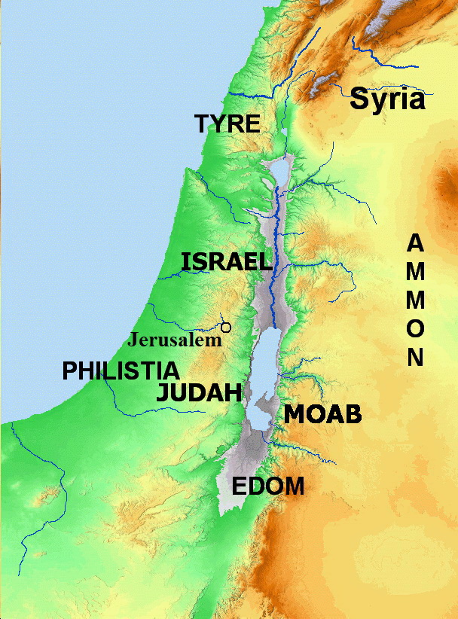
Nations around Israel
Bible Mapper 5.0

Slide 11
Conflict Between Israel and Edom
“Jacob have I loved and Esau have I hated” - Malachi 1:2,3
No reference to eternal destinies.
Refers to descendants to receive Abraham’s promises.
Refers to the nations of descendants, not to individuals.
Statement made long after both Jacob and Esau had died.
“Hate” means a lesser love (Genesis 29:33; Luke 14:26).
Conflict between Israel and Edom
Amos 1:11; Num. 20:14-20; 1 Sam. 14:47; 1 Kings 11:14-17;
2 Chron. 20:22; 21:8
Punishment on Edom: Genesis 27:40; 2 Samuel 8:14; 2 Chronicles 25:11,12; Psalm 60:8; 83:5-15; Isaiah 34:5-13; 63:1-6; Jeremiah 49:7-22; Ezekiel 25:12-14; 35:1-15; Amos 1:11,12; 9:12;
Malachi 1:2-5; Romans 9:10-13

Slide 12
Accusation #1:
Failure to Respond to God’s Love – 1:1-5
Israel questioned God’s love so He gave an example.
He loved Jacob but hated his brother Esau (the nations that descended from the brothers)
Edom inherited mountains and wilderness. What they tried to rebuild, God threw down.
God would be indignant against them forever.

Slide 13
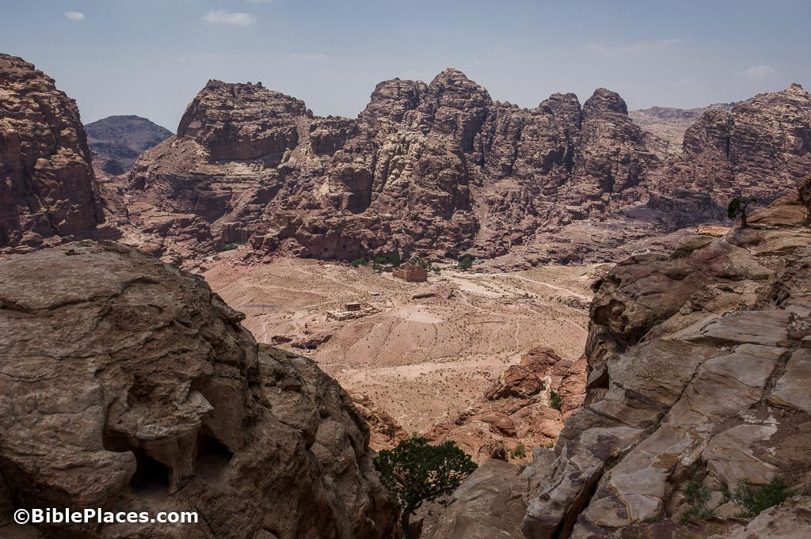
Petra

Slide 14
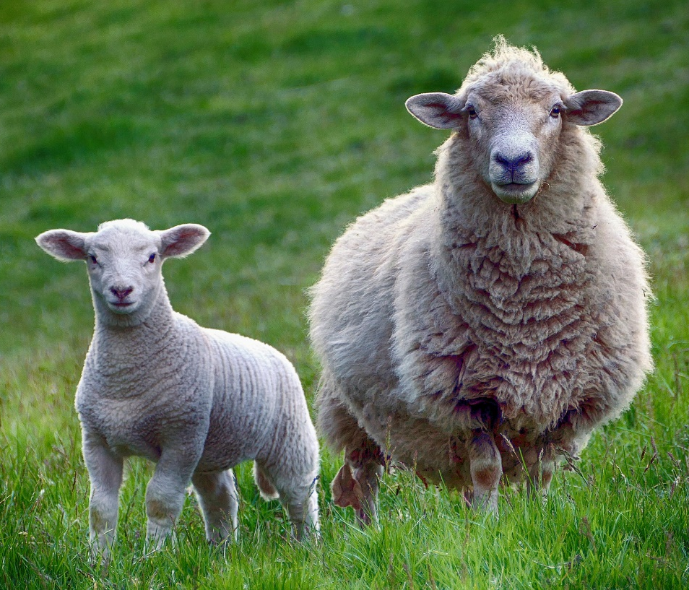
Accusation #2:
Failure to Honor God by Offering Polluted Sacrifices – 1:6-14
God deserved honor but they despised Him by offering the lame, sick, or stolen.
Would a governor, father, or master accept such gifts favorably?
God preferred they made no offering at all rather than give what was of little value.
Instead of obtaining God’s blessing, such gifts brought a curse on them.

Slide 15
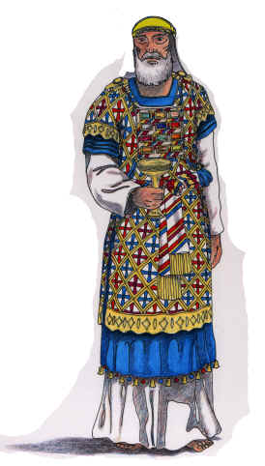
Unfaithfulness of the Priests – 2:1-9
If the priests disobeyed God’s command, He would curse them and rebuke their descendants.
God’s covenant required priests to fear God, teach the law, and practice justice.
But the priests had departed from the way, caused others to stumble, shown partiality, and corrupted the covenant.

Slide 16

Accusation #3:
Improper Marriage and Divorce – 2:10-16
Some profaned the covenant and dealt treacherously by marrying those who worshiped idols.
God rejected their worship because they treacherously divorced their wives.
God seeks godly offspring and hates divorce, so do not deal treacherously with your wives.

Slide 17
Divorce NOT for Fornication
What Happens
Married
Divorced
(unmarried)
Married
God’s View
Bound/Joined in covenant
Sin
(still bound)
Adultery

Slide 18
Accusation #4:
Wearying God by Accusing Him of Injustice – 2:17-3:6
The people wearied God by saying He was unjust and approved of some people’s evil.
God would send His messenger to prepare the way for the Messenger of the covenant.
He will purify the Levites and witness against sorcerers, adulterers, perjurers, and other evils.

Slide 19
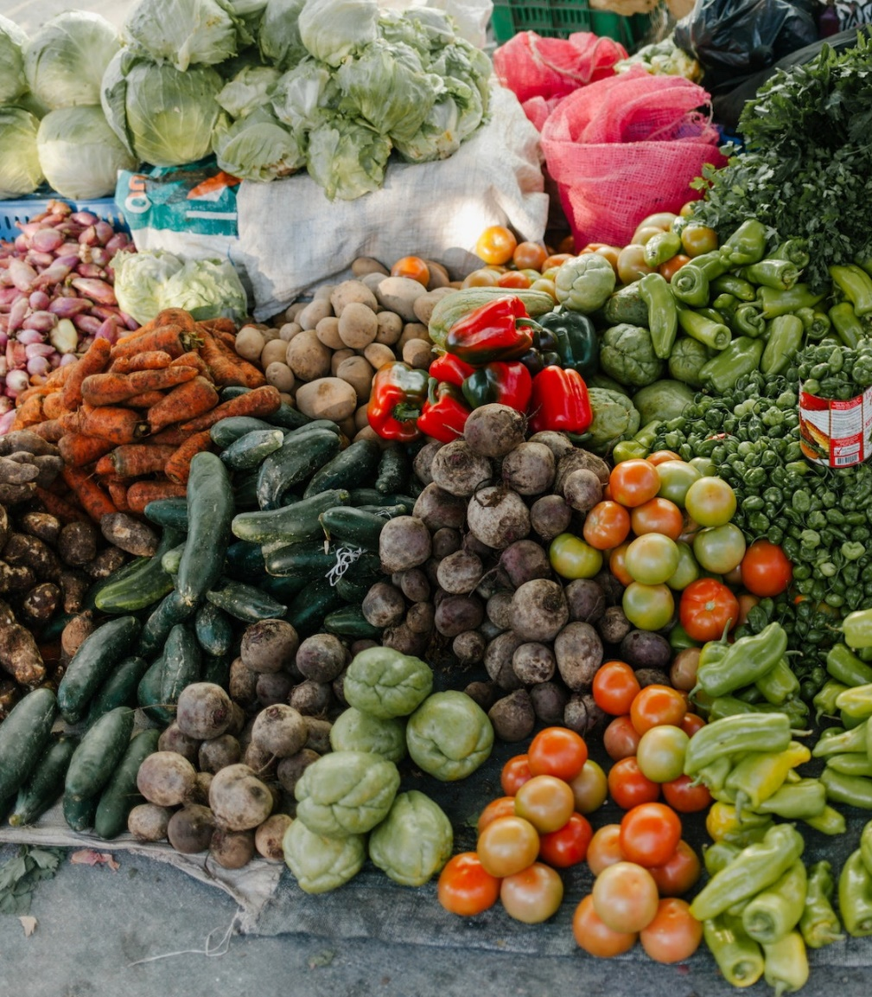
Accusation #5:
Robbing God in Tithes and Offerings – 3:7-12
The people were cursed because they robbed God in tithes and offerings.
If they brought in the tithes, He would give such a blessing there would not be room to receive it.
The devourer would not destroy their crops and all nations would call them blessed.

Slide 20

Accusation #6:
Claiming Service to God Is Vain – 3:13-4:6
Some claimed that service to God was vain because it did not give benefits they expected.
God would remember those who truly feared Him and distinguish them from the wicked.
The wicked would be burned up like stubble but those who feared God would be well fed.
God would send Elijah the prophet to turn the hearts of the fathers to the children and vice versa.
Book
of Life

Slide 22
© Copyright David E. Pratte, 2022
Permission is granted to display this PowerPoint under the following conditions:
* Display the link to www.BibleStudyLessons.com
* Minor changes in content are permitted, but no teaching should be presented that disagrees with the teaching in the article associated with this PowerPoint on www.BibleStudyLessons.com/powerpoint
* In no case may a fee of any kind be charged for our PowerPoints.
* If you have a website, please add a link to www.BibleStudyLessons.com
Scripture quotations are generally from the New King James Version (NKJV), copyright 1982, 1988 by Thomas Nelson, Inc. Used by permission. All rights reserved.
www.BibleStudyLessons.com

