Slide 1

What to Do about Nazism?
Keep quiet because:
* It involved politics/economics
* It controlled governments
* Speaking out might lead to persecution
* It was mainly a problem elsewhere
Or, speak out to express opposition because:
* It was based on fundamental religious errors
* It rejected Christianity and Jesus
* It sought world domination by military conquest
* It used violence to eliminate unwanted citizens
2 Timothy 4:2-4; Ephesians 5:11; Revelation 3:19
www.BibleStudyLessons.com

Slide 2

What to Do about Islam?
Keep quiet because:
* It involves politics/economics
* It controls governments
* Speaking out might lead to persecution
* It is mainly a problem elsewhere
Or, speak out to express opposition because:
* It is based on fundamental religious errors
* It rejects Christianity and Jesus
* It seeks world domination by military conquest
* It uses violence to make converts
2 Timothy 4:2-4; Ephesians 5:11; Revelation 3:19

Slide 3

What to Do about Marxism?
Keep quiet because:
* It involves politics/economics
* It controls governments
* Speaking out might lead to persecution
* It is mainly a problem elsewhere
Or, speak out to express opposition because:
* It is based on fundamental religious errors
* It rejects Christianity and Jesus
* It seeks world domination by military conquest
* It uses violence to eliminate unwanted citizens
2 Timothy 4:2-4; Ephesians 5:11; Revelation 3:19

Slide 4

Communist Nations
China – population 1.4 billion
Vietnam – 96 million
North Korea – 26 million
Cuba – 11 million
Laos – 7 million
Over 1½ billion people openly dominated by Communist dictatorships
Not counting many other nations struggling with Communist subversion and internal turmoil.
(www.worldatlas.com/articles/list-of-communist-countries-today.html)
(Population statistics from Wikipedia as of July, 2019)

Slide 5
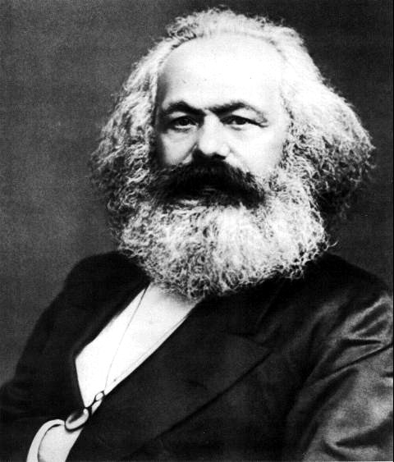
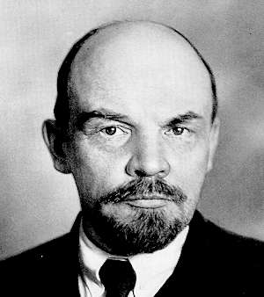
Doctrines of Marxism-Leninism
Existence of God

Slide 6
Marxism and Atheism - 1
Marx: “In simple truth, I harbour hate ‘gainst all the Gods” “.. recognize as the highest divinity, the human self-consciousness itself!”
Engels: “the last vestige of a Creator external to the world is obliterated”
Lenin: “Our program necessarily includes the propaganda of atheism” And again: “Every religious idea, every idea of god, even every flirtation with the idea of God, is unutterable vileness”
Khrushchev: “We, Communists … are atheists … Public education, the dissemination of scientific knowledge, and the study of the laws of nature, leave no place for belief in God … We consider that belief in God contradicts our Communist outlook”

Slide 7
Marxism and Atheism - 2
Khrushchev: “We remain the atheists that we have always been; we are doing all we can to liberate those people who are still under the spell of this religious opiate”
Russian Encyclopedia (1950): “God — a mythical invented being … [Communism] is incompatible with belief in God; it arose and developed in an acute and constant struggle with religion”
“Ten Commandments of Communism”: “If you are not a convinced atheist, you cannot be a good Communist … Atheism is indissolubly bound to Communism.”
Whittaker Chambers: “The problem of Communism is not an economic problem. The problem of Communism is the problem of atheism”

Slide 8
The Bible & Faith in God
God does exist.
Genesis 1:1 — In the beginning God created the heaven and the earth.
Hebrews 11:6 — Without faith it is impossible to please God. We must believe that He is and that He is a rewarder of those who diligently seek Him.
Psalms 14:1 — The fool has said in his heart, “There is no God.”
The Bible provides evidence for God’s existence.
Acts 14:17; Romans 1:18-22; Psalms 19:1

Slide 9
Doctrines of Marxism-Leninism
Existence of God
Origin of Man

Slide 10
Marxism and Evolution - 1
Communist Manifesto (Preface): The basic theory of Communism “is destined to do for history what Darwin’s theory has done for biology”
Engels: “Darwin, whom I am just now reading, is splendid.”
Marx: “… this is the book which contains the basis in natural history for our view.” “Darwin’s book is very important and serves me as a basis in natural science for the class struggle in history.” Marx wanted to dedicate his book Das Kapital to Darwin.
Lenin: “Darwin put an end to the belief that animal and vegetable species … were created by God…”

Slide 11
Marxism and Evolution - 2
Fundamentals of Marxism-Leninism: “Nature … is in constant process of development. The laws of that development have not been ordained by God … They are intrinsic in nature itself…”
“At a very early age … Comrade Stalin developed a critical mind and revolutionary sentiments. He began to read Darwin and became an atheist.” The biography records a boyhood conversation: “‘You know, they are fooling us, there is no God … I’ll lend you a book to read; it will show you that … all this talk about God is sheer nonsense,’ Joseph said. “What book is that?” I enquired. ‘Darwin. You must read it,’ Joseph impressed on me”

Slide 12

chicagosocialists.org
Supporting Chicago Teacher Strike
chicagosocialists.org
(accessed 7/24/2020)

Slide 13
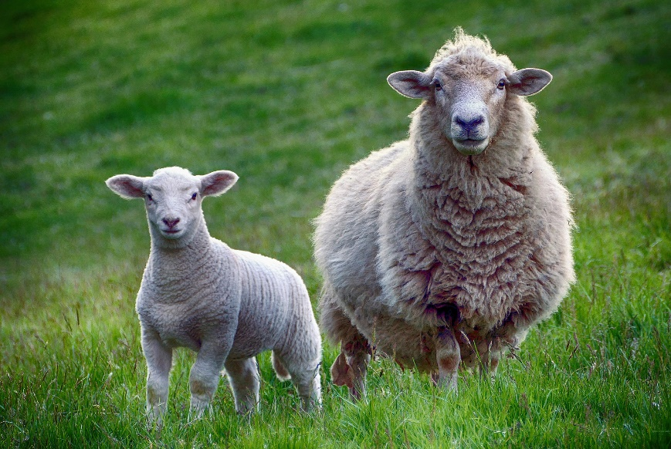
The Bible & Creation
God created all forms of life
Genesis 1:1; Acts 17:24-28
Living things reproduce after their own kind
Genesis 1:11,21,24f;
Galatians 6:7
Man is unique from the animals
Genesis 1:26-28

Slide 14
Doctrines of Marxism-Leninism
Existence of God
Origin of Man
Materialism

Slide 15
Marxism and Materialism- 1
Fundamentals of Marxism-Leninism : “The indestructible foundation of the whole edifice of Marxism-Leninism is its philosophy — dialectical and historical materialism”
“Marxism-Leninism regards the world such as it actually is, without adding an invented hell or paradise. It proceeds from the fact that all nature, including man himself, consists of matter with its different properties … There are no supernatural phenomena or forces, nor can be … The great historic service rendered by materialist philosophy is that it helped man … not to fear gods and other supernatural forces. It teaches us not to hope for happiness beyond the grave…”

Slide 16
Marxism and Materialism - 2
Lenin: “Our program is based entirely on scientific — to be more precise — upon a materialistic world conception” “We must combat religion — this is the ABC of all materialism, and consequently Marxism”
Mao Zedong:“there is nothing in the world apart from matter in motion”
Stalin: “Marx’s philosophical materialism holds … that the world develops in accordance with the laws of movement of matter and stands in no need of a ‘universal spirit’”
Khrushchev: “Scientific and atheistic propaganda is an integral part of the Communist education …, and has as its aim the dissemination of scientific, materialistic knowledge among the masses and the liberation of believers from the influence of religious prejudices”

Slide 17
The Bible vs. Materialism
God and spirit beings do exist.
John 4:24 — God is Spirit
2 Cor. 4:16-18 — Man consists of outer & inner man
Man exists after death and will be raised
Matthew 22:23-32 — Men lived after physical death
Luke 16:19-31 — Jesus told of men who were dead, yet could reason, remember, and communicate.
John 6:40,44,45; 5:28,29; Acts 24:15 — Jesus and His apostles often affirmed that all people will be raised
The resurrection of Jesus proves our resurrection
1 Corinthians 15:1-26 – Jesus’ resurrection is the proof we will be raised (verses 1-8)
John 20:24-31; 21:24 – Many eyewitnesses testified for the resurrection

Slide 18
Doctrines of Marxism-Leninism
Existence of God
Origin of Man
Materialism
Religion

Slide 19
Marxism and Religion - 1
Marx said his objective in life was: “To dethrone God and destroy capitalism”
Lenin: “Marx said ‘Religion is the opium of the people’ — and this postulate is the cornerstone of the whole philosophy of Marxism with regard to religion. Marxism always regarded all modern religions and churches, and every kind of religious organisation [sic] as instruments of that bourgeois reaction whose aim is to defend exploitation by stupefying the working-class”
Lenin: “Marxism is materialism. As such it is … relentlessly opposed to religion … This is beyond doubt … We must combat religion — this is the A.B.C. of all materialism, and consequently of Marxism”

Slide 20
Marxism and Religion - 2
Stalin: “The Party cannot be neutral towards religion, and it does conduct anti-religious propaganda against all and every religious prejudice because it stands for science, while … all religion is something opposite to science”
The Communist International stated: “One of the most important tasks of the cultural revolution affecting the wide masses is the task of systematically and unswervingly combating religion — the opium of the people”

Slide 21
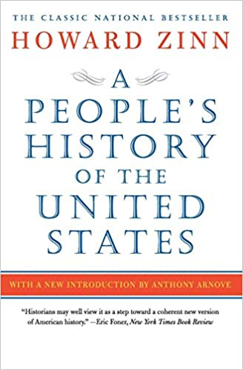
Marxism and Religion - 3
The most widely used history textbook in U.S. public schools is A People's History of the United States by the late Howard Zinn … a very leftwing version of U.S. history, full of multicultural, feminist, and class-war propaganda. …
In 2010, the FBI released 400 pages of files on Howard Zinn, and it turns out that he was an active member of the Communist Party. He … attended Communist Party meetings in Brooklyn five nights a week.

Slide 22
Marxism and Religion - 4
Publicly, Howard Zinn lied and denied his Communist Party membership, which was the common practice of Communist Party members in those years.
…His textbook was specifically written to present a Marxist version of U.S. history based on the Communist strategy of the "class war.“ - Phyllis Schlafly Report, 11/2010

Slide 23
The Bible and Religion
The Bible affirms that it is inspired by God
2 Timothy 3:16,17; 1 Corinthians 14:37
The Bible gives evidence that it is a Divine revelation
Prophecy - Luke 24:25-27,44; Acts 2:22-36; Deuteronomy 18:20-22;
Miracles/Resurrection - John 5:36; 20:26-31;
Acts 14:3; 1 Corinthians 15:1-8
So, Marxism and the gospel are incompatible
1 Corinthians 1:18-25; Ephesians 5:11

Slide 24
Doctrines of Marxism-Leninism
Existence of God
Origin of Man
Materialism
Religion
Morality

Slide 25
Marxist Doctrine of Morality - 1
Lenin: “Is there such a thing as Communist morality? Of course there is … In what sense do we repudiate ethics and morality? In the sense that they were preached by the bourgeoisie, who declared that ethics were God’s commandments. We, of course, say that we do not believe in God … And we subordinate our Communist morality to this [the class struggle]. We say: Morality is that which serves to destroy the old exploiting society and to unite all the toilers around the proletariat, which is creating a new Communist society. Communist morality is the morality which serves this struggle.” (SW9-474-479).

Slide 26
Marxist Doctrine of Morality - 2
Lenin: “We do not believe in eternal morality … At the basis of Communist morality lies the struggle for the consolidation and consummation of Communism” (SW9-478,479).
William Z. Foster: “With him [the communist] the end justifies the means. Whether his tactics be ‘legal’ or ‘moral’ or not, does not concern him, so long as they are effective” (NC-52).
Radio Moscow: “Therefore, from the point of view of Communist morality, only those acts are moral which contribute to the building up of a new Communist society” (NC-304f).

Slide 27
Marxist Doctrine of Morality - 3
Lenin. “To lie, is that wrong? Not for a good cause. To steal, is that wrong? Not for a good cause. To kill, is that wrong? Not for a good cause” (NC-355). “Promises are like piecrusts — made to be broken” (BC- 57). “Yes, of course, we are violating the treaty; we have violated it thirty or forty times” (SW7-301).
Stalin: “Sincere diplomacy is no more possible than dry water or iron wood” (NC-304).
Engels: “Thou shalt not steal. Does this law thereby become an eternal moral law? By no means” (NC-52).
Saul Alinsky said, “All effective actions require the passport of morality.”

Slide 28
The Bible & Morality
Man as a free moral agent
Joshua 24:15; Revelation 22:17; Romans 2:6-11
The Bible as a standard of morality
Psalm 119:105; Acts 17:11;
Matthew 28:18-20; 7:21-27
Bible prohibitions regarding morality remain today.
Galatians 5:19-21; 1 Corinthians 6:9-11;
Revelation 21:8; Romans 3:8-10; Romans chapter 1

Slide 29
Doctrines of Marxism-Leninism
Existence of God
Origin of Man
Materialism
Religion
Morality
The family

Slide 30
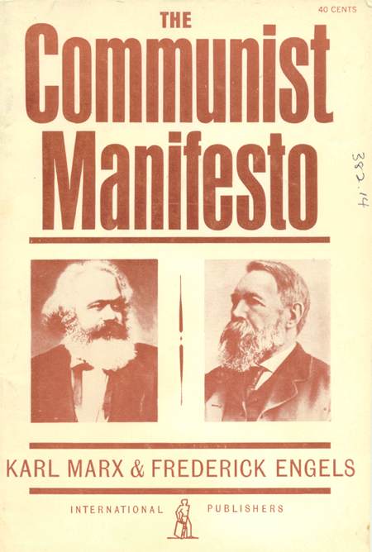
Communist Manifesto & Family
Communists “openly declare that their ends can be attained only by the forcible overthrow of all existing social conditions” (page 36).
“Abolition of the family? Even the most radical flare up at this infamous proposal of the Communists … The bourgeois family will vanish as a matter of course...” (pp. 22,23)
Marx said: “There is no greater stupidity than for people ... to marry and so surrender themselves to the small miseries of domestic and private life.” (www.azquotes.com)

Slide 31
Marxist Doctrine of the Family
Lenin: “…woman continues to be a domestic slave, because petty housework crushes, strangles, stultifies and degrades her, chains her to the kitchen and to the nursery, and wastes her labor on barbarously unproductive, petty, nerve-racking, stultifying and crushing drudgery. The real emancipation of women, real communism, will begin only when … this petty domestic economy … is transformed on a mass scale into a large-scale socialistic economy” (LR-71).
Marxist book: “Socialism leads woman on to the path of important public activities and production work … As society takes over a big share of the cares for education and maintenance of children, the position of the woman in the family will be radically lightened” (FML-603,668).

Slide 32
Feminism & the Family
Declaration of Feminism: “Women … will be the first to understand the need for a socialist revolution” (p. 1). “In order to break the tyranny of class oppression it is necessary to establish a socialist order … The end of the institution of marriage is a necessary condition for the liberation of women. Therefore it is important for us to encourage women to leave their husbands and not to live individually with men … The nuclear family must be replaced with a new form of family…” (pp 4,5,10-13).
Alice S. Rossi: “The first condition for the liberation of the wife is to bring the whole female sex back into public industry, and this in turn demands the abolition of the monogamous family ...”
“We disrupt the Western-prescribed nuclear family structure …” – BLM website

Slide 33
Marxism and Children - 1
Marx: “The education of all children, from the moment that they can get along without a mother’s care, shall be in state institutions.” (www.azquotes.com)
Lenin: “We must hate — hatred is the basis of Communism. Children must be taught to hate their parents if they are not Communists” (NC-350).
Communist Manifesto list of measures to produce the downfall of non-communist societies includes: “Free education for all children in public schools” (page 25).
Communist publication: “It is in the schools … that the foundations for a Communist outlook are laid ... and no one should be allowed to indulge in the slightest deviation from the principles of the Communist materialist upbringing of the new generation” (NC-314).

Slide 34
Marxism and Children - 2
Soviet Affairs: “The basic work in Communist education and the overcoming of the survivals of religiousness must be carried out by the school teachers … to prove to the pupils the complete contrast and complete irreconcilability between science … and religion as a fantastic, distorted and, consequently, harmful reflection of the world … the school must pose the question before parents who are believers as to the extreme harmfulness … and inadmissability of imposing religious influence on children … to maim their children morally ... by bringing them up at home on religious prejudices which are in radical contradiction with the true scientific instruction and education of the school” (NC-173).

Slide 35
Marxism and Children - 3
American Communist William Z. Foster predicted, “God will be banished from the laboratories as well as from the schools” (NC-349).
The Document: Declaration of Feminism states: “Within the structure of the nuclear family children are oppressed because they are defined as property … We support parent controlled child care centers as a necessary step toward the feninist-socialist [sic] revolution, but our vision of the upbringing of children extends beyond them. With the destruction of the nuclear family must come a new way of looking at children. They must be seen as the responsibility of an entire society rather than individual parents” (pp 13,14)

Slide 36
The Marxist Goal
“…all women become the property of the nation … Any man who wishes to make use of a nationalized woman must hold a certificate issued by the administrative Council … Any woman who by virtue of the present decree will be declared national property will receive from the public fund a salary equivalent to 575 French francs a month … One month after birth, children will be placed in an institution entrusted with their care and education. They will remain there to complete their instruction and education … until they reach the age of seventeen … All those who refuse to recognize the present decree and to cooperate with the authorities shall be declared enemies of the people … and shall suffer the consequences” (NC-72f).

Slide 37
The Bible & the Family
Marriage as a Divine institution
Genesis 2:18-24 – Marriage was ordained by God for the good of women, men, and children.
Hebrews 13:4 – Marriage is honorable, and the sexual union is pure only within marriage.
Ephesians 5:25-29 (Proverbs 31:28-31; 18:22; 19:14; Titus 2:4; 1 Peter 3:7) – Men should love, cherish, and honor their wives
Care of children entrusted to parents
Genesis 1:28 – God commanded the first man and woman to reproduce in the family relationship.
Ephesians 6:1-4; Deuteronomy 6:6-9 – Parents should train children to serve God. Children should obey and honor parents.

Slide 38
Doctrines of Marxism-Leninism
Existence of God
Origin of Man
Materialism
Religion
Morality
The Family
Private Property

Slide 39
Marxism and Private Property - 1
Communist Manifesto : “… the theory of the Communists may be summed up in the single sentence: abolition of private property” (p19). “…you reproach us with intending to do away with your property. Precisely so; that is just what we intend.” (p20)
“The proletariat will use its political supremacy to wrest, by degrees, all capital from the bourgeoisie; to centralize all instruments of production in the hands of the State …” (p24)
Lenin: “… insurrection must [include] … the expulsion of the landlords and the seizure of their lands”
And “The goal of socialism is communism.” www.azquotes.com

Slide 40
Marxism and Private Property - 2
Khrushchev: “… industry … land. All economic levers of economic management remain in the hands of the state. Finally, and this is decisive, the Communist Party directs the entire socialist building”
Teen Vogue (7/15/2020), a magazine for teenagers, published an article urging people to reject the concept “that any one person should own this earth’s land.” “While we’re working to abolish the police, we must also work to dismantle what the police were put here to protect: property.” “...basically we just need to abolish landlords.”

Slide 41
The Bible & Private Property - 1
Bible permits people to own property & business
Owning houses and property — Acts 12:5,12; 16:15; 21:8; Matthew 8:14; Luke 10:38; 19:5.
Hiring workers - Matthew 20:1-15
Using or investing money - Matthew 25:14-30
Workers should serve diligently - 1 Pet. 2:18; Luke 12:42-46; Eph. 6:5-9; Tit. 2:9,10; 1 Tim. 6:1,2; Col. 3:22-24
Supervisors should treat workers right - Matt. 7:12; Col. 4:1; James 5:1,4; Matt. 20:1-16; Eph. 6:9
Greed is forbidden in favor of sharing with the needy — Eph. 4:28; 1 Tim. 6:6-10,17-19; Luke 12:15-21; Acts 20:35

Slide 42
The Bible & Private Property - 2
The Bible forbids stealing
Romans 13:8-10 — Laws against stealing necessarily imply the right of property ownership! (Ex. 20:15,17; 1 Cor. 6:9-11; Eph. 4:28; 1 Pet. 4:15,16; Luke 12:39)
But furthermore anyone who confiscates another person’s property against his will becomes a thief.
Romans 13:1-7 - Government has the right to collect taxes, but only for the purpose of doing rightful duties of government. When government confiscates private property or business, simply because rulers want to control property or business, that is thievery.

Slide 43
Communism in Acts 2,4 ?
In Bible examples:
(1) People shared because of religious motives of love for others and devotion for God.
(2) Sharing was voluntary: a personal choice. Acts 5:4; 2 Corinthians 9:5,7; 8:12.
(3) Christians shared to meet emergency needs at limited times and circumstances.
(4) Christians met the needs of other Christians.
(5) Money was placed under the control of the church.
(6) People donated money, not businesses or property.
(7) Christians were permitted to own property and businesses even after Acts 2 & 4.

Slide 44
Doctrines of Marxism-Leninism
Existence of God
Origin of Man
Materialism
Religion
Morality
The Family
Private Property
Corruption / Revolution

Slide 45
Marxism, Corruption, Revolution-1
Communist Manifesto: “…Communists … support every revolutionary movement against the existing social and political order of things … They openly declare that their ends can be attained only by the forcible overthrow of all existing social conditions. Let the ruling classes tremble at a Communist revolution. (p. 36).
Marx: “Revolutions are the locomotives of history” (SW3-122)
Lenin said Marxists sow “among the masses hate, revulsion, and scorn toward those who disagree with us.” “The press [media] should be not only a collective propagandist and a collective agitator, but also a collective organizer of the masses.” (www.azquotes.com)

Slide 46
Marxism, Corruption, Revolution-2
Lenin: “Only insurrection can guarantee the victory of the revolution” (SW3- 327).
Again: “The substitution of the proletarian state for the bourgeois state is impossible without a violent revolution” (SW7-21).
Again: “Riots – demonstrations – street battles … – such are the stages in the development of a popular uprising … The revolutionary army is needed because great historical questions can be solved only by violence.” (SW3-312f).
Engels wrote that Communists must “recognize no means of carrying out these objects other than a democratic revolution by force” (CFF-134).

Slide 47
Marxism, Corruption, Revolution-3
Mao said: “All political power comes from the barrel of a gun.” And “Communism is not love. Communism is a hammer which we use to crush the enemy.” “Don’t make a fuss about a world war. At most, people die... It’s best if half the population is left, next best one-third.” (www.azquotes.com)
Anatole Lunarcharsky: “We hate Christians and Christianity. Even the best of them must be considered our worst enemies. They preach love of one’s neighbor and mercy, which is contrary to our principles. Christian love is an obstacle to the development of the Revolution. Down with love of our neighbor! What we want is hate … Only then can we conquer the universe”

Slide 48
Marxism, Corruption, Revolution-4
“Harry Hay, founder of the modern "gay rights" movement, was a member of the Communist Party USA and … the FBI maintained a file on him. Hay was also a vocal supporter of the North American Man/Boy Love Association.”
Roger Baldwin, one of the founders of the ACLU, was a Communist.
“The revolution is being financed by Americans who use cocaine.”

Slide 49
Neo-Marxism: Social Justice, Critical Race Theory, Wokeness, Cultural Marxism - 1
Saul Alinsky: “The organizer’s first job is to create the issues or problems, and … rub raw the resentments of the people of the community; fan the latent hostilities of many of the people to the point of overt expression. He must search out controversy and issues … An organizer must stir up dissatisfaction and discontent."
And, “They have the guns and therefore we are for peace and for reformation through the ballot. When we have the guns then it will be through the bullet.” (www.azquotes.com)

Slide 50
Neo-Marxism: Social Justice, Critical Race Theory, Wokeness, Cultural Marxism - 2
Saul Alinsky’s rules for creating chaos in society:
1) Live by the Rule of Personal Destruction. Treat your adversary as non-human, deserving of zero respect or compassion. … make your attack personal, and polarize public opinion about them. … demonize them until they are deemed Evil. …
3) Never let up with your pressure on your foe.
4) Force them to live every second of their lives by every rule they preach
7) Your actions are only important insofar as they engender an overreaction or a misstep by your enemy. Disinformation and deception are your friends.” – Rules for Radicals summarized by Sebastian Gorka, https://amgreatness.com/2020/07/29/from-alinsky-to-aoc-will-communism-finally-win-in-america/

Slide 51
Neo-Marxism: Social Justice, Critical Race Theory, Wokeness, Cultural Marxism - 3
Black Lives Matter was founded by Patrisse Cullors, Alicia Garza, and Opal Tometi.
Cullors: BLM “do[es] have an ideological frame. Myself and Alicia in particular are trained organizers. We are trained Marxists.”– justthenews.com/politics-policy/video-resurfaces-which-black-lives-matter-founder-says-groups-creators-are-trained (accessed 6/25/2020)
Her mentor was Eric Mann, a “former member of the Weather Underground charged with attempted murder of police officers in Boston back in 1969. The domestic terror group Weather Underground is responsible for multiple terrorist bombings at the U.S. Capitol, the State Department, and the Pentagon during the 1960s and ‘70s.” - thefederalist.com/2020/07/08/black-lives-matter-in-public-schools-is-turning-kids-into-little-marxists/

Slide 52
Neo-Marxism: Social Justice, Critical Race Theory, Wokeness, Cultural Marxism - 4
Black Lives Matter founder Cullors:“…is inspired by Assata Shakur who was convicted of first-degree murder for the killing of a New Jersey state trooper …. Shakur was also a member of the former Black Panthers and Black Liberation Army.” – illinoisfamily.org/faith/exposing-black-lives-matter/
Black Lives Matter’s financial sponsor umbrella group is called Thousand Currents.
“…the vice chairwoman of the board of directors for Thousand Currents is Susan Rosenberg, a convicted felon who participated in bombing buildings in the Northeast and Washington, D.C. ... Rosenberg was part of M19, short for May 19th Communist Organization.’” – www.dailysignal.com/2020/06/25/4-things-the-liberal-media-wont-tell-you-about-black-lives-matter/? (6/26/2020)

Slide 53
Neo-Marxism: Social Justice, Critical Race Theory, Wokeness, Cultural Marxism - 5
“Cullors also admits that the very first thing BLM leaders do when they hear of a ‘murder’ is to pray to the spirits and ‘pour libation’ [sacrifices]. … ‘At its core, it’s a spiritual movement’ … ‘you kind of invoke that spirit, and then those spirits actually become present with you’”
- illinoisfamily.org/marriage/hail-satan-after-terrorizing-churches-blm-witchcraft-exposed
Ariel Atkins, a Black Lives Matter organizer: “I don’t care if someone decides to loot a Gucci or a Macy’s or a Nike store, because that makes sure that person eats. That makes sure that person has clothes. That is reparations. Anything they wanted to take, they can take it because these businesses have insurance.”

Slide 54
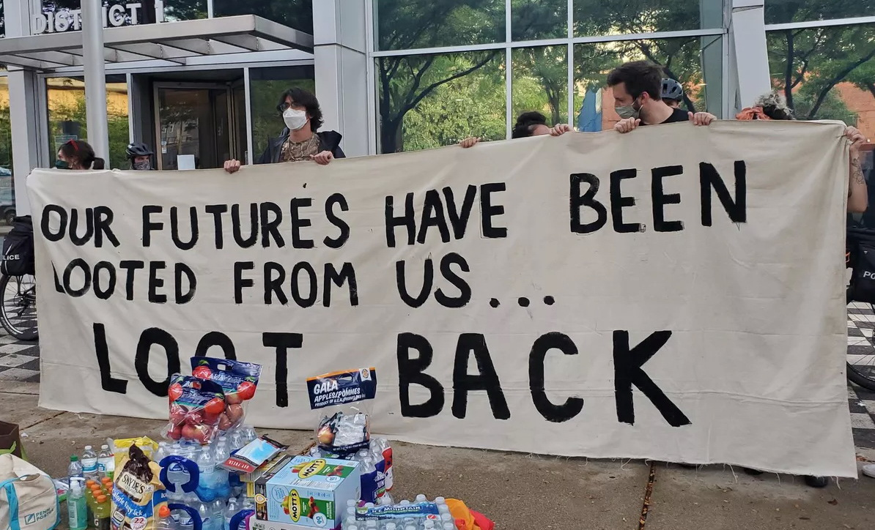
Neo-Marxism: Social Justice, Critical Race Theory, Wokeness, Cultural Marxism - 6
https://www.breitbart.com/politics/2020/08/11/chicago-blm-organizer-defends-looting-reparations/?utm_source=newsletter&utm_medium=email&utm_term=daily&utm_campaign=20200811 (“Black Lives Matter to Lightfoot,” Chicago Sun-Times, Aug. 10, 2020).

Slide 55
Bible & Corruption/Revolution
Christians should be subject to government
Romans 13:1-5; John 18:36
Christians should work for peace, not strife
Romans 12:18; Luke 6:27,28
Christians should never tempt or encourage others to sin
Matthew 18:6,7; Hebrews 10:24

Slide 56
Doctrines of Marxism-Leninism
Existence of God
Origin of Man
Materialism
Religion
Morality
The Family
Private Property
Corruption / Revolution
Persecution / Annihilation

Slide 57
Marxism, Persecution, Annihilation-1
Communist Manifesto: “…the middle-class owner of property. This person must, indeed, be swept out of the way, and made impossible” (p21).
Lenin: “…the revolutionary dictatorship of the proletariat is violence against the bourgeoisie” (SW-125). “… power that is unrestricted by any laws” (SW7-123).
Again: “The dictatorship of the proletariat does not fear to resort to compulsion, and to the most severe, decisive and ruthless expression of state compulsion” (SW8- 257).
Stalin said: “To choose one’s victims, to prepare one’s plan minutely, to slake an implacable vengeance ... There is nothing sweeter in the world.” And “The death of one man is tragic, but the death of thousands is statistic.” And “The only real power comes out of a long rifle.” (www.azquotes.com)

Slide 58
Marxism, Persecution, Annihilation - Examples
Communist Murders
Soviet Union: 35 to 45 million people
China: 34 to 63 million people
North Korea: “in some areas 60-80% of Christian leaders were killed off”
Cambodia: 2 or 3 million out of a population of 7 million
Other Persecution
Many sentenced to slave labor camps.
Others imprisoned in asylums and treated with brainwashing, mind altering drugs, psychiatric treatments
3000 people per year escape from North Korea. World Magazine, 11/2012

Slide 59
Bible & Persecution, Annihilation
Christians must love all men, not harm or murder them
Matthew 22:39; Romans 13:8-10; Matthew 7:12
Christians attempt to change others by persuasion, not by force
Mark 16:15,16; Ephesians 5:11; 6:10-18; 2 Corinthians 10:3-5; 5:10,11

Slide 60
Doctrines of Marxism-Leninism
Existence of God
Origin of Man
Materialism
Religion
Morality
The Family
Private Property
Corruption / Revolution
Persecution / Annihilation
Earthly paradise

Slide 61
Marxism & Earthly Paradise - 1
Lenin: “…there will vanish all need for force, for the subjection of one man to another, since people will grow accustomed to observing the elementary conditions of social existence without force and without subjection.”
Lenin: “… we know that the fundamental social cause of excesses … is the exploitation of the masses, their want and their poverty. With the removal of this chief cause, excesses will inevitably begin to ‘wither away.’ … With their withering away, the state will also wither away”

Slide 62
Marxism & Earthly Paradise - 2
Young Comrade: “In your religious training you are told that even if things are bad on this earth, everything will be wonderful when you die and go to Heaven … This is all a lie. When you die, you are dead and that is all there is to it. We want our Paradise right here and now”
Saul Alinsky: “A Marxist begins with his prime truth that all evils are caused by the exploitation of the proletariat by the capitalists. From this he logically proceeds to the revolution to end capitalism, then into the third stage of reorganization into a new social order of the dictatorship of the proletariat, and finally the last stage – the political paradise of communism.”

Slide 63
Bible & Man’s Rewards
Many errors of Communism would continue in their utopia
Atheism, materialism, evolution, rejection of the Bible, abolition of the family, opposition to religion, abolition of private property
The Bible teaches that most people will always be evil.
Matthew 7:13,14
Jesus teaches that our paradise comes in heaven after this life.
Hebrews 9:27; John 5:28,29; Matthew 25:46;
5:10-12; 1 Peter 1:3,4

Slide 64
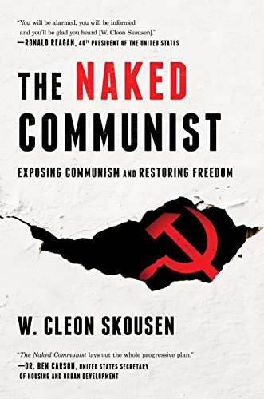
Marxist Goals to Defeat USA

Slide 65
Marxist Goals to Defeat USA 1
“Get control of the schools. Use them as transmission belts for socialism and current Communist propaganda. Soften the curriculum. Get control of teachers’ associations. Put the party line in textbooks.”
“Continue discrediting American culture by degrading all forms of artistic expression … ‘Our plan is to promote ugliness, repulsive, meaningless art’.”
“Eliminate all laws governing obscenity by calling them ‘censorship’ and a violation of free speech and free press. Break down cultural standards of morality by promoting pornography and obscenity in books, magazines, motion pictures, radio and TV.”
“Present homosexuality, degeneracy and promiscuity as ‘normal, natural, healthy.’”

Slide 66
Marxist Goals to Defeat USA 2
“Infiltrate the churches and replace revealed religion with ‘social’ religion. Discredit the Bible…”
“Eliminate prayer or any phase of religious expression in the schools on the ground that it violates the principle of ‘separation of church and state.’”
“Treat all behavioral problems as psychiatric disorders which no one but psychiatrists can understand … use mental health laws as a means of gaining coercive control over those who oppose Communist goals.”
“Discredit the family as an institution. Encourage promiscuity and easy divorce. Emphasize the need to raise children away from the … influence of parents. Attribute prejudices, mental blocks and retarding of children to suppressive influence of parents.”

Slide 67
What Can We Do?
1. Believe in God, trust Him, encourage others.
2. Defend Bible teaching regarding the spiritual nature of God, of man, and the truth of creation.
3. Practice and defend Bible teaching as the absolute standard of morality.
4. Diligently practice the teaching of Jesus, and urge others to do the same.
5. Thank God for our freedoms; pray for rulers.
6. Work to strengthen the family unit.
7. Pray for the strength to be faithful and to assist other Christians when persecution comes.
8. Maintain strong hope for the Christian’s eternal inheritance.

Slide 68
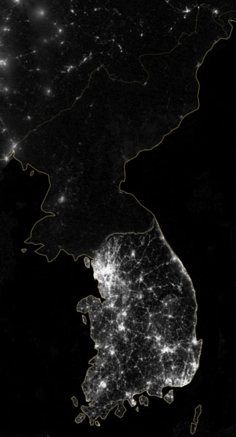
John 8:32 – You shall know the truth, and the truth shall make you free.

Slide 69
© Copyright David E. Pratte, 2020
Permission is granted to display this PowerPoint under the following conditions:
* Display the link to www.BibleStudyLessons.com
* Minor changes in content are permitted, but no teaching should be presented that disagrees with the teaching in the article associated with this PowerPoint on www.BibleStudyLessons.com/powerpoint
* In no case may a fee of any kind be charged for our PowerPoints.
* If you have a website, please add a link to www.BibleStudyLessons.com
Scripture quotations are generally from the New King James Version (NKJV), copyright 1982, 1988 by Thomas Nelson, Inc. Used by permission. All rights reserved.
www.BibleStudyLessons.com

