Slide 2

Video Bible Study
presented by
David E. Pratte
www.gospelway.com

Slide 3
The Prophecy of Micah
© Copyright David E. Pratte, 2021
Scripture quotations are generally from the New King James Version (NKJV), copyright 1982, 1988 by Thomas Nelson, Inc. used by permission. All rights reserved.

Slide 4
Questions from Bible Study Questions on Jonah, Micah, Nahum, Habakkuk
Available at
www.biblestudylessons.com/classbooks

Slide 5
Understanding Old Testament Prophecy
* The prophets are part of Scripture, and all Scripture is profitable to equip us in our service to God today
– 2 Timothy 3:16,17; Romans 15:4; 1 Corinthians 10:6,11.
* Old Testament history may help us understand the background behind prophets’ teachings.
* The prophets often used symbolic teaching. But that does not give us the right to assign a meaning to the symbols according to our own imagination.
* The prophets often included predictions about the Messiah, His Kingdom, and His message.
* Often New Testament writers give us an inspired explanation.

Slide 6
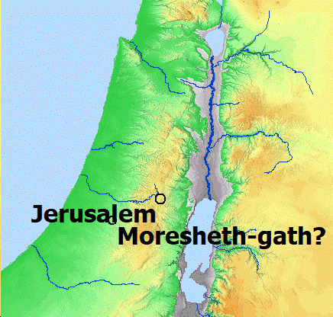
Moresheth-Gath
Bible Mapper

Slide 7
Periods of Bible history
1. Before the Flood (Creation to the flood)
2. After the Flood (the flood to the call of Abraham)
3. Patriarchs (the call of Abraham to the death of Joseph)
4. Egyptian Bondage (Joseph’s death to crossing Red Sea)
5. Wilderness Wandering (Red Sea to crossing the Jordan)
6. Conquest of Canaan (crossing Jordan to Joshua’s death)
7. Judges (death of Joshua to crowning of King Saul)
8. United Kingdom (crowning of Saul to death of Solomon)
9. Divided Kingdom (death of Solomon to the fall of Israel)
10. Judah Alone (the fall of Israel to the fall of Judah)
11. Babylonian Captivity (fall of Judah to end of captivity)
12. Restoration of Israel (return to the completion of OT)
13. Years of Silence (completion of OT to the birth of Jesus)
14. Life of Christ (from the birth of Jesus to His ascension)
15. Early Church (Jesus’ ascension to the completion of NT)

Slide 8
Prophets by Period
Period of History | Prophets
Divided Kingdom | Israel: Jonah Amos Hosea | Judah: Obadiah (?) Joel (?) Isaiah Micah
Judah Alone | Jeremiah (Lamentations) Zephaniah Nahum (?) Habakkuk (?)
Babylonian Captivity | Ezekiel Daniel
Return from Captivity | Haggai Zechariah Malachi

Slide 9
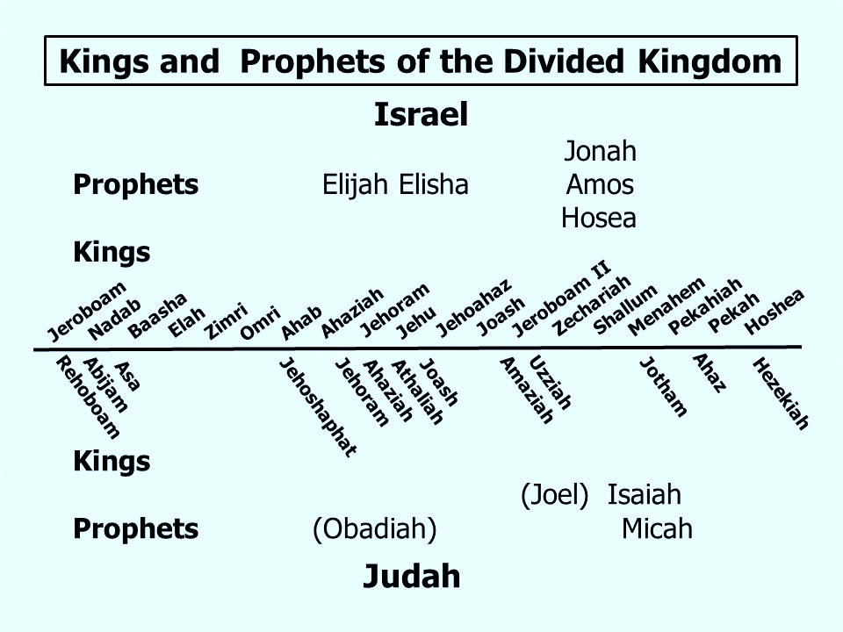

Slide 10
Themes of the Minor Prophets
Hosea – Israel’s unfaithfulness compared to Hosea’s wife
Joel – Locust plague shows Israel’s need to repent
Amos – Israel would go into captivity because of sins like those of the surrounding nations
Obadiah – Fall of Edom for rejoicing in Judah’s affliction
Jonah – God uses a fish and a plant to teach Jonah His concern for the salvation of Nineveh and all people
Micah – God puts Israel and Judah on trial for their sins.
Nahum – Prophecy of the fall of Nineveh
Habakkuk – Habakkuk questions God’s punishments
Zephaniah – God’s wrath is coming against Jerusalem and surrounding nations, but a remnant will be spared.
Haggai – Returning Jews should rebuild the temple
Zechariah – The future glory of God’s people
Malachi – Spiritual restoration among the returned Jews

Slide 11
Theme and Major Divisions of Micah
Theme: God puts Israel and Judah on trial for their sins.
Major divisions
Chapters 1,2 – Hear God’s Testimony: Descriptions of the people’s sins and predictions of punishment
Chapters 3-5 – Hear God’s rebuke of the leaders
Chapters 6,7 – Hear God’s complaint: God’s treatment of His people compared to their treatment of Him.

Slide 12
God Bears Testimony against the Peoples
Chapter 1:
God will make Samaria a heap of ruins.
Gath – Tell it not
Beth Aphrah – Roll yourself in the dust
Shaphir – Not pleasant beauty, but naked shame
Zaanan – Would not march out
Beth Ezel – Neighbors mourn but cannot comfort ??
Maroth – Pined for good but received bitterness
Lachish – Harness the chariot to the swift steeds (to flee)

Slide 13
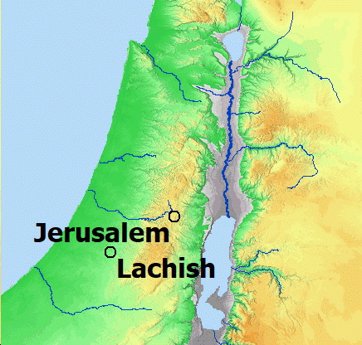
Lachish
Bible Mapper

Slide 14
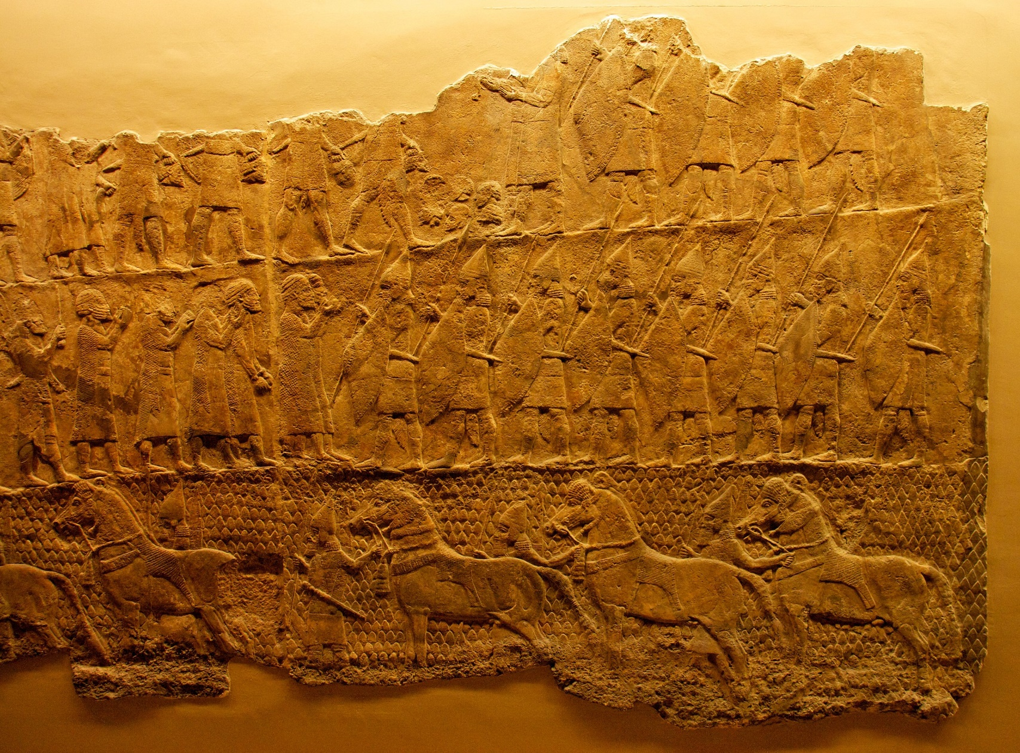
Siege of Lachish: Review of prisoners
Relief Carvings from the Palace of King Sennacherib of Assyria
Photo credit: Mike Peel (www.mikepeel.net)., CC BY-SA 4.0 <https://creativecommons.org/licenses/by-sa/4.0>, via Wikimedia Commons

Slide 15
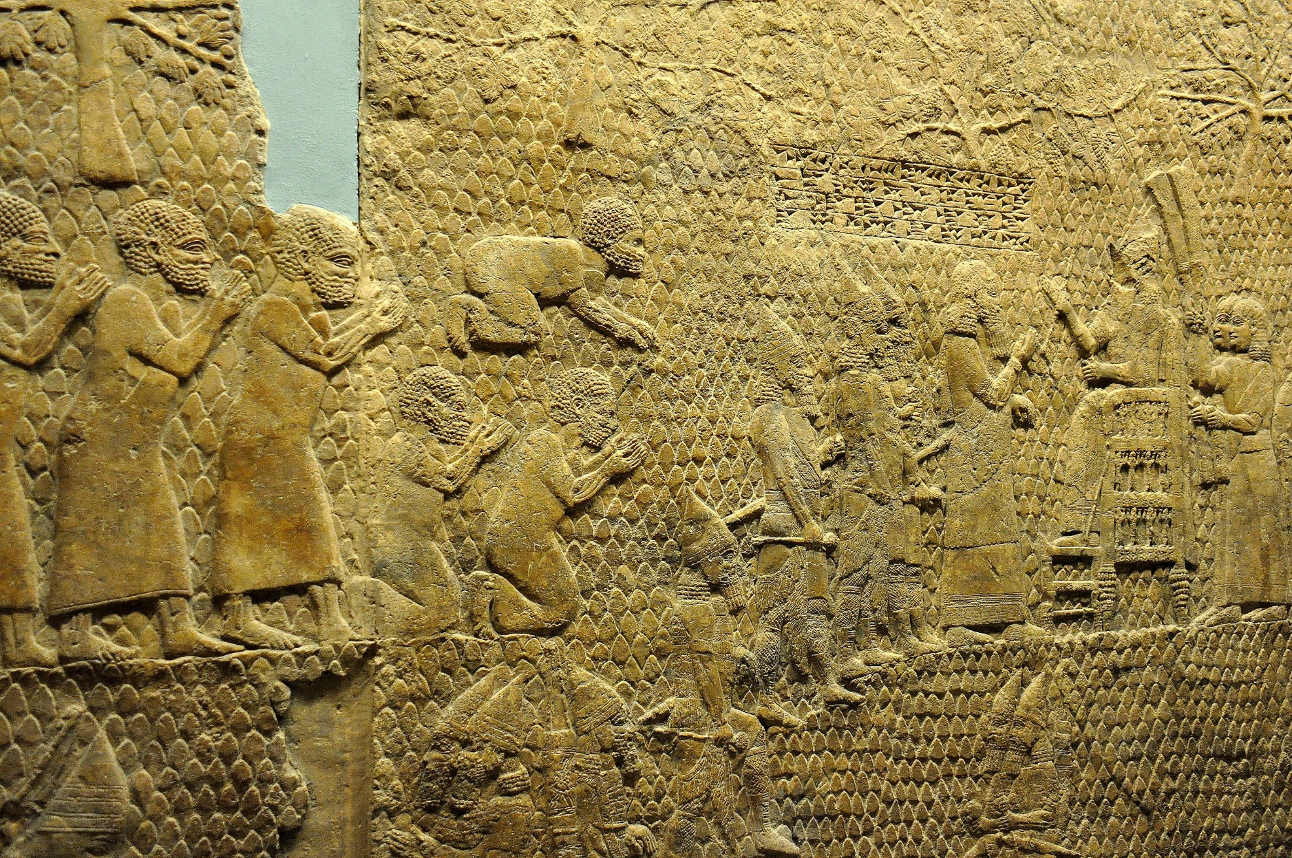
Booty from Lachish
Relief Carvings from the Palace of King Sennacherib of Assyria
Photo Credit: Osama Shukir Muhammed Amin FRCP(Glasg), CC BY-SA 4.0 <https://creativecommons.org/licenses/by-sa/4.0>, via Wikimedia Commons

Slide 16
God Bears Testimony against the Peoples
Micah 1:
God will make Samaria a heap of ruins.
Gath – Tell it not
Beth Aphrah – Roll yourself in the dust
Shaphir – Not pleasant beauty, but naked shame
Zaanan – Would not march out
Beth Ezel – Neighbors mourn but cannot comfort ??
Maroth – Pined for good but received bitterness
Lachish – Harness the chariot to the swift steeds (to flee)
Moresheth Gath – Give a parting gift
Achzib – Shall be a lie to the kings of Israel.
Mareshah – As inheritance to the enemy
Adullam – The glory of Israel shall flee

Slide 17
God’s Case against People in Power
Chapter 2:
Sins of the Leaders | Punishment of the Leaders

Slide 18
God’s Case against People in Power
Chapter 2:
Sins of the Leaders | Punishment of the Leaders
Oppression of others (verses 1,2,8,9)

Slide 19
God’s Case against People in Power
Chapter 2:
Sins of the Leaders | Punishment of the Leaders
Oppression of others (verses 1,2,8,9) | They would be oppressed (verses 3-5)

Slide 20
God’s Case against People in Power
Chapter 2:
Sins of the Leaders | Punishment of the Leaders
Oppression of others (verses 1,2,8,9) | They would be oppressed (verses 3-5)
Opposition to prophets (verses 6,11)

Slide 21
God’s Case against People in Power
Micah 2:
Sins of the Leaders | Punishment of the Leaders
Oppression of others (verses 1,2,8,9) | They would be oppressed (verses 3-5)
Opposition to prophets (verses 6,11) | Destruction from the land (verse 10)

Slide 22
God’s Case against People in Power
Micah 2:
Sins of the Leaders | Punishment of the Leaders
Oppression of others (verses 1,2,8,9) | They would be oppressed (verses 3-5)
Opposition to prophets (verses 6,11) | Destruction from the land (verse 10)
Future promise: A remnant would be brought from captivity (verses 12,13)

Slide 23
Sins of the Rulers and Religious Leaders
Micah 3:
The Rulers | The Prophets and Priests

Slide 24
Sins of the Rulers and Religious Leaders
Micah 3:
The Rulers | The Prophets and Priests
Hate good and love evil (verse 2)
Oppressed the people (verse 2)

Slide 25
Sins of the Rulers and Religious Leaders
Micah 3:
The Rulers | The Prophets and Priests
Hate good and love evil (verse 2) | Made the people err (verse 5)
Oppressed the people (verse 2) | Falsely predicted peace (verse 5)
 | Made war against non-supporters (verse 5)

Slide 26
Sins of the Rulers and Religious Leaders
Micah 3:
The Rulers | The Prophets and Priests
Hate good and love evil (verse 2) | Made the people err (verse 5)
Oppressed the people (verse 2) | Falsely predicted peace (verse 5)
Perverted justice (verse 9) | Made war against non-supporters (verse 5)

Slide 27
Sins of the Rulers and Religious Leaders
Micah 3:
The Rulers | The Prophets and Priests
Hate good and love evil (verse 2) | Made the people err (verse 5)
Oppressed the people (verse 2) | Falsely predicted peace (verse 5)
Perverted justice (verse 9) | Made war against non-supporters (verse 5)
Used power for personal gain (verse 11) | Taught for personal gain (verse 11)

Slide 28
References to the New Testament in Micah 4,5
Future
4:1 – It shall come to pass in the latter days
4:1-3 – The Lord’s house shall be established
4:4,5 – Everyone shall be without fear…
4:6-8 – In that day I will make a remnant … the Lord will reign
Present
4:9,10 – Now pain like a woman in labor
4:11-13 – Now many nations gathered against you
5:1 – Now he has laid siege against us

Slide 29
References to the New Testament in Micah 4,5
Future
4:1 – It shall come to pass in the latter days
4:1-3 – The Lord’s house shall be established
4:4,5 – Everyone shall be without fear…
4:6-8 – In that day I will make a remnant … the Lord will reign
5:2 – Out of Bethlehem shall come a Ruler
5:3-6 – Remnant shall return, He shall feed His flock, He shall deliver us from the Assyrian
5:7-9 – Remnant shall be among the peoples
5:10-15 – In that day I will remove sorcery and idolatry
Present
4:9,10 – Now pain like a woman in labor
4:11-13 – Now many nations gathered against you
5:1 – Now he has laid siege against us

Slide 30
Prophecy of Future Blessings
Micah 4,5
In the latter days the Lord’s house would be established.

Slide 31
Fulfillment of Micah 4:1-3
Prophecy | Fulfillment | Proof

Slide 32
Fulfillment of Micah 4:1-3
Prophecy | Fulfillment | Proof
Latter days | Gospel age | Acts 2:16,17; Hebrews 1:1,2

Slide 33
Fulfillment of Micah 4:1-3
Prophecy | Fulfillment | Proof
Latter days | Gospel age | Acts 2:16,17; Hebrews 1:1,2
Lord’s house | The church | 1 Timothy 3:15; 1 Peter 2:5; Ephesians 2:19

Slide 34
Fulfillment of Micah 4:1-3
Prophecy | Fulfillment | Proof
Latter days | Gospel age | Acts 2:16,17; Hebrews 1:1,2
Lord’s house | The church | 1 Timothy 3:15; 1 Peter 2:5; Ephesians 2:19
Many nations | Jews and Gentiles | Luke 24:47; Matthew 28:19; Acts 2:5,47; 10:34,35; Ephesians 2:11-19

Slide 35
Fulfillment of Micah 4:1-3
Prophecy | Fulfillment | Proof
Latter days | Gospel age | Acts 2:16,17; Hebrews 1:1,2
Lord’s house | The church | 1 Timothy 3:15; 1 Peter 2:5; Ephesians 2:19
Many nations | Jews and Gentiles | Luke 24:47; Matthew 28:19; Acts 2:5,47; 10:34,35; Ephesians 2:11-19
Word of the Lord | Gospel | Luke 24:47; Acts 1:8; 2:4,5,14

Slide 36
Prophecy of Future Blessings
Micah 4,5
In the latter days the Lord’s house would be established.
God would gather what had been driven away and make that which had been cast off a remnant.
They would go to Babylon but be rescued from there.
Their Ruler would come from Bethlehem but His goings forth were from everlasting.

Slide 37
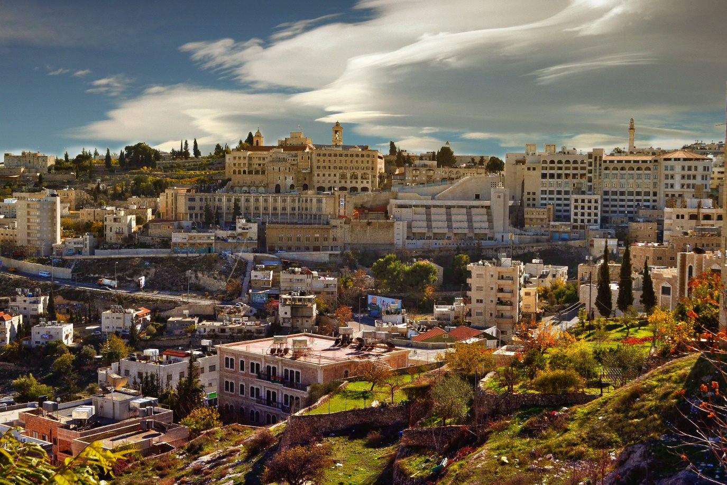
Out of Bethlehem will come a Ruler
Micah 5:2
But you, Bethlehem Ephrathah, … out of you shall come forth to Me the One to be Ruler in Israel, whose goings forth are from of old, from everlasting. (NKJV)

Slide 38
Prophecy of Future Blessings
Micah 4,5
In the latter days the Lord’s house would be established.
God would gather what had been driven away and make that which had been cast off a remnant.
They would go to Babylon but be rescued from there.
Their Ruler would come from Bethlehem but His goings forth were from everlasting.
He will give them peace, but will lead them to victory over their enemies.
Sorcery and idolatry will be removed from the land.

Slide 39
Micah 6
The Trial of the People
Verses 1-5 – God’s blessings to the people
Verses 6-8 – The service that God required of the people

Slide 40
Micah 6
The Trial of the People
Verses 1-5 – God’s blessings to the people
Verses 6-8 – The service that God required of the people
Verses 9-16 – The guilt and punishment of the people

Slide 41
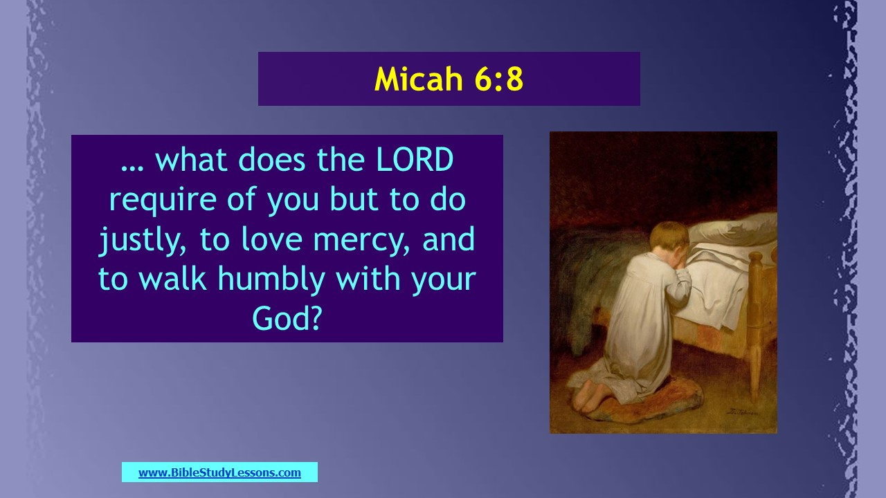

Slide 42
Micah 6
Punishment of the People
What They Desire | What They Receive
Eating Keeping for themselves Sowing Treading olives Treading grapes | No satisfaction No saving (taken by enemies) No harvest No enjoyment of oil No wine to drink

Slide 43
Micah 7
The People’s Guilt but the Remnant’s Restoration
Punishment must come because no one is upright, no one can be trusted.
A remnant will return and God will be their Shepherd.
God will have compassion and will pardon iniquities.

Slide 44
Lessons from Micah
God punishes the wicked and blesses the righteous
God opposes leaders who pervert justice and oppress the needy.
God opposes prophets and priests who teach error and emphasize personal gain.
God predicted the establishment of the church and blessings on the remnant
The Messiah would be born in Bethlehem
Enemies of God's people will be defeated
God requires justice, mercy, and humility

Slide 45
© Copyright David E. Pratte, 2021
Permission is granted to display this PowerPoint under the following conditions:
* Display the link to www.BibleStudyLessons.com
* Minor changes in content are permitted, but no teaching should be presented that disagrees with the teaching in the article associated with this PowerPoint on www.BibleStudyLessons.com/powerpoint
* In no case may a fee of any kind be charged for our PowerPoints.
* If you have a website, please add a link to www.BibleStudyLessons.com
Scripture quotations are generally from the New King James Version (NKJV), copyright 1982, 1988 by Thomas Nelson, Inc. Used by permission. All rights reserved.
www.BibleStudyLessons.com

