Slide 1
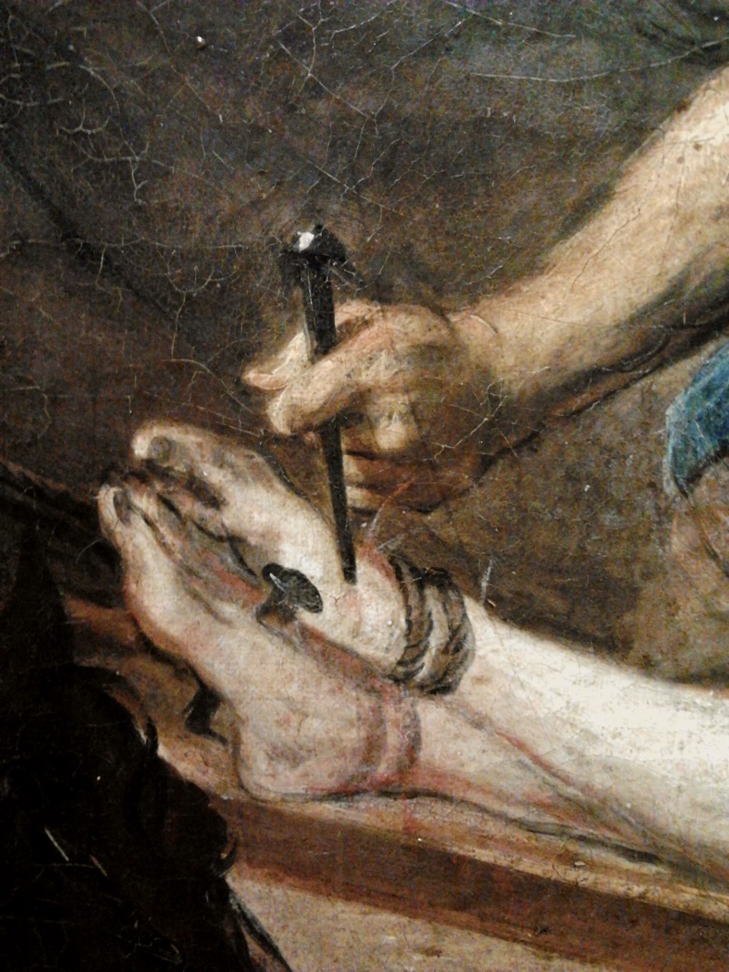
Have the Nails Pierced Your Hands/Feet?
Galatians 2:20
Die to Self
Matthew 16:24-27; Galatians 5:24,25; 2:20; 2 Corinthians 5:15; 8:5; Luke 9:23
www.gospelway.com

Slide 2
Have the Nails Pierced Your Hands/Feet?
Galatians 2:20
Die to Self
Die to the Will of Men
Follow Divine Law over Human Law
Colossians 2:20,8; Matthew 15:9
Please God Rather than People
Galatians 6:14; John 12:42,43; Matthew 10:34-39

Slide 3
Have the Nails Pierced Your Hands/Feet?
Galatians 2:20
Die to Self
Die to the Will of Men
Follow Divine Law over Human Law
Please God Rather than People
Die to Sin
1 Peter 2:24
Die to the Guilt of Sin
Romans 6:1-7,17,18
Die to the Practice of Sin
Romans 6:1,2; 8:13,14; Colossians 3:3-14

Slide 4
Have the Nails Pierced Your Hands/Feet?
Galatians 2:20
Die to Self
Die to the Will of Men
Follow Divine Law over Human Law
Please God Rather than People
Die to Sin
Die to the Guilt of Sin
Die to the Practice of Sin
2 Timothy 2:11 — To live with Jesus, we must die with Him.

Slide 5
© Copyright David E. Pratte, 2018
Permission is granted to display this PowerPoint under the following conditions:
* Display the link to www.gospelway.com
* Minor changes in content are permitted, but no teaching should be presented that differs from the teaching in the article associated with this PowerPoint on www.gospelway.com/powerpoint
* If you have a website, please add a link to www.gospelway.com
Scripture quotations are generally from the New King James Version (NKJV), copyright 1982, 1988 by Thomas Nelson, Inc. Used by permission. All rights reserved.
www.gospelway.com

