Slide 2
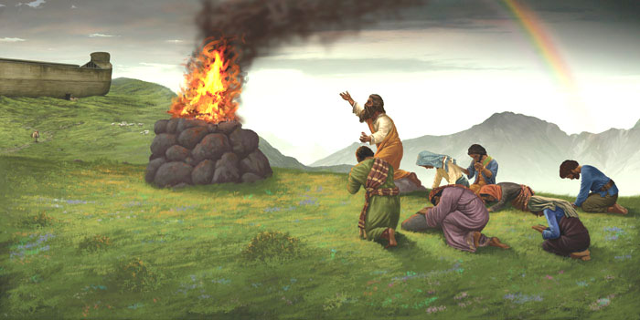
Lessons from Noah’s Family
Characteristics of leaders

Slide 3

Characteristics of Godly Leaders
Righteousness
Genesis 6:9; 7:1; Ezekiel 14:14,20; Hebrews 11:7
Faith
Hebrews 11:7
Obedience
Hebrews 11:7
Complete obedience: Hebrews 11:7; Genesis 6:22; 7:5
Worship: Genesis 8:20
Teaching: 2 Peter 2:5
Courage to be different: 1 Peter 3:20
Does your family live like Noah’s did?

Slide 4
Lessons from Noah’s Family
Characteristics of leaders
Success as a parent

Slide 5
Success as a Parent
Noah Raised His Family in a Wicked World
Genesis 6:1-13
Yet Noah Saved His Family
Genesis 6:18; 7:1,7,13,23; 8:16,18;
Hebrews 11:7; 1 Peter 3:20,21;
2 Peter 2:5,9; Proverbs 22:6
Parents, do you have the courage, like Noah, to be different from the world and succeed in raising your children?

Slide 6
Lessons from Noah’s Family
Characteristics of leaders
Success as a parent
Influence of parents

Slide 7
Influence of Parents’ Conduct
Noah’s One Failure Brought Harm
on His Family
Genesis 9:20-27
Parents Today Influence Their Children
2 Timothy 1:5; Ezekiel 16:44; 1 Kings 15:3; Matthew 18:6,7
Drinking alcoholic beverages
Proverbs 20:1; 23:29-35
Indecent clothing
Genesis 3:7-11; 3:21; Exodus 28:42

Slide 8
Lessons from Noah’s Family
Characteristics of leaders
Success as a parent
Influence of parents
Choosing a companion

Slide 9
Choosing a Marriage Companion
People of the World Chose Unwisely
Genesis 6:2; Nehemiah 13:26,27;
Deuteronomy 7:3,4; 1 Corinthians 15:33
Noah’s Family Chose Godly Companions
Proverbs 31:30; Matthew 6:33

Slide 10
Lessons from Noah’s Family
Characteristics of leaders
Success as a parent
Influence of parents
Choosing a companion

Slide 12
© Copyright David E. Pratte, 2024
Permission is granted to display this PowerPoint under the following conditions:
* Display the link to BibleStudyLessons.com
* Minor changes in content are permitted, but no teaching should be presented that disagrees with the teaching in the article associated with this PowerPoint at BibleStudyLessons.com/powerpoint
* In no case may a fee of any kind be charged for our PowerPoints.
* If you have a website, please add a link to BibleStudyLessons.com
Scripture quotations are generally from the New King James Version (NKJV), copyright 1982, 1988 by Thomas Nelson, Inc. Used by permission. All rights reserved.
biblestudylessons.com

