Slide 1

Video Bible Study
presented by
David E. Pratte
www.gospelway.com

Slide 2
The Prophecy of Obadiah
Number 3
Thanks to Christians in the Hillcrest church for their participation.
© Copyright David E. Pratte, 2021
Scripture quotations are generally from the New King James Version (NKJV), copyright 1982, 1988 by Thomas Nelson, Inc. used by permission. All rights reserved.

Slide 3
Questions from Bible Study Questions on Hosea, Joel, Amos, Obadiah
Available at
www.biblestudylessons.com/classbooks

Slide 4
Understanding Old Testament prophecy
* The prophets are part of Scripture, and all Scripture is profitable to equip us in our service to God today
– 2 Timothy 3:16,17; Romans 15:4; 1 Corinthians 10:6,11.
* Old Testament history may help us understand the background behind prophets’ teachings.
* The prophets often used symbolic teaching. But that does not give us the right to assign a meaning to the symbols according to our own imagination.
* The prophets often included predictions about the Messiah, His Kingdom, and His message.
* Often New Testament writers give us an inspired explanation.

Slide 5
Periods of Bible history
1. Before the Flood (Creation to the flood)
2. After the Flood (the flood to the call of Abraham)
3. Patriarchs (the call of Abraham to the death of Joseph)
4. Egyptian Bondage (Joseph’s death to crossing Red Sea)
5. Wilderness Wandering (Red Sea to crossing the Jordan)
6. Conquest of Canaan (crossing Jordan to Joshua’s death)
7. Judges (death of Joshua to crowning of King Saul)
8. United Kingdom (crowning of Saul to death of Solomon)
9. Divided Kingdom (death of Solomon to the fall of Israel)
10. Judah Alone (the fall of Israel to the fall of Judah)
11. Babylonian Captivity (fall of Judah to end of captivity)
12. Restoration of Israel (return to the completion of OT)
13. Years of Silence (completion of OT to the birth of Jesus)
14. Life of Christ (from the birth of Jesus to His ascension)
15. Early Church (Jesus’ ascension to the completion of NT)

Slide 6
Prophets by Period
Period of History | Prophets
Divided Kingdom | Israel: Jonah Amos Hosea | Judah: Obadiah (?) Joel (?) Isaiah Micah
Judah Alone | Jeremiah (Lamentations) Zephaniah, Nahum (?), Habakkuk (?)
Babylonian Captivity | Ezekiel, Daniel
Return from Captivity | Haggai, Zechariah, Malachi

Slide 7
Themes of the Minor Prophets
Hosea – Israel’s unfaithfulness compared to Hosea’s wife
Joel – Locust plague shows Israel’s need to repent
Amos – Israel would go into captivity for sins like the surrounding nations
Obadiah – Fall of Edom for rejoicing in Judah’s affliction
Jonah – God uses a fish and a plant to teach Jonah His concern for the salvation of Nineveh and all people
Micah – God puts Israel and Judah on trial for their sins.
Nahum – Prophecy of the fall of Nineveh
Habakkuk – Habakkuk questions God’s punishments
Zephaniah – God’s wrath is coming against Jerusalem and surrounding nations, but a remnant will be spared.
Haggai – Returning Jews should rebuild the temple
Zechariah – The future glory of God’s people
Malachi – Spiritual restoration among the returned Jews

Slide 8
Theme and Major Divisions of Obadiah
Theme: Obadiah prophesied the fall of Edom for rejoicing in Judah’s affliction.
Major divisions
Verses 1-9 — Prediction of Edom’s doom
Verses 10-16 – Edom condemned for rejoicing and taking spoils in Judah’s fall
Verses 17-21 — Prediction of Judah’s exaltation

Slide 9
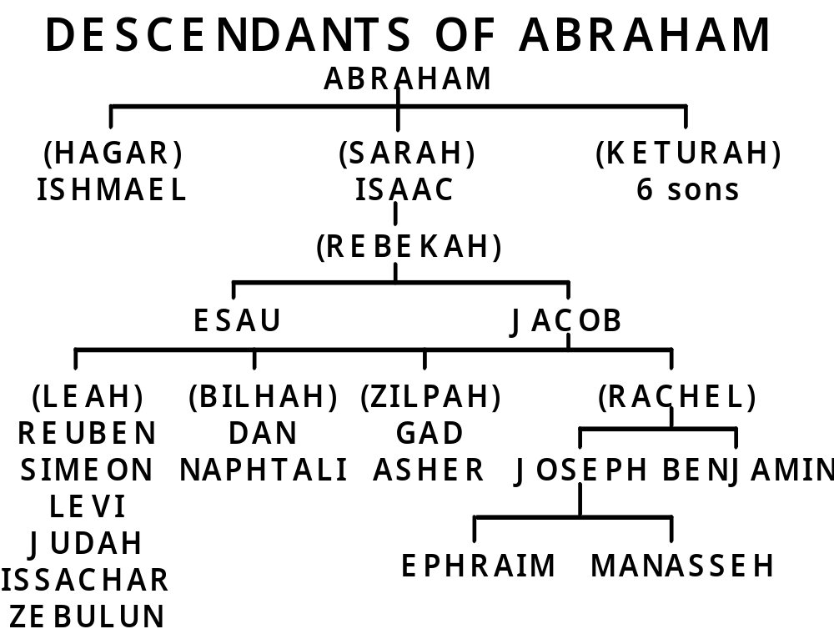

Slide 10
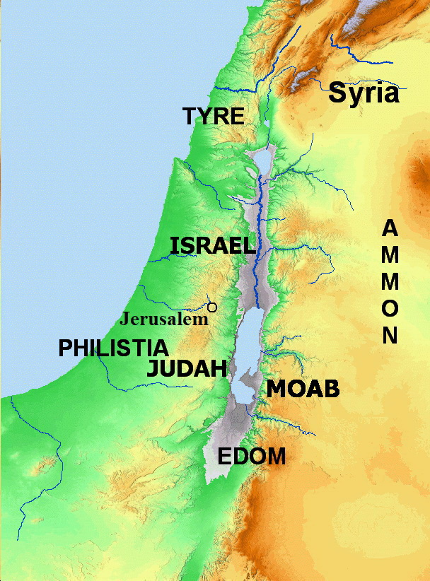
Nations around Israel
Bible Mapper 5.0

Slide 11
Conflict Between Israel and Edom
“The elder will serve the younger” - Genesis 25:22,23
Refers to the nations of descendants, not to the two individuals.
No reference to eternal salvation.
Fulfillment: 1 Chronicles 18:12,13; 2 Samuel 8:14; 2 Kings 14:7,22
“Jacob have I loved and Esau have I hated” - Malachi 1:2,3
No reference to eternal destinies.
Also refers to the nations of descendants, not to individuals.
“Hate” means a lesser love (Genesis 29:33; Luke 14:26).
Conflict between Israel and Edom
Amos 1:11; Num. 20:14-20; 1 Sam. 14:47; 1 Kings 11:14-17; 2 Chron. 20:22; 21:8
Punishment on Edom: Genesis 27:40; 2 Samuel 8:14; 2 Chronicles 25:11,12; Psalm 60:8; 83:5-15; Isaiah 34:5-13; 63:1-6; Jeremiah 49:7-22; Ezekiel 25:12-14; 35:1-15; Amos 1:11,12; 9:12; Malachi 1:2-5; Romans 9:10-13

Slide 12
Pride of Your Heart Has Deceived You - Verses 1-9
Edom would be small among the nations and greatly despised.
They trusted in secure location, but God would bring them down.

Slide 13
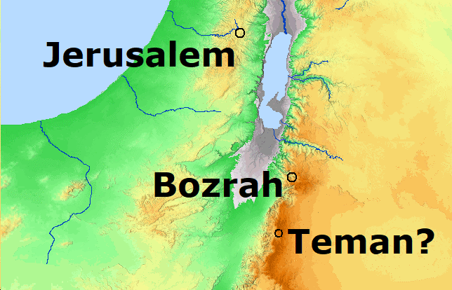
Cities of Edom
Petra o
Bible Mapper 5.0

Slide 14
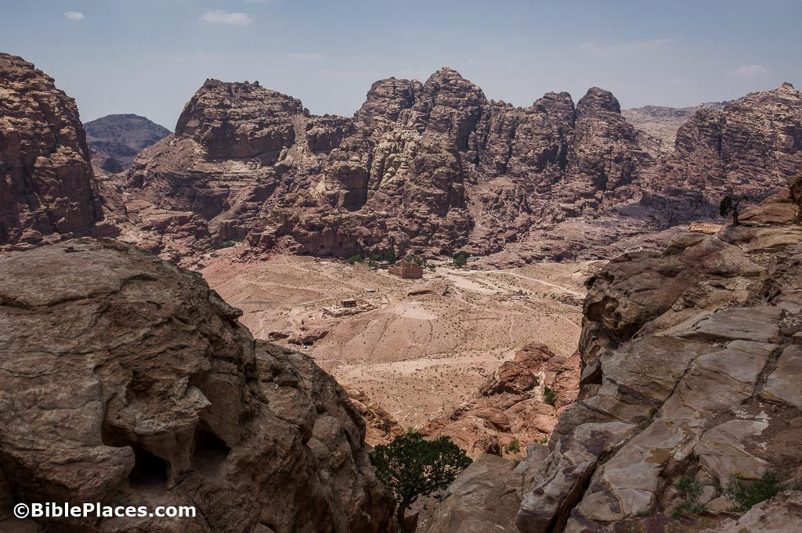
Petra

Slide 15

Petra - Temple

Slide 16
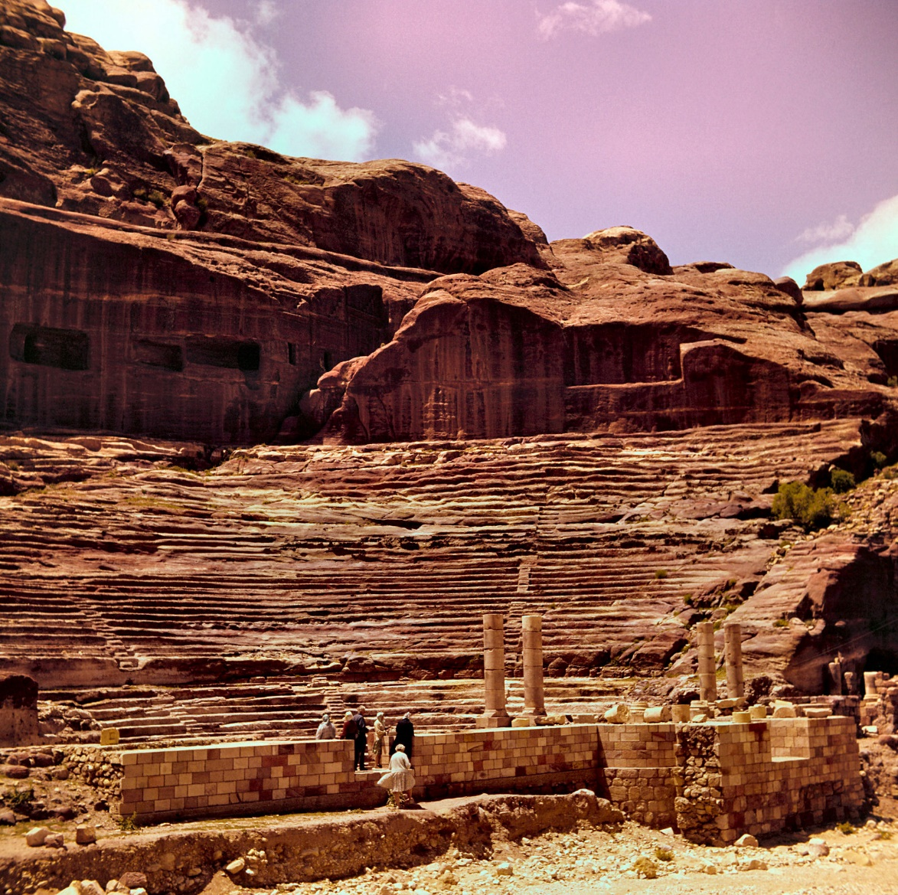
Petra – Theater

Slide 17
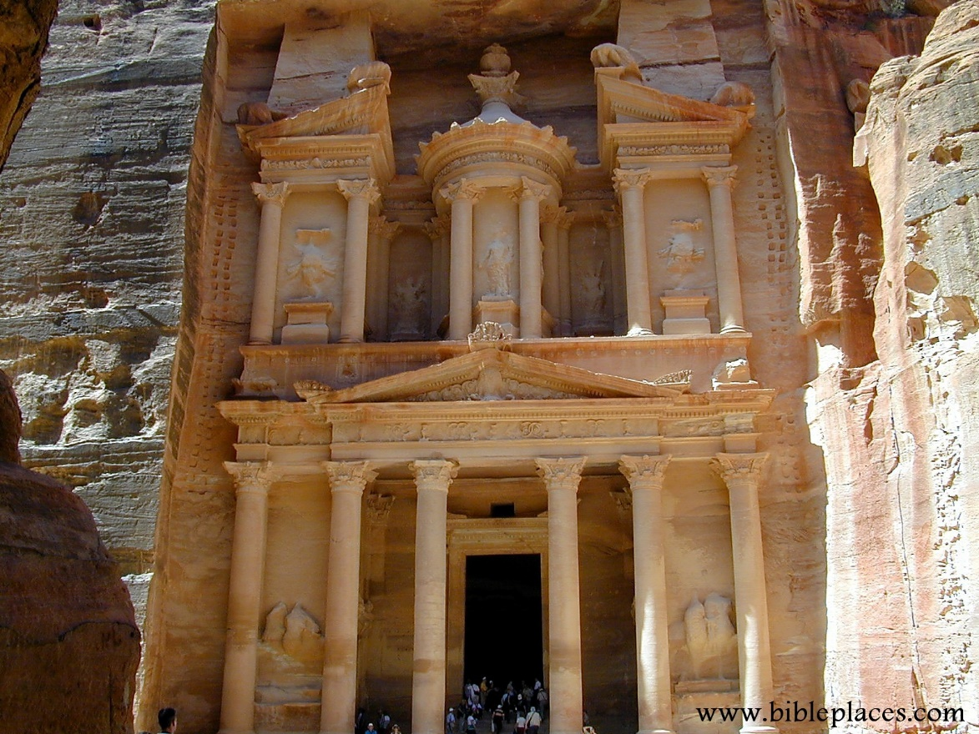
Petra - Treasury

Slide 18
Pride of Your Heart Has Deceived You - Verses 1-9
Edom would be small among the nations and greatly despised.
They trusted in secure location, but God would bring them down.
Nothing would be left.
Confederates would lay a trap and prevail against them.

Slide 19
You Were as One of Them – Verses 10-16
When strangers took captives from Jerusalem, Edom stood on the other side and were as one of them.
They gazed on the captivity of their brother, rejoiced in their destruction, and spoke proudly when Judah faced distress.
Edom entered the gate of Judah when they faced calamity and gazed on their affliction.
They laid hands on their substance.
They stood at the crossroads to cut off those who escaped and delivered up those who remained

Slide 20
Nations around Israel
Bible Mapper 5.0

Slide 21
A Summary of the Sins of Edom
Pride (verses 3,11)
Self-sufficiency (verse 3)
Fellowship with error (verses 11,14)
Sharing in ill-gotten spoils (verse 13)
Hatred toward those whom they should have respected (verses 10-14)

Slide 22
© Copyright David E. Pratte, 2021
Permission is granted to display this PowerPoint under the following conditions:
* Display the link to www.BibleStudyLessons.com
* Minor changes in content are permitted, but no teaching should be presented that disagrees with the teaching in the article associated with this PowerPoint on www.BibleStudyLessons.com/powerpoint
* In no case may a fee of any kind be charged for our PowerPoints.
* If you have a website, please add a link to www.BibleStudyLessons.com
Scripture quotations are generally from the New King James Version (NKJV), copyright 1982, 1988 by Thomas Nelson, Inc. Used by permission. All rights reserved.
www.BibleStudyLessons.com

