Slide 1
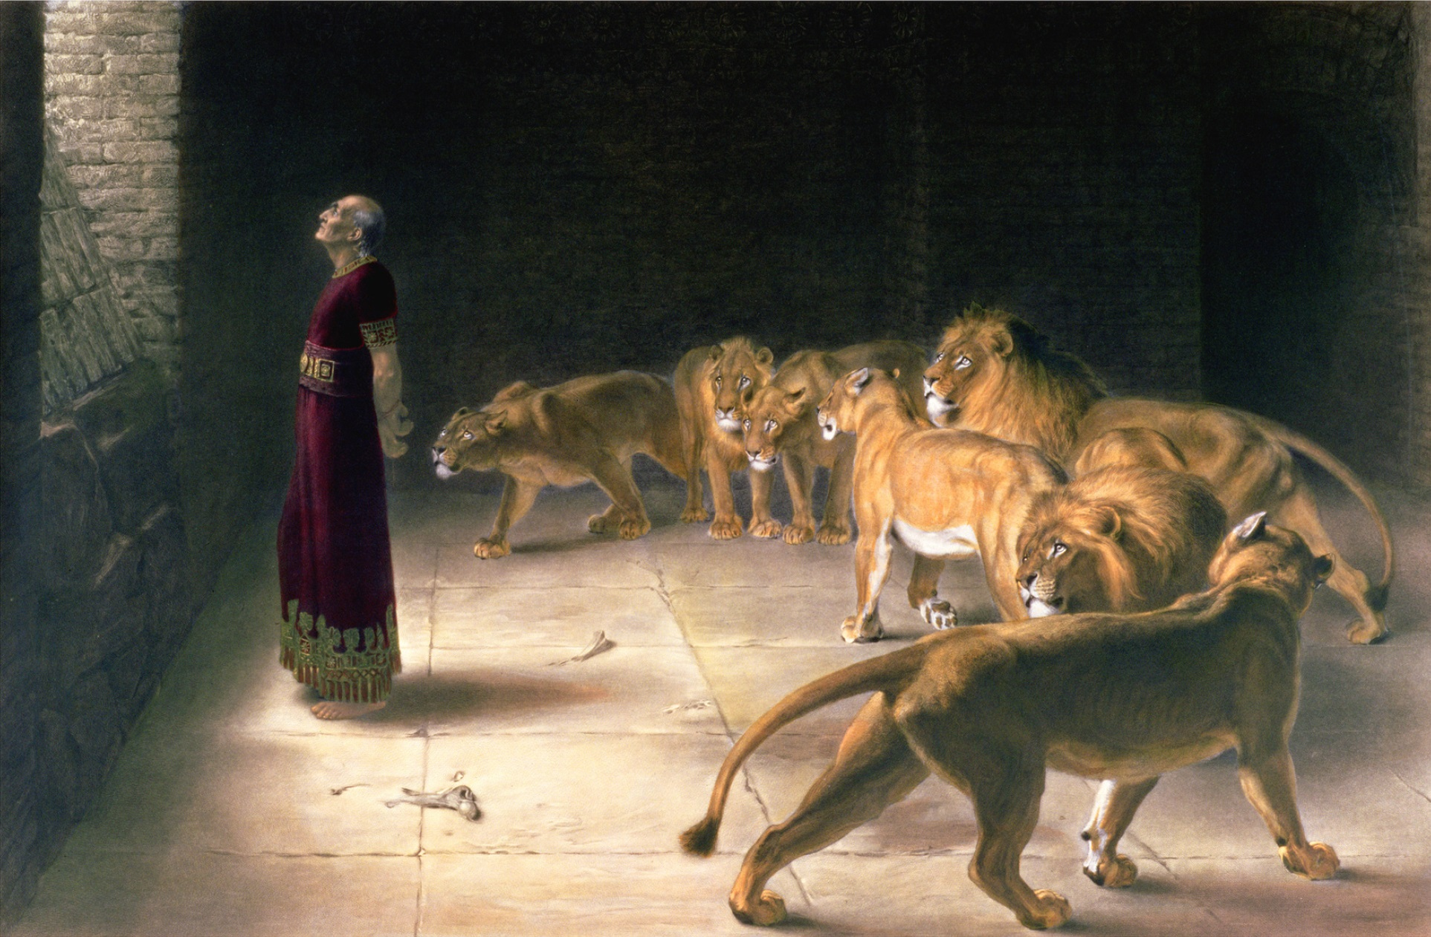
How to Handle Persecution
www.BibleStudyLessons.com

Slide 2
How to Handle Persecution
Expect Persecution
2 Timothy 3:12; Matthew 10:34-37; John 15:18-21; 16:1-4

Slide 3
How to Handle Persecution
Expect Persecution
Love & Trust God
Proverbs 3:5,6; Psalm 56:11; 1 Corinthians 10:13; 1 Peter 2:21-23; 1 Peter 4:19

Slide 4
How to Handle Persecution
Expect Persecution
Love & Trust God
Pray to God
Acts 4:23-31; 1 Peter 5:7-9; Psalm 7:1

Slide 5
How to Handle Persecution
Expect Persecution
Love & Trust God
Pray to God
Use the Scriptures
Romans 10:17; 1 Peter 3:14-16; Matthew 4:1-11

Slide 6
How to Handle Persecution
Expect Persecution
Love & Trust God
Pray to God
Use the Scriptures
Choose Companions Carefully
1 Corinthians 15:33; Proverbs 13:20; Acts 4:23; 2 Corinthians 1:3-5; Hebrews 10:23-25

Slide 7
How to Handle Persecution
Expect Persecution
Love & Trust God
Pray to God
Use the Scriptures
Choose Companions Carefully
Remember Faithful Servants Who Endured
Moses; Elijah; Daniel; Daniels’ friends; David; Apostles; Stephen; Paul
Hebrews 11:35-12:4

Slide 8
How to Handle Persecution
Expect Persecution
Love & Trust God
Pray to God
Use the Scriptures
Choose Companions Carefully
Remember Faithful Servants Who Endured
Remember Your Reward
Luke 6:22,23; Hebrews 10:32-34; Revelation 2:10
www.BibleStudyLessons.com

Slide 9
© Copyright David E. Pratte, 2019
Permission is granted to display this PowerPoint under the following conditions:
* Display the link to www.BibleStudyLessons.com
* Minor changes in content are permitted, but no teaching should be presented that disagrees with the teaching in the article associated with this PowerPoint on www.BibleStudyLessons.com/powerpoint
* In no case may a fee of any kind be charged for our PowerPoints.
* If you have a website, please add a link to www.BibleStudyLessons.com
Scripture quotations are generally from the New King James Version (NKJV), copyright 1982, 1988 by Thomas Nelson, Inc. Used by permission. All rights reserved.
www.BibleStudyLessons.com

