Slide 2
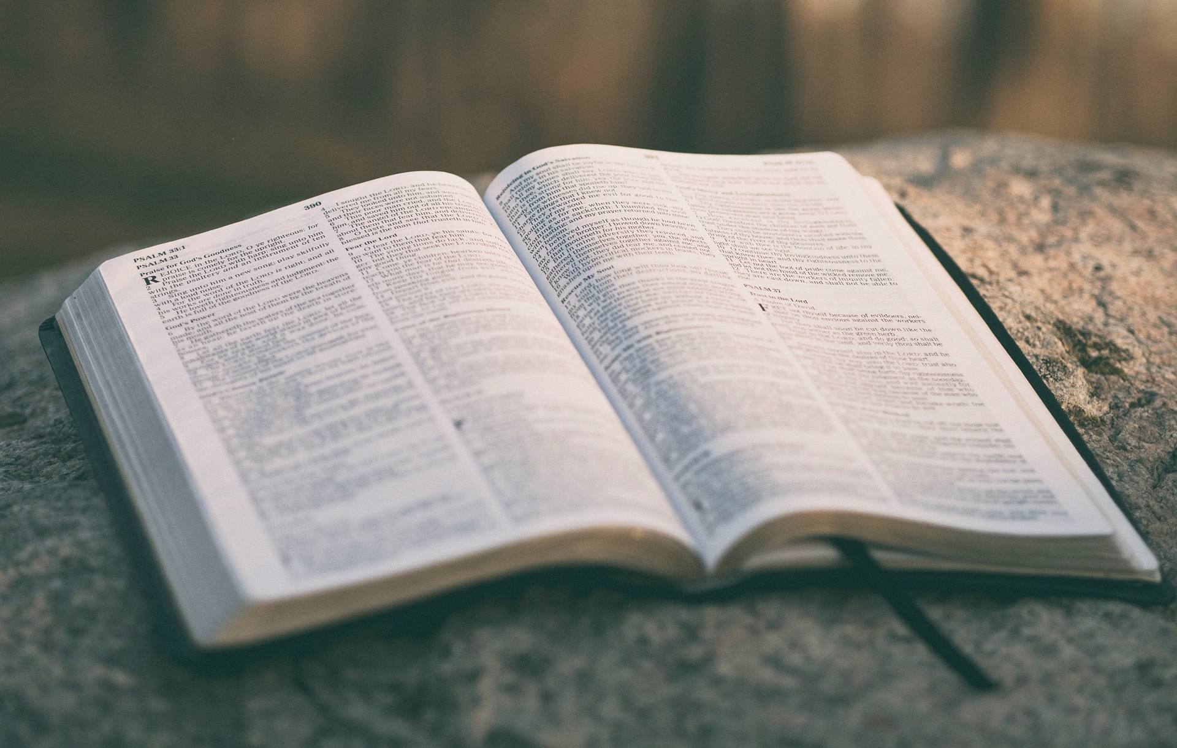
Preservation of the Bible
The Promises
    God Revealed the Scriptures So Men Could Know His Will.
biblestudylessons.com

Slide 3
    God Gave Scriptures So Men Could Know His Will
Old Testament
Exodus 24:3,4,7 – Moses wrote in a book all the words of God the people should obey.
Deuteronomy 28:58,59; 30:9,10 – People blessed if they obeyed the commands written in the book.
Jeremiah 36:1-4 – Jeremiah to write all the words God gave Israel
New Testament
1 Corinthians 14:37 – Paul wrote the commands of the Lord.
1 John 1:1-4 – John wrote so people could know God’s teaching
Revelation 1:10,11,19; chapters 2 & 3 – Jesus told John to write God’s instructions to the churches of Asia
2 Timothy 3:16,17 – All Scripture is inspired by God given to teach and instruct men so they could know all good works.

Slide 4
Preservation of the Bible
The Promises
    God Revealed the Scriptures So Men Could Know His Will.
    God Intended the Scriptures to Guide People of Future Generations

Slide 5
    God Intended Scriptures to Guide Future Generations
Old Testament
Deuteronomy 17:18-20 – Future kings to copy, study, obey God’s law
Psalm 102:18 – The psalmist wrote “for the generation to come.”
1 Chronicles 16:15 – Remember covenant for thousand generations.
New Testament
John 20:29-31 – John wrote to give testimony so people who had not seen Jesus’ miracles could read, believe, and have eternal life.
2 Peter 1:12-15 (3:1,2) – Peter wrote so people could have the written record after he died.
2 Peter 3:15,16; 1 Timothy 5:18 – Writings of Paul and Luke classified with other “Scripture” as the Old Testament had been.

Slide 6
Preservation of the Bible
The Promises
    God Revealed the Scriptures So Men Could Know His Will.
    God Intended the Scriptures to Guide People of Future Generations
    God Promised to Preserve His Word for People of All Ages.

Slide 7
    God Promised to Preserve His Word for All Ages
Old Testament
Psalm 119:152,160 – Every one of God’s ordinances endures forever
Isaiah 40:8 – God’s word unlike flower that dies; will stand forever.
Isaiah 30:8 – God’s words written in a book to be for the time to come for ever and ever.
New Testament
John 12:48 – Jesus’ words will judge us at the last day.
2 John 2 – The truth will be with us forever.
2 Peter 1:15 – Peter wrote so we could remember teachings always
1 Peter 1:22-25 – The gospel will live, abide, and endure forever. It will not be like grass or a flower that springs forth then dies.
2 Timothy 3:16,17 – God intends for “Scripture” to instruct men and provide us to all good works.

Slide 8
Preservation of the Bible
The Promises
    God Revealed the Scriptures So Men Could Know His Will.
    God Intended the Scriptures to Guide People of Future Generations
    God Promised to Preserve His Word for People of All Ages.

Slide 9
Preservation of the Bible
The Promises
The Fulfillment

Slide 10
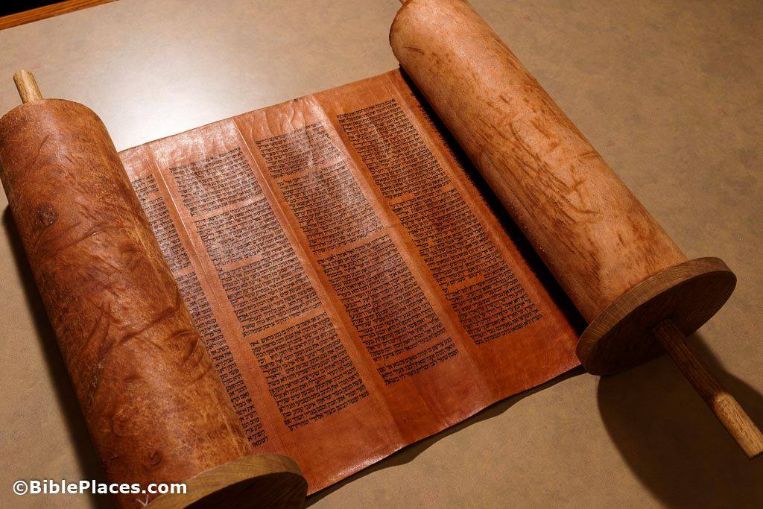
Facts about the Testaments
God inspired both testaments and promised to preserve them as authority.
Both testaments were collected, copied, circulated, and translated over many years.
Both testaments passed through generations of neglect with no new revelations added.

Slide 11
Preservation of Moses’ Writings

Slide 12
Preservation of Moses’ Writings
Joshua
60 yrs
Joshua 1:7,8; 23:2,6

Slide 13
Preservation of Moses’ Writings
Joshua | David
60 yrs | 400 yrs
Joshua 1:7,8; 23:2,6 | 1 Kings 2:3

Slide 14
Preservation of Moses’ Writings
Joshua | David | Josiah
60 yrs | 400 yrs | 800 yrs
Joshua 1:7,8; 23:2,6 | 1 Kings 2:3 | 2 Chron. 34:14-19,29-31

Slide 15
Preservation of Moses’ Writings
Joshua | David | Josiah | Nehemiah
60 yrs | 400 yrs | 800 yrs | 900 yrs
Joshua 1:7,8; 23:2,6 | 1 Kings 2:3 | 2 Chron. 34:14-19,29-31 | Nehemiah 8:1-3,8

Slide 16
Preservation of Moses’ Writings
Joshua | David | Josiah | Nehemiah | Jesus
60 yrs | 400 yrs | 800 yrs | 900 yrs | 1400 yrs
Joshua 1:7,8; 23:2,6 | 1 Kings 2:3 | 2 Chron. 34:14-19,29-31 | Nehemiah 8:1-3,8 | Many Examples

Slide 17
The Old Testament in the First Century
Copies of the Old Testament had been circulated and studied as revelation from God.
Luke 4:16-21 – In the synagogue in Nazareth, Jesus read from the prophet Isaiah.
Acts 8:27-35 – The Ethiopian treasurer was reading Isaiah. Philip used it to teach about Jesus.
Acts 15:21 – For generations in synagogues in every city Scriptures were read every Sabbath.

Slide 18
The Old Testament in the First Century
Copies of the Old Testament had been circulated and studied as revelation from God.
Inspired men cited Old Testament Scripture as authority
Matthew 4:4,7,10 – Jesus quoted Scripture to defeat Satan.
Matthew 15:1-9 – Jesus quoted the Old Testament as the commandment of God and rebuked those who did not obey it.
Matthew 22:29-33 – Jesus rebuked people for not knowing the Scriptures. He quoted Moses saying God said this “to you”
1 Corinthians 10:11; Romans 15:4 – Paul said O.T. Scriptures were written for the learning and admonition of people in his day
Acts 17:11 – The Bereans were noble-minded because they willingly searched the Scriptures to determine truth.

Slide 19
The Old Testament in the First Century
Copies of the Old Testament had been circulated and studied as revelation from God.
Inspired men cited Old Testament Scripture as authority
Inspired men appealed to Old Testament authority to confirm their own teaching.
Luke 24:27,44-46 – Jesus claimed He fulfilled Moses, all the prophets, and the psalms.
John 5:39,45-47 – Jesus said that Moses and the Scriptures testified of Him.
Acts 17:2,3 – Paul demonstrated that Jesus was the Christ by reasoning from the Scriptures.

Slide 20
The Old Testament in the First Century
Copies of the Old Testament had been circulated and studied as revelation from God.
Inspired men cited Old Testament Scripture as authority
Inspired men appealed to Old Testament authority to confirm their own teaching.
Inspired men used evidence based on minute details of the Scriptures.
Matthew 22:31,32 – Jesus proved the resurrection because God said, “I am the God of Abraham….”

Slide 21
Preservation of Moses’ Writings
Joshua | David | Josiah | Nehemiah | Jesus
60 yrs | 400 yrs | 800 yrs | 900 yrs | 1400 yrs
Joshua 1:7,8; 23:2,6 | 1 Kings 2:3 | 2 Chron. 34:14-19,29-31 | Nehemiah 8:1-3,8 | Many Examples
If the Old Testament was so completely preserved, why doubt God has likewise preserved the New Testament?

Slide 22
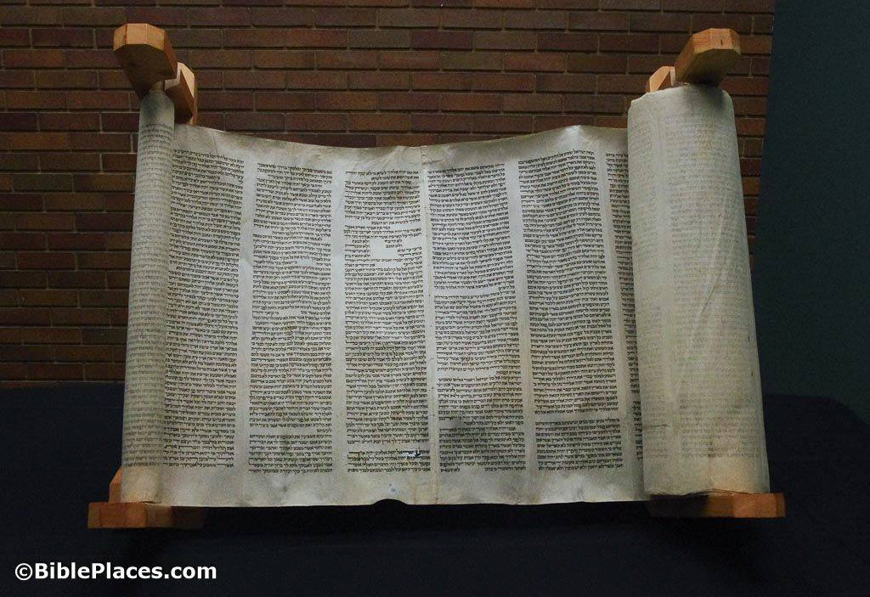
Evidence Since the First Century
Ancient Manuscripts
5000+ handwritten copies in original languages
Many dated within a few centuries/decades of writing
Copyists were fanatically precise
Ancient Translations
Ancient Quotations
Nearly whole New Testament can be reproduced
For other writings, a few manuscripts dated within 1000 years of when the men lived is considered “convincing evidence.”

Slide 23
“Thousands of Errors”?
Manuscript variations with no change in doctrine. Result from the great number of manuscripts.
Different spelling; same meaning
“Elijah” or “Elias”
Different word order; same meaning
“the Lord Jesus Christ” or “Jesus Christ the Lord”
Different word; same meaning
“God the Father” or “God your Father”
Phrases/sentences inserted/omitted
Same concept/doctrine taught elsewhere
The “true word of God, handed down without essential loss from generation to generation through the centuries” - Kenyon

Slide 24
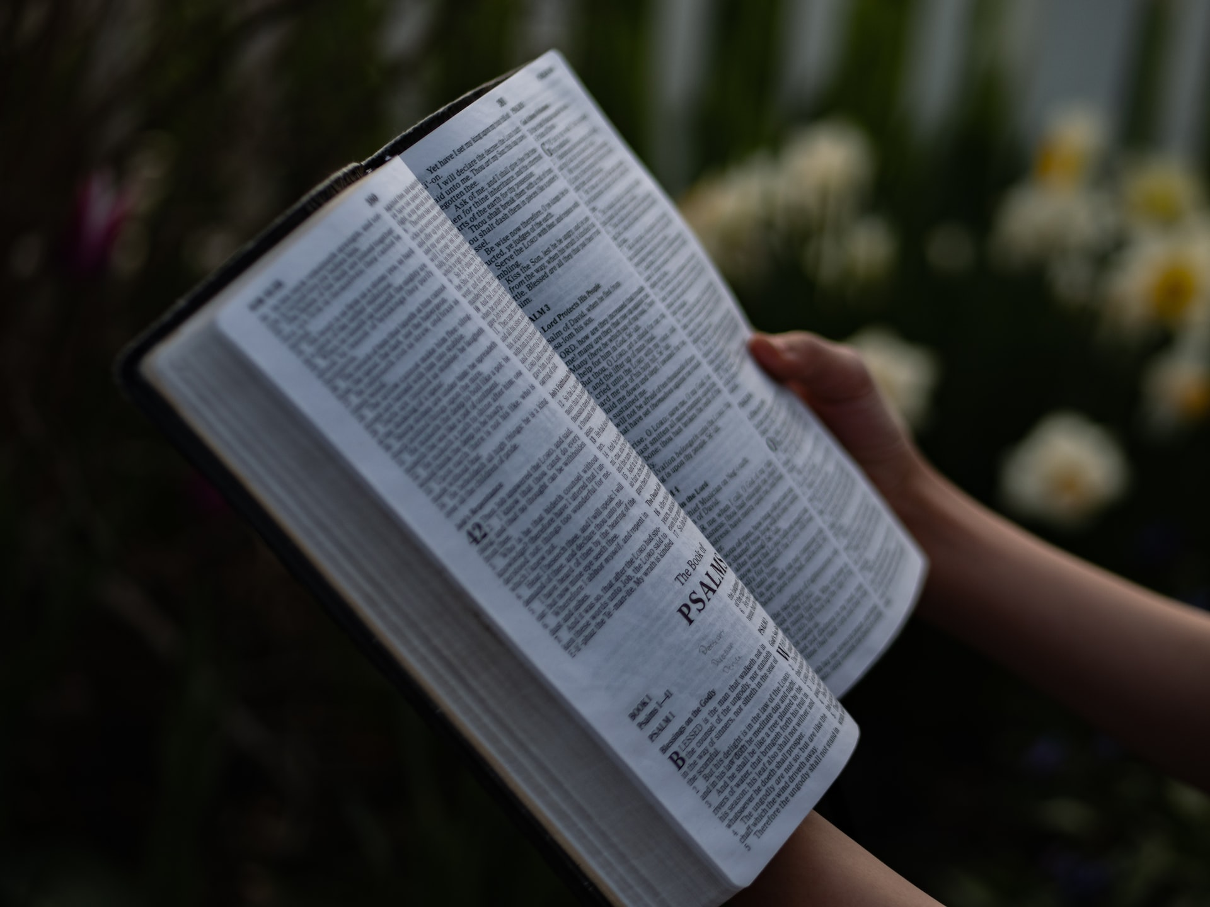
What It Means to You
* God gave the Scriptures so you are able to know His will.
* God repeatedly promised that He would preserve His word for you.
* Both Bible history and secular history confirm that God has preserved His word.
Our faith that we have God’s word rests, not on any church, humans, or human decrees but on the promises of God!

Slide 26
© Copyright David E. Pratte, 2023
Permission is granted to display this PowerPoint under the following conditions:
* Display the link to BibleStudyLessons.com
* Minor changes in content are permitted, but no teaching should be presented that disagrees with the teaching in the article associated with this PowerPoint at www.BibleStudyLessons.com/powerpoint
* In no case may a fee of any kind be charged for our PowerPoints.
* If you have a website, please add a link to https://BibleStudyLessons.com
Scripture quotations are generally from the New King James Version (NKJV), copyright 1982, 1988 by Thomas Nelson, Inc. Used by permission. All rights reserved.
biblestudylessons.com

