Slide 2
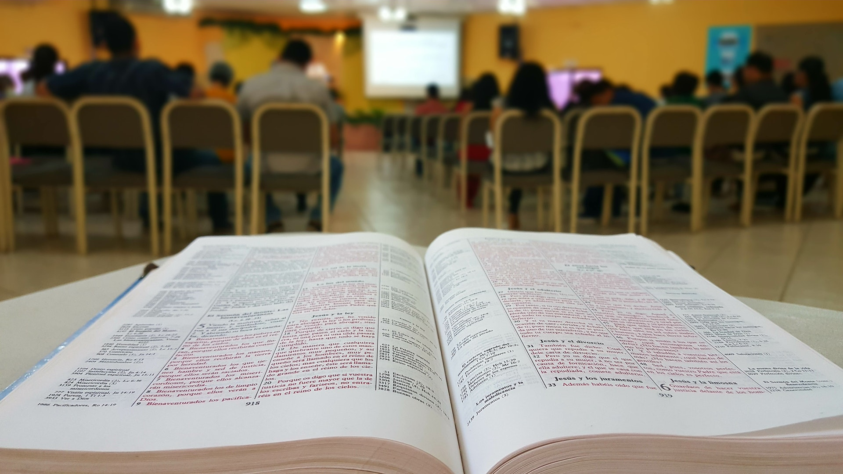
Priests and Priesthood in the Gospel
Who May Serve as Priests?
What Are the Duties of Priests?
biblestudylessons.com

Slide 3
Who May Serve as Priests?
Hebrews 5:4
No One Today Possesses the Aaronic (Levitical) Priesthood.
Numbers 3:10 - Only descendants of Aaron could be Levitical priests
Hebrews 7:11-14; 10:9,10 - The Levitical priesthood was abolished
No Man on Earth Possesses the Melchizedek Priesthood.
Genesis 14:18 (Hebrews 7:1) – Melchizedek was both priest and king
Hebrews 5:5,6,10 – Only Jesus is a priest like Melchizedek.
No One on Earth Can Be a Successor to the Apostles.

Slide 4
Who May Serve as Priests?
Catholicism claims its priests are successors to the apostles:
“Who were the first Christian priests? The Apostles, who were ordained to the priesthood by Jesus Christ Himself. …
Before they died, the Apostles made other men bishops, who in turn, made other men bishops, and in this way the power of the priesthood have been handed down during the past 2000 years.” – A Catechism for Adults, Cogan, 1975 Edition, p. 88.

Slide 5
Who May Serve as Priests?
No One on Earth Is a Successor to the Apostles.
Apostles were eyewitnesses of the resurrected Christ
Acts 1:21,22 (1 Corinthians 15:4-8; 9:1; Acts 2:32; 3:15; 4:33)
Apostles did miracles to confirm their apostleship
2 Corinthians 12:12 (Acts 3:1-10; 9:32-42; 5:12-16; 13:6-12)
Apostles could impart miraculous powers to others
Acts 8:14-19 (19:1-7; Romans 1:8-11)
Apostles taught by direct guidance of the Spirit
John 16:13; Matthew 10:19,20; Ephesians 3:3-5; 1 Cor. 14:37
The first-century apostles completed the work of apostles
Jude 3; 1 Corinthians 13:8-13 (John 16:13; 2 Timothy 3:16,17)
Like Jesus, apostles are not needed on earth today.

Slide 6
Who May Serve as Priests?
No One Today Possesses the Aaronic (Levitical) Priesthood.
Numbers 3:10 - Only descendants of Aaron could be Levitical priests
Hebrews 7:11-14; 10:9,10 - The Levitical priesthood was abolished
No Man on Earth Possesses the Melchizedek Priesthood.
Genesis 14:18 (Hebrews 7:1) – Melchizedek was both priest and king
Hebrews 5:5,6,10 – Only Jesus is a priest like of Melchizedek.
No One on Earth Is a Successor to the Apostles.
Jesus Is Our Only High Priest Today.
Hebrews 7:21-25; 1 Timothy 2:5,6
All Christians Today Are Priests of God.

Slide 7
All Christians Today Are Priests of God.
1 Peter 2:5,9 – Peter addresses “holy priesthood,” “royal priesthood”
* Elect and sanctified (1:1,2) * Destined for heaven (1:3-9)
* Call on God as Father (1:17) * Redeemed by Jesus’ blood (1:18-21)
* Purified by obedience and born again by the gospel (1:22-25)
* Living stones in God’s spiritual house (2:5)
* Believe in Jesus (2:7; 1:21)
* Belong to God, are His people, have received mercy (2:9,10)
Revelation 1:5,6 – All who have been washed from their sins.
“The words ‘priest,’ ‘priesthood’ … are never applied in the New Testament to the office of the Christian ministry. All Christians are said to be priests (1 Peter ii.5,9; Apoc. v.10) …”
– The Catholic Dictionary, Addis & Arnold, p. 692.

Slide 8
Who May Serve as Priests?
No One Today Possesses the Aaronic (Levitical) Priesthood.
Numbers 3:10 - Only descendants of Aaron could be Levitical priests
Hebrews 7:11-14; 10:9,10 - The Levitical priesthood was abolished
No Man on Earth Possesses the Melchizedek Priesthood.
Genesis 14:18 (Hebrews 7:1) – Melchizedek was both priest and king
Hebrews 5:5,6,10 – Only Jesus is a priest like of Melchizedek.
No One on Earth Is a Successor to the Apostles.
Jesus Is Our Only High Priest Today.
Hebrews 7:21-25; 1 Timothy 2:5,6
All Christians Today Are Priests of God.

Slide 9
Priests and Priesthood in the Gospel
Who May Serve as Priests?
What Are the Duties of Priests?

Slide 10
What Are the Duties of Priests?
Priests Offer Sacrifices
Levitical priests offered Old Testament animal sacrifices.
Hebrews 10:1-4,11
Jesus offered Himself as the perfect sacrifice for our sins.
Hebrews 9:11-14,24-26
All Christians offer spiritual sacrifices to God.
1 Peter 2:5; Romans 12:1; Hebrews 13:15

Slide 11
What Are the Duties of Priests?
Priests Offer Sacrifices
Priests Obtain Forgiveness of Sins.
Levitical priests offered animal sacrifices for the forgiveness of the people.
Leviticus 17:1-9; Hebrews 10:1-4,11
Jesus’ death is the perfect sacrifice which completely removes sin.
Hebrews 10:10-18; 1 John 1:7; Hebrews 7:25
All Christians can go to God through Jesus to receive forgiveness of sins.

Slide 12
What Are the Duties of Priests?
Catholicism teaches that sins must be confessed to a priest
“Who has the power to forgive sin today? All bishops and priests of the Catholic Church can forgive sin … What do you have to do to have your sins forgiven? You have to be truly sorry for them and confess them to a Catholic priest … Does the priest merely pray that your sins will be forgiven? No, acting as God’s instrument and ordained minister, he truly forgives the sins” – Catechism, pp. 78.

Slide 13
What Are the Duties of Priests?
Priests Offer Sacrifices
Priests Obtain Forgiveness of Sins.
Levitical priests offered animal sacrifices for the forgiveness of the people.
Leviticus 17:1-9; Hebrews 10:1-4,11
Jesus’ death is the perfect sacrifice which completely removes sin.
Hebrews 10:10-18; 1 John 1:7; Hebrews 7:25
All Christians can go to God through Jesus to receive forgiveness of sins.
Mark 2:7-12; Acts 8:22; Matthew 6:12; 1 Timothy 2:5,6

Slide 14
What Are the Duties of Priests?
Priests Offer Sacrifices
Priests Obtain Forgiveness of Sins.
Priests Teach God’s Law.
Levitical priests under the law were responsible to teach
Ezekiel 44:23;Nehemiah 8:2-8
Jesus our High Priest was a Master teacher
Mark 1:14; John 6:68;Matthew 28:18-20; 2 Timothy 3:16,17
All Christians should learn and teach the Scriptures.

Slide 15
What Are the Duties of Priests?
Catholicism teaches that only their priests can properly teach the word. Others must accept their word.
“In early times, the Bible was read freely by the lay people … No prohibitions were issued against the popular reading of the Bible. New dangers came in during the middle ages … To meet these evils, the Councils of Toulouse (1229) and Tarragona (1234) forbade the laity to read the vernacular translations of the Bible. Pius IV required the bishops to refuse lay persons leave to read even Catholic versions of Scripture unless their confessors or parish priests judged that such reading was likely to prove beneficial” – The Catholic Dictionary, Addis and Arnold, p. 82.

Slide 16
What Are the Duties of Priests?
Catholicism teaches that only their priests can properly teach the word. Others must accept their word.
“There was a far more extensive and continuous use of Scripture in the public services of the early Church than there is among us” – The Catholic Dictionary, Addis and Arnold, p. 509.
“...there is more certainty of doing the will of God by obedience to superiors than by obedience to Jesus Christ, should he appear in person and give his commands” – The True Spouse of Jesus Christ, page 182.

Slide 17
What Are the Duties of Priests?
Priests Offer Sacrifices
Priests Obtain Forgiveness of Sins.
Priests Teach God’s Law.
Levitical priests under the law were responsible to teach
Ezekiel 44:23; Nehemiah 8:2-8
Jesus our High Priest was a Master teacher
Mark 1:14; John 6:68; Matthew 28:18-20; 2 Timothy 3:16,17
All Christians should learn and teach the Scriptures.
Learning - Mark 7:14; Acts 17:11; Galatians 1:6-9; 2 John 9-11; Matthew 15:14; Acts 20:28-30
Teaching - Acts 8:1,4; 2 Timothy 2:2,24-26; Hebrews 3:12-14

Slide 18
Priests and Priesthood in the Gospel
Are you fulfilling your duties as priest?
* Do you present your body as a living sacrifice to God?
* Do you worship regularly giving God the sacrifice of praise?
* Do you pray diligently for forgiveness?
* Do you study God’s word daily?
* Do you diligently seek opportunities to teach others?

Slide 19
© Copyright David E. Pratte, 2023
Permission is granted to display this PowerPoint under the following conditions:
* Display the link to BibleStudyLessons.com
* Minor changes in content are permitted, but no teaching should be presented that disagrees with the teaching in the article associated with this PowerPoint at www.BibleStudyLessons.com/powerpoint
* In no case may a fee of any kind be charged for our PowerPoints.
* If you have a website, please add a link to https://BibleStudyLessons.com
Scripture quotations are generally from the New King James Version (NKJV), copyright 1982, 1988 by Thomas Nelson, Inc. Used by permission. All rights reserved.
biblestudylessons.com

