Slide 2
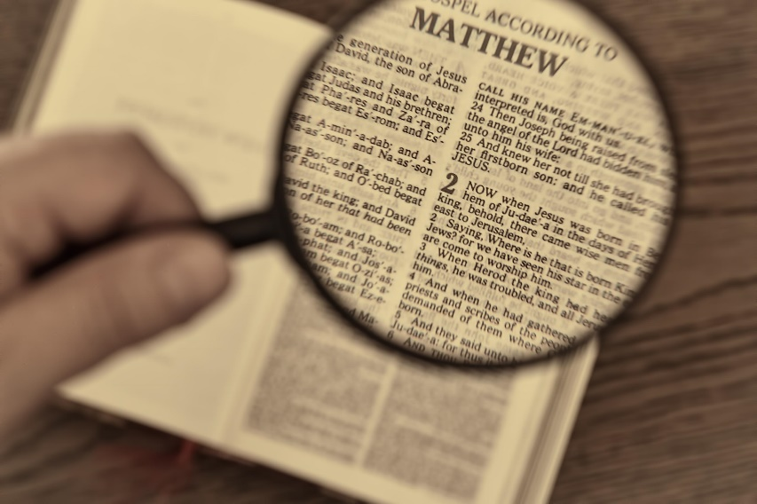
Video Bible Study
Lessons
presented by
David E. Pratte
gospelway.com

Slide 3
The Book of
Psalms
Thanks to Christians in the Hillcrest church for their participation.
© Copyright David E. Pratte, 2024
Scripture quotations are generally from the New King James Version (NKJV), copyright 1982, 1988 by Thomas Nelson, Inc. used by permission. All rights reserved.

Slide 4
Bible Study Questions on the Book of
Psalms
Available at
biblestudylessons.com/classbooks

Slide 5
Theme and Facts about Psalms
Theme: Inspired Old Testament poems used to worship God
Author: David and Others
David: Matthew 22:45; Mark 12:36 (Psalm 110); Acts 4:24,25 (Psalm 2:1,2); Luke 20:42-44 (Psalm 110); Acts 1:20 (Psalm 69); Acts 2:25-28 (Psalm 16); Acts 2:34 (Psalm 110); Romans 4:6-8 (Psalm 32).
Hebrew Poetry
Emphasized ideas and thoughts. Parallelism: Ideas repeated or contrasted to emphasize the meaning
Uses of Psalms
* Singing (Ephesians 5:19; Colossians 3:16).
* Teaching (Luke 20:42; Acts 1:20)
* Prayer (Acts 4:24-28)

Slide 6
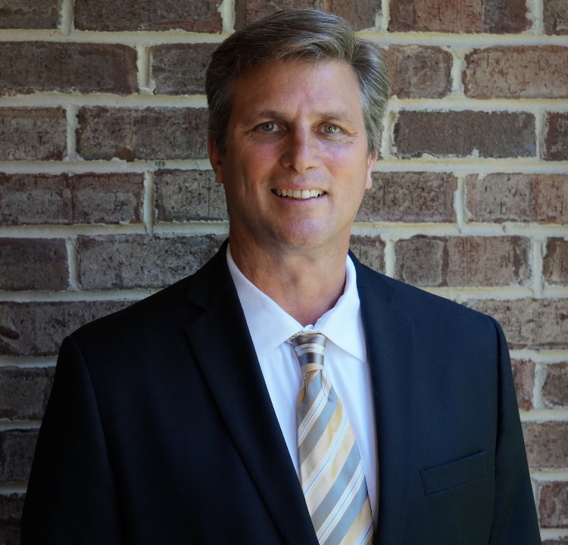
Blessed Is the Man Who…
Walks not in the counsel of the ungodly,
Nor stands in the path of sinners,
Nor sits in the seat of the scornful

Slide 7
Psalm 1: Blessed Is the Man Who Delights in the Law of the Lord
The righteous man does not follow ungodly counsel but delights and meditates on God’s law. As a result he is blessed and fruitful.

Slide 8

Psalm 1: Blessed Is the Man Who Delights in the Law of the Lord
The righteous man does not follow ungodly counsel but delights and meditates on God’s law. As a result he is blessed and fruitful.
The ungodly man is like chaff driven away by the wind. He will not stand in judgment.
God knows the way of the righteous, but the way of the ungodly shall perish.

Slide 9
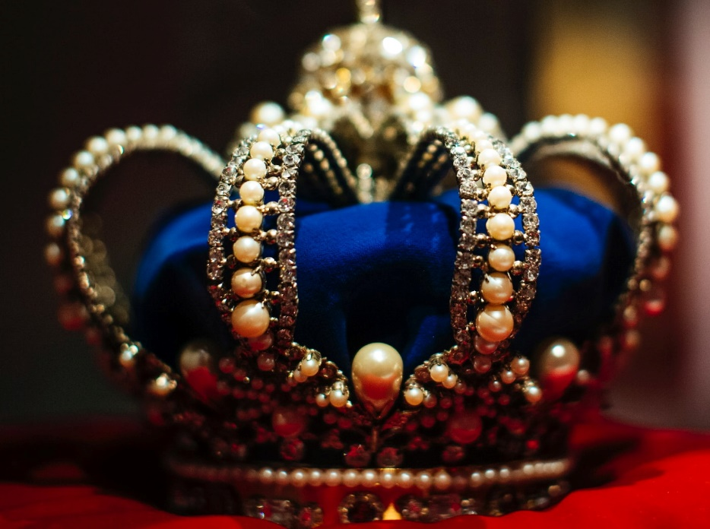
Psalm 2: I Have Set My King on My Holy Hill
The opposition against the Messiah
The coronation of the king despite the opposition
The king’s dominion over the nations
The warning to wise rulers to submit to the King

Slide 10
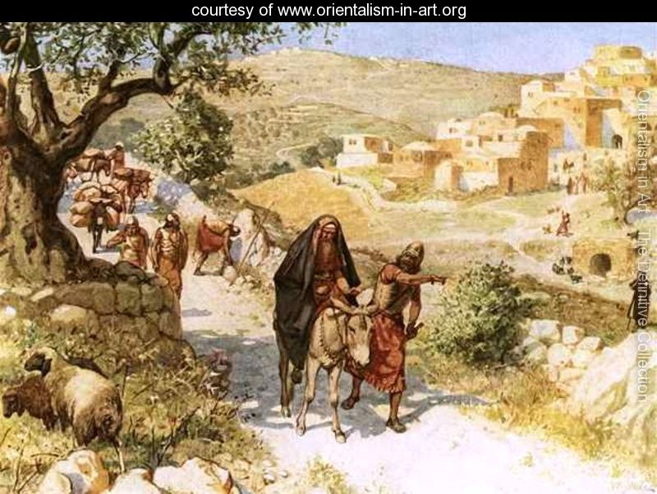
Psalm 3: You, O Lord, Are a Shield for Me
A cry of distress: Many enemies oppose me.
A sure ground of hope: The Lord is my shield of protection.
A statement of courage: I need not fear people because God sustains me.
A request for deliverance: God has smitten my enemies. Salvation belongs to the Lord.

Slide 11
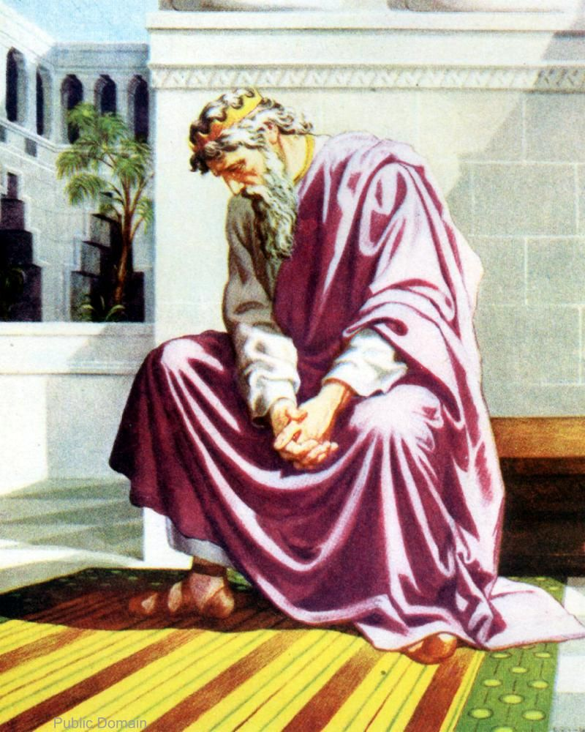
Psalm 4: You Alone, O Lord, Make Me Dwell in Safety
Hear me when I call, O God. Other people pursue falsehood and vanity.
God hears the call of those who are godly.
Trust in the Lord: He will give gladness so we may dwell in safety.

Slide 12

Psalm 5: You Are Not a God Who Takes Pleasure in Wickedness
God takes no pleasure in wickedness, so evil does not dwell with Him. He hates all workers of iniquity.
He destroys the boasters, those who speak falsehood, the bloodthirsty and deceitful.
But those who trust in God and love His name should rejoice because He will defend and bless them.

Slide 13
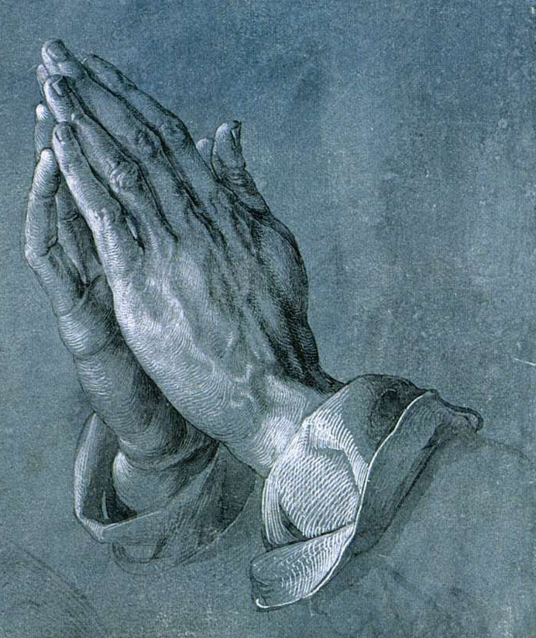
Psalm 6: Have Mercy on Me, O Lord, for I Am Weak
David calls on God to not chasten him but have mercy because he is deeply troubled.
He pleads for deliverance because he is grieving because of his enemies.
He is convinced he will prevail and his enemies will be ashamed because God has heard his prayer.

Slide 14
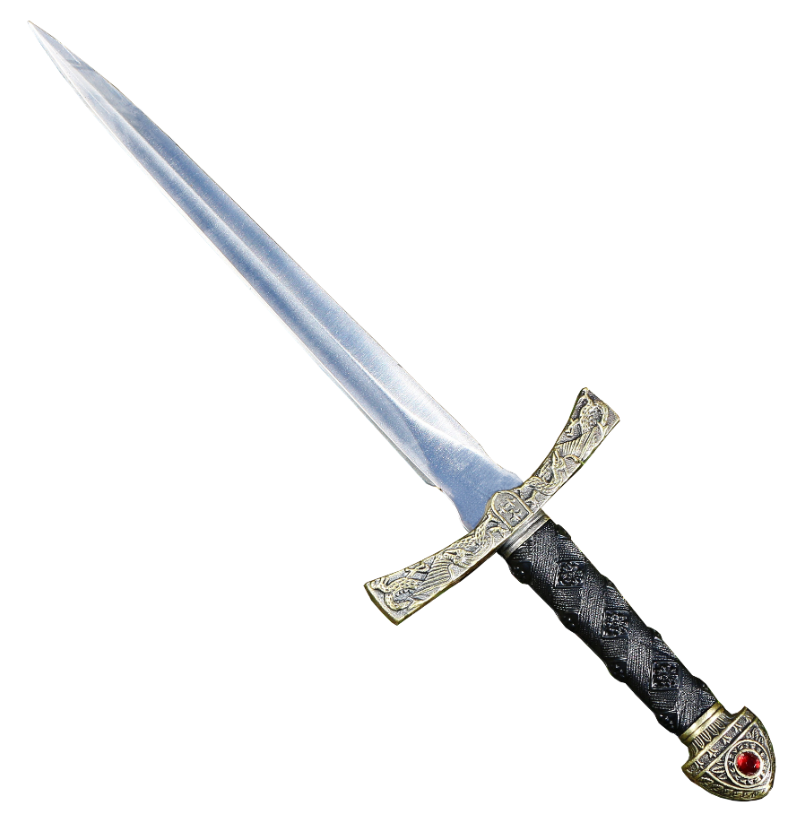
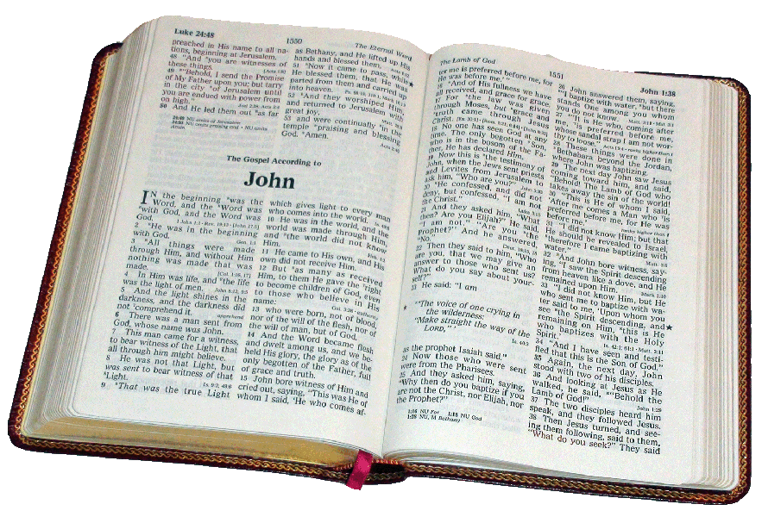
Psalm 7: God Is a Just Judge.
Deliver me, Lord, from enemies but let evil come upon me if I have done evil to others.
God will bring judgment, vindicating the righteous and punishing the wicked.
We can trust God to be just, so the wicked will suffer and mistreatment will end.

Slide 15

Psalm 8: What Is Man That You Are Mindful of Him?
By the mouth even of little children God is able to silence His enemies.
Compared to the moon and stars that God created, why has God exalted people?
God made man a little lower than the angels and placed man over all the works of His hands, including all the animals.

Slide 16
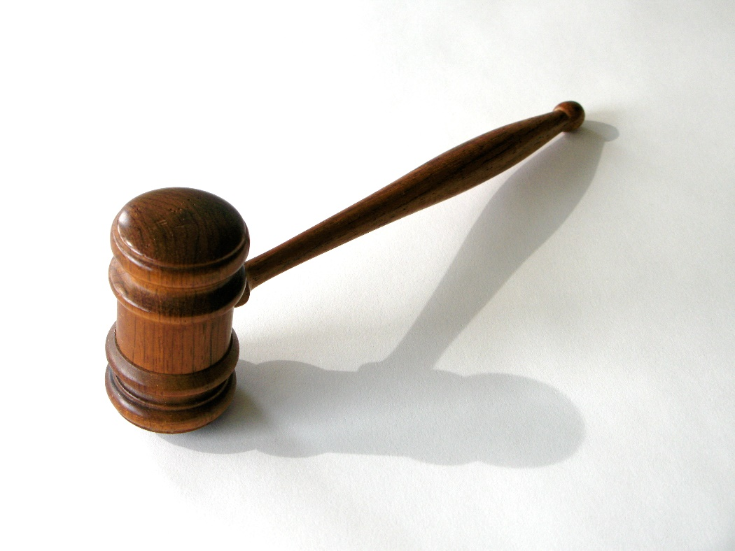
Psalm 9: Those Who Know Your Name Will Put Their Trust in You
God judges evil nations but maintains the cause of the righteous.
God’s judgments are righteous.
He is a refuge to the oppressed and avenges them against their enemies.
The wicked will be caught in the traps they set to harm others.

Slide 17
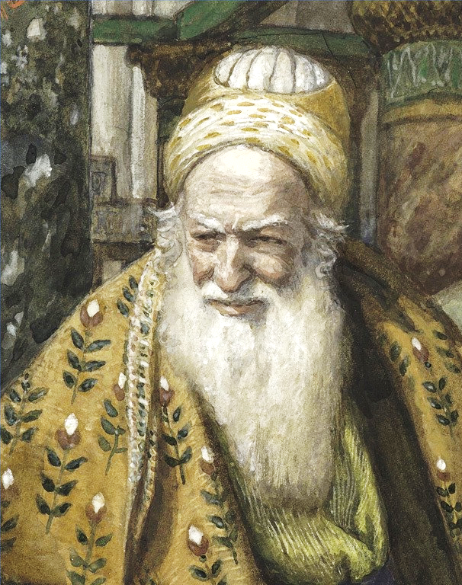
Psalm 10: The Wicked in His Pride Does Not Seek God
Proud – vv 2,3
Persecutes the poor – v 2
Boastful, proud – vv 3,4
Renounces/does not seek God – vv 3,4
Appears to prosper – v 5
Sneers at enemies – v 5
Confident he cannot fail – v 6
Cursing, deceit, oppression, trouble, iniquity – v 7
Lies in wait to harm the innocent and defenseless – vv 8-10
Denies God’s punishment – vv 11-13

Slide 18
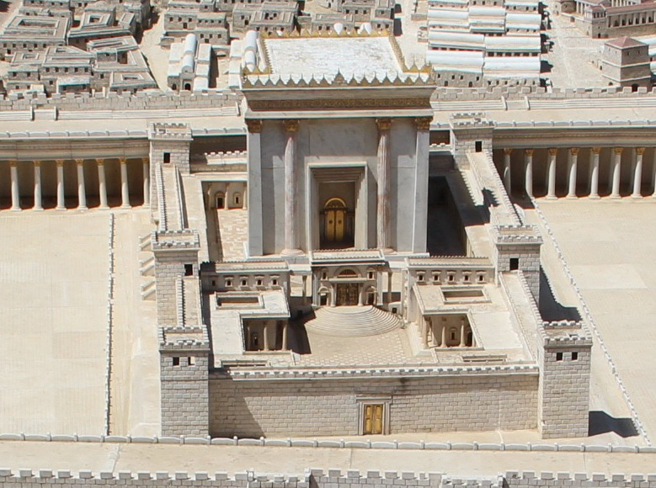
Psalm 11: The Lord's Throne Is in Heaven; His Eyes Test the Sons of Men
People urged David to flee from danger for the sake of safety.
But God is on His throne and tests both the righteous and the wicked.
We should put our trust in him because he will punish the wicked and love righteousness.

Slide 19

Psalm 12: With Flattering Lips and a Double Heart Men Speak, but the Words of the Lord Are Pure
Flattery and pride characterize people’s speech.
They think their speech will prevail and no one will hold them to account.
But God promised to protect the oppressed. His words are pure.

Slide 20
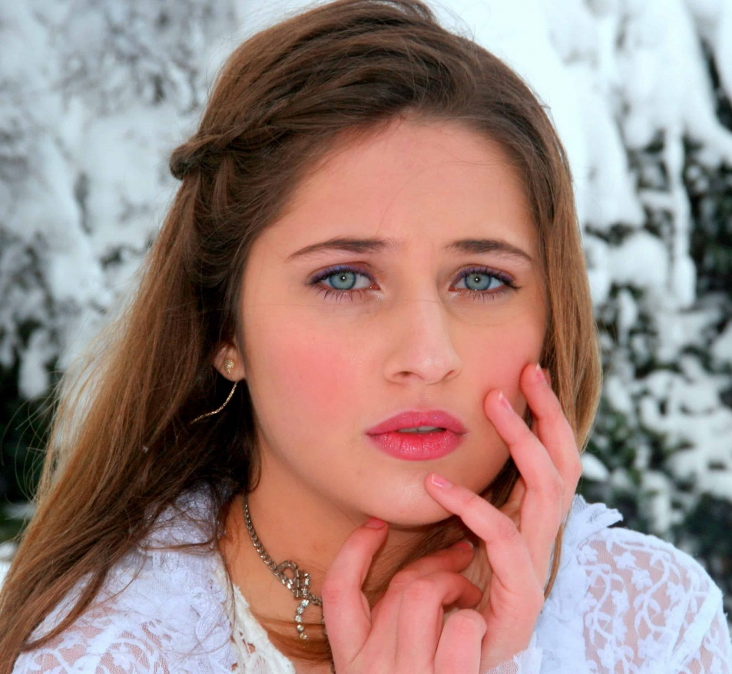
Psalm 13: I Have Trusted in Your Mercy; My Heart Shall Rejoice in Your Salvation.
People who suffer often wonder how long God will allow their problems to continue.
We need to trust God’s mercy remembering how He has dealt with His people in the past.

Slide 21
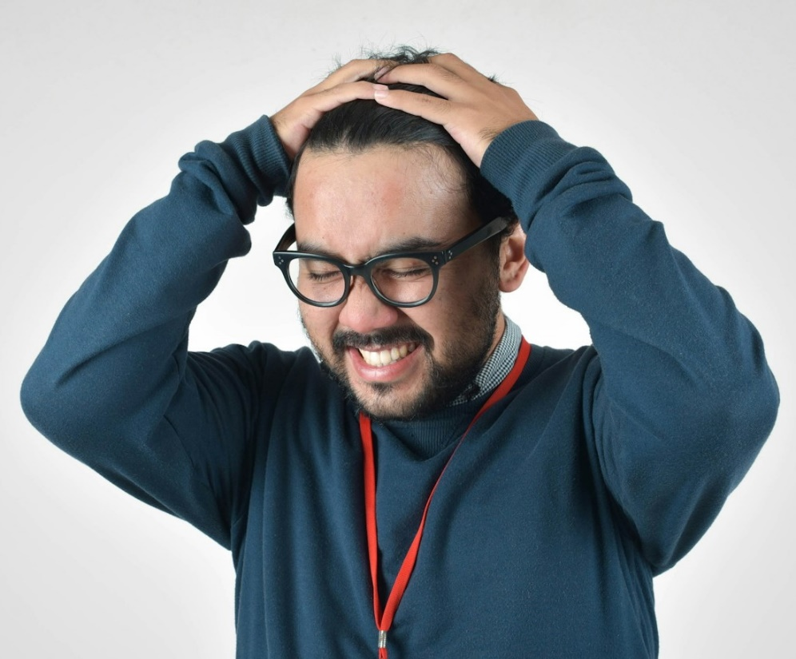
Psalm 14: The Fool Has Said in His Heart, "There Is No God."
Fools deny God’s existence and practice abominable works.
Workers of iniquity abuse and mistreat God’s people.
Yet unbelievers have reason to fear because God is with the righteous.

Slide 22
Psalm 15: Who Has the Lord’s Favor?
* Walks uprightly and works righteousness
* Speaks truth in his heart
* Does not backbite with his tongue nor take up reproach against friend
* Does not do evil to his neighbor
* Despises wickedness but honors those who fear the Lord
* Swears to his hurt and does not change
* Does not put out his money at usury or take a bribe

Slide 23
Psalm 16: Preserve Me, God, for in You I Put My Trust.
I trust in God who preserves me and I delight in His saints.
God is my inheritance, so I will praise him and avoid idols.

Slide 24
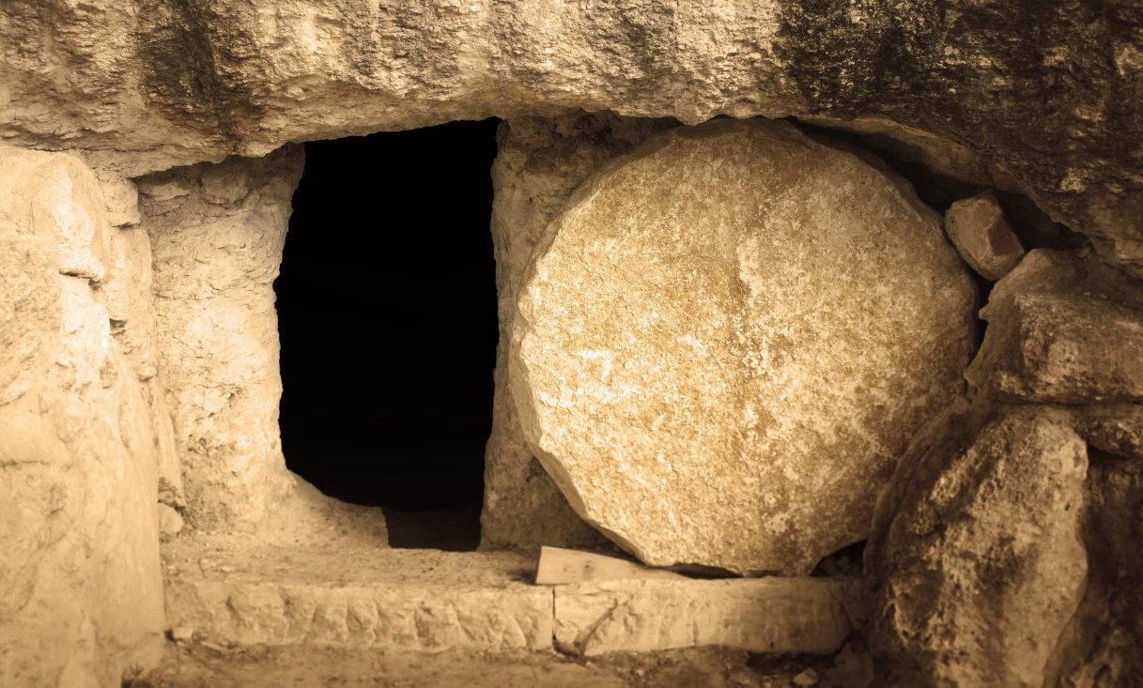
My flesh Will Rest in Hope.
See also Acts 2:25-36 and Acts 13:35
My flesh also will rest in hope.
For You will not leave my soul in Sheol,
Nor will You allow Your Holy One to see corruption.
You will show me the path of life

Slide 25
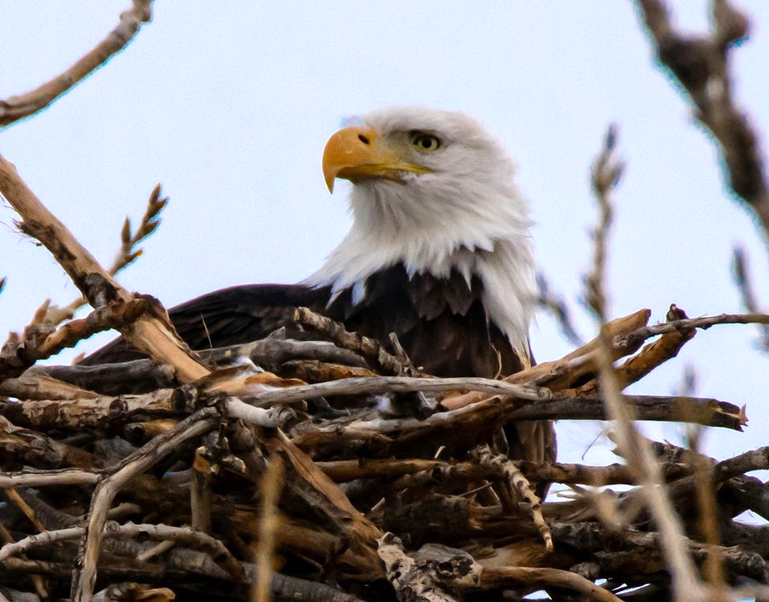
Psalm 17: Keep Me as the Apple of Your Eye; Hide Me Under the Shadow of Your Wings
David called on God to hear him since he was innocent of wrongdoing.
Enemies surrounded him and sought to cast him down.
He sought God to deliver him from those who are wicked.

Slide 26
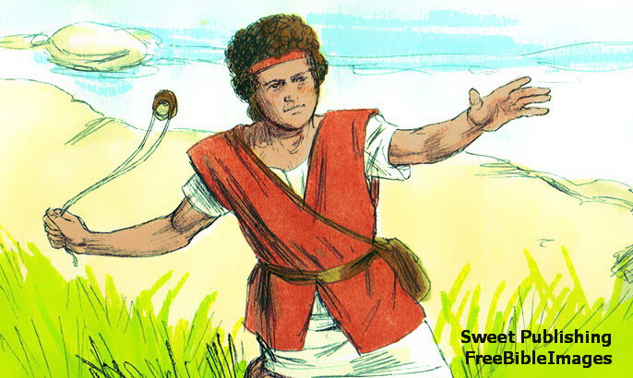
Psalm 18: I Will Call upon the Lord; So Shall I Be Saved from My Enemies.
David called on the Lord when he feared the ungodly surrounded him.
God came to his rescue with great evidence of His power.
David was delivered from his enemy to reward him for his righteousness.
God treats people according to their conduct: merciful, blameless, pure, devious, or humble.
God is a shield to His people giving them success and victory over evil.

Slide 27
Psalm 18: Recompensed according to Righteousness
People | God
Merciful | Merciful
Blameless | Blameless
Pure | Pure
Devious | Shrewd
Humble | Save
Haughty | Bring down

Slide 28
Our Spiritual Warfare Today - 1
John 18:36 – My kingdom is not of this world. If My kingdom were of this world, My servants would fight, so that I should not be delivered to the Jews; but now My kingdom is not from here.
2 Corinthians 10:3-5 – For though we walk in the flesh, we do not war according to the flesh. For the weapons of our warfare are not carnal but mighty in God for pulling down strongholds, casting down arguments and every high thing that exalts itself against the knowledge of God, bringing every thought into captivity to the obedience of Christ.
1 Timothy 1:18 – This charge I commit to you, son Timothy, … wage the good warfare,
1 Timothy 6:12 – Fight the good fight of faith …

Slide 29
Our Spiritual Warfare Today - 2
2 Timothy 4:7 – I have fought the good fight…
Revelation 6:2 – And I looked, and behold, a white horse. He who sat on it had a bow; and a crown was given to him, and he went out conquering and to conquer.
Revelation 12:10,11 – Now salvation, and strength, and the kingdom of our God, and the power of His Christ have come, for the accuser of our brethren … has been cast down. And they overcame him by the blood of the Lamb and by the word of their testimony…”
Revelation 17:14 – These will make war with the Lamb, and the Lamb will overcome them, for He is Lord of lords and King of kings; and those who are with Him are called, chosen, and faithful. See also Revelation 19:11-16; Ephesians 6:10-18.

Slide 30
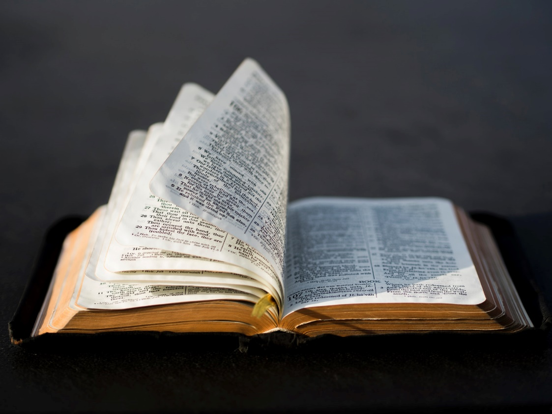
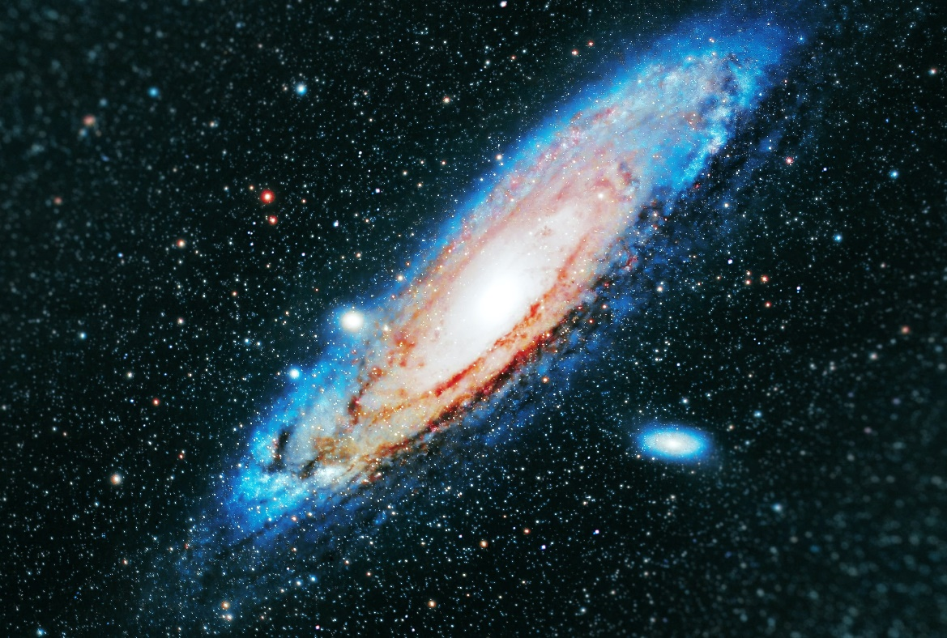
Psalm 19: Two Forms of Divine Revelation
Revelation in Nature
Revelation in Scripture

Slide 31
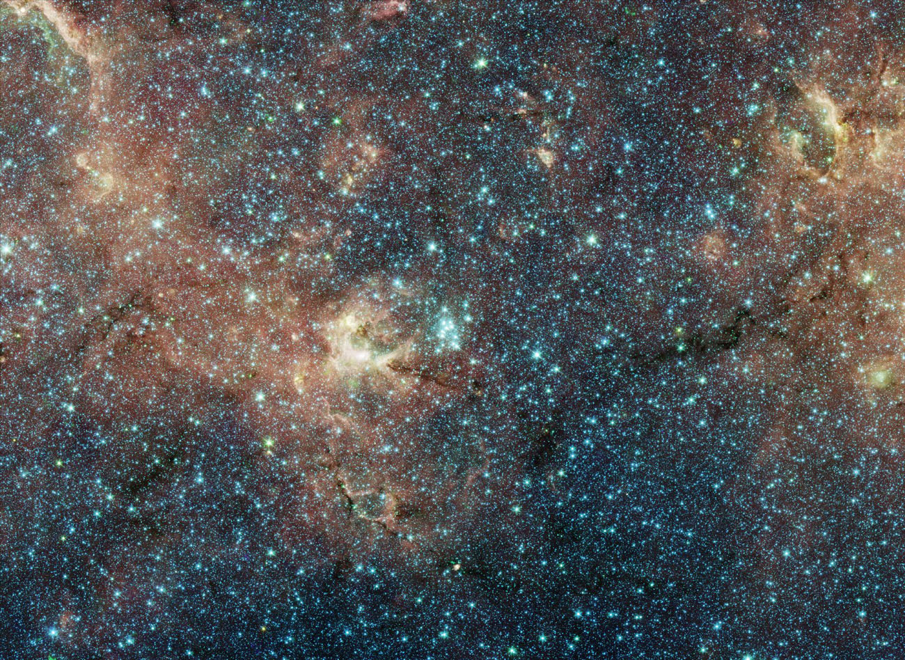
Psalm 19: The Heavens Declare the Glory of God
The Universe proves God exists and deserves our praise.
It is neither written nor spoken, yet the message is heard throughout the world.
It does not reveal what is right or wrong or what we should do to please God.
“Scientific” deduction should never be accepted if it contradicts Scripture.

Slide 32
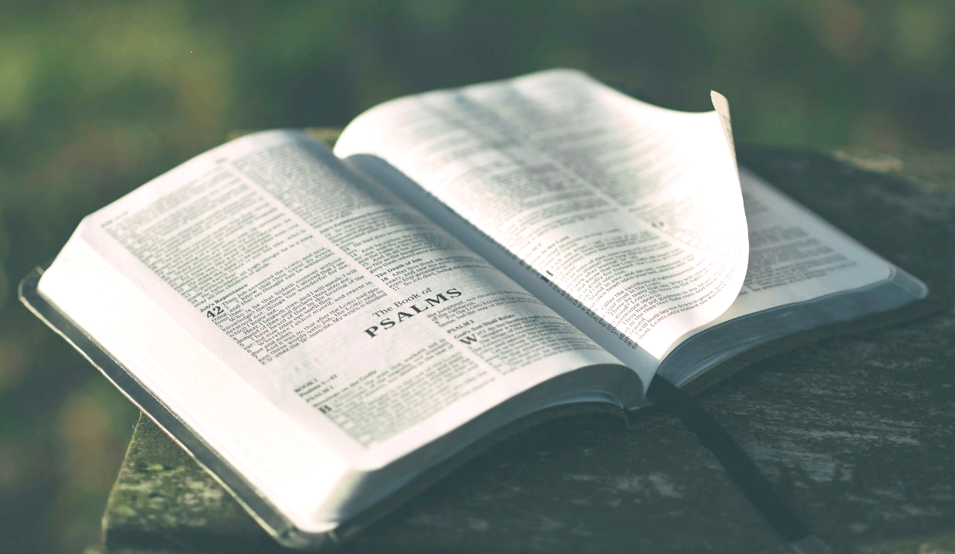
Psalm 19: The Law of the Lord Is Perfect
The law of the Lord is perfect, right, pure, and true.
His words are more valuable than gold. They warn us and lead to great reward.
We should seek to act in harmony with God’s word and avoid violating it.

Slide 33
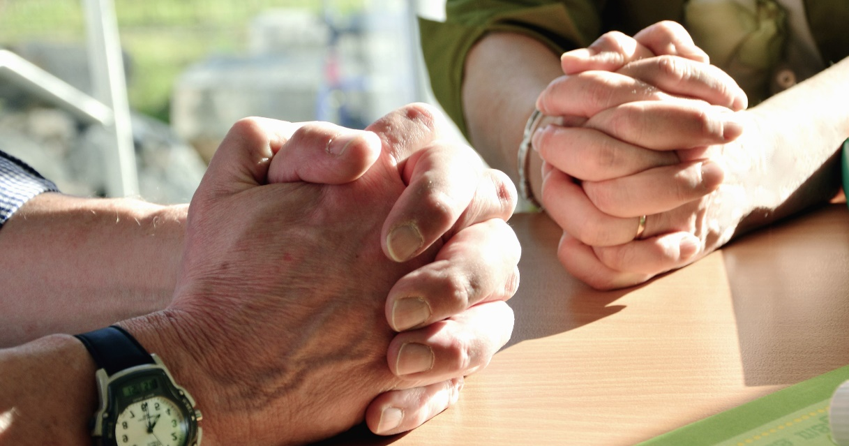
Psalm 20: May the Lord Accept Your Worship and Give You Strength in Trouble
May the Lord answer you in your trouble and send help.
May He accept your worship, and grant your requests.
The Lord will save His anointed and give strength from His right hand.
Those who trust in chariots and horses will fall, but those who remember God’s name will stand upright.

Slide 34
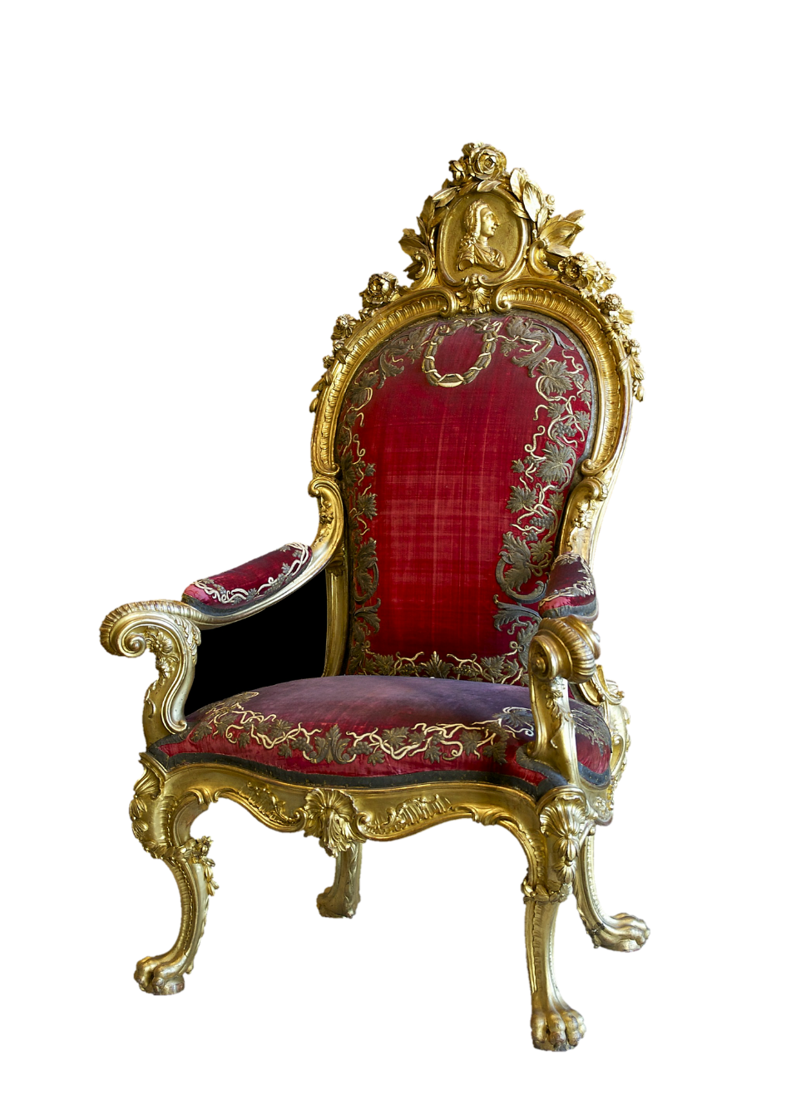
Psalm 21: The King Trusts in the Lord, and Through God’s Mercy He Shall Not Be Moved.
The king gives praise to God for His blessings and deliverance.
God will defeat all of His enemies who plot evil against Him.
God should be praised and exalted for His power.

Slide 35
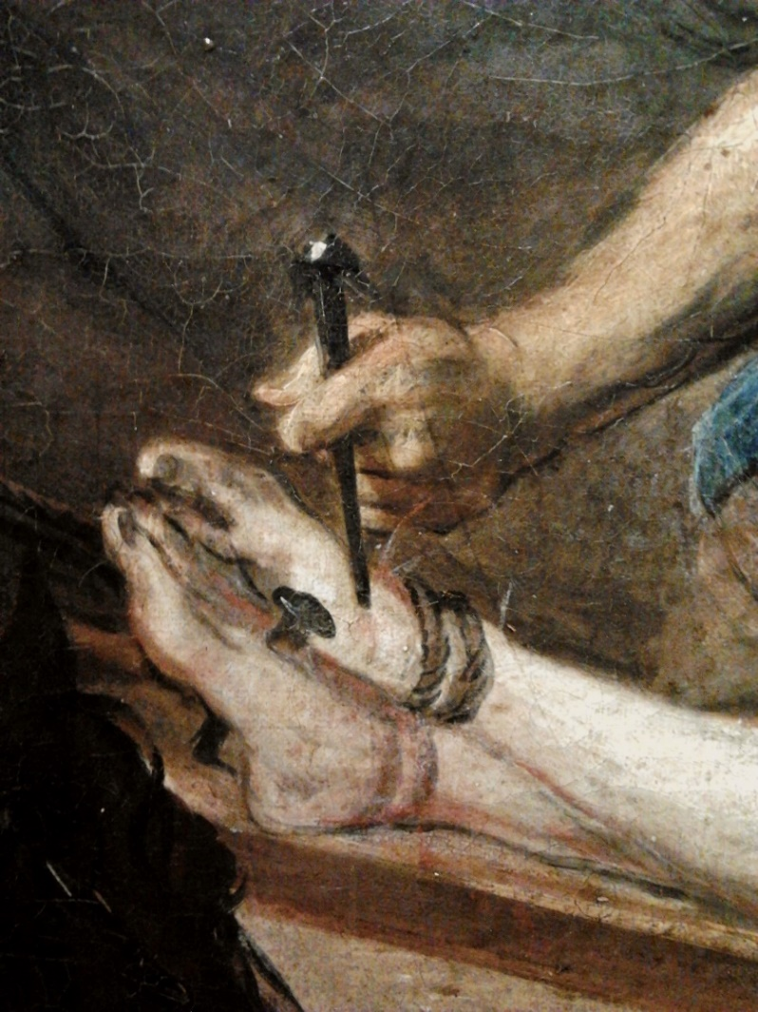
Psalm 22: Verses in This Psalm Fulfilled by Jesus
Verse | Fulfillment
Verse 1 – My God, why have You forsaken me? | Matt. 27:46
Verses 7,8 –“Let the Lord deliver him, since he delights in him.” | Matt. 27:43
Verse 16 – They pierced my hands and my feet | Matt. 27:35 John 20:26ff
Verses 17,18 – They part my clothes and cast lots for my vesture | John 19:23f Matt. 27:35
Verse 22 – I will declare Your name to My brethren; In the midst of the assembly I will sing praise | Heb. 2:12

Slide 36
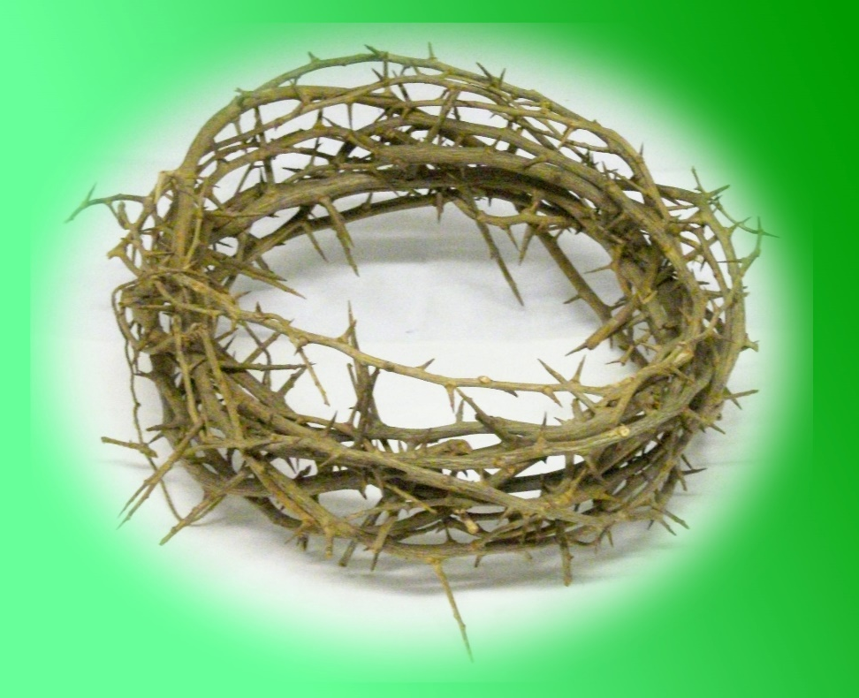
Psalm 22: My God, Why Have You Forsaken Me? In the Midst of the Congregation I Will Praise You.
Crucifixion – verses 1-21
God forsook His Son in His time of suffering: He did not come to His assistance and did not answer His prayer.
People despised and ridiculed Him. They pierced His hands and His feet. They divided His garments and cast lots for His clothing.
Resurrection – vv22-31
But then God did hear Him so He would praise God in the great assembly.
All people of all nations should worship Him for the He rules over the nations.

Slide 37
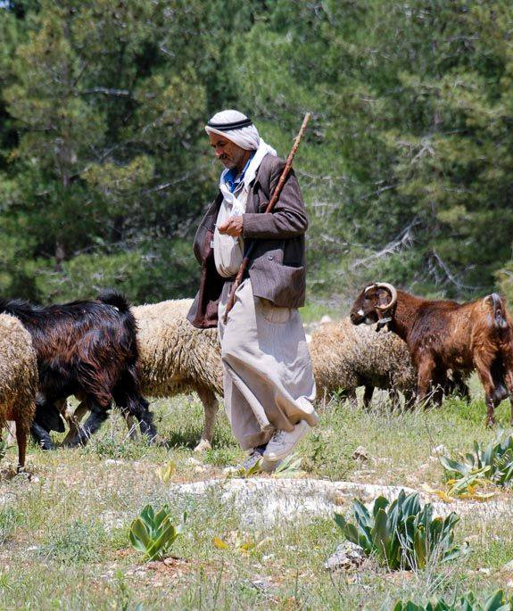
Psalm 23: The Lord Is My Shepherd; I Shall Not Want
The shepherd provides His sheep with green pastures & still waters.
He restores their soul and leads them in the paths of righteousness.
They fear no evil even when passing through the valley of the shadow of death.
They receive victory and honor even in the presence of enemies.
Goodness and mercy from the Lord bless them throughout life.
Photo credit BiblePlaces.com

Slide 38
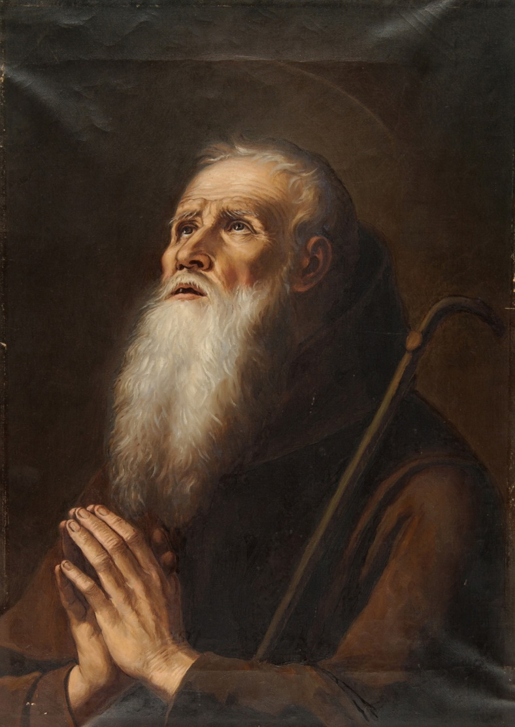
Psalm 24: The Earth Is the Lord’s, and All Its Fullness. Who May Stand in His Holy Place?
One who has proper:
Deeds (Clean hands)
Thoughts (Pure heart)
Worship (No idols)
Speech (Not sworn deceitfully)

Slide 39
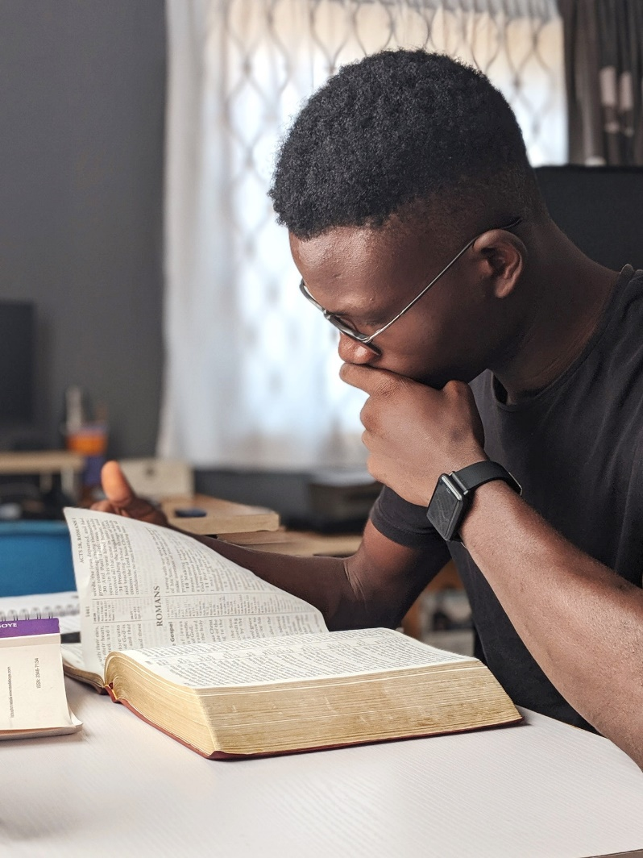
Psalm 25: Teach Me Your Ways. Look on My Affliction
and Forgive All My Sins.
I trust God to lead me in the truth so I will have no cause to be ashamed even before my enemies.
Do not remember the sins of my youth but pardon my iniquity and guide me in justice and truth.
To those who fear Him, God will teach His ways and pluck their feet out of temptation.
Look on my affliction, forgive my sins, deliver me, and let integrity and uprightness preserve me.

Slide 40
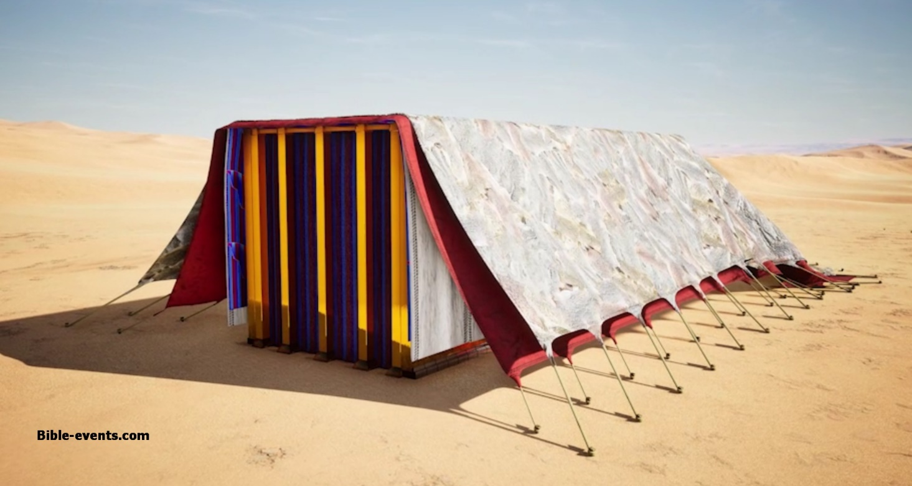
Psalm 26: I Walk in Integrity, I Hate the Assembly of Evildoers, But I Love the Place Where Your Glory Dwells.
Examine me, Lord, and vindicate me for I have walked in integrity and trusted in the Lord.
I wash my hands in innocence, hate the assembly of evildoers, and will not sit with the wicked.
I love God’s house and will tell about His wondrous works.
Do not treat me as those who are evil, but redeem me and be merciful to me.

Slide 41
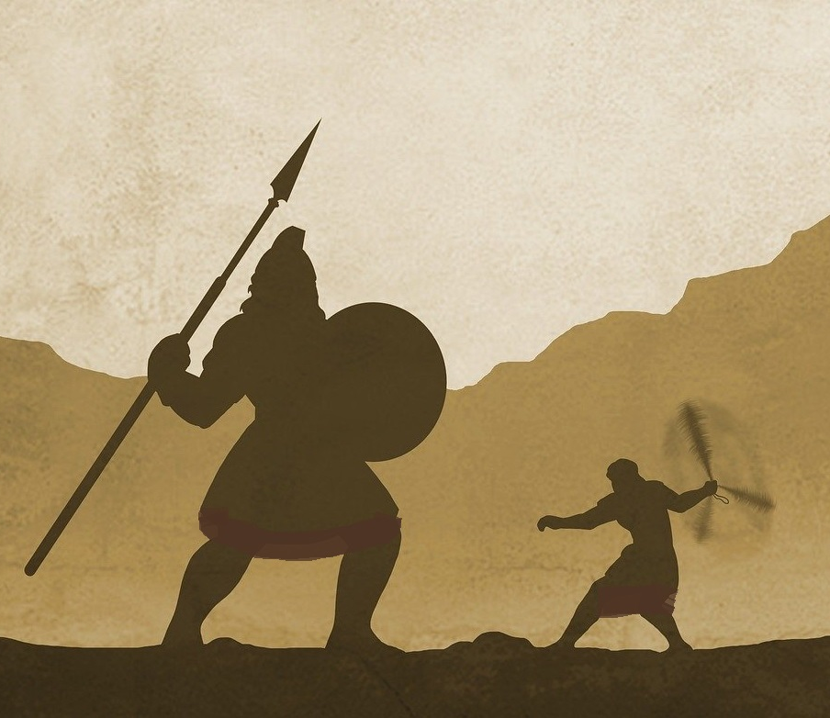
Psalm 27: Wait on the Lord; Be of Good Courage, and He Shall Strengthen Your Heart
No matter what enemies come against us, we can be confident if God is our strength and guide.
If we truly desire to worship the Lord, he will protect us in time of trouble.
If we turn to the Lord, he will not turn from us when others forsake us.
If we learn the Lord’s way, He will deliver us; if we wait on the Lord, He will strengthen us.

Slide 42
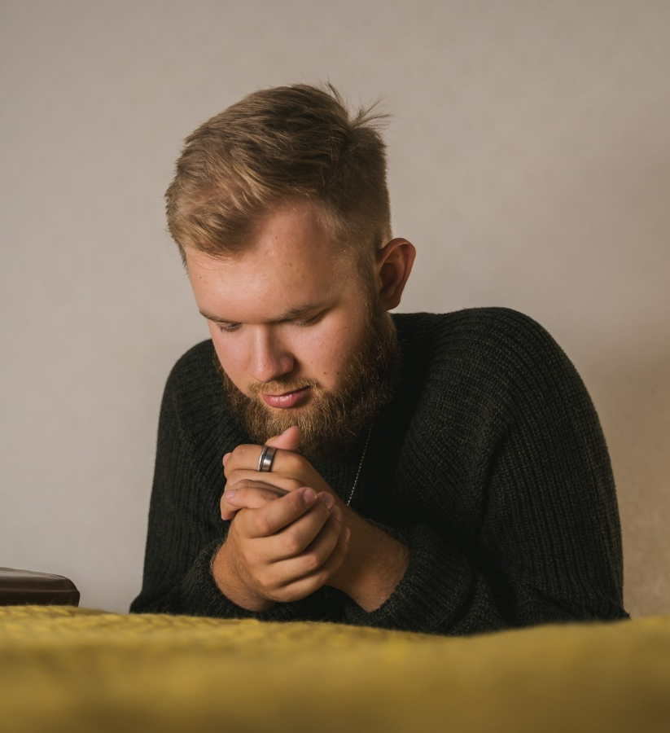
Psalm 28: Hear the Voice of My Supplications and Do Not Take Me Away with the Wicked
I cry to the Lord to not treat me like You punish the wicked.
Give the wicked what they deserve for their deeds because they do not regard God.
The Lord is blessed for giving help and joy, strength and guidance to the people and the king.

Slide 43
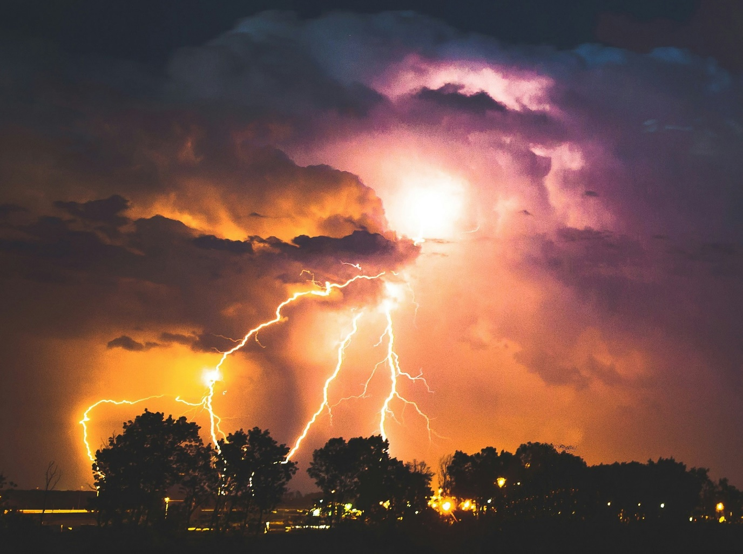
Psalm 29: The Voice of the Lord Is Powerful and Full of Majesty.
Give God the glory due Him and worship Him in the beauty of holiness.
The voice of the Lord is powerful like a storm, shaking the wilderness and splintering trees.
So the Lord gives strength and blesses His people.

Slide 44
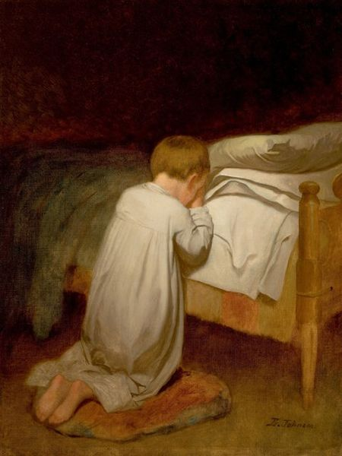
Psalm 30: My God, I Cried Out to You, and You Healed Me.
Praise to God who brought my soul from the grave so my enemies would not rejoice over me.
I thought my prosperity would continue, but God hid His face.
I cried to God for mercy and He clothed me with gladness. I will praise Him and not be silent.

Slide 45
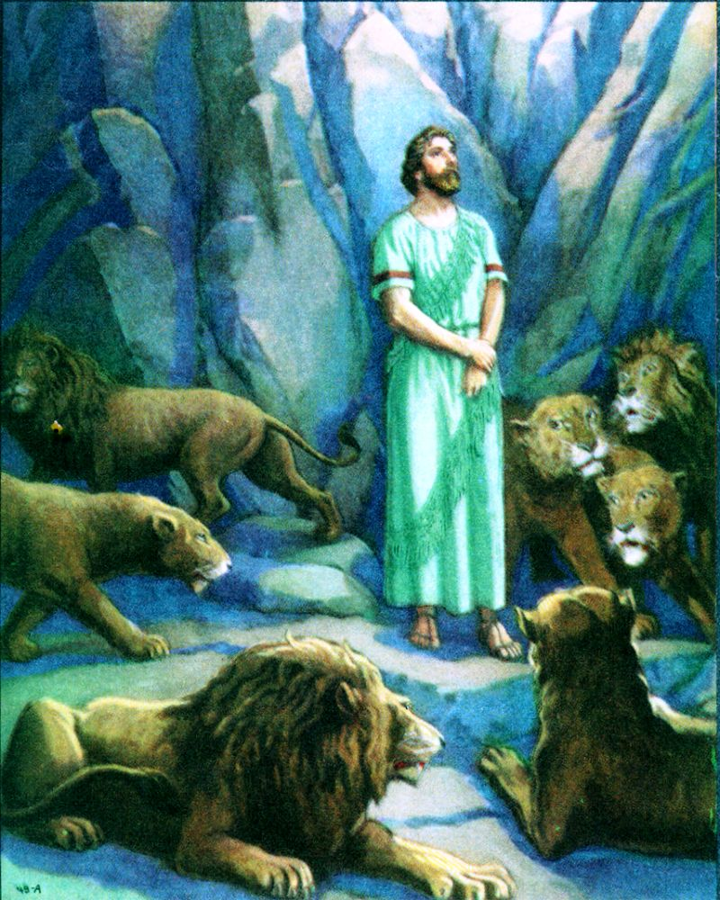
Psalm 31: The Lord Preserves the Faithful, and Fully Repays the Proud Person
You have redeemed me, so I will be glad and rejoice in your mercy.
My strength fails because of my iniquity.
I am a reproach among my enemies and neighbors, slander and fear are on every side.
Do not let me be ashamed, but let my enemies be ashamed.
The Lord preserves the faithful and repays the proud.

Slide 46
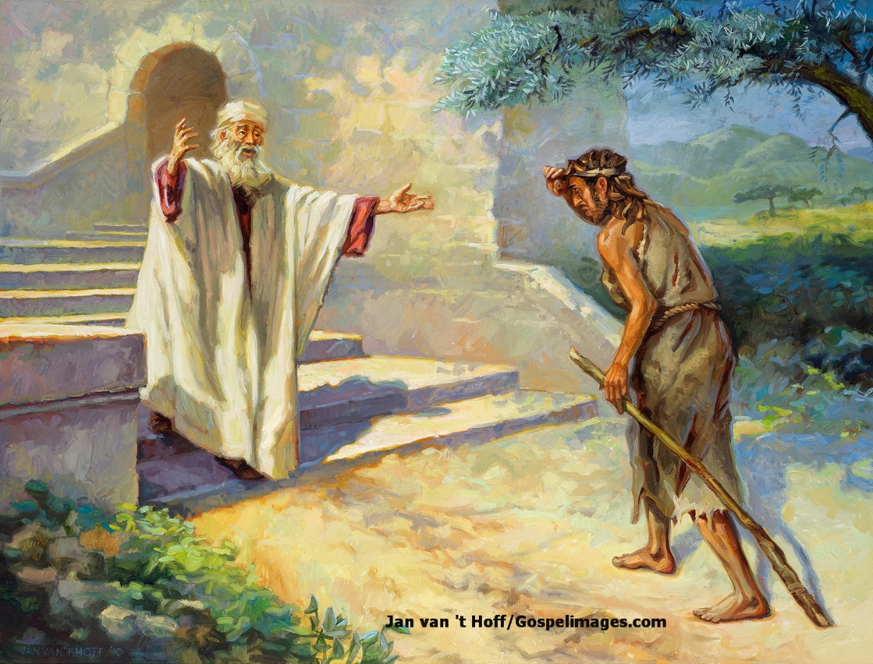
Psalm 32: Blessed Is the One Whose Transgression Is Forgiven, Whose Sin Is Covered.
The man to whom the Lord does not impute iniquity is blessed because his sins are forgiven.
When I kept silent, I groaned all day long. When I confessed my sins, You forgave me. So pray to God while He may be found.
The wicked endure many sorrows, but those who trust the Lord are surrounded by mercy.

Slide 47
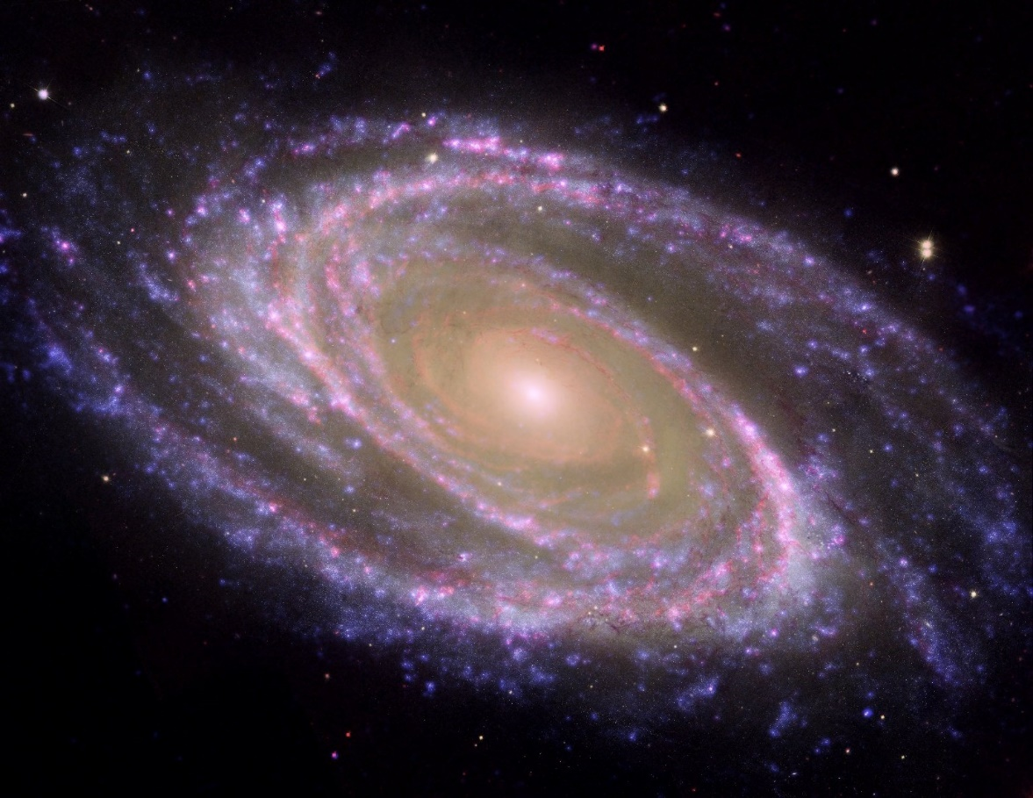
Psalm 33: By the Word of the Lord the Heavens Were Made; His Counsel Stands Forever
Praise the Lord who made the heavens and the seas by His word.
Fear the Lord whose plans overrule those of nations.
The Lord sees all the works of all people. He sees those who fear Him and delivers them.

Slide 48
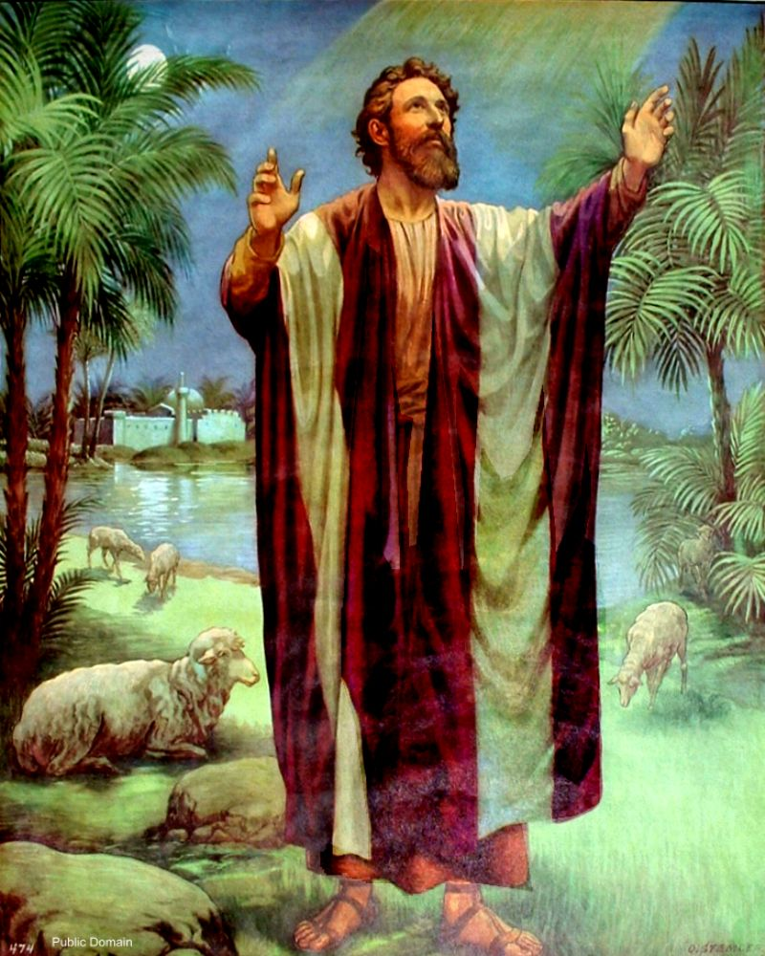
Psalm 34: God’s Ears Are Open to the Righteous, but His Face Is Against Those Who Do Evil.
Taste and see that the Lord is good. He hears and delivers from troubles.
Blessed is the man who trusts the Lord; he shall not lack any good thing.
One who seeks to see good should keep his tongue from evil, depart from evil and do good, seek peace and pursue it.
The Lord hears the cry of the righteous but His face is against those who do evil.

Slide 49
Psalm 35: Let Them Not Rejoice Who Hate Me Without a Cause.
I am accused of things I know nothing about. Enemies reward me evil for good.
When they suffered, I was deeply grieved. But when I suffered they rejoiced and attacked me. They hate me without a cause.
Vindicate me, Lord. Let them be ashamed and dishonored. Let those who rejoice in righteousness praise God.

Slide 50

Psalm 36: With God is the Fountain of Life; the Workers of Iniquity Have Fallen
The wicked man does not fear God. He speaks evil, turns from wisdom and goodness, devises wickedness, and thinks he will suffer no consequences.
But God is faithful, righteous, just, and merciful. People trust him for protection, life, and light.
Do not let the wicked prevail. They have been cast down and are not able to rise.

Slide 51

Psalm 37: Do Not Fret Because of Evildoers; Trust in the Lord, and Do Good
Do not fret nor envy evildoers, for they shall soon be cut down.
Evildoers will be cut off, but the meek inherit the earth.
The wicked plots against the upright and disadvantaged, but his day is coming.
God loves justice and does not forsake His saints, but descendants of the wicked shall be cut off.
The wicked seeks to slay the righteous, but those who wait on the Lord will inherit the land.

Slide 52

Psalm 38: I Will Declare My Iniquity and Be in Anguish over My Sin
There is no soundness in my flesh; I go mourning all day long: God is angry because of my sin.
Loved ones and friends stand afar off. Enemies lay snares and seek my destruction.
I will declare my iniquity and grieve over my sin.
Do not forsake me, Lord, but make haste to help me.

Slide 53
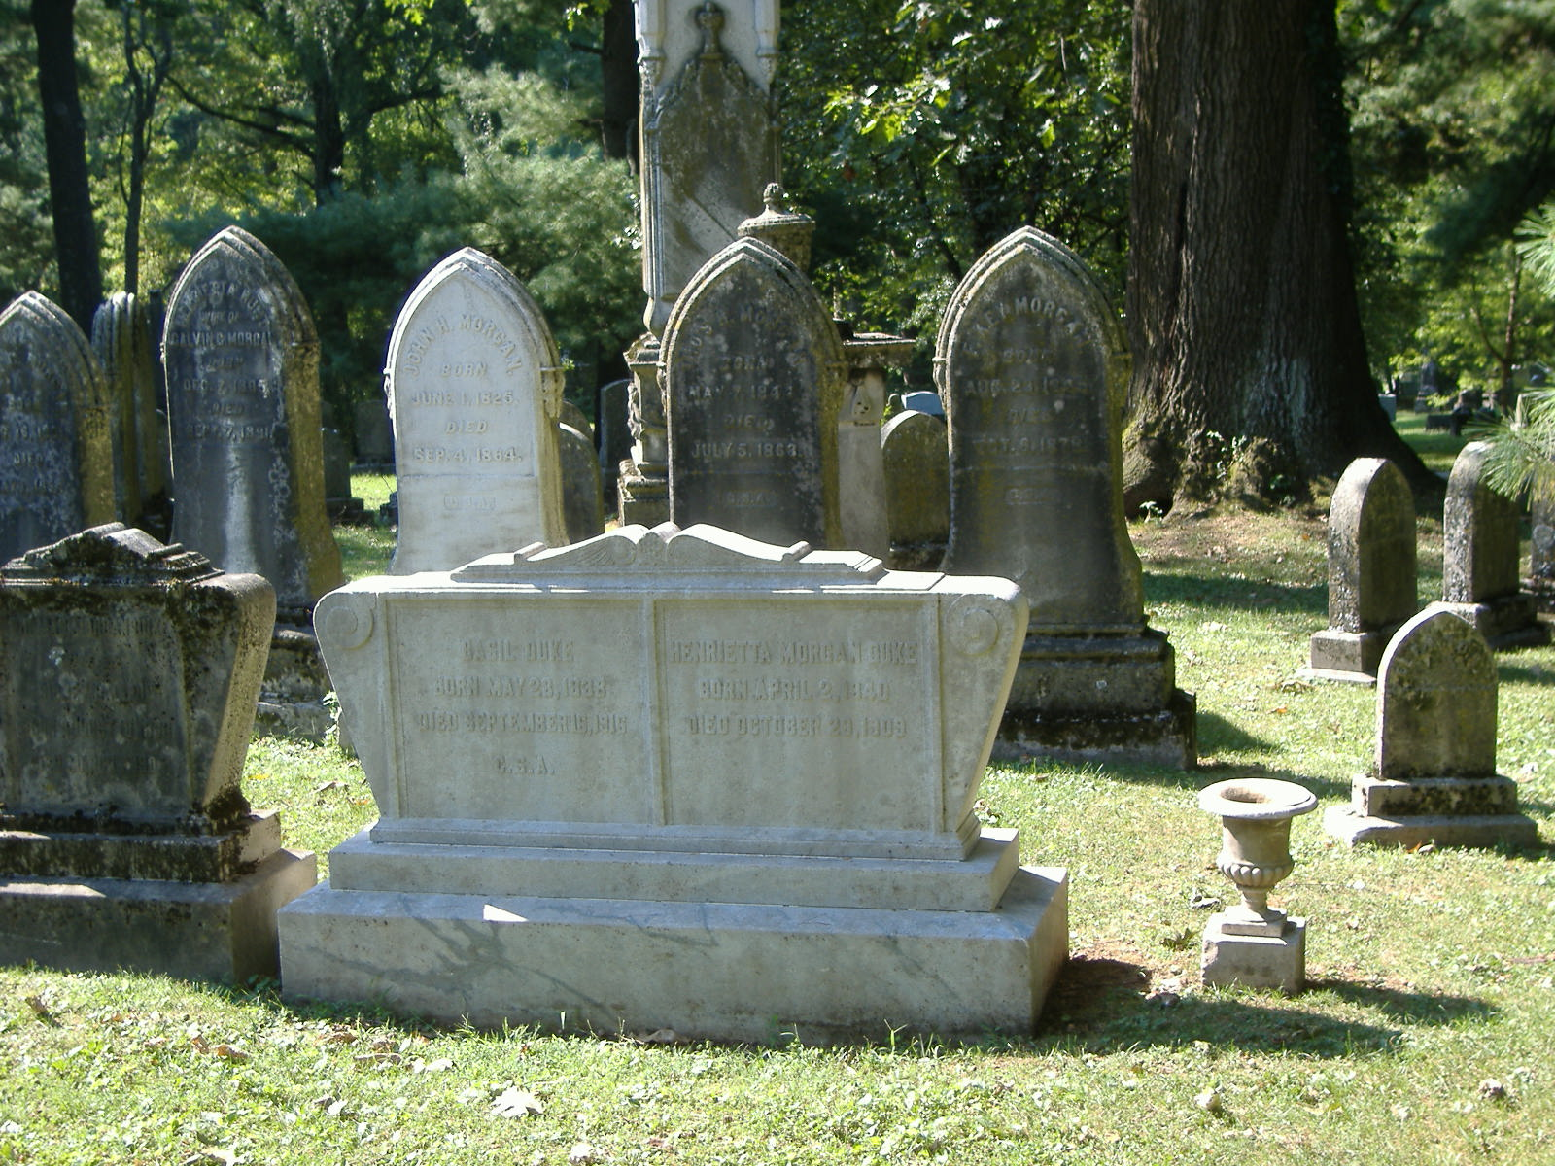
Psalm 39: Make Me to Know the Measure of My Days, That I May Know How Frail I Am
My days are as handbreadths and every man is but vapor.
It is vain for a man to keep up riches. Rather we should place our hope in God.
Deliver me from my transgressions and remove your plague from me before I am no more.

Slide 54

Psalm 40: It Is Written of Me: I Delight to Do Your Will, O God
God has done many wonderful works, more than can be numbered.
You did not desire sacrifice and offering, but I came to do your will as written of me.
I proclaimed the good news of righteousness and did not conceal the truth from the assembly.
Deliver me from the evils surrounding me; shame those who seek to destroy me.

Slide 55
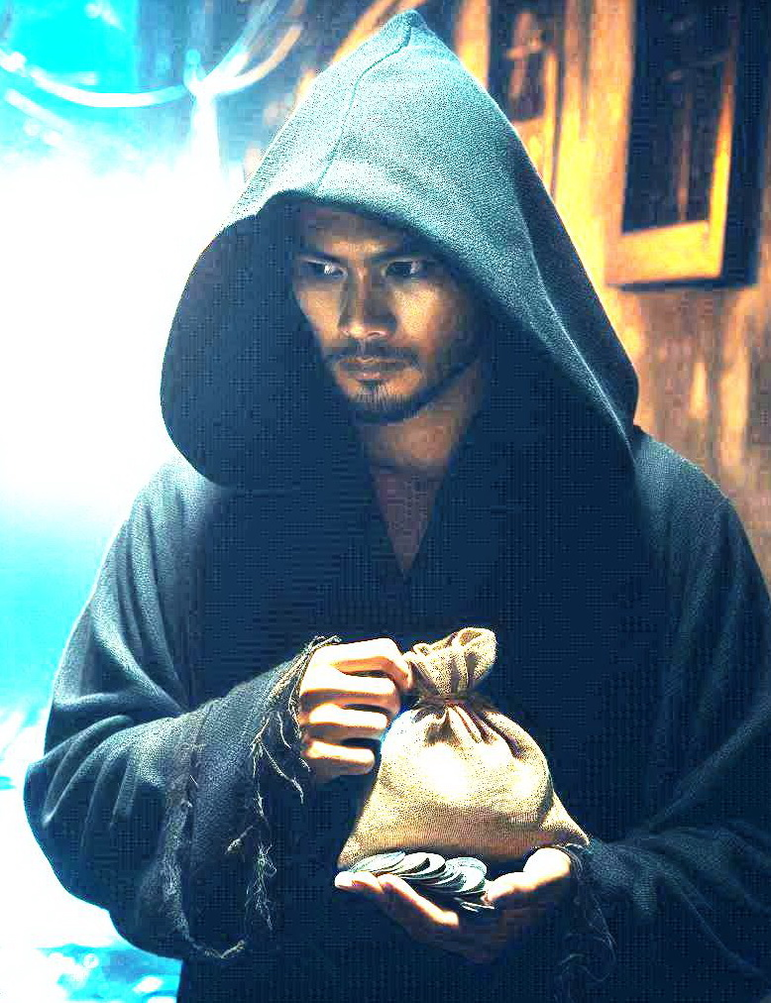
Psalm 41: Even My Own Familiar Friend, in Whom I Trusted, Has Lifted up His Heel against Me.
The Lord will deliver and strengthen one who cares for the poor.
Heal my soul, Lord, for I have sinned and my enemies desire my death.
Even if they visit me, they seek opportunity to plan harm against me.
Even my friend whom I trusted has lifted up his heel against me.
Be merciful to me, God, so my enemies do not triumph over me

Slide 56
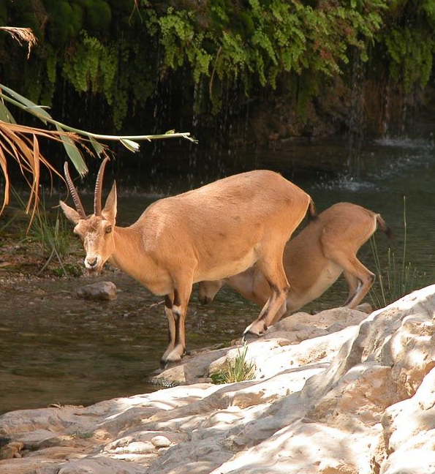
Psalm 42,43: Like the Deer Pants for Water so My Soul Pants for God.
As the deer pants for the water brooks, so my soul pants and thirsts for God.
When enemies ask where God is, I remember the times when I worshiped at the house of God.
My soul is cast down and disquieted. The Lord’s lovingkindness and song shall be with me. I will praise and hope in Him.
Vindicate me and plead my cause against my enemies. Lead me to your tabernacle.

Slide 57
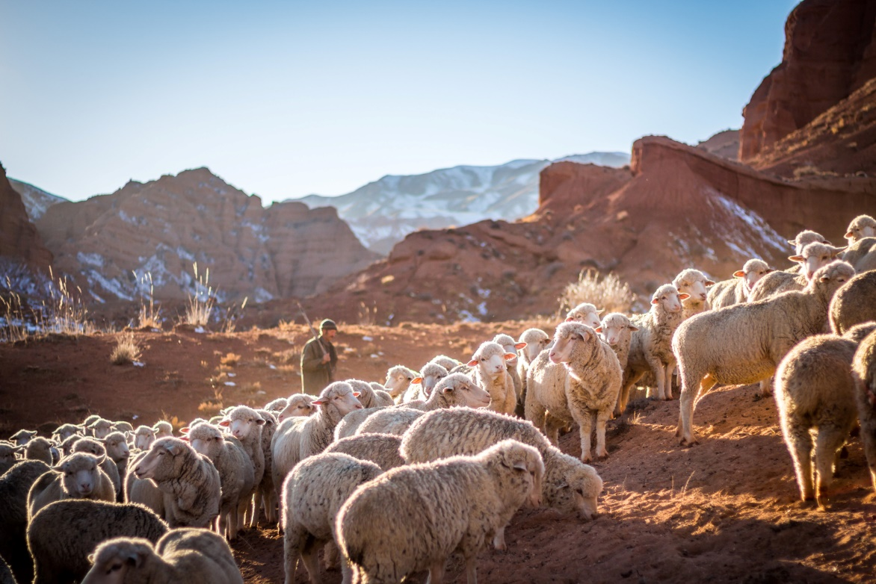
Psalm 44: For Your Sake We Are Killed All Day Long; We Are Counted as Sheep for the Slaughter.
God’s people achieve victory, not by their own power and skill, but by the blessing of God.
They felt they had been cast off and made a reproach to their enemies.
Yet they were faithful to the covenant and had not turned away from God to serve other gods.
They call upon God to not cast them off forever but redeem them.

Slide 58

Psalm 45: Your Throne, O God, Is Forever and Ever; You Love Righteousness and Hate Wickedness
The King is honored for His majesty and His conquests over His enemies.
He is called “God” who reigns forever because He loves righteousness and hates wickedness.
His queen is beloved because she is loyal and respectful to the King.
The royal wedding is accompanied by great joy and honor to the King and His bride.

Slide 59
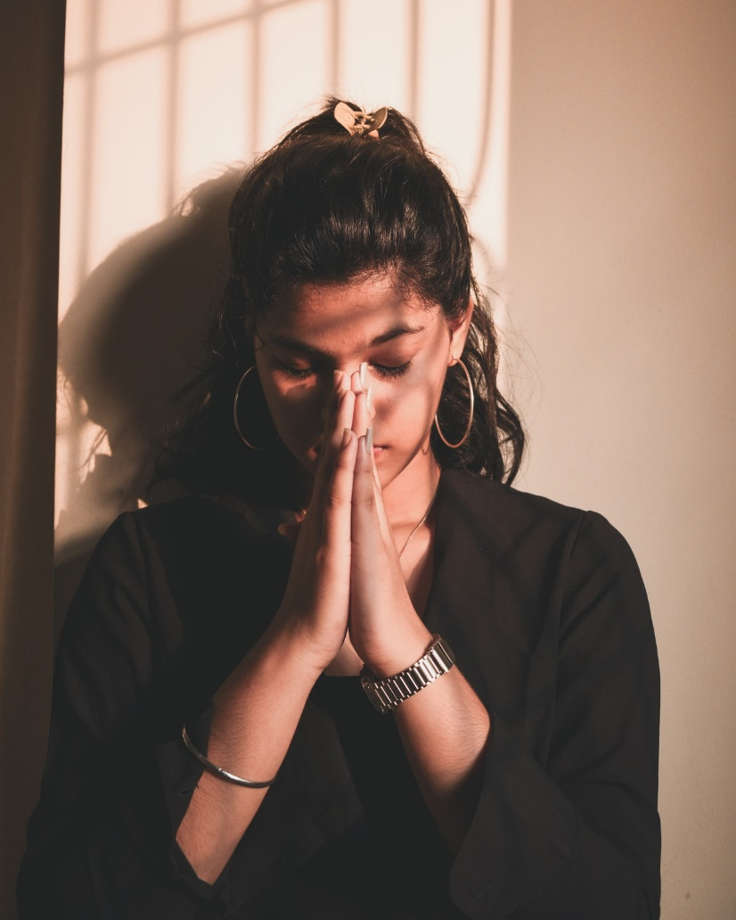
Psalm 46: God Is Our Refuge and Strength, a Very Present Help in Trouble.
God is with us as our refuge and help even in the face of the most troubling events.
God is present in the midst of His city so she shall not be moved.
God causes wars to stop. He truly is God and should be exalted throughout the whole earth.
Be still and know that I am God.

Slide 60
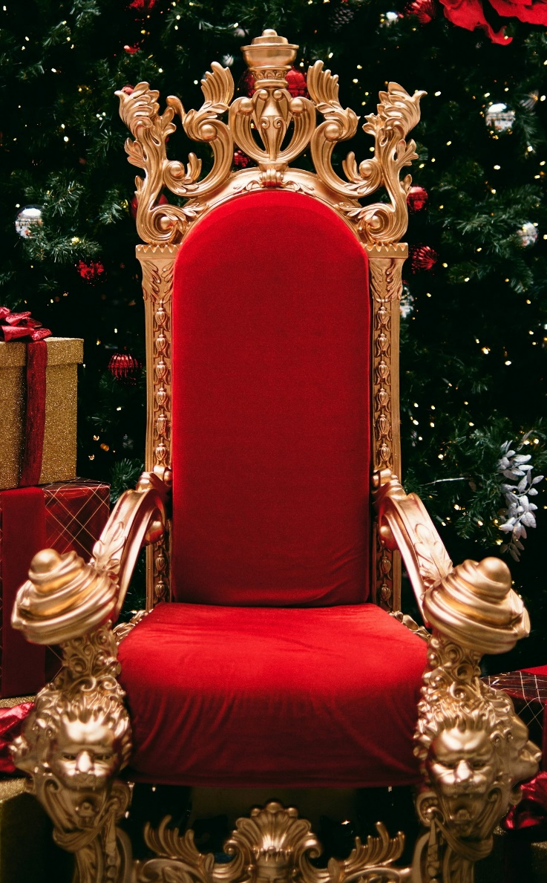
Psalm 47: God Reigns over the Nations; God Sits on His Holy Throne.
Rejoice in God who gives the victory over the nations.
Sing praises to God for He is the King of all the earth.
God sits on His throne and the princes of the nations gather before Him and exalt Him.

Slide 61
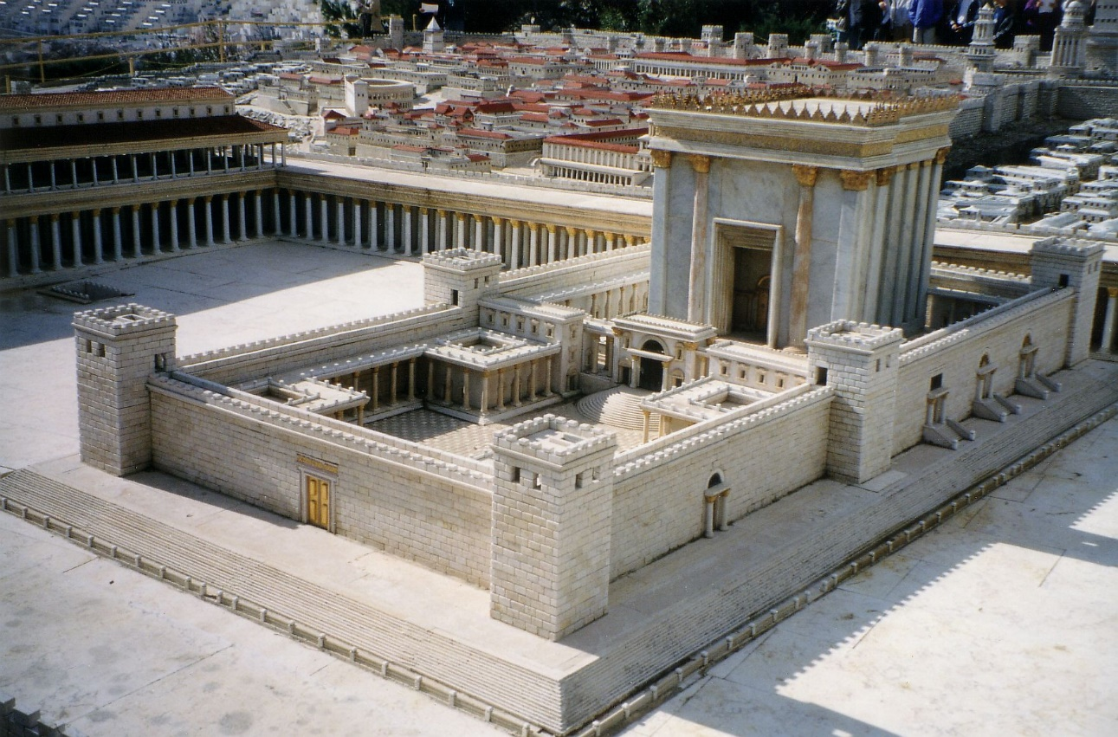
Psalm 48: Beautiful Is Mount Zion, The City of the Great King
Zion is greatly praised as the city of our God who is her refuge.
Kings assembled against her but were overtaken by fear and hastened away.
Walk around Zion and observe that you may tell it to the generation to come. Our God is forever and ever.

Slide 62

Psalm 49: None of Those Who Trust in Their Wealth Can by Any Means Redeem His Brother
Those who trust and boast in wealth cannot purchase redemption or live forever.
They think their house will last forever and name their lands after them, yet perish like beasts.
Do not fear when others become rich for they will take none of it with them when they die.

Slide 63
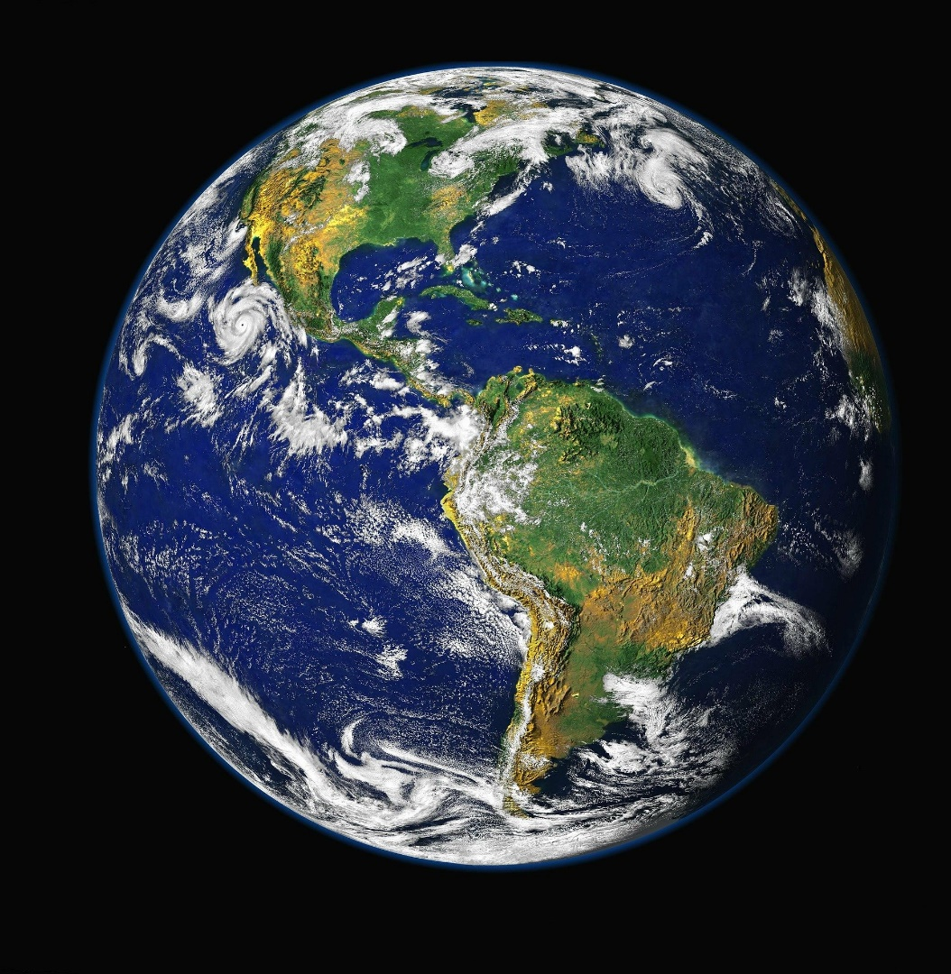
Psalm 50: God Himself Is Judge “For the World Is Mine, and All Its Fullness.”
God does not need people’s gifts since everything belongs to Him.
He wants sincere thanksgiving, keeping commitments, trusting Him, and giving Him glory.
Those who reject God’s words, consent with evil, and slander others have no right to teach.
God will show His salvation to those who offer sincere praise and order his conduct properly.

Slide 64
Psalm 51: David’s Plea for Forgiveness after His Sin with Bathsheeba
David pled with God to blot out his transgression for he acknowledged his sin against God.

Slide 65
Psalm 51:5 – Depravity Inherited from Adam?
* Ezekiel 18:20, 2 Corinthians 5:10, etc. show that individuals are guilty only for sins they commit, not for the sins of others.
* This passage says nothing about Adam or Adam’s sin.
* It nowhere says David or anyone else inherited guilt of Adam’s sin.
* The verse says nothing about David’s guilt but about the condition of David’s mother. At the time David’s mother conceived hm and gave birth to him, she was in sin and iniquity.
* The verse means David was born into a sinful environment beginning with his mother. He himself later became guilty of sin (verses 3,4) because of these evil influences.
Illustration: Acts 2:8 – The people were born in a native language.

Slide 66
Psalm 51: David’s Plea for Forgiveness after His Sin with Bathsheeba
David pled with God to blot out his transgression for he acknowledged his sin against God.
If God would cleanse his iniquities, he would teach transgressors the ways of God.
The sacrifices God desires are a broken spirit and a contrite heart.

Slide 67
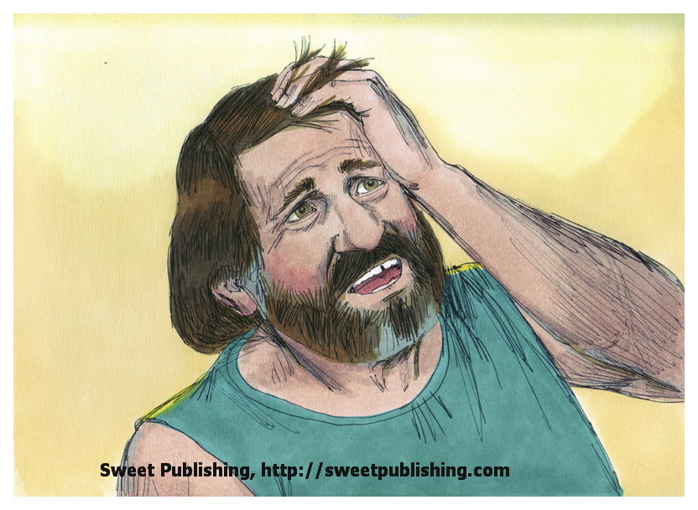
Psalm 52: Rebuke of One Who Trusts in Riches and Wickedness
One who boasts in evil loves evil more than good and loves devouring words.
God shall destroy him forever and uproot him from the land of the living.
The righteous shall see that this is what happens to one who trusts in riches and wickedness.

Slide 68
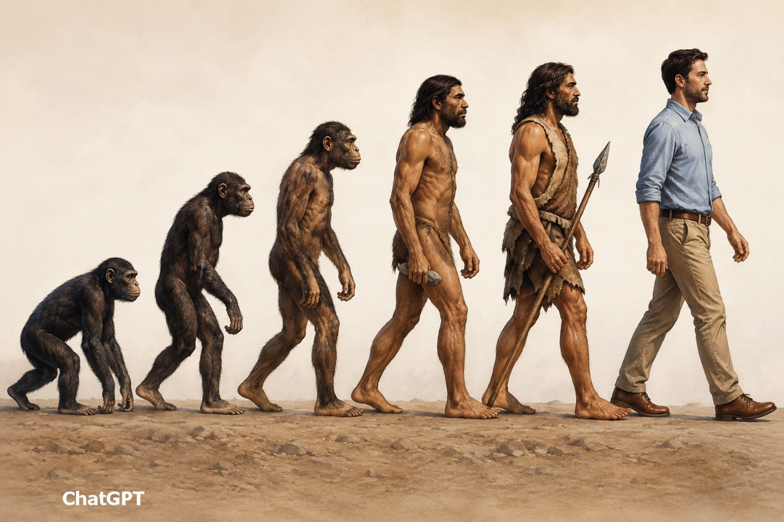
Psalm 53: The Fool Does Not Believe in God but Abuses God’s People.
The fool says there is no God. God sees they are corrupt and none does good.
Have wicked people no knowledge when they eat up God’s people and do not call upon God?
They are in great fear. In the end evil people will fall and God’s people will prevail.

Slide 69
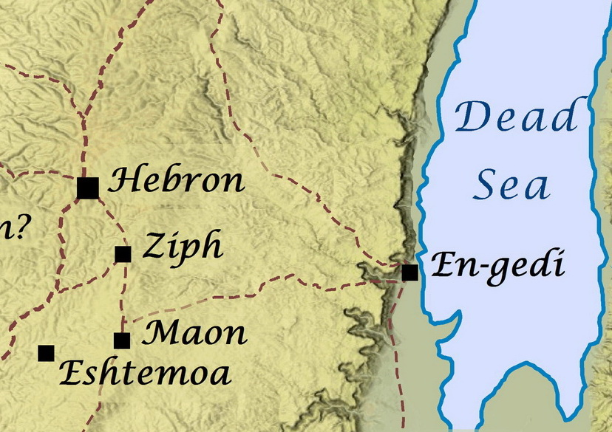
Psalm 54: God Is My Helper When Oppressors Seek My Life
Save me, O God, for oppressors seek my life.
God is my helper and will repay my enemies for their evil.
I will sacrifice to God and praise His name for He has delivered me out of all trouble.

Slide 70
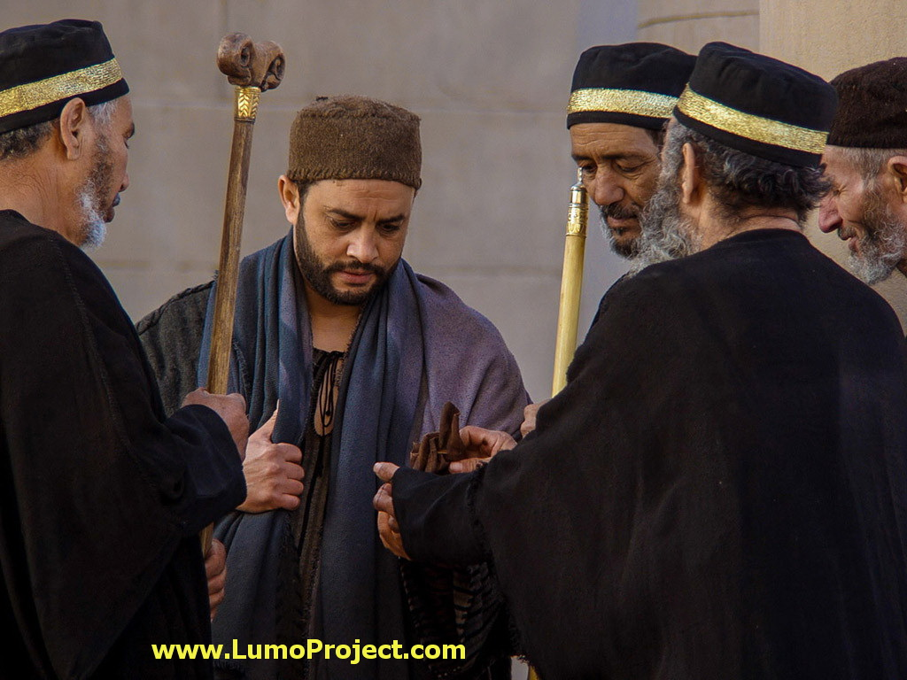
Psalm 55: Plea for God’s Help When Betrayed by a Friend
Hear my prayers because of the oppression of the wicked.
The one who mistreats me is my companion with whom I took counsel and worshiped God.
Their words were smooth and soft but war was in their heart.
Cast your burden on the Lord who will never permit the righteous to be moved.

Slide 71
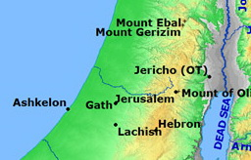
Psalm 56: Rather than Fearing Human Enemies, David Placed His Trust in God.
Enemies oppressed David, twisting his words and lying in wait for his life.
Yet David trusted God and did not fear what flesh could do to him.
He called on God to cast them down and keep a record of his suffering.
He determined to keep the vows he made to God and to praise Him for delivering his soul.

Slide 72
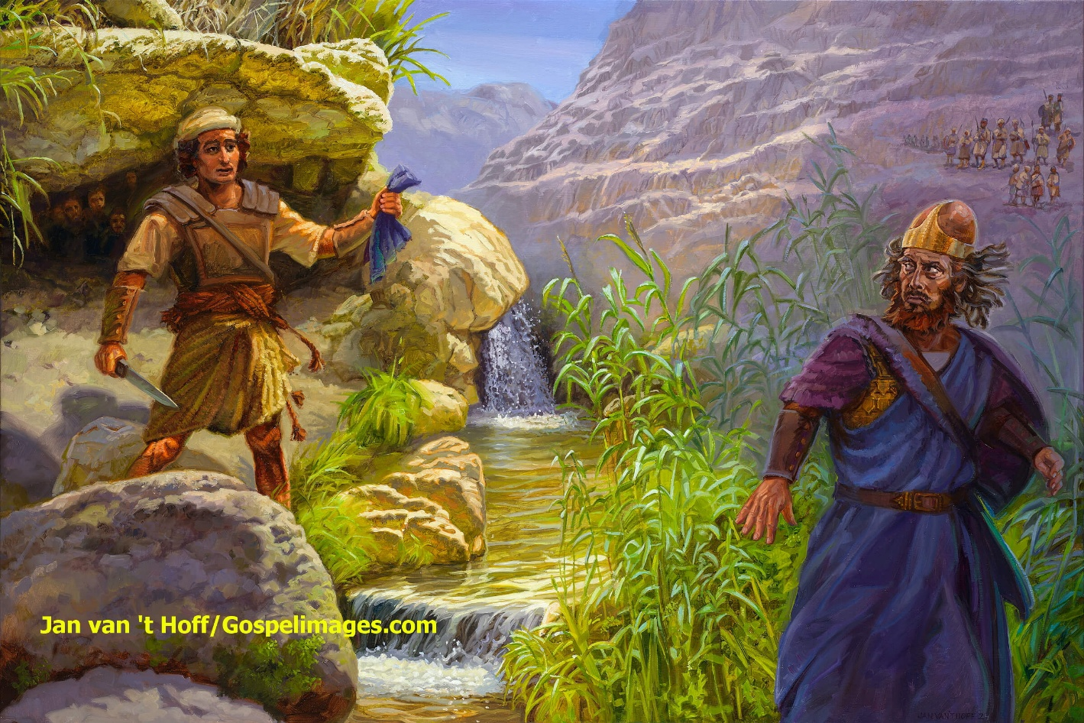
Psalm 57: A Plea to God for Mercy When Surrounded by Enemies
David glorified God and pled for His mercy and protection.
He was surrounded by men like lions with teeth like spears and arrows and a tongue like a sharp sword.
They would fall into the pit they had dug for David, and he would praise God among the nations.

Slide 73

Psalm 58: Justice Will Be Done to the Wicked Who Practice Injustice.
The wicked do not judge uprightly but work unrighteousness. They go astray from birth.
They are like a serpent that cannot be charmed.
His arrows will be harmless. He is like a miscarriage that never sees the sun.
The righteous rejoice that vengeance is done and there is a reward for the righteous.

Slide 74

Psalm 59: You Have Been My Defense and Refuge in the Day of My Trouble.
David’s enemies lay in wait for his life growling like dogs though he had committed no sin.
He called upon God to punish them but not slay them immediately as a reminder to the people.
They should be consumed for their pride and lies, but David would sing praises for God’s mercy.

Slide 75

Psalm 60: The Help of Man Is Useless. Through God We Will Do Valiantly.
God has cast us off and caused us to face hardship. Hear me and save us.
God claims Israel as His land and shows dominion over Israel’s enemies.
Help of man is useless but God will lead us to tread down our enemies.

Slide 76

Psalm 61: God Is My Shelter and Strong Tower
Hear my cry, O God, for you have been my shelter and a strong tower from the enemy.
I will abide in your tabernacle and trust the shelter of your wings for you have heard my vows.
You will prolong the king’s life so I will praise your name forever.

Slide 77

Psalm 62: They Bless with Their Mouth, But They Curse Inwardly.
Enemies continually attack a man to cast him down.
Trust in God and wait silently for Him for He is my rock, my salvation, and my refuge.
Do not put your trust in men, in riches, or in oppression. Power and mercy belong to God.

Slide 78

Psalm 63: Because You Have Been My Help, in the Shadow of Your Wings I Will Rejoice.
My soul thirsts for God because His lovingkindness is better than life; my lips will praise Him.
I meditate on Him in the night because He has been my help, my strength, and my protection.
Those who seek to destroy my life will fall, but the king shall rejoice in God.

Slide 79

Psalm 64: Hide Me from the Secret Plots of the Wicked.
Hide me from the plots of the wicked who use their tongues like a sword and secretly shoot bitter words like arrows.
The wicked lay secret snares and encourage themselves in evil.
But God will shoot at them and make them stumble over their own tongue, so people will fear and the righteous will be glad.

Slide 80

Psalm 65: You Visit the Earth and Water It, You Greatly Enrich It.
Blessed is the man who may approach the Lord; all flesh will come to Him.
God established the mountains and stills the noise of the seas.
He waters the earth and provides grain. The pastures are clothed with flocks and the valleys with grain.

Slide 81

Psalm 66: Make a Joyful Noise to God!
All the earth should sing and praise God for His great works and power.
He parted the sea and the river so the people could walk through. His eyes observe the nations.
He has tested and refined His people but brought them out.
I will offer sacrifices, pay my vows, and declare what he has done for my soul.

Slide 82

Psalm 67: O God, Let All the Peoples Praise You.
God’s mercy and blessings on His people may lead all people to know God’s way.
The nations should rejoice and praise God for His righteous judgment and government.
If all people would praise God, He would bless them and the earth would yield her increase.

Slide 83

Psalm 68: Let God’s Enemies Be Scattered but Let the Righteous Be Glad.
God scatters His enemies but cares for those in need, so the righteous rejoice.
God cared for His people Israel in the wilderness, gave them Canaan, and chose Zion.
No enemies can escape God’s justice.
God’s people will rejoice in His victory, and ultimately all peoples will honor Him.

Slide 84

Psalm 69: Zeal for Your House Has Eaten Me Up.
Uncountable enemies hate me without cause; I must restore what I have not stolen.
Zeal for God’s house has eaten me up. Those who reproach God reproach me.
No matter how diligently I do good, people ridicule me.
Pour indignation on them; let their dwelling place be desolate.
Heaven and earth and sea and everything in them should praise God.

Slide 85

Psalm 71: You Have Upheld Me from Birth; Do Not Cast Me Off in Old Age.
O God, be my protector and fortress.
You upheld me from birth; do not cast me off in my old age.
Enemies lie in wait but I will trust in God and tell of His righteousness.
God has taught me from my youth and I am old. Do not forsake me.
I will talk of Your righteousness, for those who sought my hurt are confounded.

Slide 86

Psalm 72: The King Will Rule with Righteousness and Justice
The king will judge with righteousness and justice resulting in peace and defeating oppressors.
His dominion will have no limit; kings will bow before him and all nations will serve him.

Slide 87

Tarshish, Sheba, and Seba

Slide 88
Psalm 72: The King Will Rule with Righteousness and Justice
The king will judge with righteousness and justice resulting in peace and defeating oppressors.
His dominion will have no limit; kings will bow before him and all nations will serve him.
It will be a time of great prosperity so all people will bless and praise him forever.

Slide 89

Psalm 73: I Was Envious When I Saw the Prosperity of the Wicked
I almost stumbled because I envied the prosperity of wicked.
The wicked live in ease and abundance, but the innocent are plagued.
When I considered their latter end, I saw that God would cast them down and consume them.
Those who are far from God will perish, but it is good to draw near to God.

Slide 90
Psalm 74: They Have Defiled the Dwelling Place of Your Name
An enemy broke down the sanctuary, burned it, and defiled it.
How long would God allow the enemy’s blasphemy to continue?
God had demonstrated great power in the past.
The people plead for God to observe the reproaches of the enemy and protect His people.

Slide 91

Psalm 75: God Is the Judge: He Puts Down One and Exalts Another.
At the proper time God will judge justly.
Wicked people should not boast or stubbornly persist in error.
God will require the wicked to drink the full cup of punishment they deserve.
The power of the wicked will be cut off but the righteous will be exalted.

Slide 92

Psalm 76: The Earth Feared and Was Still, When God Arose to Judgment.
The name of God is great for He has defeated His enemies.
God’s judgments not only punish the wicked but deliver the oppressed.
Therefore, everyone should worship God and give Him service.

Slide 93

Psalm 77: In My Day of Trouble I Sought The Lord; I Will Remember His Works.
In my day of trouble, I was overwhelmed and cried out to God.
Will God cast us off forever? Has He forgotten to be gracious?
I will remember the works of God who does wonders and redeemed His people.
He caused waters to tremble, shook the earth, and led his people like a flock.

Slide 94

Psalm 78: Marvelous Things He Did in the Sight of the Fathers, But They Sinned Even More.
Parents must teach children the need to serve God faithfully avoiding past sins.
God was gracious to Israel despite their sins
* In the exodus
* In the wilderness

Slide 95

Psalm 78: Marvelous Things He Did in the Sight of the Fathers, But They Sinned Even More.
Parents must teach children the need to serve God faithfully avoiding past sins.
God was gracious to Israel despite their sins
* In the exodus
* In the wilderness
* In the conquest of Canaan

Slide 96

Shiloh .
Jerusalem .

Slide 97

Shiloh

Slide 98
Psalm 78: Marvelous Things He Did in the Sight of the Fathers, But They Sinned Even More.
Parents must teach children the need to serve God faithfully avoiding past sins.
God was gracious to Israel despite their sins
* In the exodus
* In the wilderness
* In the conquest of Canaan
* In exalting Jerusalem and David

Slide 99

Psalm 79: Deliver Us for Your Name's Sake and Pour Out Your Wrath on the Nations that Do Not Know You
Gentiles had devastated God’s nation, His temple, and Jerusalem, and had slain His people.
God is urged to turn His wrath against the enemies instead of against His people.
God should deliver His people for His name’s sake since the nations reproached God for the downfall of His people.

Slide 100

Psalm 80: You Have Brought a Vine out of Egypt. Restore Us and We Shall Be Saved!
You have made us eat and drink tears and made us strife to our neighbors.
You brought Israel like a vine out of Egypt, cast out nations, and planted it so it took root.
But now you have broken down her hedges so strangers and wild animals take its fruit.
Revive us and restore us and we will be saved.

Slide 101

Psalm 81: Oh, That My People Would Listen to Me and Walk in My Ways!
God had richly blessed Israel when He led them from slavery in Egypt.
Because of the people’s disobedience, He gave them up to walk in their sins.
He was willing to bless them again if they would listen to Hm and walk in His ways.

Slide 102

Psalm 82: How Long Will You Judge Unjustly, and Show Partiality to the Wicked?
God pronounces judgment on judges who judge unjustly and show partiality to the wicked.
Rulers should defend the defenseless and do justice to the disadvantaged.
Those who fail will be punished like men despite their exalted position.

Slide 103

Psalm 83: They Form a Confederacy Against You; Let Them Be Confounded and Dismayed.
Enemies determined to cut off Israel that it may no longer exist as a nation.
God had proved in the past His ability to protect Israel from such enemies.
Let the enemies be put to shame and perish that they may know God is the Most High.
Gebal
Tyre
Hagrites
Ammon
Philistia
Moab
Amalek
Edom

Slide 104

Psalm 84: I Would Rather Be a Doorkeeper in the House of My God than Dwell in the Tents of Wickedness.
The poet cries out for God and longs to worship Him.
Those who trust God are truly blessed and increase in strength.
It is better to be a doorkeeper in God’s house than to dwell in the tents of wickedness.
God withholds no good thing from those who are upright.

Slide 105
Psalm 85: Mercy and Truth Have Met Together; Righteousness and Peace Have Kissed.
God had forgiven the people’s sins but was angry with them again.
The poet pleads for God to revive the people and to grant them mercy and salvation.
Mercy and truth, righteousness and peace will meet, and the Lord will give what is good
Mercy
Truth
Righteous-
ness
Peace

Slide 106



Psalm 86: In the Day of My Trouble I Will Call upon You, for You Will Answer Me.
Answer me, Lord, and save Your servant who trusts in You, for You are a good and forgiving God.
No other god does works like Yours. All nations should worship You because You alone are God.
Ruthless men seek my life, but You are merciful and gracious; give Your servant strength.

Slide 107

Psalm 87: Glorious Things Are Spoken of You, O City of God!
God loves the city of Zion; it should be highly praised.
To be born into the city of Zion is a great blessing. So the Lord records those born there.
This is a cause for great celebration.
Freestockphotos.com

Slide 108

Psalm 88: My Soul Is Full of Troubles and My Life Draws Near to the Grave.
The poet prayed to God because he was so deeply troubled he felt he was about to die.
He asked how he could praise God from the grave.
He prayed to ask why God had cast him off and hid his face from the poet.

Slide 109

Psalm 89 – Part 1: I Have Made a Covenant with My Servant David: Your Seed I Will Establish Forever.
God made a covenant with David to establish his throne forever.
God rules and is always faithful to His promises.
God promised to strengthen David’s descendants and protect them from enemies.

Slide 110

Psalm 89 – Part 2: Lord, Where Are the Mercies You Promised to David?
If his sons broke God’s law, God would punish them but would not alter His covenant.
Yet it appeared that David’s enemies did prevail over his seed.
Lord, remember the reproach of Your servants.

Slide 111

Psalm 90: From Everlasting to Everlasting, You Are God; Teach Us to Number Our Days
God is eternal in the past and the future. A thousand years to Him is like a day.
Life of man is short. We should learn to number our days so we can gain true wisdom.
Because of God’s mercy, we can rejoice and be glad in God’s work.

Slide 112

Psalm 91 – The Lord Is My Refuge and My Fortress; in Him I Will Trust.
The Lord is the refuge for His people. He protects from all kinds of terrors and troubles.
Even though people around them may suffer, God and His angels will protect His people.
He delivers His people because they love Him and call upon Him in trouble.

Slide 113

Psalm 92: It Is Good to Give Thanks to the Lord.
We should praise God for His great works.
The wicked will be destroyed, but the righteous will flourish.
They shall bear fruit in old age to declare the uprightness of God.

Slide 114

Psalm 93 – The Lord Reigns in Majesty, Strength, and Holiness; His Testimonies Are Sure.
The Lord is clothed with majesty, girded with strength. He is from everlasting.
He is mightier than the sound of many waters and the waves of the sea.
His testimonies are sure; Holiness adorns His house forever.

Slide 115


Psalm 94: How Long Will the Wicked Triumph?
Wicked people afflict the righteous and take advantage of the innocent and helpless.
They boast among themselves and think God does not see, but they are foolish.
God sees and hears. He even knows man’s thoughts.
He will not cast off His people but will judge righteously.

Slide 116

Psalm 95 – Come, Let Us Sing to the Lord! Do Not Harden Your Hearts, as in the Rebellion.
Let us come before God to sing His praises and give thanks with joy!
Let us worship before our Maker, the great King whose hands formed the whole earth.
Do not rebel as the fathers who went astray so God swore they could not enter His rest.

Slide 117




Psalm 96: Worship the Lord in the Beauty of Holiness! Tremble Before Him, All the Earth.
Sing to the Lord. Declare His glory and wonders among all the peoples.
God should be praised above the idols for He made the heavens.
All the earth should praise the Lord for He is coming to judge the world in righteousness.

Slide 118

Psalm 97 – The Lord Reigns; Righteousness and Justice Are the Foundation of His Throne.
The earth should rejoice that God reigns. Righteousness and justice are fundamental to His power.
Symbols of His awesome power are fire, lightning, the heavens, and mountains melting.
God is far above all gods. Those who worship other gods should be ashamed.
Those who love the Lord should hate evil. He delivers His saints from the hand of the wicked.

Slide 119

Psalm 98: The Lord Will Judge the Earth with Righteousness and Equity.
Sing to the Lord a new song for His marvelous works, His victory, and His faithfulness to Israel.
Rejoice and sing praises to the Lord, the King, with instrumental accompaniment.
Let the sea, the rivers, the hills, and everyone on earth rejoice because God will judge the earth with righteousness and justice.

Slide 120

Psalm 99 – Exalt and Worship God, for He Is Holy.
The Lord reigns high above the peoples. All should praise His name for He is holy.
Worship God who loves justice and executes justice and righteousness for He is holy.
Like Moses, Aaron, and Samuel, we should call upon the Lord who forgives. Worship Him for He is holy.

Slide 121

Psalm 100: Serve the Lord with Gladness; Come before His Presence with Singing.
Worship the Lord with joy, gladness, and singing.
He is God who made us; we are His people and the sheep of His pasture.
Be thankful to Him and bless His name for He is good; His mercy and truth endure.

Slide 122

Psalm 101 – I Will Behave Wisely in a Perfect Way. I Will Walk within My House with a Perfect Heart.
I will behave wisely and will walk in my house with integrity.
I will not allow evil in my presence and will oppose those who slander or have a proud heart.
Those who are faithful and walk with integrity may dwell with me and serve me.
He who practices deceit and lying will not continue in my house but I will destroy the wicked.

Slide 123

Psalm 102 – You Created the Heavens and the Earth. They Will Perish, But You Will Endure.
Lord, answer my prayer for my heart is stricken and my enemies reproach me. Because of your indignation you have cast me away.
You, Lord, shall endure forever and shall build up Zion that people in the future may praise the Lord.
Oh God, do not take me away in the midst of my days. You made the heavens and the earth. They will perish but you will endure.

Slide 124

Psalm 103 – Bless the Lord, O My Soul, and Forget Not All His Benefits
Everyone should praise the Lord because He forgives sins, heals diseases, and gives justice.

Slide 125
Forget Not All His Benefits
* Forgiveness of sins
* Healing from diseases
* Redemption from destruction
* Lovingkindness and tender mercy
* Good things that satisfy and that make us strong again
* Righteousness and justice for the oppressed.

Slide 126
Psalm 103 – Bless the Lord, O My Soul, and Forget Not All His Benefits
Everyone should praise the Lord because He forgives sins, heals diseases, and gives justice.
He is merciful and slow to anger, not punishing our sins but removing them as far as the east from the west.
He knows that we are dust and our days are like grass, but His mercy is everlasting.
Angels, servants, and everyone under God’s dominion should bless the Lord.

Slide 127

Psalm 104 – How Manifold Are Your Works! In Wisdom You Made Them All.
The Lord laid the foundations of the earth, covered it with the deep, and stretched out the heavens.
He sends the springs and causes grass to grow to bring forth food for animals and people.
He appointed the moon and sun, the darkness, the light, and the sea.
He gives life and food to all living things He created.
Praise the Lord as long as we live, but sinners should be no more.

Slide 128
Psalm 105 – Remember His Marvelous Works, You Children of Jacob.
The Israelites should remember God’s covenant and His wonderous works.
God used Joseph to bring Jacob’s family to Egypt to survive the famine.
He made Israel a great nation and sent Moses and Aaron to free them from captivity.
He sent the plagues to convince the Egyptians to let them go.
He provided for the people in the wilderness and gave them Canaan.

Slide 129
Psalm 106 – Like Our Fathers, We Have Sinned, Committed Iniquity, and Done Wickedly.
They rebelled at the Red Sea.
They lusted for food they liked.
They rebelled against Moses and Aaron.
They worshiped a golden calf.
They refused to enter Canaan.
They worshiped Baal of Peor and committed fornication.
They complained about water.
They did not destroy the people of Canaan but served idols.

Slide 130
Psalms 103-107 – Lessons from God’s Work in Creation and the Nation of Israel
Psalm 103 – Bless the Lord, O My Soul, and Forget Not All His Benefits
Psalm 104 – How Manifold Are Your Works! In Wisdom You Made Them All.
Psalm 105 – Remember His Marvelous Works, You Children of Jacob.
Psalm 106 – Like Our Fathers, We Have Sinned and Done Wickedly.
Psalm 107 – Give Thanks to the Lord Who Delivered Men from Distresses

Slide 131
Psalm 107 – Give Thanks to the Lord for His Goodness Who Delivered Men from Their Distresses
Give thanks to the Lord who redeemed His people from the enemy.
Israel was like wanderers retrieved.
Israel was like a prisoner being released.
Israel was like being healed from a severe illness.
Verses 6,13,19, and 28 - They cried to the Lord in their trouble, And He delivered them
Verses 8,15,21, and 31 - Oh, that men would give thanks to the Lord for His goodness

Slide 132

Psalm 109 – I Am Poor and Needy. Save Me According to Your Mercy.
Wicked people have spoken lies and rewarded me evil for good.
Let him be judged and found guilty and let another take his office.
He did not show mercy but persecuted the poor and needy, so let him be clothed with cursing.
May God show mercy and deliver the poor and needy; save him from those who condemn him.

Slide 133

Psalm 110 – A Priest Forever after the Order of Melchizedek. Rule in the Midst of Your Enemies!
The Lord said to my Lord: “Sit at my right hand. Rule in the midst of your enemies.”
Your people shall be volunteers in the day of your power.
You are a priest forever according to the order of Melchizedek.
He shall execute kings and judge among the nations.

Slide 134

Psalm 111 – The Works of the Lord Are Great. Praise the Lord!
Praise the Lord for His works are great, honorable, and glorious.
He gave food to those who fear Him, remembers His covenant, and gave His people the nations.
His precepts are sure and stand fast forever. Holy and reverend is His name.
The fear of the Lord is the beginning of wisdom.

Slide 135

Psalm 112 – Blessed Is the Man Who Fears the Lord. Praise the Lord!
Blessed is he who fears the Lord. His descendants will be mighty and his righteousness endures.
He is compassionate and lends. He is not afraid of evil but is steadfast.
He trusts in the Lord and gives to the poor. But the desire of the wicked shall perish.

Slide 136

Psalm 113 – Who Is Like the Lord Our God Who Dwells on High?
Everyone everywhere should praise God forever.
God is high above the nations; no one is like Him.
He blesses the poor and gives the barren woman a home and children.

Slide 137
Psalm 114 – When Israel Went Out of Egypt, the Earth Trembled at His Presence.
When Israel left Egypt, Israel became God’s dominion.
The sea fled and Jordan turned back. The mountains and hills skipped. Rock turned into water.
All this occurred at the presence of the Lord God.

Slide 138

Psalm 115 – Idols Are the Work of Men's Hands;
Trust in the Lord.
Why should Gentiles ask where God is? He is in heaven doing whatever He pleases.
Idols cannot speak, see, hear, smell, work, or walk. We should trust in the Lord.
May you be blessed by the Lord, Who made heaven and earth.

Slide 139

Psalm 116 – You Have Delivered My Soul from Death.
The pains of death surrounded me, I called upon the Lord, and He heard my voice.
God is gracious, righteous, and merciful. I was brought low and He saved me.
Precious in the sight of the Lord is the death of His saints.
I will offer the sacrifice of thanksgiving and pay my vows.

Slide 140

Psalm 118 – The Stone Which the Builders Rejected Has Become the Chief Cornerstone.
The Lord is on my side, so I will not fear what men can do to me.
When evil men oppose me, I should trust in God rather than man.
The Lord severely chastened me, but I shall not die.
The stone which the builders rejected has become the chief cornerstone.
Blessed is he who comes in the name of the Lord! Save now, I pray.

Slide 141

Psalm 119 – Terms Used to Describe God’s Word
Word - The most general term: God’s truth in any form
Law - “…direction, instruction, law…” –
Testimony - Solemn divine charge (God testifies the proper way to live)
Precept - Thing appointed, charge
Statute - “…prescribed task … enactment, decree, ordinance…” –
Commandment - Instruction given by one who has the right to rule.
Judgment / ordinance - Decisions of all-wise Judge about rights and duties

Slide 142

Psalm 119:1-24 – Blessed are those who walk in the law of the Lord.
God’s judgments lead us to praise Him
A young man can cleanse his way by taking heed to God’s word.
Learn, declare, rejoice in God’s word
Meditate, delight, and remember
Open my eyes that I may see wondrous things from Your law.
God rebukes those who stray.
Testimonies my delight & counselors

Slide 143

Psalm 119:25-56 – I Have Chosen the Way of Truth.
Revive me according to your word.
Teach me the way of Your statutes.
Incline my heart not to covetousness.
Turn my eyes from worthless things.
I will speak of your testimonies before kings and will not be ashamed.
Delight in Your commands, which I love.
Your word has given me life.
Indignant because people forsake the law of God.
Your statutes have been my songs.

Slide 144

Psalm 119:57-88 – I Considered My Ways and Did Not Delay to Keep Your Commandments.
I am a companion of all who fear You and keep Your precepts.
Before I was afflicted I went astray, but now I keep Your word.
Your hands have fashioned me; give me understanding to learn Your commands.
Those who fear You will be glad when they see me.
All your commandments are faithful.

Slide 145

Psalm 119:89-120 – Your Word Is a Lamp to My Feet and a Light to My Path.
Your word is settled forever in heaven.
By Your precepts You give me life.
God’s word makes us wiser than others.
I restrain my feet from every evil way.
Your precepts give understanding, so I hate every false way.
I will perform Your statutes to the end.
God rejects those who stray from His statutes.

Slide 146

Psalm 119:121-152 – All Your Precepts Concerning All Things I Consider to Be Right.
I love Your commands more than gold.
The entrance of Your words gives light and understanding.
Let not sin have dominion over me.
Rivers of water run from my eyes, because men do not keep Your law.
Your testimonies are righteous and very faithful, very pure, and truth.
All Your commandments are truth.

Slide 147

Psalm 119:153-176 – The Entirety of Your Word Is Truth.
Every one of Your righteous judgments endures forever.
I hate and abhor lying, but I love Your law.
My soul keeps Your testimonies, And I love them exceedingly.
My tongue shall speak of Your word, for all Your commandments are righteousness.
Seek Your servant for I do not forget Your commandments.

Slide 148

Psalms 120,121,122 - I Was Glad When They Said to Me, "Let Us Go into the House of the Lord."
I cried to the Lord for deliverance from lies and deceit.
I am for peace; but when I speak, they are for war.
The Lord shall preserve you from evil.
He neither slumbers nor sleeps.
God’s people should rejoice over opportunities to worship God.
We should seek and pray for the peace and wellbeing of Jerusalem.

Slide 149

Psalms 123,124,125,126 - Those Who Sow in Tears Shall Reap in Joy.
Look to the Lord for mercy when others show us scorn and contempt.
Had not God been on Israel’s side, enemies would swallow them alive.
The Lord does good to those who are good, but those who turn aside will be led away with the wicked.
The people rejoiced with laughter and singing when the Lord returned them from captivity.

Slide 150

Psalms 127,128,129,130 - Children are a blessing from God.
Unless the Lord builds the house, they labor in vain who build it.
Children are like arrows. Blessed is the man who has a full quiver.
He who fears the Lord and walks in His ways, it will be well with him.
His wife will be like a fruitful vine and his children like olive plants.
He may see his children’s children.
They afflicted me but did not prevail.
If You mark iniquities, who can stand? But there is forgiveness with You.

Slide 151

Psalms 131,132 - “I Will Set upon Your Throne the Fruit of Your Body.”
Hope in the Lord regarding matters too great or profound
Calm your soul by trusting God like a child with its mother.
David’s devotion to God and finding a place for the Ark of the Covenant
God’s promises to David and his descendants.

Slide 152

Psalms 133,134,135 - Idols Are Silver and Gold, the Work of Men's Hands.
Unity among brethren is good and pleasant.
All the Lord’s servants should bless Him.
The Lord chose Israel and does whatever He chooses in the world He made.
He freed Israel from Egypt and gave them the land of Canaan.
The idols were made by men and cannot speak, see, or hear.

Slide 153
Psalm 136 - Give Thanks to God, for His Mercy Endures Forever.
God deserves our thanks because He created the heavens, the earth, and the heavenly bodies.
God deserves thanks because He led Israel out of Egyptian captivity.
God deserves thanks because He led Israel to defeat enemies and gave them the land of Canaan.
God’s mercy endures forever.
Bashan
Amorites

Slide 154

Psalms 137,138 - By the Rivers of Babylon We Sat and Wept.
Captives in Babylon wept when they remembered Zion.
They could not sing songs of Zion.
Edom and Babylon should receive vengeance for mistreating Israel.
I will praise God for His lovingkindness and truth.
All the kings should praise Him.
God will revive me in trouble but punish enemies.

Slide 155

Psalm 139 - O Lord, You Have Searched Me and Known Me.
God knows all our actions, words, and thoughts. Nothing can be hidden from Him.
God is present so He is able to see us wherever we go.
God formed us in our mother’s womb. We are fearfully and wonderfully made.
We should oppose evil and refuse to associate with evil people.

Slide 156

Psalms 140,141 - Do Not Incline My Heart to Any Evil Thing.
Deliver me from evil men who plot violence and set traps.
Let evil men be overthrown by their own violent plots.
The Lord will maintain the cause of the righteous.
Help me to speak and do what is right when faced with temptations
Help me to accept correction.
Let the wicked fall, but let me escape their snares.

Slide 157

Psalms 142,143 - Cause Me to Know the Way in Which I Should Walk.
No one is a refuge to care for me.
God is my refuge.
I will praise His name, and He will deal bountifully with me.
If God judges without mercy, no one is righteous.
My heart is distressed because of those who persecute me.
Cause me to know the way in which I should walk.

Slide 158

Psalms 144,145 - Happy Are the People Whose God Is the Lord!
God is a fortress and source of strength; man is a passing shadow
God can rescue the king
This deliverance can lead to blessings for the people.
All Your works shall praise You and Your saints shall bless You.
We should meditate on God’s majesty and praise His greatness.
His glorious kingdom is everlasting.
He cares for the troubled and gives food to His creatures.

Slide 159

Psalms 145,146 - Do Not Trust in Princes; Happy Is He Whose Hope Is in the Lord.
All Your works shall praise You and Your saints shall bless You.
His glorious kingdom lasts forever.
He cares for the troubled and gives food to His creatures.
Do not trust in people who die.
Trust God who made the universe and keeps His promises.
He executes justice, cares for the needy, loves the righteous, and punishes the wicked.

Slide 160
Psalms 146 - Why Trust God for Help
* He made heaven and earth and everything in them.
* He keeps truth forever.
* He executes justice for the oppressed.
* He gives food to the hungry.
* He gives freedom to the prisoners.
* He opens the eyes of the blind.
* He raises those who are bowed down.
* He loves the righteous.
* He watches over the strangers.
* He relieves the fatherless and widow
* The way of the wicked He turns upside down.
* He shall reign forever.

Slide 161
Psalms 147 - Great Is Our Lord, and Mighty in Power; His Understanding Is Infinite.
Praise God for caring for Israel and for counting and naming all the stars.
Praise God for providing food and water for the animals and for protecting Jerusalem.
Praise God for snow and frost that gives water and for His word that guides His people.

Slide 162

Psalms 148 - Let Them Praise the Name of the Lord, for His Name Alone Is Exalted.
His angels and His hosts
Sun, moon, and stars
Heavens of heavens
Sea creatures and all the depths
Fire, hail, snow, clouds, wind
Mountains and all hills
Fruitful trees and cedars
Beasts, cattle. creeping things, fowl
Kings, all peoples, princes, judges
Young men and maidens; Old men and children.

Slide 163


Psalms 149,150 - Praise Him for His Mighty Acts, According to His Excellent Greatness!
Sing to the Lord a new song.
The Lord takes pleasure in His people.
Let the praises of God be in their mouth.
Praise the Lord for His great works and His exalted character.
Let everything that has breath praise God!
Which?

Slide 165
© Copyright David E. Pratte, 2022
Permission is granted to display this PowerPoint under the following conditions:
* Display the link to BibleStudyLessons.com
* Minor changes in content are permitted, but no teaching should be presented that disagrees with the teaching in the article associated with this PowerPoint on BibleStudyLessons.com/powerpoint
* In no case may a fee of any kind be charged for our PowerPoints.
* If you have a website, please add a link to BibleStudyLessons.com
Scripture quotations are generally from the New King James Version (NKJV), copyright 1982, 1988 by Thomas Nelson, Inc. Used by permission. All rights reserved.
BibleStudyLessons.com

