Slide 2
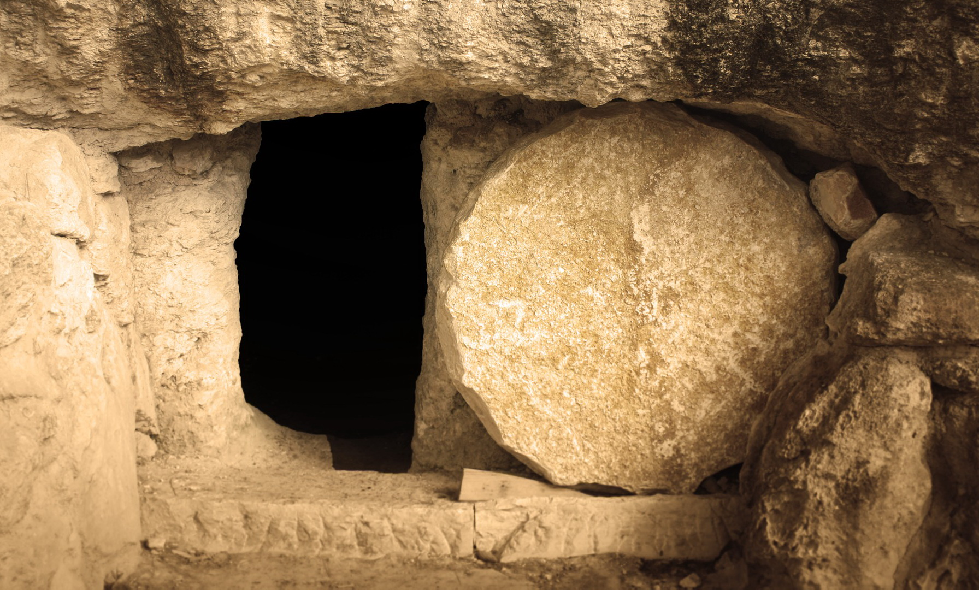
“Rejoice in the Lord Always!”
Rejoice!
www.BibleStudyLessons.com

Slide 3
“Rejoice in the Lord Always!”
True Joy Does Not Eliminate Sorrow
1 Corinthians 12:26; Romans 12:15; Ecclesiastes 3:4; Acts 20:18-25,37,38; John 11:33-35; Matthew 26:37-39
Rejoice!

Slide 4
“Rejoice in the Lord Always!”
True Joy Does Not Eliminate Sorrow
True Joy Does Not Depend on Physical Circumstances / Treatment
Matthew 5:10-12; Acts 5:40-42; 2 Corinthians 7:4,5; Hebrews 10:32-34
Rejoice!

Slide 5
“Rejoice in the Lord Always!”
True Joy Does Not Eliminate Sorrow
True Joy Does Not Depend on Physical Circumstances / Treatment
True Joy Is Based on Spiritual Circumstances
Forgiveness - Psalm 51:3,4,7-12;
Luke 15:4-10,22-24,32; Acts 8:39
Fellowship with God - Psalms 35:9;
Philippians 4:4; Isaiah 61:10
Prayer - John 16:24
Truth - 1 Corinthians 13:6
Hope of eternal life - 1 Peter 1:3-9; 4:12,13
Rejoice!

Slide 6
© Copyright David E. Pratte, 2020
Permission is granted to display this PowerPoint under the following conditions:
* Display the link to www.BibleStudyLessons.com
* Minor changes in content are permitted, but no teaching should be presented that disagrees with the teaching in the article associated with this PowerPoint on www.BibleStudyLessons.com/powerpoint
* In no case may a fee of any kind be charged for our PowerPoints.
* If you have a website, please add a link to www.BibleStudyLessons.com
Scripture quotations are generally from the New King James Version (NKJV), copyright 1982, 1988 by Thomas Nelson, Inc. Used by permission. All rights reserved.
www.BibleStudyLessons.com

Slide 7
Rejoice!
True Joy Does Not Eliminate Sorrow and Heartache
True Joy Does Not Depend on Physical Circumstances/Treatment
True Joy Is Based on Spiritual Circumstances
Joy Requires Appreciation & Praise to God
Joy Is Found in Appreciating Our Blessings
Luke 2:8-14,20; Romans 5:1-11
Joy Is Found in Worship and Praise to God
Psalm 66:1-4; 95:1-7; 122:1; Philippians 4:4,6,7

Slide 8
Rejoice!
True Joy Does Not Eliminate Sorrow and Heartache
True Joy Does Not Depend on Physical Circumstances/Treatment
True Joy Is Based on Spiritual Circumstances
Joy Requires Appreciation & Praise to God
Joy Requires Service to God & Man
Psalms 40:8; 119:10-16, 161-168; Proverbs 21:15
Motherhood - Psalm 113:9
Teaching the lost - Luke 15:3-10
Helping others - 2 Corinthians 8:1-5; Acts 20:35

Slide 9
Rejoice!
True Joy Does Not Eliminate Sorrow and Heartache
True Joy Does Not Depend on Physical Circumstances/Treatment
True Joy Is Based on Spiritual Circumstances
Joy Requires Appreciation & Praise to God
Joy Requires Service to God & Man
Joy Requires Sacrifice & Obedience
Persecution - Matthew 5:10-12; John 16:20-22,33
Self-sacrifice - Matthew 13:44; 2 Corinthians 8:1-5
Repenting of sin - Hebrews 12:11
Jesus’ example - Hebrews 12:2,3

Slide 10
Rejoice!
True Joy Does Not Eliminate Sorrow and Heartache
True Joy Does Not Depend on Physical Circumstances/Treatment
True Joy Is Based on Spiritual Circumstances
Joy Requires Appreciation & Praise to God
Joy Requires Service to God & Man
Joy Requires Sacrifice & Obedience
Do you have joy in the Lord?

