Slide 2
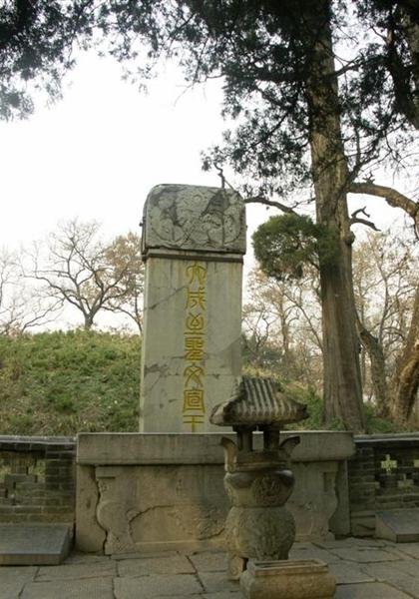
Graves of Religious Leaders
Confucius’ Tomb | Occupied
BibleStudyLessons.com
fppt.com
BibleStudyLessons.com

Slide 3
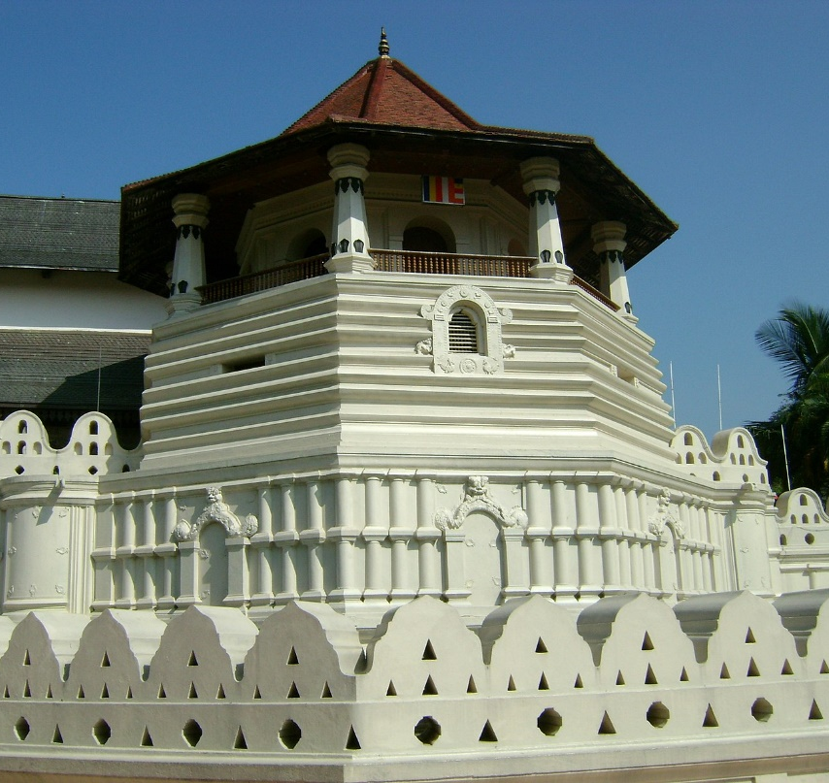
Graves of Religious Leaders
Confucius’ Tomb | Occupied
Buddha’s Tomb (tooth) | Occupied
BibleStudyLessons.com

Slide 4
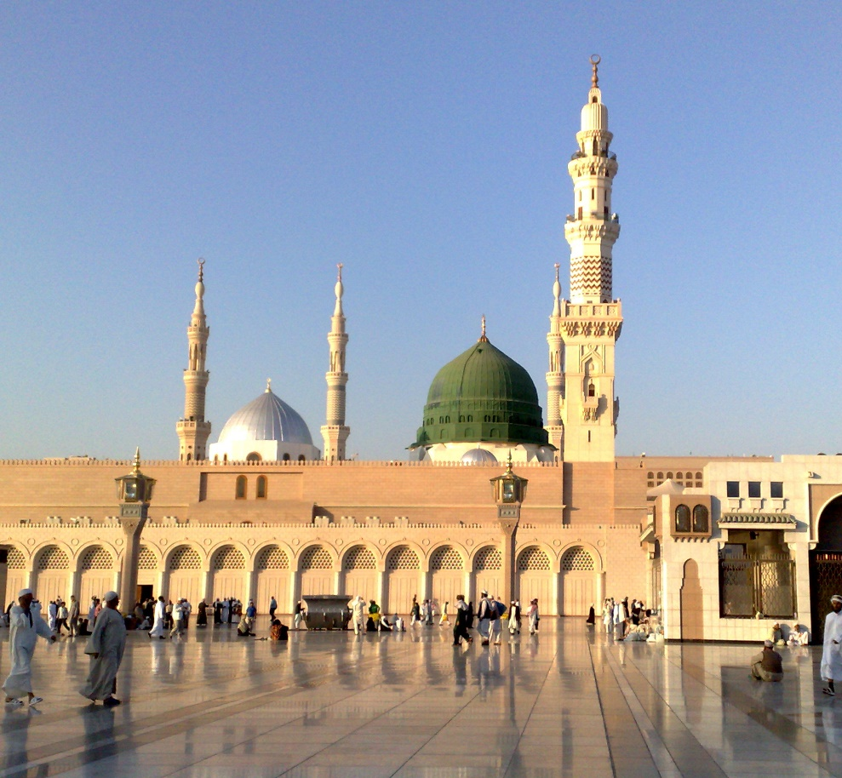
Graves of Religious Leaders
Confucius’ Tomb | Occupied
Buddha’s Tomb (tooth) | Occupied
Muhammad’s Tomb | Occupied
BibleStudyLessons.com

Slide 5
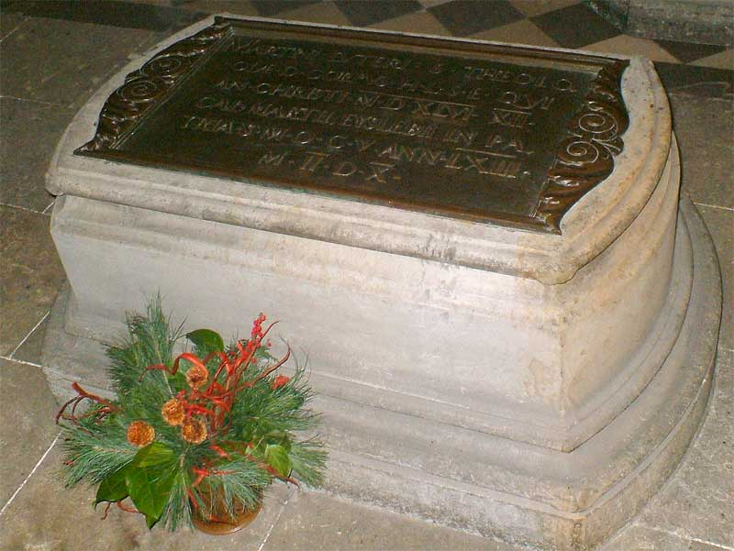
Graves of Religious Leaders
Confucius’ Tomb | Occupied
Buddha’s Tomb (tooth) | Occupied
Muhammsd’s Tomb | Occupied
Martin Luther’s grave | Occupied
BibleStudyLessons.com

Slide 6
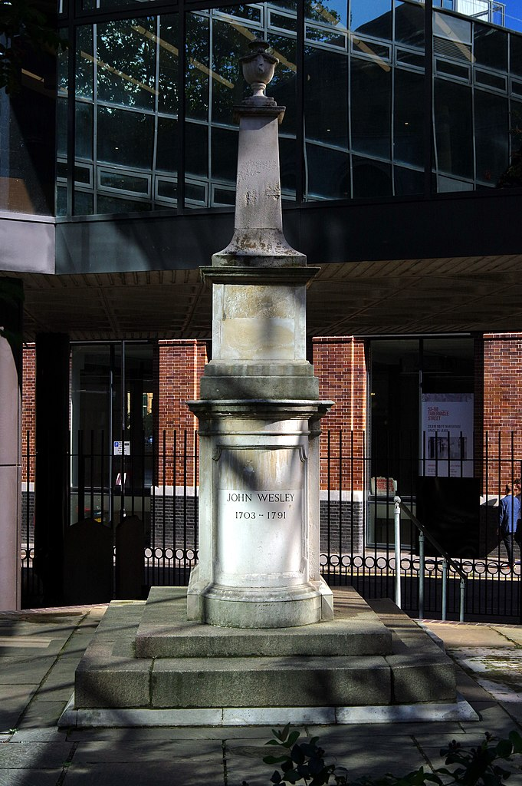
Graves of Religious Leaders
Confucius’ Tomb | Occupied
Buddha’s Tomb (tooth) | Occupied
Muhammad’s Tomb | Occupied
Martin Luther’s grave | Occupied
John Wesley’s grave | Occupied
credit Donald Judge from England, CC BY 2.0 <https://creativecommons.org/licenses/by/2.0>, via Wikimedia Commons

Slide 7
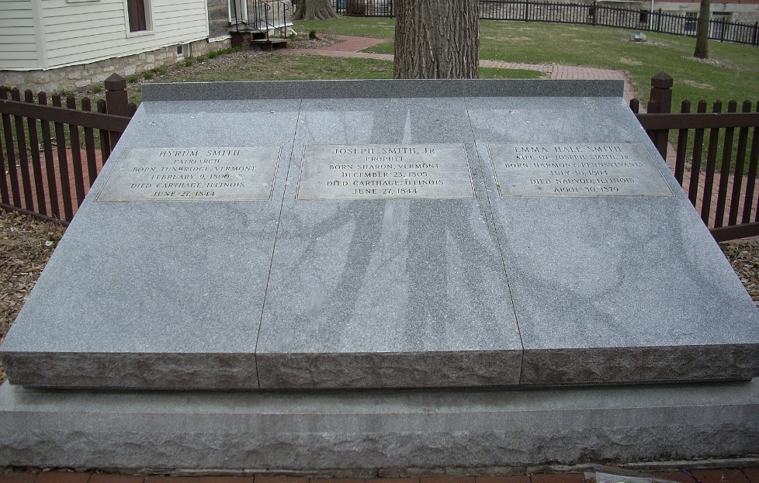
Graves of Religious Leaders
Confucius’ Tomb | Occupied
Buddha’s Tomb (tooth) | Occupied
Muhammad’s Tomb | Occupied
Martin Luther’s grave | Occupied
John Wesley’s grave | Occupied
Joseph Smith’s grave | Occupied
BibleStudyLessons.com

Slide 8
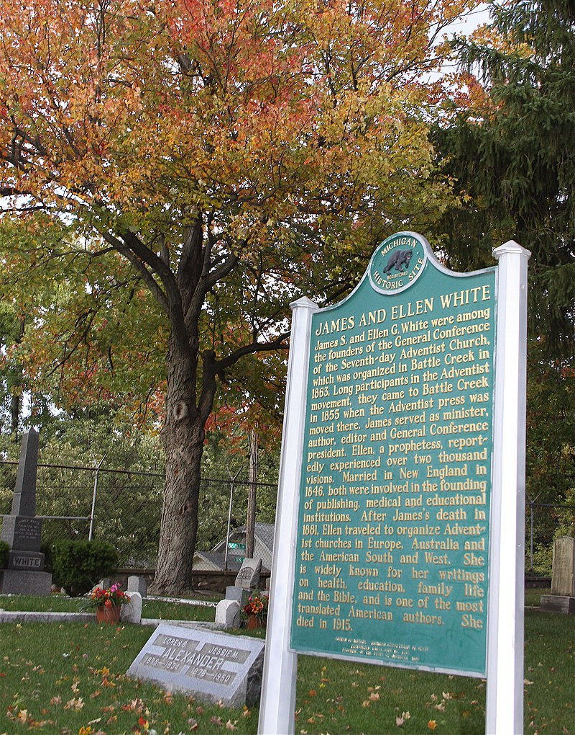
Graves of Religious Leaders
Confucius’ Tomb | Occupied
Buddha’s Tomb (tooth) | Occupied
Muhammad’s Tomb | Occupied
Martin Luther’s grave | Occupied
John Wesley’s grave | Occupied
Joseph Smith’s grave | Occupied
Ellen G. White’s grave | Occupied
Battle Creek CVB, CC BY 2.0 <https://creativecommons.org/licenses/by/2.0>, via Wikimedia Commons

Slide 9
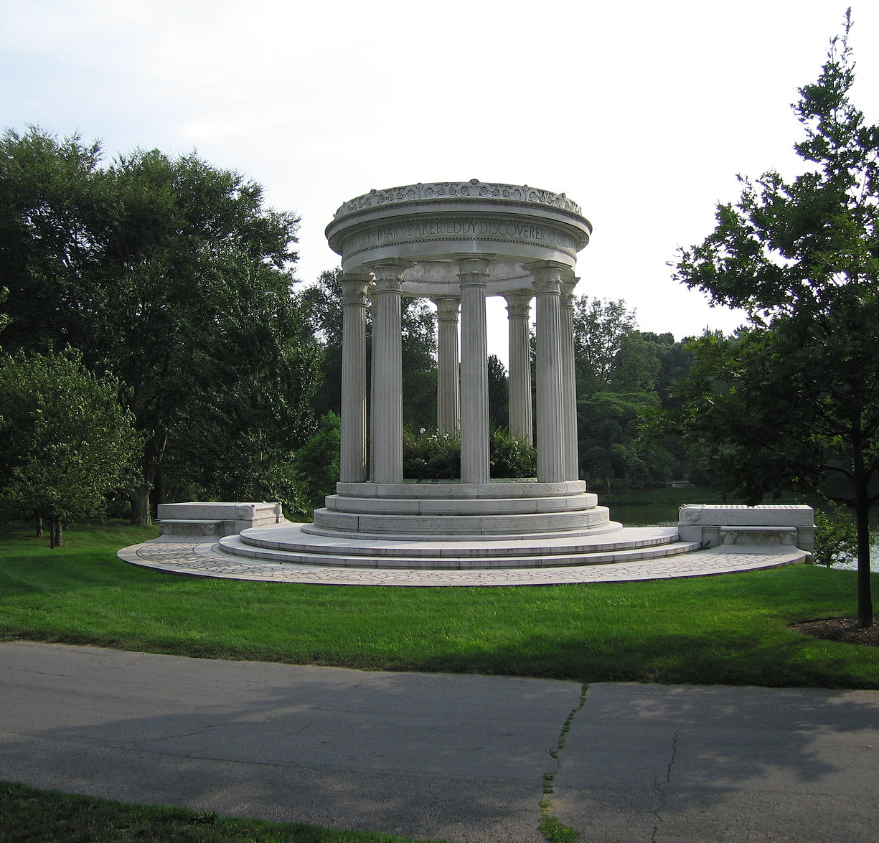
Graves of Religious Leaders
Confucius’ Tomb | Occupied
Buddha’s Tomb (tooth) | Occupied
Muhammad’s Tomb | Occupied
Martin Luther’s grave | Occupied
John Wesley’s grave | Occupied
Joseph Smith’s grave | Occupied
Ellen G. White’s grave | Occupied
Mary Baker Eddy’s grave | Occupied

Slide 10
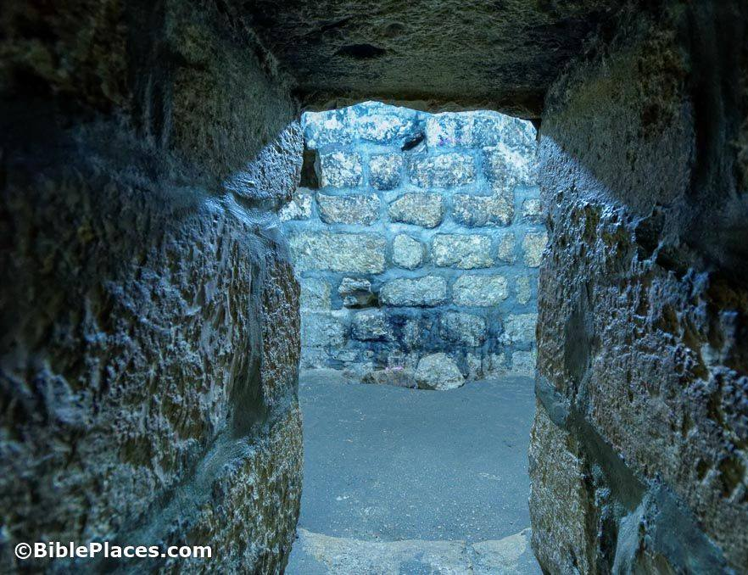
Graves of Religious Leaders
Confucius’ Tomb | Occupied
Buddha’s Tomb (tooth) | Occupied
Muhammad’s Tomb | Occupied
Martin Luther’s grave | Occupied
John Wesley’s grave | Occupied
Joseph Smith’s grave | Occupied
Ellen G. White’s grave | Occupied
Mary Baker Eddy’s grave | Occupied
Jesus Christ’s Tomb | Empty
Which founder of faith should you follow?

Slide 11
© Copyright David E. Pratte, 2022
Permission is granted to display this PowerPoint under the following conditions:
* Display the link to www.BibleStudyLessons.com
* Minor changes in content are permitted, but no teaching should be presented that disagrees with the teaching in the article associated with this PowerPoint at www.BibleStudyLessons.com/powerpoint
* In no case may a fee of any kind be charged for our PowerPoints.
* If you have a website, please add a link to https://BibleStudyLessons.com
Scripture quotations are generally from the New King James Version (NKJV), copyright 1982, 1988 by Thomas Nelson, Inc. Used by permission. All rights reserved.
biblestudylessons.com

