Slide 2
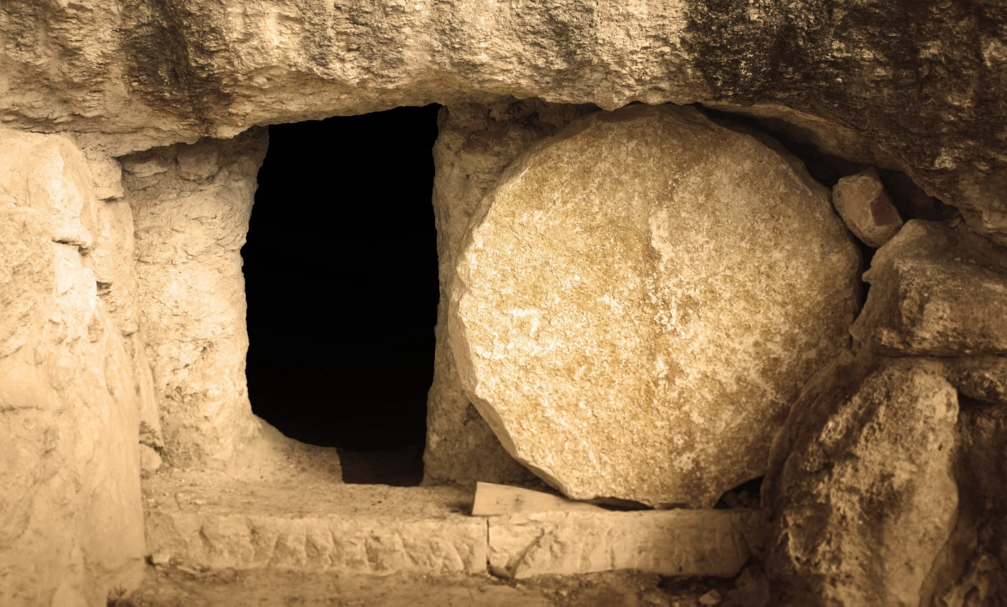
Preaching the Resurrection
The Nature of Jesus
Romans 1:4; Luke 24:44-46;
John 20:24-31;
Acts 2:23,24,29-32,36
www.BibleStudyLessons.com

Slide 3
Preaching the Resurrection
The Nature of Jesus
The Destiny of Man
Resurrection of All People
1 Corinthians 6:14;
15:12-14,20-23,25,26
Judgment of All People
Acts 17:30,31
Eternal Reward of the Righteous
1 Thessalonians 4:13-18;
1 Peter 1:3,4

Slide 4
Preaching the Resurrection
The Nature of Jesus
The Destiny of Man
The Life of Christians
Obedience to God’s Word
Acts 2:36;
2 Corinthians 5:15;
Romans 6:4-13
Power in Our Lives
Ephesians 1:19,20; 6:10-13

Slide 5
Preaching the Resurrection
The Nature of Jesus
The Destiny of Man
The Life of Christians
Forgiveness of Sins

Slide 6
The Resurrection & Forgiveness
1 Corinthians 15:13-17; Romans 5:10
Hearing and believing
1 Corinthians 15:1-4
Repentance
Acts 17:30,31
Faith and confession
Romans 10:9,10
Baptism
1 Peter 3:21; Colossians 2:12,13; Romans 6:3-5

Slide 7
Preaching the Resurrection
The Nature of Jesus
The Destiny of Man
The Life of Christians
Forgiveness of Sins
Do you believe in Jesus’ resurrection?
Are you acting on your faith?

Slide 8
© Copyright David E. Pratte, 2020
Permission is granted to display this PowerPoint under the following conditions:
* Display the link to www.BibleStudyLessons.com
* Minor changes in content are permitted, but no teaching should be presented that disagrees with the teaching in the article associated with this PowerPoint on www.BibleStudyLessons.com/powerpoint
* In no case may a fee of any kind be charged for our PowerPoints.
* If you have a website, please add a link to www.BibleStudyLessons.com
Scripture quotations are generally from the New King James Version (NKJV), copyright 1982, 1988 by Thomas Nelson, Inc. Used by permission. All rights reserved.
www.BibleStudyLessons.com

