Slide 2
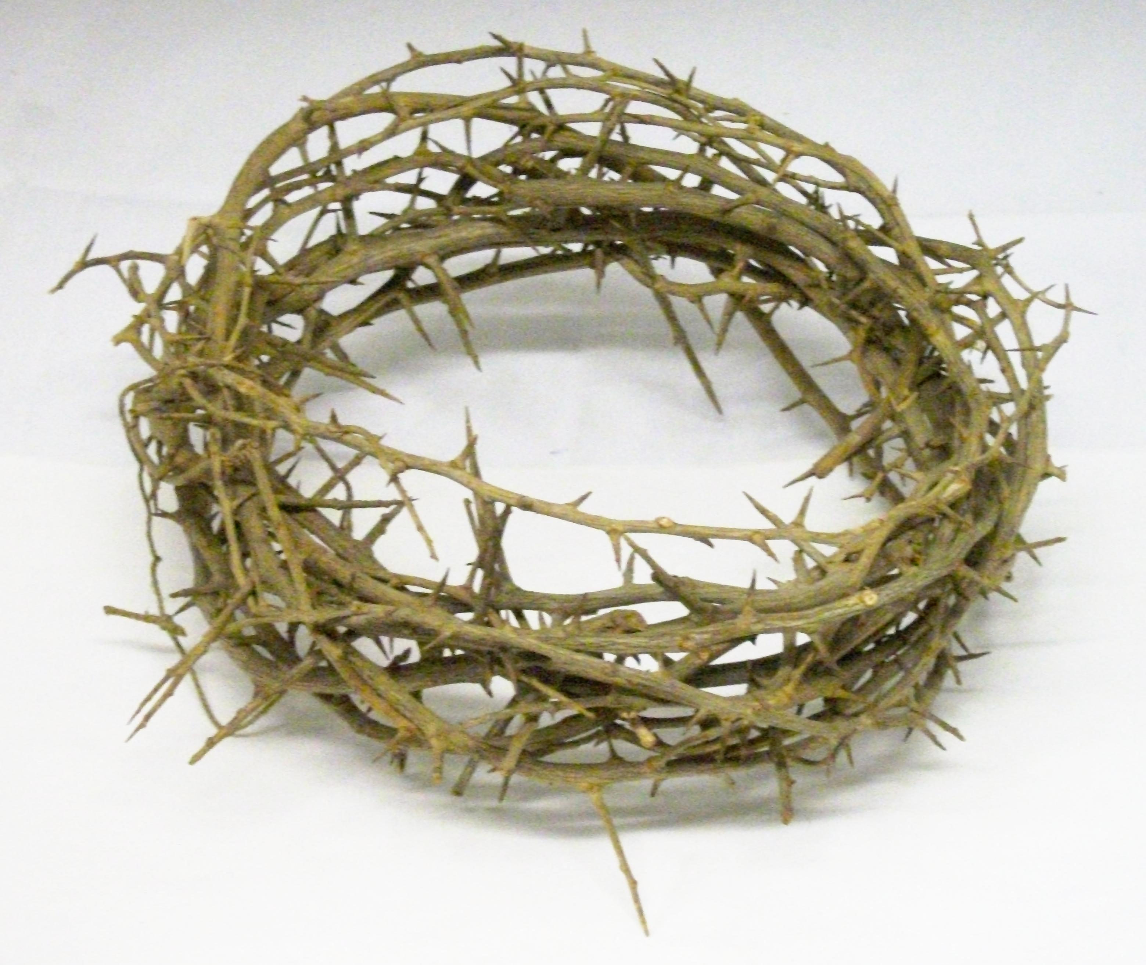
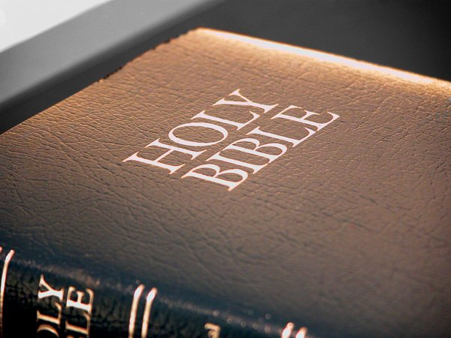
Jesus and Scripture
Accuracy of Scripture
biblestudylessons.com

Slide 3
Jesus and the Accuracy of Scripture
Jesus Confirmed the Authors of the Old Testament.
Moses as the author of Genesis through Deuteronomy
Mark 12:26 – Have you not read in the book of Moses, in the burning bush passage…?
Mark 7:10 – Moses said, “Honor your father and your mother”
John 5:46 – Jesus said, “For if you believed Moses, you would believe Me; for he wrote about Me.”

Slide 4
Jesus and the Accuracy of Scripture
Jesus Confirmed the Authors of the Old Testament.
Moses as the author of Genesis through Deuteronomy
Isaiah as the inspired prophet for all the book of Isaiah
Matthew 13:14 – And in them the prophecy of Isaiah is fulfilled (Isaiah 6:9,10)
Mark 7:6-13 – Well did Isaiah prophesy (Isaiah 29:13).

Slide 5
Jesus and the Accuracy of Scripture
Jesus Confirmed the Authors of the Old Testament.
Moses as the author of Genesis through Deuteronomy
Isaiah as the inspired prophet for all the book of Isaiah
Daniel as the source of the book of Daniel
Matthew 24:15 – The “abomination of desolation” spoken of by Daniel the prophet.

Slide 6
Jesus and the Accuracy of Scripture
Jesus Confirmed the Authors of the Old Testament.
Jesus Confirmed Many Old Testament Events.
Creation - Matthew 19:4-6
Noah and the Flood - Matthew 24:37-39
Sodom and Gomorrah - Matthew 10:15; 11:23,24; Luke 17:28-32
Moses’ miracles
Mark 12:26,27 – The burning bush (Exodus 3:6).
John 3:14 – The bronze serpent
John 6:47-51 – Manna
Jonah and the fish - Matthew 12:39-41

Slide 7
Jesus and Scripture
Accuracy of Scripture
Inspiration and Authority of Scripture

Slide 8
Jesus and the Inspiration & Authority of Scripture
Jesus Cited Scripture as Authority.
Matthew 4:4,7,10 – “It is written.”
Matthew 15:1-9 – It was God’s command; He rebuked people for transgressing it (verses 3,4,6).
Matthew 22:29-32 – It was spoken “to you by God.” People were in error because they did not know the Scriptures.
Matthew 22:43 – David wrote by the guidance of the Spirit.

Slide 9
Jesus and the Inspiration & Authority of Scripture
Jesus Cited Scripture as Authority.
Jesus Taught People to Obey Scripture.
Matthew 19:4,5 – Genesis 1 and 2 about marriage & divorce
Matthew 22:36-40 – The greatest command; “On these two commandments hang all the Law and the Prophets.”
Luke 10:25-28 – When asked how one can inherit eternal life, Jesus asked what was written in the law.
Luke 16:29-31 – People should heed Moses and prophets.
John 10:35 – “The Scripture cannot be broken.”

Slide 10
Jesus and Scripture
Accuracy of Scripture
Inspiration and Authority of Scripture
Fulfillment of Scripture

Slide 11
Jesus and Fulfilled Prophecy
General Statements
Luke 4:17-21 – “Today this Scripture is fulfilled in your hearing.”
Matthew 11:10 – Malachi 3:1 fulfilled by John the Baptist
John 5:39 – The Scriptures … testify of Me.
Luke 24:25-27 – Beginning at Moses and all the Prophets, He expounded in all the Scriptures the things concerning Himself.
Prophecies of Jesus’ death
Luke 18:31-33 – All things written by the prophets concerning the Son of Man will be accomplished.
Matthew 26:24 – The Son of Man goes just as it is written of Him,
Matthew 26:53,54 – The Scriptures fulfilled that it must happen thus
Luke 24:44-46 – “Thus it is written, and thus it was necessary for the Christ to suffer and to rise from the dead the third day.”

Slide 12
Jesus and Scripture
Accuracy of Scripture
Inspiration and Authority of Scripture
Fulfillment of Scripture
New Testament Inspiration

Slide 13
Jesus and New Testament Inspiration
Claims of New Testament Writers
2 Peter 1:16,20,21 – Prophecy never came by will of man, but holy men spoke as moved by the Holy Spirit.
Matthew 7:15 – Jesus warned about false teachers.
Galatians 1:8-12 – The gospel did not come from man, but was revealed from Jesus.
1 Corinthians 14:37 – The things which I write to you are the commandments of the Lord.

Slide 14
Jesus and New Testament Inspiration
Claims of New Testament Writers
Jesus Confirmed New Testament Inspiration.
John 16:13 – Jesus promised the apostles that the Holy Spirit would guide them into all truth.
Matthew 10:19,20 – The Holy Spirit would give them what and how to speak.
Luke 10:16 – He who hears the apostles hears Jesus; he who rejects them rejects Jesus and rejects God
John 12:48 – Jesus’ words will judge people in the last day.
2 Timothy 3:16,17 – All Scripture is given by inspiration

Slide 15
Jesus and Scripture
Accuracy of Scripture
Inspiration and Authority of Scripture
Fulfillment of Scripture
New Testament Inspiration
Jesus confirms Scripture and Scripture confirms Jesus!

Slide 17
© Copyright David E. Pratte, 2023
Permission is granted to display this PowerPoint under the following conditions:
* Display the link to BibleStudyLessons.com
* Minor changes in content are permitted, but no teaching should be presented that disagrees with the teaching in the article associated with this PowerPoint at www.BibleStudyLessons.com/powerpoint
* In no case may a fee of any kind be charged for our PowerPoints.
* If you have a website, please add a link to https://BibleStudyLessons.com
Scripture quotations are generally from the New King James Version (NKJV), copyright 1982, 1988 by Thomas Nelson, Inc. Used by permission. All rights reserved.
biblestudylessons.com

