Slide 1
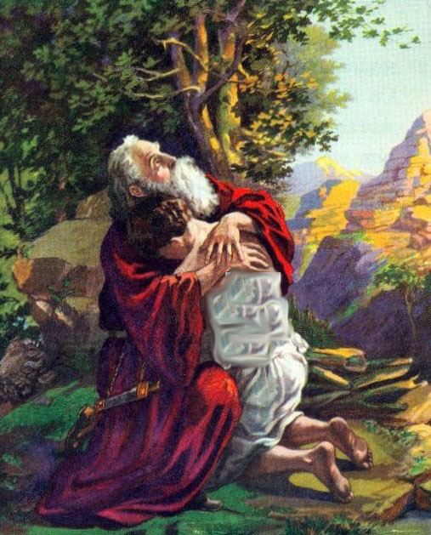
Does God Test Us Today?
www.BibleStudyLessons.com

Slide 2
Examples of Good Tests
Judges 6:39 – Gideon & the fleece
1 Kings 10:1 – Queen of Sheba tested Solomon’s wisdom
Proverbs 17:3 – Metal is tested to determine if it is gold or silver
Daniel 1:12-14 – Daniel’s diet was tested
Luke 14:19 – Man who bought oxen wanted to test them
www.BibleStudyLessons.com

Slide 3
Old Testament Passages
Exodus 15:24-26 – God tested them to obey His statutes
Deuteronomy 13:3 – Tested by false prophets
Psalms 11:4,5 – He tests sons of men … the righteous
Psalms 17:3 -- You have tested my heart
Psalms 26:2 -- Examine me, O Lord, and prove me; Try my mind and my heart. (139:23)
Proverbs 17:3 – The Lord tests the hearts.
Isaiah 48:10 – Tested in the furnace of affliction
Jeremiah 17:10 -- The Lord searches the heart and tests the mind, to give every man according to his ways.

Slide 4
Old Testament Examples
Specific Examples
Abraham and Isaac
Genesis 22:1
Characteristics
1) A command / requirement
2) A choice (challenging, difficult)
3) Success is possible, but so is failure.
4) Gives an opportunity to demonstrate faithfulness
5) Leads to rewards and teaches lessons

Slide 5
Old Testament Examples
Specific Examples
Abraham and Isaac
Genesis 22:1
Manna
Exodus 16:4;
Deuteronomy 8:2,16
Characteristics
1) A command / requirement
2) A choice (challenging, difficult)
3) Success is possible, but so is failure.
4) Gives an opportunity to demonstrate faithfulness
5) Leads to rewards and teaches lessons

Slide 6
Old Testament Examples
Specific Examples
Abraham and Isaac
Genesis 22:1
Manna
Exodus 16:4;
Deuteronomy 8:2,16
Joseph as a slave
Psalm 105:16-22;
Genesis 50:20,21
Characteristics
1) A command / requirement
2) A choice (challenging, difficult)
3) Success is possible, but so is failure.
4) Gives an opportunity to demonstrate faithfulness
5) Leads to rewards and teaches lessons

Slide 7
New Testament Passages
We must make tests.
2 Corinthians 13:5 -- Examine yourselves … Test yourselves
1 Timothy 3:10 – Test qualifications of elders and deacons
1 John 4:1 - Test the spirits because of false prophets.
Evidence that God still tests people
Zechariah 13:9 – A prophecy that God will test His people
Matthew 4:1 - Jesus was led by the Spirit to be tempted (Hebrews 2:18; 4:15)
John 6:6 – Jesus’ statement tested His apostle Philip
2 Corinthians 2:9; 8:8 – Paul’s teachings put the Corinthians to the test to see whether there were obedient
1 Thessalonians 2:4 – God tests our hearts.

Slide 8
Ways God Tests People
Affliction, suffering
James 1:2-4; 1 Peter 1:6,7; Revelation 2:10; 3:10
Rebuke/discipline
2 Corinthians 2:9; 7:11
Prayer
Matthew 6:7,8
Baptism
Mark 16:16; Acts 2:38; 22:16
Obedience
Matthew 19:21,22; 1 Corinthians 11:23-26; 2 Corinthians 8:24; John 14:15; 1 John 5:3
Characteristics
1) A command / requirement
2) A choice (challenging, difficult)
3) Success is possible, but so is failure.
4) Gives an opportunity to demonstrate faithfulness
5) Leads to rewards and teaches lessons

Slide 9
Hebrews 12:1
All of life is a test!
Have you been baptized?
Are you passing the test of life?

Slide 10
© Copyright David E. Pratte, 2020
Permission is granted to display this PowerPoint under the following conditions:
* Display the link to www.BibleStudyLessons.com
* Minor changes in content are permitted, but no teaching should be presented that disagrees with the teaching in the article associated with this PowerPoint on www.BibleStudyLessons.com/powerpoint
* In no case may a fee of any kind be charged for our PowerPoints.
* If you have a website, please add a link to www.BibleStudyLessons.com
Scripture quotations are generally from the New King James Version (NKJV), copyright 1982, 1988 by Thomas Nelson, Inc. Used by permission. All rights reserved.
www.BibleStudyLessons.com

