Slide 2

Video Bible Study
Lessons
presented by
David E. Pratte
www.gospelway.com

Slide 3
The Epistle of
Titus
Thanks to Christians in the Hillcrest church for their participation.
© Copyright David E. Pratte, 2020
Scripture quotations are generally from the New King James Version (NKJV), copyright 1982, 1988 by Thomas Nelson, Inc. used by permission. All rights reserved.

Slide 4
Bible Study Questions on the Books of
1&2 Timothy, Titus, & Philemon
Available at
www.biblestudylessons.com/classbooks

Slide 5
Theme and Major Divisions of Titus
Theme: Instruction to ordain elders and to teach the need for sound doctrine, moral purity, and good works
Major divisions
Chapter 1 – Qualifications and work of elders
Chapter 2 – Sound instruction for various groups
Chapter 3 – Salvation should lead to good works

Slide 6
Evidence Paul Was an Apostle
* He claimed it (verse 1).
* He spoke by direct guidance of the Holy Spirit
(1 Corinthians 14:37; 2:10-16; Ephesians 3:3-5; 2 Corinthians 12:7-10).
* His claim to apostleship was confirmed by miracles
(2 Corinthians 12:12; Acts 14:3,8-18; 13:6-12; 19:8-20).
* He was an eyewitness of the resurrected Christ
(Acts 9:1-18; 22:14,15; 26:16; 1 Corinthians 15:1-8; 9:1).
* He could lay hands on others to give them miraculous powers
(Acts 19:1-7; Romans 1:8-11; 2 Timothy 1:6).
* Jesus chose him and commanded him to be a witness of His resurrection (Acts 26:13-19).

Slide 7

Paul’s Apostleship
According to the faith of God's elect
And the acknowledgment of the truth
which accords with godliness
In hope of eternal life
which God, who cannot lie,
promised before time began
but has in due time manifested His word
through preaching

Slide 8
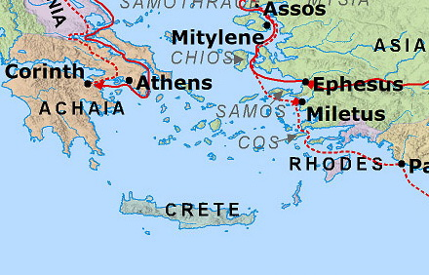
Island of Crete
Via BibleMapper

Slide 9
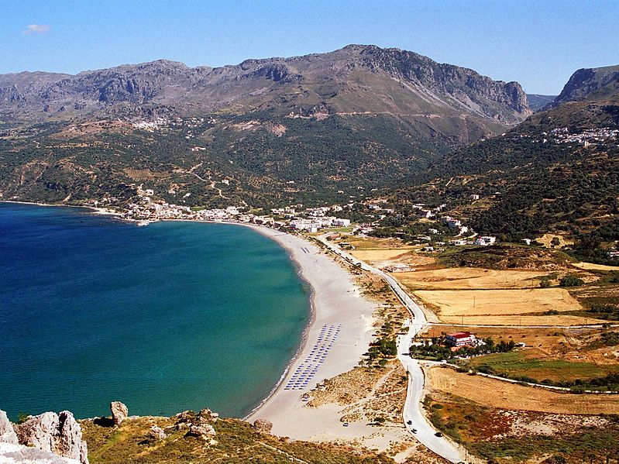
Bay on the Island of Crete
Photo credit: Olaf Tausch distributed under GNU FDL version 1.2 via Wikimedia Commons

Slide 10
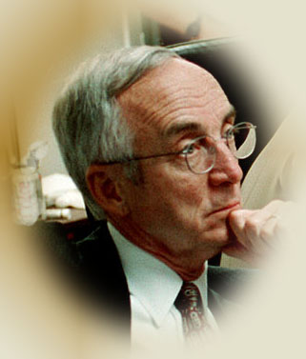
Terms for Elders
BISHOPS (Overseers)
Acts 20:28; I Tim. 3:1,2; Phil. 1:1; I Peter 5:2
"overseer ... guardian, or superintendent“ - Thayer
ELDERS (Presbyters)
Acts 14:23; 20:17; I Peter 5:1; I Tim. 4:14
"a term of rank or office ... those who presided over the (churches)" -- Thayer
PASTORS (Shepherds)
Eph. 4:11; (Acts 20:28; I Peter 5:2)
"a shepherd ... the presiding officer, manager, director, of any assembly" -- Thayer

Slide 11
Different Terms: Same Work
Acts 20:17,28
  Verse 17 - Elders
  Verse 28 - Overseers/bishops
  Verse 28 - Shepherd (pastor) the flock
Titus 1:5-9
  Verse 5 - Elders
  Verse 7 - Bishop
1 Peter 5:1-3
  Verse1 - Elders
  Verse 2 - Shepherd (pastor)
  Verse 2 - Overseers (bishops)

Slide 12
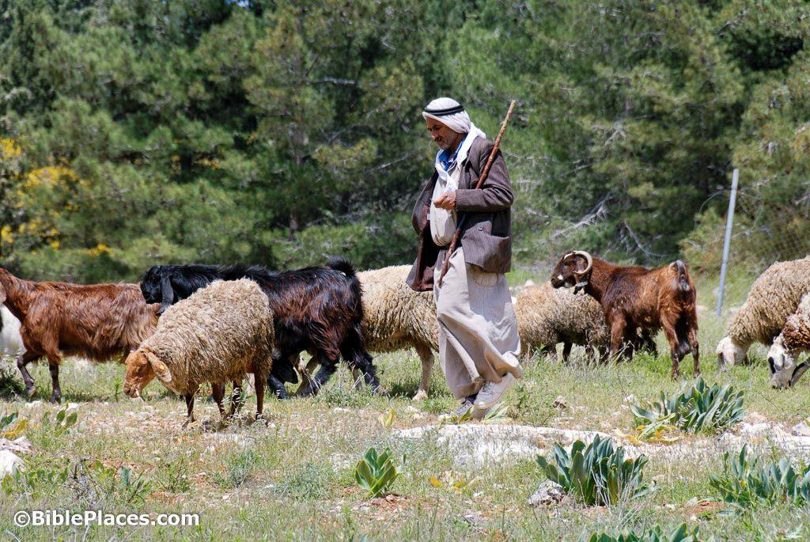
The Work of Elders
Set Good Examples
  1 Peter 5:2,3; Acts 20:28-30; Hebrews 13:7
Watch for Members’ Souls
  Hebrews 13:17; Acts 20:28ff; Titus 1:9ff
Teach Truth/Rebuke Error
  1 Peter 5:2; Acts 20:28; Hebrews 13:7;
  1 Thess. 5:12; 1 Tim. 3:2; Titus 1:9ff
Oversee/Rule Local Church
  Acts 20:28; 1 Peter 5:2; 1 Timothy 5:17; Hebrews 13:7,17; Titus 1:7

Slide 13
Terms Implying Supervision
Shepherd
Eph. 4:11; (Acts 20:28; 1 Peter 5:2)
Overseer
Acts 20:28; 1 Tim. 3:1,2;
Phil. 1:1; 1 Peter 5:2
Rule/Obey
1 Timothy 5:17; Hebrews 13:7,17
Steward
Titus 1:7

Slide 14


Scriptural Church Organization
CHRIST
LOCAL CHURCHES

Slide 15
A Plurality in Each Church
Phil. 1:1 -- Bishops (plural) in church at Philippi
Acts 15:4,22 -- Elders (plural) in church at Jerusalem
Acts 20:17 -- Elders (plural) of the church at Ephesus
Acts 20:28 -- Overseers (plural) of the flock (singular)
1 Peter 5:1-3 -- Elders (plural) to tend the flock (singular)
Acts 14:23 -- Elders (plural) in EVERY church (singular)

Slide 16
The Importance of Elders
Faithful churches had them.
Paul ordained them in every church.
Serving as a bishop is a good work.
Churches without them have something “lacking.”

Slide 17
Terms in Titus 1:5
“Set in order”
God has commanded an arrangement or system. Until a church has ordained elders, they lack that order.
“Lacking”
James 1:4 – that you may be perfect and complete, lacking nothing.
James 1:5 – If any of you lacks wisdom, let him ask of God…
James 2:15 – If a brother or sister is naked and destitute of daily food…
Luke 18:22 – Jesus said, “You still lack one thing. Sell all that you have …”
Titus 3:13 – Send Zenas and Apollos that they may lack nothing.
A church without elders is missing something useful: immaturity.
However, if they have no qualified men to serve, then they have no choice but to continue without elders. Acts 14:23; Titus 1:5.

Slide 18
Terms in Titus 1:5
“Set in order”
God has commanded an arrangement or system. Until a church has ordained elders, they lack that order.
“Lacking”
A church without elders is missing something useful: immaturity.
“Appoint”
Matthew 24:45 – a servant whom his master made ruler over his household
Matthew 25:21 – I will make you ruler over many things.
Luke 12:44 – he will make him ruler over all that he has.
Acts 6:3 – seek out … men … whom we may appoint over this business
“…to assign someone a position of authority, appoint, put in charge … a someone over (of) someth. or someone - BDAG

Slide 19
Principles Re. Qualifications
"IF A MAN IS ... A BISHOP MUST BE ..."
The qualifications are necessary
ALL qualifications are necessary
Each man must have all qualifications
Each man must be qualified when appointed and must continue to be qualified
We must not add man-made qualifications
The purpose is to select men able to do work
Lack of evidence is reason NOT to appoint
Some qualities are absolute; others are matters of degree
Developing qualifications requires time

Slide 20

Lay the Foundation First!
Please,
Let us understand the basics first
then
We can better understand how to answer related questions and make applications.

Slide 21
Qualifications – Titus 1
Blameless – v6

Slide 22
Qualifications – Titus 1
Blameless – v6
Husband of one wife - v6

Slide 23
“Husband of one wife”
Literally: “a man of one woman”
An elder must be a MAN (male).
“Husband” literally means “man”
A woman cannot Scripturally be a husband to a woman
An elder must rule well his own house (1 Timothy 3:4,5)
Work of elders requires authority that only men possess
An elder must be married, not single.
“One wife” excludes zero. A bachelor is not a husband.
An elder must have a house to rule (including children)
An elder must not have an unlawful marriage.
Genesis 2:24; Matthew 19:3-9; Romans 7:2,3

Slide 24
Qualifications – Titus 1
Blameless – v6
Husband of one wife - v6
Having faithful children not accused of dissipation or insubordination – v6

Slide 25
“Faithful” Children
1. Some translations say “believers” or “that believe” (ASV, NASB, ESV, RSV)
2. Regarding man’s faithfulness, the main application of the word always is faithfulness to God, never faithfulness to man.
Acts 16:15 – If you have judged me to be faithful to the Lord.
Ephesians 1:1 – To the faithful in Christ Jesus.
1 Timothy 6:2 – Believing masters … they are brethren.
Revelation 2:10 – Be thou faithful unto death…
1 Timothy 3:11 – Elders’ and deacons’ wives must be faithful in all things. Note that the elders’ wife and children must all be “faithful.”

Slide 26
“Faithful” Children
1. Some translations say “believers” or “that believe” (ASV, NASB, RSV, NIV)
2. Regarding man’s faithfulness, the main application of the word always is faithfulness to God, never faithfulness to man.
3. “Riot” or “dissipation” always refers to disobeying God’s moral laws.
Translated “dissipation” (NKJV, NASB, LEB), “riot” (KJV, ASV), “debauchery” (ESV, NRSV), “wild” (MEV, Pickering, NIV),“wildness” (HCSB), “loose” (WEB).
Ephesians 5:18 – Drunkenness leads to “riot.”
1 Peter 4:4 – Sins of the world are called “riot” includes lasciviousness, lust, winebibbing, revellings, carousing, and idolatry.
Luke 15:13 - related word describes prodigal son’s “riotous” living.

Slide 27
“Faithful” Children
1. Some translations say “believers” or “that believe” (ASV, NASB, RSV, NIV)
2. Regarding man’s faithfulness, the main application of the word always is faithfulness to God, never faithfulness to man.
3. “Riot” or “dissipation” always refers to disobeying God’s moral laws.
4. Regarding man’s rebellion, “insubordinate” refers always to God’s laws.
“Insubordination” (NKJV, ESV), “unruly” (KJV, ASV, MEV), “rebellion”/“rebellious” (NASB; LEB, NRSV, HCSB), “disobedient” (NIV)
Titus 1:10 – Unruly men teach things they ought not.
1 Timothy 1:9 – Lawless and unruly (insubordinate) include ungodly, sinners, anything contrary to sound doctrine

Slide 28
“Faithful” Children
1. Some translations say “believers” or “that believe” (ASV, NASB, RSV, NIV)
2. Regarding man’s faithfulness, the main application of the word always is faithfulness to God, never faithfulness to man.
3. “Riot” or “dissipation” always refers to disobeying God’s moral laws, never human laws.
4. Regarding man’s rebellion, “insubordinate” refers always to God’s laws, never simply man’s laws.
5. Elders’ wives must also be “faithful” (1 Tim. 3:11). This must mean faithful to God. Why not children?
Conclusion: Elder’s children must be Christians, faithful to God, not accused of disobeying God or His moral laws.

Slide 29
“Faithful” Children
How many of his children must be Christians?
Compare to similar language elsewhere.
1 Timothy 5:10 – A widow indeed “has brought up children.” How many of her children?
1 Timothy 3:4 – The elder must have “his children in subjection.” How many of his children?
1 Timothy 3:11 – The wives must be “grave, … temperate, … faithful in all things.” How many of the wives?
Titus 1:6 – The elder’s children must be “not accused of riot or unruly.” How many of his children?
Conclusion: Elder’s children must all be Christians, faithful to God, not accused of disobeying God or His moral laws.

Slide 30
One-Child Elder?
Evidence in Favor of Plural Children
(1) The normal, natural meaning of such language is that each elder must have more than one child.
(2) Passages say each “church” (singular) must have “elders” (plural). So a congregation with just one elder would be unscriptural. Why not reason the same with each elder and his children (plural)?
(3) Having several children proves a man can lead different kinds of people.

Slide 31
The Plural Includes the Singular?
Weak or faulty arguments
Plural children with plural parents
Ephesians 6:1 – Children, obey your parents in the Lord.
1 Timothy 3:12 – Let deacons be the husbands of one wife, ruling their children and their own houses well.
Regarding elders, each man (singular) has “children” (plural), like each church (singular) has elders (plural).

Slide 32
The Plural Includes the Singular?
Weak or faulty arguments
Plural children with plural parents
Negative of “children”
Matthew 22:24 – If a man dies, having no children
“No children” equals “zero children” equals “no child.”
Compound verbs
1 Timothy 5:10 – if she has brought up children …
1 Timothy 5:14 – younger widows marry, bear children
The original word is a compound neither singular nor plural

Slide 33
The Plural Includes the Singular?
Weak or faulty arguments
Plural children with plural parents
Negative of “children”
Compound verbs
Genesis 21:7
“Who would have said Sarah would nurse children?”
* The Septuagint Greek translation has “child” (singular).
* May refer to subsequent generations fulfilling the promise to Abraham. (Compare Hebrews 7:9,10.)
* Caring for other people’s children is sometimes referred to as nursing them. See Exodus 2:7-9; compare Ruth 4:16.

Slide 34
The Plural Includes the Singular?
Evidence that is more convincing
1 Timothy 5:4 – If any widow (singular) has “children” (plural) they should relieve her.
Mark 10:29 – No one who has left house or brothers or sisters or father or mother or wife or children or lands…
1 Timothy 5:16 – If any believing man or woman has widows, let them relieve them … the church may relieve those who are really widows.
Romans 16:17 – … note those who cause divisions and offenses … and avoid them.
Titus 3:9 – But avoid foolish controversies and genealogies and strivings and disputes about the Law…

Slide 35
Child Falls Away after Leaving Home
Would we appoint a man whose child fell away after leaving home?
What if one or more children become faithful after leaving home?
What if all a man’s children fall away after leaving home?
Titus 1:6 requires that children not only be faithful, but also not accused of riot or unruly.
Titus 1:6 gives additional information to 1 Timothy 3:4,5. There is no reason to limit it to children at home.
Proverbs 22:6, etc., show that the life of a child after he leaves home continues to reflect the father’s training.

Slide 36
God Has Unfaithful Children
Do not stretch an illustration beyond the Bible’s use.
If everyone became unfaithful, God would still be God – Romans 3:4.
No Scripture states that God must have faithful children in order to qualify to serve as God.
Jesus’ relation to the church is also compared to a man’s relationship to His wife (Ephesians 5:22ff).
God’s relationship to His people differs from father-child
Proverbs 22:6 still teaches that properly trained children will follow in the way they were trained.
If God’s children fall away, then they fall away while they are still subject to His authority (in His house)!
Fallible humans need a standard to determine qualification

Slide 37
Family Qualifications of Experienced Elders
How many children may fall away but he may still serve?
What if the elder’s children fall away while still at home?
What if an elder’s wife becomes unfaithful?
How long must he serve before we can overlook children?
How long must the child be away from home?
How “well” must he serve before we can overlook the family?
What other qualifications may we similarly overlook?
The conclusion is that the qualifications for becoming an elder differ from the qualifications for continuing.
Compare the view that a man need not meet all qualifications when he is appointed but may grow into them.
The “tenure rule” is based on human reasoning without command, example, or necessary inference in Scripture.

Slide 38
Qualifications – Titus 1
Blameless – v6
Husband of one wife - v6
Having faithful children not accused of dissipation or insubordination – v6
Not self-willed – v7

Slide 39
Not Self Willed
Translated “not self-willed” (NKJV, KJV, ASV, NASB, LEB, MEV), “not arrogant” (ESV, NRSV, HCSB), “not over-bearing” (NIV).
“…denotes one who, dominated by self-interest, and inconsiderate of others, arrogantly asserts his own will…” – Vine.
“In the two passages in which αὐθάδης occurs in the NT the reference is to human impulse violating obedience to the divine command.”– Theological Dictionary of the New Testament.
2 Peter 2:10; Philippians 2:3,4
“Self-will” involves standing for a position even when one has been shown by the Scriptures to be wrong or insisting on one’s own way as a matter of personal preference or personal advantage without regard to the problems created for others.

Slide 40
Qualifications – Titus 1
Blameless – v6
Husband of one wife - v6
Having faithful children not accused of dissipation or insubordination – v6
Not self-willed – v7; Not quick-tempered – v7

Slide 41
Not Quick Tempered
Translated “not quick-tempered” (NKJV, NASB, ESV, LEB, NRSV), “not soon angry” (ASV, KJV), “not hot-tempered” (HCSB), “not easily angered” (MEV).
“Quick-tempered” – “…‘quick-tempered persons lose no time being angry, and do so with those they ought not, over things they ought not, and far more than they ought’; Herodian … inclined to anger, quick-tempered …” – Bauer-Danker-Arndt-Gingrich.
James 1:19,20 – Every man should be slow to wrath because man’s wrath does not work God’s righteousness.
Ephesians 4:26 – Be angry but sin not.

Slide 42
Qualifications – Titus 1
Blameless – v6
Husband of one wife - v6
Having faithful children not accused of dissipation or insubordination – v6
Not self-willed – v7; Not quick-tempered – v7
Not given to wine – v7

Slide 43
Elders and Alcoholic Drinks
Forbidding an extreme does not excuse a lesser extreme
Isaiah 10:2; Romans 13:9; Proverbs 23:29-33
Modern “social drinking” is excessive drinking
Bible “wine” is fermented or unfermented or diluted
(Isaiah 16:10; 65:8; Jeremiah 48:33; Song 5:1; Genesis 40:9-11; Revelation 19:15; 14:19,20). Compare “cider.”
Distilled alcoholic beverages were unknown in Bible times.
One can of beer is as alcoholic as a shot of whiskey!
Avoid practices that tend toward deeper sin.
Proverbs 23:29-33; 20:1
Self-control and sobriety require clear judgment and inhibitions
Isaiah 28:7; Leviticus 10:9,10; Proverbs 31:4,5; 1 Peter 5:8;1 Cor. 9:25-27
1 Peter 4:3 condemns various degrees of drinking
Good example; Good report outside the church (1 Timothy 3:7).

Slide 44
Qualifications – Titus 1
Blameless – v6
Husband of one wife - v6
Having faithful children not accused of dissipation or insubordination – v6
Not self-willed – v7; Not quick-tempered – v7
Not given to wine – v7; Not violent – v7

Slide 45
Not Violent
Translated “not violent” (NKJV, ESV, LWB, NRSV), “no striker” (ASV, KJV), “not pugnacious” (NASB), “not a bully” (HCSB, MLV).
“…bruiser, ready with a blow; a pugnacious, contentious, quarrelsome person…” – Grimm-Wilke-Thayer.
An elder must not resort to violence or force to achieve his goals.
Romans 12:17-21

Slide 46
Qualifications – Titus 1
Blameless – v6
Husband of one wife - v6
Having faithful children not accused of dissipation or insubordination – v6
Not self-willed – v7; Not quick-tempered – v7
Not given to wine – v7; Not violent – v7
Not greedy for money – v7

Slide 47
Not Greedy for Money
Translated “not greedy for money” (NKJV, NRSV), “not greedy for (or given to) filthy lucre” (KJV, ASV), “not fond of sordid gain” (NASB), “not greedy for gain” (ESV, NRSV), “not greedy for dishonest gain” (LEB, MEV), “not covetous” (MLV).
Hebrews 13:5 – All Christians should be free from love of money, content with what we have, trusting God
Luke 16:14 – We cannot have two masters
2 Timothy 3:2 – Grievous times come when men are lovers of self, money, etc.
1 Timothy 6:10 – Love of money is the root of all kinds of evil. Those minded to be rich fall into temptations, lusts, etc. One who is rich can serve God, but must not trust riches but use them to further God’s work (verses 17-19).

Slide 48
Qualifications – Titus 1
Blameless – v6
Husband of one wife - v6
Having faithful children not accused of dissipation or insubordination – v6
Not self-willed – v7; Not quick-tempered – v7
Not given to wine – v7; Not violent – v7
Not greedy for money – v7; Hospitable – v8

Slide 49
Hospitable
Translated “hospitable” (NKJV, NASB, NRSV, ESV, HCSB, MLV), “given to hospitality” (ASV), “lover of hospitality” (KJV).
“Hospitable” – “…hospitable, generous to guests…” – Grimm-Wilke-Thayer.
Romans 12:13 – All Christians should be “given to hospitality.”
1 Peter 4:9 – We should show hospitality one to another without murmuring.
Hebrews 13:2 – Forget not to show love to strangers.

Slide 50
Qualifications – Titus 1
Blameless – v6
Husband of one wife - v6
Having faithful children not accused of dissipation or insubordination – v6
Not self-willed – v7; Not quick-tempered – v7
Not given to wine – v7; Not violent – v7
Not greedy for money – v7; Hospitable – v8
Lover of what is good – v8

Slide 51
Lover of What Is Good
Translated “lover of good men” (KJV), “lover of what is good” (NKJV), “lover of good” (ASV, ESV), “lover of goodness” (NRSV), “loving what is good” (LEB).
1 Corinthians 13:6 – Love rejoices not in iniquity, but rejoices in truth.
2 Thessalonians 2:10-12 – Those who do not love truth will believe a lie and be condemned.
Romans 12:9 – Those who love good will hate evil.
3 John 3,4 – John had great joy when he heard of those who walk in truth.
2 Timothy 3:3 – Perilous times come (verse 1) when men are lovers of themselves and lovers of money (verse 2), but despisers of good (verse 3).

Slide 52
Qualifications – Titus 1
Blameless – v6
Husband of one wife - v6
Having faithful children not accused of dissipation or insubordination – v6
Not self-willed – v7; Not quick-tempered – v7
Not given to wine – v7; Not violent – v7
Not greedy for money – v7; Hospitable – v8
Lover of what is good – v8
Sober-minded – v8;

Slide 53
Sober-minded
Translated: “sober” (KJV), “sober-minded” (NKJV, ASV), “prudent” (LEB, NRSV), “self-controlled” (ESV, MEV), “sensible” (NASB, HCSB, MLV).
One must think clearly and seriously, using good judgment, making good decisions in order to control oneself.
“Sober-minded” – “…of sound mind, sane, in one’s senses … curbing one’s desires and impulses, self-controlled, temperate…” – Grimm-Wilke-Thayer.
1 Timothy 2:9 – Women should think seriously about clothing
Titus 2:5,6 – Young men and women should think seriously about spiritual matters.
1 Peter 4:7 – All people should think seriously about death and judgment.

Slide 54
Qualifications – Titus 1
Blameless – v6
Husband of one wife - v6
Having faithful children not accused of dissipation or insubordination – v6
Not self-willed – v7; Not quick-tempered – v7
Not given to wine – v7; Not violent – v7
Not greedy for money – v7; Hospitable – v8
Lover of what is good – v8
Sober-minded – v8; Just – v8;

Slide 55
Just
Translated “just” (NKJV, ASV, KJV, NASB, LEB, MEV), “upright” (ESV, NRSV), “righteous” (HCSB).
“Just” (dikaioV) – “… in accordance with high standards of rectitude, upright, just, fair …” – Bauer-Danker-Arndt-Gingrich.
Matthew 20:4 – The owner of the vineyard promised to pay laborers what was right (“just”).
Colossians 4:1 – Masters should render to servants what is “just” and equal.
John 7:24 – Judge not according to appearance but judge “righteous” (just) judgment.
2 Thessalonians 1:5 – God’s judgment on men will be “just” (right – verse 6).

Slide 56
Qualifications – Titus 1
Blameless – v6
Husband of one wife - v6
Having faithful children not accused of dissipation or insubordination – v6
Not self-willed – v7; Not quick-tempered – v7
Not given to wine – v7; Not violent – v7
Not greedy for money – v7; Hospitable – v8
Lover of what is good – v8
Sober-minded – v8; Just – v8;
Holy – v8;

Slide 57
Holy
Translated “Holy” (NKJV, KJV, ASV, NRSB, ESV, MLV) or “devout” (NASB, LEB, NRSV).
“Holy” – “…undefiled by sin, free from wickedness, religiously observing every moral obligation, pure, holy, pious…” – Grimm-Wilke-Thayer.
Jesus and God are holy (Acts 2:27; 13:35; Hebrews 7:26; Revelation 15:4).
1 Timothy 2:8 – Men should pray lifting up holy hands.
Luke 1:75 – We should serve God in holiness and righteousness all our days.
Ephesians 4:22-24 – Put away the old man (former way of life) with its lusts and be renewed in mind, putting on the new man created in righteousness and holiness.

Slide 58
Qualifications – Titus 1
Blameless – v6
Husband of one wife - v6
Having faithful children not accused of dissipation or insubordination – v6
Not self-willed – v7; Not quick-tempered – v7
Not given to wine – v7; Not violent – v7
Not greedy for money – v7; Hospitable – v8
Lover of what is good – v8
Sober-minded – v8; Just – v8;
Holy – v8; Self-controlled – v8

Slide 59
Self-controlled
“Temperate” is translated “self-controlled” (NKJV, ASV, NASB, NRSV, HCSB, MLV), or “disciplined” (ESV).
“Self-controlled (εγκρατης) – “pert. to having one's emotions, impulses, or desires under control, self-controlled, disciplined…” – Bauer-Danker-Arndt-Gingrich.
“…2. having power over, possessed of (a thing) … 3. mastering, controlling, curbing, restraining: … controlling oneself, temperate, continent…” – Grimm-Wilke-Thayer.

Slide 60
Qualifications – Titus 1
Blameless – v6
Husband of one wife - v6
Having faithful children not accused of dissipation or insubordination – v6
Not self-willed – v7; Not quick-tempered – v7
Not given to wine – v7; Not violent – v7
Not greedy for money – v7; Hospitable – v8
Lover of what is good – v8
Sober-minded – v8; Just – v8;
Holy – v8; Self-controlled – v8
Holding fast the faithful word … able, by sound doctrine, both to exhort and convict those who contradict – v9

Slide 61
Holding Fast the Faithful Word
“Hold fast”
2 Timothy 1:13 – Hold fast the pattern of sound words
2 Thessalonians 2:15 – stand fast and hold the traditions
“Faithful word”
Revelation 19:9 – These are the true sayings of God.
Revelation 21:5; 22:6 – these words are true and faithful.
“Sound doctrine”
1 Timothy 1:10 – contrary to sound doctrine
1 Timothy 6:3 – wholesome words, even the words of our Lord Jesus Christ, and doctrine which accords with godliness,
2 Timothy 1:13 – Hold fast the pattern of sound words
Titus 2:1 – speak the things proper for sound doctrine

Slide 62
Holding Fast the Faithful Word
“Exhort”
Hebrews 13:22 – bear with the word of exhortation
1 Thessalonians 5:11 – Therefore comfort each other and edify one another, just as you also are doing.
1 Timothy 5:1 – Do not rebuke an older man, but exhort him as a father, younger men as brothers,
“Convict”
Matthew 18:15 – tell him his fault
Luke 3:19 – rebuked concerning all the evils Herod had done
John 3:20 – lest his deeds should be exposed.
John 16:8 – convict the world of sin/righteousness/judgment
James 2:9 – convicted by the law as transgressors.
Ephesians 5:11 – unfruitful works of darkness, expose them.

Slide 63
False Teachers – 1:10-16
They are rebellious and teach things they should not
They lead others astray (evil influence)
They often use deceit and lies
They often have ulterior motives (personal gain)
They should be rebuked, even sharply
They turn from the truth teaching fables and commandments of men
Their mind and conscience are defiled
They profess to know God but deny Him by their works

Slide 64
Instructions for Special Groups
Older Men (2:2)
Older Women (2:3)
Younger Women (2:4,5)
Younger Men (2:6-8)
Servants (2:9,10)

Slide 65

Instructions for Older Men
Sober
Reverent
Temperate
Sound in faith, in love,
in patience

Slide 66
Instructions for Special Groups
Older Men (2:2)
Older Women (2:3)
Younger Women (2:4,5)
Younger Men (2:6-8)
Servants (2:9,10)

Slide 67

Instructions for Older Women
Reverent in demeanor
Not slanderers
Nor enslaved to much wine
Teachers of that which is good
(train the young women)

Slide 68
Who Should Teach God’s Word?
Acts 8:1,3,4 – Those who were scattered by persecution
Galatians 6:1 – Those who are spiritual
2 Timothy 2:24-26 – The Lord’s servants
1 Thessalonians 5:11 – “Brethren” (Christians)
Ephesians 4:15,16 – Every part of the body
Hebrews 3:12-14 – Those who partake of Christ
Hebrews 5:12-14 – By reason of time
Hebrews 10:23,24 – Those who hold fast the confession
1 Peter 3:15 – Those who sanctify the Lord in their hearts
Jude 3 – Those who partake of the common salvation

Slide 69
Women as Teachers of God’s Word
Exodus 15:20,21 – Miriam, a prophetess, led the women.
Ruth 1:8-17; 2:20 – Ruth and Naomi had spiritual discussions.
1 Samuel 25:2-42 – Abigail counselled David very respectfully
2 Kings 22:14-20 – Huldah a prophetess gave a revelation
Proverbs 1:8 – A son should not forsake the law of his mother.
Proverbs 31:1 – King Lemuel was taught by his mother.
Proverbs 31:26 – The worthy woman spoke words of wisdom.
Luke 1:39-56 – Elisabeth and Mary exhorted one another.
John 4:28-30,39-42 – The Samaritan woman told about Jesus
Acts 2:17; 21:9; Judges 4:4 – Women had the gift of prophecy
Acts 18:24-26 – Priscilla with her husband corrected Apollos.
2 Timothy 1:5 – Timothy taught by grandmother and mother

Slide 70

Instructions for Younger Women
Love their husbands
Love their children

Slide 71
Married Woman Loves Her Husband
Genesis 2:18-24 – Woman was created as a helper to man.
Genesis 3:16 – Her desire shall be for her husband.
1 Corinthians 11:9 – Man was not created for the woman, but woman for the man.
Proverbs 31:12 – She does her husband good, not evil.
Ephesians 5:33 – The wife should respect her husband.
Examples of love between husband and wife
Genesis 24:67 (Isaac and Rabekah);
Genesis 29:18-20 (Jacob and Rachel);
1 Samuel 1:5,8 (Hannah and Elkanah).
See also Esther 2:17; Deuteronomy 24:5; Song of Solomon.
Titus 2:4 – Young women taught to love their husbands.

Slide 72
Married Woman Bearing Children
John 16:21 – Mother rejoices when the child has been born.
Psalm 113:9 – For a barren woman a child is a blessing
Psalm 127:3-5; 128:3-6 – By bearing children, a woman gives blessing and honor to her husband.
Matthew 1:18-25; Luke 1:26-56; Galatians 4:4 – God chose a woman to give birth to God’s own Son.
1 Thessalonians 2:7 – A nursing mother cherishes her children.
1 Timothy 5:14 – Younger widows marry and bear children.
Children viewed as a great blessing. Genesis 3:20 (Eve); 21:1-6 (Sarah); 25:21 (Rebekah); 29:31-30:24 (Rachel and Leah); Judges 13:2-24 (mother of Samson); Ruth 4:12-21 (Ruth); 1 Samuel 1 (Hannah); Luke 1:7,13-15,24,25,57,58 (Elizabeth)

Slide 73
Mothers Love, Care, Train Children
Exodus 2:1-10 – Jochebed cared for and protected Moses
1 Samuel 1:23; 2:19 – Hannah gave Samuel food and clothing
1 Kings 3:16-27 – True mother cared for her child
Proverbs 1:8; 6:20; 31:1 – Do not forsake law of mother
Ephesians 6:1; Luke 2:51 – Jesus was subject to His mother
1 Timothy 5:10 – One of the “good works” of widows indeed is that they are to have “brought up children.”
2 Timothy 1:5; 3:15 – Timothy’s faith and knowledge of Scripture came through his mother and grandmother..
Proverbs 29:15 – If a child is left to himself, the result brings shame to his mother.
Titus 2:4 – Young women should love their children.

Slide 74
Instructions for Younger Women
Love their husbands
Love their children
Discreet
Chaste
Good

Slide 75
Good Works for Women
* Homemakers, caring for husband and children (verse 4)
* Helping needy people - 1 Timothy 5:4,10,16; Acts 9:36-39; Proverbs 31:20
* Hospitality - 1 Peter 4:9; Hebrews 13:2; Romans 12:13;1 Timothy 5:10; Acts 12:12ff; 2 Kings 4:8-11
* Bible study and prayer - 1 Samuel 1:10-2:5; Luke 2:36-38; 10:38-42; Acts 12:12; 16:13; 17:11,12; 1 Timothy 5:5,6
* Attending church meetings for worship and study - Deuteronomy 31:12; Nehemiah 8:2,3,8; John 4:23,24; Acts 1:14; 11:26; Hebrews 10:23-25; 1 Corinthians 14:34,35
* Teaching others (verses 3,4.)

Slide 76
Instructions for Younger Women
Love their husbands
Love their children
Discreet
Chaste
Good
Homemakers

Slide 77
“Homemakers” - Definitions
Translations: “homemakers” (NKJV, HSCB, MEV), “keepers at home” (KJV), “workers at home” (ASV, NASB), “working at home” (ESV), “busy at home” (LEB), “domestic” (RSV), “good managers of the household” (NRSV).
“… pert. to carrying out household responsibilities, busy at home, carrying out household duties…” – Bauer-Danker-Arndt-Gingrich.
“caring for the house, working at home…” – Grimm-Wilke-Thayer.

Slide 78
Responsibilities of Homemakers
Companionship and help to her husband (verse 4)
Bearing, loving, and training children (verse 4)
Managing household affairs
1 Timothy 5:14 – marry, bear children, “manage the(ir) house/home” (NKJV, MEV, MLB, ESV, NRSV), or “guide the house” (KJV), “keep house” (NASB), “rule the household” (ASV)
Psalm 113:9 – God grants her a home/household “to keep house” (KJV, ASV, MLV), “abide in the house” (NASB)
Proverbs 31:27 – The virtuous woman “watches over the ways of her household” (NKJV), “looks well to the ways of her household” (KJV, ASV, NASB, ESV, NRSV), “watches over the activities of her household” (HCSB)

Slide 79
Responsibilities of Homemakers
Companionship and help to her husband (verse 4)
Bearing, loving, and training children (verse 4)
Managing household affairs
Purchasing/growing food and preparing meals
Proverbs 31:14-16 – brings food from afar, provides food for her household, raises food in a vineyard. (Genesis 18:6;
1 Kings 17:11; Matthew 13:33; 24:41; 1 Samuel 28:24,25.)
Purchasing/making and caring for clothing
Proverbs 31:13,19,21,22 – works with her hands making cloth/clothing, sees that she and her family are well clothed
(1 Samuel 2:19; Exodus 35:25,26; Acts 9:39)

Slide 80

Summary of Women’s Responsibilities
Household Responsibilities | Other Responsibilities
Companion/help to husband Bearing/loving/training child Managing household affairs Obtain food/preparing meals Obtain/care for clothing | Hospitality Helping the needy Bible study and prayer Attending church meetings Teaching others
Compare: Husbands as Bread Winners
Shepherds, farmers, physicians, carpenters, tentmakers, preachers, sailors, etc.
(Genesis 3:17-19; Ephesians 5:28,29; 1 Timothy 5:8;
2 Thessalonians 3:12; 1 Thessalonians 4:10-12).

Slide 81
Instructions for Younger Women
Love their husbands
Love their children
Discreet
Chaste
Good
Homemakers
Obedient to their own husbands

Slide 82
Obedient to Their Husbands
Translated “obedient to their own husbands” (NKJV, KJV), “being in subjection to their own husbands” (ASV), “subject to” (NASB, MLV) or “submissive to” (ESV, NRSV, HCSB).
Genesis 2:18 – Woman was created to be a helper to man
Genesis 3:16 – Her husband would rule over her.
Ephesians 5:22-24,33 – Husband is head of the wife as Jesus is Head of the church. She should submit as the church submits to Jesus. (Colossians 3:18; 1 Corinthians 11:3.)
1 Peter 3:1-6 – Wives should be subject to their husbands just as Sarah was obedient to Abraham.
Acts 5:29 – A woman may disobey her husband only if he expects her to do something sinful against God.

Slide 83
Instructions for Younger Women
Love their husbands
Love their children
Discreet
Chaste
Good
Homemakers
Obedient to their own husbands
That the word of God may not be blasphemed.

Slide 84
Instructions for Special Groups
Older Men (2:2)
Older Women (2:3)
Younger Women (2:4,5)
Younger Men (2:6-8)
Servants (2:9,10)

Slide 85

Instructions for Younger Men
Sober-minded
A pattern of good works
In doctrine showing integrity, reverence, incorruptibility
Sound speech that cannot be condemned

Slide 86
Instructions for Special Groups
Older Men (2:2)
Older Women (2:3)
Younger Women (2:4,5)
Younger Men (2:6-8)
Servants (2:9,10)

Slide 87
Instructions for Servants
Obedient to their own masters
Well pleasing in all things
Not answering back
Not pilfering
Showing all good fidelity
Adorn the doctrine of God

Slide 88
What Grace Does – Titus 2:11-15
Brings salvation to all men (verse 11)

Slide 89
God’s Grace Offered to All
Titus 2:11 – For the grace of God that brings salvation has appeared to all men.
Romans 11:32 – God has mercy on all, just as many as were in bondage to sin.
Hebrews 2:9 – By God’s grace Jesus tasted death for everyone.
Romans 2:11 – God is no respecter of persons. He wants all to be saved, so Jesus died for all.
1 Timothy 2:4 – God desires all men to be saved and to come to the knowledge of the truth.
1 Timothy 2:6 – Jesus gave Himself a ransom for all.
2 Peter 3:9 – The Lord is not willing that any should perish but that all should come to repentance.

Slide 90
What Grace Does – Titus 2:11-15
Brings salvation to all men (verse 11)
Instructs us

Slide 91
Grace Has Appeared Teaching Us
Ephesians 1:5-11 – Forgiveness according to His grace, the mystery of His will which He purposed (verse 9). According to His purpose who works according to His will (verse 11).
2 Timothy 1:8-10 – God saved and called us according to His purpose and grace revealed in Christ … through the gospel.
Acts 15:11,7 – Jews & Gentiles saved by God’s grace in the same manner. They heard the word of the gospel and believed.
11:14 – Peter spoke to them words whereby there were saved
Acts 20:24,32 – Paul testified the gospel of the grace of God. He commended them to the word of God’s grace.
Galatians 1:6-9 – We are called in Christ’s grace. But another gospel removes us from Him who called us in grace.

Slide 92
What Grace Does the Gospel Does
 | Grace | The Gospel
Calls | 2 Timothy 1:9; Galatians 1:6 | 2 Thessalonians 2:14
Teaches | Titus 2:11,12 | 2 Timothy 3:16, 17
Produces faith | Acts 18:27 | Romans 10:17; John 20:30,31
Saves | Ephesians 2:5,8; 2 Timothy 1:9; Acts 15:11 | Romans 1:16; James 1:21; Acts 11:14
Strengthens | 2 Timothy 2:1; 2 Thessalonians 2:16,17 | Colossians 1:9-11; Acts 20:32; Romans 16:25,26
Gives eternal life | Titus 3:7 | John 6:63,68

Slide 93
Conditional Grace
Example | Reference | Favor | Merit | Conditions
Joshua | Joshua 6:1-20 | Walls fell | None | March, blow
Naaman | 2 Kings 5:9-14 | Leprosy cured | None | Dip 7 times
Gideon | Judges 7:1-22 | Battle won | None | Torches, blow
Noah | Genesis 6 | Saved from flood | None | Build ark
Jews | Acts 2:36-38 | Remission | None | H,B,R,B
Gentiles | Acts 10,11 | Salvation | None | H,B,R,B
Paul | Acts 22:16 | Sins washed | None | H,B,R,B
Romans | Romans 6,10 | Justified | None | H,B,R,C,B
Grace eliminates merit but not conditions

Slide 94
What Grace Does – Titus 2:11-15
Brings salvation to all men (verse 11)
Instructs us to:
* Deny ungodliness and worldly lusts
Grace does not excuse sin; it teaches us to deny it!

Slide 95
What Grace Does – Titus 2:11-15
Brings salvation to all men (verse 11)
Instructs us to:
* Deny ungodliness and worldly lusts
* Live soberly, righteously, and godly (verse 12)
* Look for the appearing of Christ (verse 13)
* Purify us for His own special people, zealous for good works (verse 14)

Slide 96
Remind Them… – Titus 3:1-3
to be subject to rulers and authorities
to obey
to be ready for every good work
to speak evil of no one
to be peaceable
gentle
showing all humility

Slide 97
Remind Them… – Titus 3:1-3
to be subject to rulers and authorities
to obey
to be ready for every good work
to speak evil of no one
to be peaceable
gentle
showing all humility
we ourselves were also once
foolish
disobedient
deceived
serving various lusts and pleasures
living in malice and envy
hateful and hating one another

Slide 98
According to His Mercy He Saved Us – Titus 3:5
not by works of righteousness which we have done
Works of
Human
Righteousness

Slide 99
Different Kinds of Works
* Works of the flesh — Galatians 5:19ff [Romans 13:12ff]
Violations of God’s law (sin)
These works do not save but rather condemn
* Works of the law (or works of human righteousness) —
Galatians 2:16; Romans 3:28 [Titus 3:5].
Require a sinless lifetime to justify
These works cannot save sinners.
* Works of faith — 1 Thessalonians 1:3 [Galatians 5:6]
Result from following the law of faith (gospel).
Do not earn a gift, but meet conditions to receive a gift
These works are essential to salvation.
Some works are essential to salvation but others are not!

Slide 100
Gospel Obedience Necessary to Salvation
Many verses teach that obedience is essential: Matthew 7:21-27; 22:36-39; John 14:15,21-24; Acts 10:34,35; Romans 2:6-10; 6:17,18; Hebrews 5:9; 10:39; 11:8,30; Galatians 5:6; 2 Thessalonians 1:8,9; James 2:14-26; 1 Peter 1:22,23; 1 John 5:3; 2:3-6.
If obedience to commands is not necessary to salvation, then love, repentance, confession, and even faith are not necessary since these are commands – see Matthew 22:37-39; Acts 17:30; Romans 10:9,10; 1 John 3:23; John 6:28,29.
Baptism is necessary to receive forgiveness: Mark 16:15,16; Acts 2:38; 22:16; Romans 6:3,4; Galatians 3:26,27; 1 Peter 3:21.

Slide 101
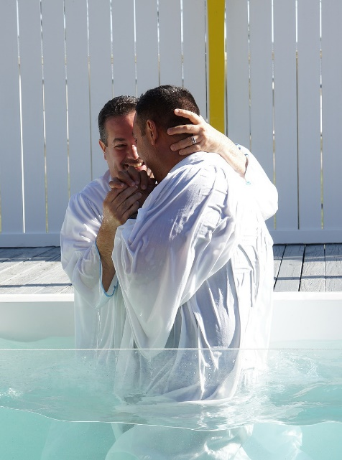
According to His Mercy He Saved Us – Titus 3:5
not by works of righteousness which we have done
but through the washing of regeneration and renewing of the Holy Spirit
Works of
Human
Righteousness
Therefore, baptism is not a work of human righteousness!

Slide 102
Concluding Admonitions
Be careful to maintain good works (v8).
Avoid foolish disputes, genealogies, contentions, and strivings about the law (v9)
Reject a divisive man after the first and second admonition (v10)
“heretic” (KJV), “factious” (ASV, NASB), “stirs up division” (ESV) “schismatic, factious, a follower of false doctrine” (Thayer).
“…an opinion, especially a self-willed opinion, which is substituted for submission to the power of truth, and leads to division and the formation of sects…” (Vine)
2 Peter 2:1-3; 1 Corinthians 11:19; Galatians 5:19-21
A form of this word is also translated “sect.”
First & second admonition; Reject (have nothing to do – ESV; avoid)

Slide 103
Concluding Admonitions
Be careful to maintain good works (v8).
Avoid foolish disputes, genealogies, contentions, and strivings about the law (v9)
Reject a divisive man after the first and second admonition (v10)
Let our people also learn to maintain good works, to meet urgent needs (v14)

Slide 104
© Copyright David E. Pratte, 2020
Permission is granted to display this PowerPoint under the following conditions:
* Display the link to www.BibleStudyLessons.com
* Minor changes in content are permitted, but no teaching should be presented that disagrees with the teaching in the article associated with this PowerPoint on www.BibleStudyLessons.com/powerpoint
* In no case may a fee of any kind be charged for our PowerPoints.
* If you have a website, please add a link to www.BibleStudyLessons.com
Scripture quotations are generally from the New King James Version (NKJV), copyright 1982, 1988 by Thomas Nelson, Inc. Used by permission. All rights reserved.
www.BibleStudyLessons.com

