Slide 2
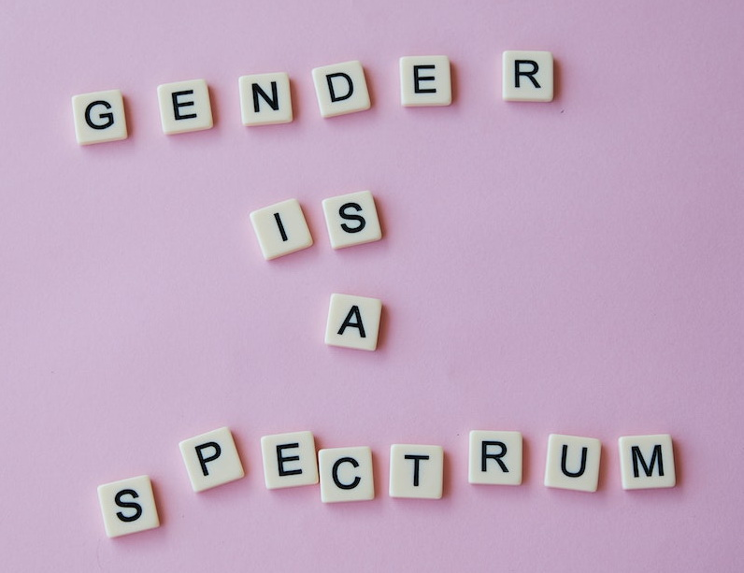
The Bible and Gender
?
?
?
?
biblestudylessons.com

Slide 3
Factors Contributing to Transgenderism
Permissive, liberal parents; absent/negligent/abusive fathers
Confused sex roles and feminism
Peers
Social media (smartphones)
Schools, educators
Counselors, psychologists, doctors
The Creator knows what is best!

Slide 4
The Bible and Gender
?
Number of Genders
?
?
?
biblestudylessons.com

Slide 5
Number of Genders - 1
God Created Two Genders: Woman and Man.
Genesis 1:26-28; 2:7,21-24; Matthew 19:4 – God created man in His own image: male and female so they could reproduce
Leviticus 12:7 – A woman gives birth to a male or a female.
Exodus 20:10,17 – All servants were either male or female.
Numbers 5:6; Deuteronomy 17:2; 2 Chronicles 15:13; Esther 4:11 – General rules apply to all people: man or woman.
Joshua 6:21; 1 Samuel 15:3; 27:9,11 – Israel utterly destroyed everyone: man and woman.

Slide 6
Number of Genders - 2
Parents are father and mother.
Matthew 15:4-6; Ephesians 6:2; Exodus 20:12 – Honor your father and your mother
Matthew 10:37 – He who loves father or mother … son or daughter more than Me is not worthy of Me.
Children are sons and daughters / brothers and sisters.
Genesis 5:4-30; 11:11-25 – People reproduced sons & daughters
Exodus 10:9 – Everyone left Egypt, including sons and daughters.
Numbers 26:33 – Zelophehad had no sons, but daughters.
2 Corinthians 6:18 – God will be a Father to you, and you shall be My sons and daughters.

Slide 7
The Bible and Gender
?
Number of Genders
When Gender Is Determined
?
?
?
biblestudylessons.com

Slide 8
When Gender Is Determined - 1
Children Were Born Sons or Daughters.
Women bore sons or daughters
Genesis 24:36 – Sarah bore a son to Abraham.
Genesis 41:50; 44:27 – To Joseph were born two sons.
Exodus 2:22 – Moses’ wife bore him a son.
2 Samuel 3:2; 5:13; 11:27; 12:24 – Sons/daughters born to David
Job 1:2 – Seven sons and three daughters were born to Job.
Other examples
Exodus 1:16,22 – Kill every son born but spare every daughter.
Leviticus 12:7 – Law for her who has borne a male or a female.
Jeremiah 29:6 – Men beget & wives bear sons and daughters.
Revelation 12:5,13 – Woman bore / gave birth to a male Child

Slide 9
When Gender Is Determined - 2
A Child Is Conceived Male or Female.
Woman conceives and gives birth to sons or daughters.
Genesis 21:2 – Sarah conceived and bore a son.
Genesis 29:32,33,35; 30:7,17,29,23 – Jacob’s wives conceived / bore sons
Exodus 2:2 – Moses’ mother conceived and bore a son.
1 Samuel 1:20 – Hannah conceived and bore a son (Samuel). (2:21)
Isaiah 7:14 – Virgin shall conceive and bear a Son and call Immanuel.
Luke 1:31 – The angel Gabriel promised Mary: “You will conceive in your womb and bring forth a Son, and shall call His name Jesus.”

Slide 10
When Gender Is Determined - 3
A Child Is Conceived Male or Female.
A man begets and a woman conceives a son or daughter.
Genesis 6:10 – Noah begot three sons
Genesis 11:11-25 – Men begot sons and daughters.
1 Chronicles 7:15 – Zelophehad begot only daughters.
Job 3:3 – The night in which it was said, “A male child is conceived.”
Jeremiah 16:3; 29:6 – Sons and daughters were born; their mothers bore them, their fathers begot them.
Luke 1:36 – Elizabeth has also conceived a son in her old age.
Gender is determined at the moment of conception!
Men have anatomy to beget children and women to give birth.

Slide 11
The Bible and Gender
?
Number of Genders
When Gender Is Determined
Gender Roles
?
?
?
biblestudylessons.com

Slide 12
Gender Roles - 1
Transgenderism and Homosexuality
LGBTQ = Lesbian, Gay, Bisexual, Transgender, Queer.
1 Corinthians 6:9-11 – Homosexuals will not inherit the kingdom.
Romans 1:26-28 – When men or women exchange what is natural and burn in lust for their own natural sex, it is “vile passions,” “against nature,” “shameful,” reject God, debased minds, and not fitting.
Family Roles of Husband and Wife
Ephesians 5:22-25,28 – Wives submit to husbands. Husbands love wives
1 Timothy 5:8 – The man should provide for his household.
Titus 2:5; 1 Timothy 5:14; 1 Peter 3:1 – Women should be homemakers, manage the house, and be obedient to their husbands.

Slide 13
Gender Roles - 2
Modesty, Decency, and Chastity
Genesis 3:21 – God created tunics to hide the shame of nakedness.
Titus 2:5; 1 Peter 3:1-5 – Women clothe themselves to be chaste.
Mark 7:21-23; Romans 13:13 – God specifically forbids licentiousness: sexually suggestive activities.
Other Gender Guidelines
1 Corinthians 14:34,35; 1 Timothy 2:11,12 – Women submit to men in spiritual teaching and must not speak to the assembled church.
Deuteronomy 22:5 – A woman shall not wear anything that pertains to man, nor shall a man put on a woman's garment: it is abomination.
1 Corinthians 11:14,15 – Nature teaches long hair for a man is dishonor but long hair to a woman is a glory.
If people may change genders, all role guidelines are anarchy

Slide 14
The Bible and Gender
?
Number of Genders
When Gender Is Determined
Gender Roles
Dealing with Transgenderism
?
?
?
biblestudylessons.com

Slide 15
How to Deal with Transgenderism
* Accept and submit to God’s plan – Ecclesiastes 12:13,14;
2 Timothy 3:16-4:4; Jeremiah 17:9; 1 Corinthians 1:18-25.
* Recognize / resist temptation – Ephesians 6:10-18; James 4:7
* Acknowledge / speak truth – Proverbs 6:16,17; Ephesians 4:25
* Appreciate and accept your natural gender and help others do likewise – 1 Peter 3:7; Galatians 3:28
* Be a good steward of your body – 1 Corinthians 6:19,20; Romans 12:1,2; 1 Corinthians 12:18,25
* Parents, train your children to appreciate and follow God-given roles – Ephesians 6:4; Proverbs 22:5

Slide 16
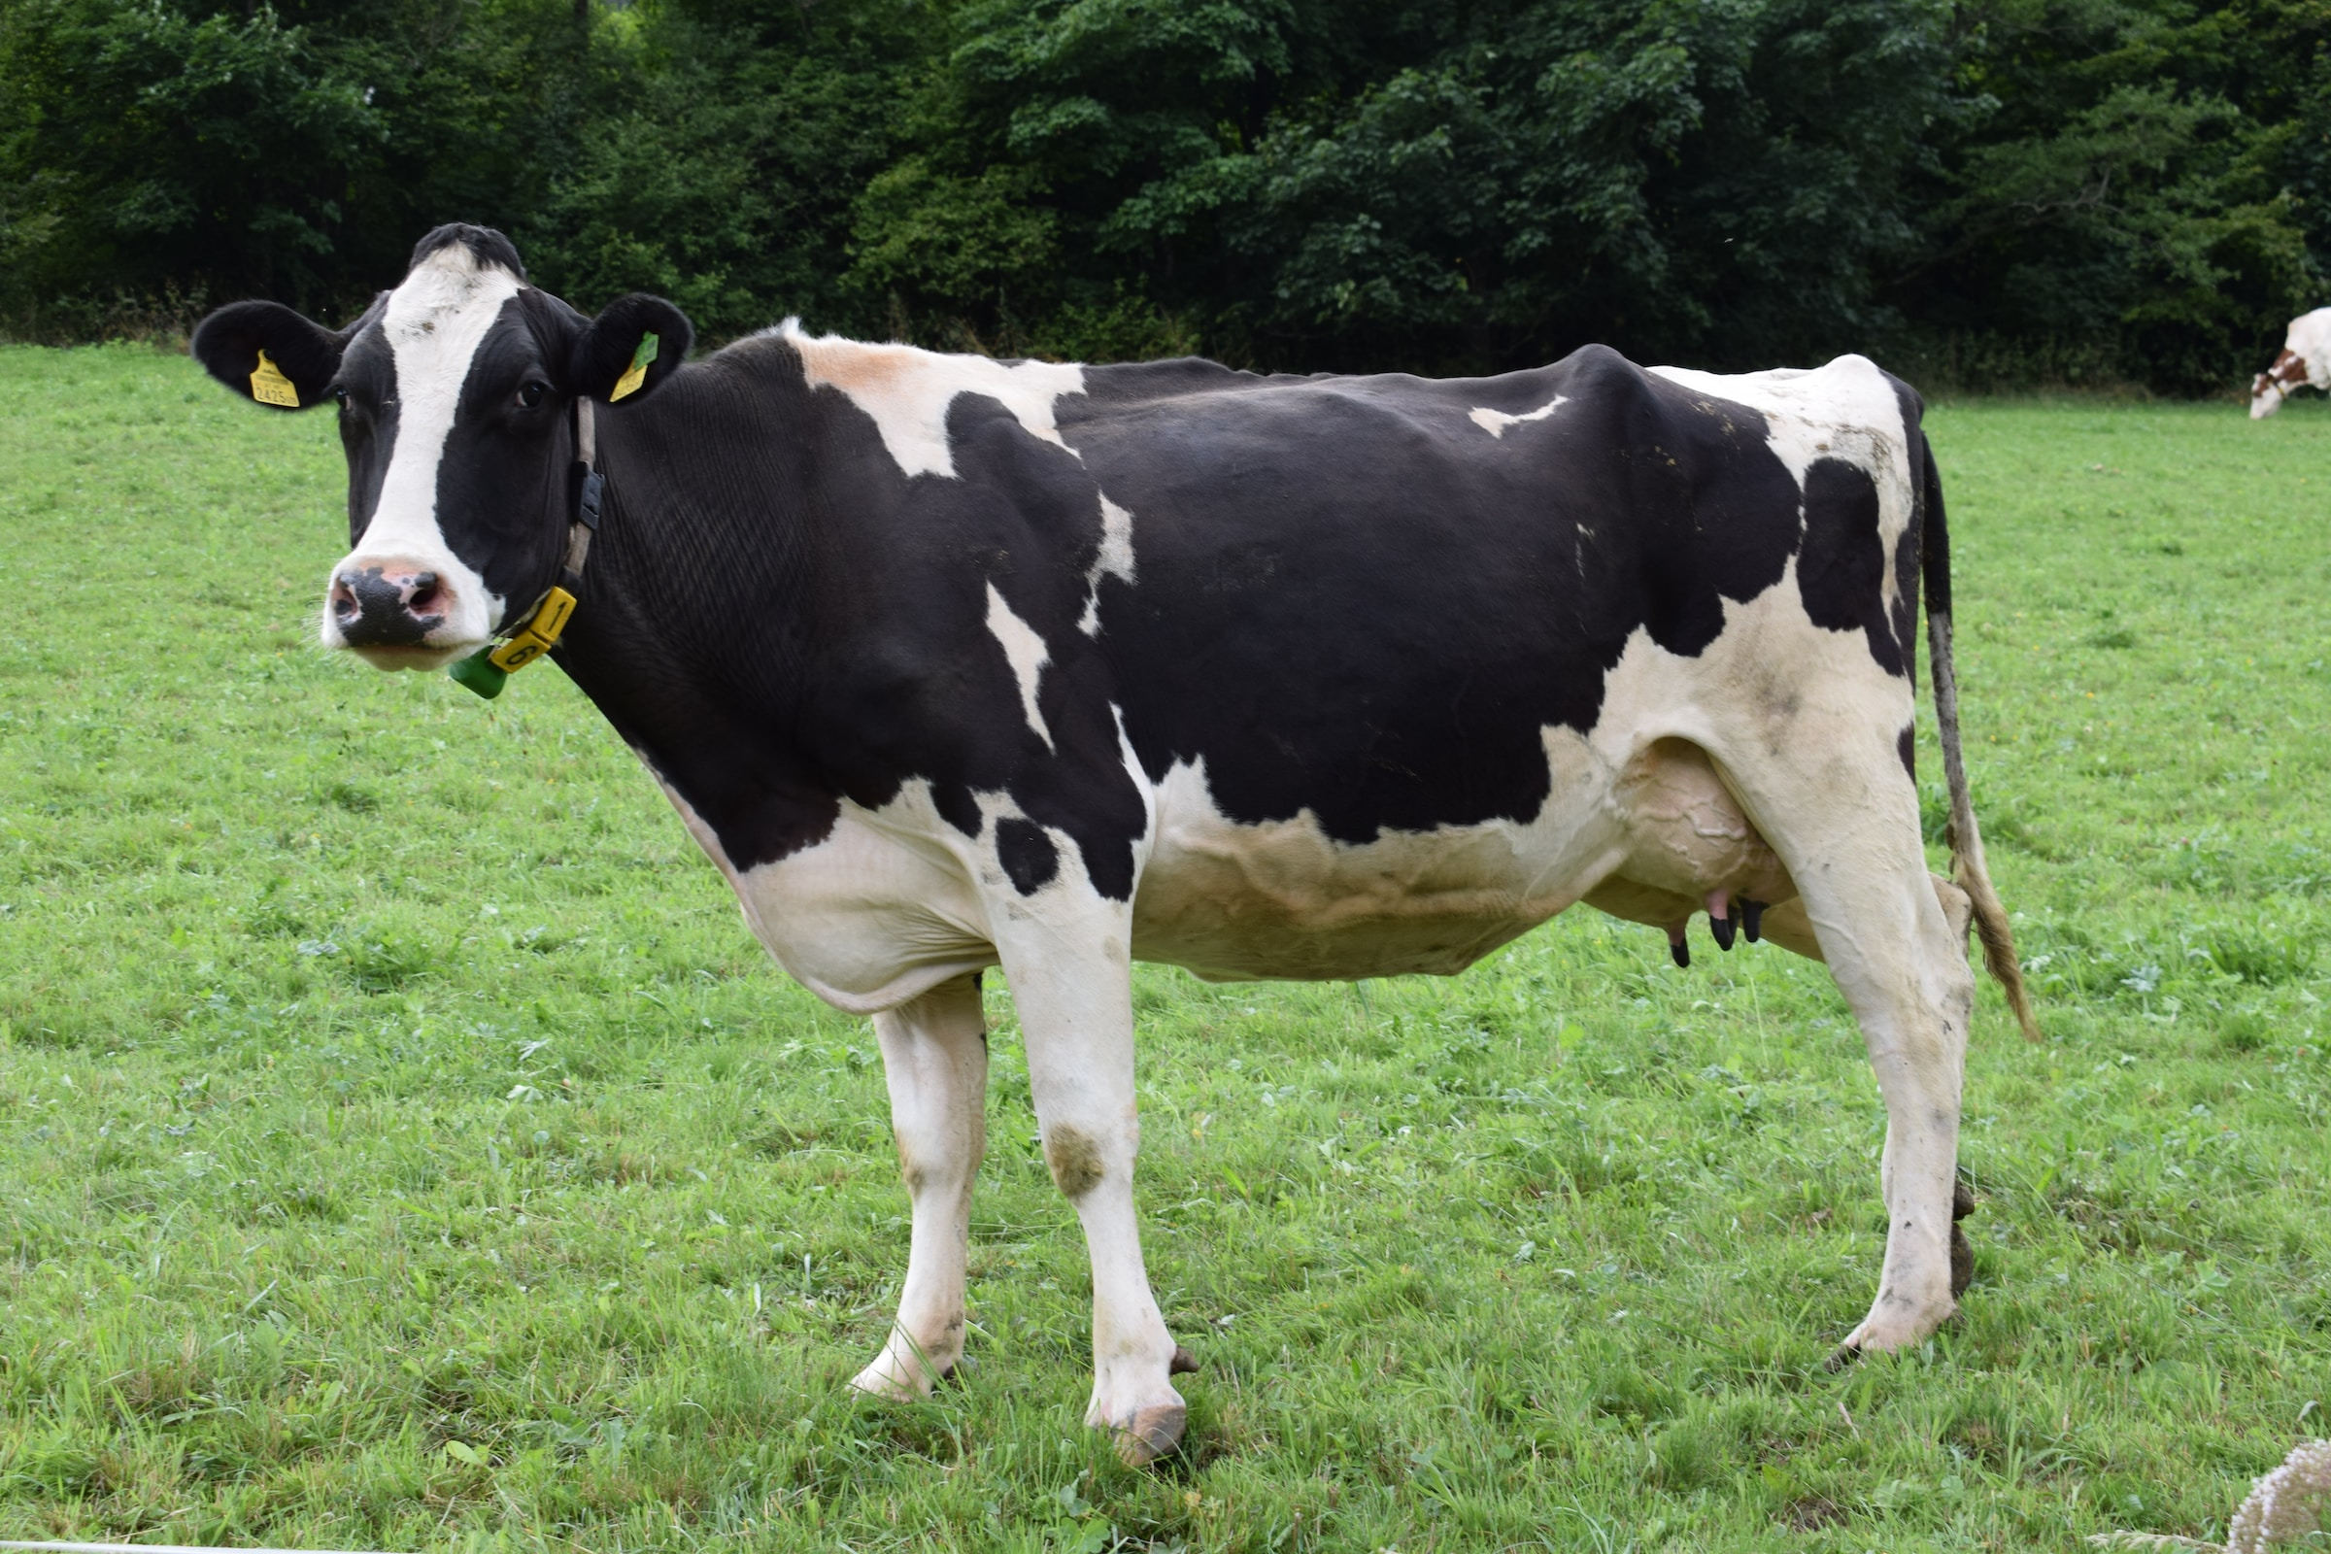
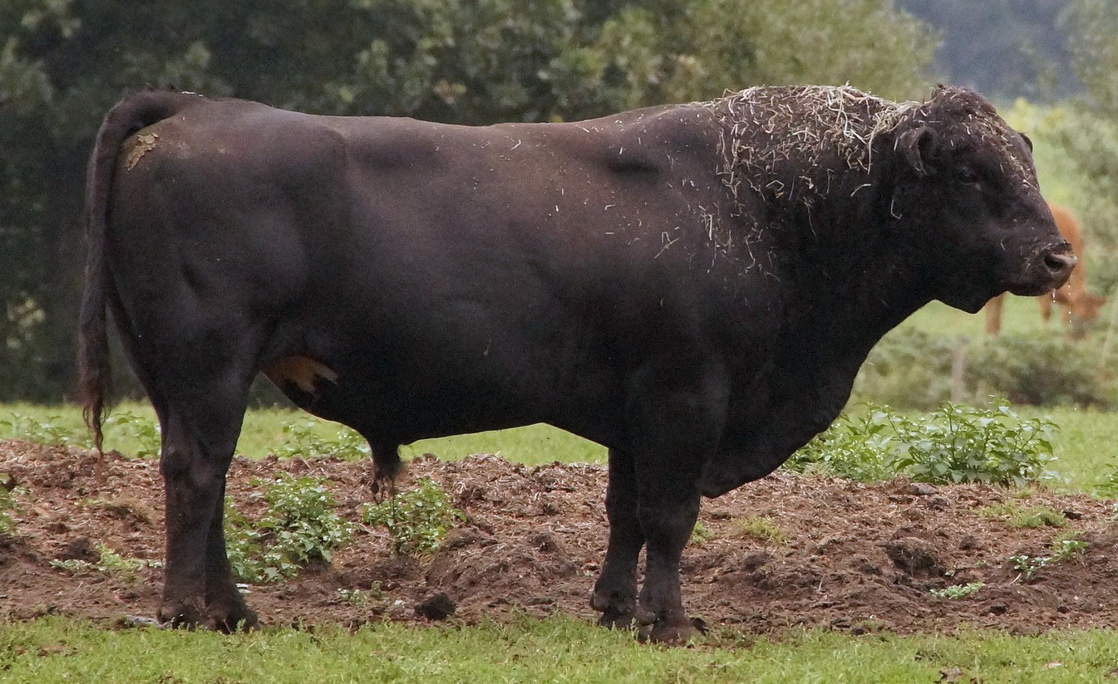
The Transgender Issue in a Nutshell
Do you understand the difference between…
a Cow…
and
a Bull?!
A cow is a cow. A bull is a bull.
A man is a man. A woman is a woman.
God made it that way.

Slide 18
© Copyright David E. Pratte, 2023
Permission is granted to display this PowerPoint under the following conditions:
* Display the link to BibleStudyLessons.com
* Minor changes in content are permitted, but no teaching should be presented that disagrees with the teaching in the article associated with this PowerPoint at www.BibleStudyLessons.com/powerpoint
* In no case may a fee of any kind be charged for our PowerPoints.
* If you have a website, please add a link to https://BibleStudyLessons.com
Scripture quotations are generally from the New King James Version (NKJV), copyright 1982, 1988 by Thomas Nelson, Inc. Used by permission. All rights reserved.
biblestudylessons.com

