Slide 1
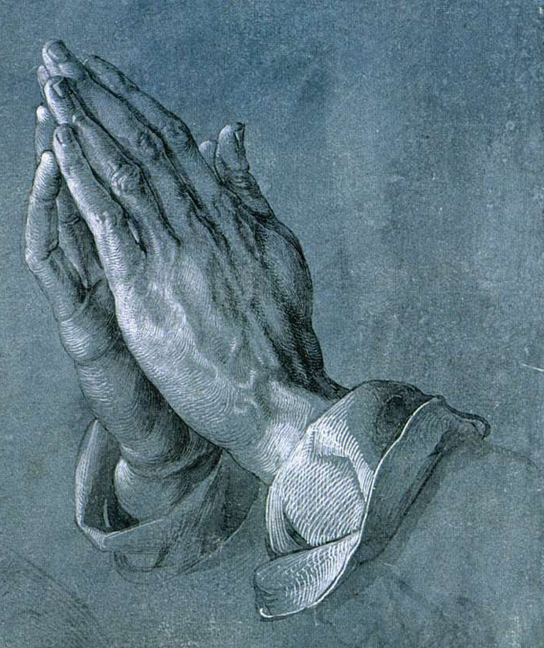
Trusting God
Trust and Action Work Together
Psalm 37:3; 1 Timothy 4:10;
Galatians 5:6
Proper Relationship with God
Mark 16:16; James 2:24,22; Acts 8:22;
1 John 1:9
www.BibleStudyLessons.com

Slide 2
Trusting God
Trust and Action Work Together
Psalm 37:3; 1 Timothy 4:10;
Galatians 5:6
Proper Relationship with God
Physical Necessities
Matthew 6:11; 1 Timothy 5:8;
2 Thessalonians 3:10

Slide 3
Trusting God
Trust and Action Work Together
Psalm 37:3; 1 Timothy 4:10;
Galatians 5:6
Proper Relationship with God
Physical Necessities
Care for Health and Life
3 John 2; Colossians 4:14; Luke 5:31;
2 Corinthians 12:7-10

Slide 4
Trusting God
Trust and Action Work Together
Psalm 37:3; 1 Timothy 4:10;
Galatians 5:6
Proper Relationship with God
Physical Necessities
Care for Health and Life
Number of Children
Genesis 1:26-28

Slide 5
Trusting God
Trust and Action Work Together
Psalm 37:3; 1 Timothy 4:10;
Galatians 5:6
Proper Relationship with God
Physical Necessities
Care for Health and Life
Number of Children
Choosing Rulers
Daniel 4:32; 1 Timothy 2:1,2;
Esther 7:1-10; Acts 22:24-29; 23:12-33; 25:10-12; 16:35-40

Slide 6
Trusting God
Trust and Action Work Together
Trust Depends on God to Provide Needs and Produce Results
Psalm 37:5
Proper Relationship with God
Proverbs 3:5,6; Luke 18:9-14

Slide 7
Trusting God
Trust and Action Work Together
Trust Depends on God to Provide Needs and Produce Results
Proper Relationship with God
Physical Necessities / Care for Health and Life / Number of Children
1 Timothy 6:17; 5:5; Psalm 34:8-10

Slide 8
Trusting God
Trust and Action Work Together
Trust Depends on God to Provide Needs and Produce Results
Proper Relationship with God
Physical Necessities / Care for Health and Life / Number of Children
Civil Government
Isaiah 31:1; Psalm 118:8,9

Slide 9
Trusting God
* We must follow the guidance of God’s word.
* We must work to accomplish needed results.
* We must recognize God as the real source of all that we need.
* We must trust God to use our effort to produce whatever results He chooses in His own way and His own time.
2 Corinthians 3:4,5

Slide 10
© Copyright David E. Pratte, 2020
Permission is granted to display this PowerPoint under the following conditions:
* Display the link to www.BibleStudyLessons.com
* Minor changes in content are permitted, but no teaching should be presented that disagrees with the teaching in the article associated with this PowerPoint on www.BibleStudyLessons.com/powerpoint
* In no case may a fee of any kind be charged for our PowerPoints.
* If you have a website, please add a link to www.BibleStudyLessons.com
Scripture quotations are generally from the New King James Version (NKJV), copyright 1982, 1988 by Thomas Nelson, Inc. Used by permission. All rights reserved.
www.BibleStudyLessons.com

