Slide 2
Victory in Jesus
The Victory
www.BibleStudyLessons.com

Slide 3
The Victory
Jesus
John 16:33 | Opposition from the World

Slide 4
The Victory
Jesus
John 16:33 | Opposition from the World
Hebrews 4:15 | Sin and Temptation

Slide 5
The Victory
Jesus
John 16:33 | Opposition from the World
Hebrews 4:15 | Sin and Temptation
Luke 11:21,22; Revelation 6:2; 19:11-16; Acts 4:12 | Satan & His Forces

Slide 6
The Victory
Jesus
John 16:33 | Opposition from the World
Hebrews 4:15 | Sin and Temptation
Luke 11:21,22; Revelation 6:2; 19:11-16; Acts 4:12 | Satan & His Forces
Hebrews 2:9,14 | Death

Slide 7
The Victory
Jesus |  | Us
John 16:33 | Opposition from the World | Numbers 13:30; 14:6-9; Joshua 1:5-9; Romans 8:35-39
Hebrews 4:15 | Sin and Temptation
Luke 11:21,22; Revelation 6:2; 19:11-16; Acts 4:12 | Satan & His Forces
Hebrews 2:9,14 | Death

Slide 8
The Victory
Jesus |  | Us
John 16:33 | Opposition from the World | Numbers 13:30; 14:6-9; Joshua 1:5-9; Romans 8:35-39
Hebrews 4:15 | Sin and Temptation | Romans 12:21; 1 Cor. 9:25-27; 10:13
Luke 11:21,22; Revelation 6:2; 19:11-16; Acts 4:12 | Satan & His Forces
Hebrews 2:9,14 | Death

Slide 9
The Victory
Jesus |  | Us
John 16:33 | Opposition from the World | Numbers 13:30; 14:6-9; Joshua 1:5-9; Romans 8:35-39
Hebrews 4:15 | Sin and Temptation | Romans 12:21; 1 Cor. 9:25-27; 10:13
Luke 11:21,22; Revelation 6:2; 19:11-16; Acts 4:12 | Satan & His Forces | Ephesians 6:10-18; Rev. 12:10,11; 17:14; Phil. 4:13; Romans 8:31; 1 John 4:4
Hebrews 2:9,14 | Death

Slide 10
The Victory
Jesus |  | Us
John 16:33 | Opposition from the World | Numbers 13:30; 14:6-9; Joshua 1:5-9; Romans 8:35-39
Hebrews 4:15 | Sin and Temptation | Romans 12:21; 1 Cor. 9:25-27; 10:13
Luke 11:21,22; Revelation 6:2; 19:11-16; Acts 4:12 | Satan & His Forces | Ephesians 6:10-18; Rev. 12:10,11; 17:14; Phil. 4:13; Romans 8:31; 1 John 4:4
Hebrews 2:9,14 | Death | Romans 8:38; 1 Cor. 15:20-26,52-57

Slide 11
Victory in Jesus
The Victory
The Reward
www.BibleStudyLessons.com

Slide 12
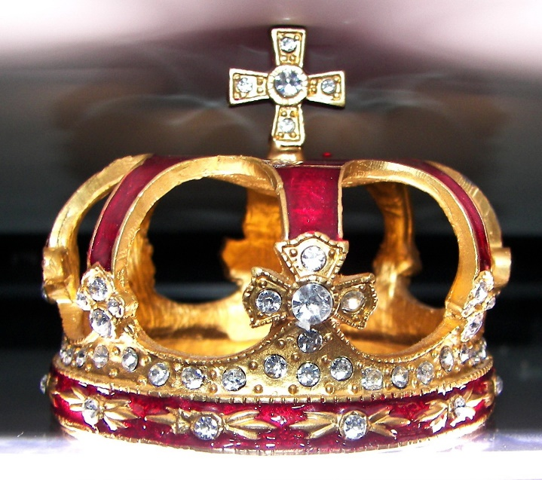
The Reward
Names in the Book of Life
Revelation 3:5
Crown of life
1 Corinthians 9:24,25;
2 Timothy 4:7,8; Revelation 2:10
Dwell with God in His holy city
Revelation 21:1-8

Slide 13
Victory in Jesus
The Victory
The Reward
The Rules
www.BibleStudyLessons.com

Slide 14
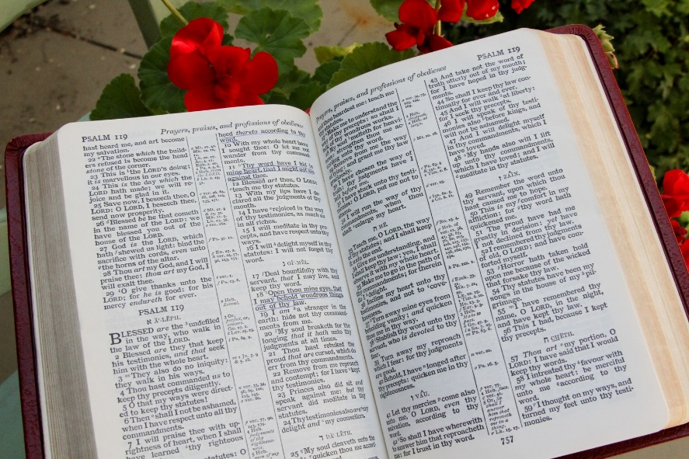
The Rules
2 Timothy 2:5
Become God’s child: Believe & obey
1 John 5:3-5
Serve faithfully
Hebrews 12:1-4;
1 Corinthians 15:57,58

Slide 16
© Copyright David E. Pratte, 2022
Permission is granted to display this PowerPoint under the following conditions:
* Display the link to www.BibleStudyLessons.com
* Minor changes in content are permitted, but no teaching should be presented that disagrees with the teaching in the article associated with this PowerPoint at www.BibleStudyLessons.com/powerpoint
* In no case may a fee of any kind be charged for our PowerPoints.
* If you have a website, please add a link to www.BibleStudyLessons.com
Scripture quotations are generally from the New King James Version (NKJV), copyright 1982, 1988 by Thomas Nelson, Inc. Used by permission. All rights reserved.
www.BibleStudyLessons.com

